Slide 1
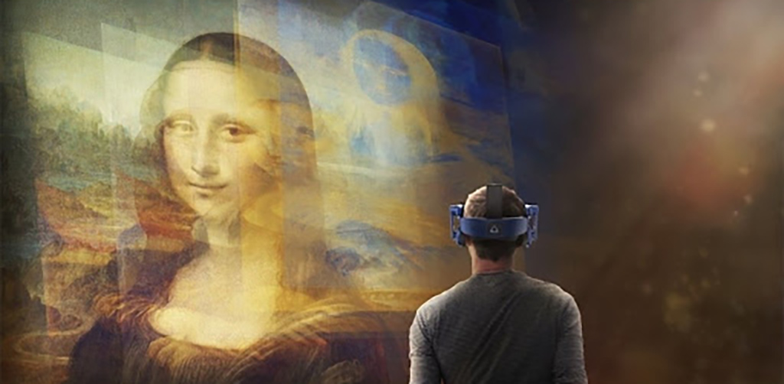
Impact of Contemporary Self-image (Selfie) on Aesthetics
&
Presented at SASSI-2020
MISBAH UL ISLAM KHOKHAR
PhD Scholar (Digital Media Arts)
Nanjing University of the Arts
China
Impact of New Aesthetics of Self-Image
Vice-versa.

Slide 2
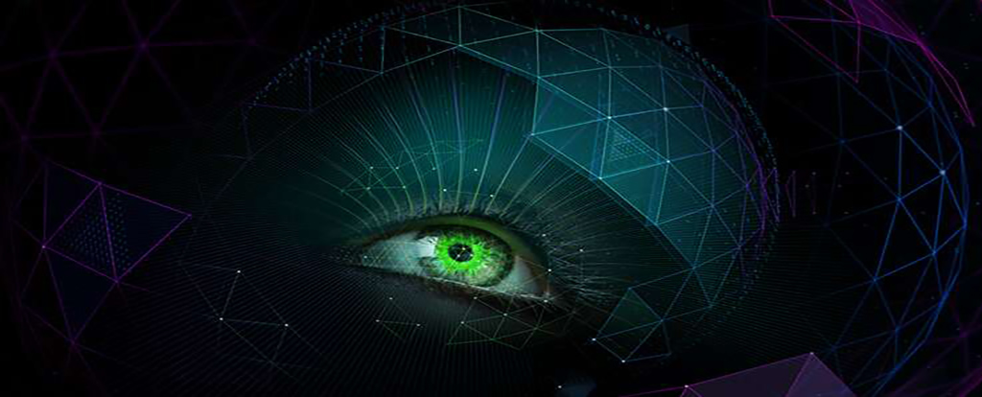
To analyze the impact of Contemporary Self-image (Selfie) on Aesthetics and Impact of New Aesthetics of Self-Image vice-versa. Firstly we need to understand the evolution of ;
1- Art…, to New Media Arts
2- Aesthetics…., to New Aesthetics
3- Self-image…, to Contemporary Self-image.

Slide 3
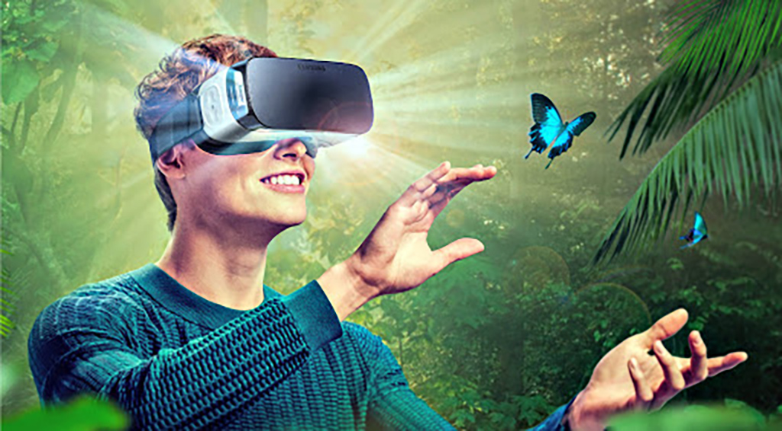
1- Traditional Art…, to New Media Arts

Slide 4
1- Traditional Art…, to New Media Arts
Art is a collection of human activities in the development of visual, auditory, or performing objects (artworks), reflecting the artistic, intellectual, or technical skills of the artist intended to be admired for their beauty or emotional strength. Many activities related to the creation of artworks include art criticism, the study of art history and aesthetic dissemination of Art. The three classical branches of art are painting, sculpture and architecture.
New Media Art refers to artworks produced using new media technologies, including digital art, computer graphics, computer animation, virtual art, internet art, interactive art, video games, computer robotics, 3D printing, cyborg art, and biotechnology art.
The word differentiates itself by its subsequent cultural artifacts and social events which can be seen in contrast to those derived from ancient visual arts (i.e. traditional painting, sculpture, etc.). This medium issue is a central feature of a great deal of modern art and many art schools and major universities are now offering degrees in "New Genres" or "New Media."
New media art also includes contact between the artist and the viewer, or between the viewers and the work of art that reacts to them. However, as several theorists and curators have pointed out, these modes of interaction, social exchange, engagement, and transformation do not differentiate new media art but rather serve as a common ground which has parallels in other strands of contemporary art practice.
New media issues are often derived from television, mass media and new electronic methods of providing the artworks include presentation to installation, with activities varying from conceptual to virtual art.

Slide 5
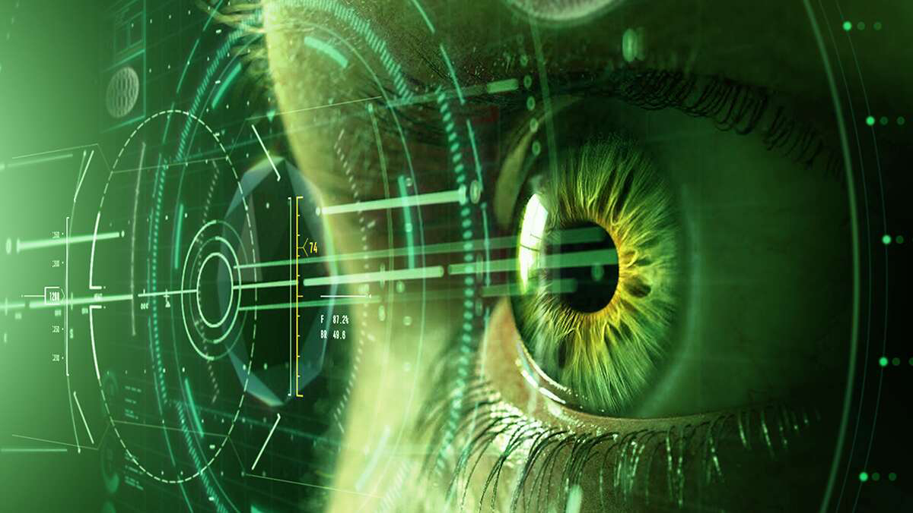
2- Aesthetics…., to New Aesthetics

Slide 6
2- Aesthetics…., to New Aesthetics
New media art, which by techniques is an art expression, is progressively evolving in the 21st century and is also called the modern age. It changes the lifestyle of human beings and the esthetic understanding of art. Today, digital media art has become an important form of contemporary art representing new artistic characteristics that can not be contrasted with traditional art. Aesthetics of modern media art can not be isolated from media technologies.Discussing new media art in terms of speech form is not technology but art form that emerges from technology while the distinction lies only in the bearing and transmission media. Around the same time, aesthetics of new media art evolves as the aesthetic subject, object, and atmosphere make the subsequent changes.
While affected by the genetic factors within the psychological system, the awakening and edification of the world mainly acquires aesthetic views of individuals. Throughout conventional art aesthetic practices the permeation and reinforcement of techniques and knowledge dissemination roles to the artistic psychological world occur all the time. Digitization is the central strategy for the creation and production of "New Aesthetic" views of art.

Slide 7
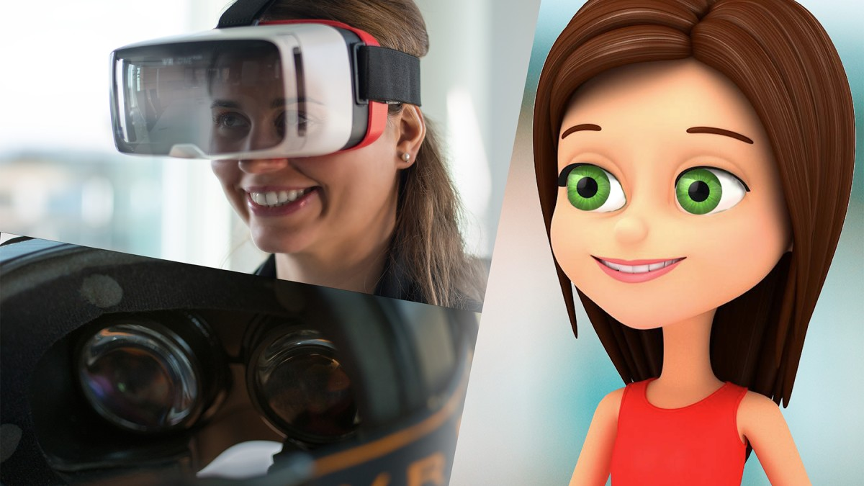
3- Self-image…, to Contemporary Self-image.

Slide 8
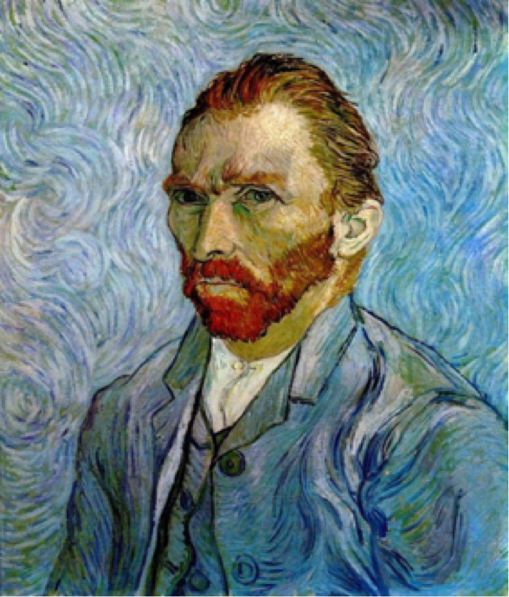
3- Self-image…, to Contemporary Self-image.
Long before the 19th century, the portrait can only be seen in the form of traditional painting, but after the emergence of a self-portrait photography, relevant media also appeared. Although the self-portrait of various sizes can be located on the theory of history and photography, the self-portraits can also be seen as an inventive, and standard practices.
(Figure-01 - Self Portrait, 1889 by Vincent Van Gogh –
Courtasy: www.vincentvangogh.org)
In the history of selfie, the practice of self-expression of a lineage found in art schools in the form of portrait-paintings and sculpture-portraits. Painting-Portraitures usually presented to others, but the selfie is a modern-days consumer sort of the portraiture. The image is the essential of today's society, it has become large-scale means of interactions, therefore, the crux of everyday life is; humanity has converted to “homus photographicus”. Approximately everyone in today’s society possess a smartphone-cameras, and they are connected to social media networks. Everyone use these images to communicate their feelings, opinions, and views irrespective of their complicated nature (Farías, 2015).

Slide 9
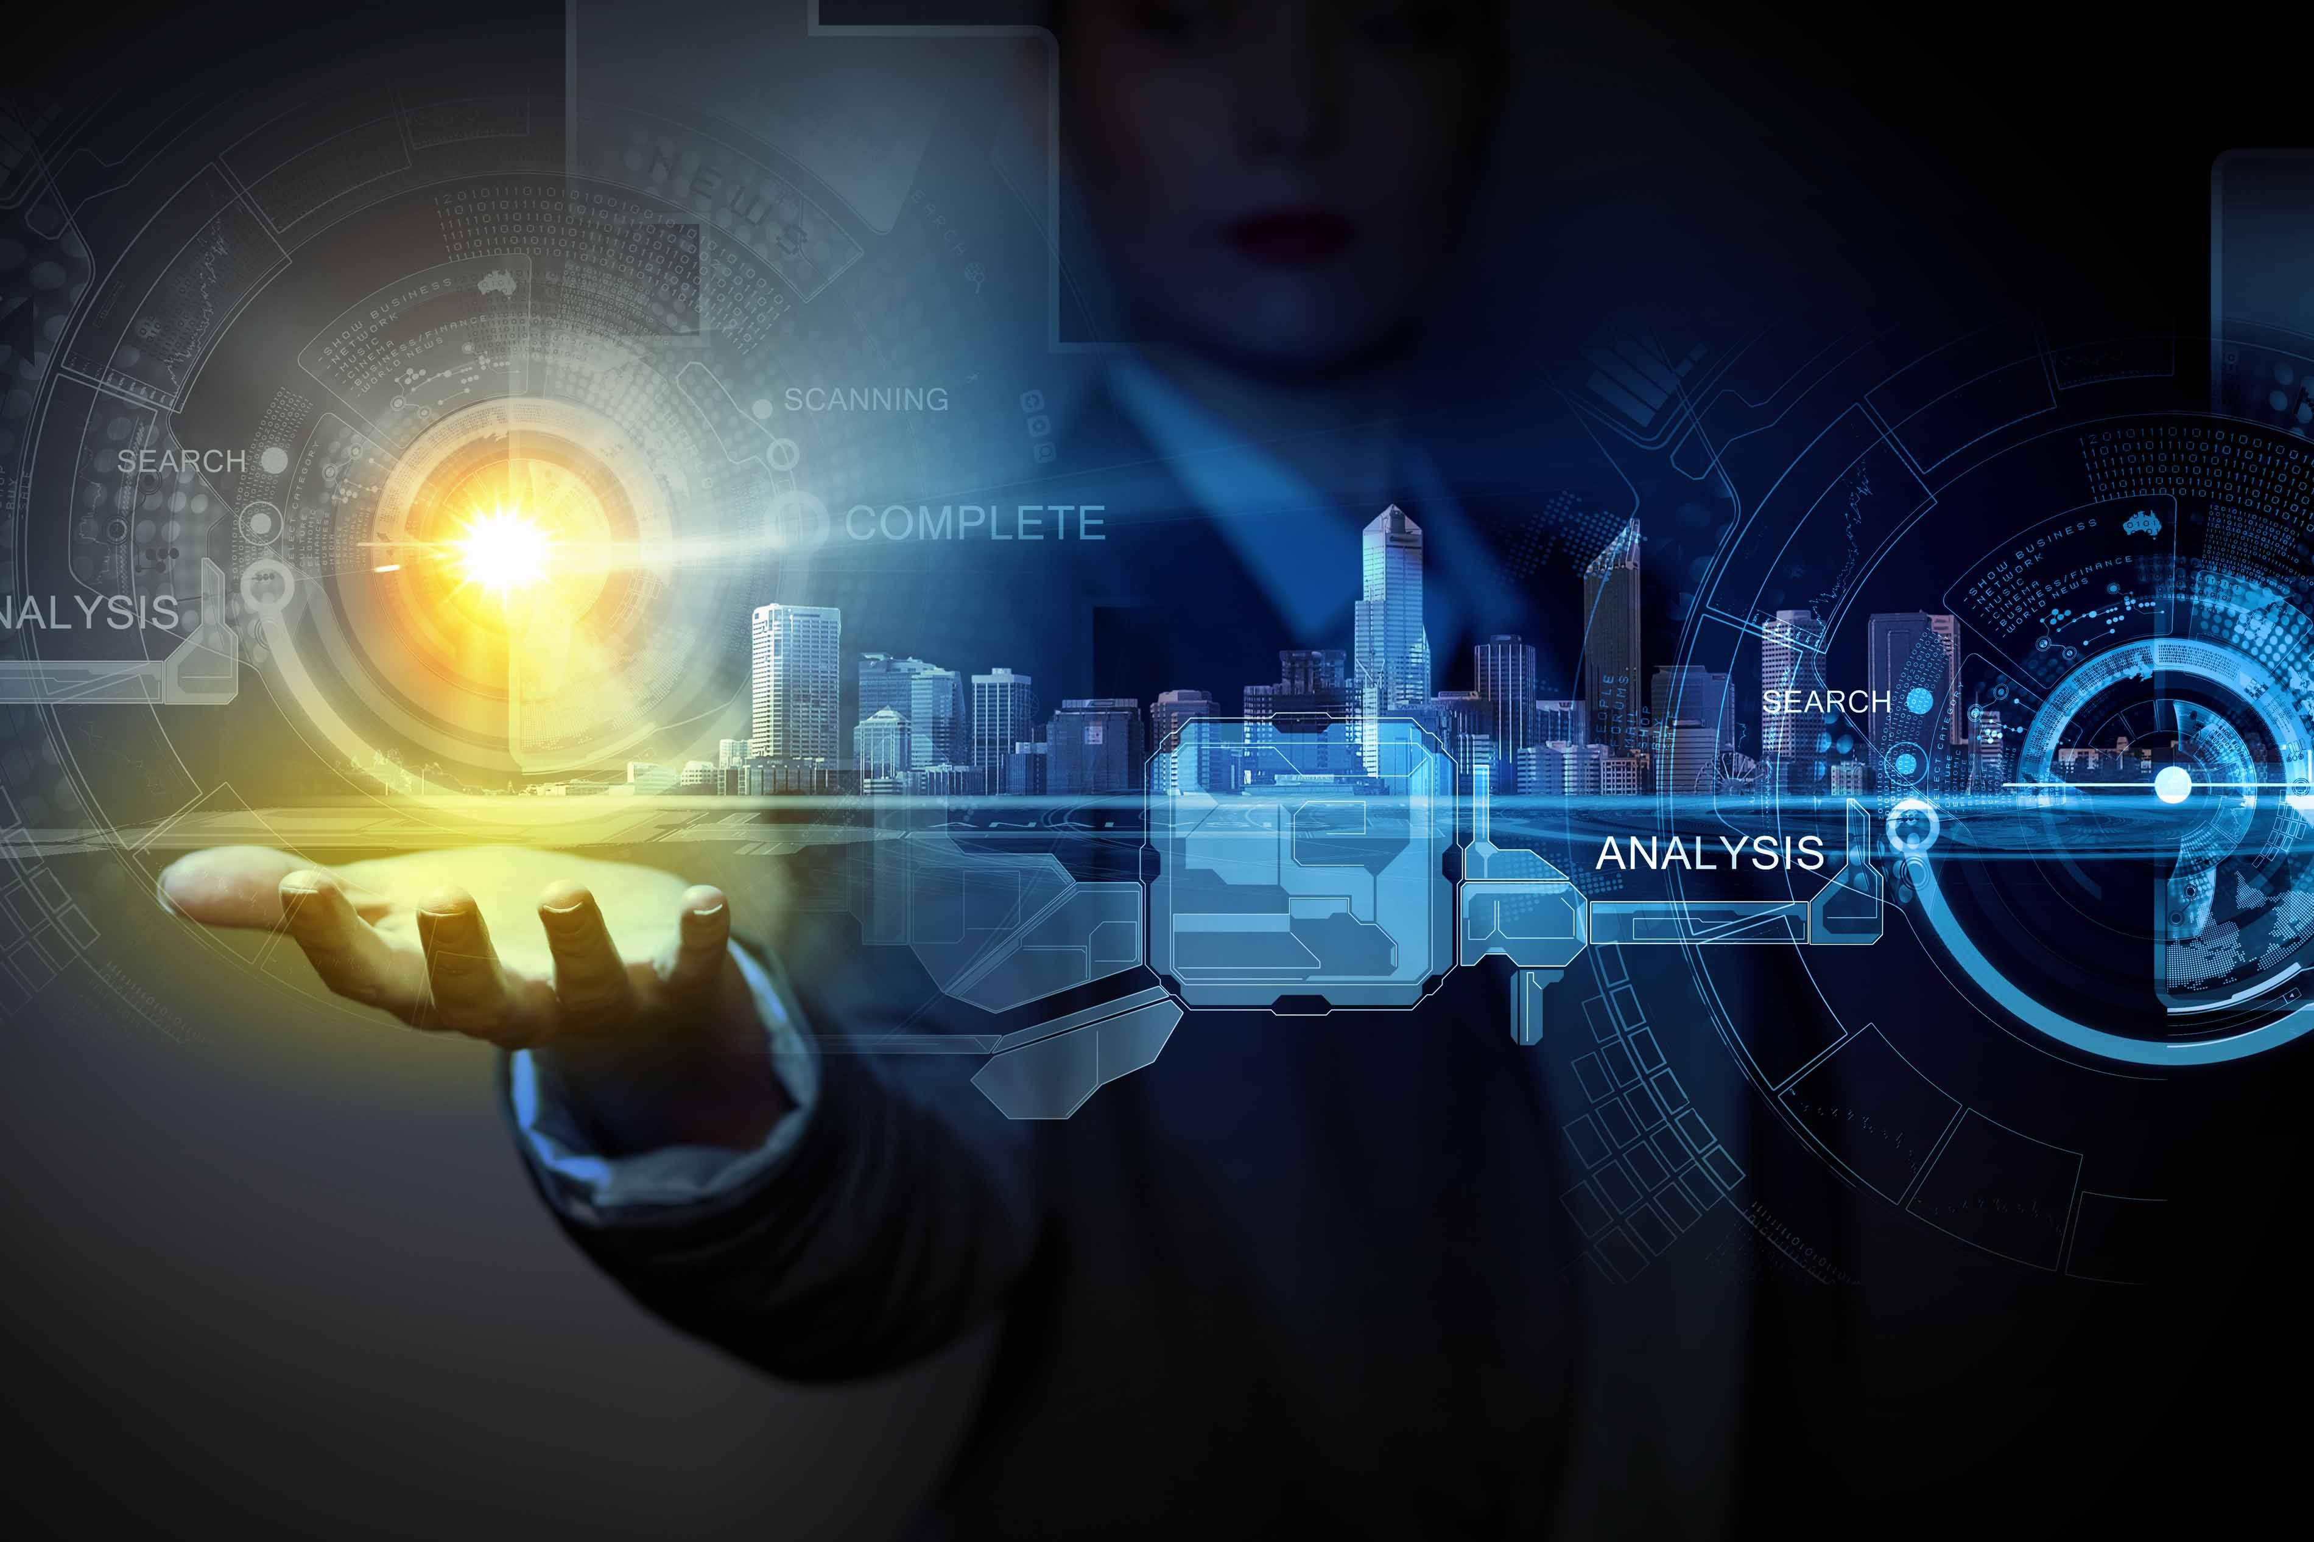
Impact of Contemporary Self-image (Selfie) on Aesthetics
&
Characteristics of Self Image in New Aesthetics Environment

Slide 10
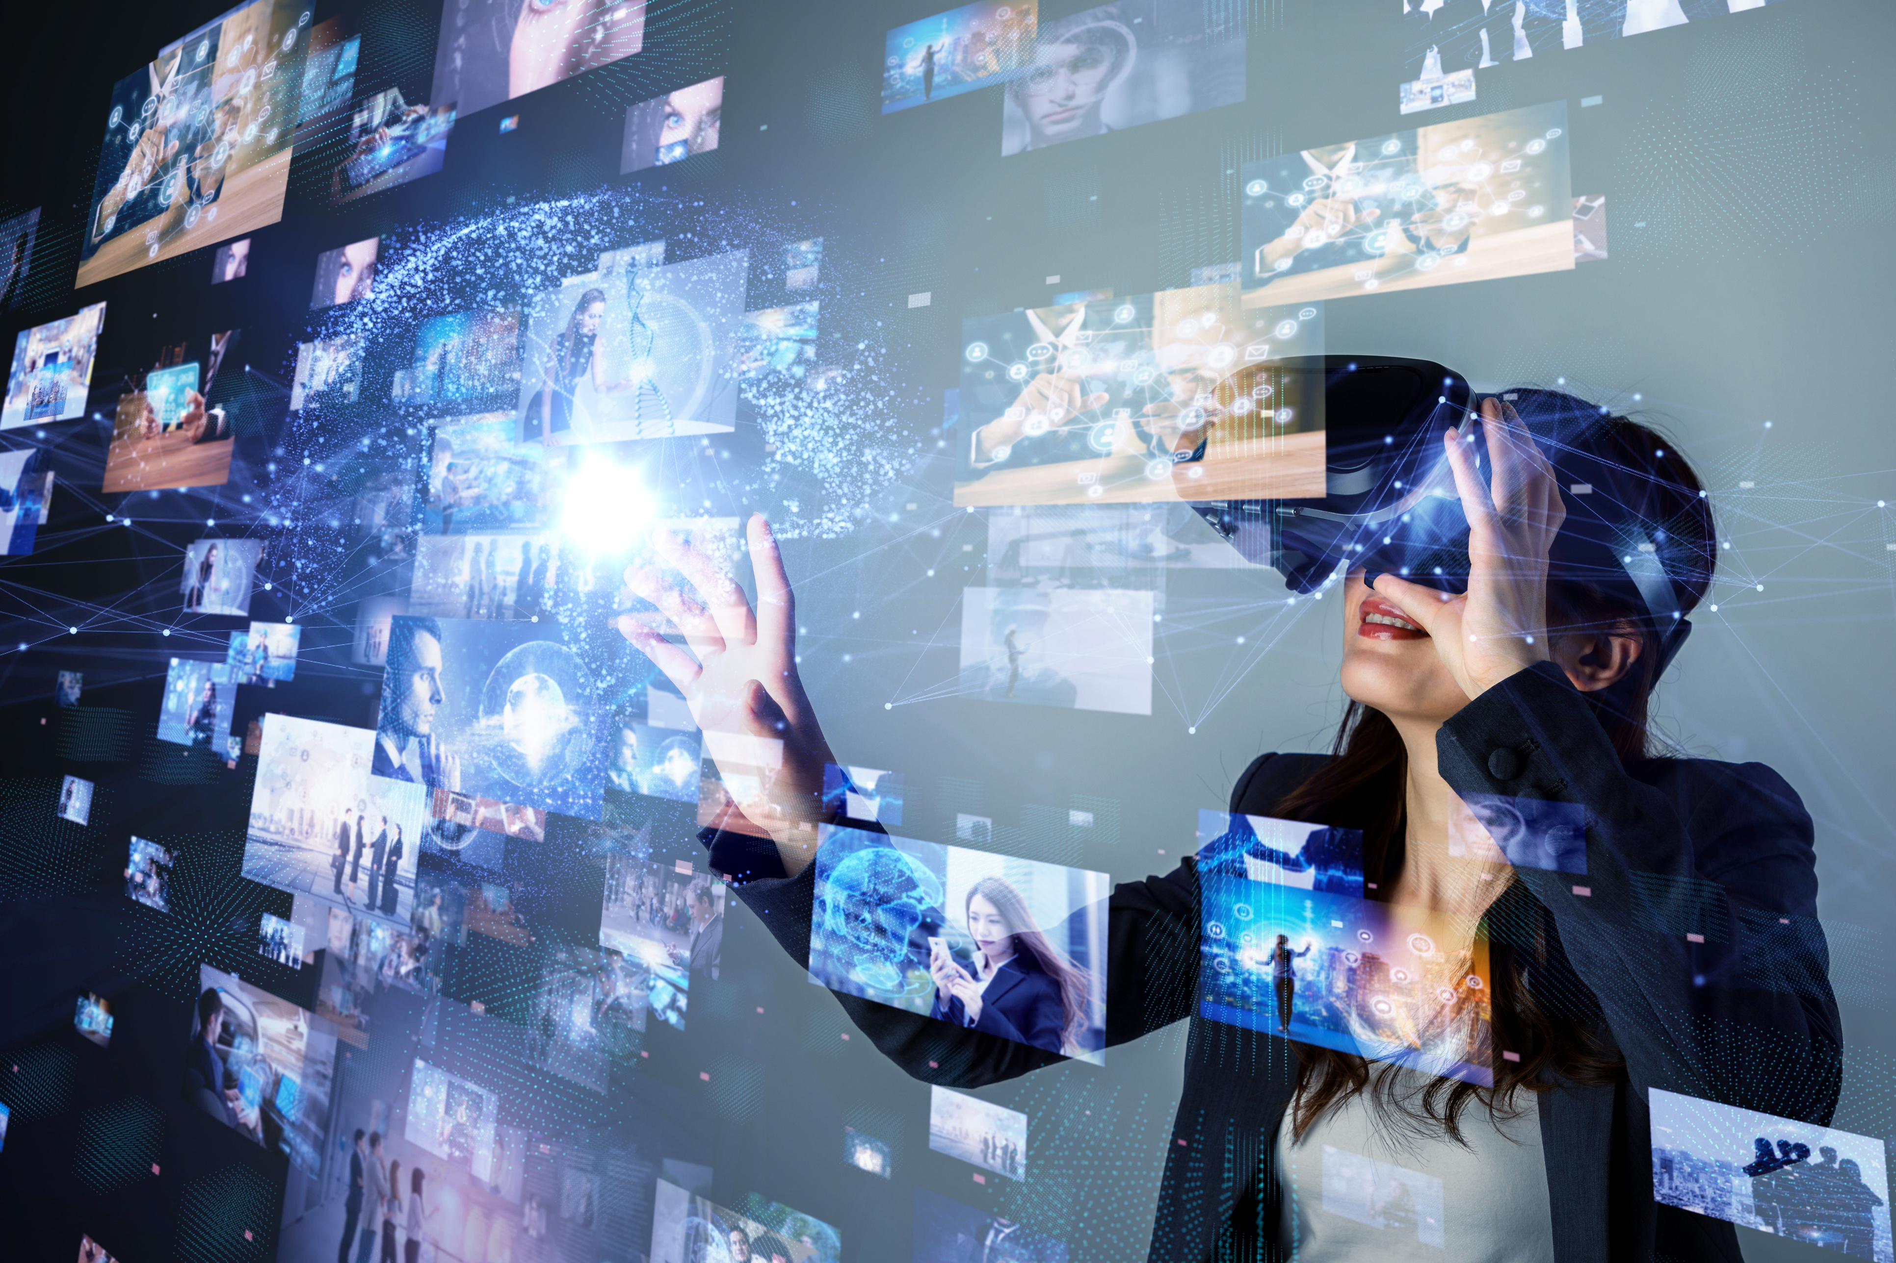
Contemporary Selfie has the ability to share it immediately with a friend or a group of people. During the starting period of contemporary self-portrait, the image quality of smartphone retrogresses compared to the taken by compact cameras. Under these circumstances, the user has an edge in networked photography by using a smartphone. The insufficiency, cumulated capability by the practicality of the new image practices and especially by the particularly cumulative capability of distributing it on the social networks (Gunthert, 2019).

Slide 11
a. Internetwork and Visual Culture of self-image:
The Form of social media self-portrait is often called "selfie" obsessed with the formation of a culture, especially teens and early twenties young women of their self-image strategy of particular interest. On Facebook, Tumblr, Flickr, Instagram, and other social media sites, the selfies are everywhere. It has become an effective way of self-expression, encouraging their selfies to share closely related to their life and private moments thus in a while self-fashioning in the form of creative participation. Selfie generally is considered to be a superficial manifestation of network narcissism, both loved by the people, but some people are cast aside. However, it can be a self-definition as one of the most effective and flourishing ways.

Slide 12
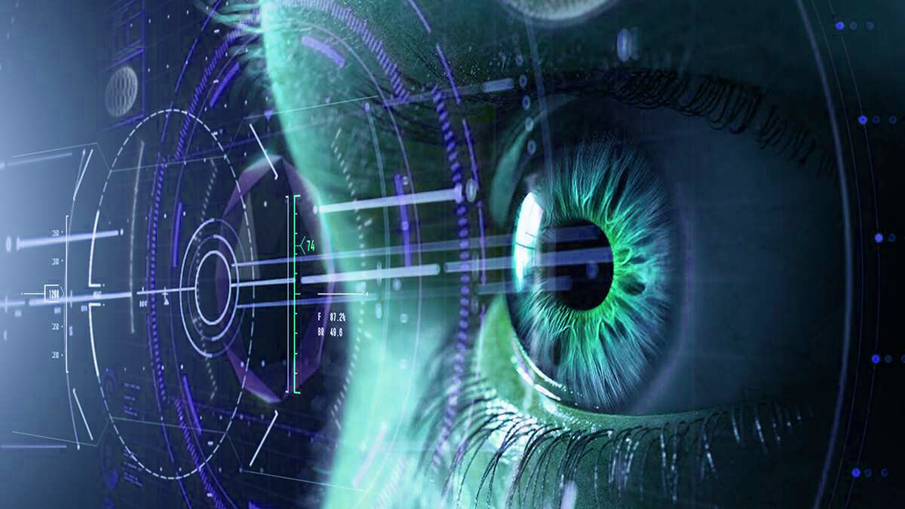
b. Selfie on Social Media and its Aesthetic Value:
On social media platforms the discussion regarding a self-portrait portray different moods and colors about life is not considered basically because of its aesthetical values since it used to record every aspect of life, and contribute for the activity of self-representation and fulfill its contextual means.

Slide 13
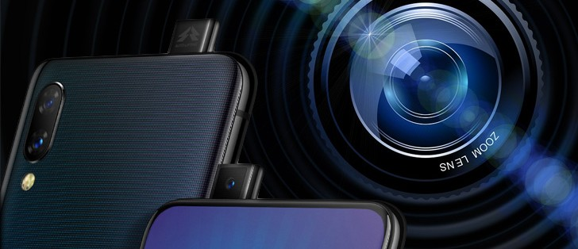
c. Selfie is product of De-specialization of conventional photography:
The modern era of de- specialization changes the ways of traditional techniques, importance, medium, and nature of photographic practice. The digital revolution (the combination of camera-phone and a broader communication network has settled some new trends, the contemporary image making practice to become a forte practice in this emerging and widely communication world.

Slide 14
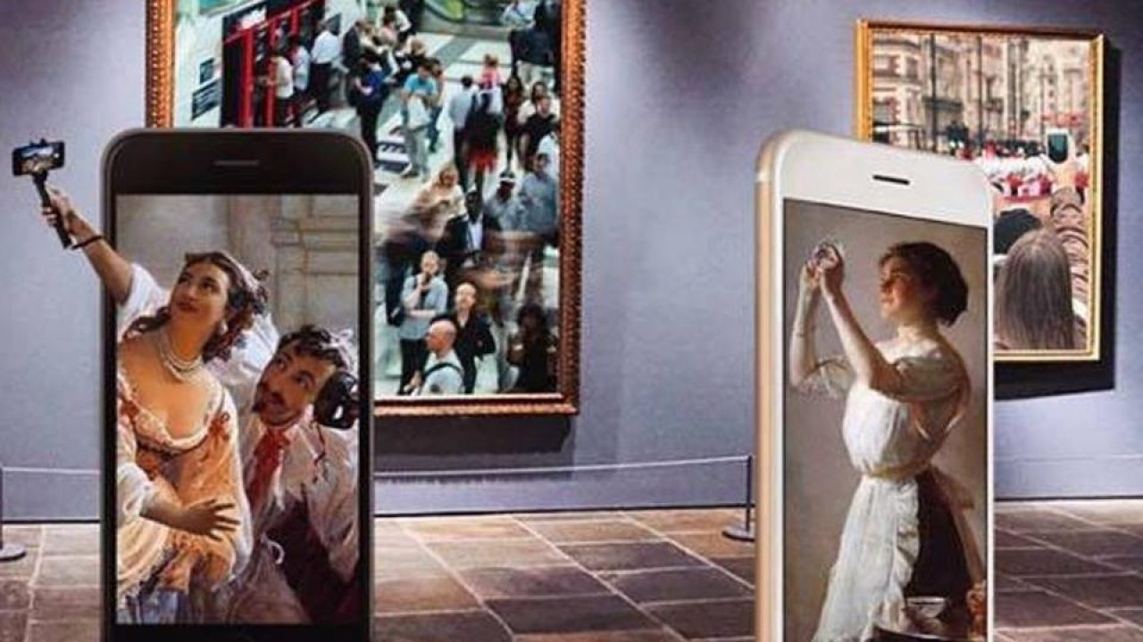
d. A Paradigm Shift:
The revolution of de-specialization transforms conventional photographic archetype founded on traditional techniques, importance, medium, and nature of the photographic practice. Meanwhile, image capturing techniques once formed an independent, intensely recognized space. Its incorporation into versatile organisms makes it a more revolutionary dynamic system. This revolutionary merger of camera technology and communication technology was a game-changer into the facilitation of contemporary selfie image taking practice. This advancement has enabled, photography has become a niche in the information and communication technology world.

Slide 15
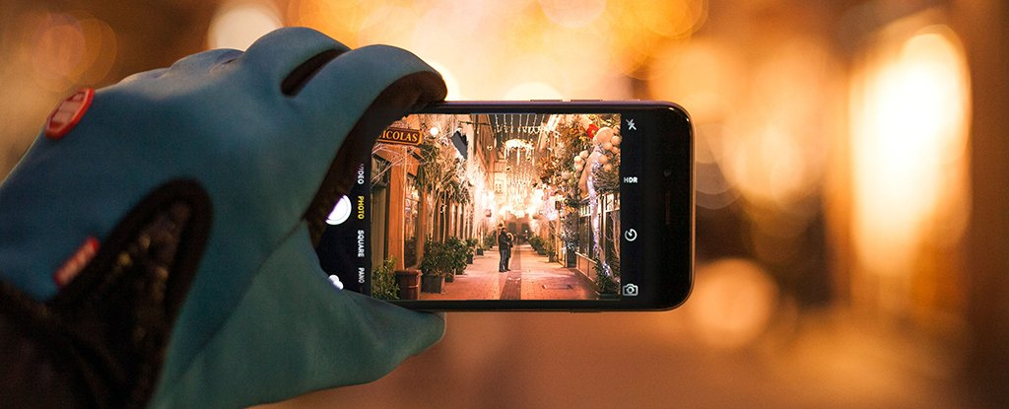
e. Contemporary selfie is a result of Minimalization and compact-ability:
We can analyze the minimalization process of clock industry which impact the industry between 15th to 19th century. That miniaturizes the church-clock to the pocket size time-piece. It was a big revolution. The same thing happened with the smartphone, which does not only integrate a tiny multipurpose camera but also integrated lots of amazing Applications which can distribute these self-portraits to our desired groups of people within the fractions of time. Almost every person carries this minimalized smartphone camera and cause a revolutionary breakthrough in the world of communication. That was not even precisely thinkable two decades before. It enables every person to share their happening, thoughts, ideas, with their pictures in a fantastic way. That minimalized gadget has created a new visual culture.

Slide 16
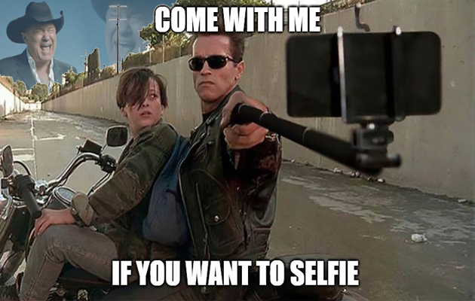
f. Contemporary Selfie and internet meme:
Internet has long-term aesthetic trends, one of which is "Network vilify, or Internet meme" a not previously named style, throughout the many separate networks culture, primarily through the meme content. The Internet can be created by amateurs vilify no particular aesthetic intent; it can also be by the author intended it as a term characteristic personality. Due to the unique architecture of bottom-up media, and its spread on the Internet, many packages are expressions from the Internet to vilify the beginning of a long-abandoned demonize the Internet can reappear in the form of a new platform or creator who has a sexual reference, although this meme style can be attracted to business and political interests, are being sold to many consumers. Its participants often will respond in the case of strong public opposition to such exploitation, or simply give up this style of co-opted into the new version. Internet meme embodies many of the core values of network creators and community; therefore, to understand this aesthetic value linkage for any culture is essential.

Slide 17
g. Locational and Relational Characteristics of Selfie:
“Selfies have changed aspects of social interaction, body language, self- awareness, privacy, and humor, altering temporality, irony, and public behavior. It’s become a new visual genre—a type of self-portraiture formally distinct from all others in history. Selfies have their own structural autonomy. This is a very big deal for art”. (Saltz 2014). Today’s Selfie makers and Users on Social Media or any other online platform consider to be Locational and Relational Selfies. Selfie as a Media-particular genre of Photographic Patois. Selfies later are proceeded to reflect the social and moral associations to assuming patois selfie-making practice for arty and ethnographical representation, suggesting for embrace a practice of categorizing as virtuous (De Seta, 2015). Chinese Social media platforms WeChat is a good example of relational and Locational Social Media Selfies sharing platform. “WeChat” in particular, are similarly central in the works of transmedia artist Michael Beets. While working in Shanghai on the production of SELF – A Smartphone Theater Experience, he explains the impact of locational social media on his own creative practice: “WeChat had just come out, or rather was becoming increasingly popular. Everybody was downloading it and talking about the “People Nearby” function and how easy it was to find people, or for people to find you within a certain distance. It blew my mind that people were willing to share their personal information in such a free, and to a certain degree unrestricted, manner. (De Seta, 2015)(Michael Beets, personal communication 2014)

Slide 18
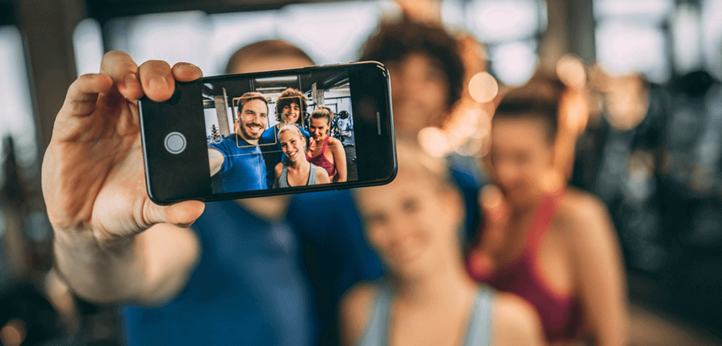
h. Selfie and Social Dynamics:
Selfies have changed dimensions of our social interface, our gestures, self-conscious, confidentiality, and absurdity, changing temporality, irony, and our social behaviors. The selfie has got the status of a new genre – that makes it distinctive from the previous versions of self-portraits that are being made in history. Modern Self-portrait (selfie) has particular organizational sovereignty. That is always considered to be a huge deal for the art and aesthetics of selfie (Saltz, 2014). Contemporary Selfie Genres is itself a true vernacular photography genre. Which is rear exhibit in Art-exhibitions and galleries, but they are widely being shared with our social circle through our Social Media (Rettberg, 2014).

Slide 19
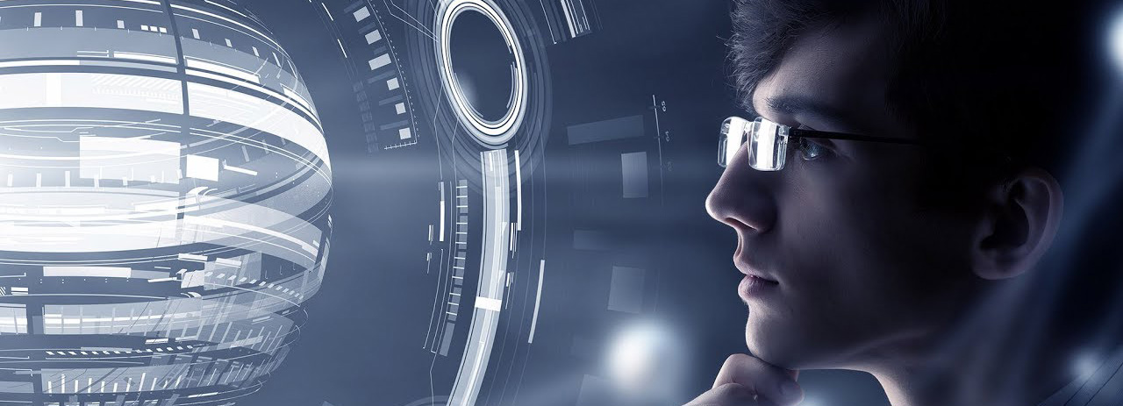
i. Selfie is an Art Form of “virtual aesthetic category”:
Unlike traditional art-forms, a Selfie is a popular art form in new media art, where non-existent features and effects can be created at random by humans’ intuition and imagination with the New Media Technologies by software’s means of blending and generating the techniques.
The digital presentation of Selfie has the characteristics of homogeneity that is to generate and delivery information by the data, images, human bodies, light and temperature. These characteristics break the traditional aesthetic principles and form virtual aesthetic categories. Whether aesthetic sense or objects come into being earlier than the other, aesthetic sense will drive the objects to obtain a certain aesthetic value.

Slide 20
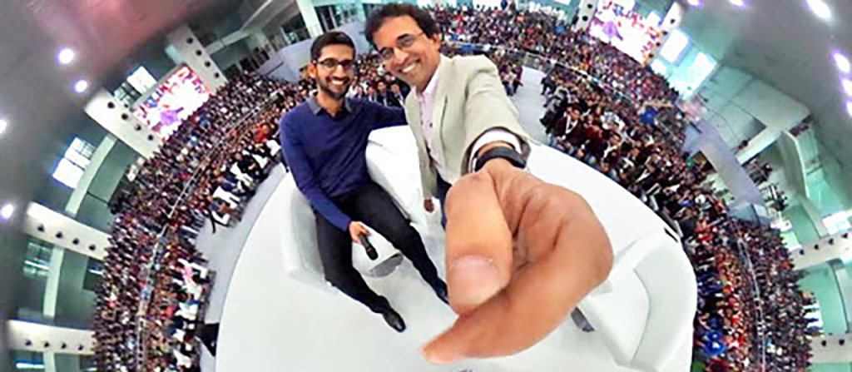
j. Selfie – A Photography with Blend of Multimedia Genres and lost Authorship:
On the level of contemporary photography aesthetics, the internet has created a multimedia genre (i.e. something that incorporates and blends different media of text, images, video, graphics, sound) with a new standard of communication methods. Digital technology has also made it much easier for different media, different distribution networks and different audiences to implement the existing digital cultural practice of making different versions of the same project. The conventional strong link between the identification of an art object and its medium is broken if one can create radically different versions of the same art object.

Slide 21
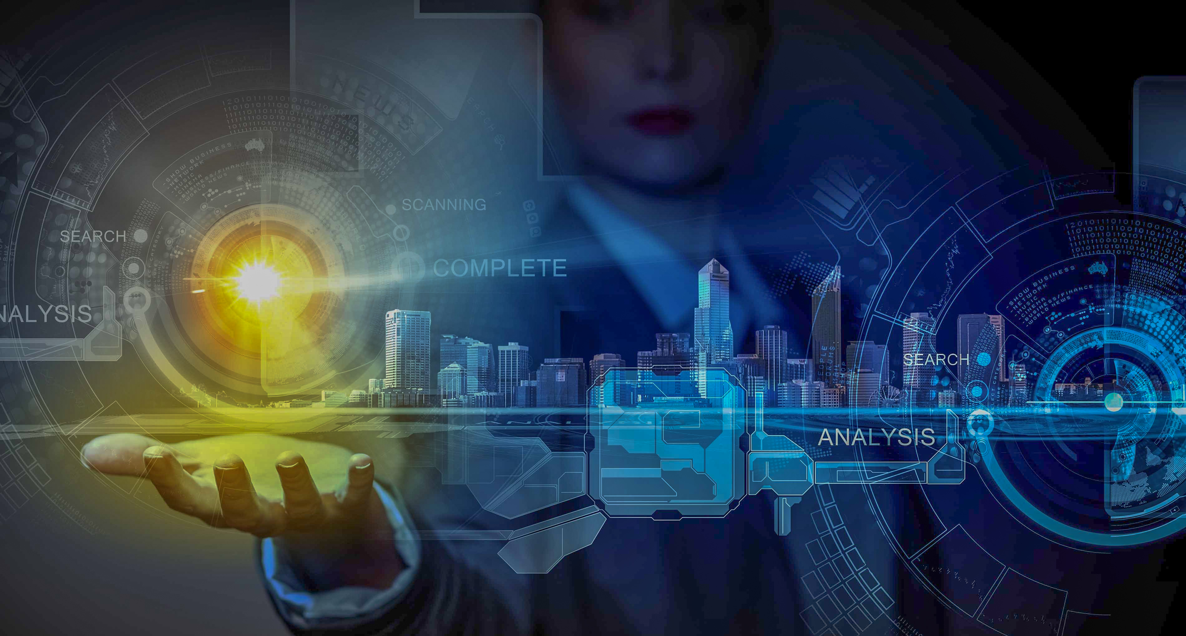
k. Contemporary Selfie exists in a very dynamic aesthetics communication environment:
In traditional Self-portrait art aesthetic activity, audiences are in a passive situation; they can spiritually attract to the subject of artwork by limited information of the medium. The audience can experience the true means of the subject of the artwork. At the same time, the subject of the medium can meet with the aesthetic needs of the public only by using limited resources. But the New Media Art environment is in two-way communication, which makes the aesthetic subject (Selfie) become both creators and receivers so that they can acquire aesthetic experience of creation and recreation. At the same time, feedback and art appreciation are very dynamic. Selfie become the subject of an extensive range of audience with active feedback and appreciation. That environment becomes two-way but more dynamic and faster, as compared to the traditional art environment.

Slide 22
l. Selfie-maker in the sharing process - A decomposition of aesthetic distance (everyone can be the artist):
In the New-Media Aesthetic environment, everyone can become an art-creator or artist. By definition, “Artist” is a social character, it can be any artist, the reason why they gain fame is not only individual talent and opportunities but also their social status and level of education. In spite of all this, they depend upon the communication platform, which is also the reason for their fame. When selfie and selfie makers come into the new media environment, the networked media becomes a compelling model of communication, which makes it possible that everybody becomes an “artist.” This environment is a bit different because without the name of an artist and rich media and environment. Many amateurs get the opportunity to become an artist, and they own their online identities, their work, and their audience. Even they can make their strong identity through their self-portraits as compared to the traditional art environment within a short time.

Slide 23
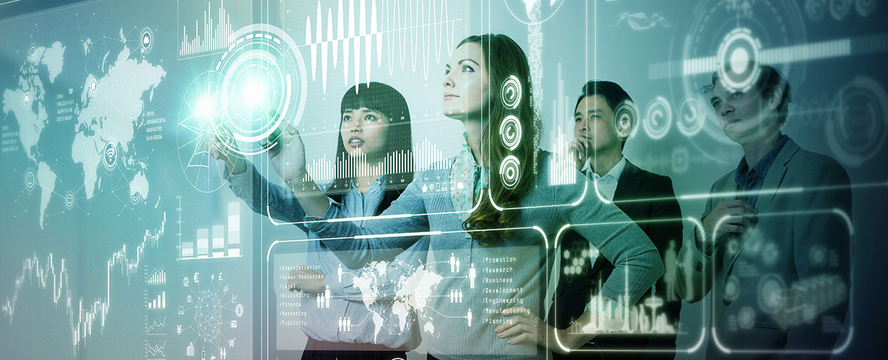
m. Contemporary Selfie gave birth to New Artistic Existential Form to a Self Portrait:
With the appearance of modern network, self-portrait becomes very popular. Digital Selfie based on computer and internet has become a new art form to produce and communicate. In the post-internet era, it has become the most convenient method and a compulsory part of the modern lifestyle. In a society full of digital imagery, self-image creation requires no patent for professionals. On the other hand, Selfie-makers are creating selfies, which is according to their own aesthetic ideal by using new media digital tools and techniques. In modern high-tech society, the art of selfie making has become part of contemporary life through the continues process of conflict, integration, and recombination.

Slide 24
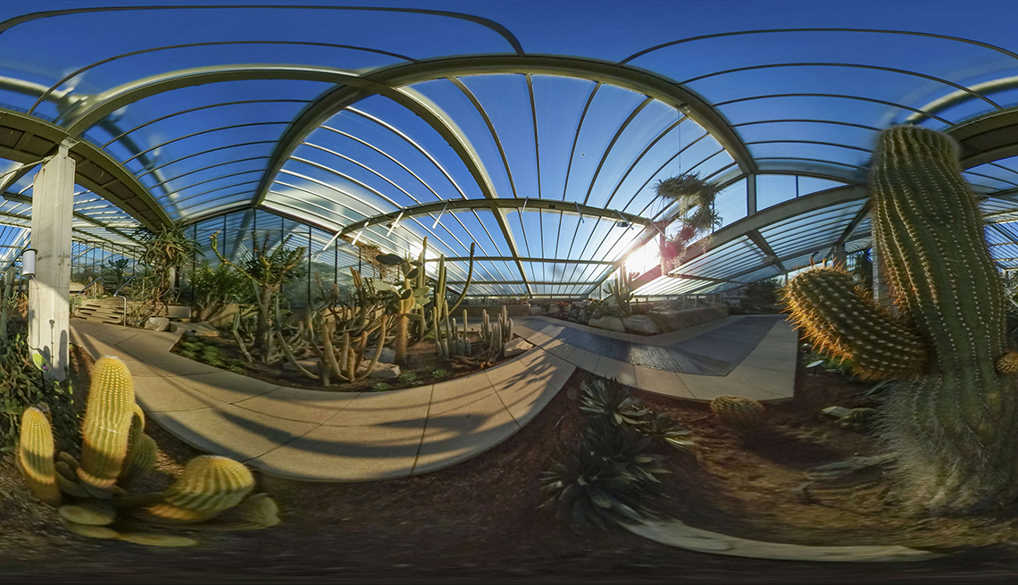
The Future of Aesthetic Trends of Self-Image:

Slide 25
The Future of Aesthetic Trends of Self-Image:
In short, the portrait is not a new practice, it was a very specialized job, but later photographic de-specialization makes it possible that an ordinary person can do photography. Commonly, the image is fiction; no one denies the ability of their subjectivity and tampering. However, the significance of the processing occurs throughout the linear duration. The still image, before the occurrence, the moment was a captured time. It has happened in the past is the image of the witness. However, viewers have the right to recollect some remembrances, historical reconstruction of personal storytelling is possible.
In the current era, one of the purposes of self-photography is consumers desire for everlasting existence, but the exciting thing that finally they do not want to be the history, which probably negates their presence, means that there is or no death. Quality reproduction of objects, including images, is a modern track; it has become a global cognitive process. However, this is the tradition of post-modern culture that quick and mass image-making and removal of personal visual story-telling and their implications. Selfie made it possible to explore these aesthetic experiences; time is significant in order to distinguish some of the problems that vary in different layers of meaning. It also reaffirms its recognition of society's surreal spectacle of quality and demand. Selfie evoke through social media verification, look for self-portrait's construction, and even different social roles and identities interpretation of deconstruction.

Slide 26
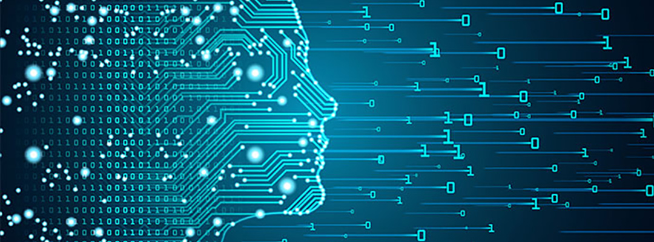
n. Questions about the future of selfies:
Our topic is mainly surrounding the expansion of aesthetic analysis and discourse of contemporary society selfie. This issue involves not only aesthetic but also relates to the impact of technology on aesthetics, impact on social and cultural entities, as well as about the impact of technology on the digital culture of the selfie.
In this endeavor, we are exploring selfie with self-portraits (selfie) users of the 20th century to create a software-driven network, selfie early photographic art, engineering, and other aesthetic selfie historical ties. While asking what innovations and behaviors remain, which has become more common and vanished, we can also introduce question of variance. Capturing, editing, and sharing photos quickly, whether to give more visual diversity? Alternatively, will this result in more repetitions, unity, and social imitation, just as food, cats, and other popular selfie things will drown most the vast majority? To what extent can these technologies enhance our own aesthetic characterization? Will our current selfies development become an outdated and outdated future school?

Slide 27
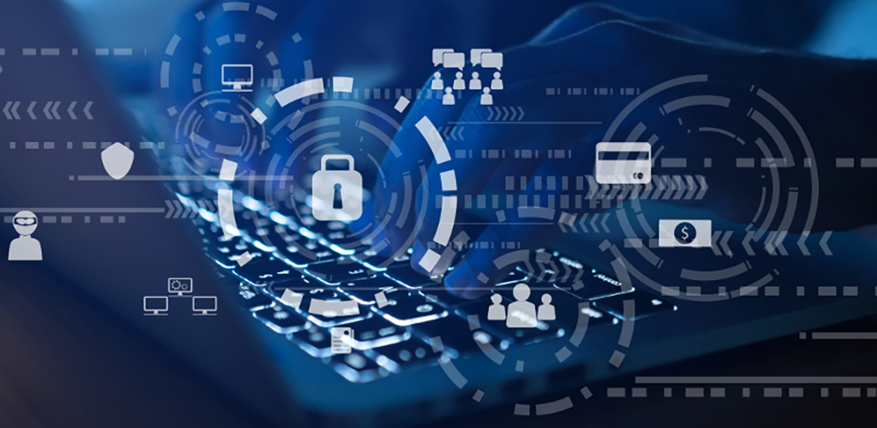
o. Future Threats to Contemporary Selfie Photography Practice:
Throughout history, the self-portrait was always a mode of self-representation, that evolves through different medium genres and techniques. Contemporary selfie is a part of Digital medium Photography, do This genre has a danger of vanishing? Entirely antagonistic. For example, if there is a combination of photography equipment and some smart communication device, it would be unlikely considered an interconnecting device exclusive of the photo capturing device. Embedding camera with a multi-purpose communication device, the photography purpose is always a sovereign. Smartphone has acquired global adaptability and also appropriation for gaining wider acceptability of image-making. The integration of the photographic device proclaims the exceptional usability of this original function. Afar from the extensive fabrication of social imagery as a self-representing portrait, it sets tremendous revolutionary trends of its newer and newer usability in modern society.

Slide 28
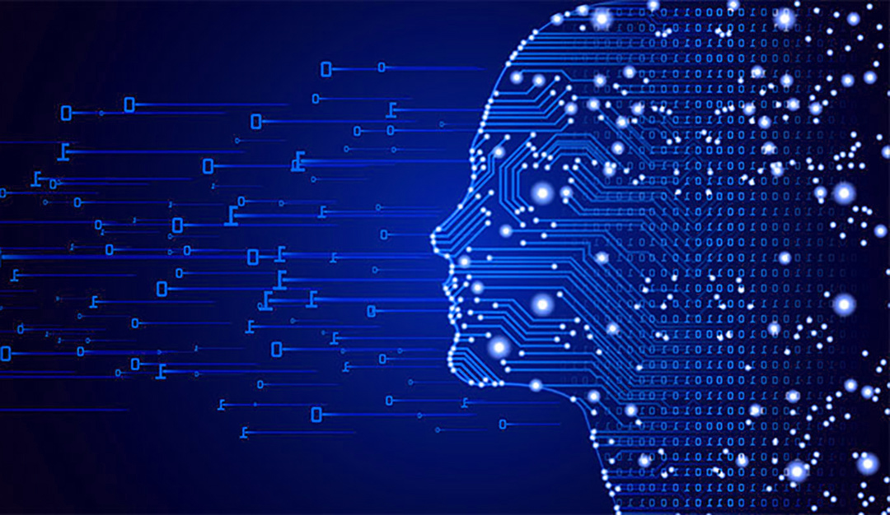
p. Future implications of selfies and digital self:
Generally, Self-images on social media are useful for “Future Existence.” In this modern society, new media is recently moving towards the image-making of people and their actions into the entities. Though, people can be linked willfully. The images can be turned into meaning carriers by new media, and turn the folks into the “meaning- creator” in this undertaking procedure (Vilem Flusser, 1989).

Slide 29
CONCLUSION: Future of Aesthetics trends of Self Representations:
Our analysis of selfie aesthetics describes how individual selfies and self-representational media interrogate these conventions and construct alternatives, opening up new potentialities for self-constitution and selfhood using new aesthetical paradigms. Typically, selfies are assumed to be concerned wholly with the individual, it also indicates how the visual rhetoric of doubling can operate within self-representational art to assert selves as always necessarily relational. It is observed self-representational art and technologies can invoke plurality rather than individuality, articulating ways of being that are multiple, relational, and networked. Their seemingly solipsistic individuality is not the only assumption about selfies. Politically, selfies are regarded as tools that can bring into visibility truth of identities that have been marginalized. But here a more ambivalent form of visibility is at play. As Each Self-image repeats, overlaps, and obscures other iterations of their self-representation. It has shown how the instantaneity of photography not only preserves that which is recorded but simultaneously opens up gaps in the record that produce the grounds on which alternative histories can be aesthetically produced, reproduced and imagined.
The idea of self is being challenged and transformed by many prospects that are being presented by the modern digital world. In the early 21st century, many facets of transformation and its effects rely on the digital world, future technologies and their possession. The prosthesis of modern self-extensions is being used, but future predictions of cyborg or post-human can develop unique technology to photography. For example, using 3D fabricating technologies and Digital Hologram, it is reasonably possible to imitate the digital assets, even moreover omitting it’s virtual or real parts. Virtual Avatar are the next generation of self representation in new digital culture. Video self representation in the form of V-log is also a modern tool of self representation using the benefits new aesthetic environment. The concept of extended-self and its meanings need to be changed correspondingly. Meanwhile, there are many new horizons to explore, which can enhance the understanding of the digital extended-self in this modern world.

Slide 30
THANK YOU

