Slide 1
Wicked Redemption:
A Music Perspective Analysis of “Ain’t No Rest for the Wicked”
By Jamison A. Will

Slide 2
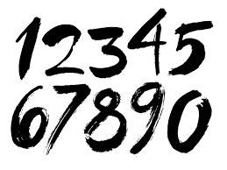
A Music Perspective:
Discursive Symbols:
Units with fixed associations (letters/numbers)
Nondiscursive Symbols:
Units beyond words or numbers (nonverbal/paralanguage)
Musical Artifacts:
To be an artifact, the meaning (intended or not by creator)must be widely shared by an identifiable group

Slide 3
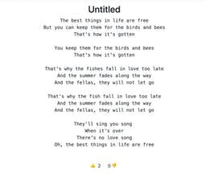
Music as Rhetoric:
Musical Rhetoric:
Persuasive arguments conveyed through music that reinforce/challenge taken-for-granted beliefs/behavior
Nondiscursive Rhetoric:
Study of how these symbols function as persuasion
Music Perspectives:
Explains how musical sounds (nondiscursive) with or without lyrics (discursive) function rhetorically

Slide 4
Musical Aesthetics/Communication:
Musical Aesthetics:
Appreciation/evaluation of musical form/designs sometimes within a well defined criteria
Musical Communication:
Refers to individual and unique meanings, not necessarily shared, that we attach to musical work

Slide 5
Illusion of Life: Based from Susanne Langer’s early work
Illusion of Life:
Called this because music is not real life; it represents human experiences and emotions
Impacts:
Discursive symbols (letters/words) are not real things; they are representations of real things
Nondiscursive symbols (musical sounds) are not actual emotions; rather they are representations of emotions

Slide 6
Music & Emotions:
Music Communicates Emotions using:
Intensity Patterns:
Tension (allegro/ fast paced) and speeding up (accelerando) and increased volumes (crescendo)
Release Patterns:
Relief (slow rate/largo) and slowing down (ritardando) and reducing volumes (decrescendo)
Paralinguistics as in Music:
As we listen to cues, pitch, and tone in vocal communication as so we listen to rhythm, harmony, melody, instrumentation and articulation

Slide 7
Virtual Time & Experiences:
Virtual Time:
Actual time is succession one-dimensional of moments (minutes) whereas music suspends this and substitutes rhythm, harmony etc. of its intensity/release patterns
Virtual Experience:
Not real experience but a lyrical accounting of life via an artist’s perspective

Slide 8
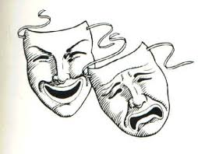
Comic Vs. Tragic Lyrics:
Comic Lyrics:
Not funny or hilarious, but the protagonist is determined to beat the odds/cannot fail
Tragic Lyrics:
Protagonist has sense of hopelessness, attempts to cope with reality

Slide 9
Augmentation of Lyrics:
Poetic Lyric Illusions:
Lyrics are backwards looking, reflecting on the resolved past
Dramatic Lyric Illusions:
Forward looking into unresolved future

Slide 10
Congruity Vs. Incongruity
Congruent Interaction:
Emotional meanings of lyrics which are reinforced
Incongruent Interaction:
Emotional meanings of lyrics which contradict one another, and alter meanings which would have been conveyed by either one

Slide 11
Congruity of “Ain't No Rest For The Wicked”
Congruity Analysis Conclusion:
-tragic lyrics + release patterns + poetic illusion e.g.
“He'd stuffed his bank account with righteous dollar bills “I told him, You can have my cash, but first you know I gotta ask”
What made you want to live this kind of life?" (poetic illusion)
But even still I can't say much because I know we're all the same
Oh yes we all seek out to satisfy those thrills”
(tragic lyrics)

Slide 12
Ambiguity & Ascription
Strategic Ambiguity
Strategic Ambiguity is making a claim using vague language that avoids specifics but helps listeners
“But even still I can't say much because I know we're all the same
Oh yes we all seek out to satisfy those thrills”
(ambiguous lyrics)
Strategic Ascription
There is also a story being told in these lyrics

Slide 13
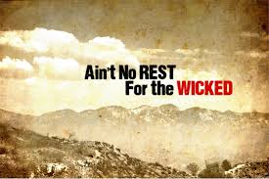
Listen to the Song
Piece together the Conclusion…
https://www.youtube.com/watch?v=HKtsdZs9LJo

Slide 14
Analysis of “Ain’t No Rest for The Wicked”
Musical congruity -tragic lyrics + release patterns + poetic illusion e.g.
Group theme that the “wicked” can’t rest, and need to survive through unethical methods
Slow beat after chorus, gives us time to understand whats happening
Backward reflecting, happened in the past, and is being reflected upon
Lyrical Ascription
Story of what happened to himself
Tragic lyrics- protagonist has sense of hopelessness and “whatever happens happens” attitude
Lesson
The wicked will do what they need to survive, no matter what they need to do, and that we are all wicked in that we’ll do whatever we need to survive no matter the method
There is no redemption for any of us...

Slide 15
Conclusion
We will do what we need to to survive
Sellnow’s Illusion of Life method is a viable and effective tool for analyzing songs through multiple levels and filters
We will continue to use this tool to analyze future pieces/artifacts and continue to learn new/ surprising things utilizing this tool
Hope you Enjoyed! Thank you

