Slide 1
Pop Culture Presentation
By Caitlin Stoddard
Notes:
When I was a child there was a television show that impacted my life with how he used narration to teach me about life. The television show I am talking about is Mr. Rogers’ Neighborhood.

Slide 2
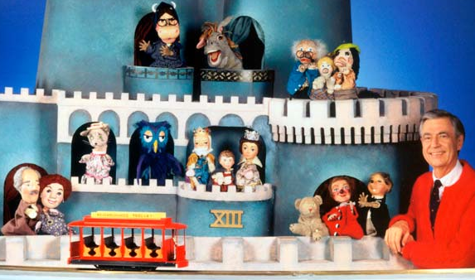
Notes:
Fred Rogers understood how a mind of a young child works and he was brilliant with using narration as a tool to help discuss topics that were hard for young children to understand.

Slide 3
Narration
Notes:
Narration is the action of telling a story. When Mr. Rogers narrates in his show, he always makes sure that the story as a beginning, middle and end. Also he uses different ways to use narration. The elements he uses are music and puppets to help tell the story.

Slide 4
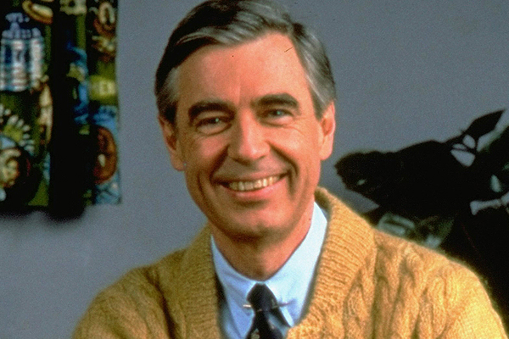
Argument
Mr. Rogers' Neighborhood used different concepts of narration to teach young children about life.
Notes:
There is no doubt in my mind that Mr. Rogers used his narration skills impact his young audience because he understood how younger children learn in their eviroments.

Slide 5
The Neighborhood
Narrator - How the story is being told.
Narrative paradigm - A framework that places storytelling at the heart of human connection.
Paradigm - Is the framework for understanding the world around us
Syntagmatic/Paradigmatic - The narration is a natural flow but sometimes Fred will ask his young viewers to flashback to a previous topic.
Notes:
There are two sides of Mr. Rogers’ Neighborhood and let's start with the first side. What I enjoyed about the neighborhood is how Mr. Rogers is the narrator and he is directly looking at you. Within the narration there is a framework called narrative paradigm and when Mr. Rogers talks to his audience, there is a human connection because he is directly talking to his audience about the topic of the show. Another framework is paradigm and Fred uses this well because with the narration, his audience is able to understand about the world they live in. Also Mr. Rogers uses syntagmatic which means everything he talks about is a natural flow or easy for younger children to understand. However he does challenge his audience by using paradigmatic because Mr. Rogers often does ask his audience to think back to yesterdays episode to reflect on a topic. Now to the other side!

Slide 6
The Land of Make Believe
Coherence - The way a story hangs together.
Structural - The sequence of events flow nicely.
Character - The characters are flat and help develop the story.
Material - The stories are consistent with related themes.
Syntagmatic - The stories are being told on a natural flow which is suitable for young children.
Notes:
When I was a child I always wanted to visit The Land of Make Belief because it was filled with great imagination and stories. Plus I wanted to visit my favorite character Daniel. When Mr. Rogers transitions to The Land of Make Believe the narration becomes a coherence because the story continues to hang together by the puppets, actresses and actors. Because of the coherence, this leads to structural because the events flow nicely in the story. The characters in the Land of Make Believe are a flat or in other words predictable. For example, when I see Daniel I know I am expecting a shy and low voiced character. Also I will point out there are a lot of characters and I can’t remember all of them but every single one of them help develop the story. The material is easy going and simple because whatever the topic Mr. Rogers talked about, The Land of Make Believe will further discuss that topic. The stories and themes are always related regardless how serious the topic is. And of course The Land of Make Believe is syntagmatic because the stories are told on a natural flow or easier for young children to understand.

Slide 7
Conclusion
In closing, Mr. Rogers used different concepts of narration to impact the lives of young children but perhaps the greatest accomplishment of all was letting each child know how much he cared about them.
Notes:
What I truly loved about Mr Rogers is how he never treated anyone differently. He genuinely cared about people and he impacted my life with kindness. Thank you.

