Slide 1
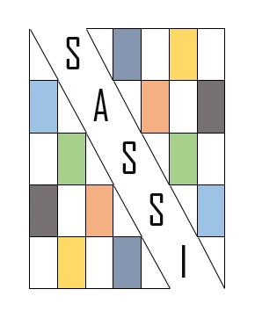
Data (Mis) Visualization
and its impact on
Academic Advancement and Public Understanding
Chair: Nicole Webber | Assistant Professor, University of Northern Colorado
Panelists:
Dale Edwards | Professor, University of Northern Colorado
Rob Reinsvold | Professor, University of Northern Colorado
Margarita (Maggie) Shawcross | Assistant Professor, University of Northern Colorado
Jingying (Crystal) Zhen | Graduate Student, University of Northern Colorado & Shandong Normal University (China)
SASSI 2020 Conference
The Image of Impact
in Literature, Media, and Society

Slide 2
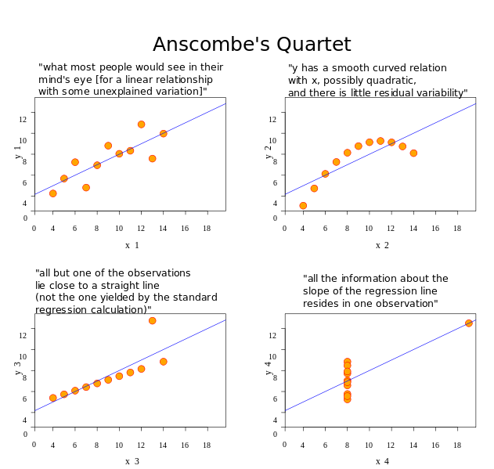
Data Viz & Impact
Visualizations of data have both the power to demonstrate impact and instigate impact
Distilling information visually can have both beneficial and harmful results
Nicole Webber
Assistant Professor,
Business & Communication Librarian
Source: Wikimedia Commons
All four sets of data share the same mean, variance, correlation, and regression line; however it is nearly impossible to appreciate their differences until they are translated into visual representations and compared.

Slide 3
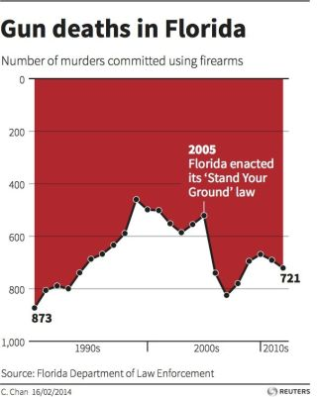
Accurately depicting data with colors, symbols, and other encoding is a challenging endeavor that requires skill and the understanding of basic principles.
When graphs, charts, infographics, and other visuals misrepresent the data behind them, it may be the result of a simple oversight or it may be that the creator is purposefully trying to deceive their viewer into a particular conclusion.
Nicole Webber
Assistant Professor,
Business & Communication Librarian
This problematic chart places “0” at the top of the y-axis, making it appear that there were fewer gun deaths in 2012 than 2005.
Source: Live Science 2014

Slide 4
Dr. Dale Edwards
Professor of Journalism & Media Studies
Margarita (Maggie) Shawcross
Assistant Professor,
Health Sciences Librarian
Dr. Rob Reinsvold
Professor of Biology
Jingying (Crystal) Zhen
Graduate Student, Digital Media & Computer Graphics
Nicole Webber
Assistant Professor,
Business & Communication Librarian
Notes:
This panel will address questions regarding the implications that various forms of data and information visualization have on the pedagogy, research, culture, and public face of their respective academic fields.

Slide 5
Panelist Introductions
Tell us about yourself, your interest in data visualization, and the role that data visualization plays in your discipline.
I

Slide 6
I
Panelist Introduction
My name is Dale Edwards and I am a professor of Journalism and Media Studies at UNC. My main interest in data visualization is as an aid to present information to the public as a journalist. We started with newspaper graphics, especially when color became available, and with a nice graphic, you can give a lot of information quickly and understandably.
Dr. Dale Edwards
Professor of Journalism & Media Studies

Slide 7
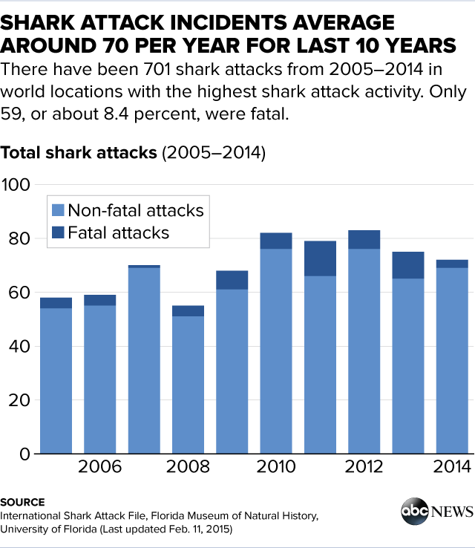
Newspaper Graphic
In a newspaper one can put a graphic on the page and the reader can take as much time as they wish to read and study it.
But even in newspapers, graphics can get too busy.

Slide 8
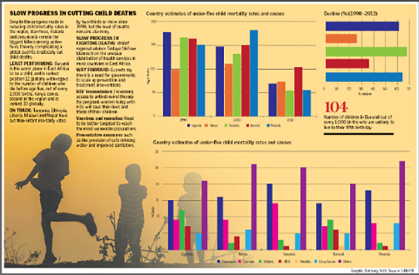
But it can get too busy, even in print
I
Research has shown that readers will ignore this type of graphic simply because it’s too busy.
That issue is even more critical in broadcast.
Dr. Dale Edwards
Professor of Journalism & Media Studies

Slide 9
Broadcast Limitations
I
That’s because you have only a limited time and limited medium. In television you put a graphic on the screen and it is likely it will only be there for 10 seconds or less. Thus it has to be crafted carefully to get the information across, but be simple and clear enough that a viewer can digest it quickly. That’s not easy. But visual data is highly useful because it allows you to put more detailed information on the screen while describing it generally by voice.
Limited amount of time on screen
Must, therefore, be simple
But, with voice in background, can be useful

Slide 10
For Example: A Nice TV Graphic
I
Only three elements, and they’re short.
The anchor has to tell the rest of the story. One of the most common uses of data visualization is weather.
Dr. Dale Edwards
Professor of Journalism & Media Studies

Slide 11
Weather Graphics
I
Here’s one from Channel 7, giving the seven-day forecast.
Lots of information there, but it’s pretty readable and you can find what’s important to you, especially with the anchor helping.
But, there’s a drawback, as you might expect. One of my biggest pet peeves is graphics used for sports.

Slide 12
It’s busy, but at least one sport
I
Take a look at this one. OK, it’s busy, but at least you’re talking about one sport. It’s all baseball, right? Probably about the game we’re broadcasting during the time we’re using the graphic.
You’re not going to see everything, but it will probably still make it.
Dr. Dale Edwards
Professor of Journalism & Media Studies

Slide 13
Criminally Busy Graphics
I
But take a look at this one:
Really? Could you not put MORE information on there? Let’s see…we have hockey, we have the NFL, we have major league baseball, we have a college football score…AND we have a crawl at the bottom giving current games and scores.
It’s too busy. It’s confusing. We are trying to cram too much data on the screen at a time and it overloads the average viewer.

Slide 14
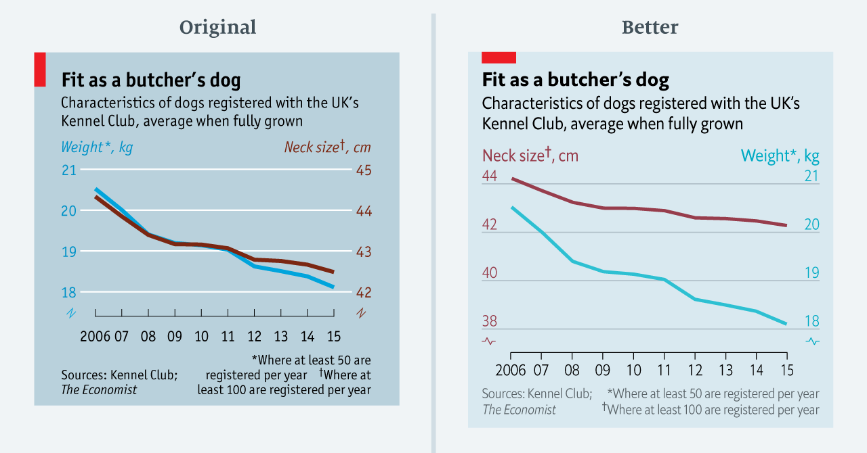
I
As you can see, data visualization is a big part of journalism, and sometimes we use it well…and sometimes, not so much.
Dr. Dale Edwards
Professor of Journalism & Media Studies
Source: The Economist

Slide 15
I
Panelist Introduction
Formerly
Consumer Health Librarian
Public Librarian, Health programming
Health educator
Currently
Health Sciences Librarian at the University of Northern Colorado
Duties include: teaching library instruction sessions, assisting with research
Interested in Health Literacy : connecting folks with health information they could understand
Margarita (Maggie) Shawcross
Assistant Professor, Health Sciences Librarian

Slide 16
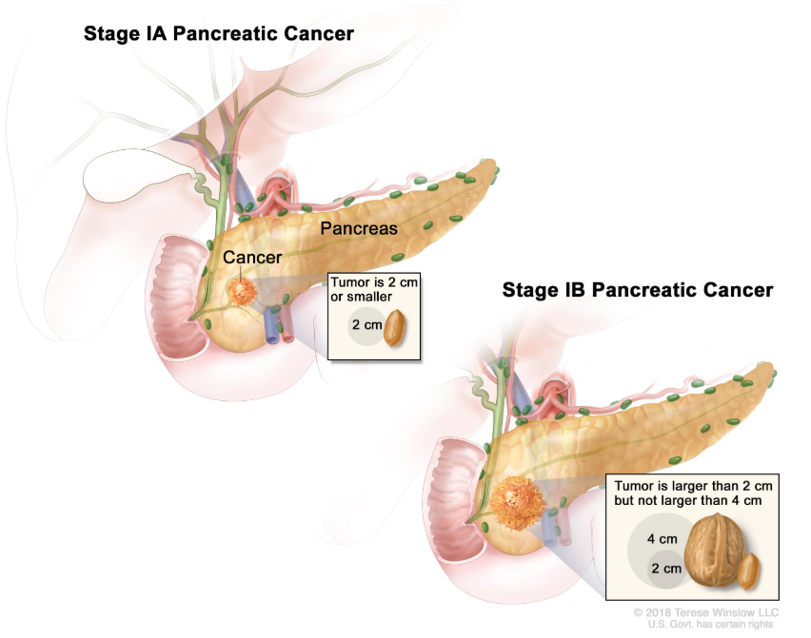
I
Data Visualization in health is HUGE!!!!!
Example: A patient receiving a diagnosis and not understanding health information.
Data visualization takes technical information and puts it in a visual format that makes it easier for patients to understand
(Teresa Winslow LLC, 2018)
Notes:
So what power does data visualization hold in health and how does it affect my work?
Data visualization is taking information and creating a visual representation of that information and in my case it’s health information. The impact of data visualization on the field of health has been huge.
Let me give you an example:
Imagine that you are experiencing pain, you don’t think it’s a big deal, so you go about your life. Until the pain becomes unbearable. You finally go see your doctor, and they diagnose you with pancreatic cancer. So, you, a Spanish speaker with a limited education are presented with health information. This health information can be technical, confusing, daunting and then add the emotions tied to a life-changing event. This is a real-life example that happens every day in the health field.
The talk about possible treatments, surgical options, recovery times can be too much. But then comes in data visualization. Data visualization takes that technical information and puts in a visual format that effectively illustrate health information. Now as a patient, you are given the opportunity to understand an often-complex issue in terms that you could understand.
Data visualization has been tremendously impactful on health and health education, I just gave you an example of what it would look like in a doctor’s office. But it can be helpful in other health settings:
For example, if you were a health organization wanting to share your message. Data visualization in health can help publicize a program or educate the public on very complex issues and translated them into simplified snippets of information. It directly impacted how I delivered health information when I was a health educator. And as librarian, I am compelled to work with patrons and students to encourage them to become better “consumers” of information by knowing where to find the best information possible, and asking important questions related to the information being shared, rather than just accepting the information for what it is.

Slide 17
I
Designers of data visualization need to do the following:
Understand the audience that they are targeting
Is the information written in a way that the audience can understand? What is the creator of the visualization trying to get the viewer to get out of this visualization? Do you want them to learn something or entertain or engage or anger?
Set up a clear framework
The designer needs to have a clear understanding of how the semantics (the meaning of the words and graphics used) and the syntax(how the arrangement of words and graphics will help in the formation of an idea/message) will work together. This is where the use of color, positions, texts, size comes into play.
Tell a story
The storytelling piece is important because that is what will used to engage the audience.
Margarita (Maggie) Shawcross
Assistant Professor, Health Sciences Librarian
Notes:
As a librarian and instructor, I feel that it is important to develop data and visual literate students. And it is important for them to know the difference between a good data visualization and a bad data visualization.
This is not simple. When making data visualization accessible to the general public the designer needs to find that special balance between how much is enough information and when is too much to much?
When is more information better? Well if you’re conducting a medical study, yes, more information is better. But if you’re sharing the results of the study, no more information is not better.

Slide 18
I
The data presented here is the national obesity rates from 1985 to 2002, at that time. This “obesity epidemic” is widely regarded as one of the greatest threats to Americans' health, and some experts believe that the current generation of children may be the first generation in American history to have a shorter life expectancy than their parents—primarily because of obesity.
Having the year to year data, in front of me, very clearly showing me the numbers of obesity rising and rising was scary to me.
(Centers for Disease Control and Prevention, 2020)
Notes:
But now to my favorite example of data visualization.
It’s not necessarily my favorite because of the topic but rather because of the impact that it had on me personally and professionally. I remember being a student in the public health program in 2002 and my professor had shown us this data.
Why was this data visualization so memorable?
Well, it was simple and got the message across that we need to work on combating obesity immediately.
First, the message was clear, and it constructed a good story. Obesity rates are rising, very quickly. The “graph” or the map of the United States was recognizable and familiar and that along with the colors…. the use of blues (cool colors) to warmer yellow, oranges and finishing up with the deep reds was very impactful.

Slide 19
I
Panelist Introduction
I approached this question through my lens as a scientist and science educator.
Helping students learn how to interpret data from various sources cuts at the very nature of what science actually is.
In the next slide, I list 7 key ideas regarding the nature of science taken from the Next Generation Science Standards. Whenever I use a representation of data (graph, map, table, infographic, etc.) for my students or the general public, it is with these 7 key ideas in mind.
For my favorite data visualization, I chose a few graphics related to the evolving data related to COVID-19. The data come from John Hopkins University, CDC, and WHO.
In planning for the SASSI Conference, I used this example as how we in science make our inferences on the best available evidence at the time and will continually revise our inferences as more data emerges. At the same time, we need reliable and accurate data.
The significance was obvious given the current global situation.
Dr. Rob Reinsvold
Professor of Biology

Slide 20
Key Ideas Regarding the Nature of Science
I
Scientific knowledge is based on empirical evidence.
Scientific knowledge is open to revision in light of new evidence.
Scientific models, laws, mechanisms, and theories explain natural phenomena.
Science is a way of knowing.
Scientific knowledge assumes an order and consistency in natural systems.
Science is a human endeavor.
Science addresses questions about the natural and material world.
(Next Generation Science Standards, 2013)

Slide 21
Coronavirus Disease 2019 (COVID-19)
I
On 30 Jan 2020, the World Health Organization declared the outbreak a “public health emergency of international concern (PHEIC)”.
On 11 Mar 2020, WHO formally declared COVID-19 a pandemic.
How do we make sense of the data?
Dr. Rob Reinsvold
Professor of Biology

Slide 22
Our Challenge:
I
How do we make informed decisions based on the best available empirical evidence?
Source: https://www.cdc.gov/coronavirus/2019-ncov/summary.html
Spread of COVID-19 as of Mar 2, 2020

Slide 23
The image above is a screenshot from 3/11/20 of an interactive website maintained
by John Hopkins University. Click on the image and you will pull up the live website.
Notes:
This site shows the emerging data that is updated daily from the CDC, WHO, and John Hopkins University data. It clearly demonstrates how scientific data is always being added. In this case, it is being added hourly. Helping our students make informed decisions is critical.

Slide 24
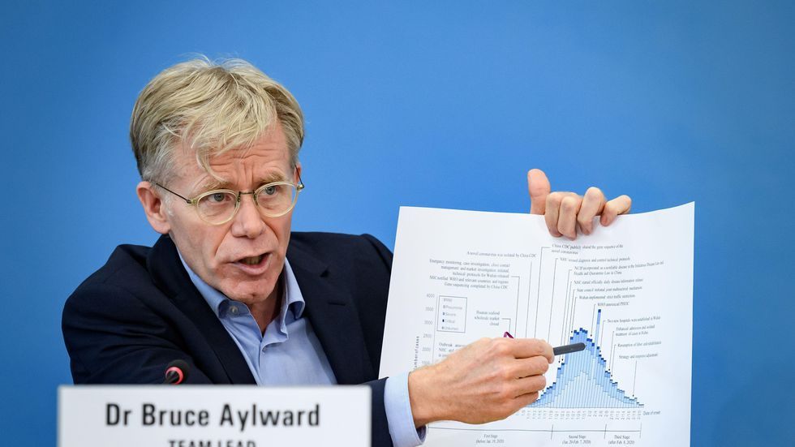
I
Notes:
Epidemiologist Dr. Bruce Aylward, of the World Health Organization, shows graphics documenting the coronavirus outbreak at a press conference in Geneva on Feb. 25.
A day earlier, WHO noted that China had, as of that morning, reported more than 77,000 cases of COVID-19, including more than 2,600 deaths. It also said that the epidemic peaked and plateaued there between Jan. 23 and Feb. 2, and has been declining steadily since then. Outside China, there were at that point 2,074 cases in 28 countries, and 23 deaths. WHO noted that the sudden increase in cases in Italy, Iran and South Korea were "deeply concerning" but that all countries should have confidence that "this virus can be contained.“
This is another example of using emerging data to make decisions. In this case the decisions about what should be done have a very narrow window of opportunity. The same could be said for interpreting data on global climate change or efficacy of new medical treatments. Data needs to be simple enough to make the point without leading to inaccurate conclusions.

Slide 25
Source: https://www.cdc.gov/coronavirus/2019-ncov/summary.html
As of Mar 3, 2020
Notes:
This map was taken from the CDC on Mar 3, 2020. At the time, the number of cases was still relatively low yet many of the epidemiologist were already predicting a greater spread. President Trump was saying that even though it was an epidemic in China, we did not need to worry about anything in the United States.

Slide 26
The Dilemma
I
No current cure or vaccine
Best public health approach – control the spread, thus minimizing new contacts
Implications
Disruption of our normal interactions (e.g. avoiding situations that promote spread)
Economic effects – supply chain, travel, panic
Limiting exposure to groups (e.g. large assemblies, political rallies, concerts, amusement parks, etc.
Redistributing health supplies and resources
Preparing schools for potential closures to minimize impact on learning (while protecting health of students)
Dr. Rob Reinsvold
Professor of Biology
Notes:
This is a good example where we do need to make informed decisions on the best available evidence possible. There are very real life and death implications.

Slide 27
What do we know?
I
Current data suggests that COVID-19 has a mortality rate of more than 20 times the common flu virus (2.3% vs. 0.1%)
SARS-CoV-2 (the virus that causes COVID-19) is more contagious than flu virus
R0 of SARS-CoV-2 = 2.2
R0 of influenza virus = 1.3
Person-to-person spread via respiratory droplets (coughs & sneezes)
May test positive and still be asymptomatic
Symptoms may appear 2-14 days after exposure (fever, cough, shortness of breath)

Slide 28
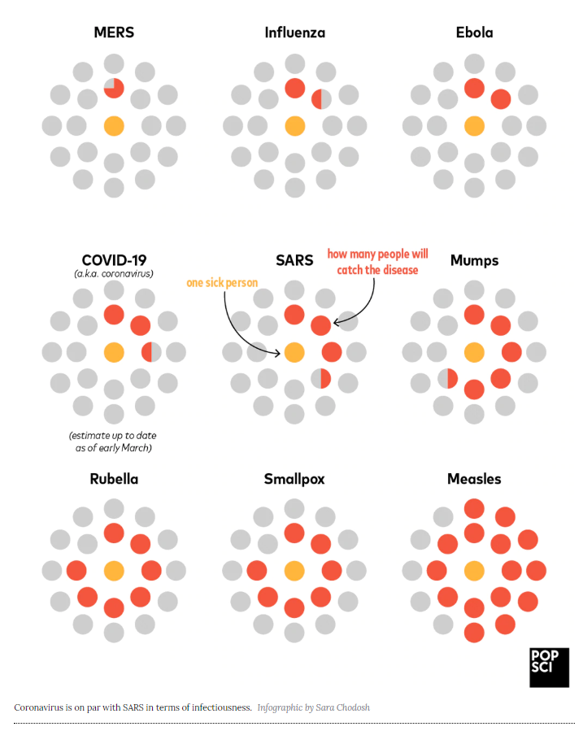
How contagious is coronavirus?
R₀ is pronounced “R naught”. It is a measure for how contagious an infectious disease is.
R₀ is the average number of people who will catch a disease from one contagious person.
The graphic on the right shows the contagious person in the middle (in orange) and the average people who catch the disease from this original person (in red) around this individual. It is a graphic of relative R₀ values.
COVID-19 is more contagious than flu yet less than measles.
Dr. Rob Reinsvold
Professor of Biology
Notes:
Although this infographic is very visual and simplifies the concept of R0, it may also suggest that every infected person always infects the same number of other people (rather than representing an average value).

Slide 29
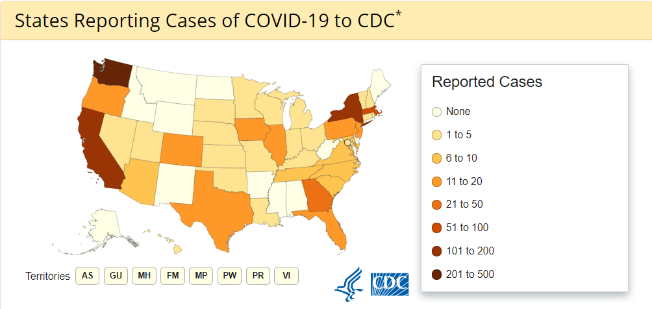
Source: https://www.cdc.gov/coronavirus/2019-ncov/summary.html
As of Mar 11, 2020 (8 days later)
Notes:
On Mar 11, 2020, eight days after the other screenshot, the emerging picture is more dramatic. Conferences (such as SASSI) are being cancelled, politicians are placing themselves in self-quarantine, schools are closing or going exclusive online, travel is being restricted, the stock market has crashed, Colorado has been declared an emergency area, and grocery shelves are being emptied.
This is another opportunity for helping students and the general public make well-reasoned and well-supported decisions. Are we overreacting or not reacting fast enough? What does the data imply? What do we know about other behavior and spread of other viruses? What is lost when the data is averaged across the whole state as implied in the graphic above?

Slide 30
The Learning Opportunity
I
Helping students make inferences based on empirical evidence
Rather than hearsay, social media, fear, stigma, or other unsubstantiated sources
Helping students revise inferences as new data becomes available
Science as self correcting
Helping students evaluate the source of data
Relative reliability of sources (primary scientific literature, internet source, social media, etc.)
Helping students rely on empirical data to explain natural phenomena
Debunking conspiracy theories or supernatural explanations as being scientific
Helping students understand their world better
Making sense of information
Dr. Rob Reinsvold
Professor of Biology

Slide 31
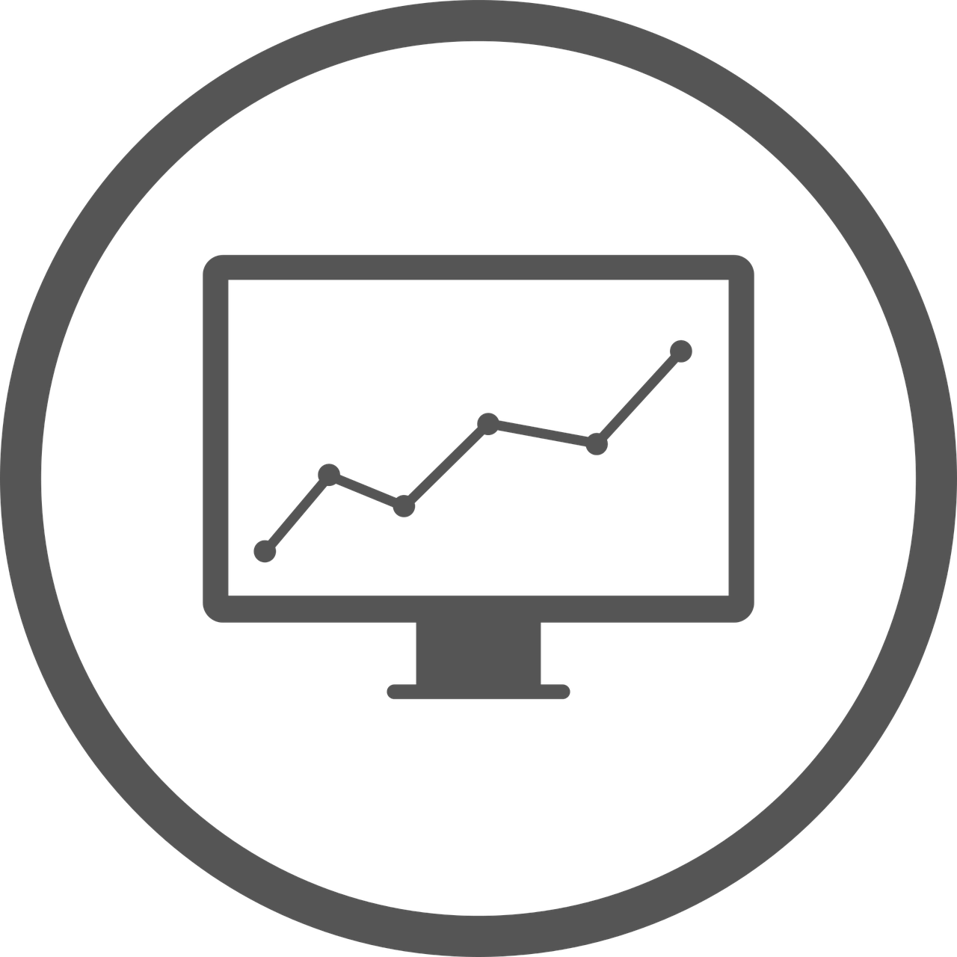
I
Panelist Introduction
Master Program in Digital Media, University of Northern Colorado, USA
Master Program in Computer Graphics, Shandong Normal University, China
Jingying (Crystal) Zhen
Graduate Student, Digital Media & Computer Graphics

Slide 32
I
How to understand data visualization?
Fast Communication
+
Easy Understanding
Data
Visual coding
Decoding
Understand
Notes:
The process of data visualization is through data analysis and then designing visual coding. The viewer can understand the information more quickly through decoding the graphics.

Slide 33
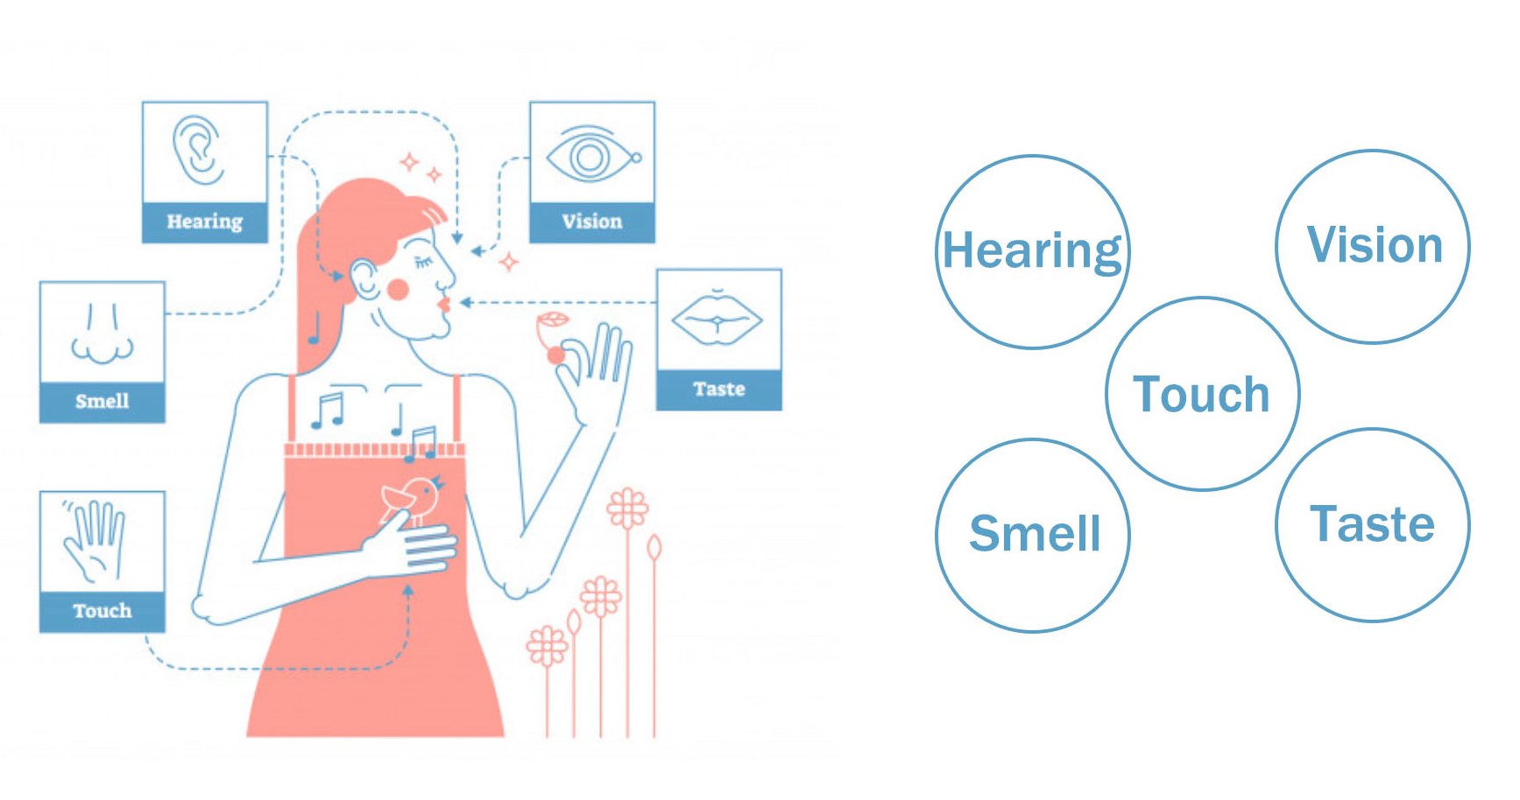
I
How to get information more effective?
Visual sense and cognition
Humans perceive information through vision, hearing, touch, smell, taste.

Slide 34
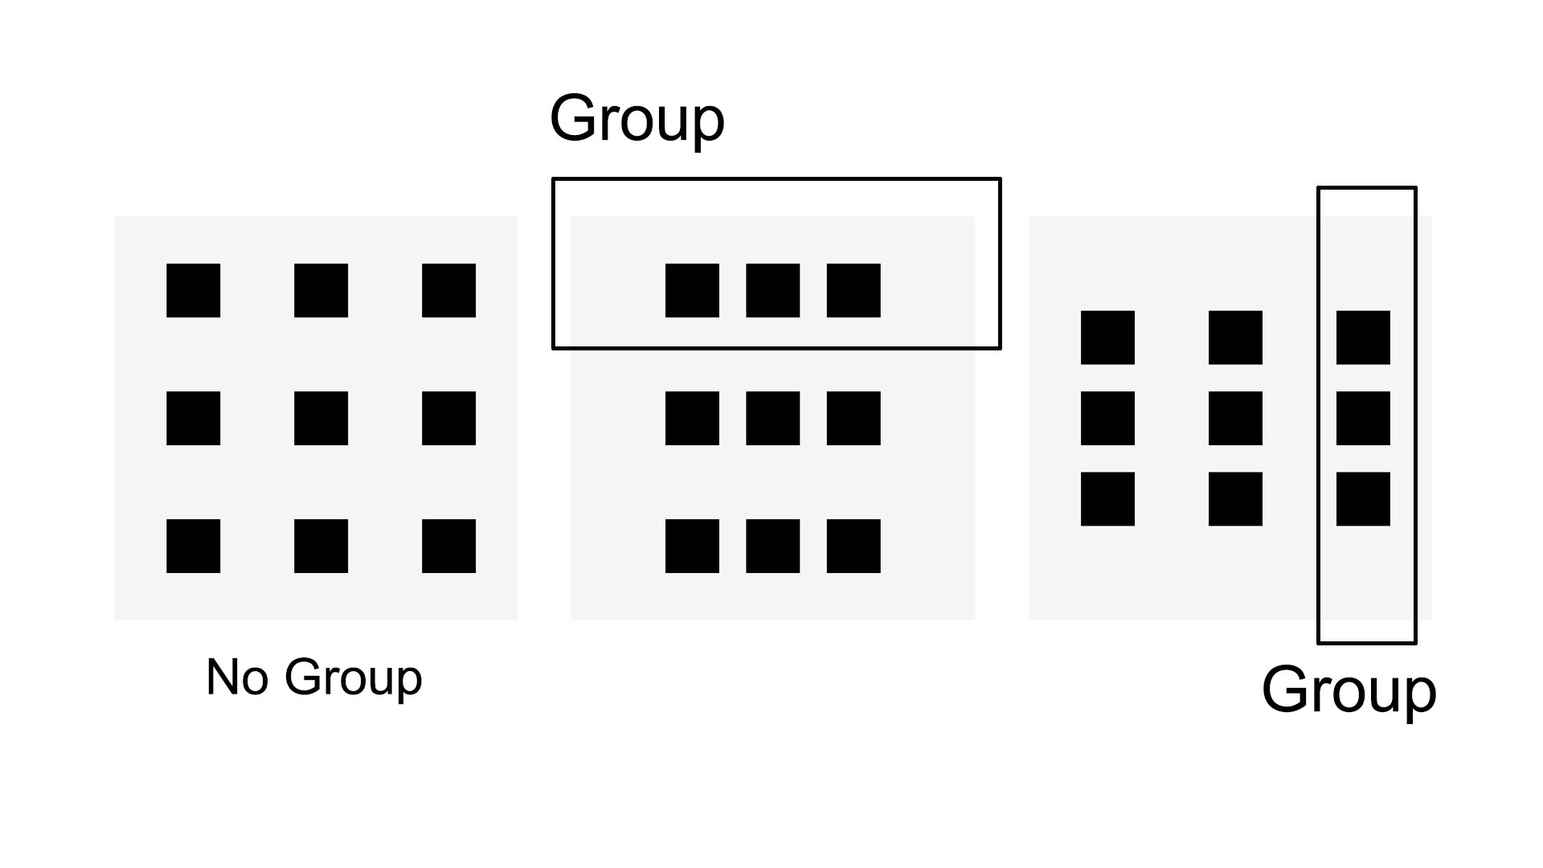
I
How does the naked eye get information?
1/ Closeness principle
Human’s automatically visualize objects that are close to each other as a group.
Jingying (Crystal) Zhen
Graduate Student, Digital Media & Computer Graphics

Slide 35
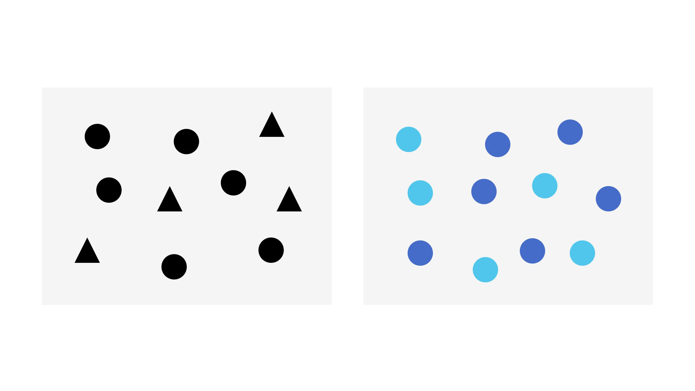
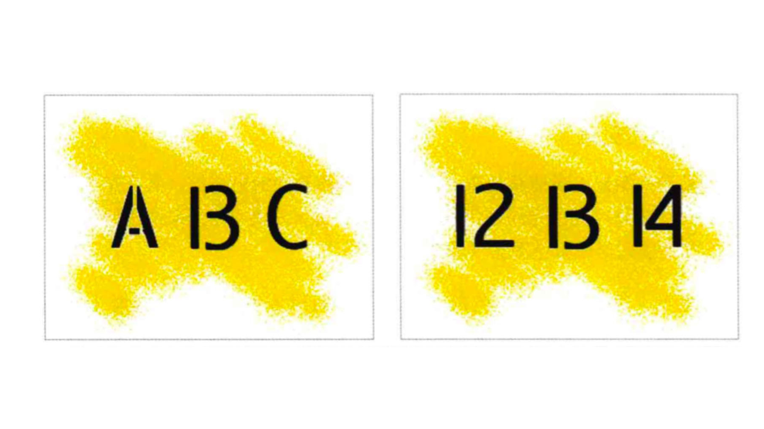
I
2/ Similarity principle
When we observe objects, we group them by common shape and/or colour.
3/ Rule of thumb
We would think that the left is B, and the right is 13.

Slide 36
I
The shades of color are relative
Darker
Lighter
Jingying (Crystal) Zhen
Graduate Student, Digital Media & Computer Graphics

Slide 37
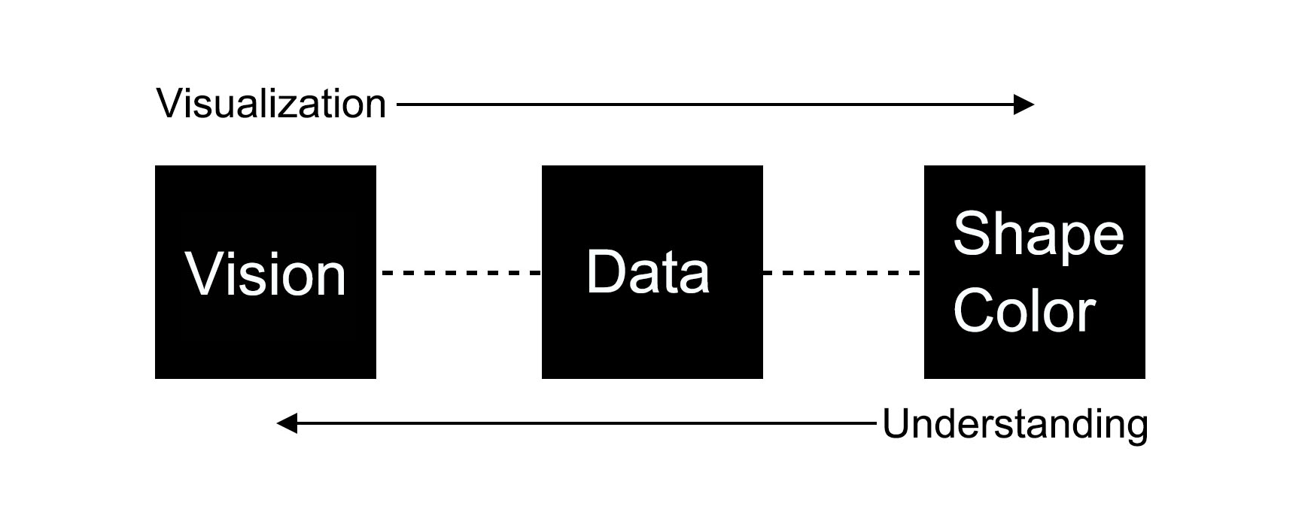
I
The relationship between visualization and understanding

Slide 38
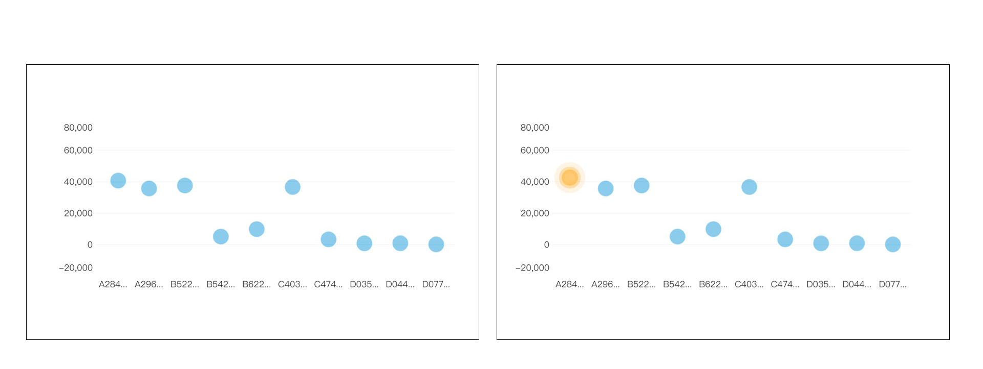
I
Example:
More easy to find important “point”
When designing data visualization graphics, highlighting the important points with different colors will be more easily noticed by the audiences.
Jingying (Crystal) Zhen
Graduate Student, Digital Media & Computer Graphics

Slide 39
Panelist Questions
Describe an example of how data visualization has been misconstrued or abused in your field. What was the actual (or potential) impact?
1

Slide 40
1
Panelist Question
One situation in which data visualization is abused in the journalism field is through the use of social media to disseminate information that is either known to be false or misconstrued when it is disseminated. Then journalistic outlets tend not to correct the mis-reported information with the same prominence as the original.
Dr. Dale Edwards
Professor of Journalism & Media Studies

Slide 41
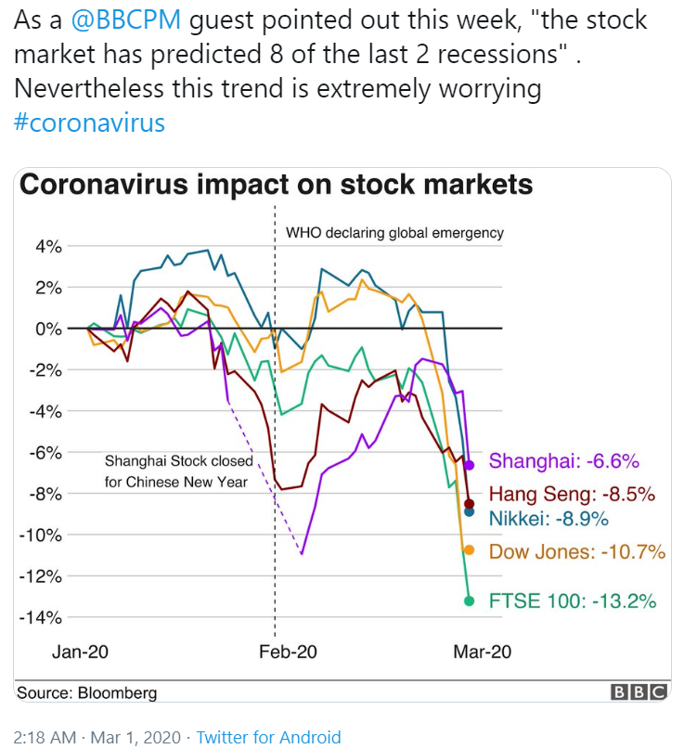
1
Panelist Question
For instance, just this past week when the stock market collapsed Monday, many news outlets blamed the drop almost entirely on the Coronavirus and criticized the Trump administration for lack of preparation, lack of intelligence, ineptitude, or some form of all of them.
Although the Coronavirus certainly played a role in the stock market volatility, an even larger factor was Saudi Arabia’s decision to flood the world oil market with increased production in an effort to harm Russia and Iran. Oil prices dropped 30 percent literally overnight. But the focus in the media was on the Coronavirus while only mentioning the oil price drop in passing.

Slide 42
1
Panelist Question
Has happened many times in health
Prominent recent example: Wakefield Study, Falsely linking MMR vaccine to autism
Impact has been decreased confidence in vaccination programs and
We’ve seen increases in diseases we assumed eradicated
Margarita (Maggie) Shawcross
Assistant Professor, Health Sciences Librarian
Notes:
Data visualization is great in that it provides an immediate visual impact of important health data but simplifying the process of presenting health information for a general audience can also be problematic as it can make it easy for those presenting the data to misconstrue the data or mislead the public with the data they chose to present.
Maybe the errors in the visualization are intentional, but maybe they are purposeful and mean to mislead. And when we present data in a visual form the whole point is to use less text, but less text means leaving out supporting data and the consumer is unable to see the whole picture.
Data Visualization has been misconstrued in the health field many times. And probably the most famous recent example would be the now-retracted Wakefield Study published in 1998 in the Lancet that linked the MMR vaccination to Autism. The article proposed a link between the measles, mumps and rubella (MMR) vaccine and autism. the information from the study, despite it having clear limitation of lack of controlled population (it was 12 children), recall bias (parents were asked to remember dates of onset of “autism” symptoms) and selection bias. The impact of this study has been decreasing confidence in the vaccination program which has led families to choose not to vaccinate their own children. For decades vaccines have been essential in eradicating serious and highly contagious diseases and now we are seeing rising numbers in diseases we thought we have pretty much contained.

Slide 43
1
Panelist Question
The major problem with many infographics or graphs that are sometimes presented to the general public is too much simplification. Scientific data is often based on sampling and thus such to statistical analysis. Often some common measures of the variance of the data (such as standard error) is removed for simplicity and conclusions are made that are not supported by the data.
Sometimes the nuances of the data is lost in the infographic. For example, in the earlier slide with COVID-19 by state, it may imply that the distribution of cases is evenly spread across a state (as implied by the color scheme) rather than clustered to particular cruise ships or nursing homes.
Another problem is when some of the data is eliminated or intentionally altered, especially in cases where the presentation is influenced by political agendas, such as selectively showing data on global climate change.
Dr. Rob Reinsvold
Professor of Biology

Slide 44
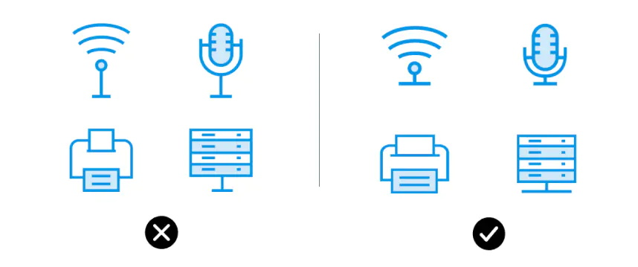
I
When Designing:
Spacing lends clarity
Icons should be full and clear
Jingying (Crystal) Zhen
Graduate Student, Digital Media & Computer Graphics
Colors with low saturation are difficult to distinguish

Slide 45
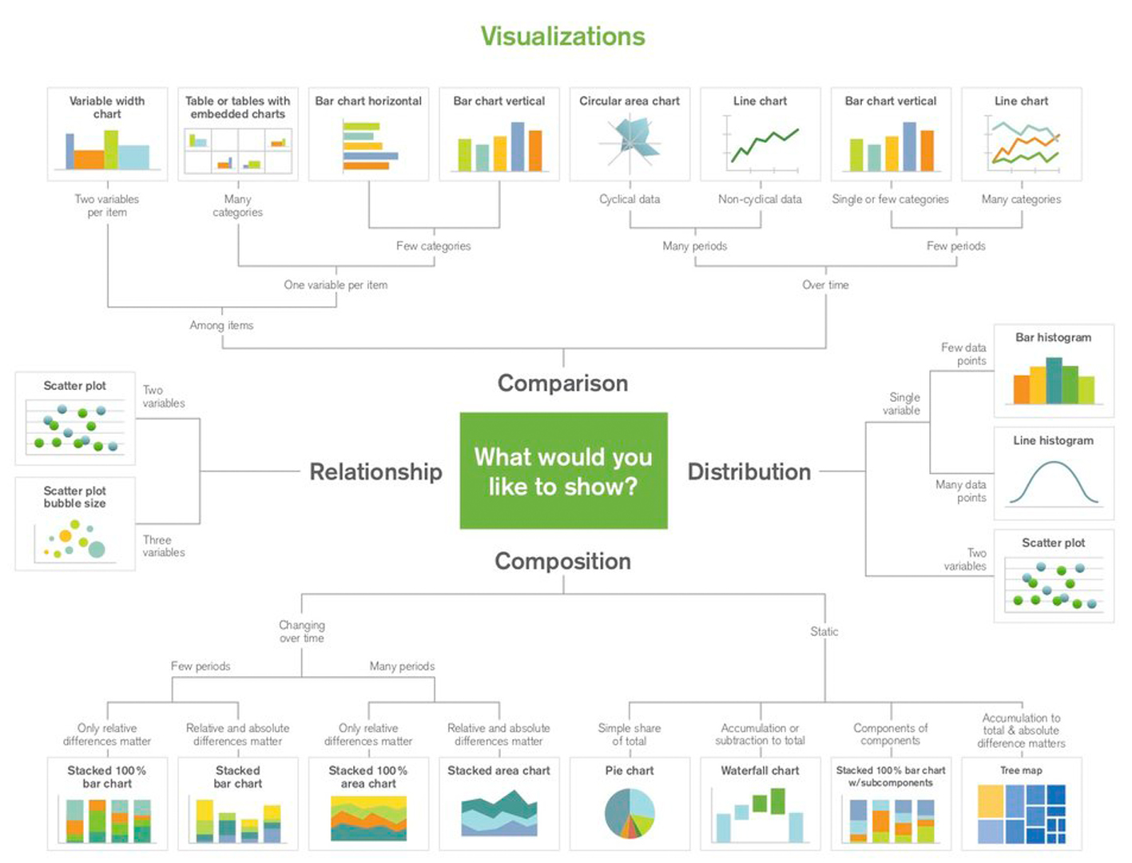
I
© Abela Chart Suggestion

Slide 46
Panelist Questions
What do you think is the biggest mistake consumers make in reading charts, graphs, or infographics?
2

Slide 47
2
Panelist Question
The biggest mistake people make is that they don’t have or take the time to really examine a chart or graph and see what it is really saying. That problem is exacerbated on television because their access to the graphic is limited to only a brief time and they cannot go back and look at it again and study it. Most television stations now post graphics on their websites/apps, but the number of people who take the time to go to the website for further information, compared to the number of people in the audience, is very small indeed.
Dr. Dale Edwards
Professor of Journalism & Media Studies

Slide 48
2
Panelist Question
Biggest mistake: People not asking themselves “What is the reason behind the data visualization? “
CRAAP Test
Currency
Relevance
Authority
Accuracy
Purpose
(Google CRAAP Test, 2019)
Margarita (Maggie) Shawcross
Assistant Professor, Health Sciences Librarian
Notes:
The biggest mistake that consumers make in reading charts, graphs or infographics, in health, is not asking themselves what the reason is behind this data visualizations. Is it to inform me? Is it to sell me something?
In libraries and when talking to students, patients, members of the public about evaluating health information I find it helpful to talk to them about the CRAAP test. CRAAP is an acronym for Currency, Relevance, Authority, Accuracy, and Purpose. So ask them to think about these things when they are looking at health information, especially health information online.
Currency: the timeliness of the information
When was the information published or posted?
Has the information been revised or updated?
Is the information current or outdated for your topic?
Are the links functional?
Relevance: the importance of the information for your needs
Does the information relate to your topic or answer your question?
Who is the intended audience?
Is the information at an appropriate level (i.e. not too elementary or advanced for your needs)?
Have you looked at a variety of sources before determining this is one you will use?
Would you be comfortable using this source for a research paper?
Authority: the source of the information
Who is the author/publisher/source/sponsor?
Are the author's credentials or organizational affiliations given?
What are the author's credentials or organizational affiliations given?
What are the author's qualifications to write on the topic?
Is there contact information, such as a publisher or e-mail address?
Does the URL reveal anything about the author or source?
Accuracy: the reliability, truthfulness, and correctness of the content
Where does the information come from?
Is the information supported by evidence?
Has the information been reviewed or refereed?
Can you verify any of the information in another source or from personal knowledge?
Does the language or tone seem biased and free of emotion?
Are there spelling, grammar, or other typographical errors?
Purpose: the reason the information exists
What is the purpose of the information? to inform? teach? sell? entertain? persuade?
Do the authors/sponsors make their intentions or purpose clear?
Is the information fact? opinion? propaganda?
Does the point of view appear objective and impartial?
Are there political, ideological, cultural, religious, institutional, or personal biases?

Slide 49
2
Panelist Question
The biggest mistake is not scrutinizing the source of the information. Some sources are more reliable than others.
Another error is only looking for data to support a preconceived conclusion rather than looking at a fair representation of all the available data on an issue, and then making informed decisions.
A healthy skepticism is useful.
Dr. Rob Reinsvold
Professor of Biology

Slide 50
Panelist Questions
How do we make data visualization accessible to the general public while maintaining the integrity (or properly illuminating the limitations) of the original data?
3

Slide 51
3
Panelist Question
First, we have to make sure that the information we present is factual and complete. Another thing media outlets are guilty of is cherry-picking data to support a frame and not providing the context relevant to the data. We create graphics that portray the information we want to emphasize, but do not provide data that contradict the frame we have chosen. This is a major failure because it does the exact opposite of what we are discussing at this point. If a media outlet is to be ethical and have integrity it must present data clearly and straightforwardly, providing the needed context and any qualifiers that are appropriate. That’s not something we do well, but we should.
Dr. Dale Edwards
Professor of Journalism & Media Studies

Slide 52
3
Panelist Question
Designers of Data Visualizations need to:
Understand the audience they are targeting
Presenting the information in a manner that their audience can understand
Good Data Visualization, needs to:
1. Have clear framework
2. Tell a story
3. Good balance of information (not too much, not too little)
Margarita (Maggie) Shawcross
Assistant Professor, Health Sciences Librarian
Notes:
Well as a librarian and instructor, I feel that it is important to develop data and visual literate students. And it is important for them to know the difference between a good data visualization and a bad data visualization.
Designers of data visualization are told that to have a successful data visualization they need to:
Understand the Audience that they are targeting
Is the information written in a way that the audience can understand? What is the creator of the visualization trying to get the viewer to get out of this visualization? Do you want them to learn something or entertain or engage or anger?
Set up a clear framework
The designer needs to have a clear understanding of how the semantics (the meaning of the words and graphics used) and the syntax(how the arrangement of words and graphics will help in the formation of an idea/message) will work together. This is where the use of color, positions, texts, size comes into play.
Tell a story
The storytelling piece is important because that is what will used to engage the audience.
This is not simple. When making data visualization accessible to the general public the designer needs to find that special balance between how much is enough information and when is too much to much?
When is more information better? Well if you’re conducting a medical study, yes, more information is better. But if you’re sharing the results of the study, no more information is not better.

Slide 53
3
Panelist Question
Sampling data must show some measure of variance (e.g. SE) to indicate when differences are truly significant or merely within normal variability.
Can’t sacrifice accuracy for pretty colors and flashy images. These do catch the attention, yet we need both accurate data and effective images.
At the same time, too much information, can obscure the interpretation. Even scientists often get overwhelmed by some tables or graphs presented in the primary papers. First and foremost, it is the job to communicate a clear message.
Clarity and conciseness while maintaining accuracy is the sweet spot.
Dr. Rob Reinsvold
Professor of Biology

Slide 54
Individual Question
Tell us about the rise of data journalism. What are the ethical considerations for journalists? What role should journalists play in providing context, issuing updates/corrections, and responding to challenges of the data they present?
Dr. Dale Edwards
Professor of Journalism & Media Studies

Slide 55
Q
Individual Question
It should not come as a major surprise that the rise of data journalism coincided closely with the ubiquity of the worldwide web. As more and more information became available online we in the media found we could get more information, do it for less money, and provide our audience with a much more complete picture of what is going on. And the availability of information on the web has greatly enhanced our ability to put our fingers on information quickly. For instance, when Congress passed the Electronic Freedom of Information Act, executive branch agencies were directed to place as many records as possible in a computer format. Those records later moved online. So, for example, when a journalist wanted to find information from the U.S. Census, they used to have to go to a depository library and look at the paper census reports. They had to first learn what data might be available, then find which volume of the census report it might be in, and then find the specific data, and then interpret it. Now, the census is compiled and reported electronically and data are available by Boolean search.
Dr. Dale Edwards
Professor of Journalism & Media Studies

Slide 56
Q
Individual Question
Dr. Dale Edwards
Professor of Journalism & Media Studies
The interpretation piece is still there, but the data themselves are much more accessible and more complete. Some issues there, however, include relying too heavily on “if it isn’t available on the web, oh well” and not looking further. We have the responsibility to still confirm the accuracy of data because while you can find an ocean of information on the web, its quality is only as good as the integrity of the person who created or posted it. We also have the clear ethical responsibility to provide context and limitations of the data we present. Research in the media field indicates some troubling things: First, people tend not to trust what journalists say unless they agree with it. Second, audience members rarely research statements made in the media for additional context unless they disagree with what is said. Third, journalists tend to be generally disinterested in correcting misstatements, or at least giving the correction far less prominence than the original statement. The old adage in the newspaper world was that the mistake goes on the front page under a headline in 48-point type, and the correction goes on page 23, right above the obituaries, and with an 18-point headline that says something useless like “Reporting error told.” The immediacy of Twitter and other social media has made it much easier to contact journalists directly, but that has not necessarily led to improvement in the quality of reporting. Generally it has led to even increased polarization about the quality of reporting and bias. We have the responsibility to be objective, careful, and transparent. We don’t always live up to that responsibility.

Slide 57
Individual Question
In library instruction, we often teach the value of credible sources and evaluation of the written word. How do we expand this instruction to include visual information?
Margarita (Maggie) Shawcross
Assistant Professor,
Health Sciences Librarian

Slide 58
ACRL Visual Literacy Competency Standards
Q
Individual Question
Visual literacy is a set of abilities that enables an individual to effectively find, interpret, evaluate, use, and create images and visual media. . . . A visually literate individual is both a critical consumer of visual media and a competent contributor to a body of shared knowledge and culture. (ACRL 2011)

Slide 59
Visual Literacy and Academic Libraries
Q
Individual Question
We want students to be able to:
Interpret and analyze images
Evaluate images
Use images effectively
Finding the right image for needs
Use images ethically, and cite them properly
EVENTUALLY, know how to create good visual materials.
Margarita (Maggie) Shawcross
Assistant Professor, Health Sciences Librarian
Notes:
Visual literacy may mean different things to different folks. For example a graphic designer, art historian and a librarian may look or access for different things when it comes to an image. As an academic librarian my end goal is to develop critical thinkers who will know how “to effectively find, interpret, evaluate, use and create images and visual media. (ACRL 2011).
Essentially, we want students to be able to:
Interpret and analyze images, to be able to understand the potential meanings and contexts of said image;
Evaluate images;
Are they accurate? Is the source reliable? Has the image been manipulated?
Use images effectively;
Find images that relevant to their research and communicate their use effectively
Define what image is needed for their research and being able to find images that align with that research;
Use images ethically and cite visual materials;
Eventually create visual media
Interpreting and Analyzing Images
When being presented with an image, we would like students to be able to observe and describe the image, interpret that image and then evaluate it. When observing and describing it are they able to: notice trends/patterns, do they know what type of graph or visualization is being used, who is the source of the data and how it was collect? When interpreting the data we would like students to be able to know the meaning and purpose being the information being presented. We would like them to ask themselves: what is the conclusion drawn from this image/visualization? Does it bring up more questions? When evaluating the image, we are asking if the design was effective: Do the design elements work to convey the message? Was the appropriate graph used to visualize the data? Was there a better way to display this data?
Evaluate Images
When evaluating images to be used, a student should be able to decide if the image to be used is a good image. Students should evaluate an in image for the following:
Can I understand the meaning of this image?
Can I legally use this image? Is it open access or do I have to purchase it? Do I just need to cite it.
Is this image effective in conveying the message I am meaning to put across?
Does this image contain enough written information to explain the image and is the information reliable?
Finding the right image and
Just like with articles, researchers swear that the perfect image describing what they need is out there. But where do you find said image? When someone approaches me and asks me to assist them in finding this perfect image/data visualization I ask a few questions to know how to best help them:
What kind of image do you need?
How do I go about finding it?
Using Images Ethically
Like when finding a great article, it is important to cite and credit the image you choose to use. Students need to do their best to make sure to give credit to the person who created the image to be used. This includes finding the name of the creator, the title and date of image and a link to the original work.

Slide 60
Individual Question
With the complexity and amount of science reported in the news and other venues, there is an apparent need for the average citizen to be much more science- and data-savvy. How do you prepare future science educators to be advocates of credible visualization and communication in the sciences? What place does visual literacy have in education in general?
Dr. Rob Reinsvold
Professor of Biology

Slide 61
Q
Individual Question
For our students, we are doing more lessons where we show the students the data directly from a primary scientific paper (the original source) and then show a representation of the same data in a newspaper, magazine, or popular article. Students are asked to see if they would draw the same conclusions from matching datasets.
We want our students to see how the visualization of the data may change dependent on the audience and the purpose of the message.
At the same time, working with graphic designers or news editors to expect both accuracy and the proper level of simplicity is also needed.
Finally, since more and more people are relying on social media to make decisions, we need to get the consumers of information to always question the credibility of the source of the information.
Dr. Rob Reinsvold
Professor of Biology

Slide 62
Individual Question
What is the role of emotion in data visualization? How can visualizations evoke specific emotions? What should audiences be aware of?
Jingying (Crystal) Zhen
Graduate Student, Digital Media
& Computer Graphics

Slide 63
Emotion from
Color and Shape
Q
Individual Question
The pictures on the right show the process of traditional Chinese weaving, which help viewers to touch the emotion of culture through colors and graphics.
Data visualization for Weaving Process

Slide 64
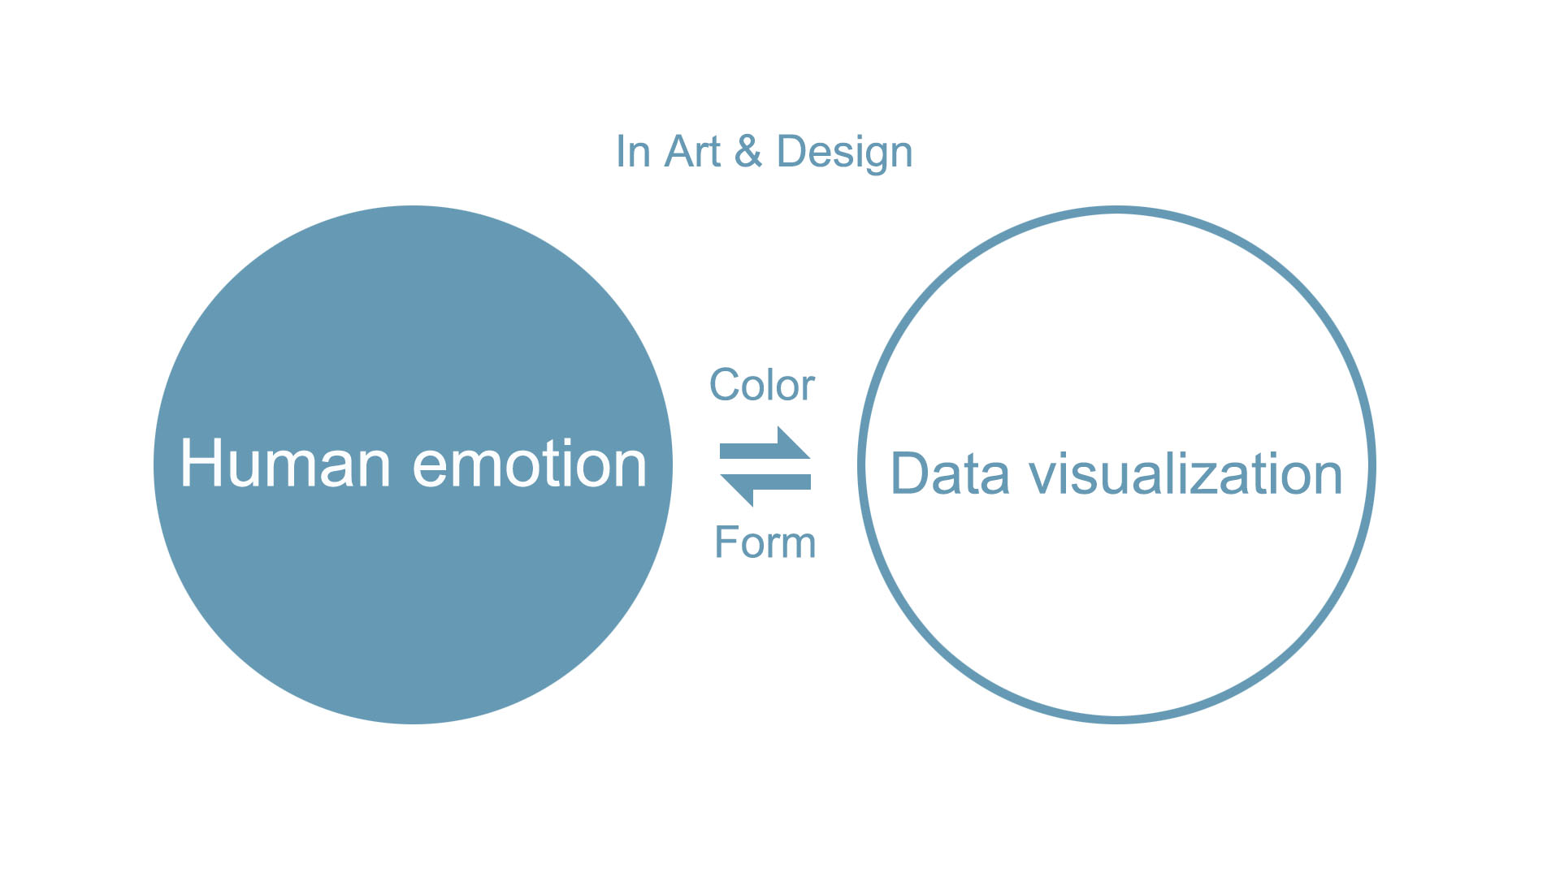
Q
Individual Question
Emotional design refers to the creative behavior activities for the purpose of emotional communication between people and objects.
Norman, D. A. (2004). Emotional design: Why we love (or hate) everyday things. New York: Basic Books.
Jingying (Crystal) Zhen
Graduate Student, Digital Media & Computer Graphics

Slide 65
Contact
Dr. Dale Edwards
Professor of Journalism & Media Studies
Dale.Edwards@unco.edu
Margarita (Maggie) Shawcross
Assistant Professor, Health Sciences Librarian
Maggie.Shawcross@unco.edu
Dr. Rob Reinsvold
Professor of Biology
Robert.Reinsvold@unco.edu
Jingying (Crystal) Zhen
Graduate Student, Digital Media & Computer Graphics
Zhen6212@bears.unco.edu
Nicole Webber
Assistant Professor, Business & Communication Librarian
Nicole.Webber@unco.edu

Slide 66
References
ACRL visual literacy competency standards for higher education. (2011). Retrieved from http://www.ala.org/acrl/standards/visualliteracy
Balkac, M., & Ergun, E. (2018). Role of infographics in healthcare. Chinese Medical Journal, 131(20), 2514-2517. doi:10.4103/0366-6999.243569
Brown, N. E., Bussert, K., Hattwig, D., & Medaille, A. (2016). Visual literacy for libraries. Chicago: ALA Editions.
Centers for Disease Control and Prevention. (2020). Adult obesity facts. Retrieved from https://www.cdc.gov/obesity/data/adult.html
CRAAP test-google search. (2019). Retrieved from https://www.google.com/search?safe=active&hl=en&tbm=isch&source=hp&biw=1266&bih=513&ei=YZZXKfNLI6OrwSLk5bgDw&q=craap+test&oq=CRAA&gs_l=img.1.0.0l10.25069.25973..28913%E2%80%A60.0..2.154.515.0j4%E2%80%A6%E2%80%A64%E2%80%A6.2j1..gws-wiz-img%E2%80%A6..0..35i39_CideUoTl8o
Evergreen, S. (2017). Effective data visualization: The right chart for the right data. London: Sage Publications, Inc.
Fontichiaro, K., Oehrli, J. A., & Lennex, A. (Eds.). (2017). Creating data literate students. Michigan: Michigan Publishing.
Lallanilla, M. (2014, April 23). Misleading gun-death chart draws fire [Website]. https://www.livescience.com/45083-misleading-gun-death-chart.html
Lankow, J., Crooks, R., & Ritchie, J. (2012). Infographics (1. Aufl. ed.). New York: Wiley. Retrieved from http://ebooks.ciando.com/book/index.cfm/bok_id/498700
Leo, S. (2019, March 27). Mistakes, we’ve drawn a few: Learning from our errors in data visualization [Website]. https://medium.economist.com/mistakes-weve-drawn-a-few-8cdd8a42d368
Makary, M. A., & Daniel, M. (2016). Medical error—the third leading cause of death in the US. Bmj, 353, i2139. doi:10.1136/bmj.i2139
McCrorie, A. D., Donnelly, C., & McGlade, K. J. (2016). Infographics: Healthcare communication for the digital age. The Ulster Medical Journal, 85(2), 71-75. Retrieved from https://www.ncbi.nlm.nih.gov/pubmed/27601757
National Cancer Institute. (2018). Definition for exocrine pancreas tnm stages ia and ib2. Retrieved from https://www.cancer.gov/images/cdr/live/CDR687928.jpg
Wakefield, A. J., Murch, S. H., Anthony, A., Linnell, A., DM Casson, Malik, M., . . . Walker-Smith, J. A. (1998). Ileal-lymphoid-nodular hyperplasia, non-specific colitis, and pervasive developmental disorder in children.351, 637-641.

