Slide 1
Conflict Management
Mallory Gibson
08.02.16

Slide 2
Why is conflict important? Tuchman’s Stages of Group Development
Norming
Working with each other
Storming
Challenging each other
Performing
Working as one
Forming
Learning about each other

Slide 3
The Sapir-Whorf Hypothesis
The language that we know, hear, and speak determines the way we interpret and understand
Intent vs. Impact
Non-verbal Communication
Eye Contact
Posture
Facial Expressions
Clothing
Artifacts (jewelry, tattoos, piercings, etc.)
Gestures
Touch

Slide 4
Types of difficult Behaviors
Gossiping
Manipulating
Showing Off
Goofing Off
Disengaging
Complaining
*When your professional hat goes on,
your personal hat comes off*

Slide 5
How to handle conflict
48 Hour Rule
Discuss the behavior with the person within 48 hours or forget it happened.
Breathe, Reflect, and Respond
Take a look at your own behavior first
Provide constructive feedback rather than criticisms
Remember that everyone can be sensitive about their situations
Do not ever verbally attack the other person.
Simply state your case and your ideas

Slide 6
How to handle conflict
Praise in public (if they like public recognition) and challenge in private
Be specific about what you have an issue with
Allow the other person to vent fully before you begin trying to reach a resolution
Go into the situation with your ideal solution in mind. If both parties do this, it is much easier to come to a solution.
Don’t forget to ask the other people in the conflict what they need, and realize that you may be the one in the wrong.

Slide 7
Conflict Styles
Take out a piece of paper and a writing utensil
Section off 5 segments, with room for a section header and three numbers
Don’t spend too long thinking about your answers, just go with your gut instinct
Give each statement a numerical value
1. Always, 2. Very often, 3. Sometimes, 4. Not very often, 5. Rarely

Slide 8
Section 1
I argue my case with peers, friends, and staff members to demonstrate the merits of the position I take
I am firm in resolve when it comes to defending my side of the issue.
I uphold my solutions to problems.

Slide 9
Section 2
I seek to investigate issues with others in order to find solutions that are mutually acceptable.
I seek to bring everyone’s concerns out into the open in order to resolve disputes in the best possible way.
I trade important information with others so that problems can be solved together.

Slide 10
Section 3
I try to avoid being singled out, keeping conflict with others to myself.
I avoid discussing my differences with others.
I avoid hard feelings by keeping my disagreements with others to myself.

Slide 11
Section 4
I attempt to meet the expectations of others.
I try to accommodate the wishes of my staff members and friends.
I accept the recommendations of colleagues, peers, and coworkers.

Slide 12
Section 5
I try to reach compromises through negotiation.
I compromise in order to reach solutions.
I put forward middle position in order to break deadlocks.

Slide 13
What is your conflict style?
Add up your results for each section.
Which section is your lowest? (Ties are totally okay!)

Slide 14
Section 1 – Competing shark
Sharks use a forcing or competing conflict management style
Highly goal-oriented
Relationships take on a lower priority
Sometimes use aggressive behavior to resolve conflicts
Advantage: If a shark’s decision is correct, a better decision without compromise can result.
Disadvantage: May breed hostility and resentment toward the person using it.

Slide 15
Appropriate times to use a shark style
When conflict involves personal differences that are difficult to change
When fostering intimate or supportive relationships is not critical
When others are likely to take advantage of noncompetitive behavior
When conflict resolution is urgent; when decision is vital in crisis
When unpopular decisions need to be implemented

Slide 16
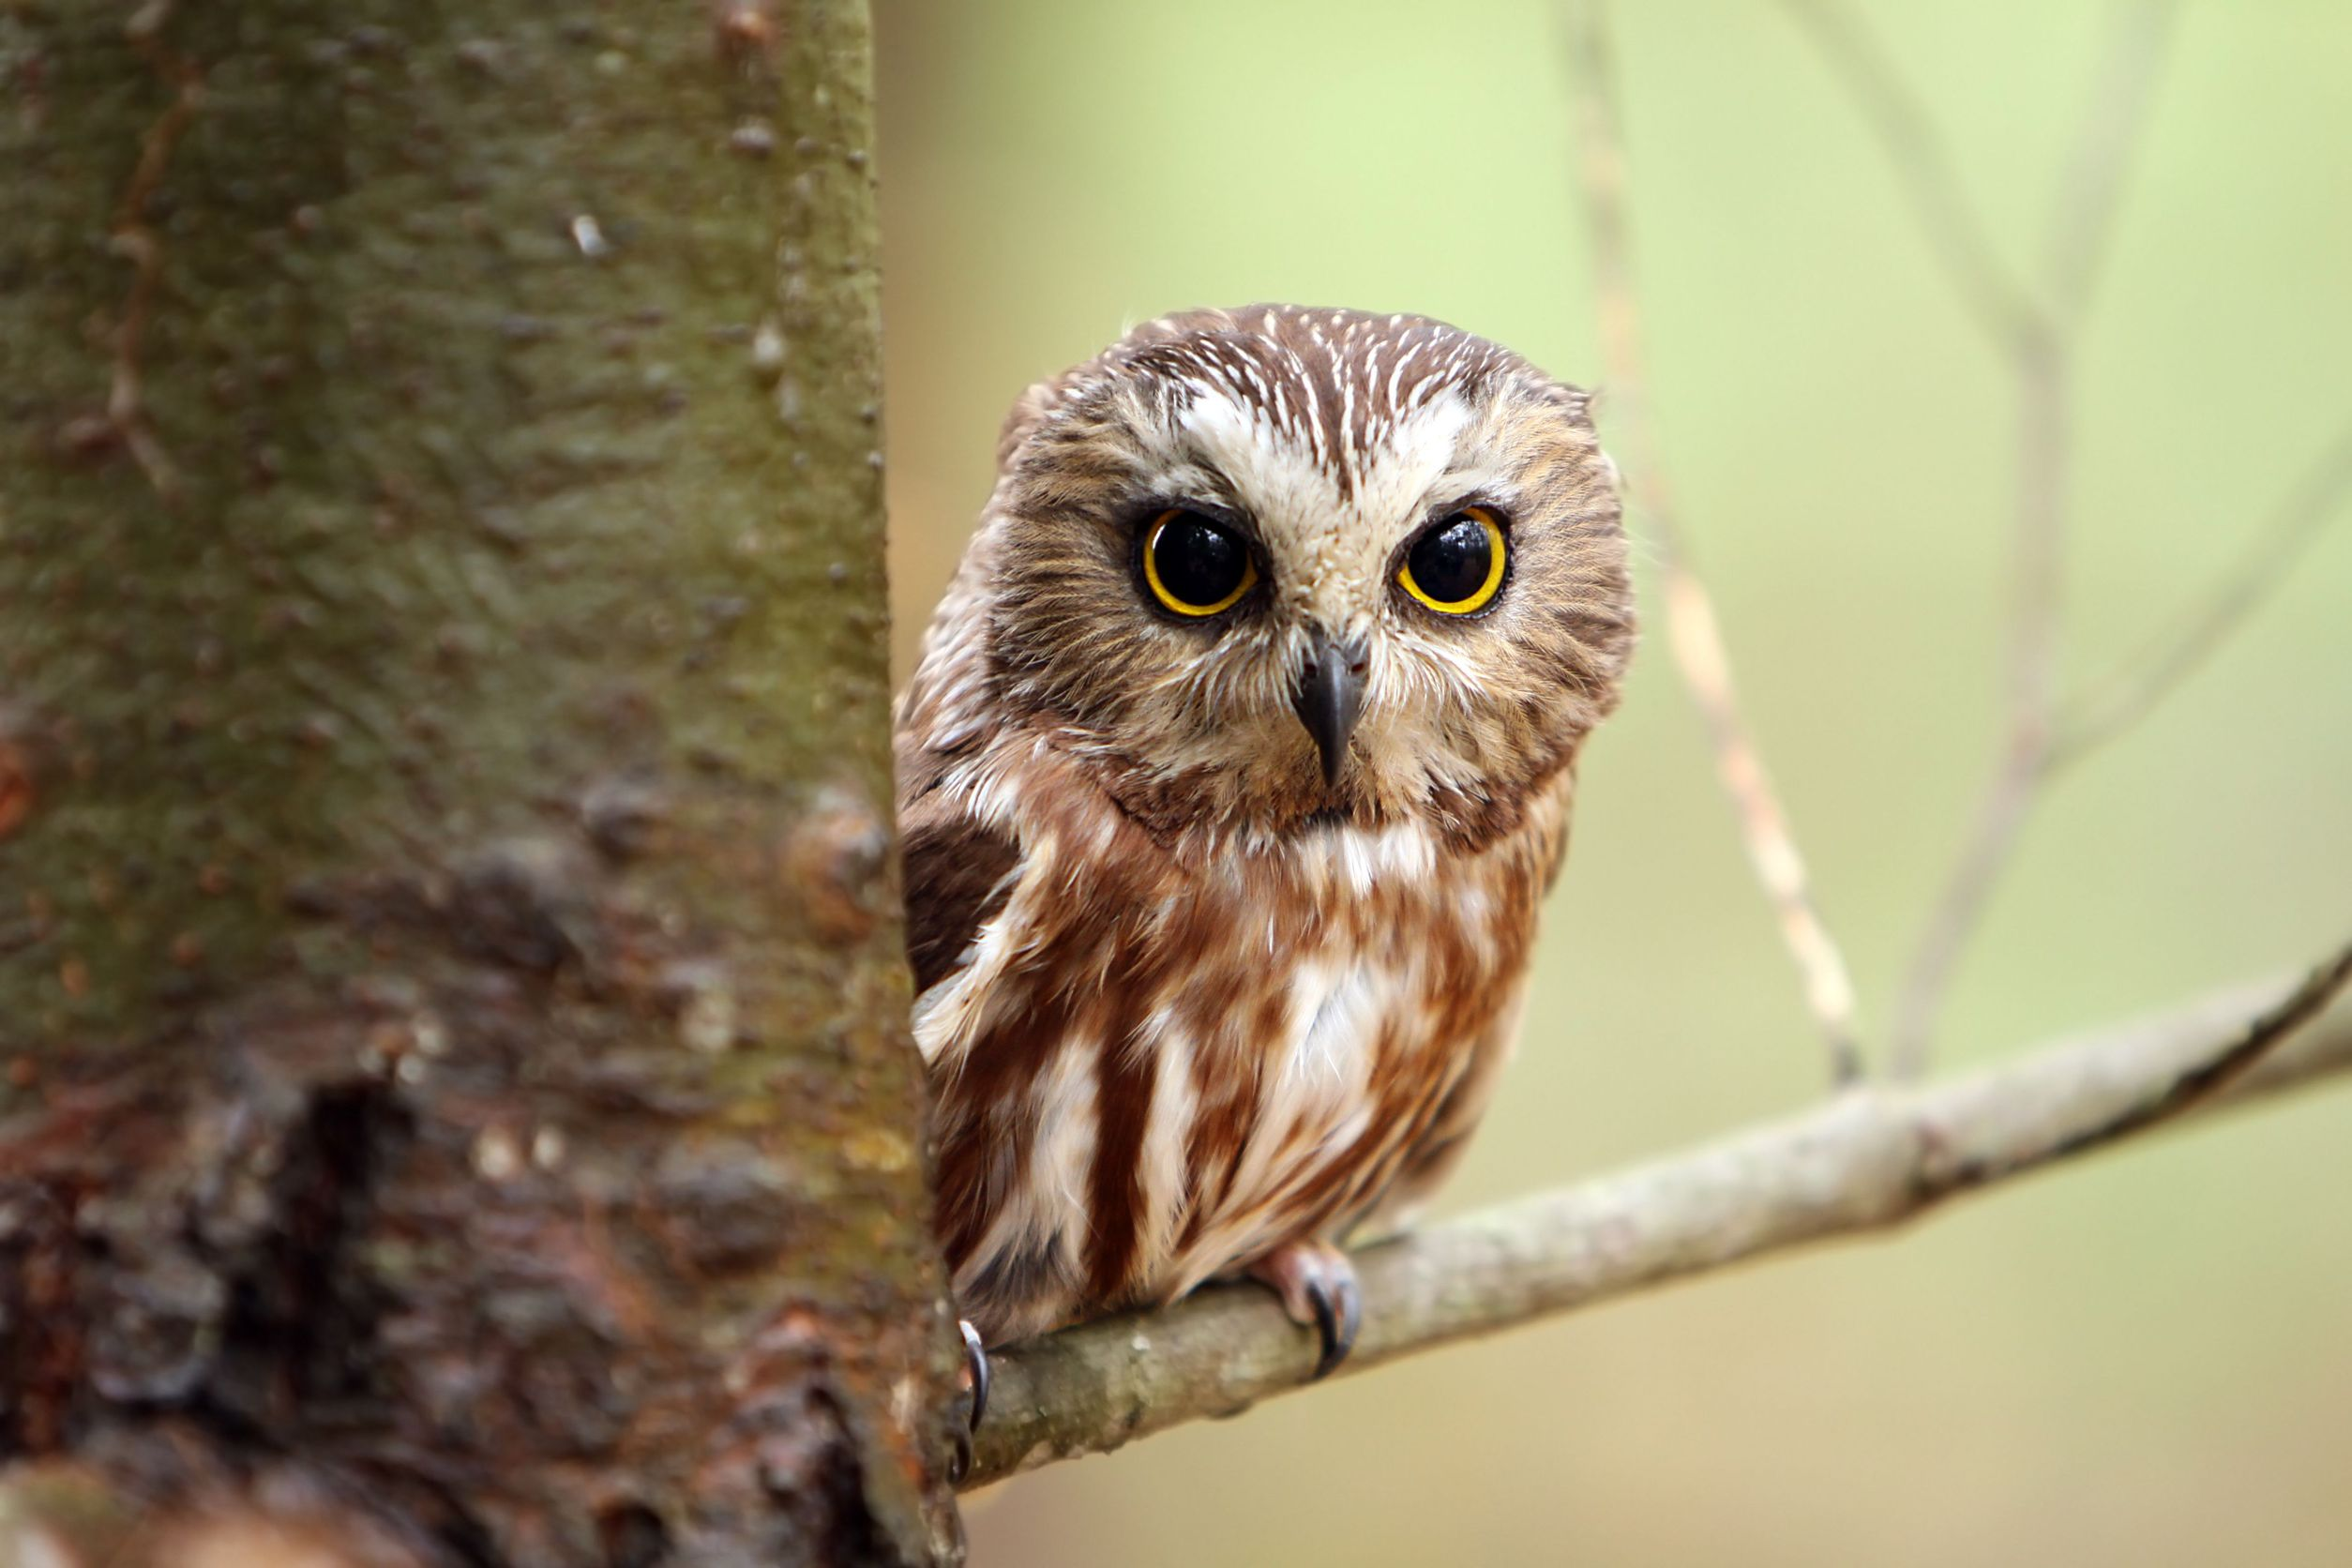
Section 2 – Collaborating owl
Owls use a collaborating or problem confronting conflict management style valuing their goals and relationships
Owls view conflicts as problems to be solved finding solutions agreeable to all sides
Advantage: both sides get what they want and negative feelings eliminated
Disadvantage: takes a great deal of time and effort

Slide 17
Appropriate times to use owl style
When maintaining relationships is important
When time is not a concern
When peer conflict is involved
When trying to gain commitment through consensus building
When learning and trying to merge differing perspectives

Slide 18
Section 3 – Avoiding Turtle
Turtles adopt an avoiding or withdrawing conflict management style
Tend to ignore conflict rather than resolve it; leads them to be uncooperative and unassertive
Tend to give up personal goals and display passive behavior
Advantage: may help to maintain relationships that would be hurt by conflict resolution
Disadvantage: conflicts remain unresolved; overuse of style leads to others viewing them as pushovers

Slide 19
Appropriate times to use a turtle style
When the stakes are not high or the issue is trivial
When confrontation will hurt a working relationship
When there is little chance of satisfying your wants
When gathering information is more important than an immediate decision
When time constraints demand a delay

Slide 20
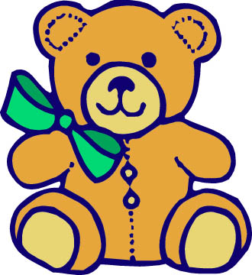
Section 4 – Accommodating Teddy Bear
Teddy bears use a smoothing or accommodating conflict management style with emphasis on human relationships
Tend to ignore their own goals and resolve conflict by giving into others; unassertive and cooperative
Advantage: accommodating maintains relationships
Disadvantage: giving in may not be productive, bear may be taken advantage of

Slide 21
Appropriate times to use Teddy Bear Style
When maintaining the relationship outweighs other considerations
When suggestions/changes are not important to accommodator
When minimizing losses in situations where outmatched or losing
When harmony and stability are valued

Slide 22
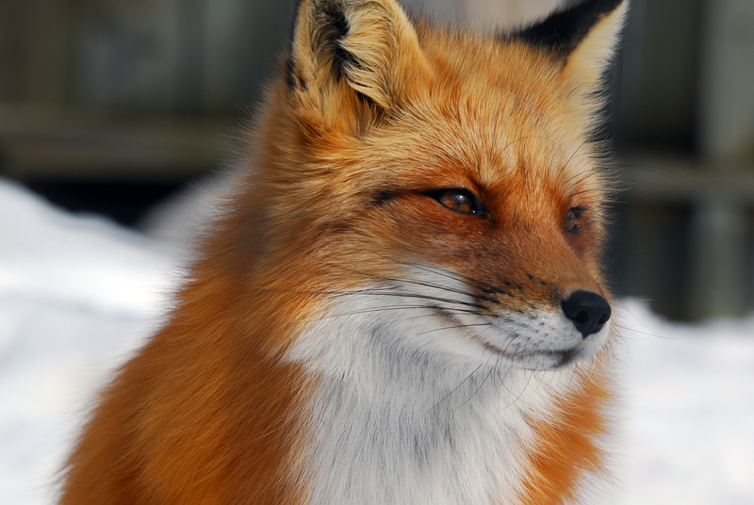
Section 5 – Compromising Fox
Foxes use a compromising conflict management style; concern is for goals and relationships
Willing to sacrifice some of their goals while persuading others to give up part of theirs
Compromise is assertive
Advantage: relationships are maintained and conflicts are removed
Disadvantage: compromise may create less than ideal outcome and game playing can result

Slide 23
Appropriate times to use fox style
When important/complex issues leave no clear or simple solutions
When all conflicting people are equal in power and have strong interests in different solutions
When there are no time constraints.

Slide 24
Discussion
How does your role come across to others?
How might your role be put into action this year?
What would a group of all one animal look like?
Why is it important to have a balance of different animals in a group?
Why is it important to know the conflict management styles of the people you work with?

Slide 25
Learn & Grow
Whatever animal you are, it’s okay!
There will be situations where some animal styles will be more effective than others.
Learn more about your style so you can better know when it is appropriate to use your style and when to defer to others.
Learn to feel comfortable being all the different animals according to the situation.
Strive to be all 5 animals at some point in your leadership journey.
Learn how to best work with other animals.

Slide 26
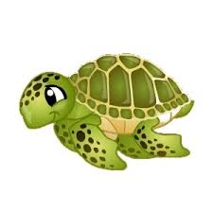
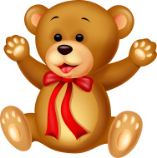
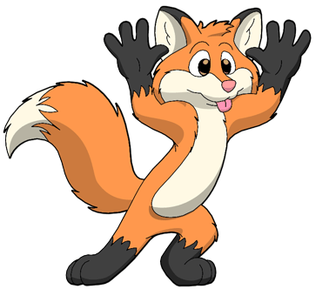
Questions?

