Slide 1
Receipt Imaging
Morgan Gray
Receipt Imaging Training
12/02/2019

Slide 2
Getting Started
You’ll need to have electronic copies of your receipts in order to load them in the Wells Fargo system. There are a number of ways to do this:
Scan each receipt and save them as PDF files
Take a picture of each receipt
Save an electronic copy of your receipts from an email or from a website
For image heavy receipts, e.g. Office Depot, save as JPEG
Use a PDF scanning app on your phone to scan the receipts
One example of a commonly used PDF scanner is “Genius Scan”
Download the Wells Fargo CEO Mobile app from the Apple App Store or Google Play
Once you have the receipt(s) ready, login to the Wells Fargo system.
Contact a PCard Program Administrator if you have any trouble accessing the system.
Complete your reallocation as usual, i.e. adding transaction descriptions, changing FOAPAL’s as needed.
Once ready to upload the receipts, continue on to the next step.

Slide 3
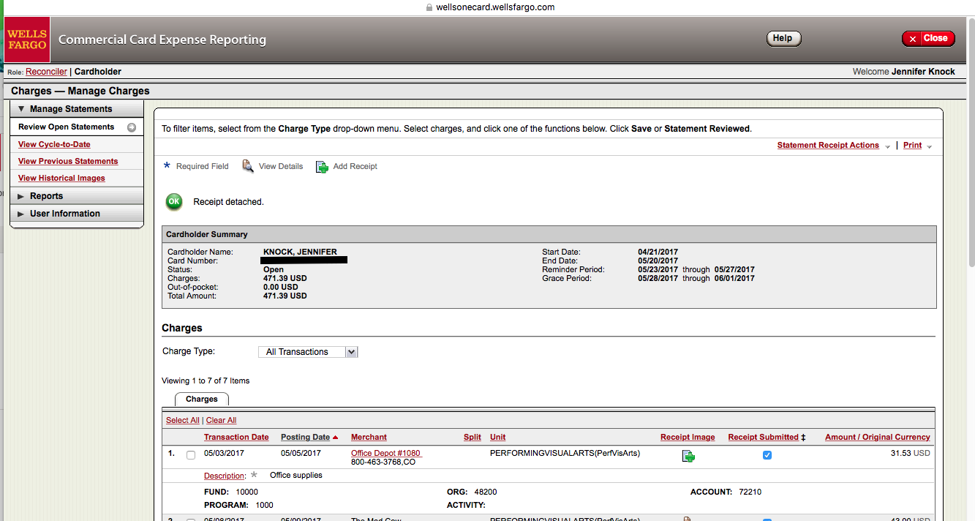
Uploading A Receipt - Online
Click on the green + symbol under ”Receipt Image” to add a receipt for that charge

Slide 4
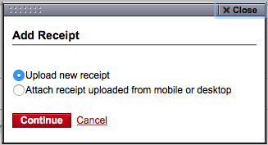
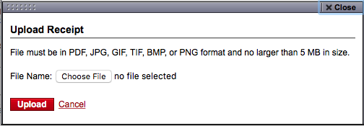
Uploading A Receipt - Online
Make sure “Upload new receipt” is selected and click continue.
Note: For receipts uploaded prior to a charge posting, select “Attach receipt…” to search all uploaded receipts for the correct one.
Click “Choose File” and find the saved receipt file. Then click upload once it appears next to “File Name”.

Slide 5
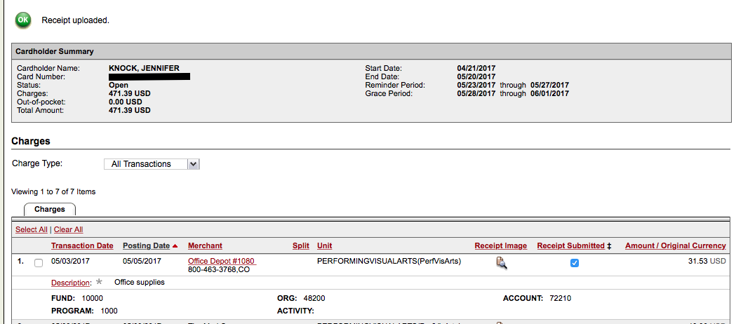
Uploading A Receipt - Online
Text here will say “Receipt uploaded.” once it is complete.
The green + symbol will be replaced with a magnifying glass when a receipt is attached.

Slide 6
Uploading A Receipt - Online
You will repeat this process for every charge on your statement.
If you have more than one file for a single charge, you will need to upload each file individually. Please see the next section for how to upload additional files.
If you accidentally upload the wrong file or if you need to delete a file for any reason, please see the next section for those instructions.
If you have the same receipt for multiple charges, please see the “Upload at Statement Level” section.

Slide 7
Add or Delete Receipts - Online
To add another document or delete an already uploaded document for a charge, click on the magnifying glass symbol.

Slide 8
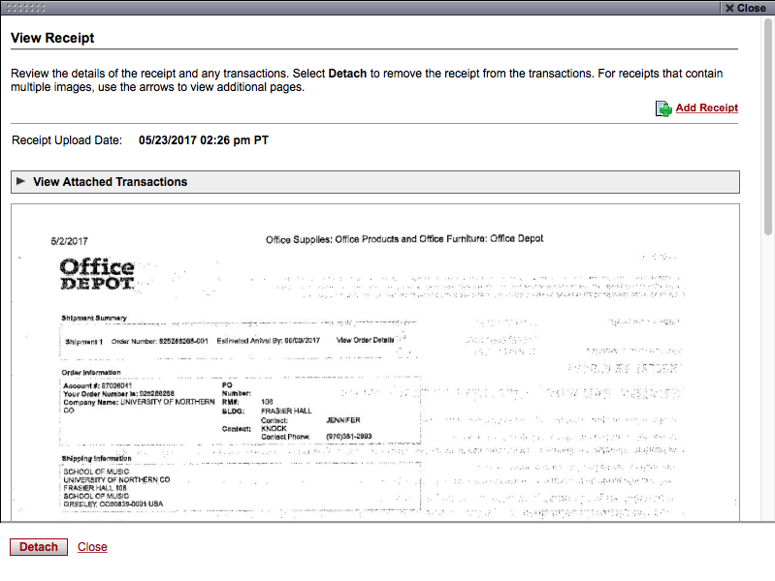
Add or Delete Receipts - Online
Click on “Add Receipt” to upload another file.
Click on “Detach” to remove/delete the current page.

Slide 9
Upload At Statement Level - Online
If you have any other documentation that needs to be included with your statement that cover more than one of your charges, you can attach those at the statement level.
For example, you can attach an Official Function Form or a FOAP approval email at the statement level instead of attaching the form to each individual charge.
If you have a single receipt that covers multiple charges, you can attach that at the statement level as well.
If you do this, please be sure to put “Receipt attached at statement level” in the descriptions for each charge included.
If you want to attach a receipt before a transaction has posted, you can attach that at the statement level and attach it to the transactions once it posts.

Slide 10
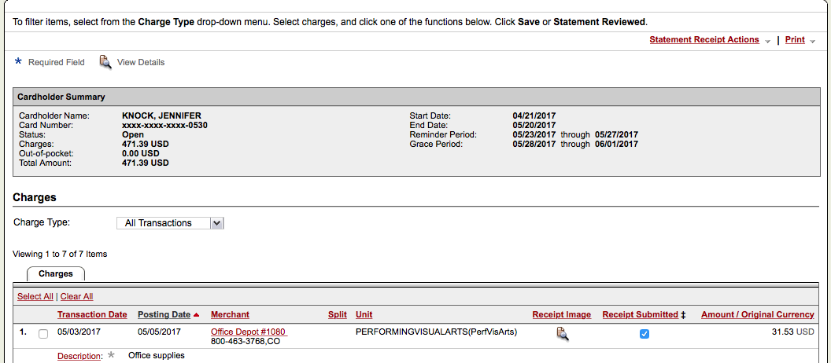
Upload At Statement Level - Online
Click on “Statement Receipt Actions”

Slide 11
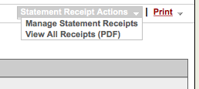
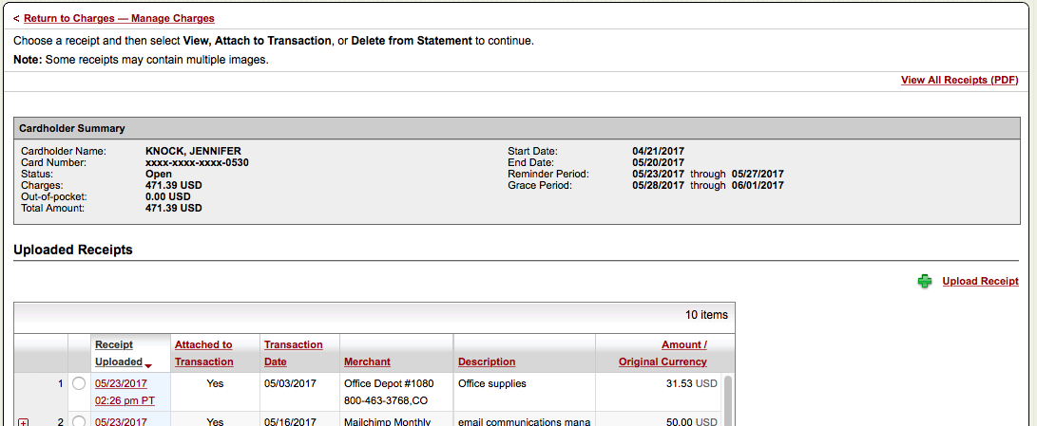
Upload At Statement Level - Online
Select “Manage Statement Receipts”.
Click on “Upload Receipt”.
The, follow the same process as before to upload the document file(s) and/or receipt(s). Note: You may need to do each file one at a time.

Slide 12
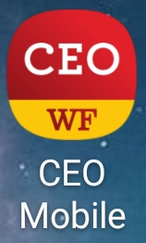
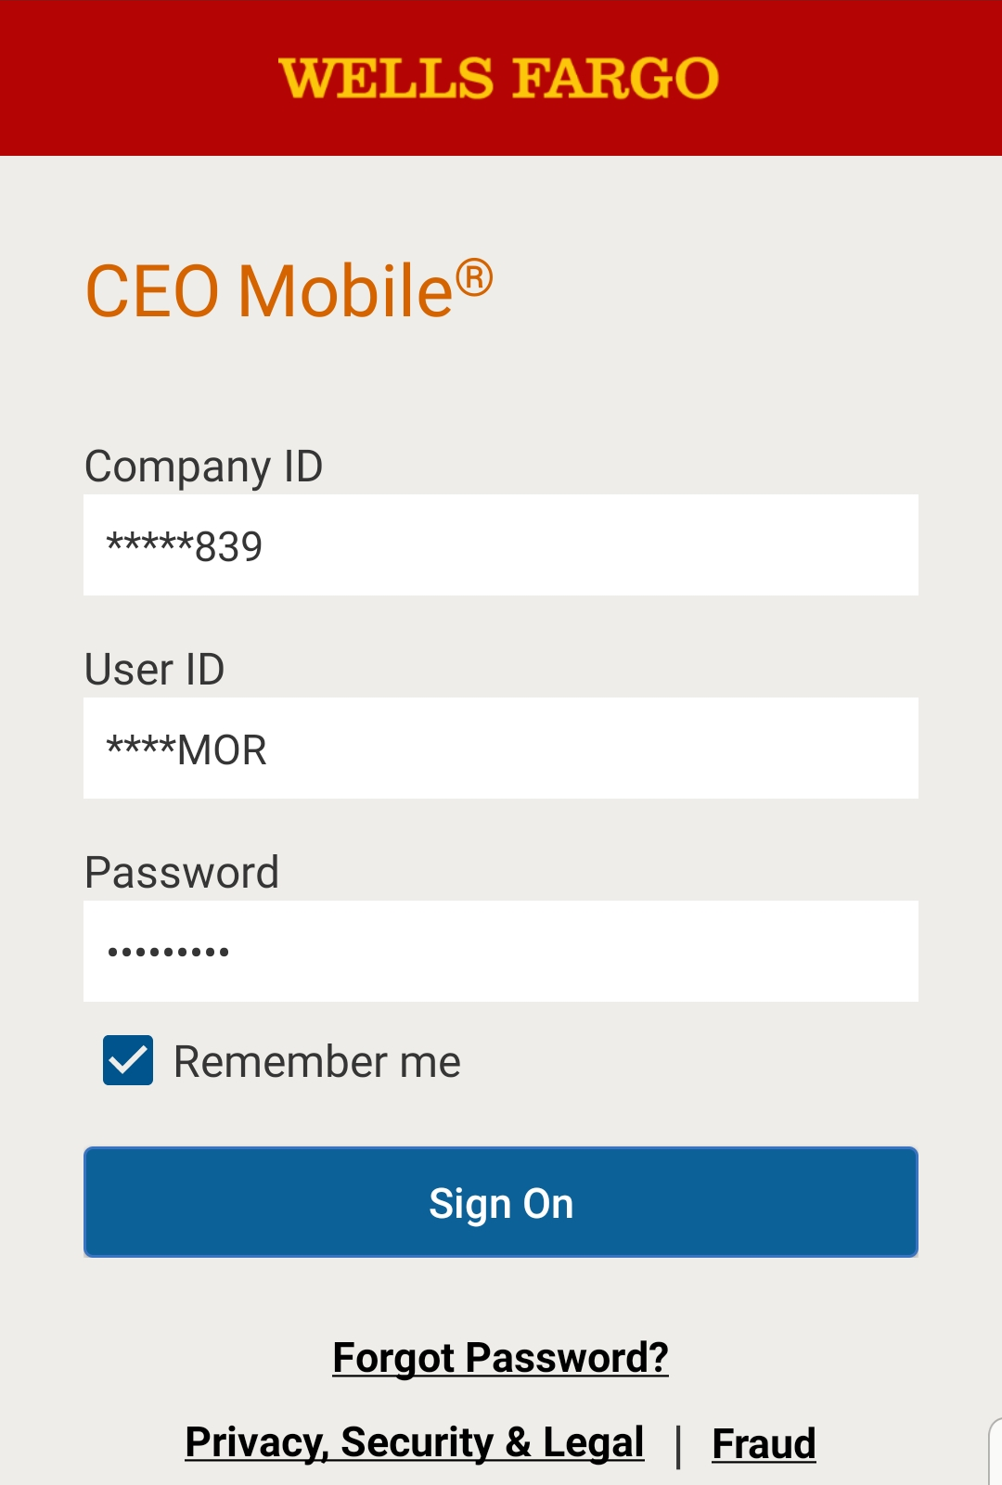
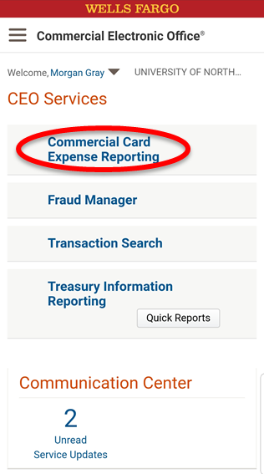
Upload At Statement Level - Mobile
Open the Wells Fargo CEO Mobile app.
Enter your login credentials and click “Sign On”.
You may select “Remember Me” to have the app save the Company ID and User ID. The password will need to be entered every time.
Click the Commercial Card Expense Reporting link to access your account.

Slide 13
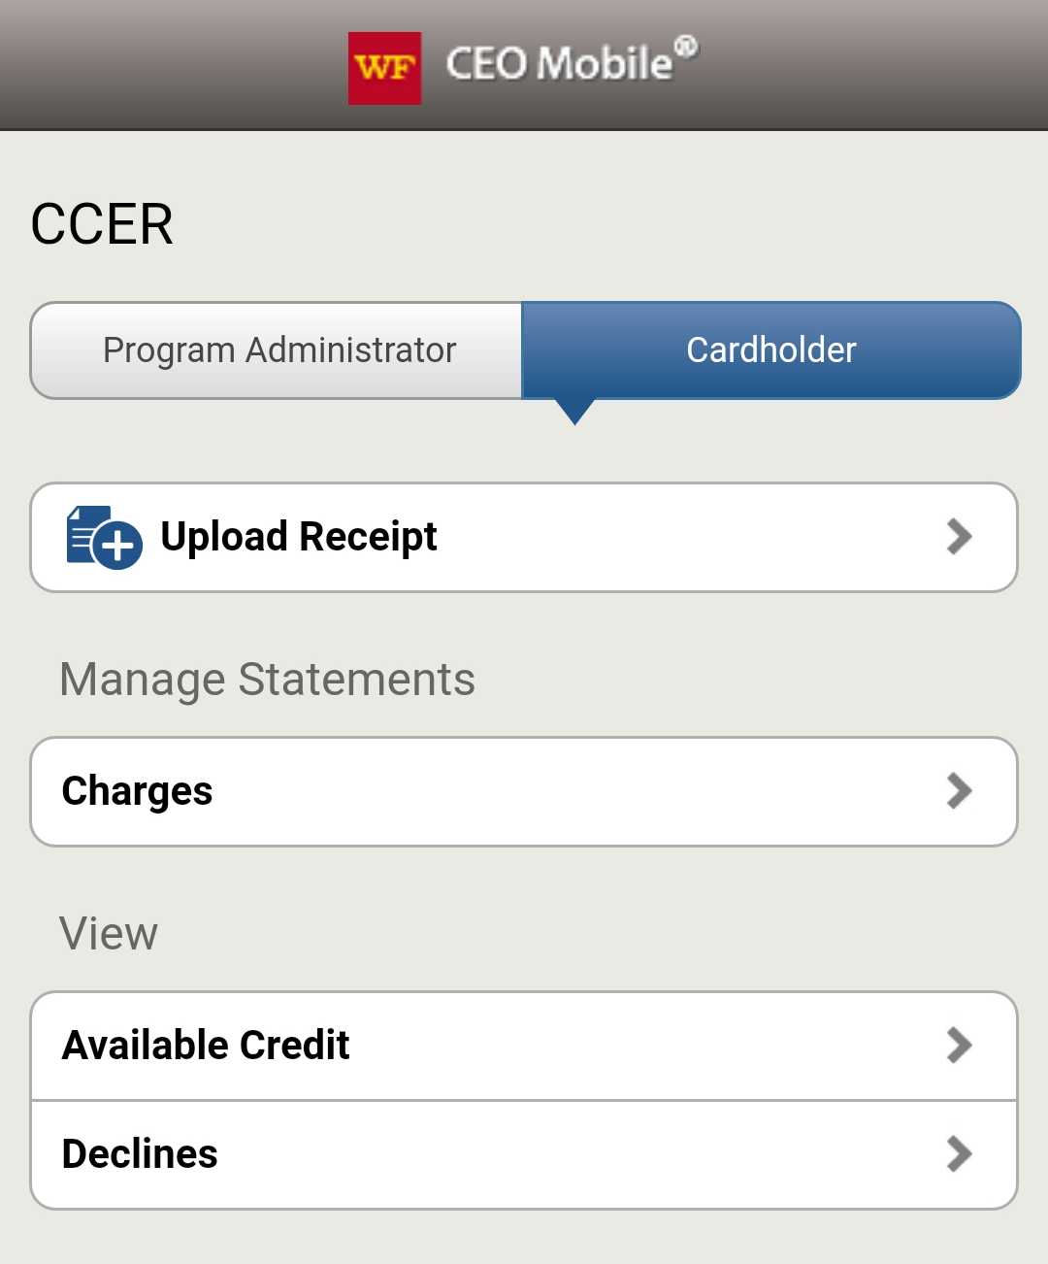
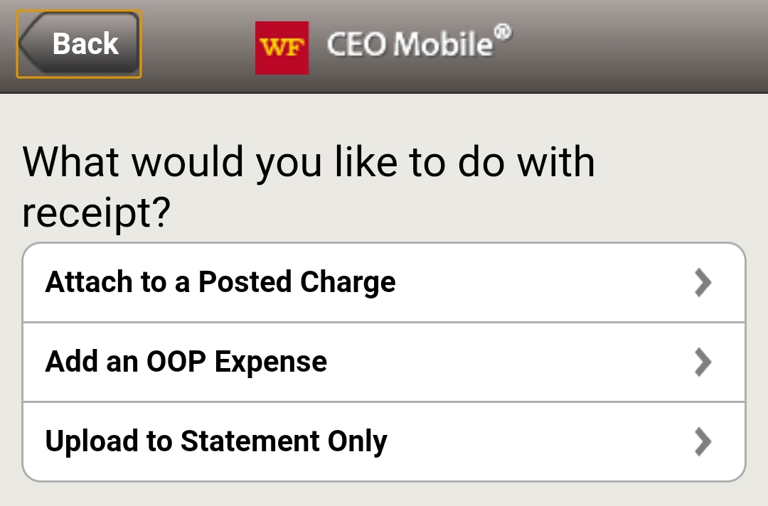
Upload At Statement Level - Mobile
Select Cardholder if there is more than one option, then click “Upload Receipt”.
Select “Upload to Statement Only”.

Slide 14
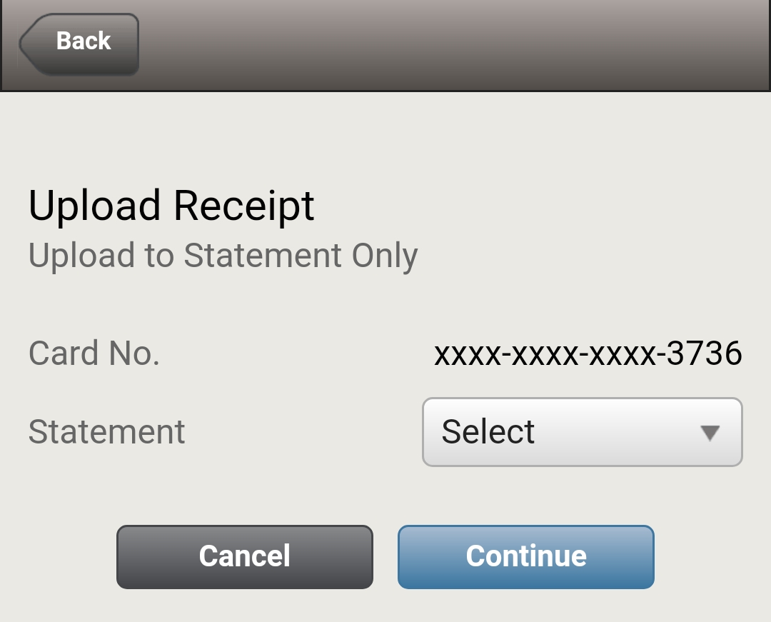
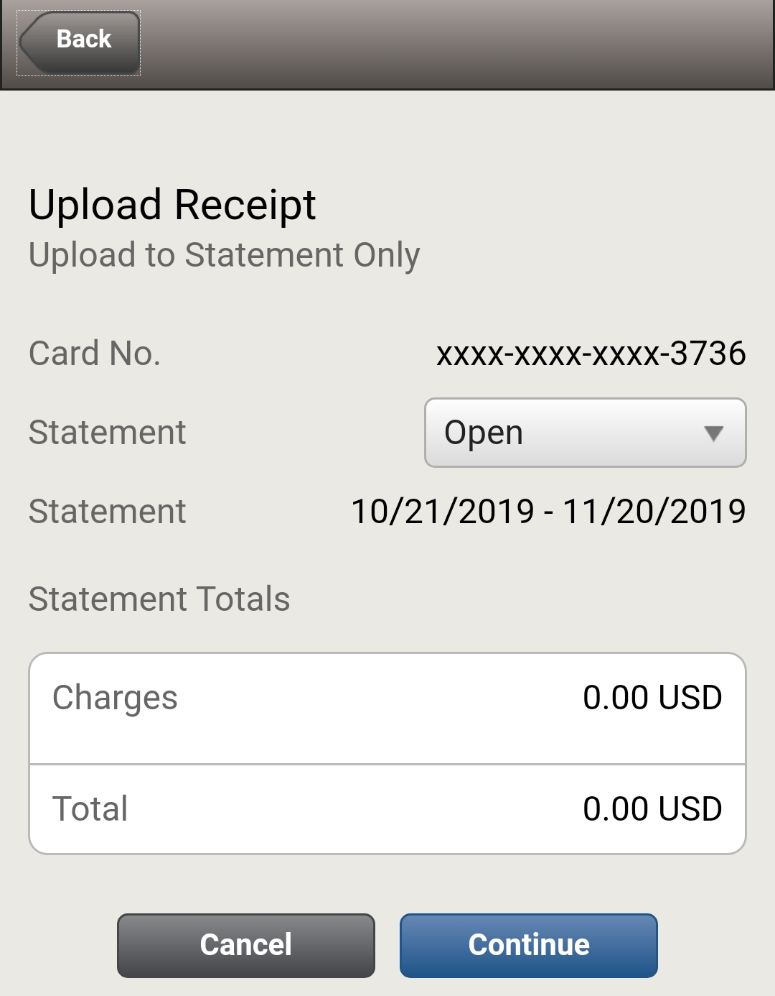
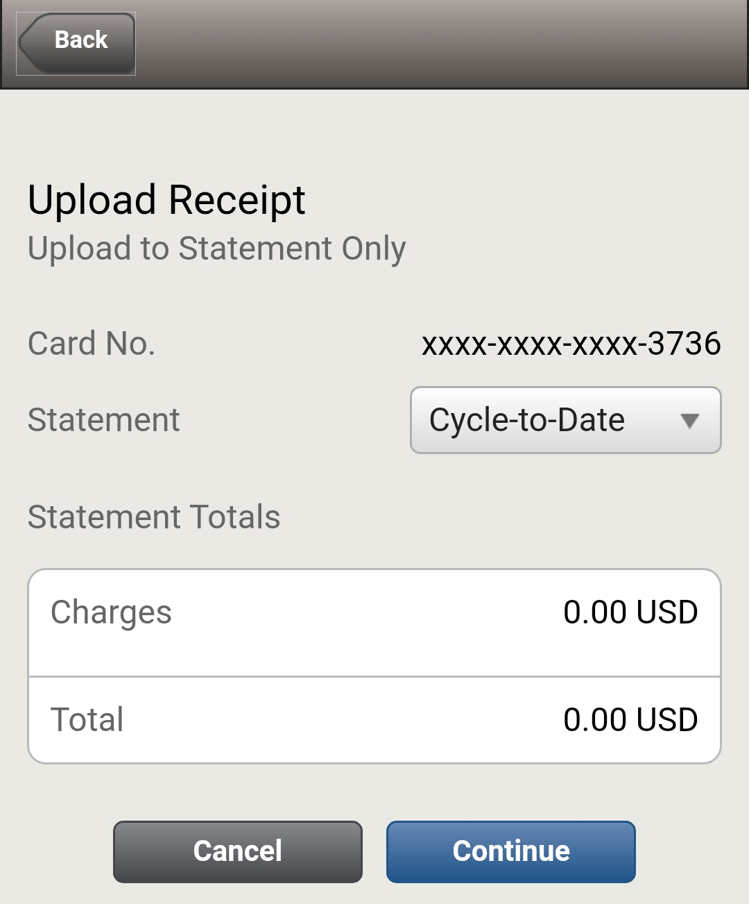

Upload At Statement Level - Mobile
Using the dropdown, select the statement to attach the receipt to.
The Cycle-to-Date covers the statement for the current billing cycle, while the Open statement covers the previous billing statement. The dates for that billing cycle are viewable.
Once the correct statement has been selected, click “Continue”.

Slide 15
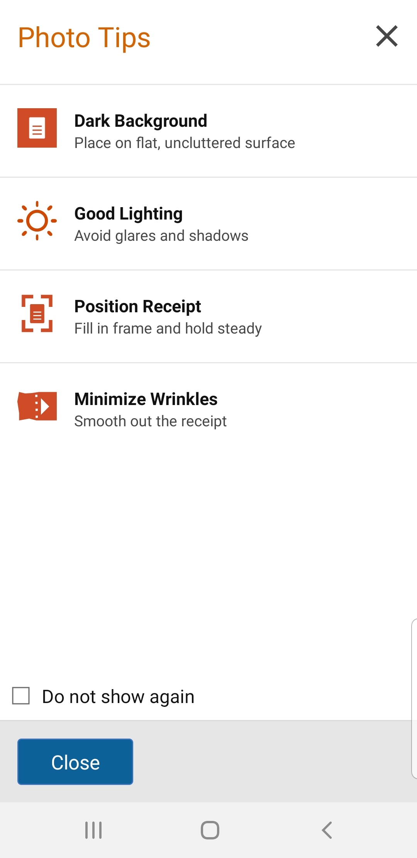
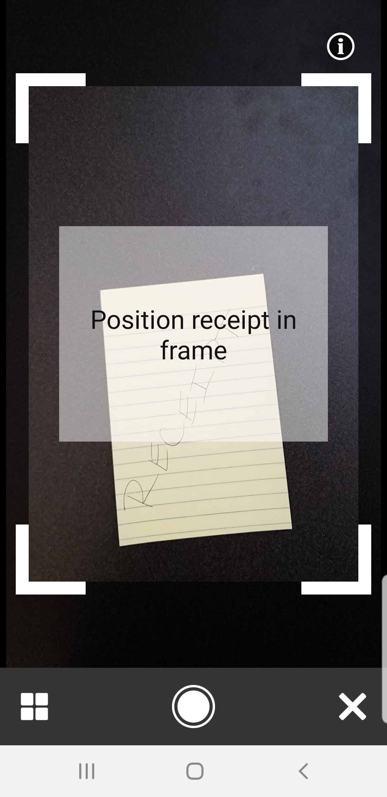
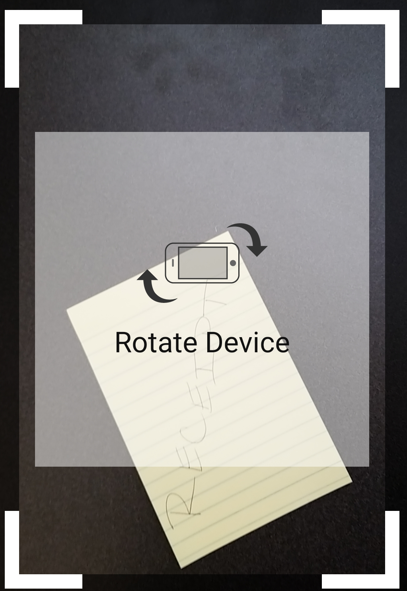
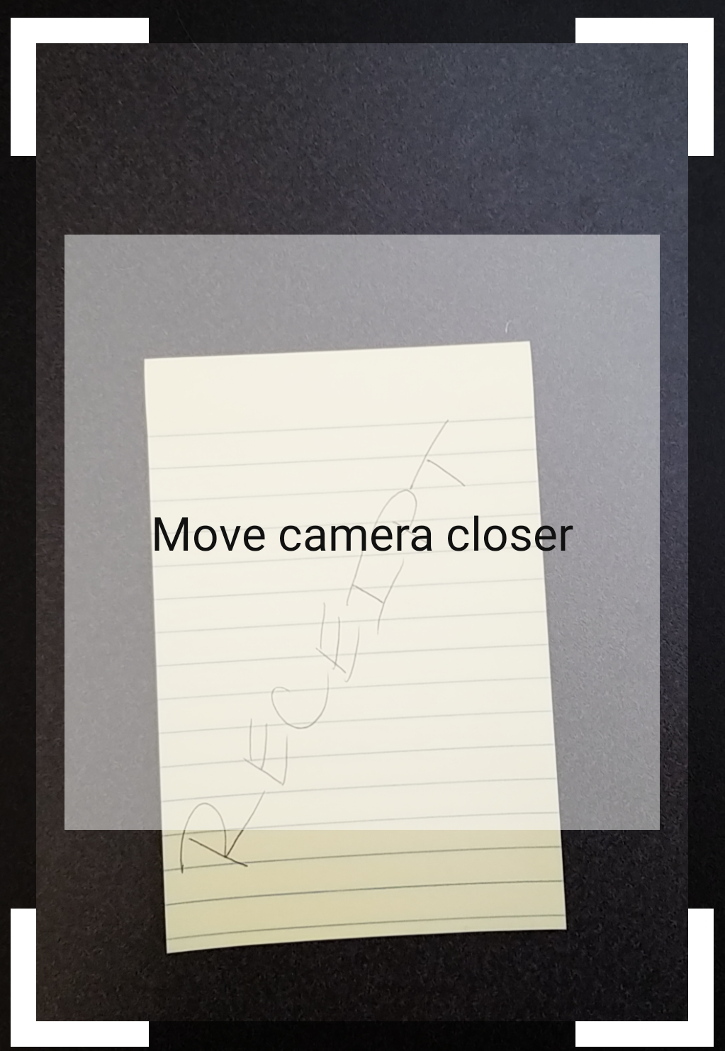
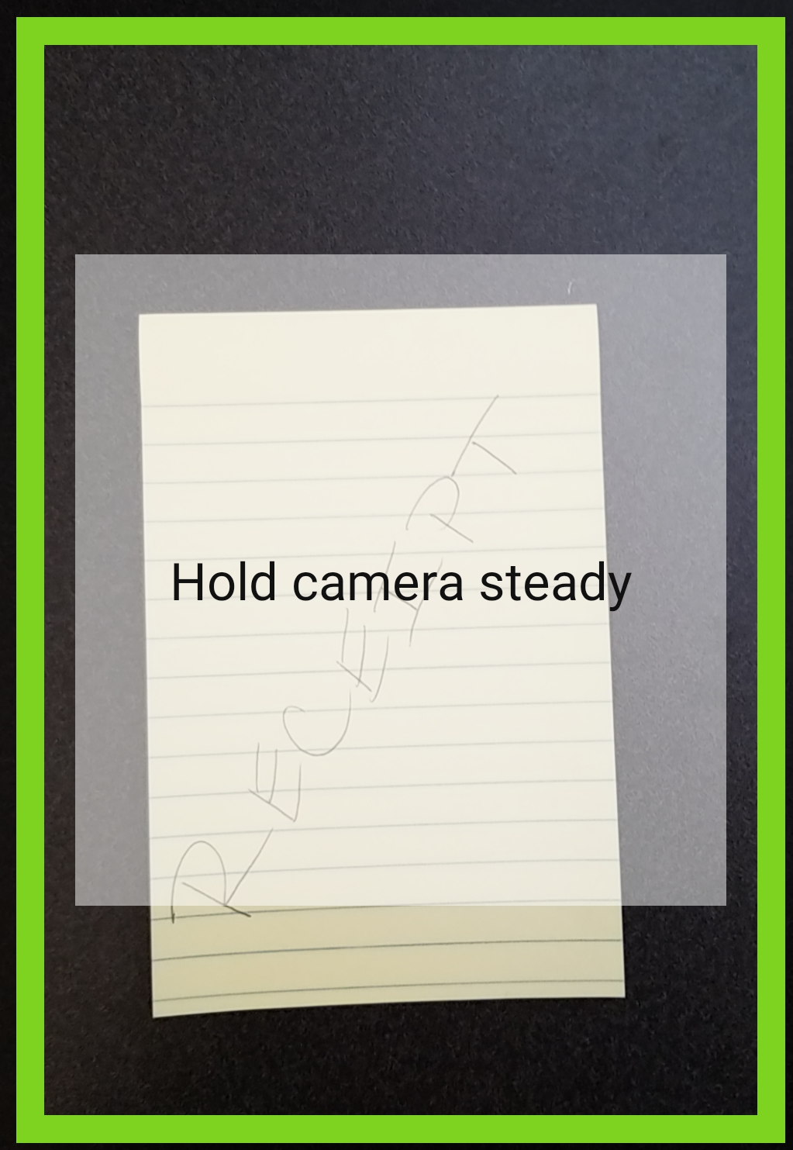
Upload At Statement Level - Mobile
Photo Tips will show every time a receipt is attached, along with helpful hints to ensure receipts are always easy to read.
If you do not want to see the photos tips, check the “Do not show again” box and click “Close”.

Slide 16
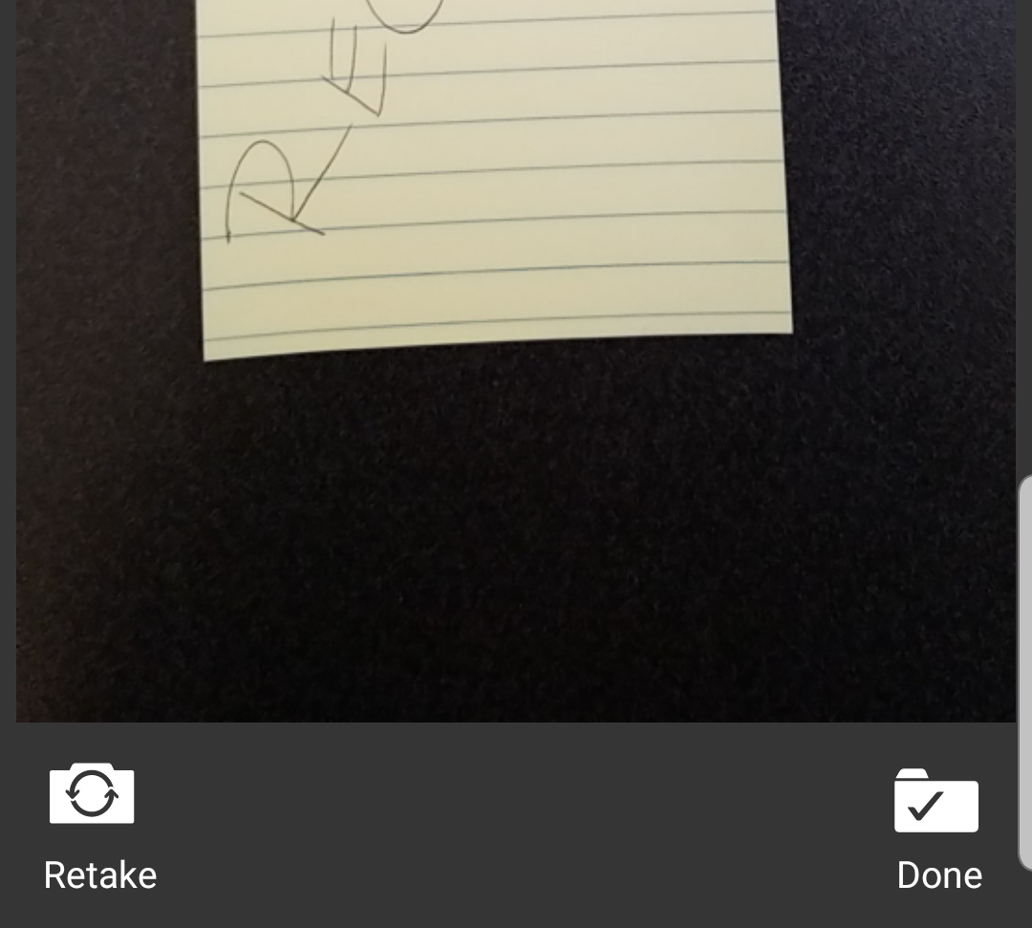
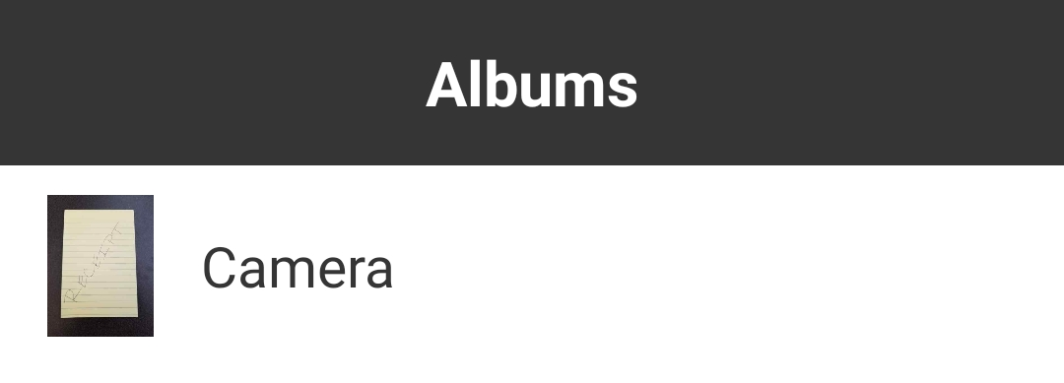
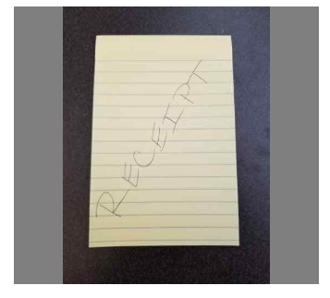
Upload At Statement Level - Mobile
The picture may be retaken if necessary, otherwise click “Done”.
Alternatively, a photo may be taken using the phone’s camera and accessed through the Gallery by selecting the icon in the lower left-hand corner of the screen.

Slide 17
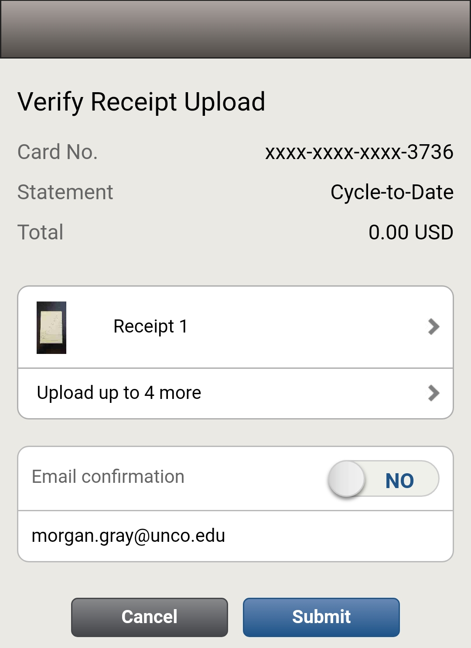
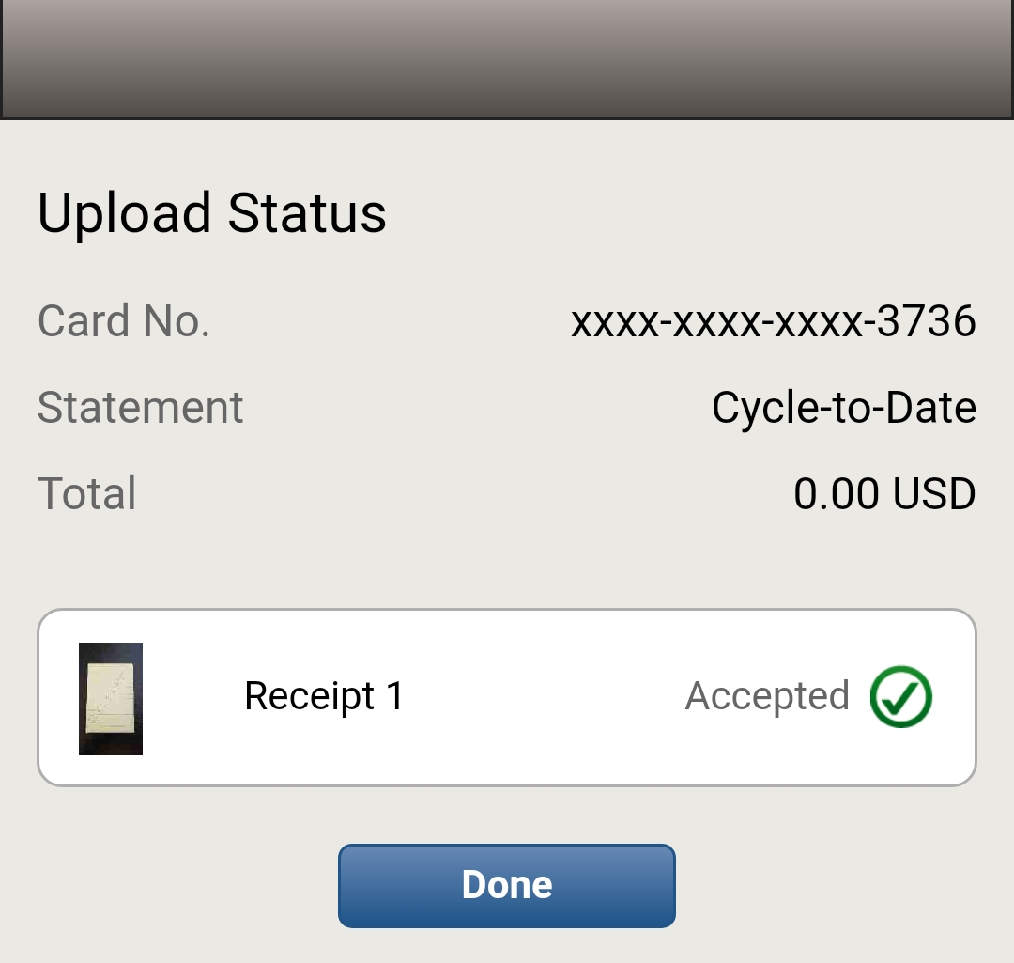
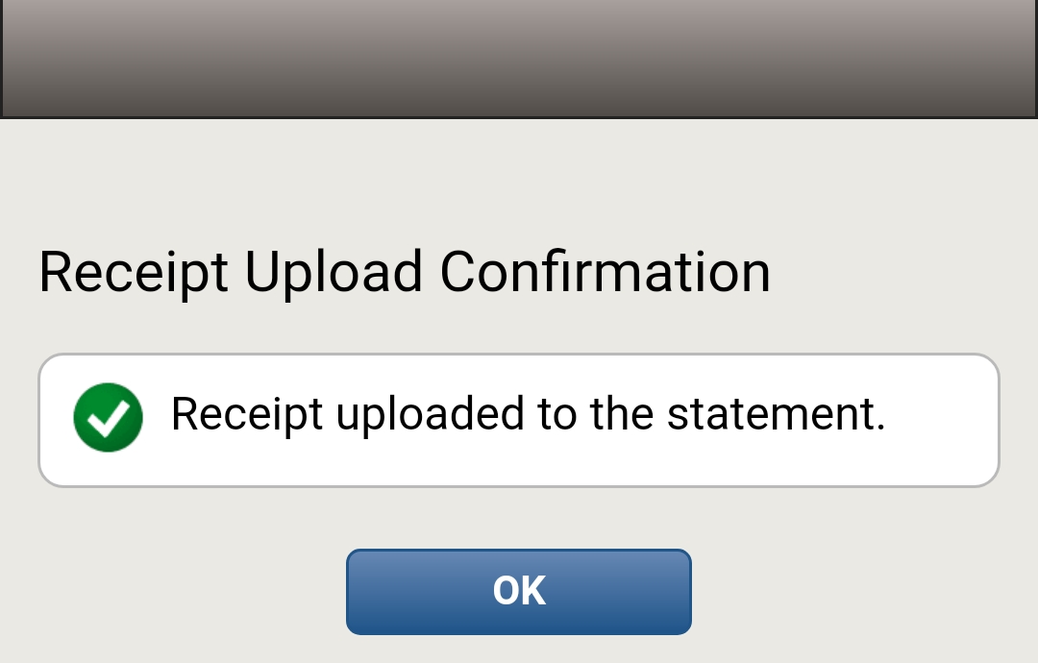
Upload At Statement Level - Mobile
Up to five receipts can be uploaded at a time. Once all receipts have been uploaded and an email confirmation choice has been made, select “Submit”.
The Upload Status screen will verify that all uploaded receipts were accepted. Retake any photos if necessary. When complete, click “Done”.
Once the app has confirmed that all receipts have been uploaded to the statement, click “OK”. Additional receipts may be added at this time.

Slide 18
That’s It!
Once your receipts are uploaded and your descriptions are entered, you are done! Just save and log out of the Wells Fargo System.
The “Statement Reviewed” button must be clicked in order for the Approver to be able to approve the statement.
Please discuss with your Admin if you are responsible for this as clicking this Statement Reviewed button before reallocations are complete will lock the statement from further changes to posted FOAP(A)s.
Statements and receipts should be completed as early in the reallocation period as possible, to allow ample time for Statement Approval.
Feel free to upload receipts as you get them and/or as your charges post to the system. This will prevent you from having to hold onto receipts nearly as long.

Slide 19
THANK YOU!
Morgan Gray
Receipt Imaging Training
12/02/2019

