Slide 1
Approving Statements
Morgan Gray & Alta Herndon
12/01/2017

Slide 2
Getting Started
Approving PCard Statements within the Wells Fargo system is a process that involves logging into Wells Fargo and reviewing transactions and receipts.
Once you have received the automated email(s) from Wells Fargo that a cardholder’s statement is ready to be approved, login to the Wells Fargo system and continue on to the next step.
Contact a PCard Program Administrator if you have any trouble accessing the system:
Alta Herndon
alta.herndon@unco.edu
Morgan Gray
morgan.gray@unco.edu

Slide 3
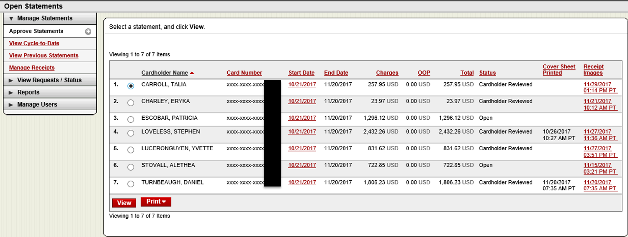
Selecting Statements
Once you’ve logged into Wells Fargo, you will be able to see all the cardholders for whom you approve PCard transactions. To view a statement, click the radio button next to the cardholder’s name and then click the red “View” button at the bottom of the page.

Slide 4
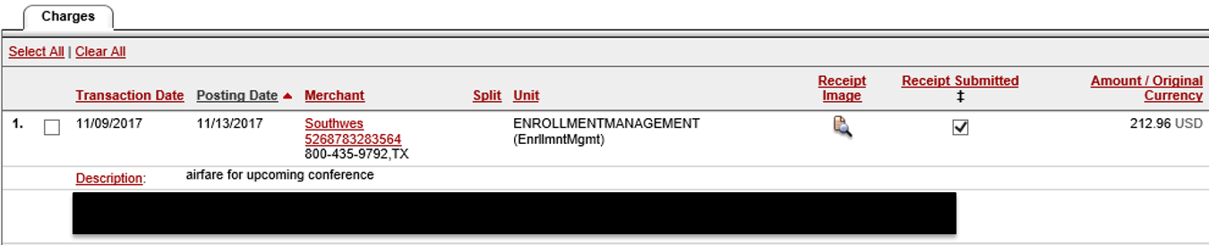
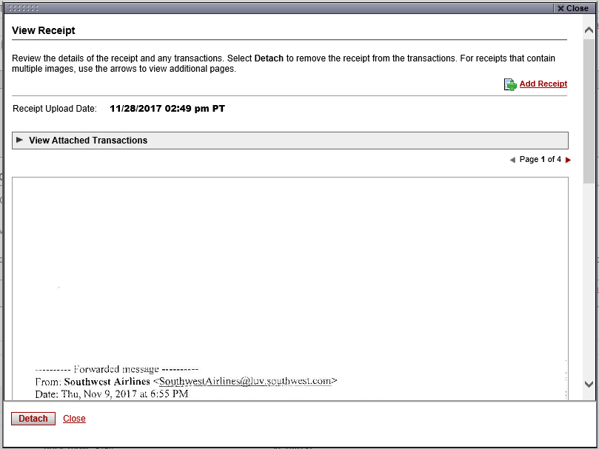
Reviewing Receipts and FOAP
To review a transaction receipt, move your cursor to the column titled “Receipt Image” and click on the paper/magnifying glass icon.
The receipt is displayed.

Slide 5
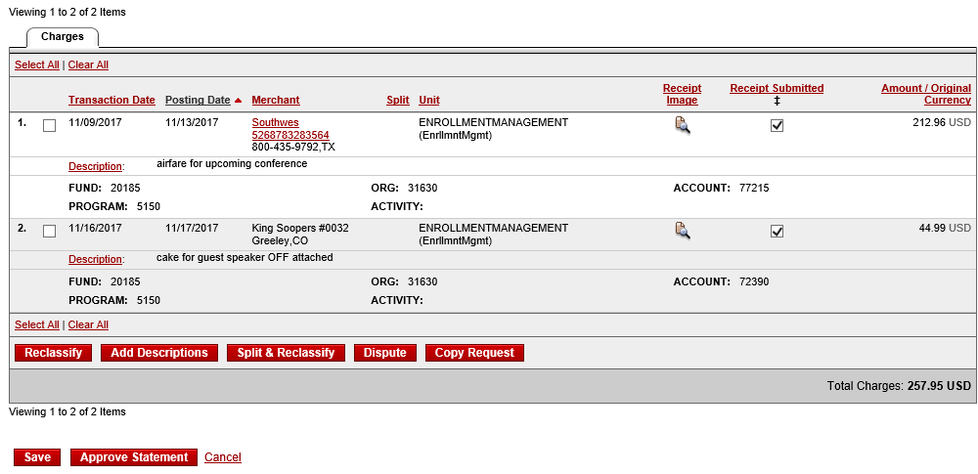
Reviewing Receipts and FOAP
The FOAP for the transactions displayed below are redacted, but when approving, you will see fields that display the FUND, ORG, ACCOUNT, PROGRAM and ACTIVITY codes. Confirm that each portion of the FOAP is correct. If any FOAPs need to be corrected, check the boxes next to those transactions and click the “Reclassify” button to make any necessary changes. Approved statements will be locked to further changes by the Approver.
Once all receipts and FOAPs are reviewed, click the red “Approve Statement” button at the bottom of the page.

Slide 6
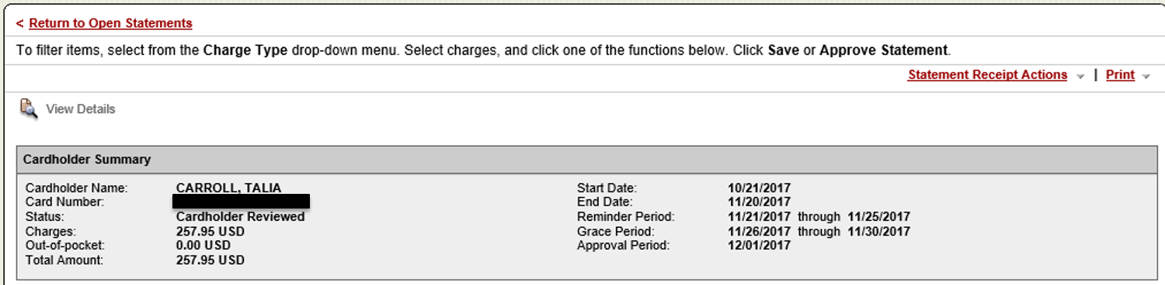
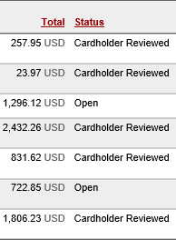
Selecting Statements
Return to open statements by selecting the active red text at the top left-hand side of the page that reads “<Return to Open Statements.”
Repeat the process for each cardholder whose card status is “Cardholder Reviewed.” If a cardholder’s status is listed as “Open” and the total on their card is not $0.00, the cardholder may need to be reminded that receipt images need to be uploaded and the FOAP updated as needed for accurate accounting of expenses.
Once the cardholder or their designated reallocator completes these task, the “Statement Reviewed” button will have to be clicked in order for you to be able to approve the statement.

Slide 7
THANK YOU!
Morgan Gray & Alta Herndon
12/01/2017

