Slide 1
Setting up a Proxy to Approve WTE (Web Time Entry)

Slide 2
PURPOSE: Setting up a proxy is highly recommended for all Web Time Entry Approvers. Whenever you are out of the office and Time needs to be approved your Proxy can do that for you.
Sign into URSA
Click on Employee
Under Column 3 - Employee
a. Click on Timesheet
Click on “Proxy Set up” at the bottom of the page
Click on the drop down box and select the name of the person you want to be able to approve your time for you. This still tags your name as the approver! You are trusting them to use your NAME to approve!
Then click the Add Remove box and click SAVE
This is the same way you REMOVE them. You need to remember to Remove Proxy’s as they leave your area or no long your proxy. This is not maintained by Payroll.
Call Payroll with the Proxy’s name and org so we can add them to PSAORGN
Proxy set up is complete
If you do not see their name in the drop down box – additional security is needed. Please call Payroll. 1.2946

Slide 3
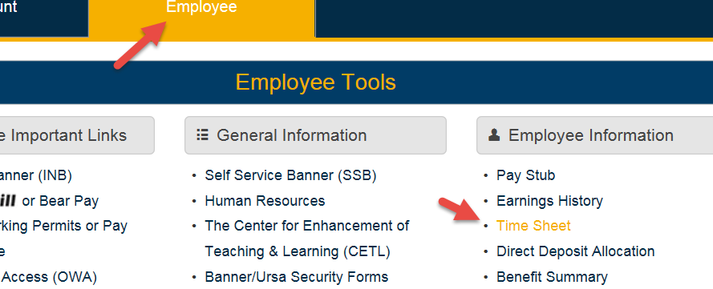
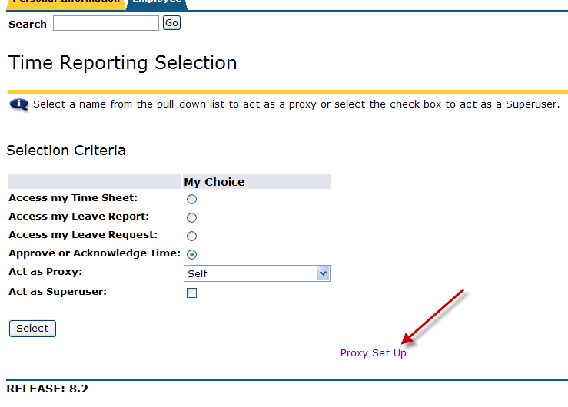
Under Employe Information Click on Time Sheet
At the bottom in the middle of the page you will see “Proxy Set up”

Slide 4
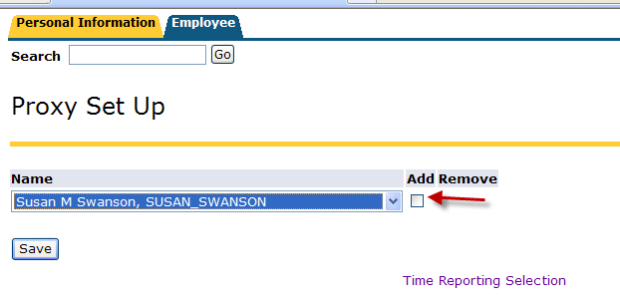
The names appear in alpha order of last names
Find the name of the person you want to proxy for you. If their security is set up to be a PROXY there name will be there. If not contact payroll
Check the ADD/REMOVE Box and Save.
Be sure and call Payroll on the ORG you want your proxy to proxy in.
To remove a PROXY – UNCHECK the Add/Remove box and SAVE.

Slide 5
QUESTIONS?
Call Payroll at 351-2700

