Slide 1
The Colorado STEM Teacher Preparation Symposium University of Northern Colorado Greeley, CO
December 10, 2013
Charles Coble
Co-Director, Science and Mathematics Teacher Imperative, SMTI
Partner, The Third Mile Group & Teacher Prep Analytics

Slide 2
View of Colorado from my Office

Slide 3
What I am NOT going to talk about!
Rising Above the Gathering Storm or RAGS Category 5
The latest TIMMS or PISA results
NRC’s A Framework for K-12 Science Education: Practices, Crosscutting Concepts, and Core Ideas
Next Generation Science Standards: For States, By States
Common Core State Standards - Math

Slide 4
What I am also NOT going to talk about!
Reauthorization of the America Competes Act
{Change the Equation}
Battelle STEMx (of which Colorado is a member)
STEM Education Coalition
STEM & American Legislative Exchange Council (ALEC)

Slide 5
What I am going to talk about!
STEM: what is it and why it is important
PECAST - briefly
Selected national initiatives to advance the quantity and quality of ‘SteM’ teachers
What are some of the major K-12 STEM initiatives, like STEM schools and Project-Based Learning
Selected state and local STEM teacher prep initiatives
Selected sources of support

Slide 6
Jobs and the Economy
Notes:
While there are significant issues confronting the nation, like Climate Change, Energy, Transportation, Communication, Housing, Food, Air & Water Security, Health & Disease Control, The one most dominant in the minds of the general public is JOBS.

Slide 7
STEM & Economic Prosperity
According to the Council on Foreign Relations, 60 percent of U.S. employers are having difficulties finding qualified workers to fill vacancies at their companies.
While the U.S. economy is still recovering, job postings in in the STEM occupations outnumber unemployed workers by nearly two to one.
At all levels of educational attainment, STEM job holders earn 11 percent higher wages compared with their same-degree counterparts in other jobs.
Notes:
I know this audience may recall recent articles about the over-supply of PhDs in science-related fields.
True or not, hose are not the STEM jobs that I am talking about.

Slide 8
STEM-Related Jobs
The growth in STEM jobs has been three times greater than that of non-STEM jobs over the last 10 years. And throughout the next decade, STEM occupations are projected to grow by 17 percent, compared to 9.8-percent growth for other occupations. (Source: U.S. Dept. of Commerce, Summer 2011)
In comparison to their non-STEM counterparts, STEM workers earn 26 percent more on average and are less likely to experience joblessness. (Source: U.S. Dept. of Commerce, Summer 2011)
Notes:
STEM jobs are there now and the need will continue to grow
STEM-related jobs pay better and employees experience less unemployment than others.

Slide 9
STEM-Related Jobs that Are HOT!
Forestry
Oil/gas extraction - pipeline transport
Energy manufacturing (solar & wind)
Allied Health & EMT professionals
Pharmaceuticals
Machine manufacturing and repair
Instrument manufacturing and repair
Computer software design-use-fix
Laboratory technicians
A/V-computer manufacturing and repair
Commercial equipment and supplies
Source: Science and Engineering Indicators 2012; http://www.nsf.gov/statistics/seind12/pdf/seind12.pdf
Notes:
I think most of us here are familiar with recent critical reports on the (possible) overstating the need for STEM grads. That may not even be true, but those critiques largely refer to higher level STEM degrees, PhDs, specifically. There are well documented shortages in STEM-related jobs that require technical or community college level degrees or certifications.
Those of us in this room tend to think of and generally place a higher value on advanced STEM education, but the vast majority of our society need the knowledge and skills necessary to get a good paying job – and a quality STEM education is a pathway to their success.

Slide 10
But, there are some concerns
John Cassidy. Measuring America’s Decline, The New Yorker, October 23, 2013
Research carried out by the Organisation for Economic Co-operation and Development, a Paris-based forum and research group, which counts thirty-three high- and middle-income countries among its members.
The numbers come from the O.E.C.D.’s inaugural Survey of Adult Skills, in which 5,000 people in each country were asked to answer the question on a computer and thus also assess their ability to function in a technology-rich environment.

Slide 11
Notes:
In literacy among sixteen-to-twenty-four-year-olds, Finland’s youth came out on top, with a score of 296.7; the average score was 277.9. The United States scored 260.9, which put it second to last, above Italy.

Slide 12
Notes:
In numeracy among sixteen-to-twenty-four-year-olds. Once again, Finland was in first place, with a score of 284.9. The United States was dead last, with 240.0. (Russia, too—though not a full member of the O.E.C.D.—beat us by quite a lot.)

Slide 13
Notes:
In proficiency in problem-solving, the researchers, categorized each subject according to his or her level of proficiency: level one, level two, or level three. For the purposes of constructing a single set of standings, Cassidy combined some figures, calculating the percentage of subjects who achieved the top two levels. The U.S. didn’t do any better. With a score of 37.6 per cent, it came in last place out of nineteen (or out of twenty if you include Russia).
So, while I stated earlier that the jobs I was referencing were not for PhD scientist, but neither are they for those lacking in literacy, numeracy and proficiency in problem-solving.

Slide 14
STEM Smart Brief: CADRE
The need to overhaul the nation’s teacher training programs is now the consensus of K-12 practitioners, politicians and policymakers.
A top priority is improving the practices of STEM teachers – and their job-based supports.
Virtually all states are in some phase of redesigning teacher prep to build more content knowledge and inquiry skills into preservice prep – or they are bypassing ‘traditional’ teacher ed.
NSF Grant #0822241 to Community for Advancing Discovery Research in Education at EDC, INC. http://successfulstemeducation.org

Slide 15
Turning the Tide: Strategies for Producing the Mathematics & Science Teachers Our Schools Need
1. Engaging arts and sciences faculty as leaders of innovation and reform
UTeach * UC-Boulder
2. Developing new pathways and incentives to enter the teaching profession
Boston Residency * CUNY Teacher Academy
3. Establishing ambitious, widely shared and measurable goals with support and accountability for action
University of California * University of North Carolina
System System
Notes:
Turning the Tide was an early STEM initiative of the National Association of System Heads (NASH) that was kicked off in 2006. NASH is a voluntary convening of 50+ heads of university systems in the United States.
These were the top 3 priorities for action and some examples of institutions, organizations and systems that were leading in these areas.
Source: Charles R. Coble, Catherine Walker, Katy Anthes, Ned Erickson and Arika Long. National Association of System Heads (NASH), Washington, DC 2006

Slide 16
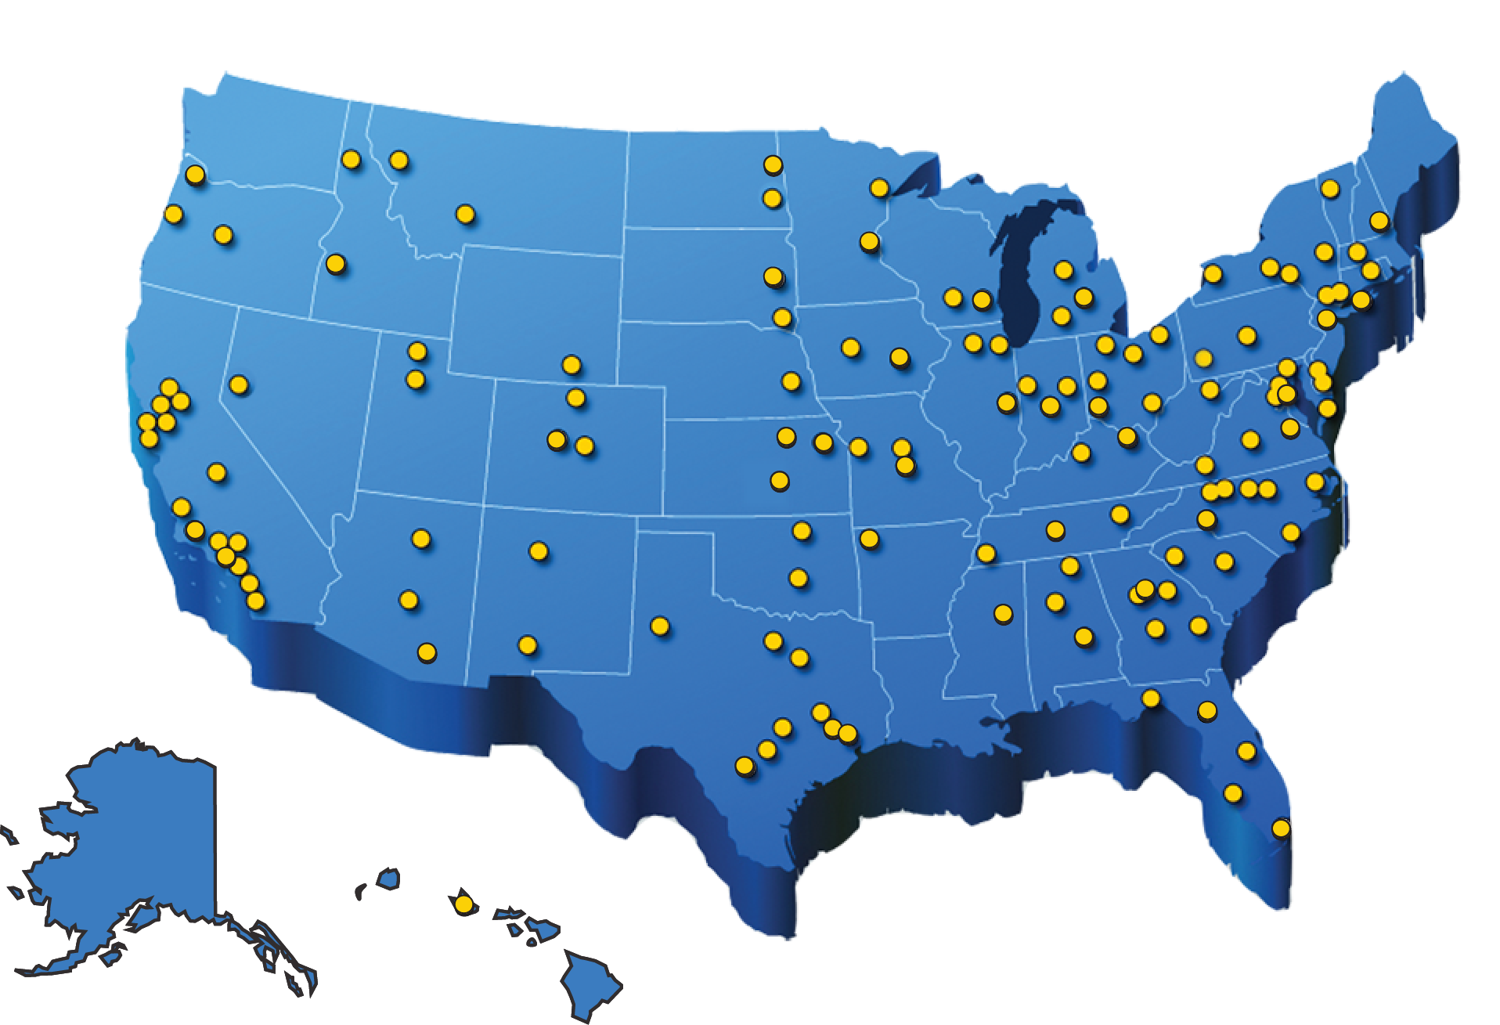
Science and Mathematics Teacher Imperative (SMTI) - APLU
Notes:
The Association for Public and Land-grant Institutions kicked off the Science and Mathematics Teacher Imperative almost exactly 5 years ago this month. There are currently 135 institutions, whore Chancellor’s and President’s have signed pledges to increase both the QUANTITY and QUALITY of science and mathematics teacher preparation on their campuses.
UC-Boulder
UC-Denver
Colorado State University
UC-Boulder Chancellor Phil Distefano is just wrapping up his chairmanship of the SMTI Steering Committee

Slide 17
Science and Mathematics Teacher Imperative (SMTI) - APLU
Notes:
The SMTI work is being guided by this perspective of science and math teacher education – that it is an all-campus responsibility that begins before it begins and it is not over on graduation day.
With the support of the Carnegie Foundation and two NSF grants, we have developed a well-vetted tool, called the Analytic Framework which institutions have used to assess the quality of their programs. If you are interested is using it, just be in touch.

Slide 18
President’s Council of Advisors on Science and Technology (PECAST)

Slide 19
President’s Council of Advisors on Science and Technology (PECAST)
Engage to Excel – February 2012
Catalyze widespread adoption of empirically validated teaching practices;
Advocate and provide support for replacing standard laboratory courses with discovery-based courses;
Launch a national experiment in postsecondary mathematics education to address the math preparation gap;
Encourage partnerships among stakeholders to diversify pathways to STEM careers;
Create a Presidential Council on STEM Education.

Slide 20
President’s Council of Advisors on Science and Technology (PECAST)
Capturing Domestic Competitive Advantage in Advanced Manufacturing – July 12, 2012
Success in advanced manufacturing and entrepreneurship will require a workforce with fundamental science, technology, engineering, and math skills and broad problem-solving skills, decision-making skills, and people skills that do not emerge from a conventional K-12 education. We need Problems Based Learning instruction.

Slide 21
STEM
There are thousands of STEM initiatives, alliances, collaborations, partnerships, schools and academies across the United States at the nation, state and at local levels led by governments, public schools, museums, philanthropies and a variety of public-private partnerships.
But, are the arrows pointed in the same direction? In fact….

Slide 22
What is STEM?
= SCIENCE and MATHEMATICS – just kiddin’ about STEM!
= SCIENCE, MATH, technology – tech as best supporting actor.
= SCIENCE, MATH, TECHNOLOGY, engineering
– throw the engineers a bone.
= SCIENCE, MATH, TECHNOLOGY, ENGINEERING – all present and accounted for, but really how do you do this?

Slide 23
Notes:
This past Fall I completed, with some colleagues in North Carolina, a STEM Education ScoreCard. We chose to transform STEM into Strategies that Engage the Mind because of the range of knowledge and skills needed for the 21st Century workplace.

Slide 24
Notes:
We identified 3 Guiding Principles of Engagement, Development and Persistence upon which to build our STEM model and 6 critical components:
The NC Stem Workforce and Economic Impact
Informal Education (a tremendous source of engagement) and STEM Literacy in NC
Strategic Investments & Innovation – like our State Broadband initiative, UNC Public Television, the Research Triangle Park and others
College and Career Readiness – what does our longitudinal and trend data tell us
Teacher Quality – are we getting better or worse?
Leadership and Support – the essential ingredient

Slide 25
Attributes of a STEM School*
I. Integrated Science, Technology, Engineering and Mathematics curriculum, aligned with state, national and international, and industry standards
Project-based learning with integrated content across STEM subjects
Connections to effective in and out-of-school STEM programs
Integration of technology and virtual learning
Authentic assessments and exhibition of STEM skills
Professional development on integrated STEM curriculum, community/industry partnerships and postsecondary education connections
Outreach, support and focus on underserved, especially females, minorities, and economically disadvantaged
* NC Science, Math and Technology Center and the NC Department of Public Instruction

Slide 26
Attributes of a STEM School*
II. On-going community and industry engagement
A communicated STEM plan is adopted across education, communities and businesses
STEM work-based learning experiences to increase interest and abilities in fields requiring STEM skills for each student and teacher
Business and community partnerships for mentorship, internship and other STEM opportunities that extend the classroom walls
III. Connections with postsecondary education
Alignment of student’s career pathway with postsecondary STEM programs
Credit completion at community colleges, colleges and/or universities (High Schools Only)
* * NC Science, Math and Technology Center and the NC Department of Public Instruction
Notes:
I know you have a number of STEM-focused schools that feature problems based learning – like the STEM Magnet High School in Northglenn, CO
And COLORADO has a large number of initiatives to advance STEM focused learning and schools.
- The Colorado Experiential STEM Learning Network (CESLN)
- Violeta Garcia is Colorado's new STEM education coordinator.
- Colorado Legacy Foundation, in conjunction with the governor's office and a variety of other groups, has been working on a project to more clearly define criteria for quality initiatives and collaboration, which is what this meeting is all about.

Slide 27
STEM Schools-Courses
Avery STEM
Technology, Engineering and Design – 3-D Design & Printing, Principles of Technology
Agricultural Science – Horticulture, Sustainable Agriculture
Health Sciences– Medical Terminology, Medical Assisting
Academic Core – all aligned to the ‘affinity themes’ above and college transfer for Jr/Sr students
Notes:
Because I had easy access to the curriculum structure of our SYEM schools in NC, this and the next slides are examples of their design.
You also have a number of STEM schools in Colorado.

Slide 28
STEM Schools & Courses
Buncombe County Discovery Academy
Health Care – Biomedical Science
Science & Technology – Information Technology
Advanced Manufacturing/Applied Engineering – Engineering Design
Knowledge-Based Entrepreneurship – E I & II
Arts & Culture – Game Art Design

Slide 29
STEM Schools focus on Project-Based Learning, but What is PBL?
Students collaborate on meaningful projects that require critical thinking, creativity, and communication in order for them to answer challenging questions or solve complex problems.

Slide 30
What is Project-Based Learning?
Students see a purpose for mastering state-required skills and content concepts.

Slide 31
What is Project-Based Learning?
Students are assessed not only their understanding of academic content, but also on their ability to successfully apply that content when solving authentic problems.

Slide 32
New Tech Schools
A national network of elementary, middle and high schools that have adopted a PBL and largely focused on STEM
Currently - 136 New Tech Schools in 23 states in the U.S.
www.newtechnetwork.org
Notes:
There are no New Tech Schools in Colorado, however, there are several STEM schools in the states that follow some of the same design principles of the New Tech Schools Network

Slide 33
Teacher Prep for STEM/PBL Schools*
More content courses require for entry and exit
Required Capstone course to ‘put it together’
Practical coursework to learn specific practices – teaming, questioning, inquiry
More knowledge of local district curriculum
Intern experiences that are congruent with subject/grade level and future teaching expectations
*Pathways Project of NYC & National Academy of Sciences (2010).

Slide 34
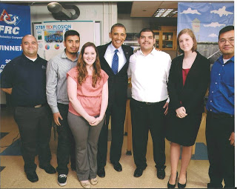
STEM Teacher Prep: UTeach
University of Texas- Austin
Mr. Bobby Garcia (far left) with Robotics team and special guest- Manor New Tech HS-- May 9, 2013
Project-Based Learning (3 s.h.) is required in UTeach and at UTeach Replication sites

Slide 35
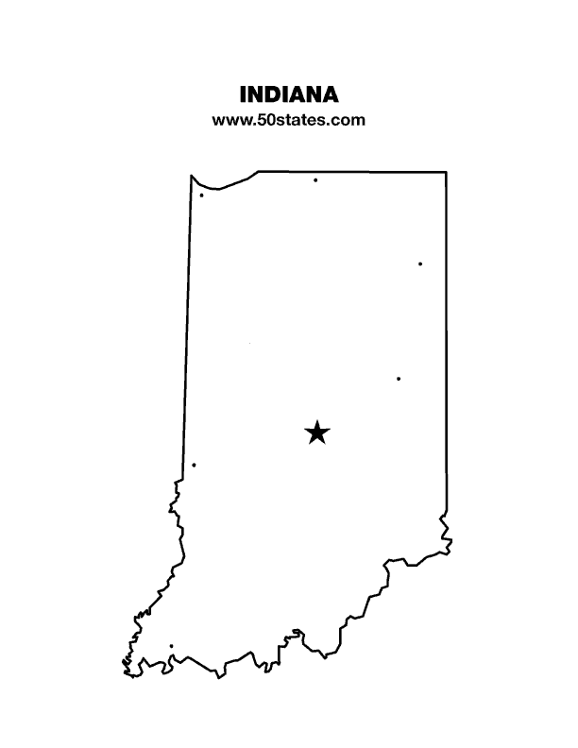
STEM Teacher Prep: Indiana STEM Teach
Center of Excellence in Leadership of Learning (CELL) and the Independent Colleges of Indiana
Support campuses to implement PBL preparation to teacher candidates and professional development to teachers
Support teachers to be dual certified in STEM courses

Slide 36
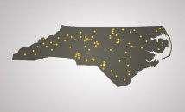
STEM Teacher Prep: NC New Schools
NC STEP (STEM Teacher Education Program)
A non-traditional 15 month teacher education program administered by NCNS, funded by the federal Transitions to Teaching grant
Candidates receive a year of school-based training at an innovative school supported by NCNS, combined with seminars and online coursework through WIDE World, through Harvard Graduate School of Education
Notes:
What is NC STEP?NC STEP is an alternative licensure program seeking mid-career professionals and recent college graduates interested in becoming secondary science, technology, engineering or math (STEM) teachers. Administered by NC New Schools and approved by the State Board of Education, this cost-free, non-traditional teacher prep program is supported by a federalTransition to Teaching grant. This program has also been selected as a partner in 100Kin10, a national multi-sector effort to increase the number of STEM teachers by 100,000 during the next 10 years, and has been approved by the North Carolina State Board of Education as an alternative route to teacher licensure.Who can apply?NC STEP is a teacher preparation program designed for a very specific audience. To be eligible, applicants must have a four-year college degree (bachelor's degree) in a science, technology, engineering or mathematics (STEM) related field and have an interest in becoming a teacher of STEM courses in a NC secondary school. Applicants who currently hold a teaching license are not eligible for the program.

Slide 37
STEM Teacher Prep: Teach for America
Today, more than 3,200 1st & 2nd -year STEM corps members are teaching math and science primarily in low wealth urban and rural schools, making TfA one of the largest providers of math and science teachers in the country.
TfA aspires to have 5,000 STEM first and second-year corps members by 2015.
56% of STEM alumni stay in education and 32% stay in the classroom.

Slide 38
STEM Teacher Prep: Informal Education
Carnegie Science Center/Chevron STEM Center
pre K-12 school
colleges and universities
technical schools
business and industry
workforce and career development organizations
economic development organizations

Slide 39
STEM Teacher Prep: Informal Education
Exploratorium – San Francisco
Teacher In-service
Teacher Induction
Bank Street College – NY Zoological Park
Teacher Preparation

Slide 40
Questions
How do we better assure a strong and shared responsibility for STEM education across the STEM departments and the schools of education?
How do we assure that the clinical experiences of teacher candidates reinforce a shared vision for STEM education (single discipline, integrated content, problems-based learning, etc.)?

Slide 41
Be in touch!
Charles R. Coble
Co-founder & Partner
The Third Mile Group &
Teacher Preparation Analytics
Co-Director, Science and Mathematics Teacher Imperative, APLU
coblec@thirdmilegroup.com

Slide 42
STEM Teacher Prep: NSF Sources for Support
Two divisions within NSF’s Education and Human Resources (EHR) are particularly relevant to the issue of STEM teacher preparation:
*Division of Undergraduate Education (DUE)
A key DUE program is the Robert Noyce Teacher Scholarship Program (www.nsfnoyce.org)
*Division of Research on Learning in Formal and Informal Settings (DRL)
Notes:
Noyce Scholarships are part of the AMERICA COMPETES ACT of 2002, which is up for re-authorization.
Other DUE Programs
Math and Science Partnerships (MSPs), which aims to raise achievement levels of K–12 students and reduce the gaps in achievement typically seen in diverse student populations
Advanced Technology Education (ATE), which focuses on education of technicians for technology fields
Scholarships in STEM, which provides scholarships and support to academically talented but financially needy students to permit them to complete their STEM major
DRL programs
Discovery Research K–12, which supports research proposals involving important current or anticipated needs in prekindergarten through high school education
Innovative Technology Experiences for Students and Teachers, which seeks to find the best way to prepare students to participate in the twenty-first century workforce, focusing on K–12 students and their teachers
Research and Evaluation on Education in Science and Engineering, which supports research on STEM learning in all of its guises, necessarily including preparation of teachers

Slide 43
STEM Teacher Prep: NSF Sources for Support
The Discovery Research K-12 program (DRK-12) seeks to significantly enhance the learning and teaching of (STEM) by preK-12 students and teachers, through research and development of innovative resources, models and tools.
The DRK-12 program has four major research and development strands: (1) Assessment; (2) Learning; (3) Teaching; and (4) Implementation Research.

