Slide 1
CLOUD IDENTIFICATION EXERCISE
(Directions taken directly from the Flynn, 2018 AMS abstract)
Reference:
Flynn, W. J., 2018: Cloud Identification Exercise. 27th Symposium on Education, Austin, TX, Amer. Meteor. Soc., 137, https://ams.confex.com/ams/98Annual/webprogram/Paper336693.html.
Before class, the instructor prints a selection of 8-10 clouds (on a color printer) to make enough for each student in the class. In class, after a brief introduction of terms used to identify clouds, students are shown a simplified outline of the activity. Full instructions of the activity are:
1) Pass out individual cloud pictures (in random order) to each student in the room
2) Students are asked to use their newly-acquired meteorological terms to describe their clouds, and identify them (individually, in writing)
3) Students get up from their seats find others with the same cloud to form small groups
4) In small groups, students discuss their cloud and determine its type, write down their reasoning, and select a group speaker
5) The instructor walks around to each group to overhear discussion and guide groups who have trouble
6) When all groups have identified their cloud type, they rearrange themselves so the groups are organized left-to-right from low, middle, and high clouds (and vertically developing clouds where appropriate)
7) The instructor notes their order, and has the group speaker announce the cloud type for each group
8) Students return to their seats
9) The instructor shows projected images of each of the cloud types to the entire class, and calls on each group speaker to state their cloud type and explain the cloud’s characteristics using meteorological terms
10) Solutions to the cloud activity are provided online or distributed to the class

Slide 2
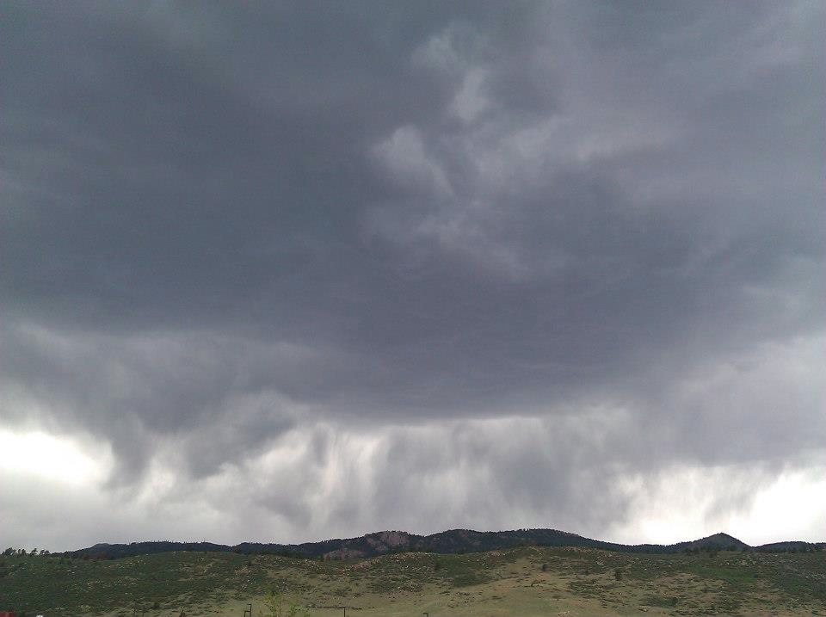
Cloud Types:
High – Cirr-
cirrus
cirrostratus
cirrocumulus
Middle – Alto-
altostratus
altocumulus
Low
stratus
stratocumulus
nimbostratus
Clouds with Vertical Development
Cumulus (little to moderate vertical development)
Cumulonimbus (towering vertical development)
This is a(n) _______________________ cloud.

Slide 3
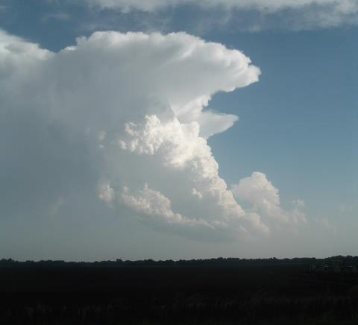
Cloud Types:
High – Cirr-
cirrus
cirrostratus
cirrocumulus
Middle – Alto-
altostratus
altocumulus
Low
stratus
stratocumulus
nimbostratus
Clouds with Vertical Development
Cumulus (little to moderate vertical development)
Cumulonimbus (towering vertical development)
This is a(n) _______________________ cloud.

Slide 4
Cloud Types:
High – Cirr-
cirrus
cirrostratus
cirrocumulus
Middle – Alto-
altostratus
altocumulus
Low
stratus
stratocumulus
nimbostratus
Clouds with Vertical Development
Cumulus (little to moderate vertical development)
Cumulonimbus (towering vertical development)
This is a(n) _______________________ cloud.

Slide 5
Cloud Types:
High – Cirr-
cirrus
cirrostratus
cirrocumulus
Middle – Alto-
altostratus
altocumulus
Low
stratus
stratocumulus
nimbostratus
Clouds with Vertical Development
Cumulus (little to moderate vertical development)
Cumulonimbus (towering vertical development)
This is a(n) _______________________ cloud.

Slide 6
Cloud Types:
High – Cirr-
cirrus
cirrostratus
cirrocumulus
Middle – Alto-
altostratus
altocumulus
Low
stratus
stratocumulus
nimbostratus
Clouds with Vertical Development
Cumulus (little to moderate vertical development)
Cumulonimbus (towering vertical development)
This is a(n) _______________________ cloud.

Slide 7
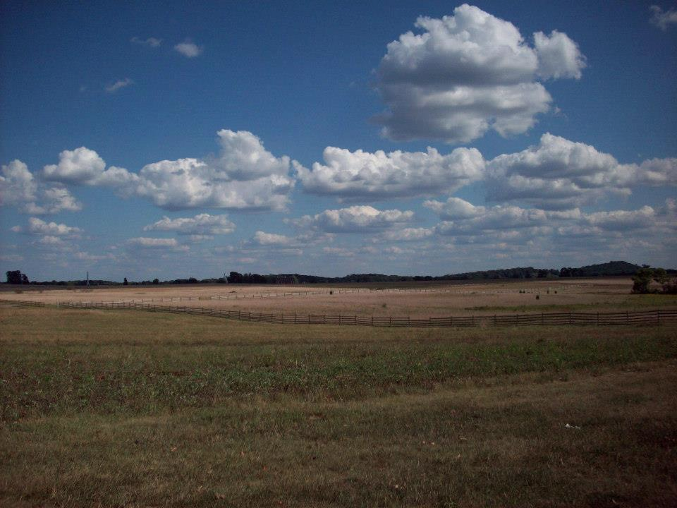
Cloud Types:
High – Cirr-
cirrus
cirrostratus
cirrocumulus
Middle – Alto-
altostratus
altocumulus
Low
stratus
stratocumulus
nimbostratus
Clouds with Vertical Development
Cumulus (little to moderate vertical development)
Cumulonimbus (towering vertical development)
This is a(n) _______________________ cloud.

Slide 8
Cloud Types:
High – Cirr-
cirrus
cirrostratus
cirrocumulus
Middle – Alto-
altostratus
altocumulus
Low
stratus
stratocumulus
nimbostratus
Clouds with Vertical Development
Cumulus (little to moderate vertical development)
Cumulonimbus (towering vertical development)
This is a(n) _______________________ cloud.

Slide 9
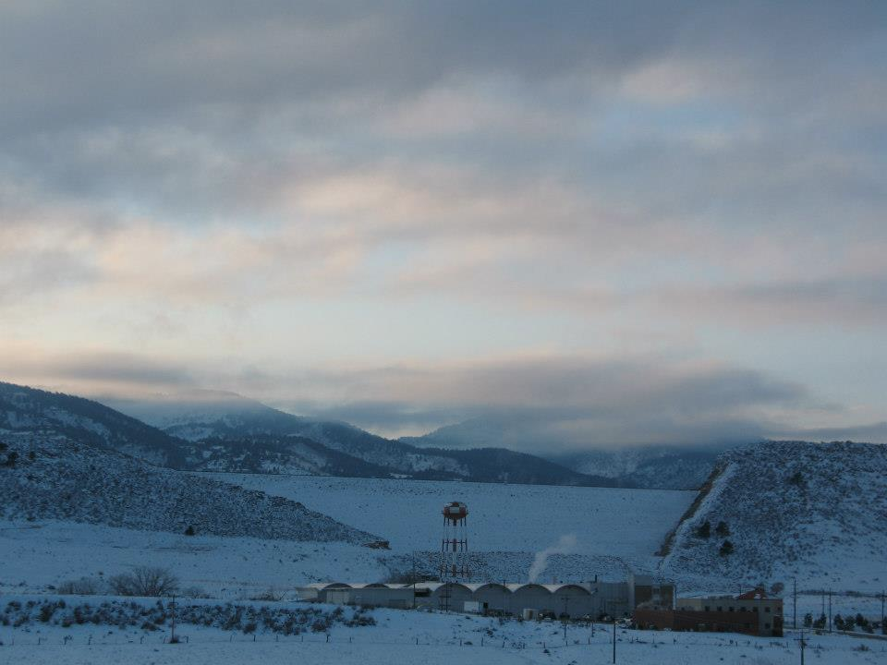
Cloud Types:
High – Cirr-
cirrus
cirrostratus
cirrocumulus
Middle – Alto-
altostratus
altocumulus
Low
stratus
stratocumulus
nimbostratus
Clouds with Vertical Development
Cumulus (little to moderate vertical development)
Cumulonimbus (towering vertical development)
This is a(n) _______________________ cloud.

Slide 10
Cloud Types:
High – Cirr-
cirrus
cirrostratus
cirrocumulus
Middle – Alto-
altostratus
altocumulus
Low
stratus
stratocumulus
nimbostratus
Clouds with Vertical Development
Cumulus (little to moderate vertical development)
Cumulonimbus (towering vertical development)
This is a(n) _______________________ cloud.

