Slide 1
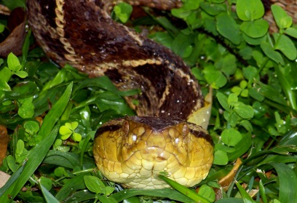
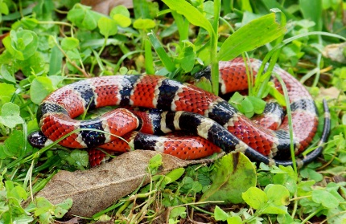
Reptilian Venoms and Toxins:
Diversity and
Mechanisms of Action
Stephen P. Mackessy, PhD
BTG Webinar - 24 July 2018
School of Biological Sciences
University of Northern Colorado
Greeley, CO USA

Slide 2
sss
Outline
Overview
  Species diversity
  Venom composition
Major venom toxin families and their effects
  Three-finger toxins (3FTxs)
  Phospholipases A₂ (PLA₂)
  Serine proteinases
  Metalloproteinases
  Myotoxin a/crotamine
  Summary & Conclusions

Slide 3
Human Envenomations
2009 – recognized by WHO as a neglected tropical disease
  Created higher profile of the problem
  15 March & 24 May 2018 – report and resolution adopted by WHO
Envenomations
  complex & serious multisystem medical emergency
  varies with species, sometimes profoundly
  Results from complex biochemistry of venoms
    May be 100+ components in one venom

Slide 4
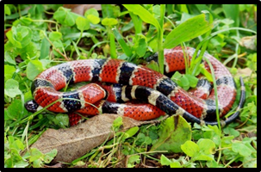
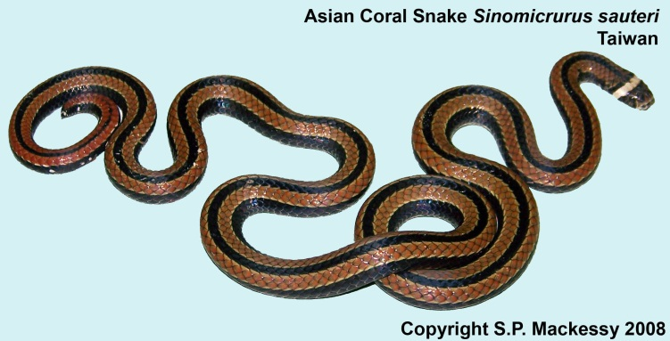
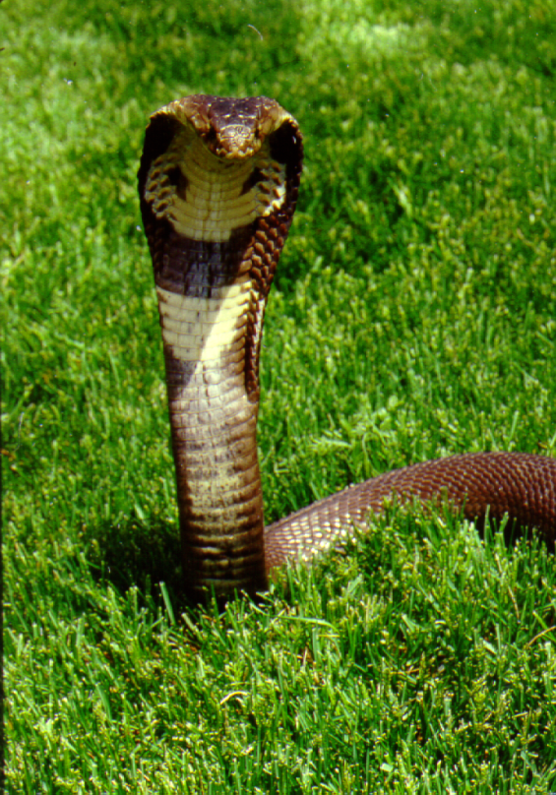
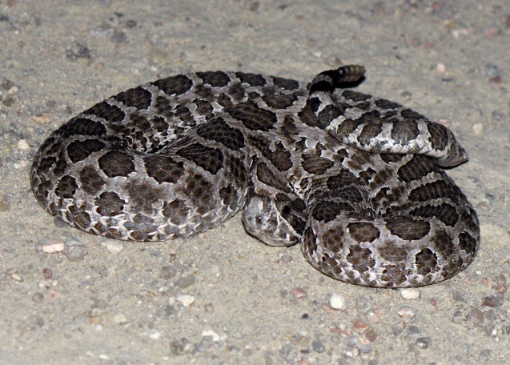
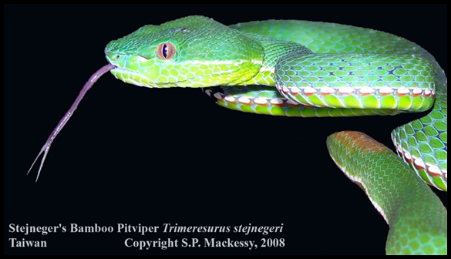
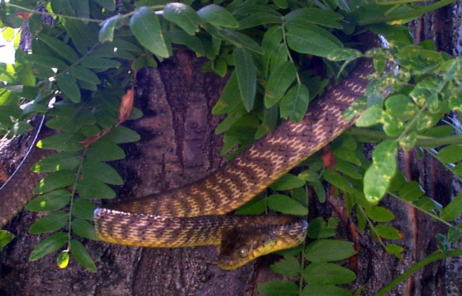
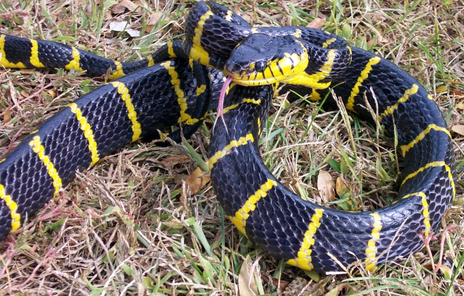
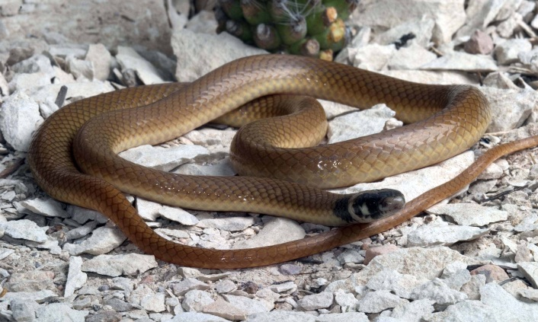
Venomous snakes

Slide 5
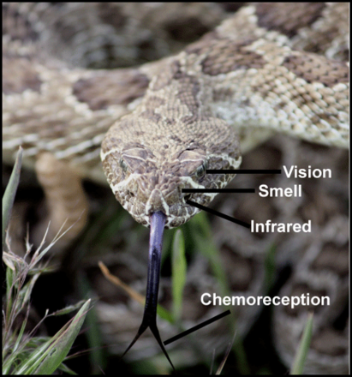
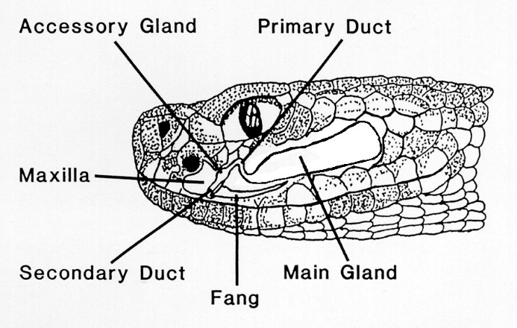
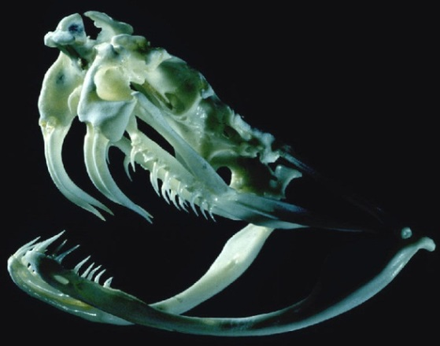
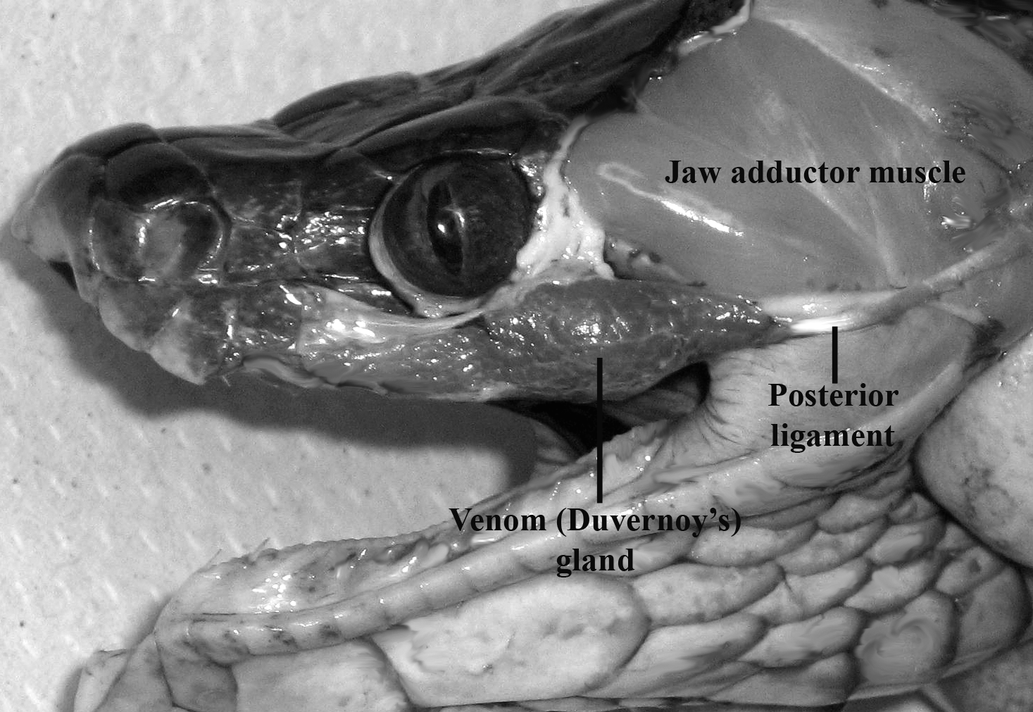
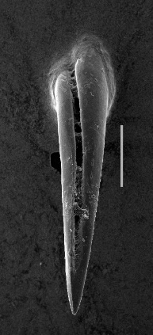
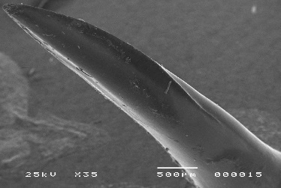
Venom delivery systems
Front-fanged snake (Crotalus) - high pressure system
Rear-fanged snake ("Colubridae") – low pressure system

Slide 6
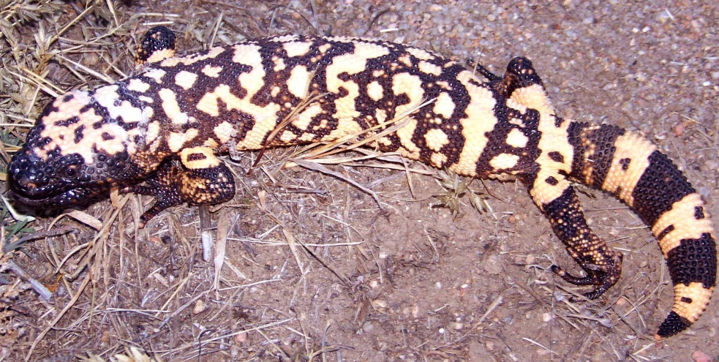
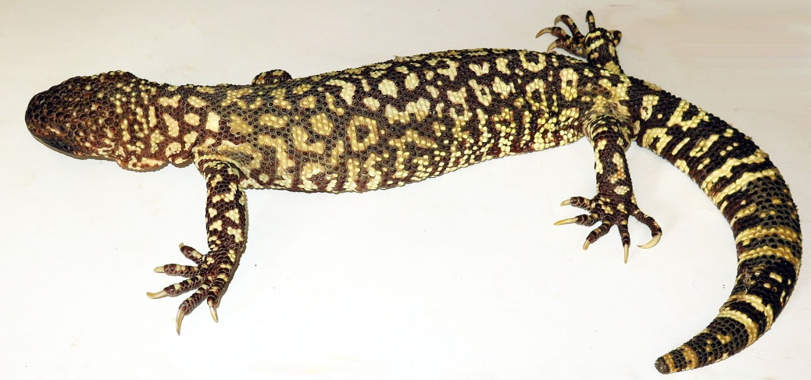
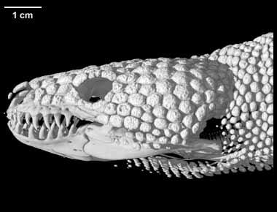
Venomous Lizards - Helodermatidae
Heloderma suspectum – Gila Monster
Heloderma horridum – Beaded Lizard
(digimorph.com)

Slide 7
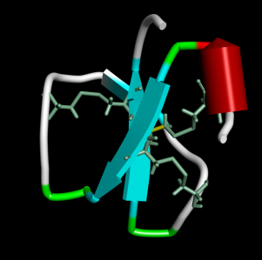
Composition of snake venoms
Proteins/peptides >90% of venom mass
~12-15 protein families in a typical venom (front-fanged snake)
highly conserved structure, stable molecular scaffold
However - within a protein family - many different homologs, often with different pharmacologies
mutation of specific non-structural residues →
different ligand-binding properties
exceptionally potent biological activities

Slide 8
Protein families (~24-32) in snake venoms: limited number, multiple isoforms
Three-finger toxins • Cysteine-rich secretory proteins
Phospholipases A₂ • Myotoxin a/crotamine
Metalloproteinases • C-type lectins
Serine proteinases • Disintegrins
Exendins • Snake venom growth factors – VEGF, NGF
L-amino acid oxidase • Vespryn/ohanin
Serine proteinase inhibitors • Waprin/Kunitz BPTI
Hyaluronidase • Waglerin
Dipeptidyl peptidase • Sarafotoxins
Acetylcholinesterase • Prokineticin/AVIT proteins
Exonuclease/PDE • Bradykinin potentiating peptide
5'-nuclotidase and natriuretic peptide
Underlined = often most abundant proteins in venoms

Slide 9
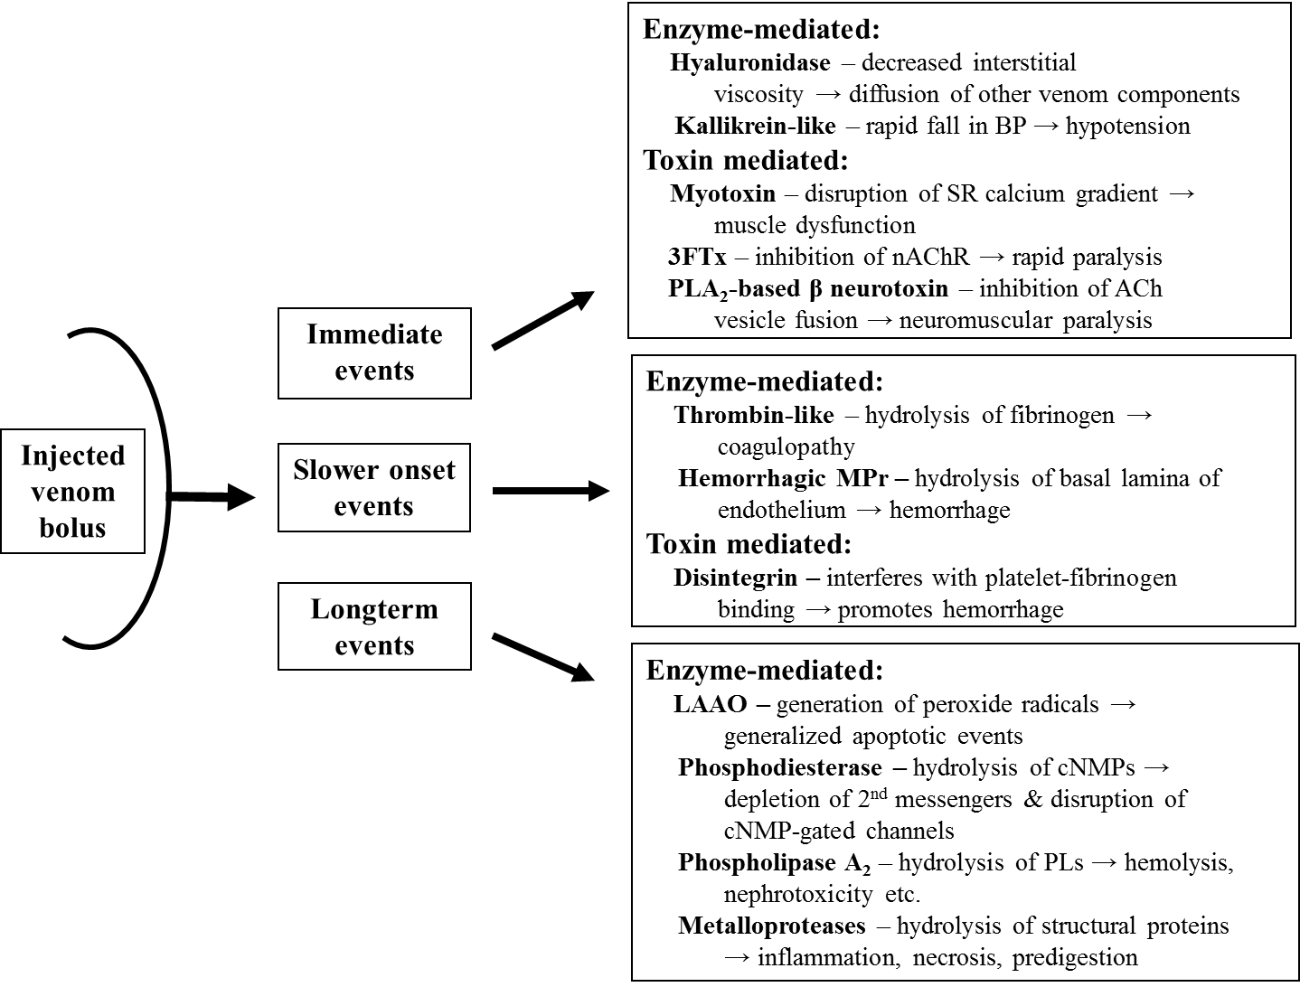
Envenomation events: hypothetical
Mackessy, 2008

Slide 10
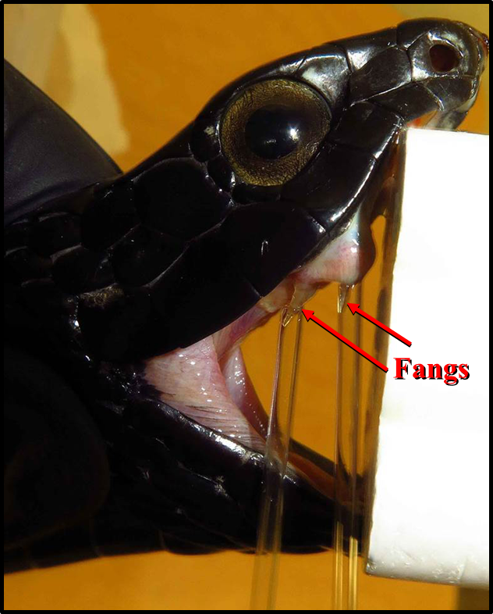
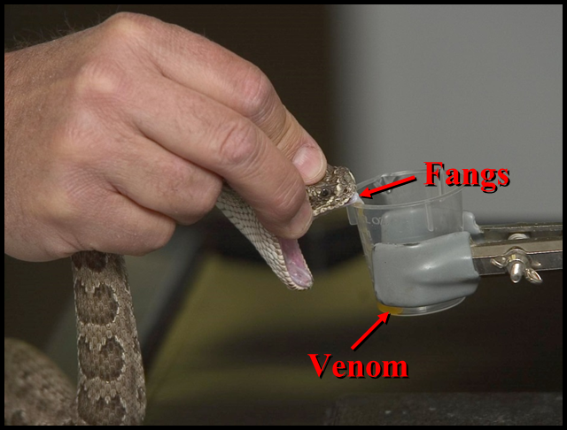
Venom extraction
Rattlesnakes –
front fanged
Colubrid snakes –
rear fanged

Slide 11
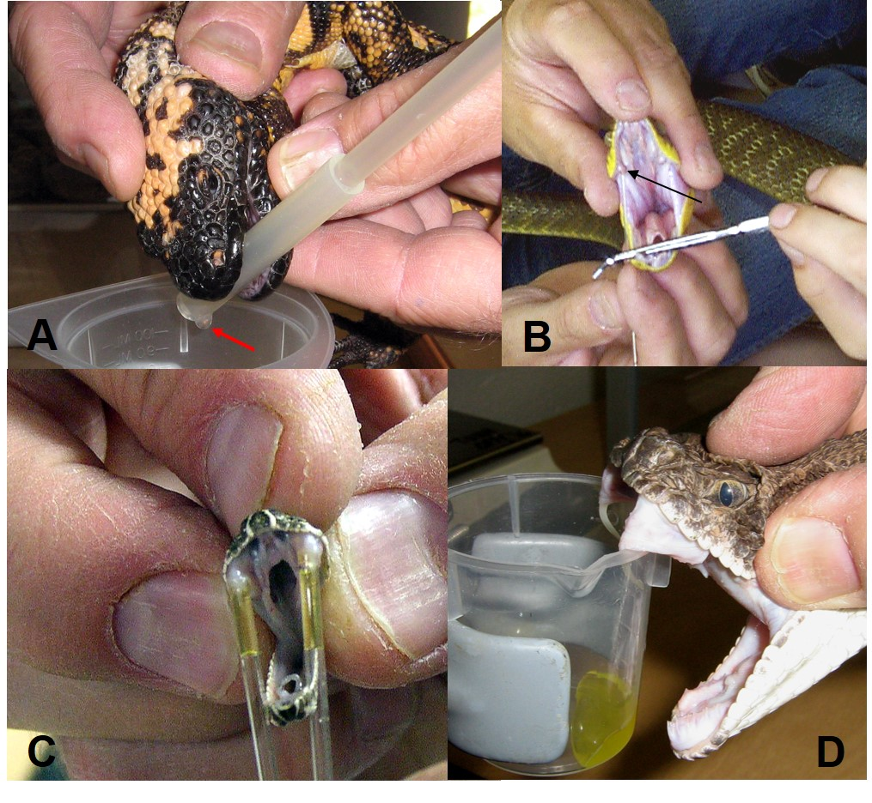
Venom extraction
Most vipers – large venom yields

Slide 12
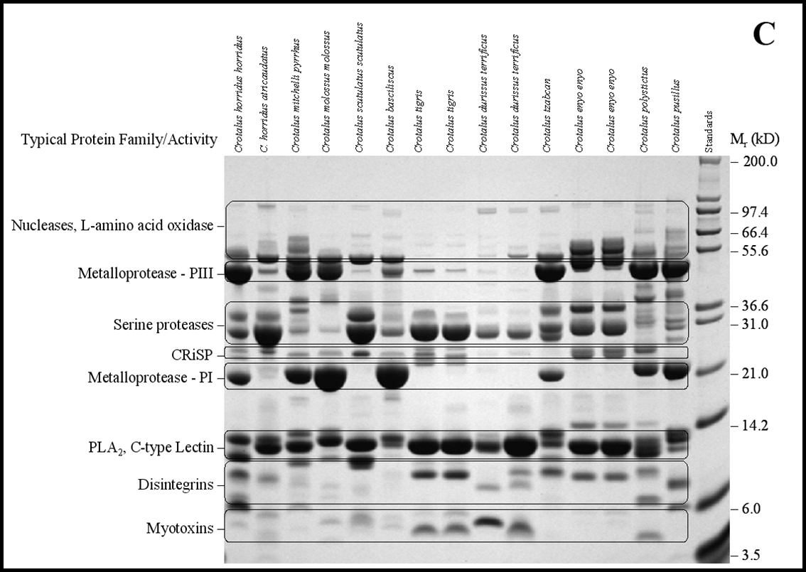
“Fingerprinting” rattlesnake venoms –
1D SDS-PAGE
Mackessy, 2010

Slide 13
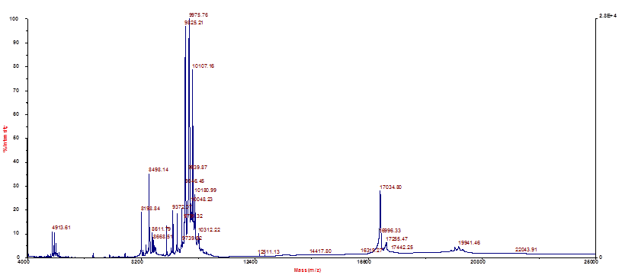
MALDI-TOF mass spectrometry –
crude venom (~0.5 μg)
3FTxs
Dimeric 3FTx –
irditoxin
Brown Treesnake - Boiga irregularis

Slide 14
Venomic studies
Venomics = venom proteome
Small amounts of material (venom) are required
  RP-HPLC → real-time ESI-MS – intact mass
  ↓ -OR- whole venom trypsinization
  SDS-PAGE + band trypsinization → peptide mass fingerprinting/de novo seq.
Potential to catalog entire proteome of a species
Facilitates move to high throughput approach
  individual and population level variation
Deep comparisons of venom composition differences between species are possible
  Calvete et al., 2007. J. Mass Spectrometry 42:1405. Snake venomics. Strategy and applications

Slide 15
Antivenomic studies
Antivenomics – utilizes antivenom bound to affinity columns
  First approximation for estimating efficacy of antivenom
  In vitro – avoids use of animals
  Calvete et al., 2009. FEBS Lett. 583:1736. Venoms, venomics, antivenomics.
Whole venom
Antivenomics – Crotalus v. viridis venom
on RP-HPLC
Saviola et al., 2015. J. Proteomics 121:28.
Bound - captured
Flow through – not captured

Slide 16
Transcriptomic studies
Potential to reveal ALL possible venom toxins
  Amplify and sequence “all” mRNA transcripts in gland
Coupled with next-gen sequencing methods, can rapidly obtain a “complete” catalog of toxins present
Favors high throughput approaches
  complete cDNA/amino acid sequences obtained
  individual variation
  population level variation
  phylogenetic patterns of venom evolution
Much deeper comparisons of venom composition between species are possible

Slide 17
Venom delivery systems
Front-fanged snake (Crotalus) - high pressure system
Rear-fanged snake ("Colubridae") – low pressure system

Slide 18
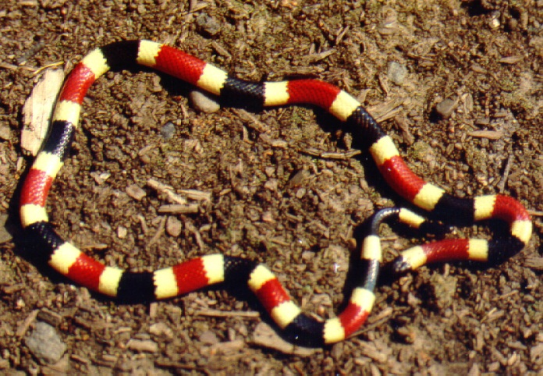

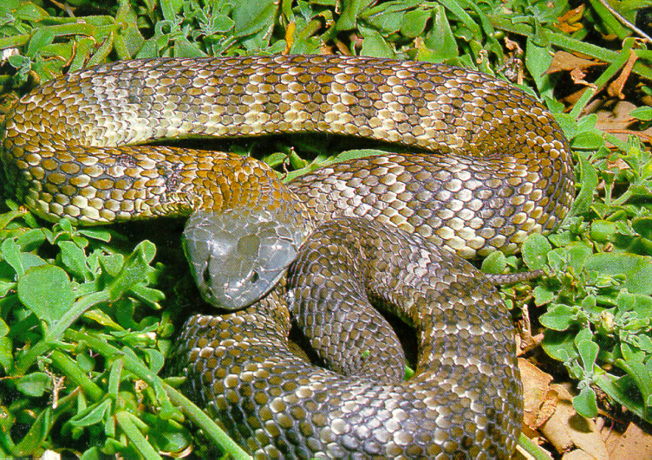
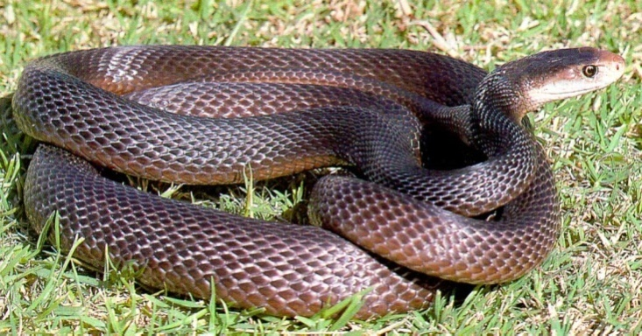
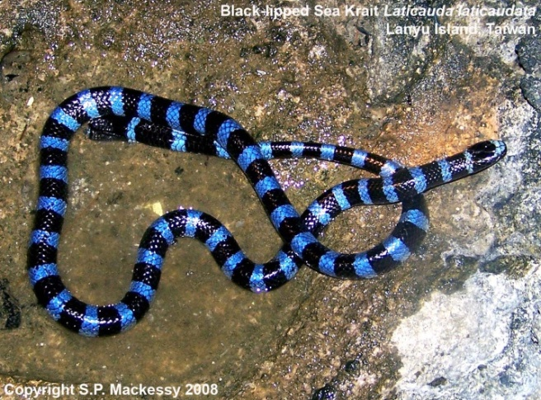
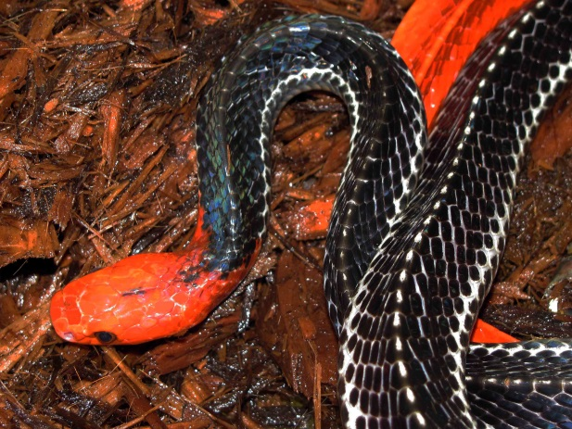
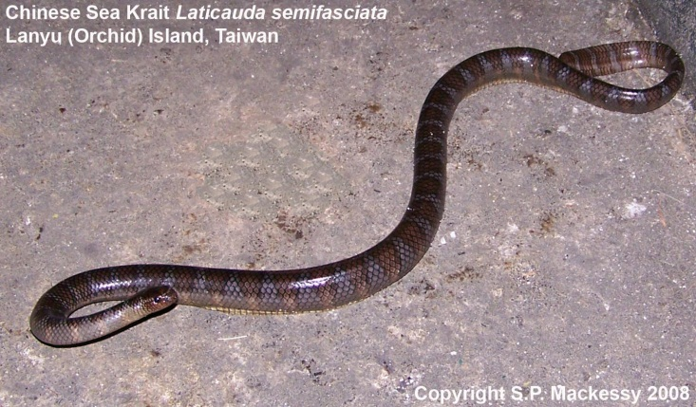
Front-fanged snakes - Elapids

Slide 19



Relative abundance of toxins:
Family Elapidae
PLA₂
PLA₂
Other
3FTx
Micrurus clarki - P
Lomonte et al., Toxins 2016, 8, doi:10.3390/
Micrurus fulvius - T
Margres et al. BMC Genomics 2013, 14:531
Micrurus altirostris - P
Correa-Netto et al., J. Proteomics 2011, 74:1795
PLA₂
PLA₂
PLA₂
CRiSP
Bungaro-
toxins
SVMP
Pelamis platura - P
Lomonte et al. J. Proteomics 2014, 103:137
Bungarus flaviceps - T
Siang et al. BMC Molecular Biology 2010, 11:24
Calliophis birvirgata - P
Tan et al., J. Proteomics 2016, 132:1

Slide 20
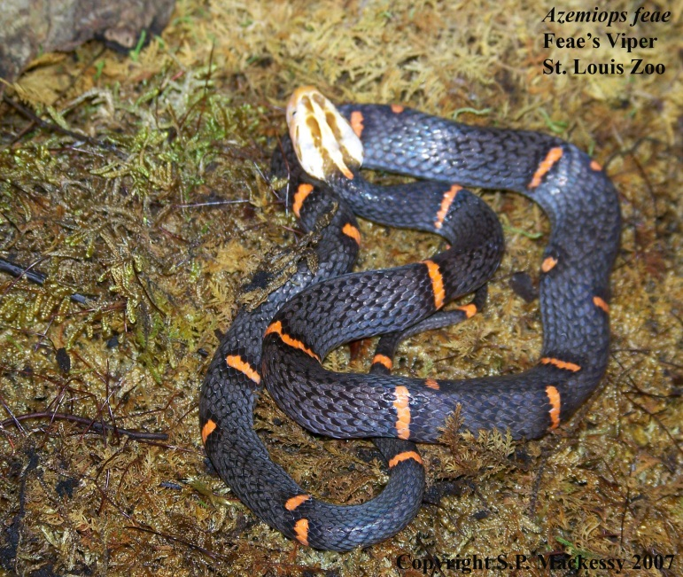
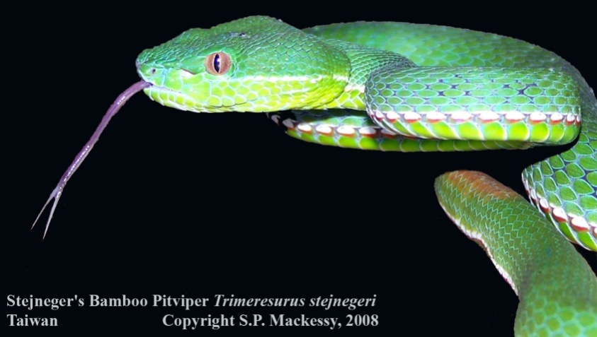
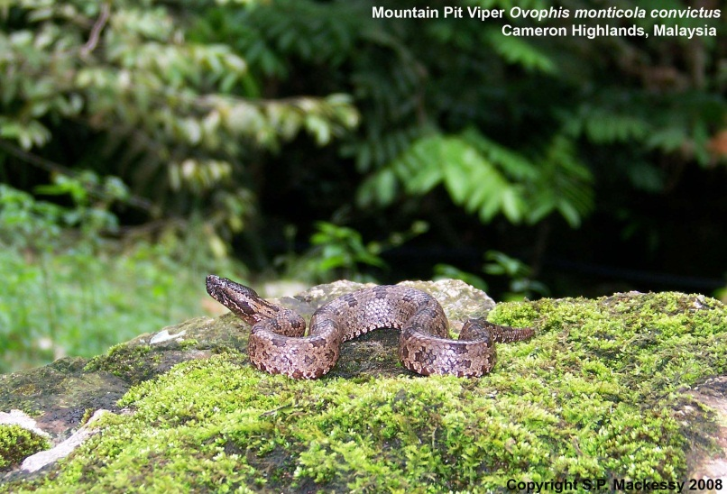
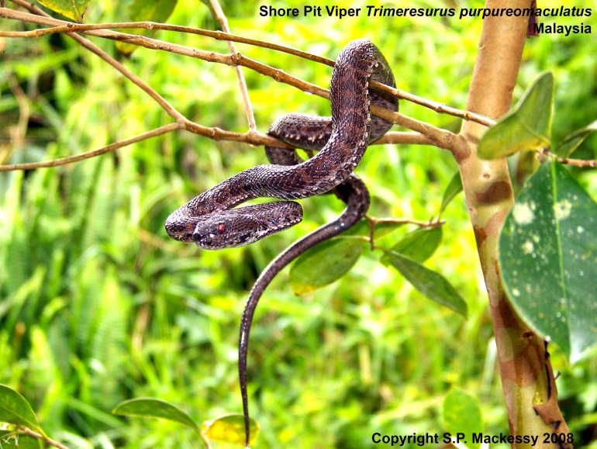
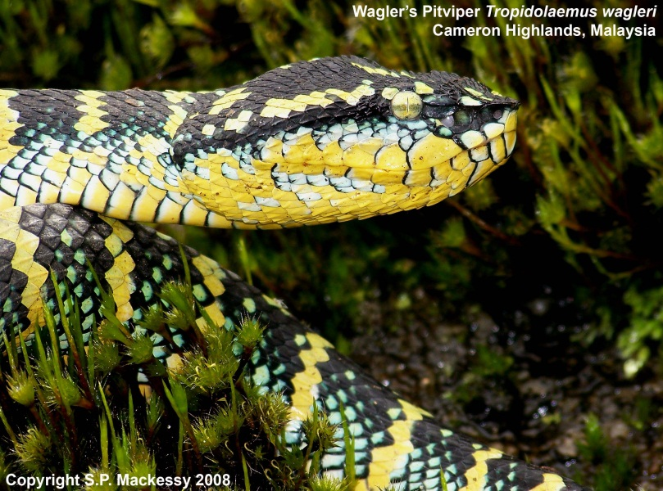
Front-fanged snakes - Vipers

Slide 21
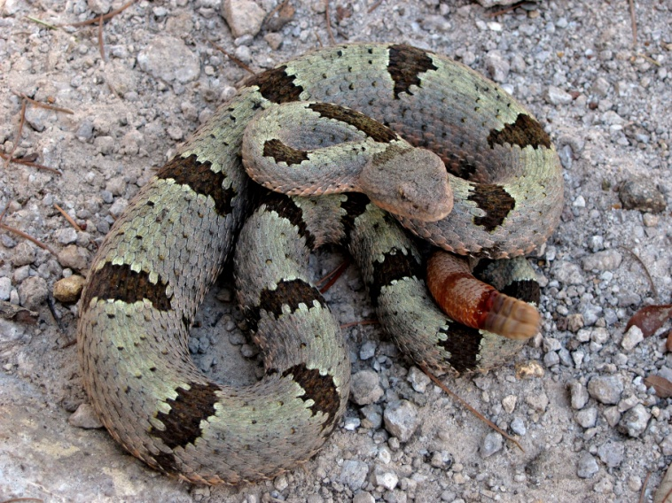
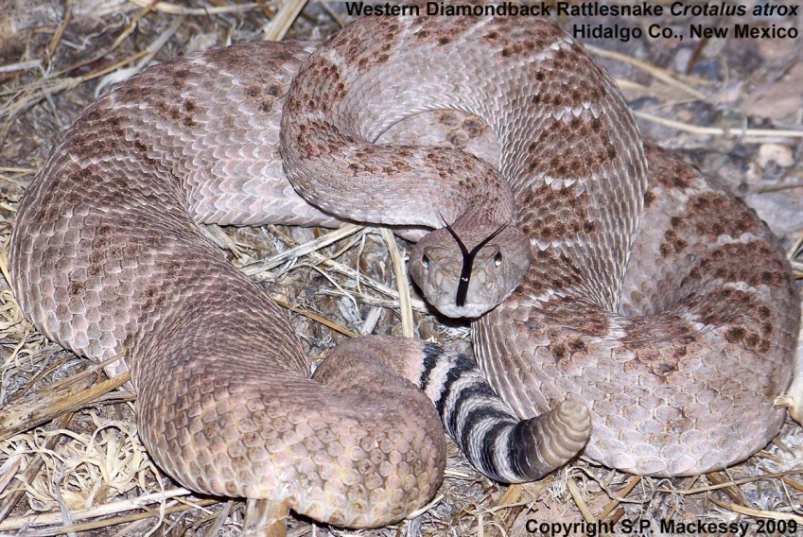
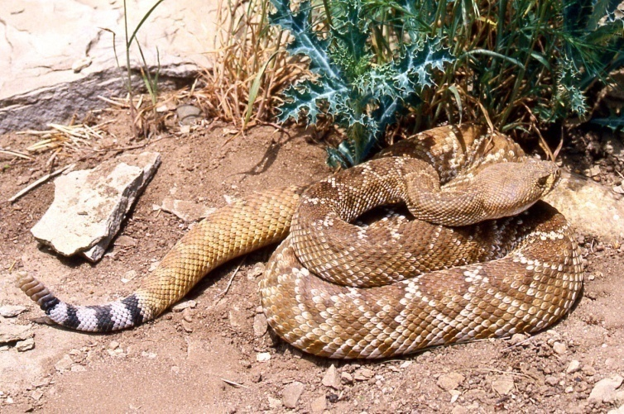
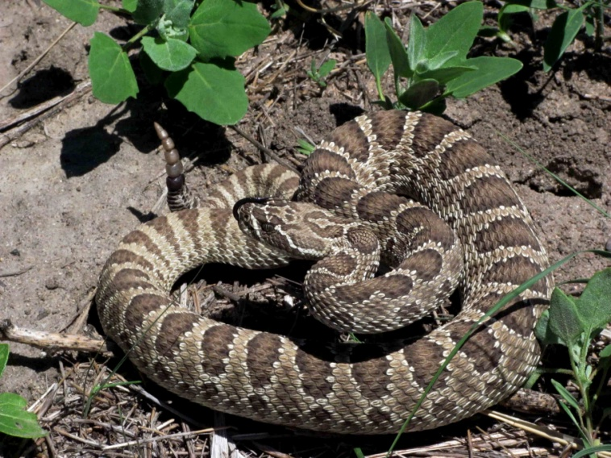
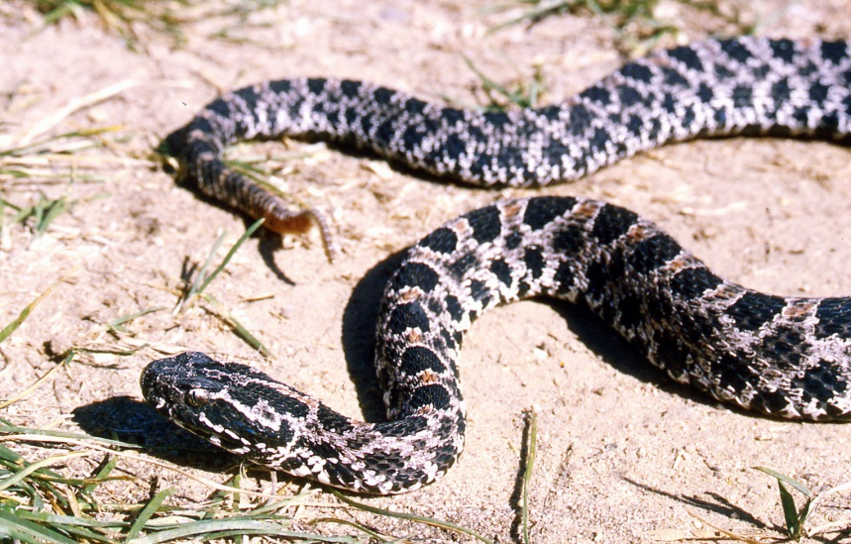
Front-fanged snakes - Rattlesnakes

Slide 22
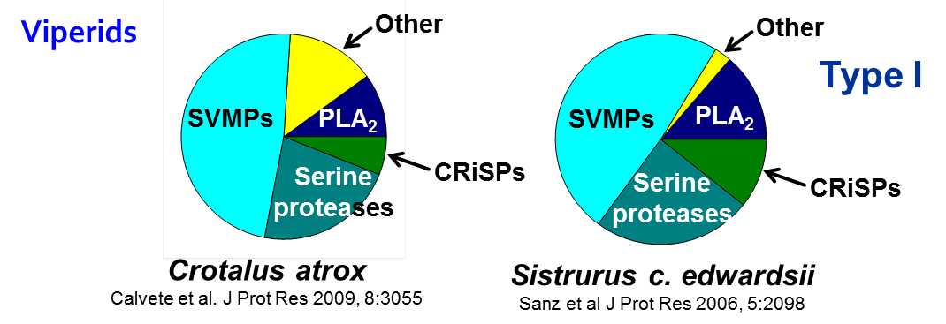
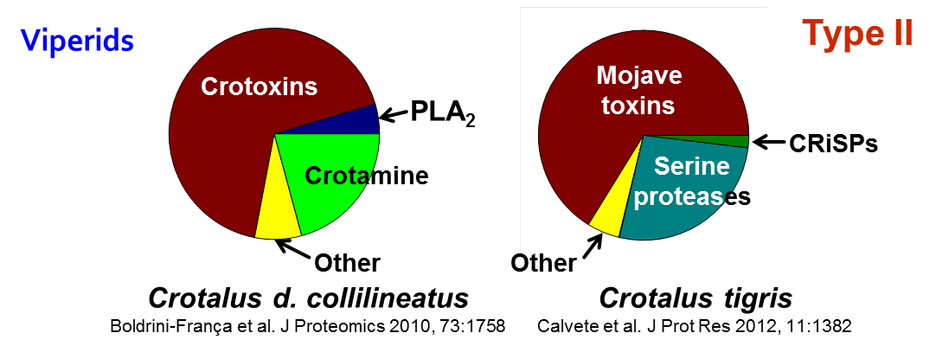

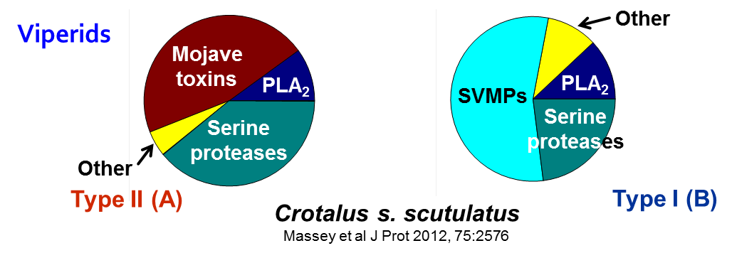
Comparative venomics within rattlesnakes:
A few toxin families dominate most venoms
Type I
Other
Myo
a
PLA₂
Myo
a
PLA₂
Serine
protease
CRiSP
Serine
protease
SVMP
SVMP
Crotalus adamanteus
Margres et al.,J. Proteomics 2014,96: 145
Crotalus viridis viridis – Colo.
Saviola et al.,J. Proteomics 2015, 121:28
Type II
Crotoxins
Serine
Proteases
Other
Crotalus d. terrificus
Melani et al.,J. EuPa Op Proteo.2015, 8:144
Modahl et al., 2015 Venom Genomics and Proteomics

Slide 23

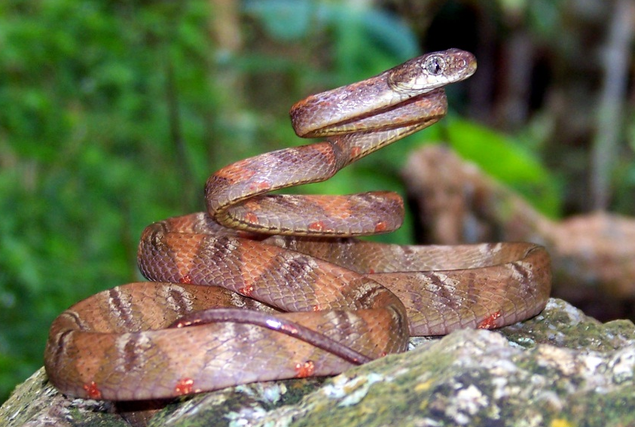
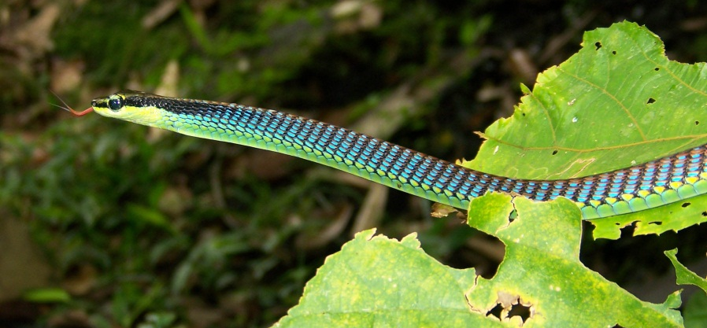
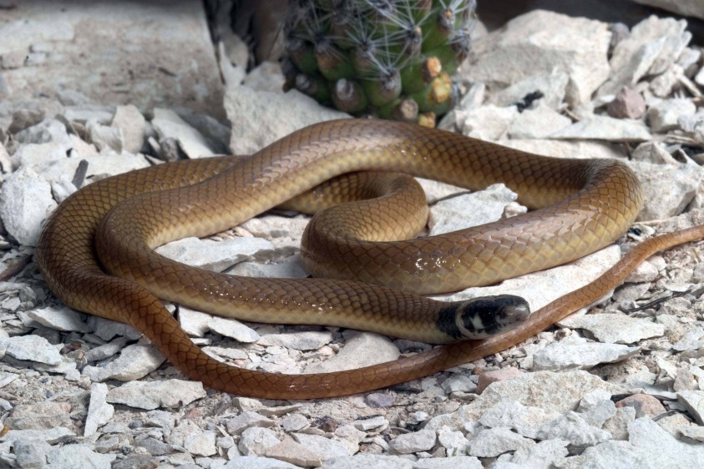
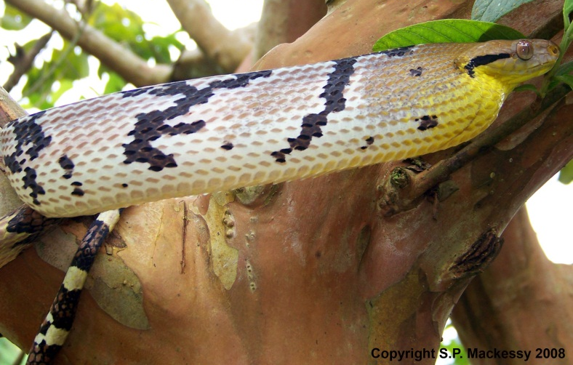
Rear-fanged snakes - “Colubrid” Snakes

Slide 24
Relative abundance of toxins:
“Colubrid” snakes
SVMP
3FTx
PLA₂
CTL
SVMP
III
CRiSP
SVMP
III
Dispholidus typus
Pla et al.,BBA 2017, 1861:814
Hypsiglena sp. torquata
McGivern et al, BMC Genomics 2014, 15:1061
Borikenophis portoricensis
Modahl et al., J Proteomics 2018, in press
3FTx
3FTx
SVMP
III
3FTx
CRiSP
CRiSP
CRiSP
SVMP
Boiga irregularis
Pla et al.,J Proteomics 2018, 174:71
Spilotes sulfureus
Modahl et al., Proceedings B 2018, in press
Ahaetulla nasuta
Modahl et al., J Proteomics 2018, in press

Slide 25
Targeted systems: peripheral nervous system
Block ACh release
Rattlesnake & viper NTxs
Block ACh receptor
Elapid NTxs
Ranawaka et al., 2013 PLoS NTD 7:e2302

Slide 26
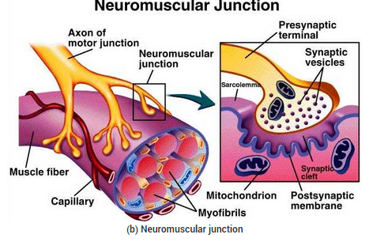

Targeted systems: muscular system
Muscle structure – PLA₂ myotoxins
Vipers, some elapids
Calcium pumps, sarcoplasmic reticulum
myotoxin a, crotamine
Primarily some rattlesnakes

Slide 27

Targeted systems: vasculature & coagulation cascade system
Structural damage – SVMPs
Vipers, some elapids
Hemolysis – PLA₂s
Most species
Bradykinin liberation - kalSVSPs
Many vipers, few elapids
Platelets – promote/inhibit aggregation
- disintegrins, CTLs, etc.
∅
Hypofibrinogenemia - thrSVSPs
Vipers, some elapids
Factor X activators – SVMPs, SVSPs
Some elapids, boomslang

Slide 28



Venom Toxins

Slide 29


Venom protein family 1: three-finger toxins
Gene evolution and diversification
Taxon-specific toxicity
Therapeutic challenge

Slide 30

3FTx: highly conserved scaffold, diverse pharmacologies
Moderate-sized peptides - 6.5-8.2 kD, 60-78 aas
Highly conserved cysteines/disulfides
  4 or 5 define the 3 finger fold
  non-structural residues highly variable
Occur broadly among snake venoms
Diverse biological activities:
  curaremimetic toxins - (α-neurotoxins) – nAChR inhibitor
  → flaccid paralysis of skeletal muscle – post-synaptic
  cardiotoxins • platelet aggregation inhibitors
  AChE inhibitors • L-type calcium channel blockers
  mAChR inhibitors • nAChR modulators
  receptivity pheromone • limb regeneration modulator
III
I
II
  see Doley and Kini, 2010 review

Slide 31




3FTx: conserved molecular fold
Mammalian Toxicity
Cobrotoxin – 0.1 µg/g
Irditoxin ~ non-toxic
Denmotoxin ~ non-toxic
Brown Treesnake
Mangrove Snake
III
I
Monacled Cobra
II
Cobratoxin – red; Irditoxin A – multi; Denmotoxin - blue

Slide 32
3FTx diversification: interaction of mechanisms
Gene duplication → raw material
  duplicate gene – rapid evolution
ASSET¹ – “gross level changes” in surface residues – results in altered targeting – neofunctionalization
Point mutations – “fine tune” ligand-receptor binding interactions
Appears to occur in several major protein families of toxins – affects surface residues
¹ ASSET = Accelerated segment switching in exons to alter targeting
Doley et al., 2008, 2009 BMC Evol. Biol.

Slide 33
Therapeutic challenge of 3FTxs
α-neurotoxins – bind exceptionally tightly to receptor
  often bind nAChR of skeletal muscle
  binding affinities in the (sub)nanomolar range – i.e., + permanently
Small molecules (~6-8 kDa) – diffuse/transported rapidly
Often at high concentrations in venoms
  α-cobratoxin – 15-20% of total venom proteome of Naja naja and N. kaouthia
Untreated – often fatal due to respiratory failure
  phrenic nerve/diaphragm AChR

Slide 34



Venom protein family 2: PLA₂s
Monomeric enzymes → multimeric lethal toxins
Gene evolution and diversification
Found in most venoms (rare in colubrids)
Huang & Mackessy, 2004 Toxicon

Slide 35
PLA₂: enzymatic activity
Phospholipid
Lysophospholipid
Fatty acid
Enzymes often show preference for specific PLs
  common FA released – arachidonic acid
Often cytotoxic/hemolytic – low lethal toxicity

Slide 36


PLA₂: lethal activity
Typically heterodimeric/multimeric toxins
Enzyme activity low/none
  lethal toxicity – high
Interferes with Ca²⁺-dependent vesicle fusion/ACh release – pre-synaptic effect
  → flaccid paralysis

Slide 37
US rattlesnake species producing crotoxin homologs
Crotalus scutulatus – Mohave Rattlesnake – most important
  Common, aggressive, rel. large size
  Large venom capacity – up to ~40% Mojave toxin
  (Massey et al., 2012 – J. Proteomics)
  Occur from so. Calif. → w. Texas, much of México
Other species
  C. tigris, C. o. concolor, C. o. helleri (few), C. horridus (some), C. lepidus (some)

Slide 38
Potent toxic effects possible
Crotalus scutulatus – expect signs of neurotoxicity, fasciculations; minimal local necrosis, ecchymosis
  Uncommonly – type I/B venom – parts of S-Cent. AZ
  Lack Mojave toxin – SVMPs, myotoxins high – very different presentation – sim. to C. atrox
C. tigris & C. o. concolor bites uncommon – similar neurotoxic presentation

Slide 39

Venom protein family 3: serine proteinases
Family S1 enzymes - related to trypsin
  conserved disulfides, catalytic triad
Gene diversification via duplication & ASSET
Diverse activities and effects → coagulopathies
  thrombin-like and kallikrein-like, prothrombin activator, plasmin-like activity
    → hypofibrinogenemia, bradykinin release, angiotensin hydrolysis, etc.
  often abundant in venoms – Sistrurus catenatus edwardsii – 10-12 homologs/isoforms
Mackessy, 2010 Toxins & Hemostasis

Slide 40


Serine proteinases: structure/activity
Substrate
binding site
Common motif – conserved structural and catalytic residues, others highly variable
Functional significance – novel substrate binding → new pharmacologies
Doley et al., 2009 BMC Evol. Biol.
Mackessy, 2010 Toxins & Hemostasis

Slide 41
Serine proteinases – envenomation effects
Kallikrein-like SPs may produce transient/extended hypotension & shock – liberate bradykinin AND hydrolyze angiotensins
  common in most NA pitviper venoms
Thrombin-like SPs – result in rapid depletion of fibrinogen
  normal FpA released, but FpB is not – a large cleavage product instead → microclots produced
  association with occasional recurrent coagulopathy?
  also common in pitviper venoms
“Other” SPs – poorly defined

Slide 42

Fibrinogen
1st antivenom
↓
Last antivenom
↓
Prothrombin time
Activated partial thromboplastin time
Coagulopathy associated with
Midget Faded Rattlesnake bite

Slide 43

Venom protein family 4: metalloproteinases
Broadly distributed in “all” venoms
  often dominant components of viperid and colubrid venoms
Functionally important, abundant toxins
  biological → structural protein degradation, hemorrhage
  envenomation → ecchymosis, necrosis, inflammation, coagulopathies – often do not respond well to antivenom therapy
Inverse relationship
between toxicity and
metalloproteinase activity
of crude rattlesnake venoms
Type I
Type II
Mackessy, 2008 Trends Rattlesnake Venoms

Slide 44
Type I vs type II rattlesnake venoms –
“tenderizer vs toxicity”
Type I
Other
Myo
a
PLA₂
Myo
a
PLA₂
Serine
protease
CRiSP
Serine
protease
SVMP
SVMP
Crotalus adamanteus
Margres et al.,J. Proteomics 2014,96: 145
Crotalus viridis viridis – Colo.
Saviola et al.,J. Proteomics 2015, 121:28
Type II
Crotoxins
Serine
Proteases
Other
Crotalus d. terrificus
Melani et al.,J. EuPa Op Proteo.2015, 8:144
Modahl et al., 2015 Venom Genomics and Proteomics

Slide 45


Metalloproteinase: PIII hemorrhagic
SVMP – Brown Treesnake (Boiga irregularis)
  has typical 3 domain structure: MPr, disintegrin, cys-rich
Yellow residues = conserved
HExxHxxGxxH zinc-binding motif
Sequence similarities -
broadly follow phylogeny

Slide 46





Metalloproteinase: PIII hemorrhagic
Colubrid MPr – Puerto Rican Racer
(Alsophis portoricensis)
A metalloproteinase
An α-fibrinogenase
Oxidized B chain insulin
mouse skin lung muscle
Hemorrhagic activity
Weldon & Mackessy, 2010 Toxicon, 2012 Biochimie

Slide 47
Rattlesnake metalloproteinases
Commonly three classes: PI, PII & PIII
  metalloproteinase, disintegrin and cysteine-rich domains
  may have differential toxicity/substrate preferences for basal lamina and ECM proteins
Abundant components of type I venoms – nearly lacking from type II (highly toxic) venoms
Responsible for “time is tissue” adage – can produce severe necrosis, ecchymosis, hemorrhage, etc.
Often challenging to control symptoms unless AV is administered early

Slide 48


Venom protein family 5: small basic toxins – myotoxin a and homologs
Myotoxin a – Prairie Rattlesnake venom – 42 amino acids,
mass ~4820 Da
In some populations of C. v. viridis – accounts for 37% of venom protein
Saviola et al, 2015 J. Proteomics

Slide 49
Myotoxin a – a mammal-specific toxin
Toxicity toward inbred mouse – LD₅₀ ~ 2.0 µg/g
  effect on prey – limb hyperextension, “immediate” paralysis
  “low” lethal potency but high abundance toxin
Toxicity toward lizard (Sceloporus, Hemidactylus) - LD₅₀ >>25 µg/g
  no toxic effects observed
Like other toxins, amount/presence is regionally variable and varies with species
Mackessy & Saviola, 2016 Int Comp Bio

Slide 50
Summary
Diverse protein families in reptile venoms
include enzymes and specific ligand-binding toxins
  common motif – conserved molecular fold, highly variable activities
  biological roles – varied – evolved primarily to facilitate prey handling
  Human envenomations – complex, evolving medical crisis
Mechanisms of actions
  co-opted regulatory molecules – introduced at vastly increased concentrations and inappropriate times
  actions via structural damage, elimination of key regulatory components, release of bioactive products or blockage of ion channels/receptors

Slide 51
Conclusions
Snake venoms
  fascinating potent biomolecules with a myriad of activities
  models for many different areas in basic research
  Human envenomations – need for better integration of basic and clinical research → improved treatment efficacy
Toxins as drugs – several in use or in clinical trials
  wealth of opportunities for applied and basic research
  disintegrins – biological role and dominant pharmacology VERY different
Snakes as model organisms - many areas of biology

Slide 52

Acknowledgements: Support
Colorado Bioscience grant (COEDIT) USGS-BRD
NIH-NIGMS
UNC-OSP
NSF-DEB

Slide 53




Acknowledgements: Colleagues
E.M. Peichoto R.M. Kini J. Pawlak R. Doley
Univ. Nacional Argent. NU Singapore Scripps Inst. Tezpur Univ.

Slide 54













Acknowledgements: Students

Slide 55

Thanks for
your attention

Slide 56

Questions?

