Slide 1

Performance Management At UNC
Classified and Exempt Staff
Human Resources
2018

Slide 2

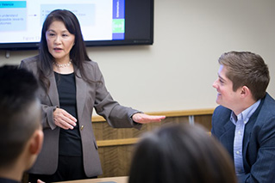
Performance Plan
What is a Performance Plan?
Outlines duties
Aligns goals
Facilitates conversation
Documentation

Slide 3

Goal Planning
A goal without a plan is just a wish.
-Red Hat JBOSS
What is Goal Planning?
It is important to:
  The university
  The department
  The individual

Slide 4

Gathering
Employee’s documentation
Notes from meeting
Information from others
Keep track of the negatives and positives

Slide 5

Planning
Plan the meeting
Manage the meeting
Prepare for the meeting

Slide 6

Dates to Remember
April 30th – Goal Planning Due
October – Mid year review
March 31- Evaluations due

Slide 7
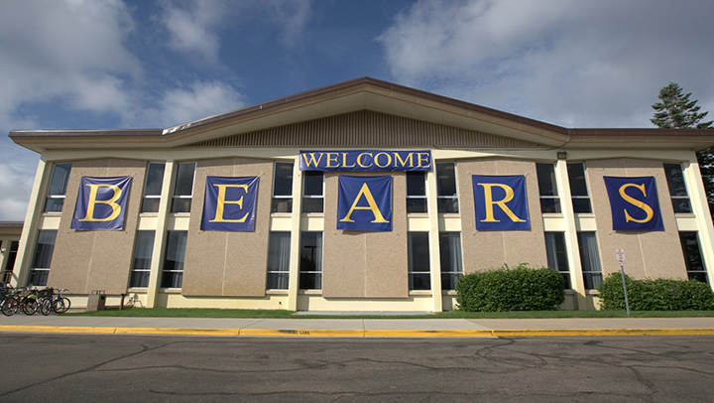
THANK YOU!
Human Resources
2018

