Slide 1
New Employee Orientation
“How To” for Supervisors
2018

Slide 2

Training Objectives
Recognize the benefits and goals of new employee orientation
Assume a leadership role in the process
Determine the topics to be covered
Plan and execute successful orientations

Slide 3
Benefits of Orientation
Welcome new employee
Provides essential information
Helps you get to know the employee and assess training needs
Create a Positive 1st Impression
Reduce turnover

Slide 4
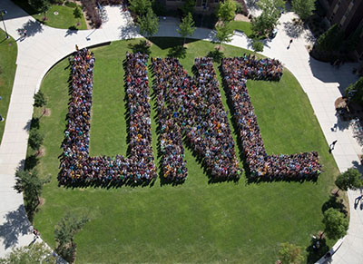
Key Information
UNC information
Dept. information
Benefits information
Job information

Slide 5

Your Leadership Role
Have an orientation plan
Coordinate with Human Resources
Oversee orientation process
Evaluate progress of new employee

Slide 6

Orientation Background

Slide 7

Before the First Day
Background check
PDID form
HRS confirmation of hire
Welcome letter
1 day parking pass
Complete Prior to First day checklist

Slide 8

Before the First Day (cont.)
Make staff aware of new employee
Designate a workstation
Plan and schedule orientation activities
Gather necessary information and paperwork
Select an assistant

Slide 9

The First Day
Welcome the new employee
Introduce employee to co-workers and workplace
Complete paperwork
Have employee attend HR orientation session

Slide 10

After the First Day
Continue going through Department checklist.

Slide 11

Week 2 – Week 4
Review first week
Answer questions or concerns
Make sure benefits have been set up
Complete Department Orientation checklist and send to HR
Discuss goals for review period

Slide 12
Planning and Execution
Questions?

Slide 13

What Does HR Cover?
Online training requirements
Safety and Security
Review of Becoming a Bear booklet
Compensation system
How to access pay stubs
Ensure employee has follow up Benefits appointment

Slide 14

Overview of Supervisor Checklist
Attendance
Equipment/Property use
Professionalism
Personal concerns
Job expectations
Department Functions
Training

Slide 15
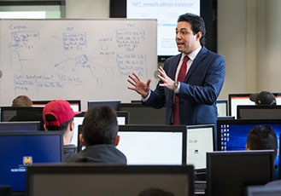
Key Points to Remember
Orientation provides information new employees need to get off to a good start
Orientation has a direct impact on future productivity, performance, and job satisfaction
You play a key role in the success of the orientation process

Slide 16
THANK YOU!

Slide 17
FMLA
“How To” for Supervisors
2018

Slide 18
FMLA Summary
Overview
Unpaid job-protected leave
Classified: 13 weeks of leave/12 month period
Faculty/Professional Admin: 12 weeks of leave/ 12 month period
Employees maintain health benefits while on leave, unless they don’t make payments for their portion of the cost
Eligibility
at least 12 months
Has worked 1,250 hours in the last 12 months
Qualifying Reasons
Birth/adoption of a child
Employee’s serious health condition
Care for a family member with a serious health condition
Qualifying need arising out of the fact that an employee’s family member is a military member on covered active duty

Slide 19
FMLA Process
Employee notifies manager of need to take leave
  Employee or Manager contacts HR to determine eligibility
  Employees submits required paperwork to HR
HR approves or denies request & notifies employee & manager
Employee takes leave
Manager tracks leave time & submits to HR monthly
Before Employee returns, submit Fitness-for-Duty to HR
  Not required when employee is out on leave for a family member’s serious health condition
HR notifies Manager when Employee is authorized to return to work

Slide 20
FMLA Forms
HR Website/Employee Resources/HRS Forms/Benefits, Health/Safety
  FML Request for Employee’s Health Condition (completed by employee & physician 30 days before leave)
  Fitness to Return to Work (submitted to HR before returning to work)

Slide 21
Workers’ Compensation
“How To” for Supervisors
2018

Slide 22
Reporting Injuries
If the injury is life or limb threatening injury, call 911
Contact HR following the injury
  HR will provide current list of designated medical providers
Complete Injury/Illness form and submit to HR
  As soon as possible, but no later than 4 days after the injury
If treatment is required
  HR will work with employee to schedule appointments with DM
  If treated in an urgent care center or ER for first visit, submit paperwork to HR (if this is not done the employee will be billed for the appointment)
  At appointment, employee will receive a Physician’s Report
    Must provide a copy to manager immediately following the appointment
    Form will outline any work restrictions as a result of the injury

Slide 23
Reporting Injuries
Manager should review the Physician’s Report & restrictions with the employee and make any necessary adjustments to his/her work schedule and clarify expectations
If employee is unable to perform regular duties due to injury, some alternative work ideas:
  Safety training videos on Pinnacol site
  MS Classes to improve skills (Word, Excel, PowerPoint)
  SkillSoft Training Library (Communications, Compliance, etc.)

Slide 24
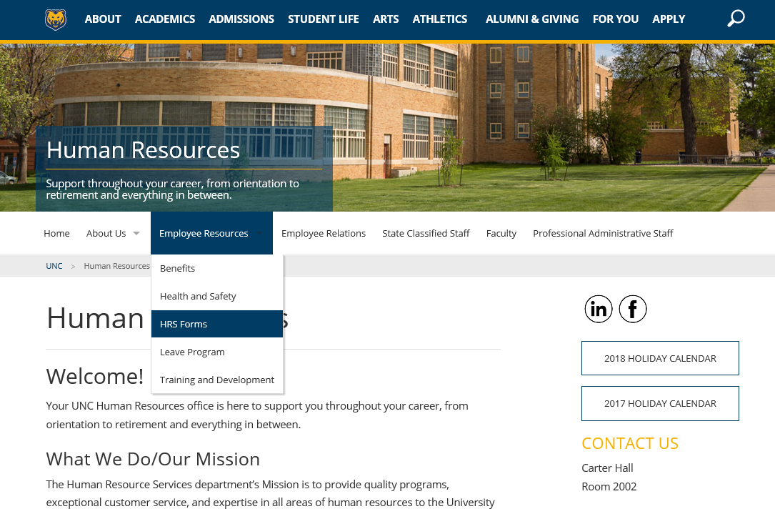
WC Forms
HR Website/ Employee Resources/ HRS Forms/ Benefits,Health/Safety/ Injury Illness Report Form

