Slide 1
The Civil War in the West
Four Corners Community History Project
December 12, 2011
Grand Junction and Montrose, Colorado

Slide 2
US Population (1860)
Total Free Population 27,489,561
Total Slave Population 3,953,760 (12.6%)
Far West: 620,927 (0.2 percent)
Grand Total: 31,443,321

Slide 3
Far West Population (1860)
California: 379,994 ---
Colorado: 34,277 ---
New Mexico: 95,516 ---
Nevada: 6,857 ---
Oregon: 52,465 ---
Utah: 40,244 (29 slaves)
Washington: 11,594 ---
San Francisco ranked 15th in size (56,802);
Only city west of the Mississippi River in the top 100

Slide 4
Colorado Census details (1860)
The total population in this year was 34,277.
Only forty-six of those were black (0.00013%)
1,577 were white females (4.8 percent).
The remaining 32,654 were white males.
Overall, the males outnumbered the females by more than twenty to one.
Denver was the largest city (4,277).

Slide 5
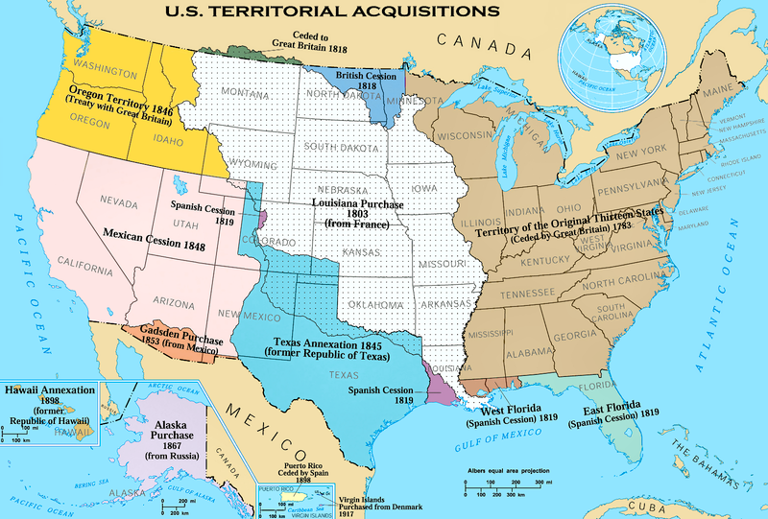
US Territories Map

Slide 6
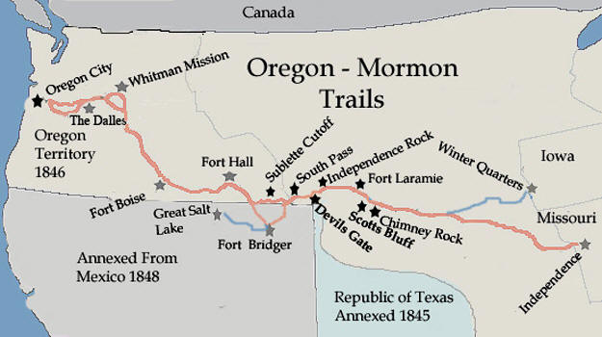
Oregon/Mormon Trails (1840s)

Slide 7
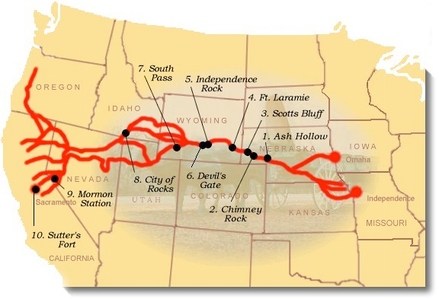
California Trail (1849)

Slide 8
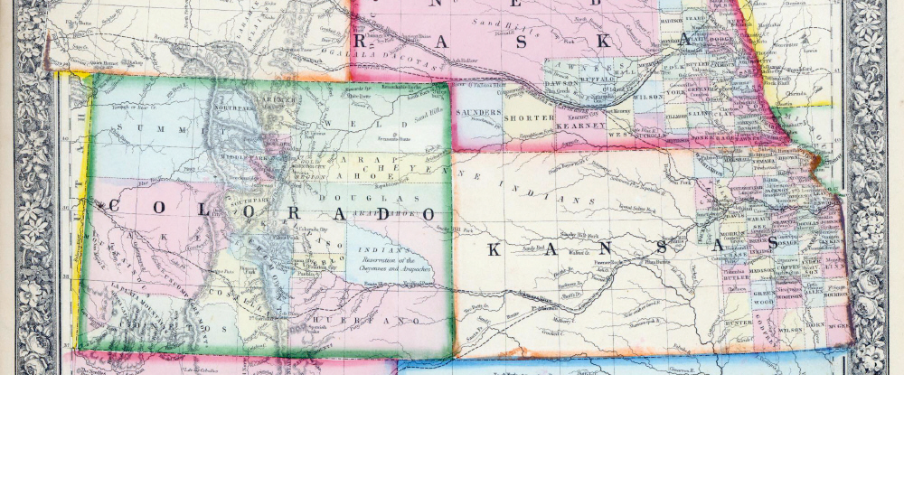
Map of the Interior West (1861)

Slide 9
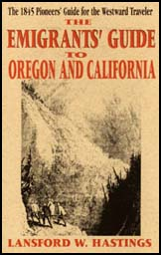
Lansford Hastings, The Emigrants’ Guide to Oregon and California (1845)

Slide 10
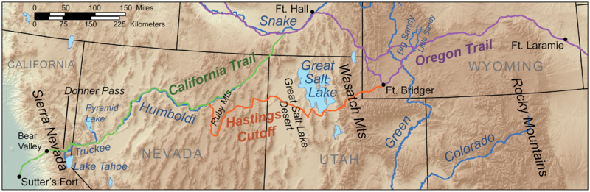
Hastings’ Cutoff Route

Slide 11
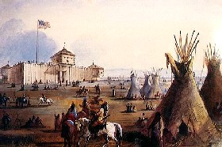
Fort Laramie (Alfred Jacob Miller)

Slide 12
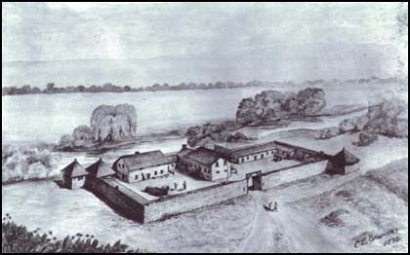
Sutter’s Fort, California (1845)

Slide 13
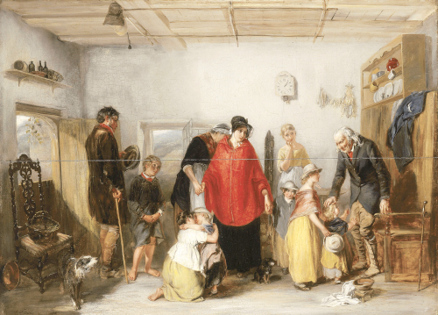
The Emigrants’ Departure, 1838
(Paul Falconer Poole)

Slide 14
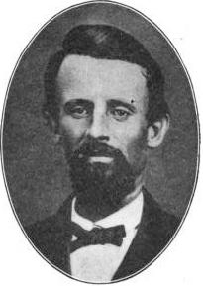
George Donner

Slide 15
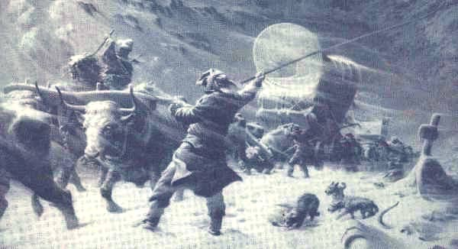
The Donner Party (1846)

Slide 16
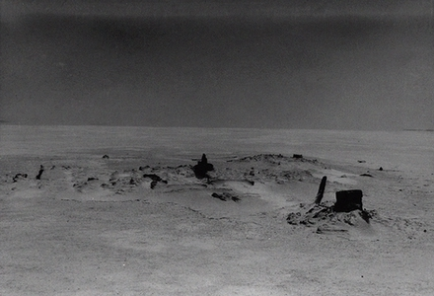
Remains of Donner Party wagons (Great Salt Lake)

Slide 17
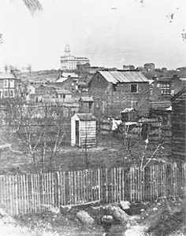
Nauvoo, Illinois

Slide 18
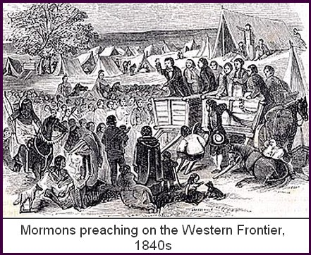
Mormons Preaching on the Western Frontier (1840s)

Slide 19
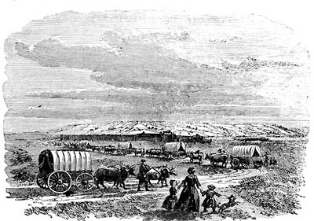
Mormon Wagon Train

Slide 20
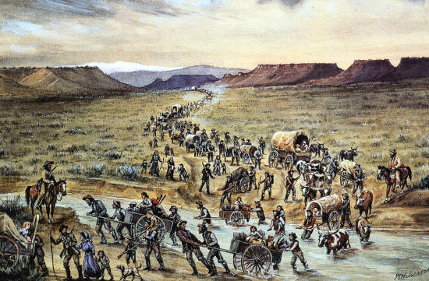
Mormons Crossing River

Slide 21
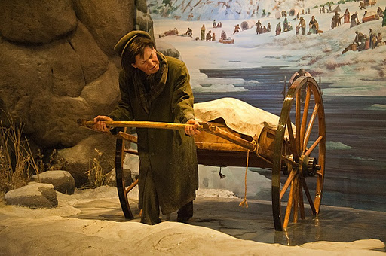
Mormon Handcarts

Slide 22
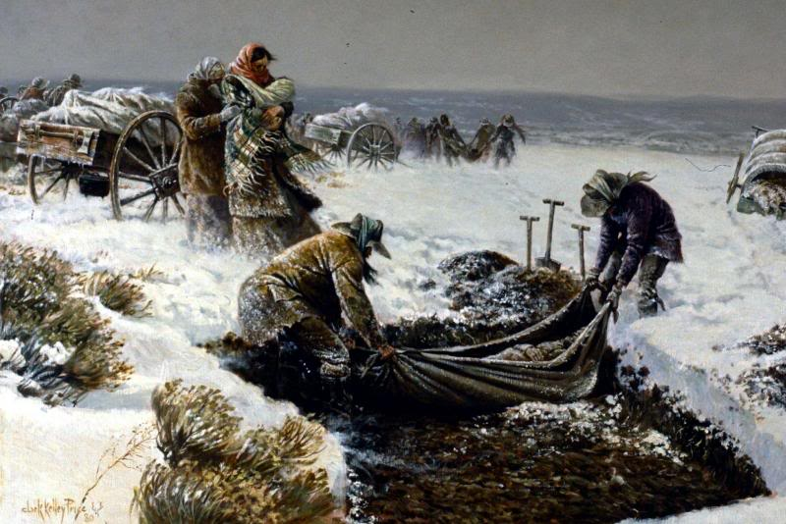
Death along the Mormon Trail

Slide 23
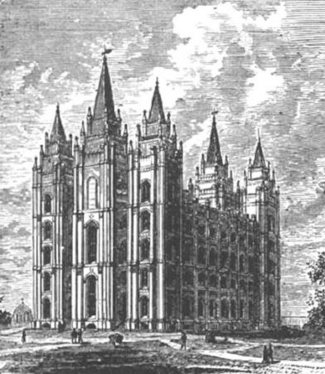
Salt Lake City Tabernacle

Slide 24
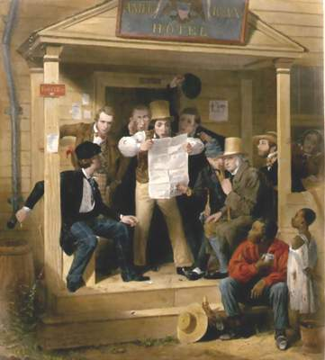
News of the War with Mexico

Slide 25
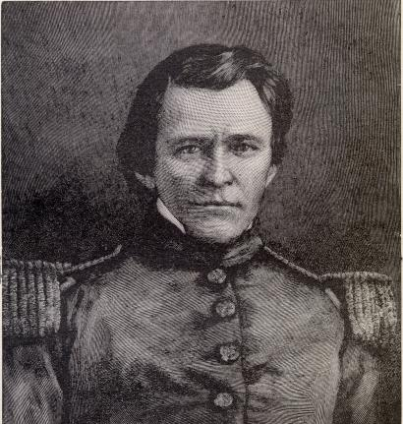
Lt. Ulysses S. Grant in Mexico (1846)

Slide 26
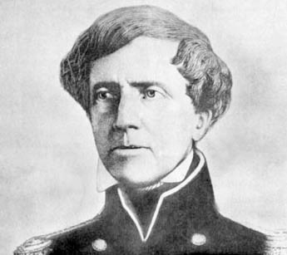
Stephen Watts Kearny (1846)

Slide 27
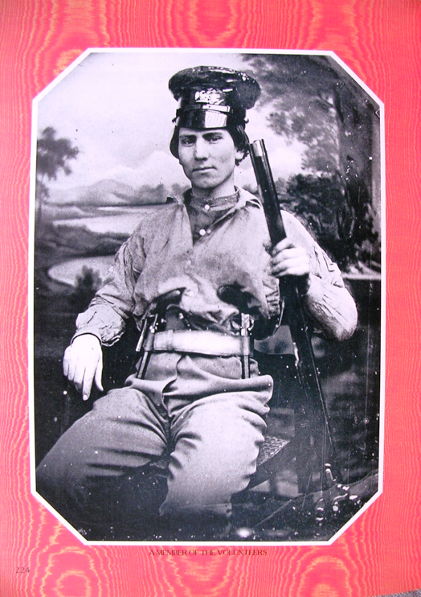
Mexican War Volunteer

Slide 28
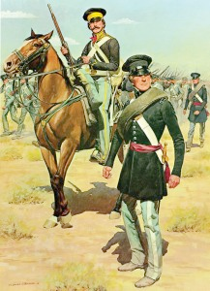
H. Charles McBarron, The American Soldier (1847)

Slide 29
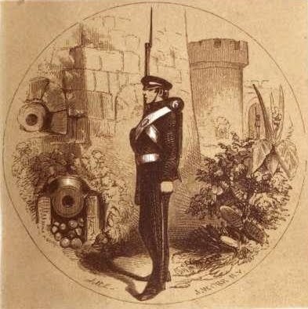
George Ballantine, The Mexican War, by an English Soldier (1860)

Slide 30
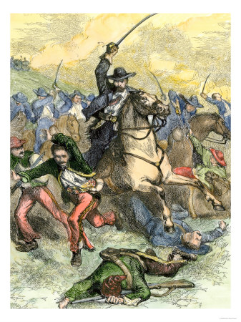
Battle of Buena Vista

Slide 31
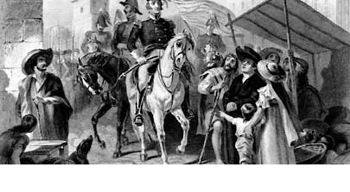
Gen. Zachary Taylor in Mexico City (1848)

Slide 32
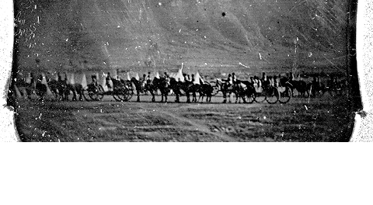
Daguerreotype of US troops at Battle of Buena Vista (1847)

Slide 33
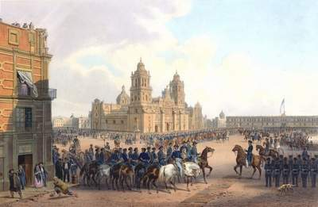
Gen. Winfield Scott Enters Mexico City

Slide 34
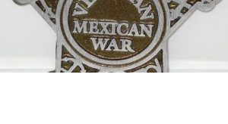
Grave Markers for Mexican War Veterans

Slide 35
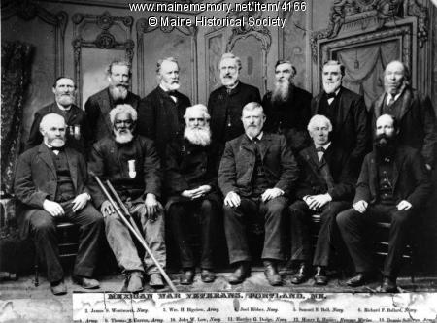
Mexican War Veterans in Portland, Maine (1885)

Slide 36
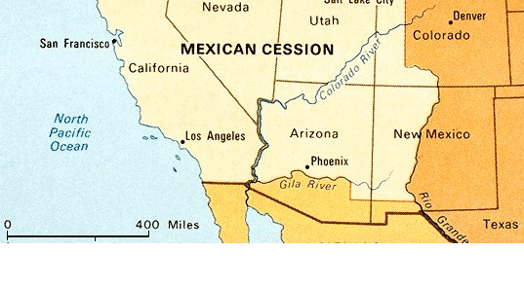
The Mexican Cession (1848)

Slide 37
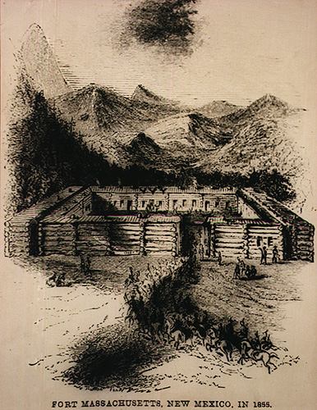
Fort Massachusetts (1855)

Slide 38
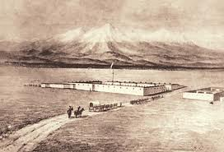
Fort Garland (1868)

Slide 39
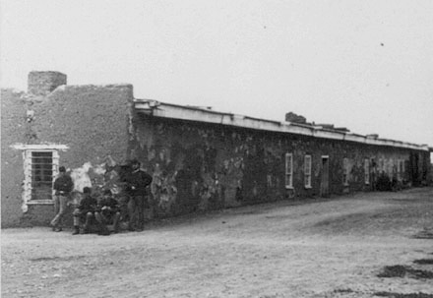
Fort Garland (1874)

Slide 40
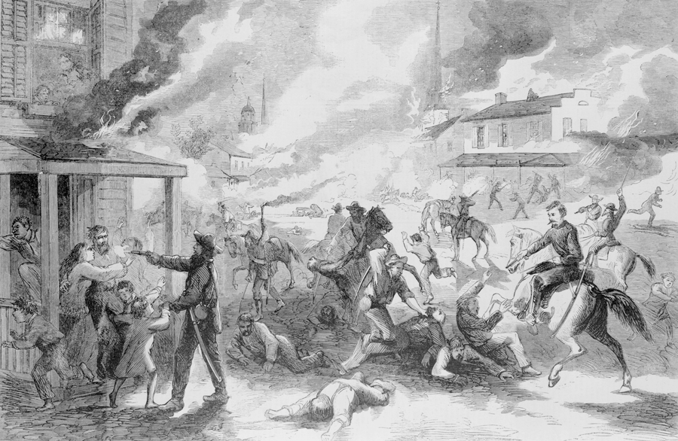
Battle of Lawrence, Kansas (1857)

Slide 41
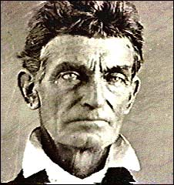
John Brown at trial (1859)

Slide 42
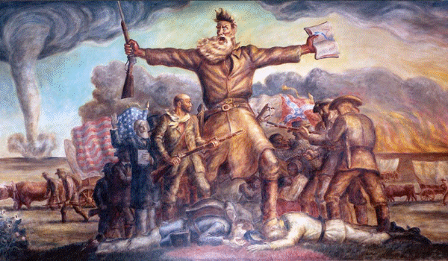
Painting of John Brown at Kansas State Capitol

Slide 43
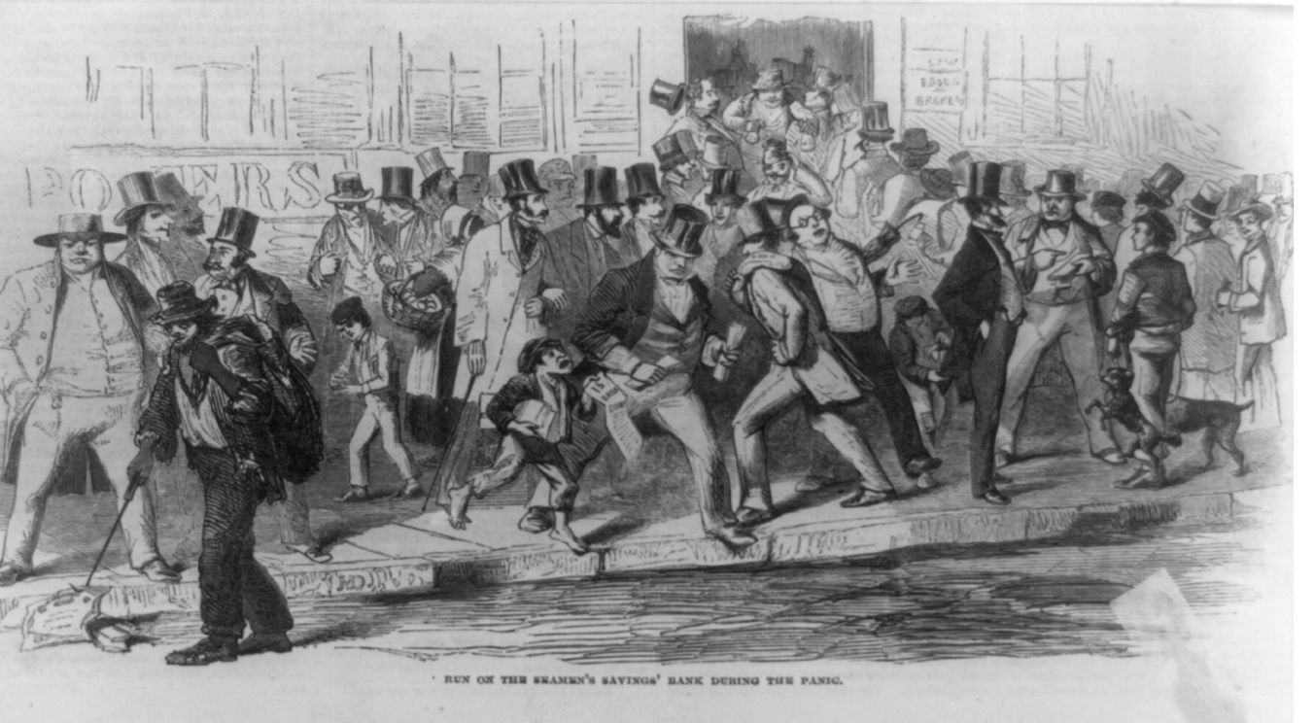
“Run on the Seamans’ Savings Bank During the Panic” (1857)

Slide 44
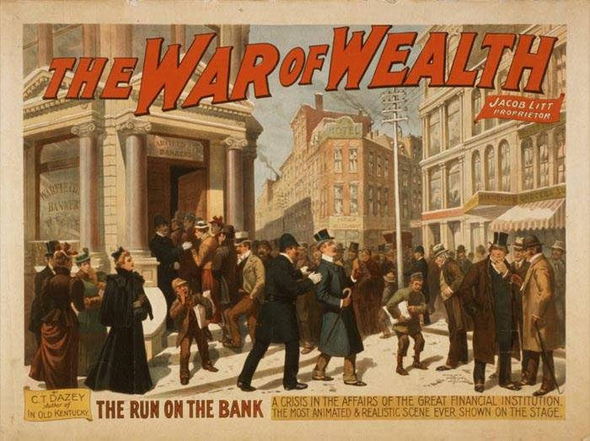
The War on Wealth (1857)

Slide 45
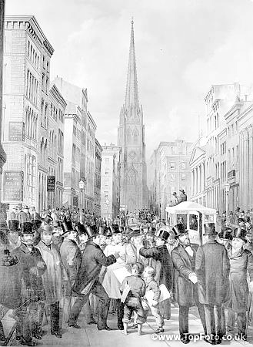
Wall Street Panic of 1857

Slide 46
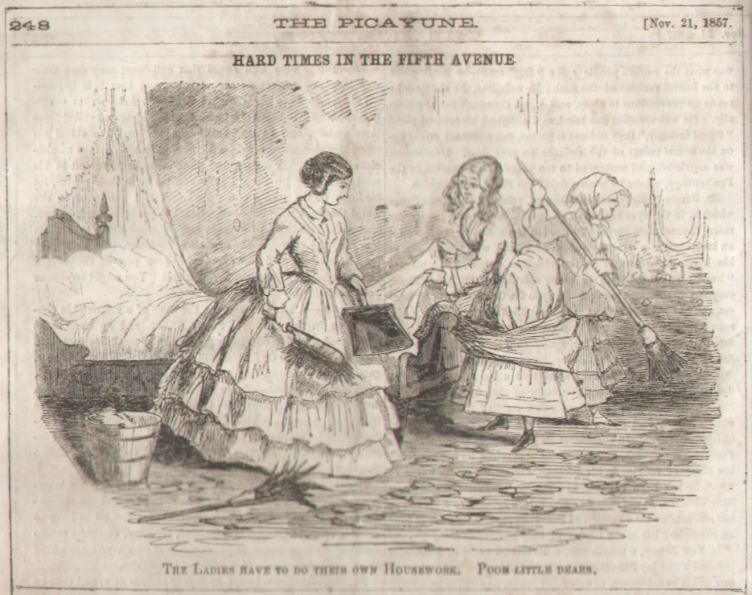
“Hard Times in the Fifth Avenue”
New Orleans Picayune (Nov. 21, 1857)

Slide 47
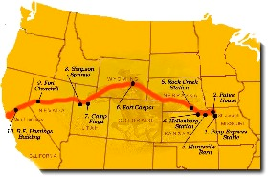
Pony Express Route (1860-1861)

Slide 48
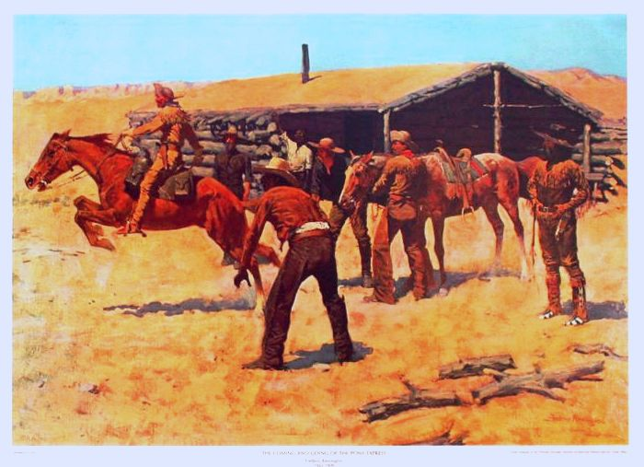
Frederic Remington, Coming and Going of the Pony Express (1900)

Slide 49
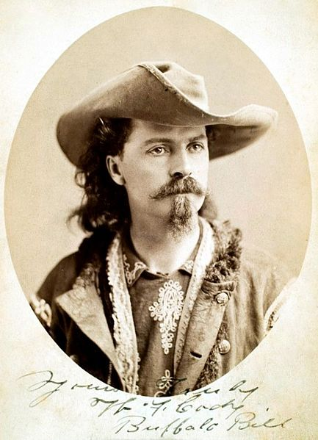
Bill Cody, Express Rider (1861)

Slide 50
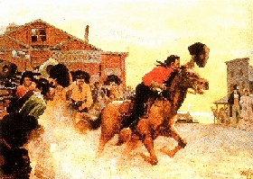
Charles Hargens, The First Ride

Slide 51
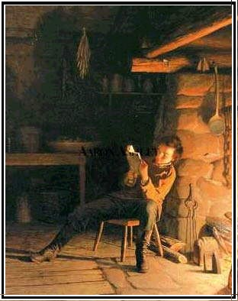
Lincoln reading by firelight

Slide 52
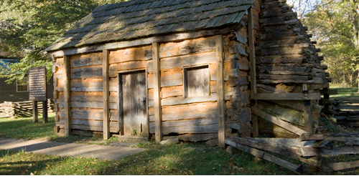
Lincoln Boyhood Home

Slide 53
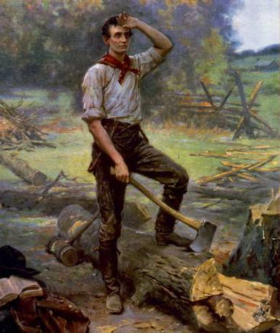
Young Abraham Lincoln splitting logs

Slide 54
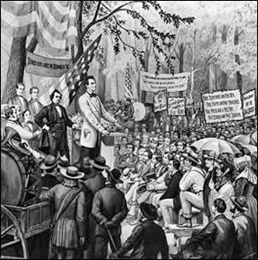
Lincoln-Douglas Debates (1858)

Slide 55

Lincoln in 1861

Slide 56

Homestead Act postage stamp (1962)

Slide 57

Lincoln and the Morrill Land-Grant Act (1862)

Slide 58

Lincoln and western slavery

Slide 59

Lincoln freeing slaves

Slide 60

Lincoln as “gorilla”

Slide 61

The Two Platforms (1860)

Slide 62

Lincoln’s Pardon of Cherokees at the End of the Civil War

Slide 63

Pueblo Indians with Lincoln Cane (1923)

Slide 64

Executions during Minnesota Sioux War (1862)

Slide 65

John Wilkes Booth

Slide 66

Lincoln’s final train ride (1865)

Slide 67

Sculpture of Lincoln on horseback

Slide 68

Mount Rushmore

Slide 69

Daniel Day-Lewis in new Lincoln movie (2012)

Slide 70

Elliott West, The Contested Plains (1998)

Slide 71

Gold Rush poster

Slide 72

Advertising for Pike’s Peak Gold Rush in Missouri

Slide 73

Map to Pike’s Peak Region (1859)

Slide 74

Gregory Gold Diggings (1859)

Slide 75

Pike’s Peak Gold Rush (1859)

Slide 76

Mining in Russell Gulch (1860)

Slide 77

William Green Russell (1859)

Slide 78

1862 Map of Colorado

Slide 79

1873 Colorado Map

Slide 80

Map of Colorado (1874)

Slide 81

1893 “Columbian” Map of Colorado

Slide 82

Southern California’s “Territory of Colorado” (1859)

Slide 83

Territory of Jefferson (1859)

Slide 84

Territorial claims on Colorado (1860)

Slide 85

Kansas Governor James W. Denver (1859)

Slide 86

Robert W. Steele, Governor of the Territory of Jefferson (1859)

Slide 87

Denver City Post Office (1860)

Slide 88

Clark Gruber Bank and Mint in Golden (1860)

Slide 89

Denver and Auraria (1860)

Slide 90

Clark Gruber Gold Pieces

Slide 91

Dr. John Parsons’ 1859 Gold Mint (South Park)

Slide 92

Governor John Evans

Slide 93

John Chivington (1860)

Slide 94

Recruiting for 1st Colorado Volunteers (1861)

Slide 95

Battle of Glorieta Pass (1862)

Slide 96
Treaty of Fort Wise (1861)
Treaty of Fort Wise (1861)
On February 18, 1861, six chiefs of the Southern Cheyenne and four of the Arapaho signed the Treaty of Fort Wise with the United States,^{[5]} at Bent's New Fort at Big Timbers near what is now Lamar, Colorado, recently leased by the U.S. Government and renamed Fort Wise, in which they ceded to the United States most of the lands designated to them by the Fort Laramie treaty.^{[2]} The Cheyenne chiefs were Black Kettle, White Antelope, Lean Bear, Little Wolf, Tall Bear, and Left Hand; the Arapaho chiefs were Little Raven, Storm, Shave-Head, and Big Mouth.^{[5]}
The new reserve, less than one-thirteenth the size of the 1851 reserve,^{[2]} was located in eastern Colorado^{[4]} along the Arkansas River between the northern boundary of New Mexico and Sand Creek.^{[6][2]} Some bands of Cheyenne including the Dog Soldiers, a militaristic band of Cheyennes and Lakotas that had evolved beginning in the 1830s, were angry at those chiefs who had signed the treaty, disavowing the treaty and refusing to abide by its constraints.^{[7]} They continued to live and hunt in the bison-rich lands of eastern Colorado and western Kansas, becoming increasingly belligerent over the tide of white immigration across their lands, particularly in the Smoky Hill River country of Kansas, along which whites had opened a new trail to the gold fields.^{[8]} Cheyennes opposed to the treaty said that it had been signed by a small minority of the chiefs without the consent or approval of the rest of the tribe, that the signatories had not understood what they signed, and that they had been bribed to sign by a large distribution of gifts. The whites, however, claimed the treaty was a "solemn obligation" and considered that those Indians who refused to abide by it were hostile and planning a war.^{[9]}

Slide 97

Colorado Volunteers Recruiting Poster (1864)

Slide 98

Cheyenne, Kiowa, and Arapaho
Delegation to Denver
(Sept. 28, 1864)

Slide 99

Camp Weld Council
(September 28, 1864)
Notes:
(Photo courtesy Colorado Historical Society)
Meeting at the Camp Weld Council in Denver On September 28, 1864
Standing (l to r): White Wing, Bosse, John Smith (interpreter), rest unknown
Seated: Neva, Bull Bear, Black Kettle, One-Eye and an unidentified Indian
Kneeling: Maj. Ned Wynkoop & Capt. Silas Soule.

Slide 100

Painting of the Sand Creek Massacre

Slide 101

Location of Sand Creek site

Slide 102

Eugene Ridley (Northern Arapaho), Sand Creek Massacre
Notes:
The image at left is part of a larger depiction of the Sand Creek massacre, painted on elk hide by Northern Arapaho artist Eugene Ridgely. His great-grandfather Lame Man survived the attack. Soldiers attack after most of the warriors have left to go hunting (far right). The Cheyenne chief White Antelope stands by the American flag and white peace flag at the center of the camp, yelling to the soldiers that they are mistakenly attacking a peaceful camp (center), but they ignore him. Women, children and the elderly flee, pursued by the soldiers, who kill and mutilate them (left).

Slide 103

Robert Bentm (son of William Bent and Owl Woman)

Slide 104

Edmond Guerrier
Notes:
A portrait of Edmond Guerrier. Guerrier was the son of Frenchman William Guerrier and Walks In Sight, a Cheyenne. Guerrier provided testimony to Congressional investigators at Fort Riley, Kansas in 1865 concerning the Sand Creek Massacre.

Slide 105

Captain Silas Soule

Slide 106

Colorado Territory (1949)

Slide 107

Colorado Territory (Italian version)

Slide 108

French version of Colorado Territory

Slide 109

The Guns at Fort Petticoat (1957)
Notes:
In 1864 during the American Civil War, Texan Lt. Frank Hewitt is serving with the U.S. Cavalry in a Regular Army Regiment under Colonel John Chivington. On patrol, Hewitt meets a group of Indians who are unarmed and returning to the Sand Creek reservation they were not supposed to leave. When briefing Col. Chivington, the Colonel orders the Sand Creek Massacre to punish the Indians. The fictional story tells the tale of an Army deserter training a disparate group of women to be Indian Fighters climaxing in a Battle of the Alamo type action.

Slide 110

Soldier Blue (1970)

