Slide 1
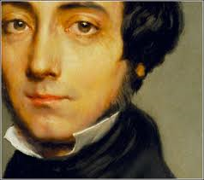
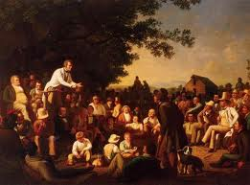
Alexis de Tocqueville and the Age of Jackson
June 15, 2011

Slide 2
A Plan for the Morning
1) Contexts for Tocqueville’s Observations
2) Discussion of Key Themes
3) Religion in the Age of Jackson
4) Conclusion: why does Tocqueville matter?

Slide 3
Your impressions before today?
Why did he come to the U.S.

Slide 4
Contexts for Tocqueville’s Arrival
Louisiana Purchase, 1803
War of 1812
Slavery’s Transformation…a Southern institution by 1831
Abolitionists and Immediate Emancipation, The Liberator, 1831
Nat Turner’s Slave Revolt, 1831
The Market Revolution

Slide 5
The Market’s Consequences
Transportation
Travel Times
Western Settlement

Slide 6
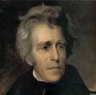
Andrew Jackson and the Second Party System
Whigs and Democrats, the Second Party System (1828-1850s)
National Political Parties
Voter Participation

Slide 7
Year Eligible Voter
Participation
1824 | 25%
1828-36 | 56%
1840-60 | 78%

Slide 9
The Second Party System (1828-1850s)
Andrew Jackson, Pres. 1828-1836
Jackson’s Inauguration
“Proper” Voters in the Age of Jackson

Slide 10
Tocqueville and the Age of Jackson
Politics
Economics
Race
Religion

Slide 11
Democracy in America
Key Themes, Observations, Conclusions

Slide 12
Quote One
“This entire work has been written under the spell of a kind of religious terror in the soul of the author, a terror produced by the sight of an irresistible revolution that has been underway for so many centuries, overcoming every obstacle, and that today is proceeding amid all the destruction it has caused….To instruct democracy, if possible, to revive its beliefs, purify its morals, regulate its movements; gradually to substitute experience for inexperience, knowledge of true interests for blind instincts; adapt government to time and place and modify it according to the circumstances of the people: of all the tasks required of the leaders of our day who govern society, these are foremost.” (p. 38)

Slide 13
Quote Two
“When, after a careful examination of American history, we study its political and social condition closely, we are left with a deep conviction of one truth: that there is not an opinion, a custom, a law, I might even say not a single event, that cannot be easily explained by first beginnings, by the inception. Anyone who reads this book will find…the key to almost the entire work.” (p. 44)

Slide 14
Quote Two (continued)
“The founders of New England were both ardent sectarians and enthusiastic innovators.” (p. 45)
“The American social condition is entirely democratic. This has been its character since the birth of the colonies and it is even more so today. As I said in the preceding chapter, a high degree of equality prevailed among the emigrants who came to settle on the coast of New England.” (p. 46)

Slide 15
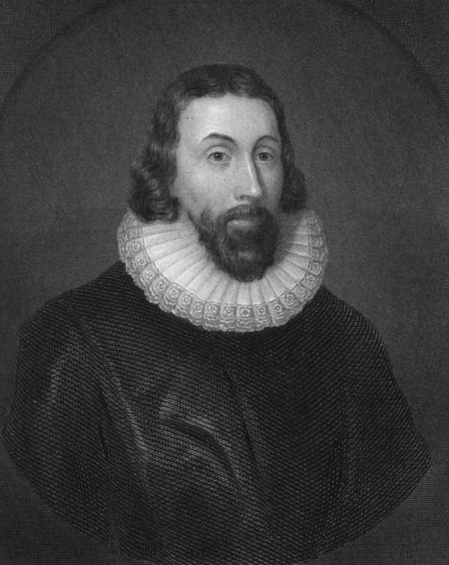
“God Almighty, in his most holy and wise providence, hath so disposed of the condition of mankind, as in all times some must be rich, some poor, some high and eminent in power and dignity, others mean and in subjection.”— John Winthrop, “Model of Christian Charity, 1630.

Slide 16
Quote Three
“The absolute sovereignty of the majority is the essence of democratic government; in a democracy, nothing outside the majority is capable of mounting resistance to it…Under the Old Regime, French people believed the king was infallible….Americans have that same view of the majority….Thus, the majority’s actual power in the United States is enormous…once the majority has formed its opinion on any question, nothing can stop it or even block it long enough to allow time for the arguments of those who are crushed in the process to be heard. The consequences of this state of affairs are deeply troubling and dangerous for the future.”

Slide 17
Additional Themes?
At your tables, complete the following exercise:
Explain a theme or observation you found important or interesting in Democracy in America.
Mark one or two passages that illustrate this theme.
Discuss how you might teach this theme to your students.
[Please have one person write down your group’s responses]

