Slide 1
The Era of Reconstruction (1865-1876)
Four Corners Community History Project
Field Workshop
February 27, 2012
Montrose, Colorado

Slide 2
US Census and Race: 1870
The Black South (37% overall)
Alabama: 47%
Arkansas: 25%
Florida: 49%
Georgia: 42%
Kentucky: 17%
Louisiana: 50%
Mississippi: 53%
North Carolina: 36%
South Carolina: 59%
Tennessee: 25%
Texas: 31%
Virginia: 42%

Slide 3
US Census (1870): Literacy Rates
Black vs. White Male Adult Illiteracy (Ratios)
Alabama: 98,344/17,429 (5.6 to 1)
Arkansas: 22,689/13,610 (1.6 to 1)
Florida: 18,052/3,876 (4.6 to 1)
Georgia: 112,361/21,899 (5 to 1)
Kentucky: 43,277/43,826 (1 to 1)
Mississippi: 87,327/9,357 (9.3 to 1)
North Carolina: 76,177/33,111 (2.3 to 1)
South Carolina: 77,924/12,490 (6.2 to 1)
Tennessee: 63,248/37,713 (1.67 to 1)
Texas: 47,583/17,505 (2.7 to 1)
Virginia: 109,687/27,647 (4 to 1)
Overall Southern Ratio: black male illiteracy was four times that of whites.
No data in 1870 census for women’s literacy rates (black or white).

Slide 4
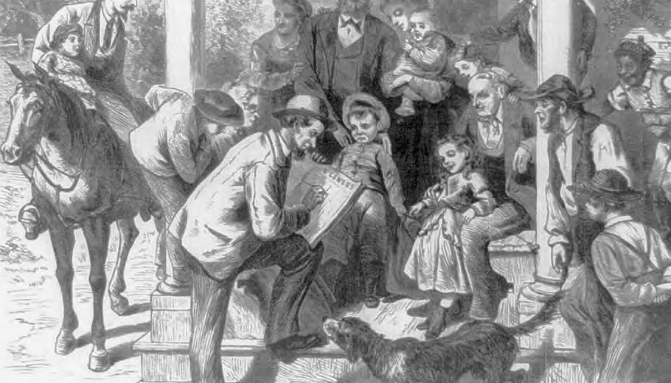
Government Census Taker in 1870

Slide 5
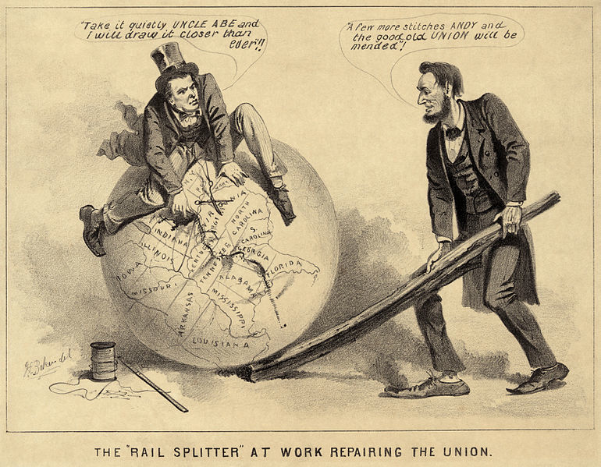
“The Rail-splitter Repairing the Union” (1865)

Slide 6
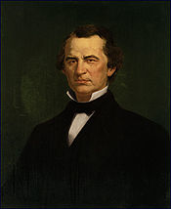
President Andrew Johnson (1865-1869)

Slide 7
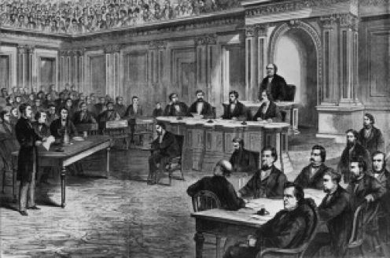
Andrew Johnson’s Impeachment (1868)

Slide 8
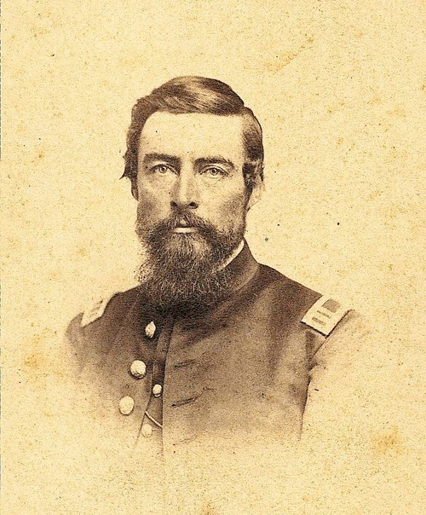
Edmund G. Ross

Slide 9
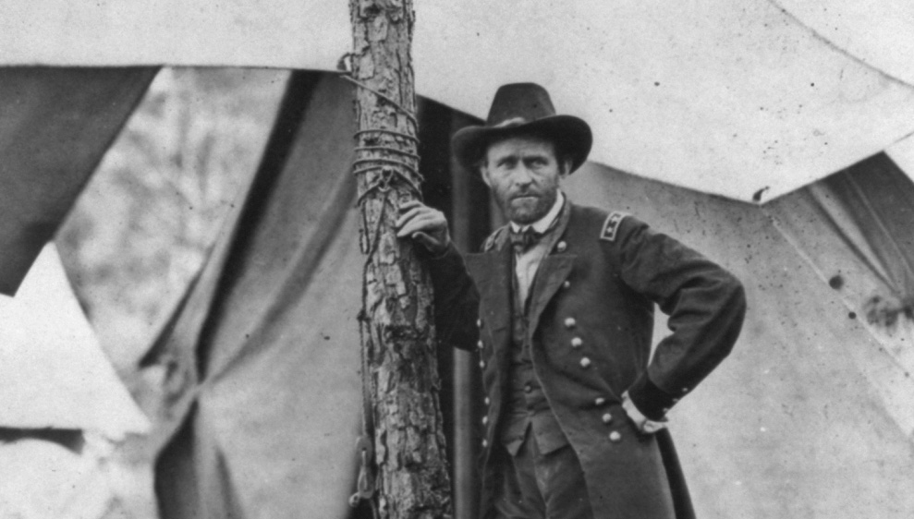
Grant in the Civil War

Slide 10
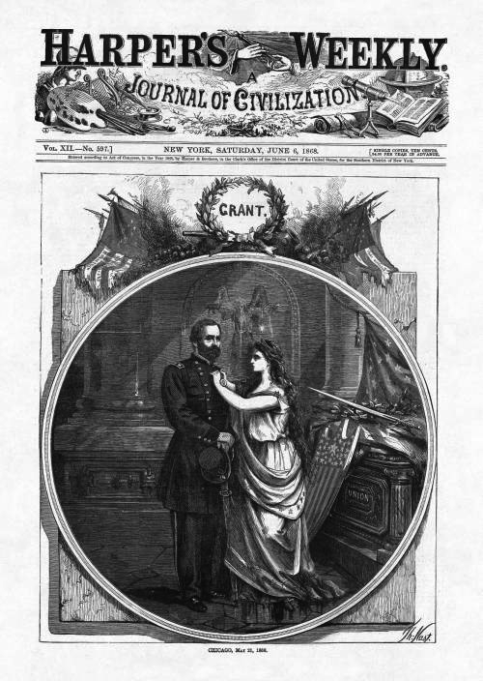
Election of 1868

Slide 11
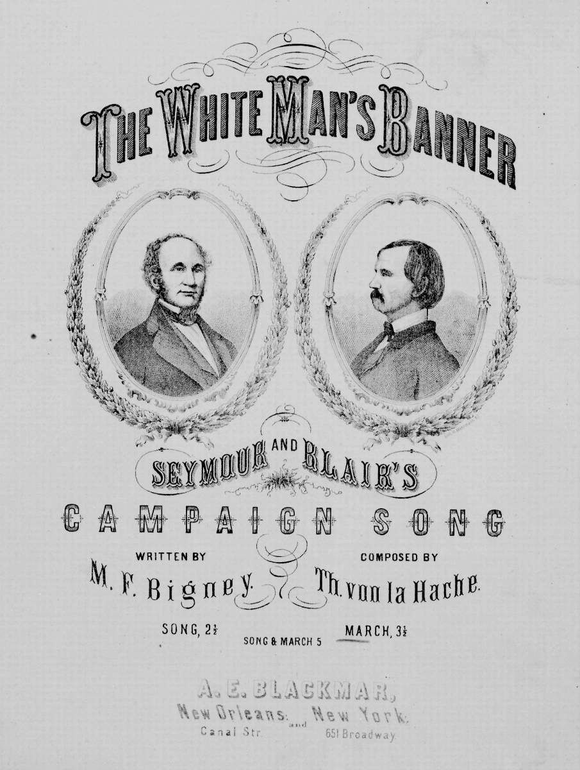
Anti-Grant Poster (1868)

Slide 12
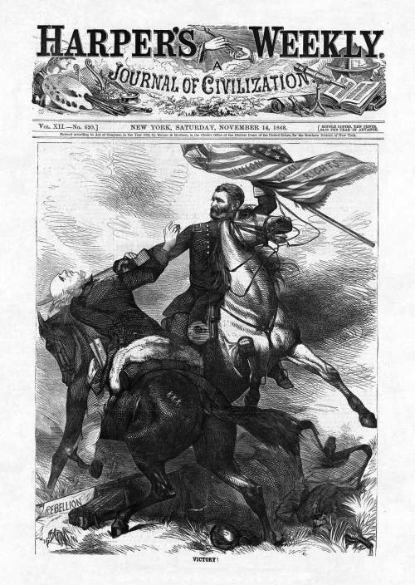
Grant’s Victory (1868)

Slide 13
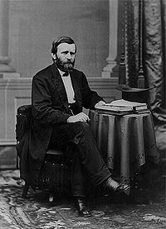
US Grant (1869)

Slide 14
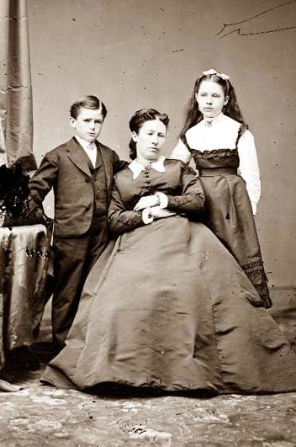
Julia Dent Grant and Children

Slide 15
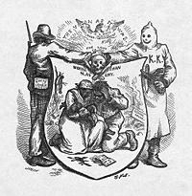
Ku Klux Klan and White League (Harper’s Magazine)

Slide 16
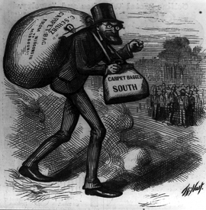
Carpetbagger (Harper’s Weekly, 1870)

Slide 17
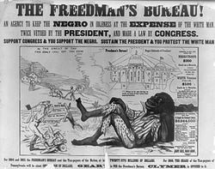
Pennsylvania poster opposing the Freedman’s Bureau (1866)

Slide 18
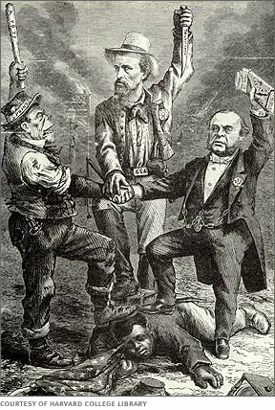
“This is a White Man’s Government” (1868)

Slide 19
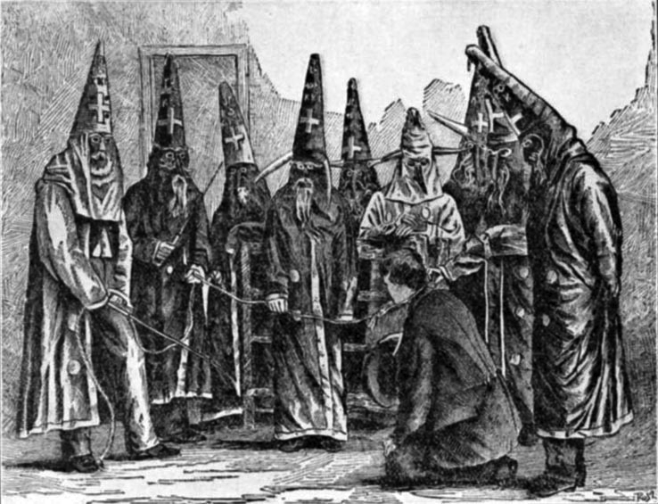
“Redemption” and the End of Reconstruction (1870)

Slide 20
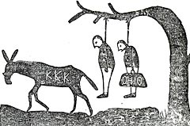
“Klan Warning” (1868)

Slide 21
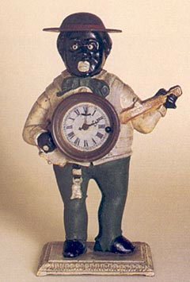
“Sambo clock” (1875)

Slide 22
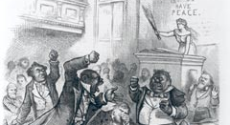
“Colored Rule in a Reconstructed (?) State,” Harper’s Weekly (March 1874)

Slide 23
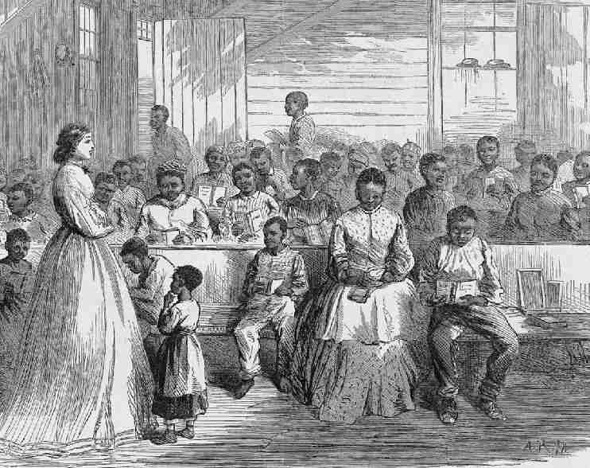
Freedman’s Bureau School

Slide 24
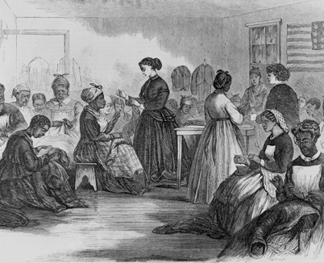
Women’s Education

Slide 25
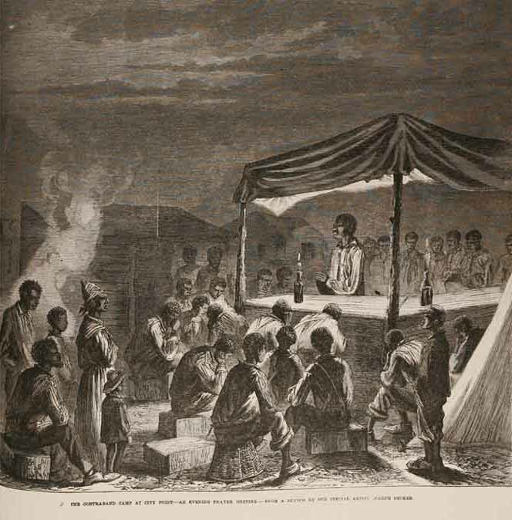
“The Contraband Camp at City Point-An Evening Prayer Service” (1864)

Slide 26
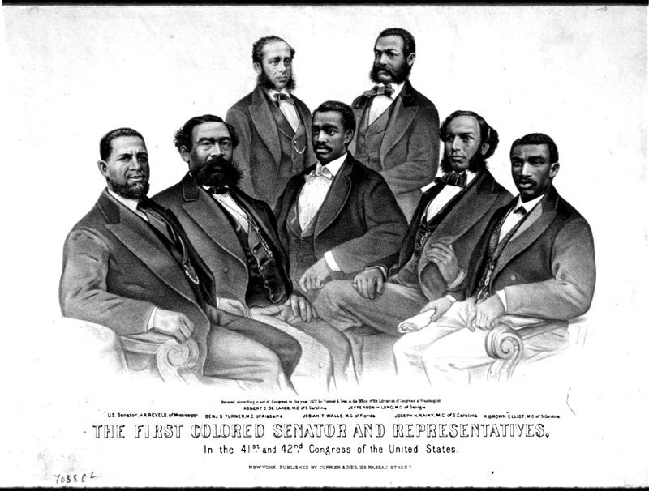
Black Representatives in Congress (1873)

Slide 27
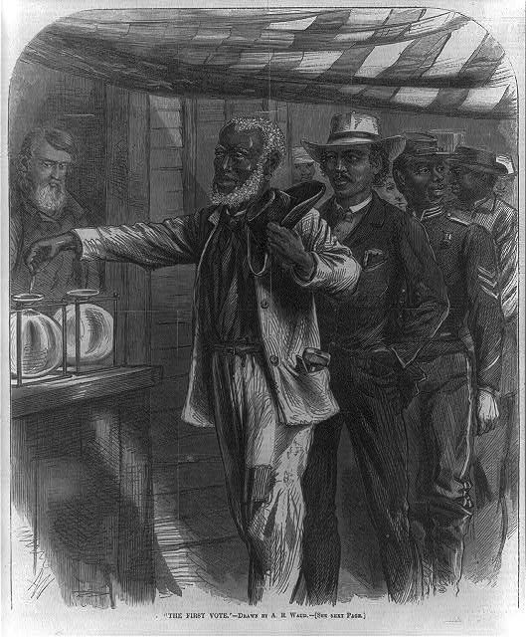
“The First Vote”

Slide 28
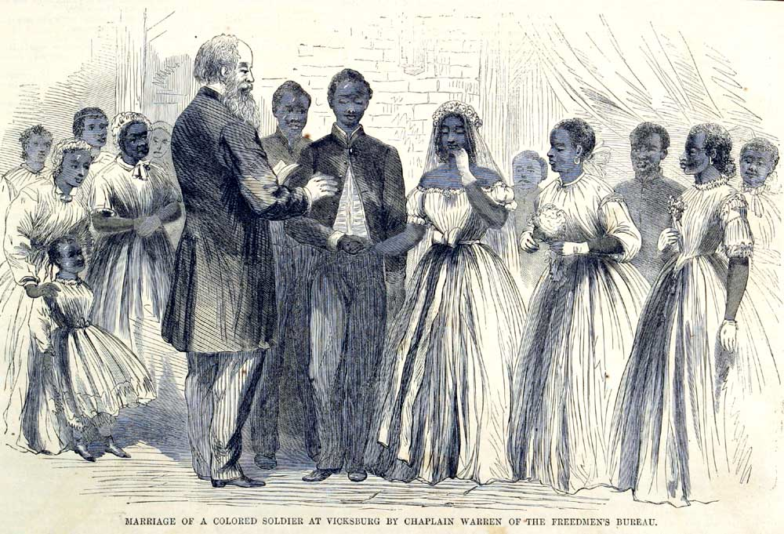
“Marriage of a Colored Soldier at Vicksburg” (1866)

Slide 29
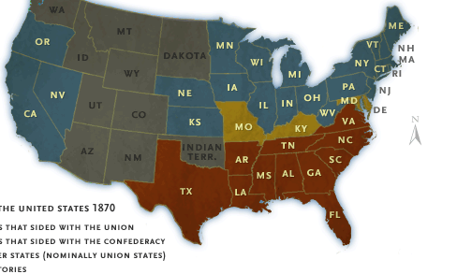
Northern and Southern States (1870)

Slide 30
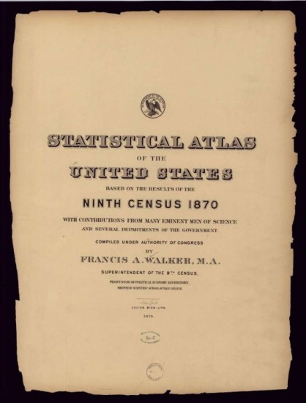
Statistical Atlas of the United States, Ninth Census 1870 (1874)

Slide 31
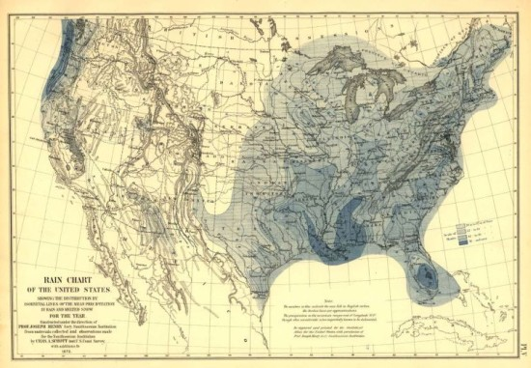
1870 “Rain Chart”

Slide 32
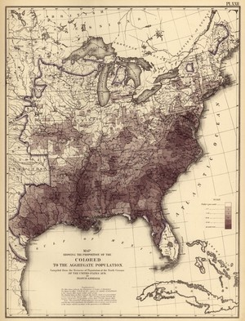
Map of US in 1870 (Black Population)

Slide 33

“Colored to the Aggregate Population” (1870)

Slide 34
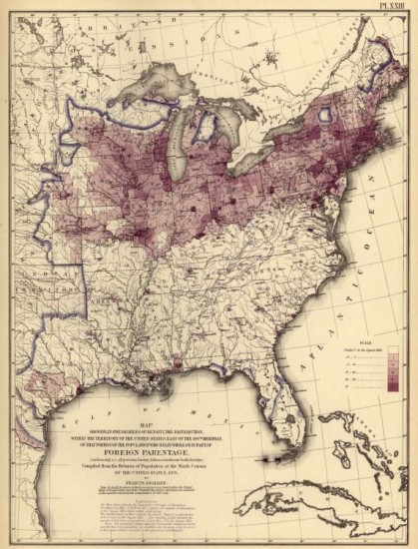
“Foreign Parentage” (1870

Slide 35
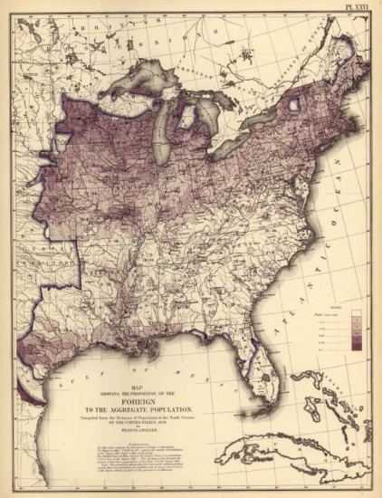
“Foreign to the Aggregate Population” (1870)

Slide 36
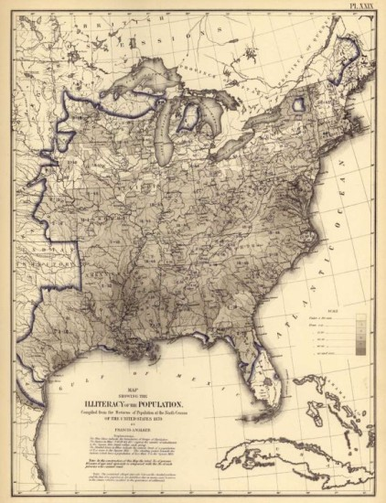
“Illiteracy of the Population” (1870)

Slide 37
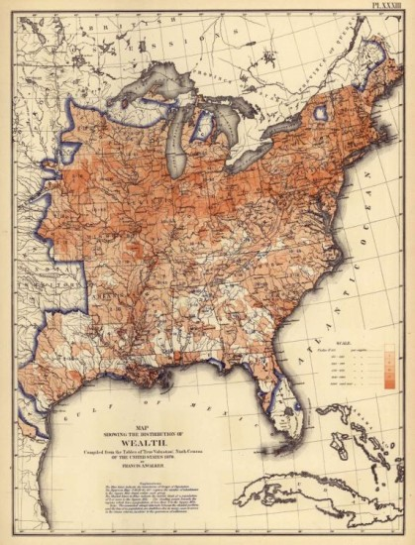
“Distribution of Wealth” (1870)

Slide 38
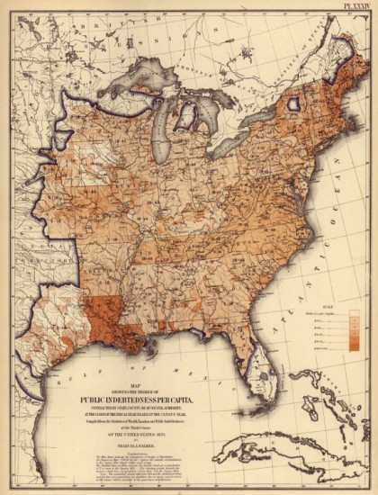
“Public Indebtedness Per Capita” (1870)

Slide 39
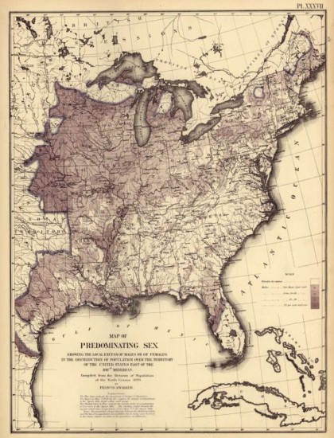
Male-Female Ratios (1870)

Slide 40
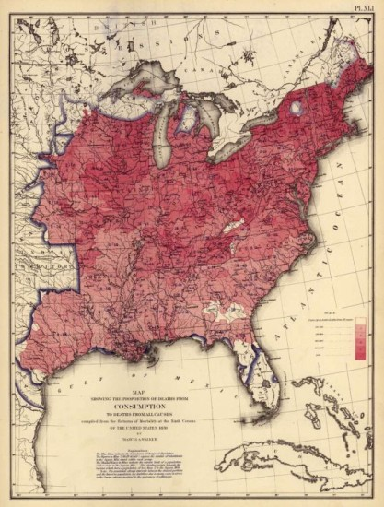
Ratio of Deaths (base of 10,000) caused by Consumption (1870)

Slide 41
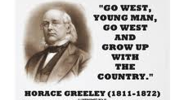
Horace Greeley

Slide 42
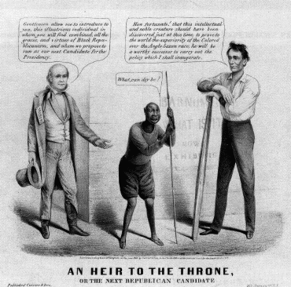
Horace Greeley and Lincoln

Slide 43
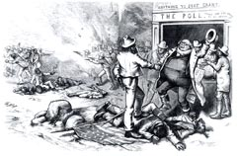
“Let us Clasp Hands over the Bloody Chasm,” Harper’s Weekly (Oct. 1872)

Slide 44
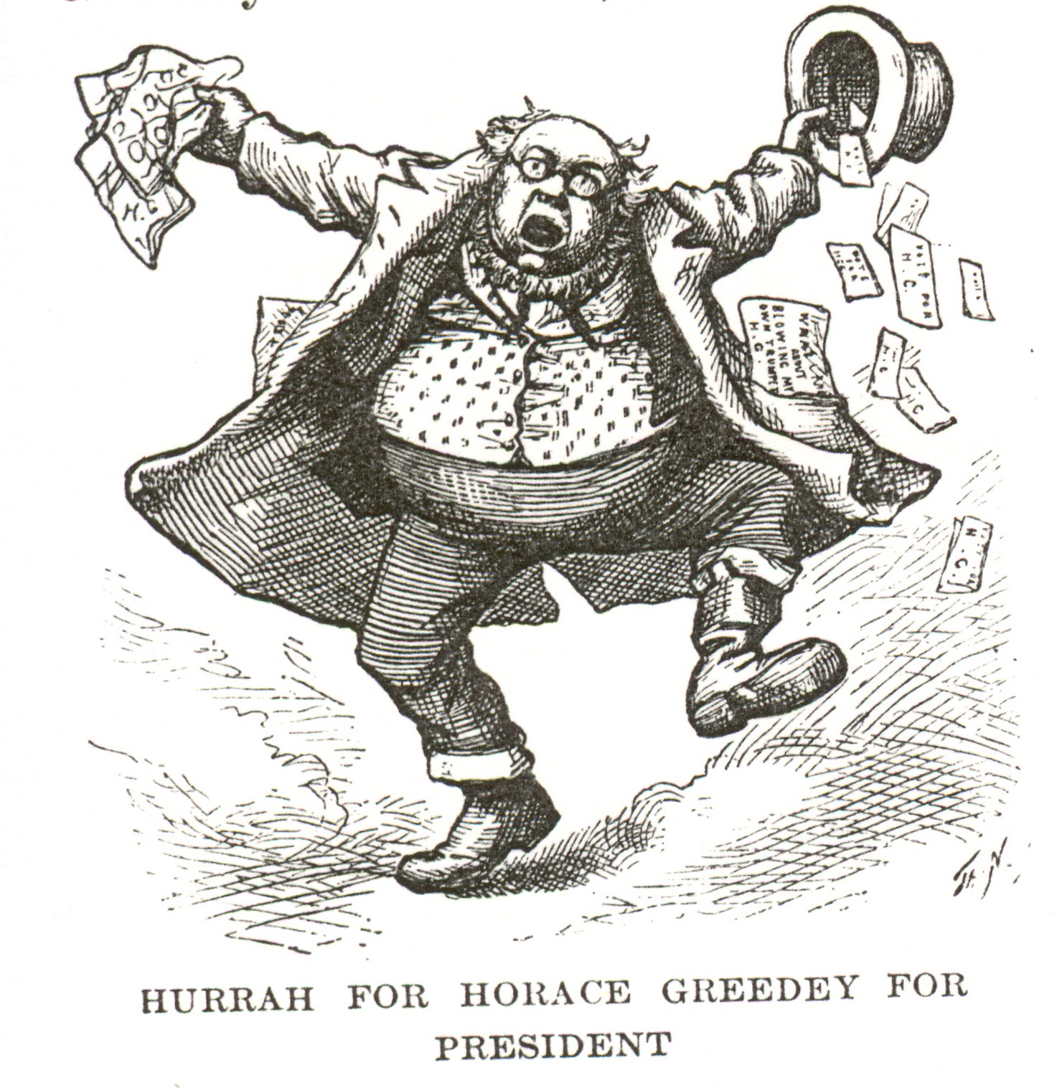
Thomas Nast, “Greeley for President” (1872)

Slide 45
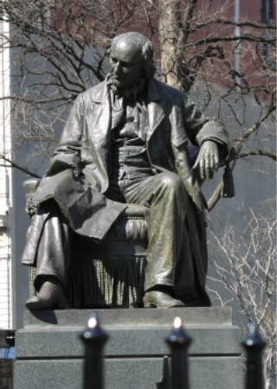
Statue of Horace Greeley in New York City

Slide 46
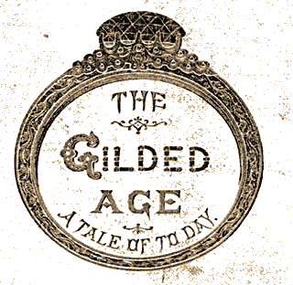
Mark Twain, The Gilded Age (1872)

Slide 47
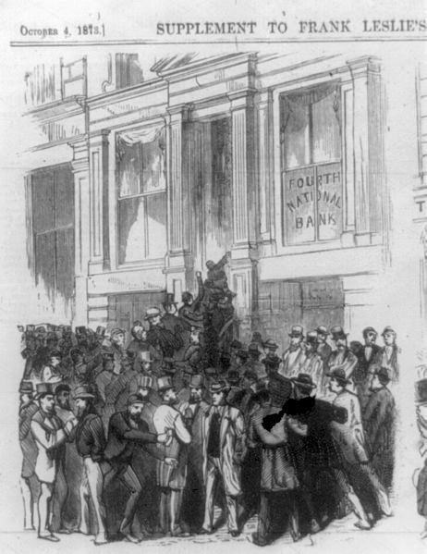
Bank Run, New York City (1873)

Slide 48
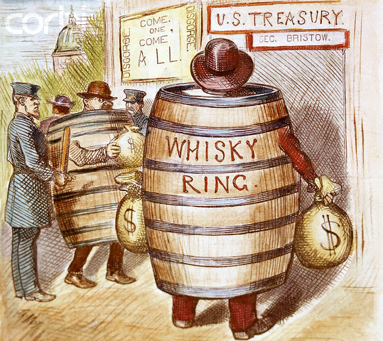
Thomas Nast, “Whisky Ring”

Slide 49
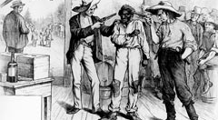
“Of Course He Wants to Vote the Democratic Ticket” (1876)

Slide 50
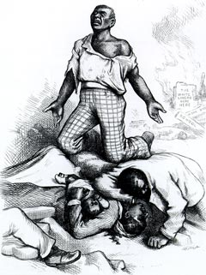
Thomas Nast, “Is This a Republican Form of Government?” (1876)

Slide 51
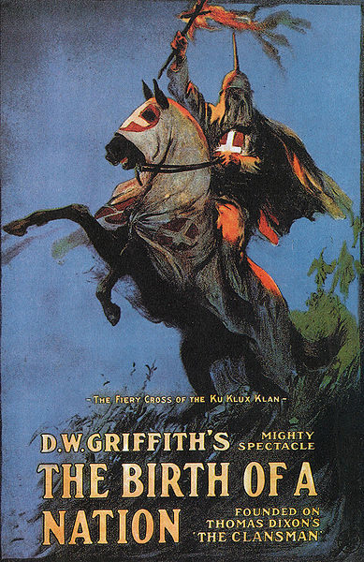
D.W. Griffith, Birth of a Nation (1915)

Slide 52
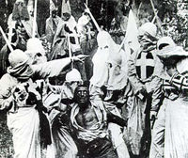
Scene from Birth of a Nation

Slide 53
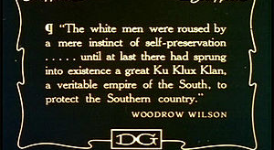
Woodrow Wilson, History of the American People (1918)

