Slide 1
The Civil War
Four Corners Community History Project
November 28, 2011
Ignacio, Colorado

Slide 2
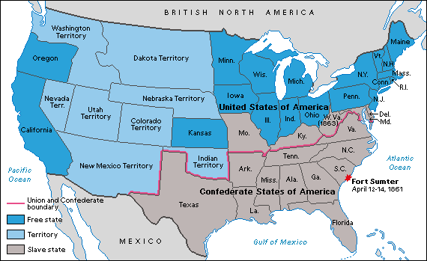
Map of Civil War States

Slide 3
Civil War Statistics
Comparison of Union and CSA
Union CSA
Total pop. 22.1 mil. (71%) 9.1 mil. (29%)
Free pop. 21.7 mil 5.6 mil.
Slaves (1860) 400,000 3.5 mil.
Soldiers 2.1 mil (67%) 1.06 mil (33%)
Railroad miles: 21,788 (71%) 8,838 (29%)
Factory goods: 90% 10%
Weapons: 97% 3%
Cotton bales (1860) 4.5 mil.
Cotton bales (1864) 300,000
Pre-war exports 30% 70%

Slide 4
Scholars and The Civil War: The “Pre-Professionals”/Amateurs (1865-1885)
Northern elite saw American freedom as most important theme
Ivy League-educated scholars wanted a “national” narrative without regional differences
Southern slaveowners were to blame for violence

Slide 5
The “Professional” Historians (1885-1910)
Age of “Professionalization” in science and corporate world affects historians
Scholars with Ph.D. degrees from German and later American universities
Emphasis on “facts” instead of “theories;” “objectivity” versus “grand narrative”
Southern scholars “had a point” about Northern overreaction to war
Response to shift in public mood highlighted by Supreme Court Case of Plessy v. Ferguson (1896): “separate but equal doctrine”/emphasis on “Local conditions” instead of national policies
Goal of “Reconstruction” needed to include historians bringing southerners into the profession
]”Scientific Racism” and southerners’ need to control black people accepted by northern scholars

Slide 6
Progressive Historians (1910-1940)
New generation influenced by complexities of urban life (immigration, class differences, solving of urban problems, more involvement of government in people’s lives)
Belief in “national” over “states’ rights” emphasis on history; belief in “relativism” (new theory of Einstein in physics, social sciences like anthropology [“cultural relativism”]
Charles and Mary Beard, The Rise of American Civilization (1927): class differences and city life mattered more to shaping the nation than rural life and slavery (focus on current events)
War seen as “tragic:” “Irrepressible conflict;” “needless war”

Slide 7
Consensus Historians (1940-1960)
Generation influenced by World War II/Cold War and need for unity (Progressives seen as traitors; relativism replaced by “universalism” and patriotism)
Return to “Professional” thinking that Northern and Southern scholars had much in common
Coming together to fight Communism was more important than focus on differences and failures

Slide 8
New Left Historians (1960-1990)
Radical thinkers of “group-identity” school influenced by social and cultural changes of post-WWII era
New generation of scholars included women and minorities who questioned the “conventional wisdom” of American patriotism
Civil War themes now focused on slavery, southern racism, northern hypocrisy towards freedom (Lincoln seen as weak on abolition, etc.)

Slide 9
“Individual-Identity” Historians (1990-present)
Movement towards smaller groups and individual stories (use of diaries, journals, letters, etc.)
Women, workers, immigrants draw attention (Drew Gilpin Faust, Mothers of Invention: Women of the Slaveholding South in the American Civil War)
Faith and religion also studied by newer scholars (Faust, This Republic of Suffering: Death and the American Civil War)

Slide 10
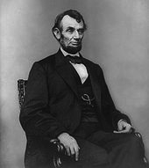
Abraham Lincoln

Slide 11
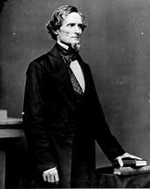
Jefferson Davis

Slide 12
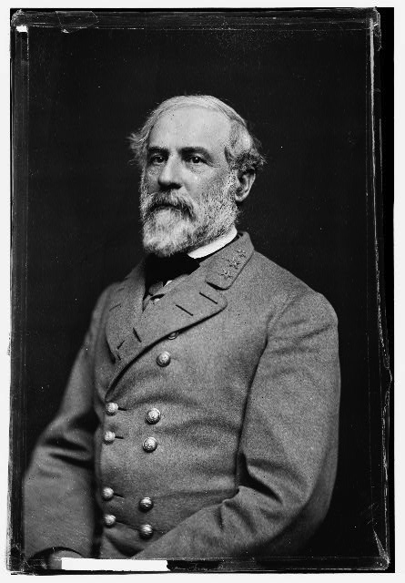
General Robert E. Lee

Slide 13
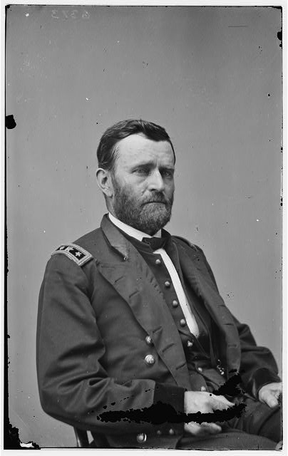
General Ulysses S. Grant

Slide 14
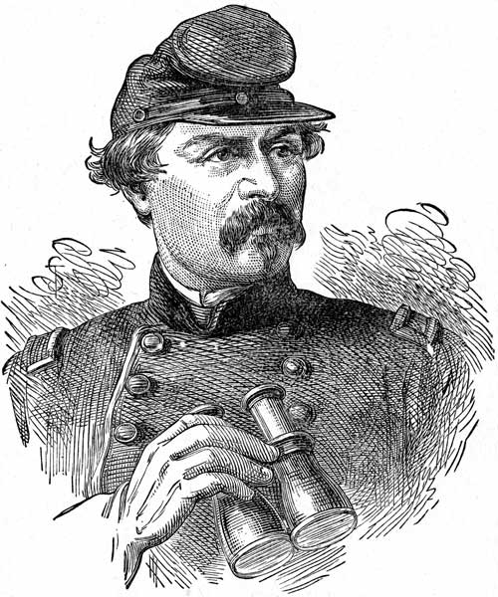
General George McClellan

Slide 15
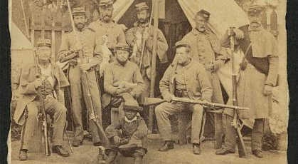
Life in Camp Cameron May 1861

Slide 16
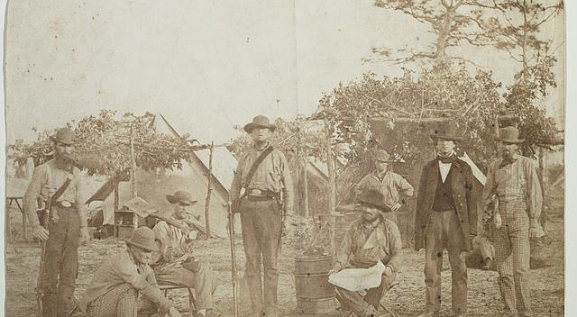
Confederate Camp Pensacola, Florida

Slide 17
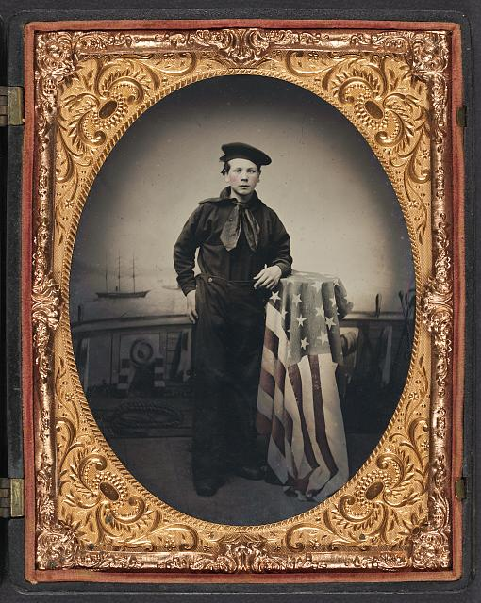
Unidentified Young Sailor

Slide 18
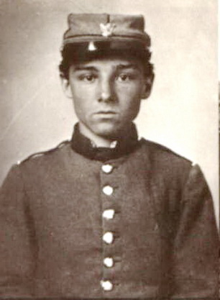
Young Northern Soldier

Slide 19
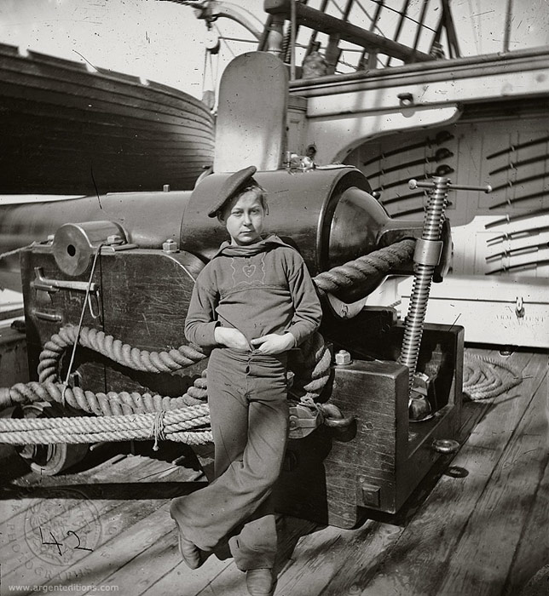
Boy Sailor

Slide 20
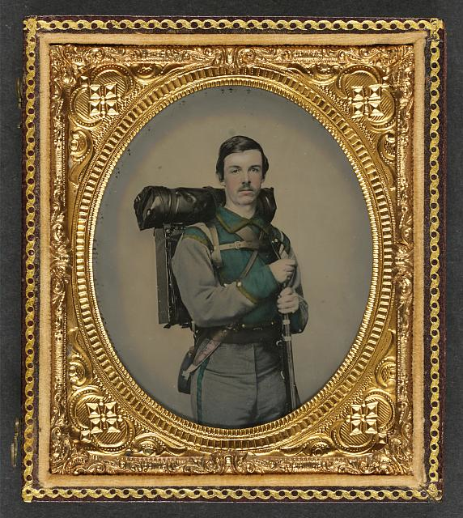
Young Confederate Soldier in Uniform

Slide 21
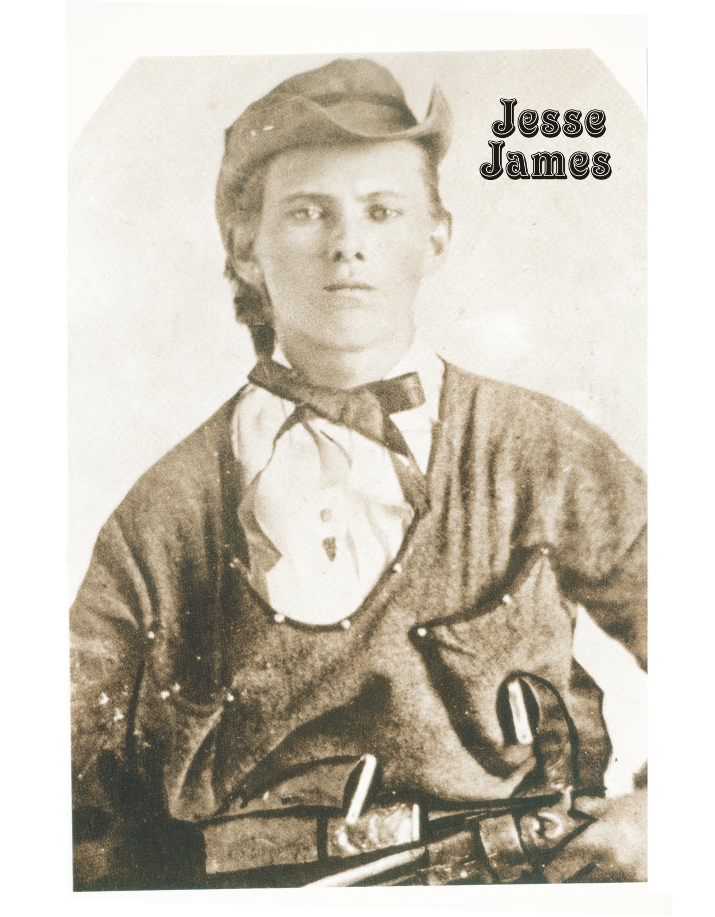
Jesse James in the Civil War

Slide 22
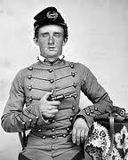
Cadet George A. Custer (1859)

Slide 23
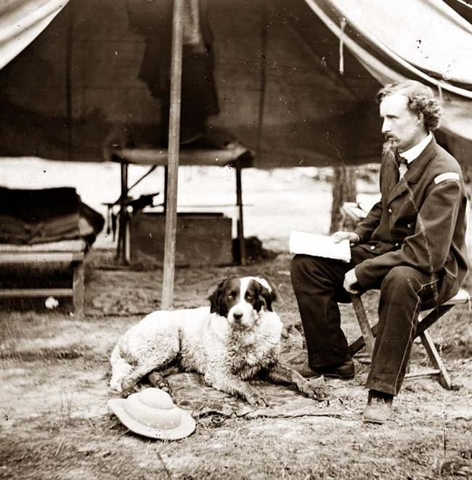
Lt. George A. Custer (1862)

Slide 24
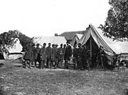
Custer at Battle of Antietam (1862)

Slide 25
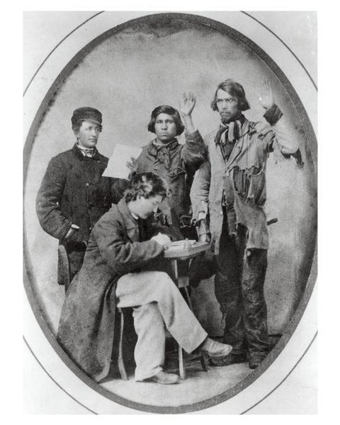
American Indian Recruits

Slide 26
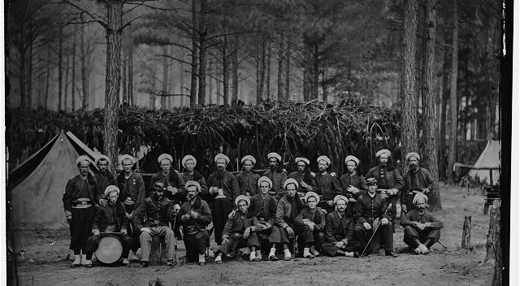
114th Pennsylvania Infantry (Zouaves)

Slide 27
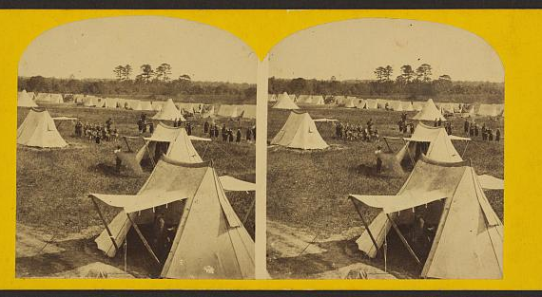
Fortress Monroe, Virginia

Slide 28
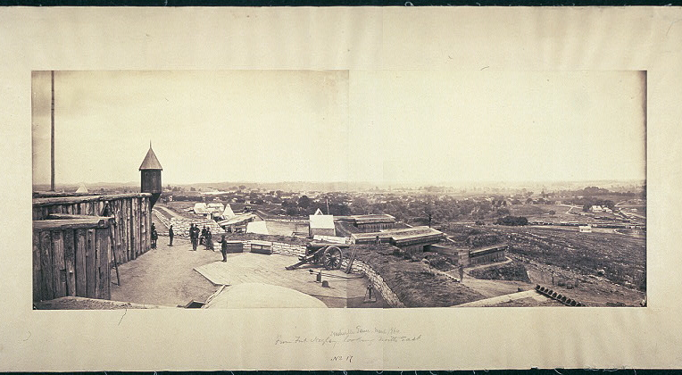
Fort Negley, Nashville, TN

Slide 29
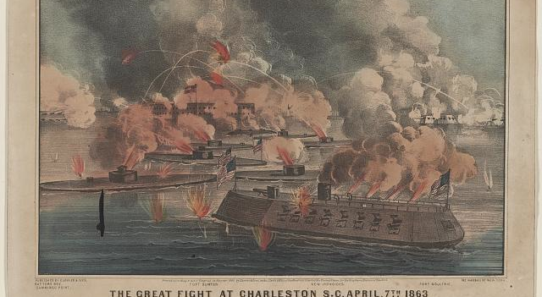
Battle of “Iron-Clads” at Charleston, SC (1863)

Slide 30
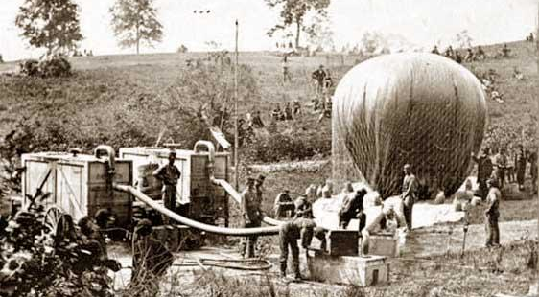
Civil War Balloon

Slide 31
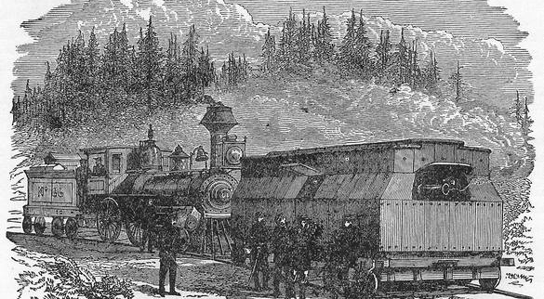
“Armored Railroad Car”

Slide 32
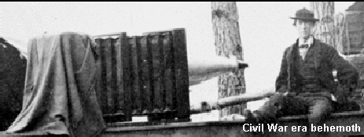
Civil War Camera

Slide 33
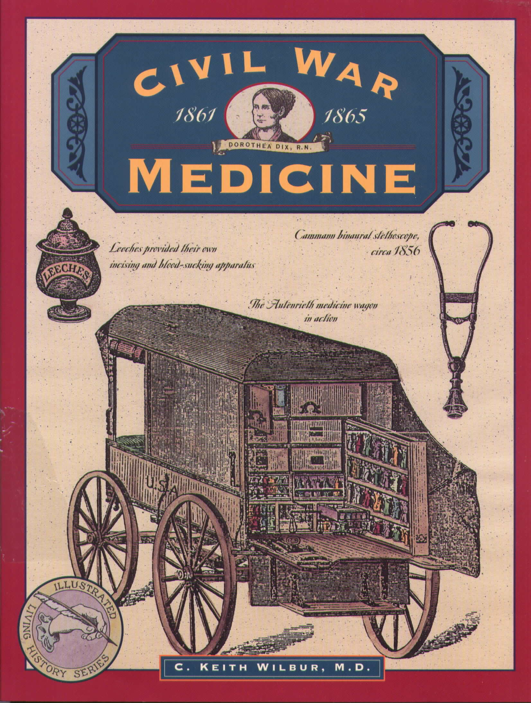
Civil War Medicine

Slide 34
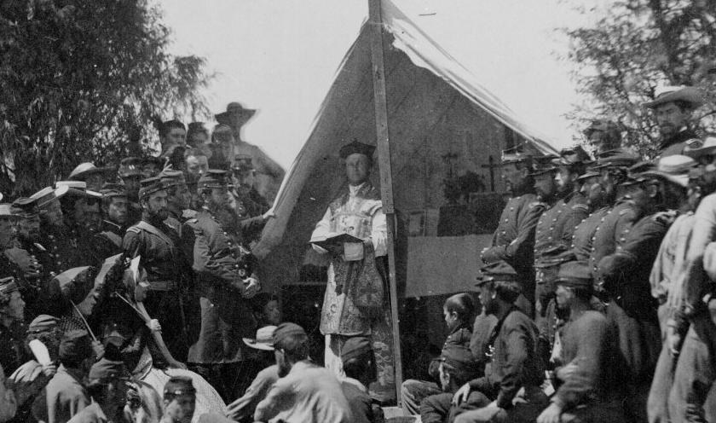
Roman Catholic Chaplain

Slide 35
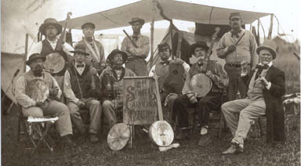
Carolina String Band

Slide 36
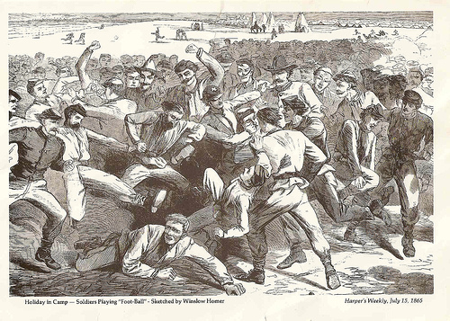
Soldiers Playing Football (July 1865)

Slide 37
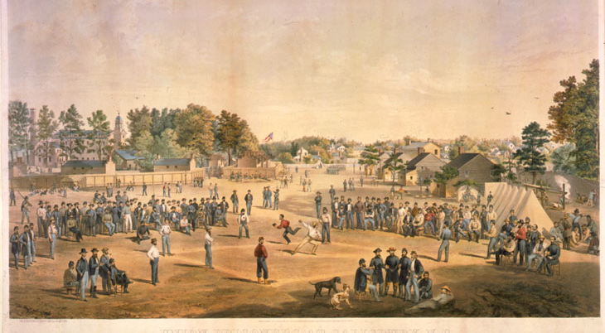
Union Prisoners Playing Baseball

Slide 38
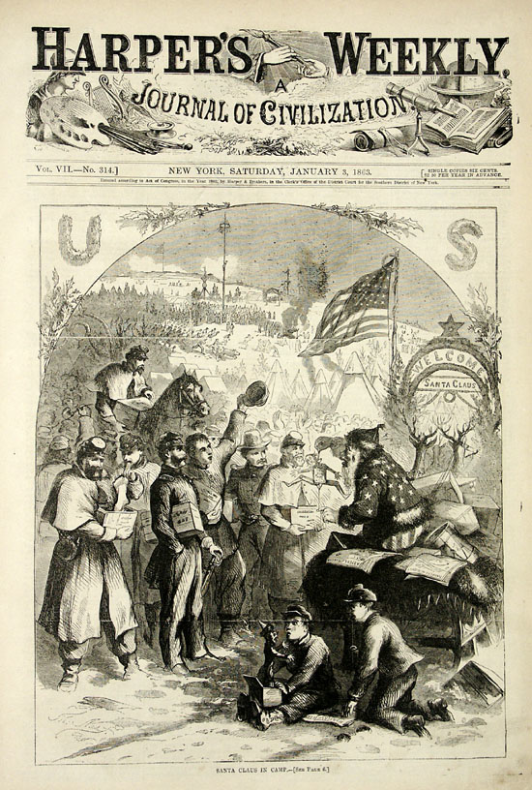
Santa Claus in the Civil War

Slide 39
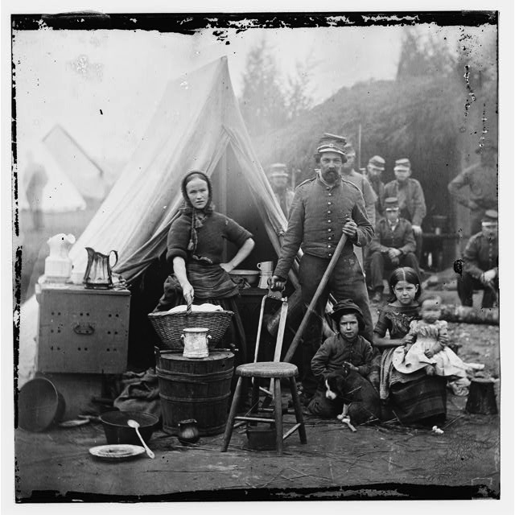
Tent Life, 31st Pennsylvania Infantry

Slide 40
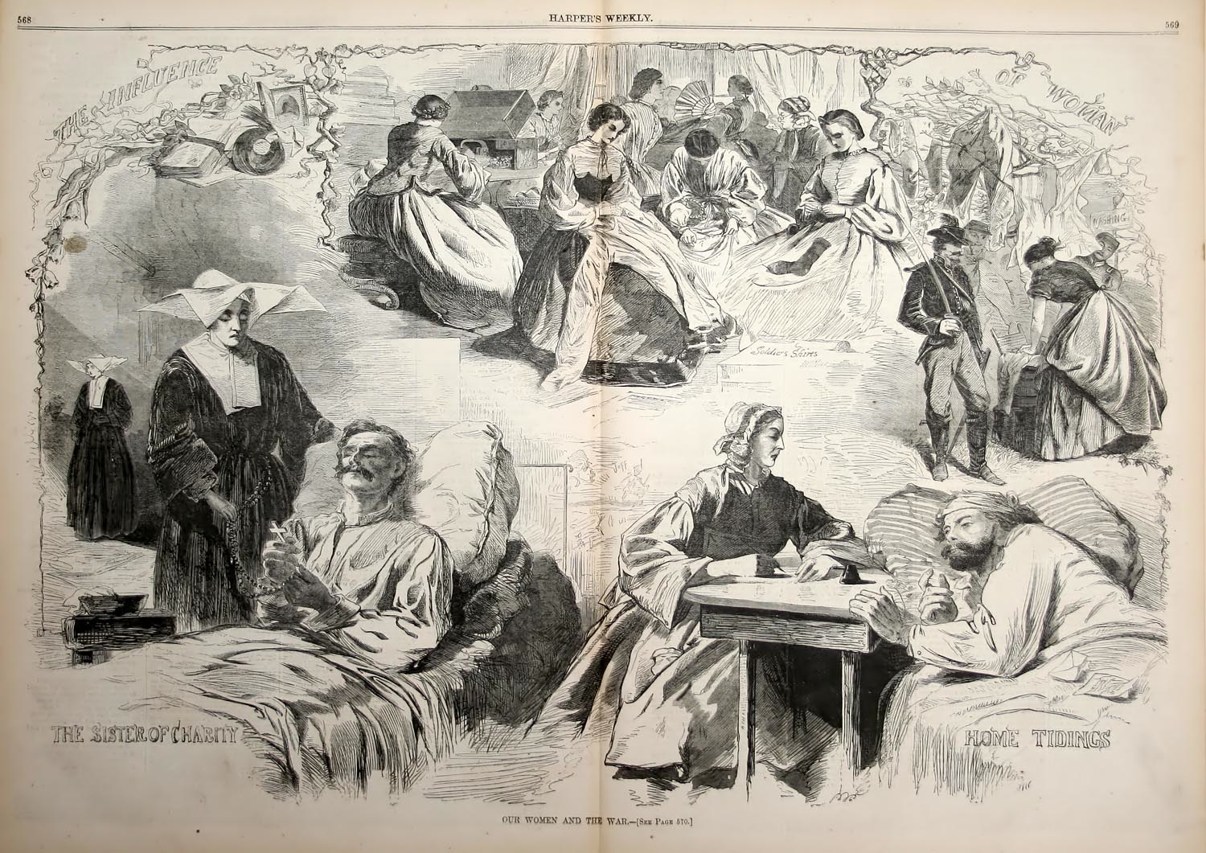
Women and the Civil War

Slide 41
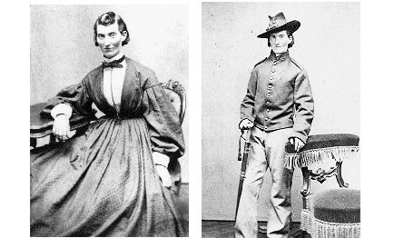
Frances Clayton in War

Slide 42
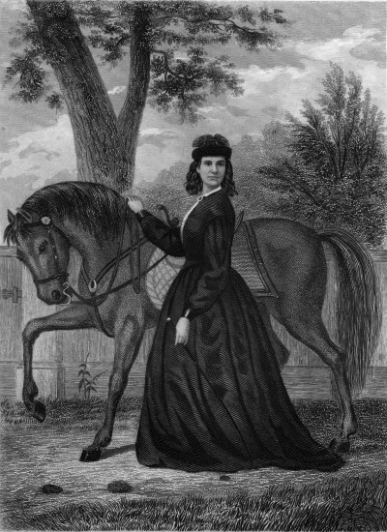
Sarah Emmonds: Solider, Nurse, Spy

Slide 43
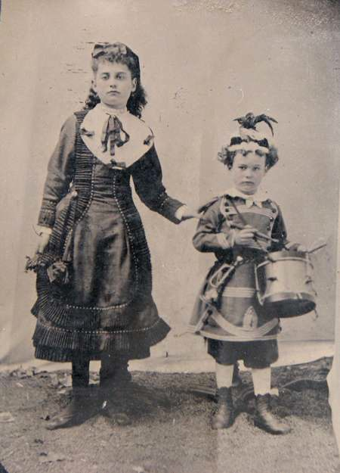
Children at Decoration Day Ceremony

Slide 44
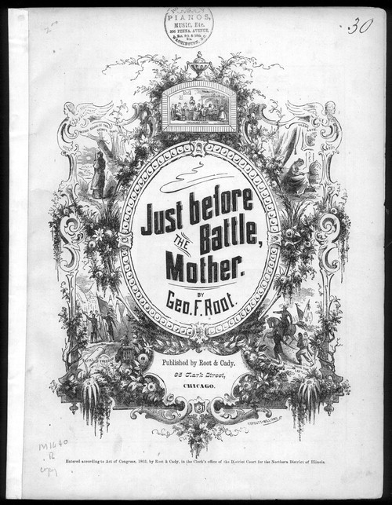
“Just Before the Battle, Mother” (sheet music)

Slide 45
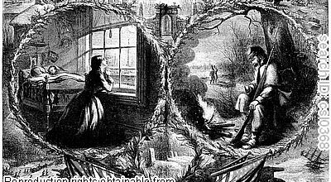
Christmas Card in Civil War

Slide 46
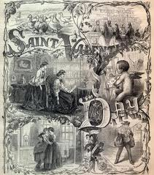
St. Valentine’s Day Card

Slide 47
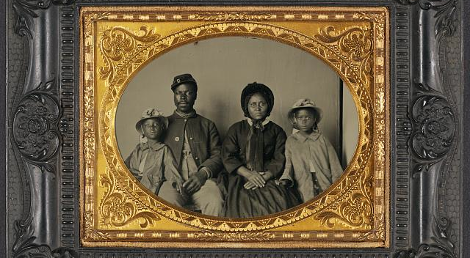
Black Union Solider and Family

Slide 48
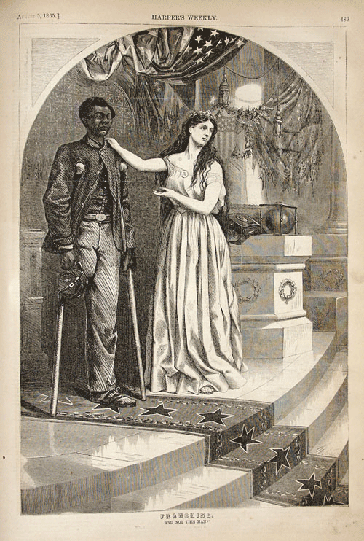
Lady Liberty and Black Veteran

Slide 49
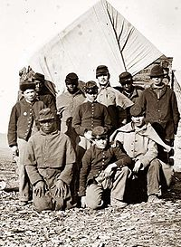
Black and White Union Soldiers

Slide 50
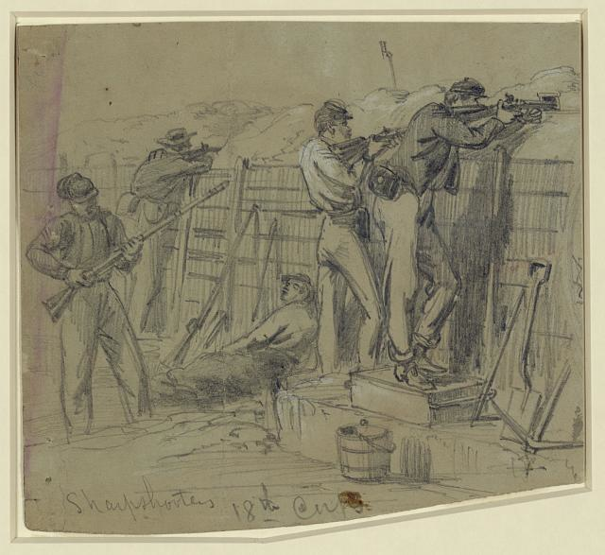
Sharpshooters 18th Corps

Slide 51
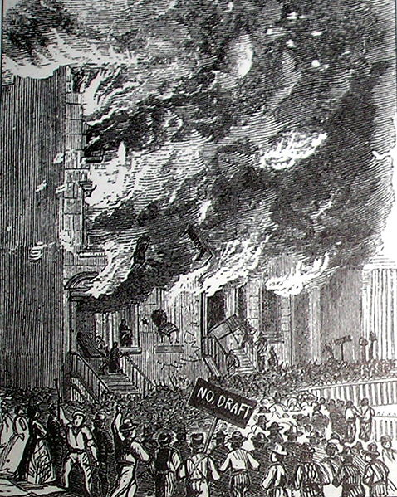
New York City Draft Riots (July 1863)

Slide 52
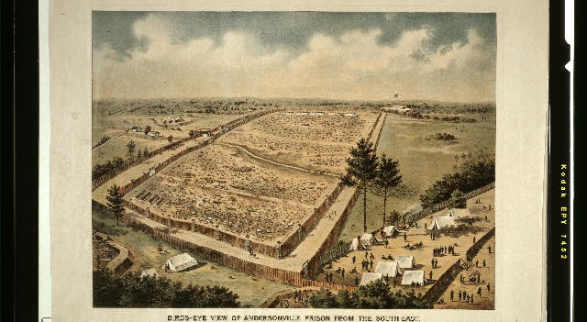
Andersonville Prison

Slide 53
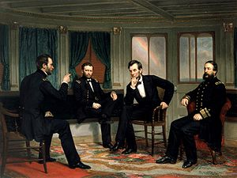
The Peacemakers (March 1865)

Slide 54
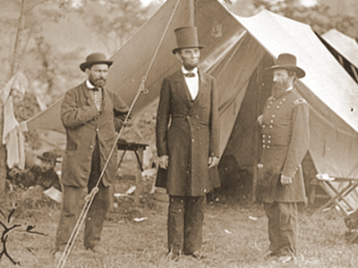
Lincoln on the Battlefield

Slide 55
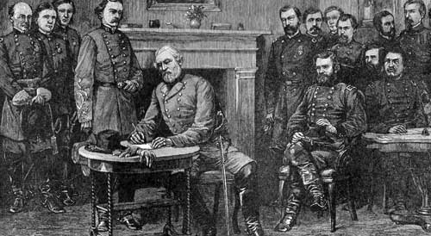
Surrender at Appomattox (April 9, 1865)

Slide 56
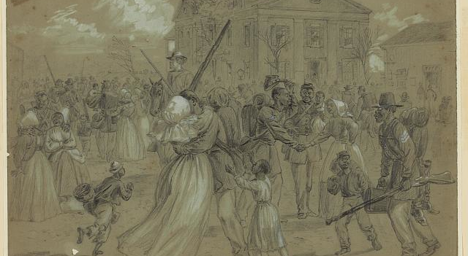
Black Soldiers Mustered Out at Little Rock, AR

Slide 57
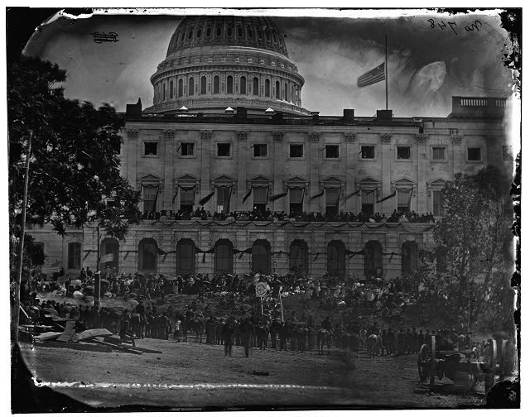
Grand Review of Union Army, Washington, DC (May 1865)

Slide 58
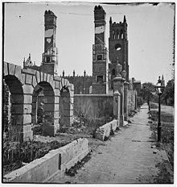
Charleston, SC (1865)

Slide 59

Ruins in Richmond, VA

Slide 60

Fort Sumter at war’s end

