Slide 1
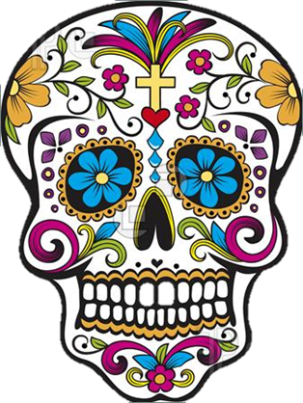
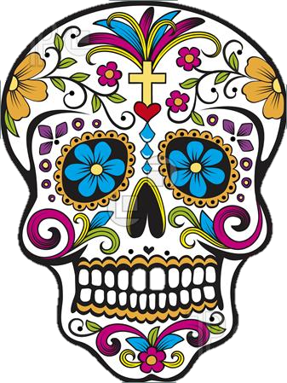

DIA DE LOS MUERTOS DAY OF THE DEAD
University Center, Panorama Room
University of Northern Colorado
October 28th , 2014
Dr. Priscilla Falcon
Priscilla.Falcon@unco.edu

Slide 2
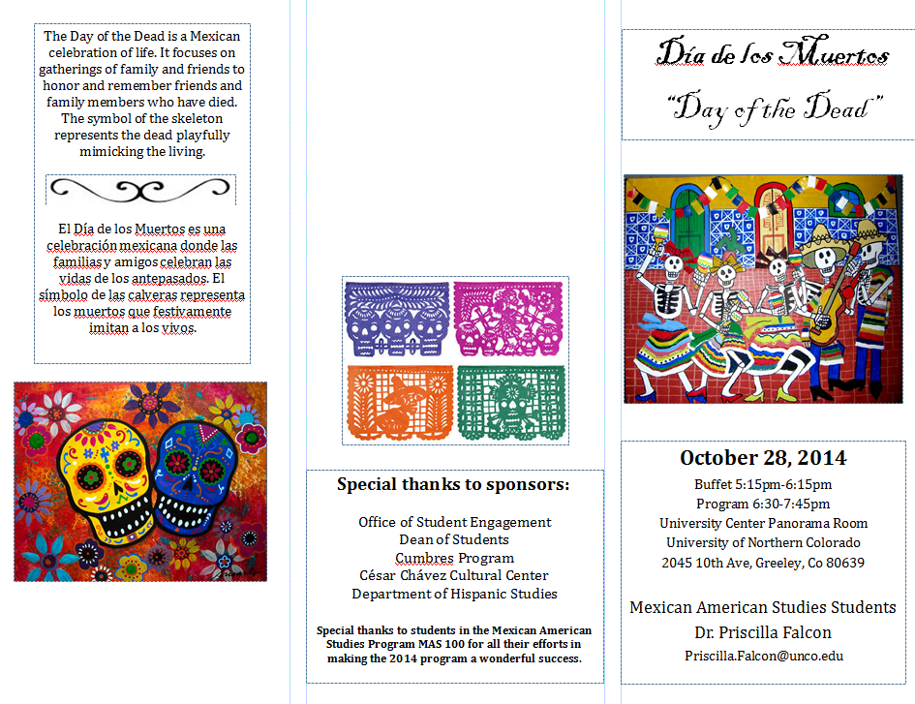
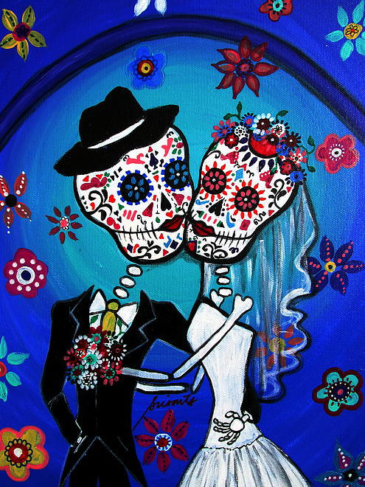
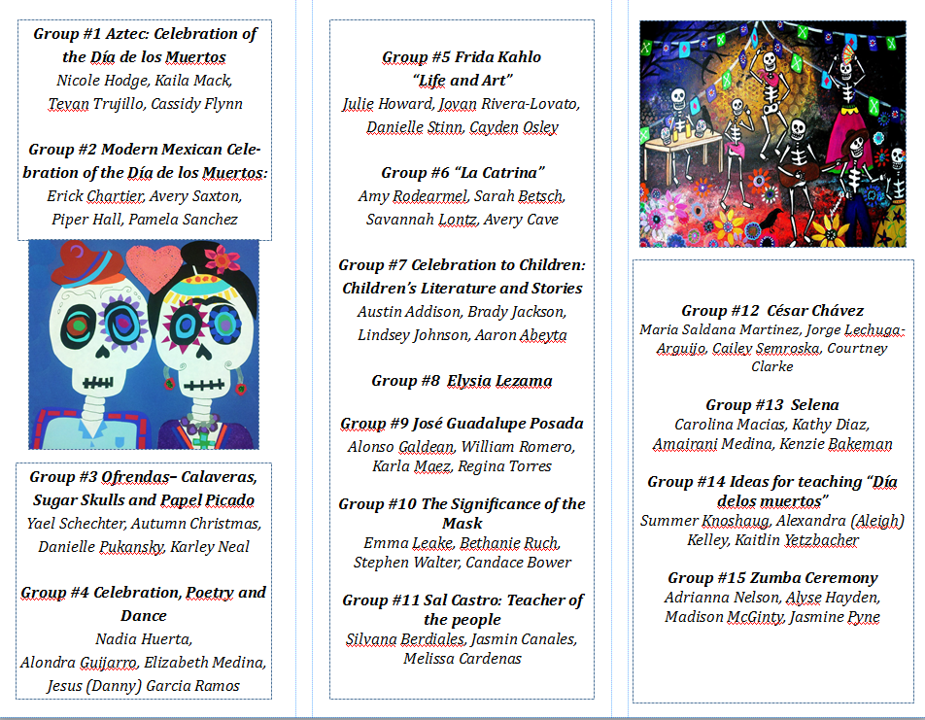
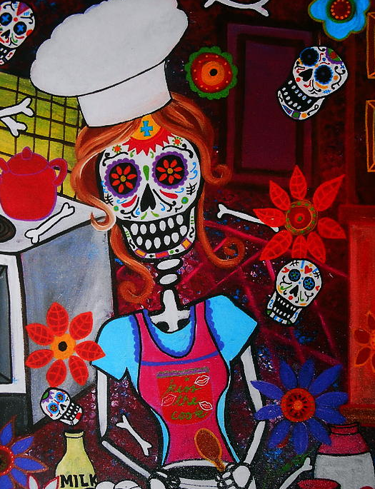

Slide 3
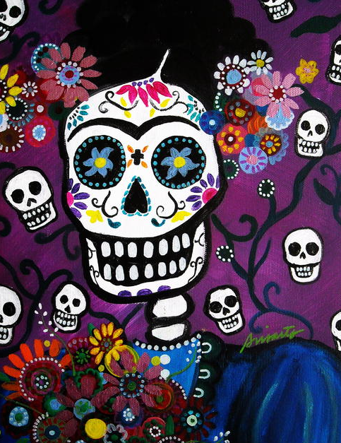
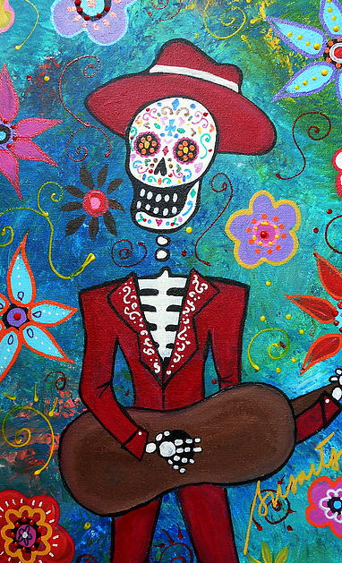
The Day of the Dead is a Mexican celebration of life. It focuses on gatherings of family and friends to honor and remember friends and family members who have died. The symbol of the skeleton represents the dead playfully mimicking the living.
El Día de los Muertos es una celebración mexicana donde las familias y amigos celebran las vidas de los antepasados. El símbolo de las calveras representa los muertos que festivamente imitan a los vivos.

Slide 4
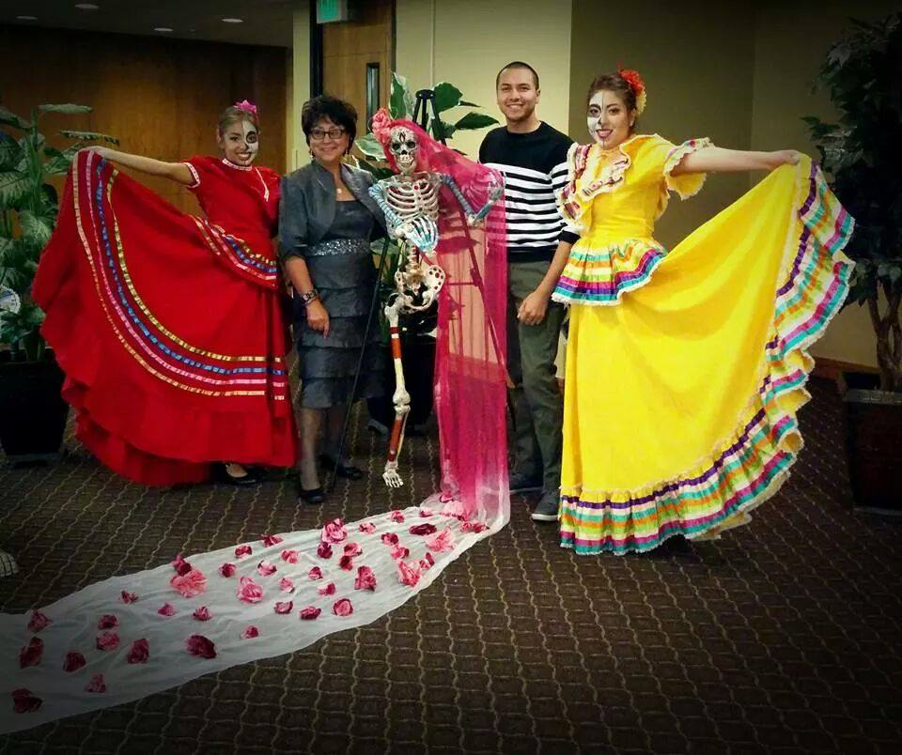
Jorge Tinajera
Dr. Priscilla Falcon
Nadia Huerta
Alondra Guijaro

Slide 5
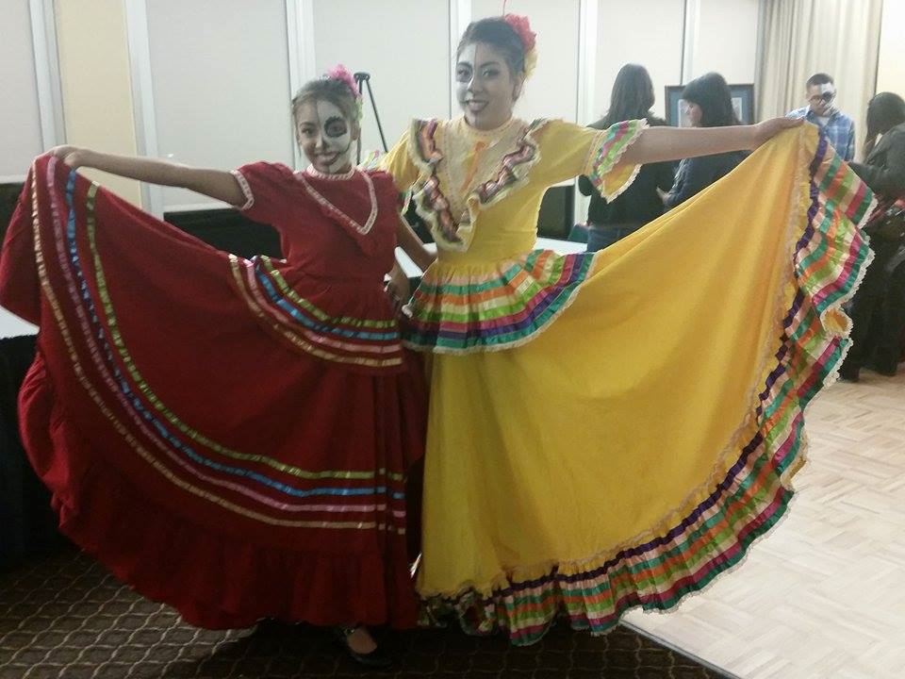
Alondra Guijaro
Nadia Huerta

Slide 6
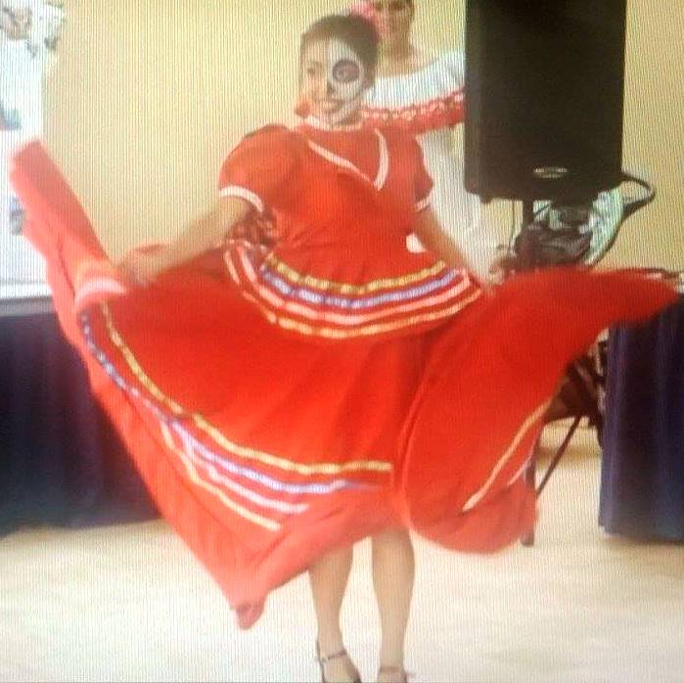
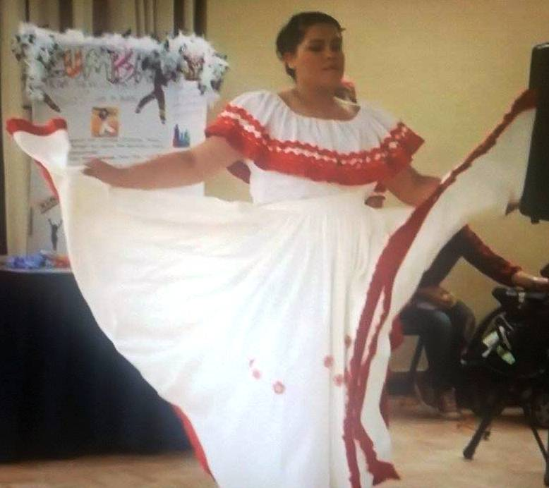
Alondra Guijaro
Elizabeth Medina

Slide 7
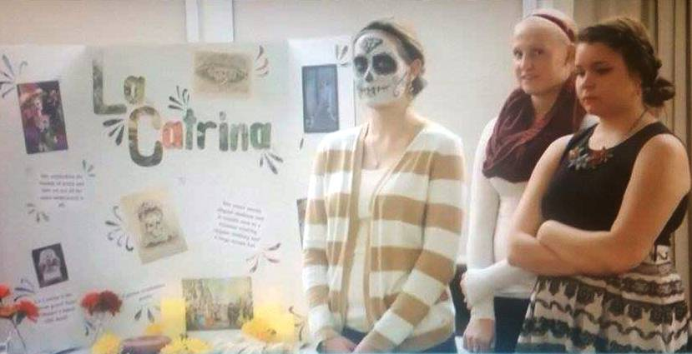
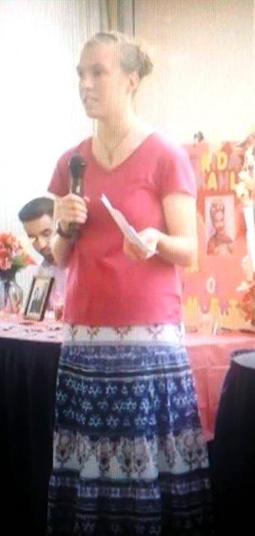
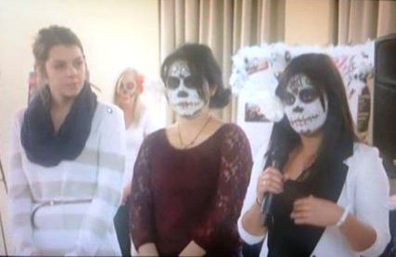
Avery Cave
Sarah Betsch
Amy Rodearmel
Savannah Lontz
Carolina Macias
Kenzie Bakemen
Amairani Medina

Slide 8
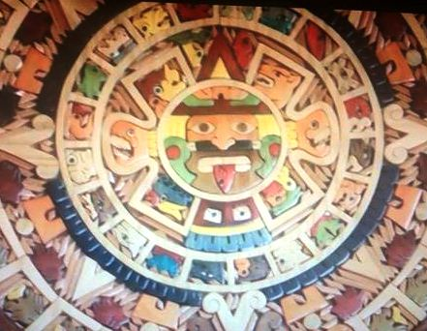
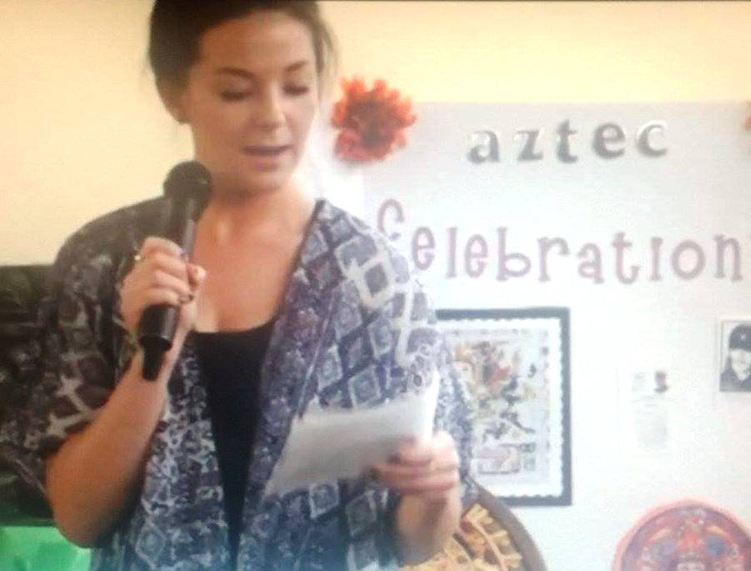
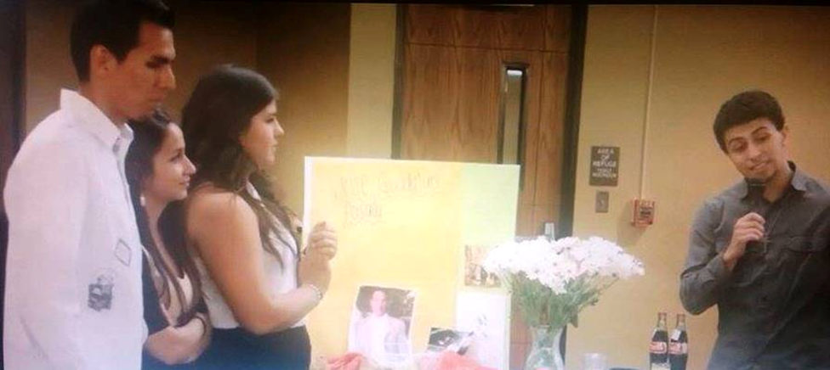
Cassidy Flynn
Will Romero
Alonso Goldean
Regina Torrez
Karla Mayez

Slide 9
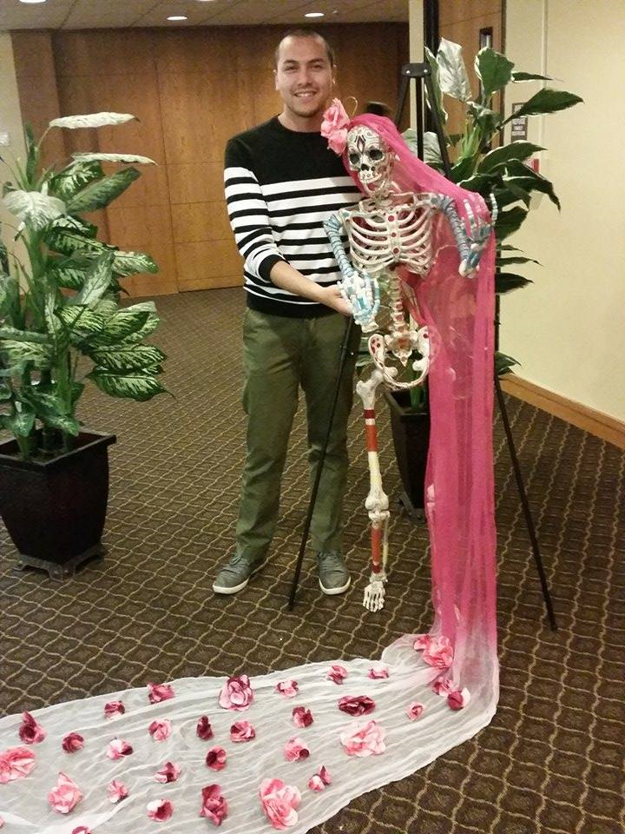
Jorge Tinajera

Slide 10
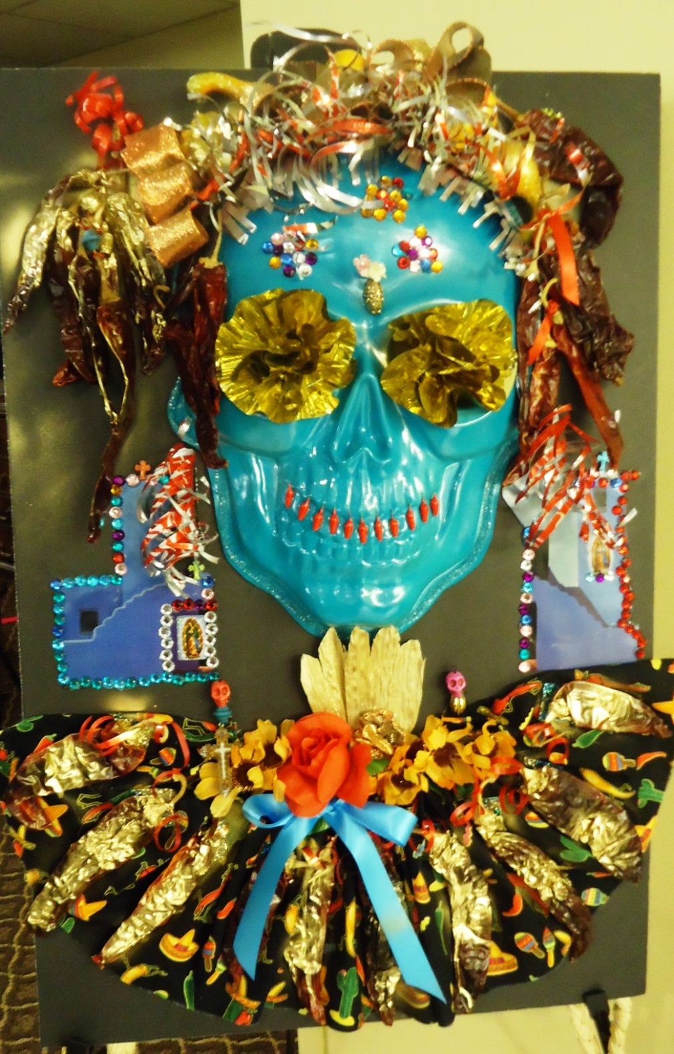

Slide 11
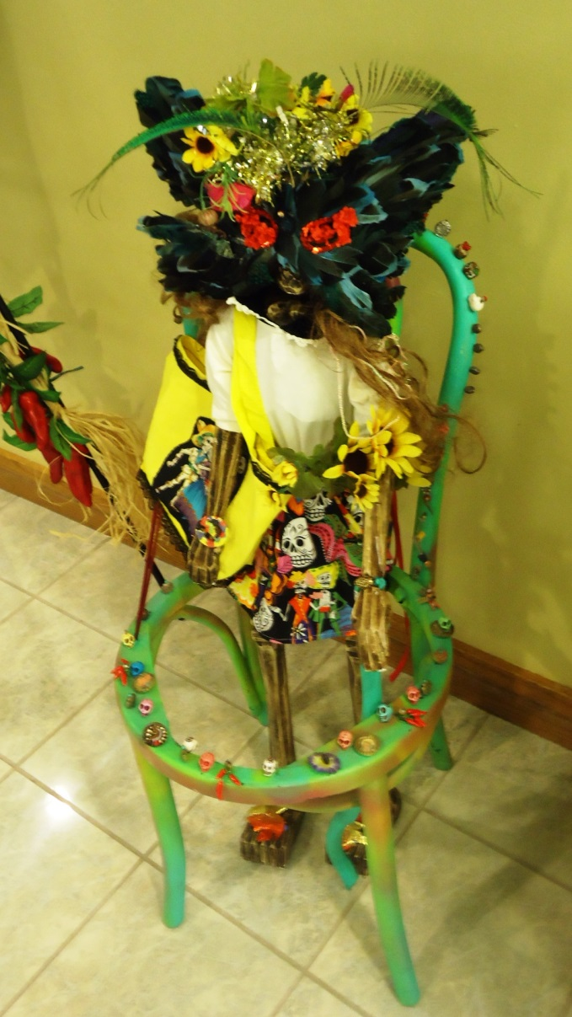
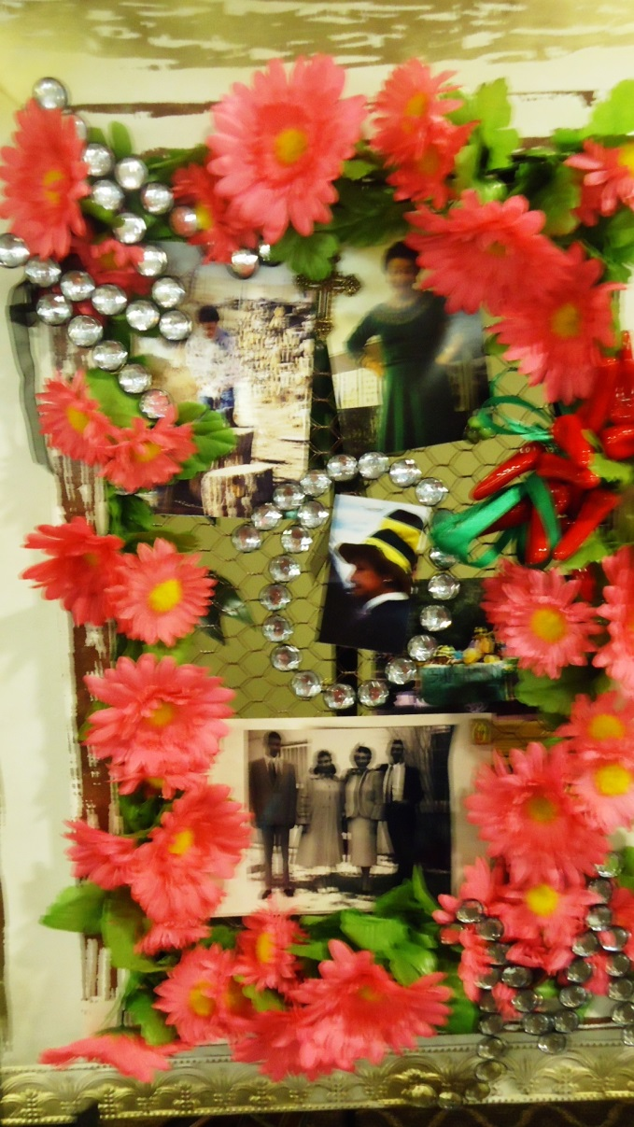
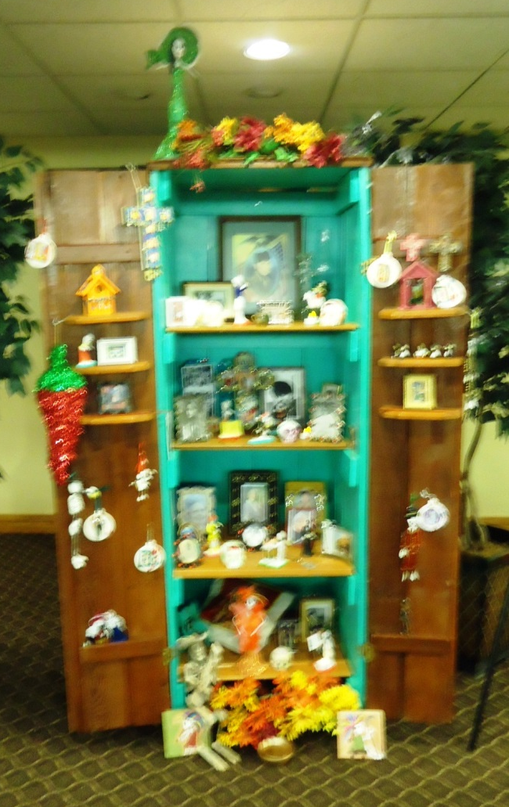

Slide 12
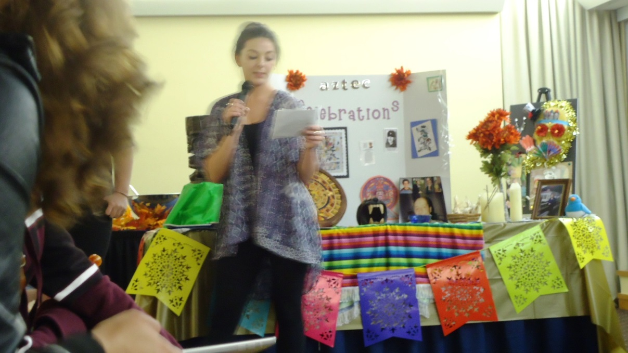
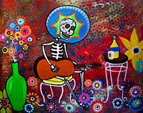
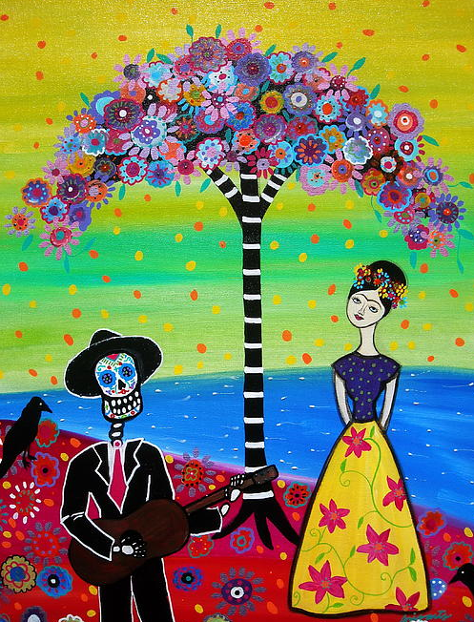
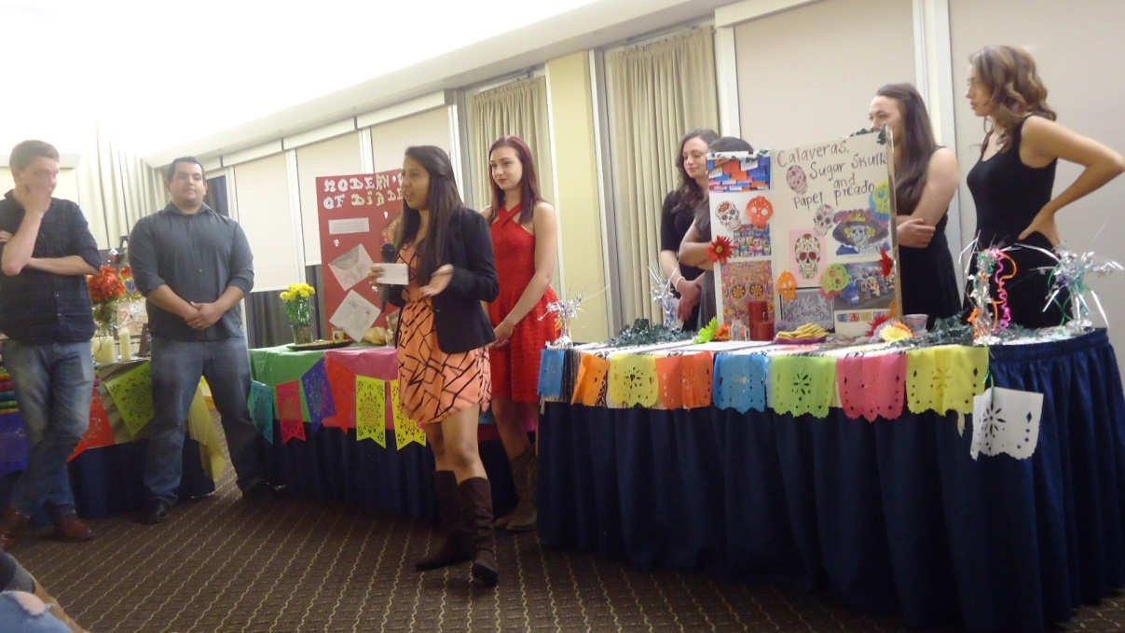
Cassidy Flynn
Danielle Pukansky
Yael Schechter
Karely Meal
Piper Hall
Avery Saxton
Erick Chartier
Pamela Sanchez

Slide 13
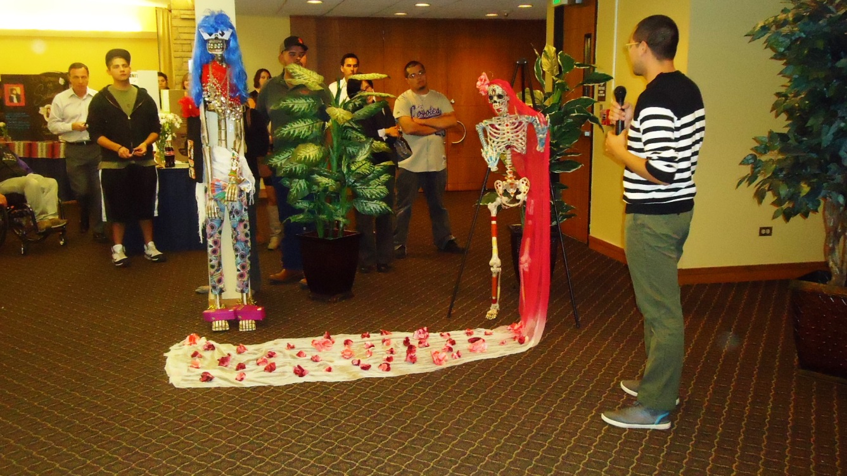
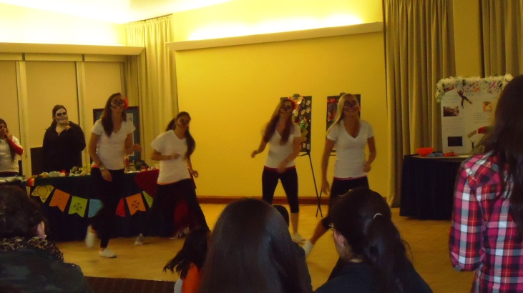
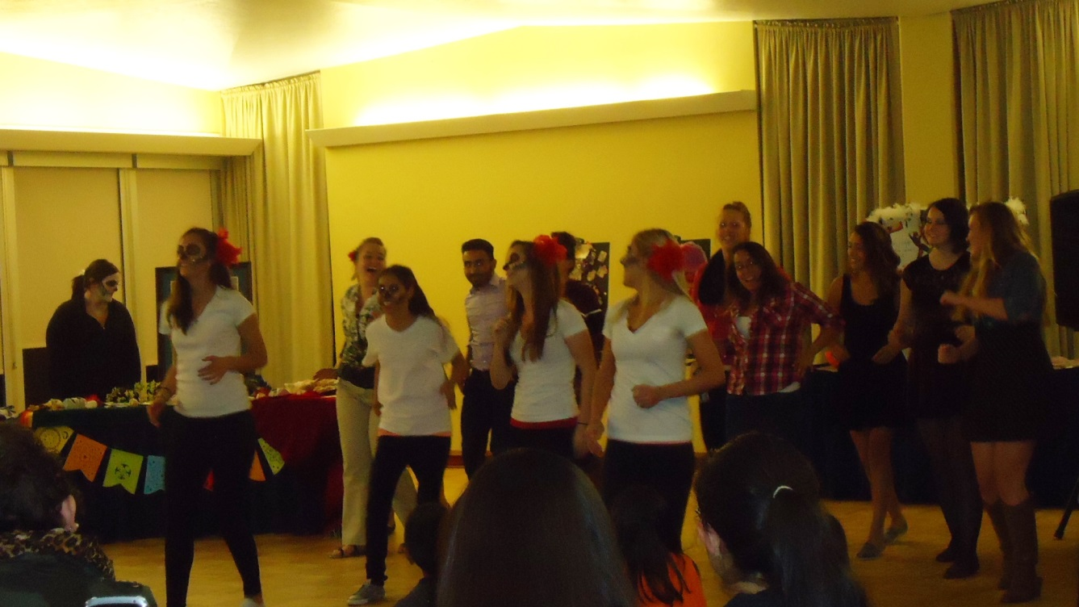
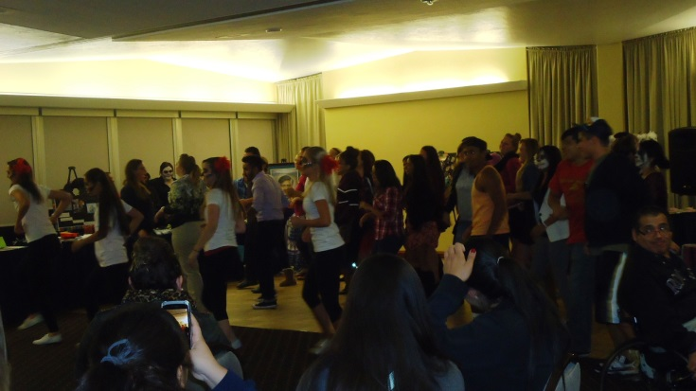
Maddy McGnty
Jasmine Pyne
Alyse Hayden
Adrianna Nelson
Jorge Tinajera
Maddy McGnty
Alyse Hayden
Adrianna Nelson
Jasmine Pyne

Slide 14
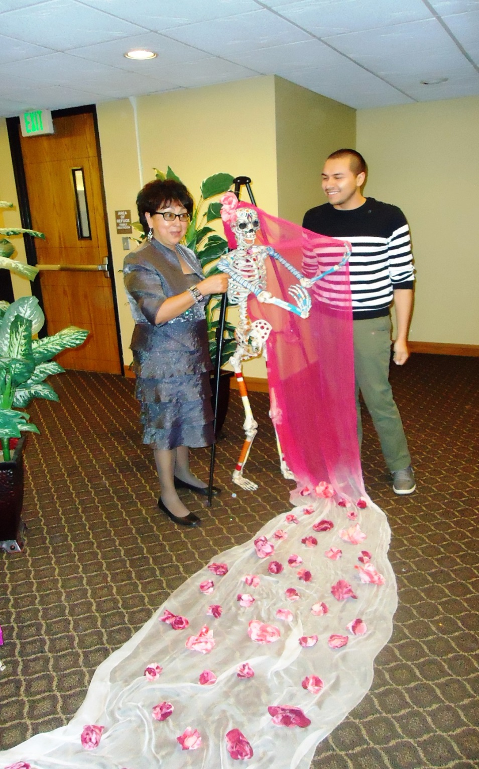
Jorge Tinajera
Dr. Priscilla Falcon

Slide 15
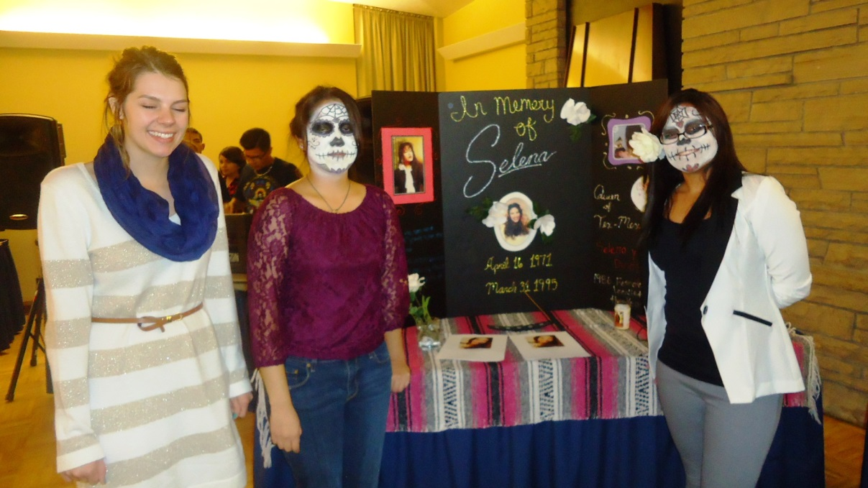
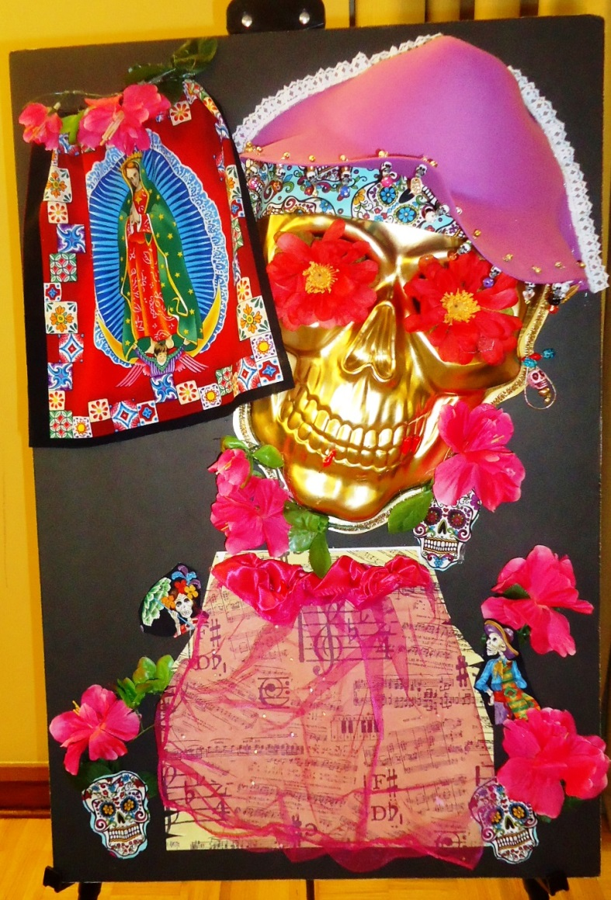
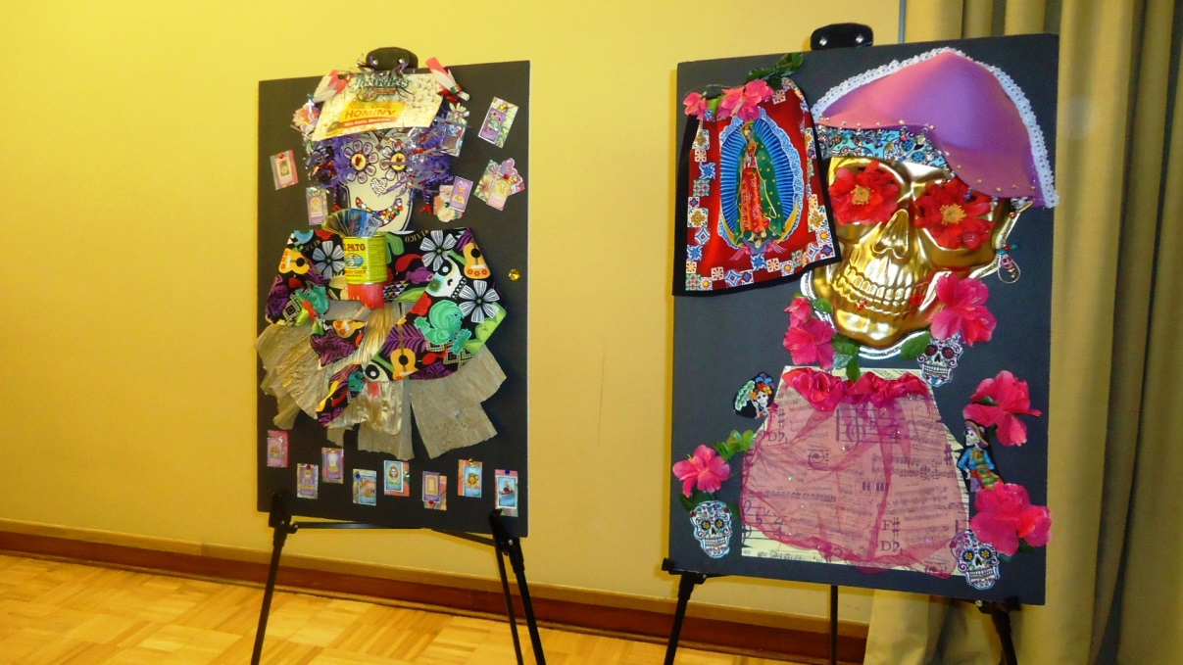
Carolina Macias
Amairani
Medina
Kenzie Bakemen

Slide 16
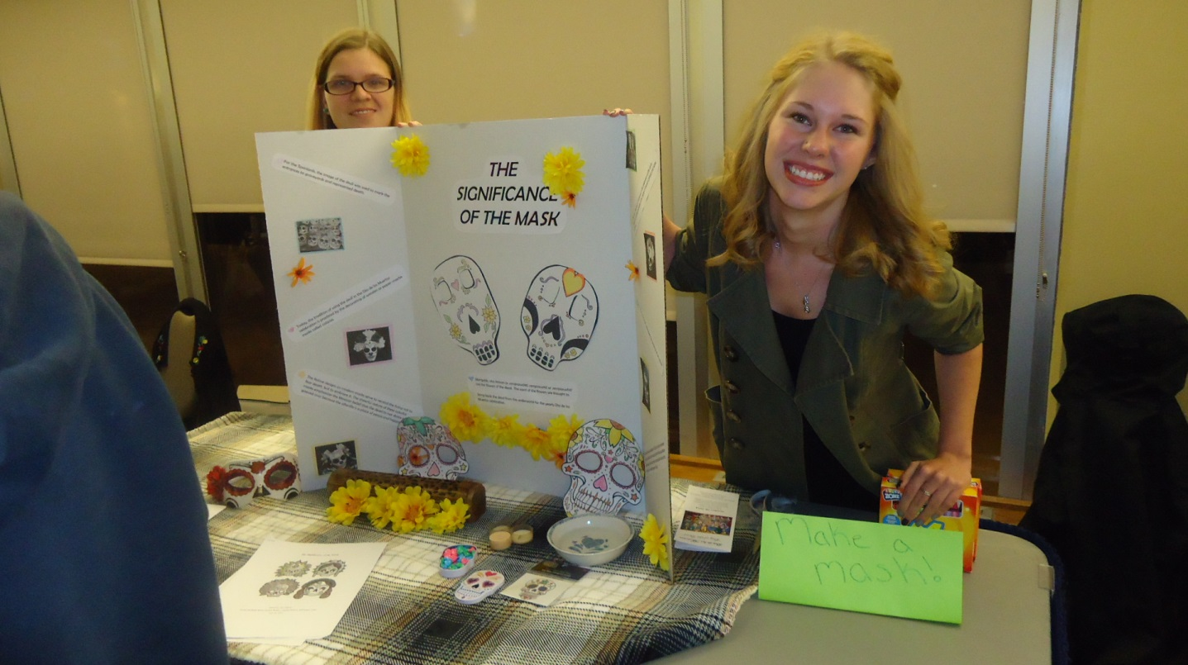
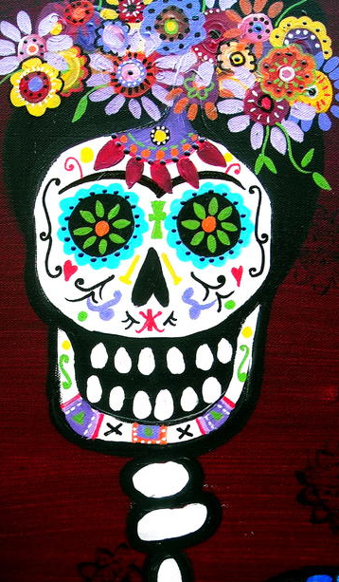
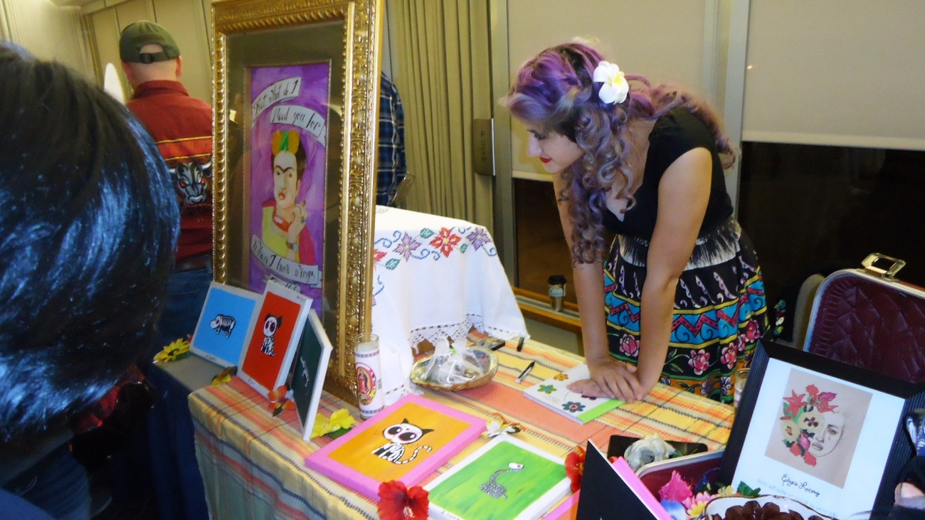
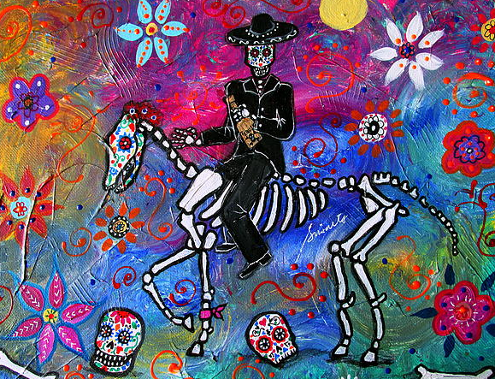
Candace Bower
Bethanie Ruch
Elysia Lezama

Slide 17
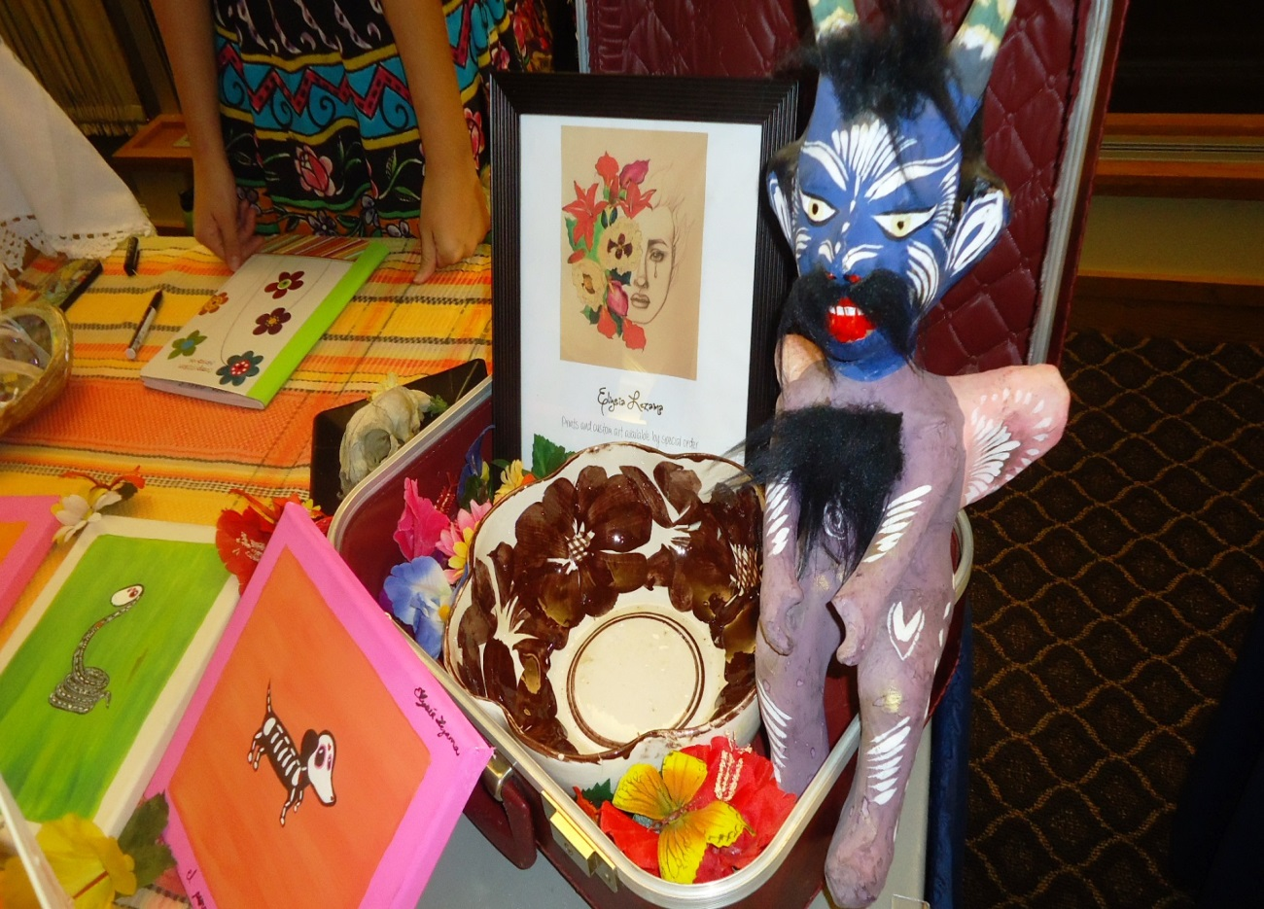
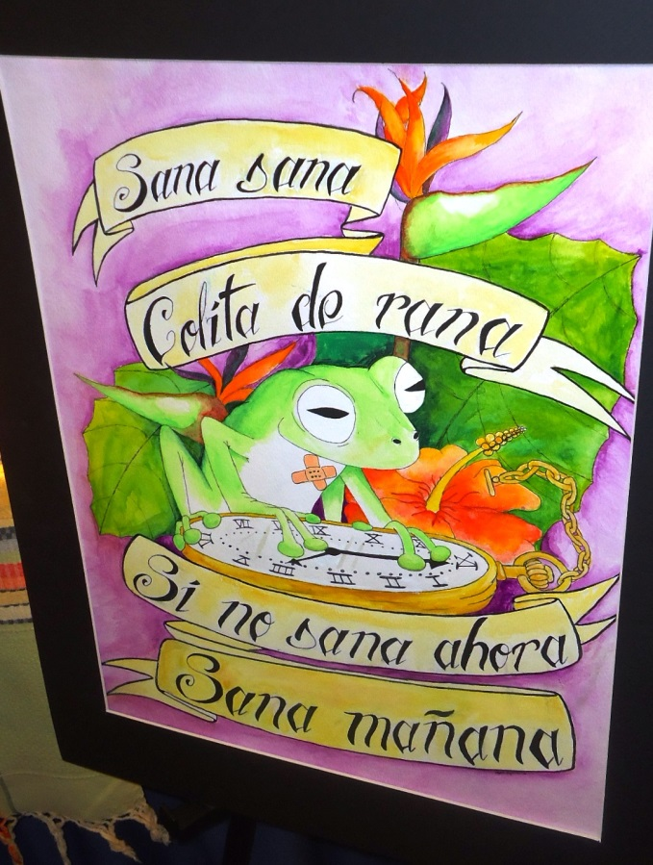

Slide 18
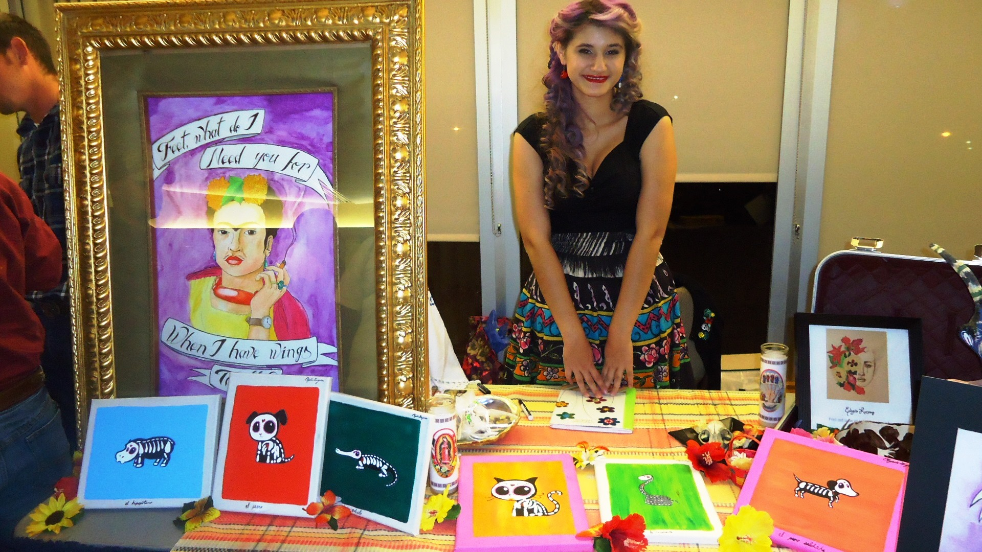
Elysia Lezama

Slide 19
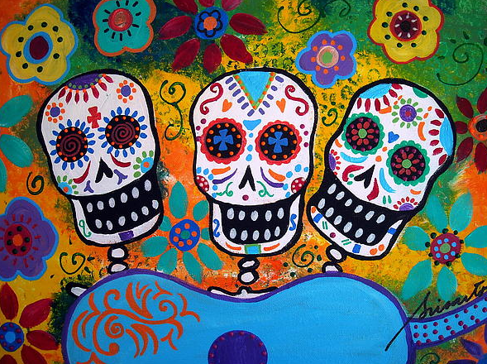
Special thanks to sponsors:
Office of Student Engagement
Dean of Students
Cumbres Program
César Chávez Cultural Center
Department of Hispanic Studies

