Slide 1
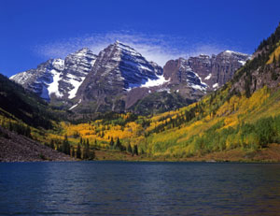
Mountain
Large natural elevation of the earth's surface rising abruptly from the surrounding level

Slide 2
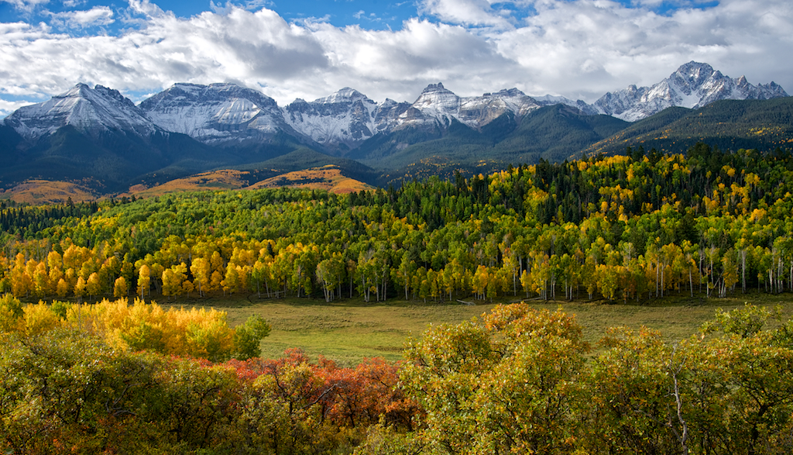
Mountain Range
Row or group of mountains

Slide 3
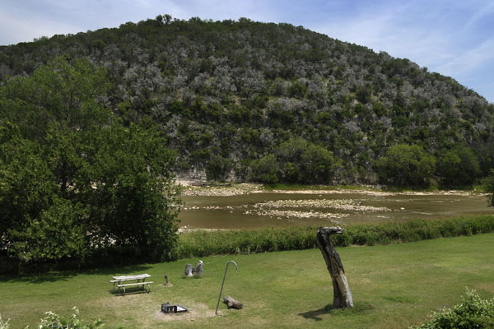
Hill
High, rounded land which is lower than a mountain

Slide 4
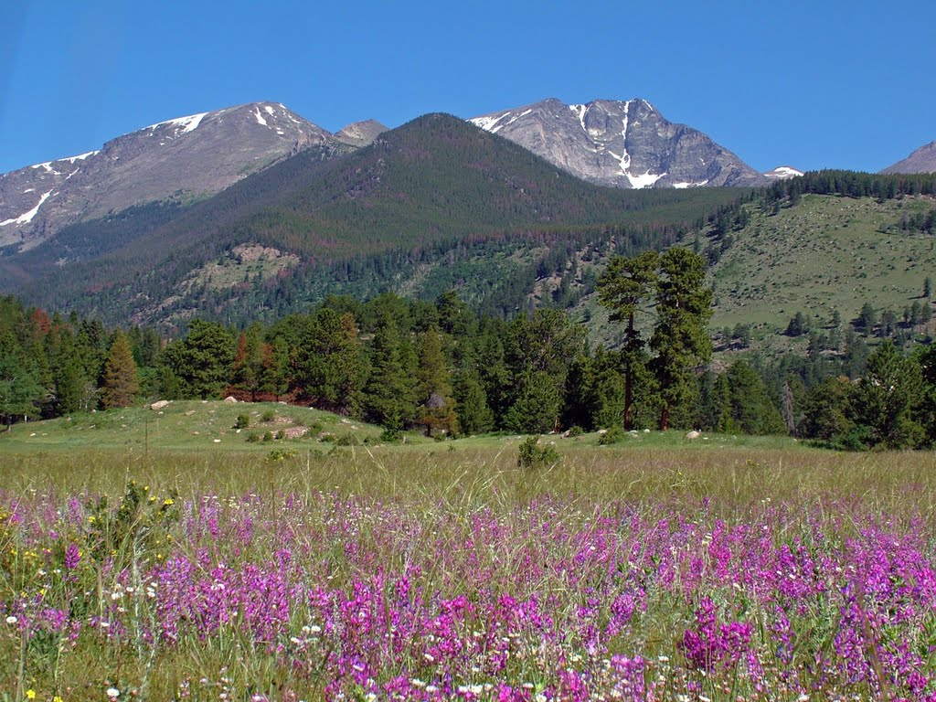
Park
Area of high, flat land surrounded by mountains

Slide 5
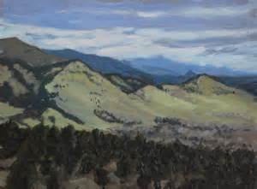
foothills
Hills near the bottom or foot of the mountain
Where the mountains seem to start to growing out of the plains

Slide 6
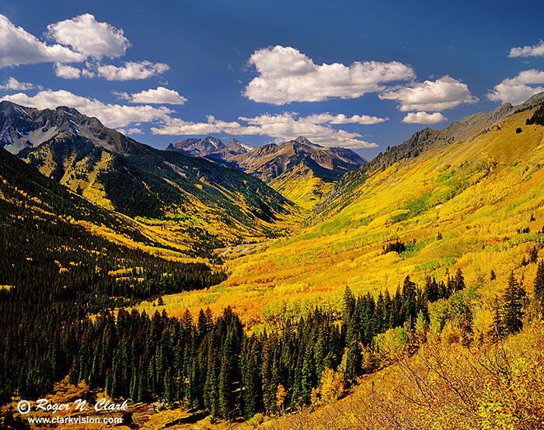
Valley
Low, flat land between hills or mountains

Slide 7
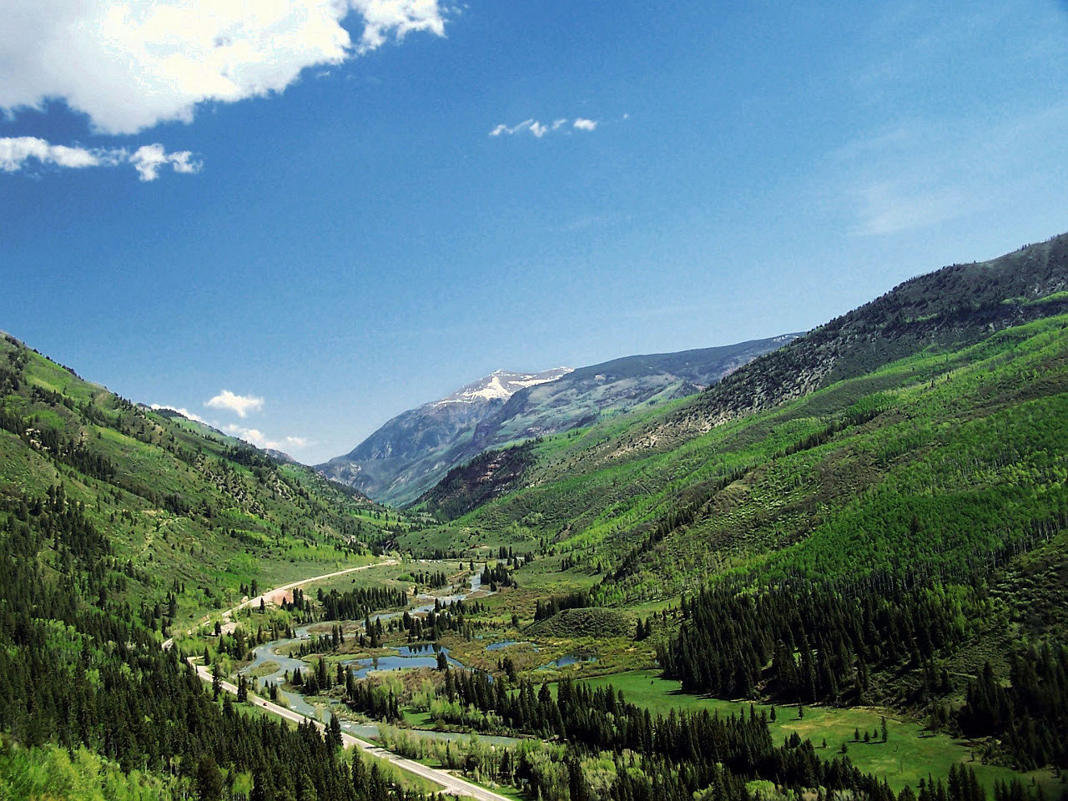
River valley
Area on each side of a river

Slide 8
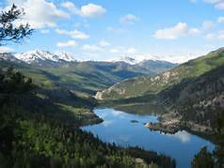
Lake
Large body of water, surrounded by land

Slide 9
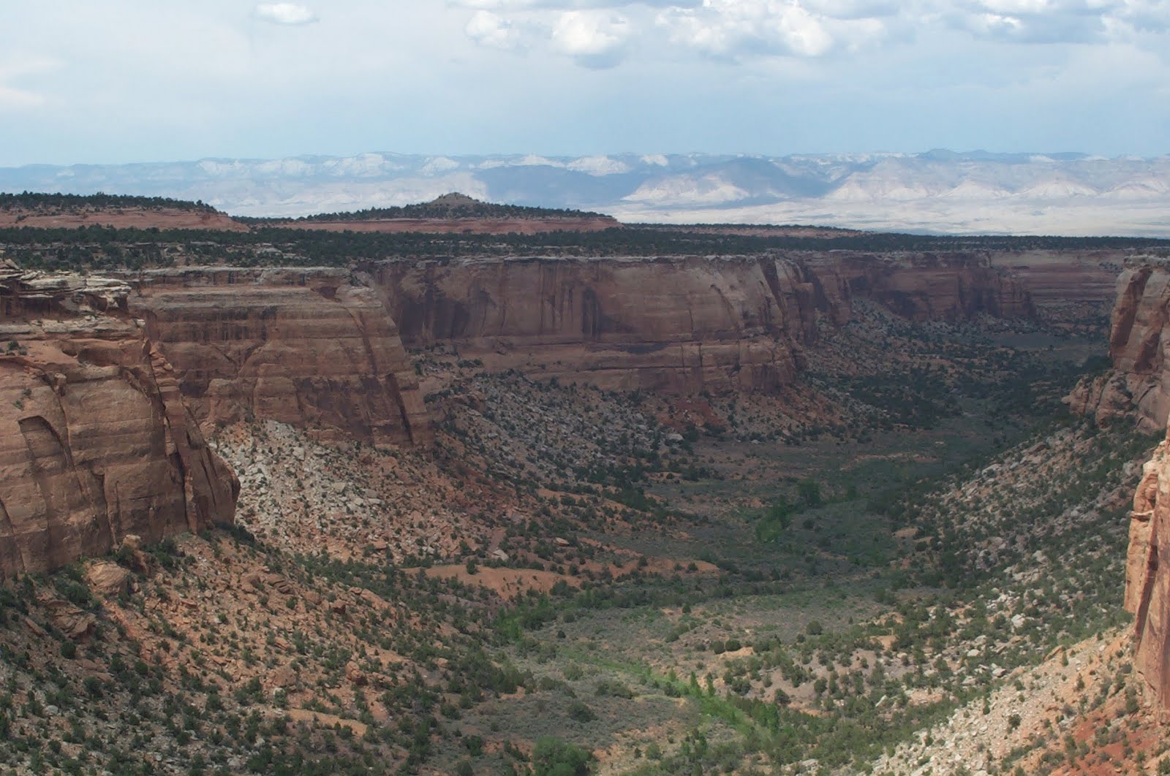
Plateau
Area of flat land higher than the land around it

Slide 10
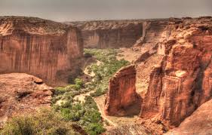
Canyon
Deep valley with steep sides

Slide 11
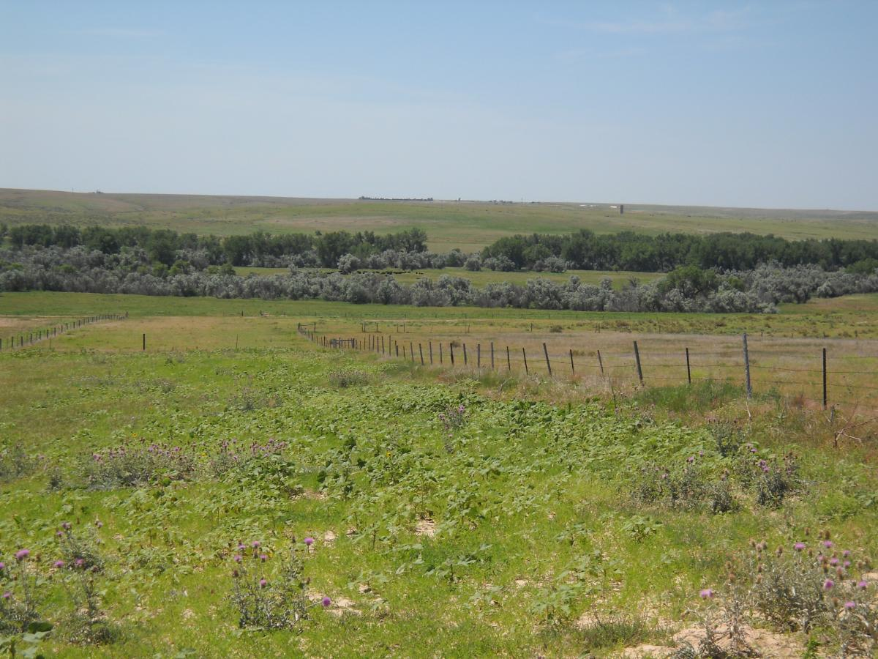
Plains
Big open area of flat lands that usually does not have many trees or hills

Slide 12
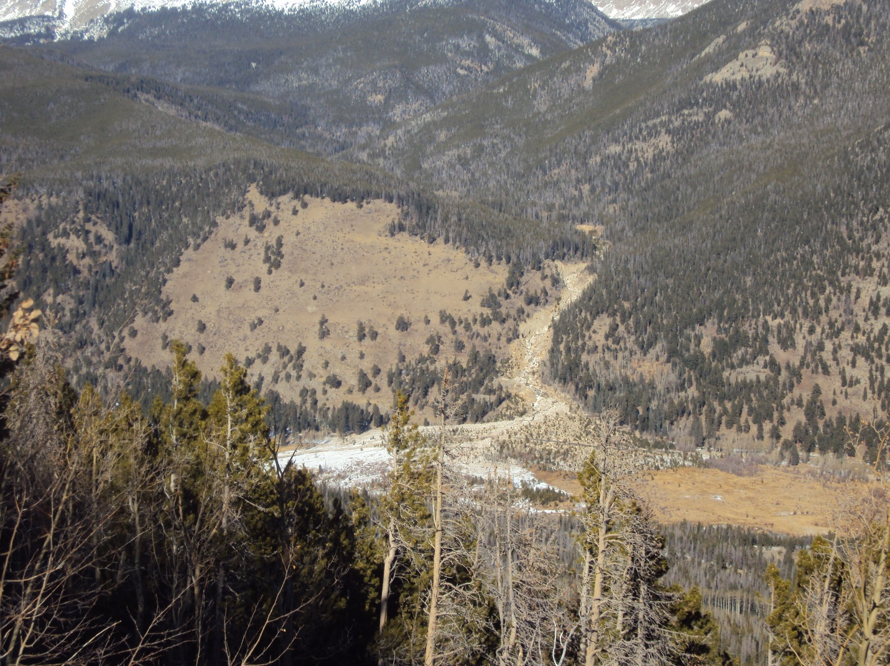
Alluvial fan
Triangle-shaped deposit of gravel, sand, and small pieces of sediment, usually created as flowing water interacts with mountains, hills, or the steep walls of canyons

Slide 13
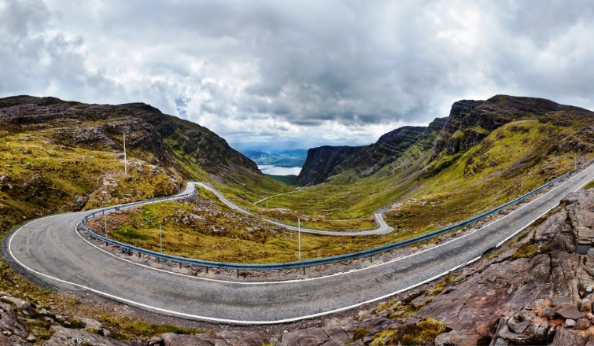
pass
Narrow route across a relatively low notch or depression in a mountain barrier

Slide 14
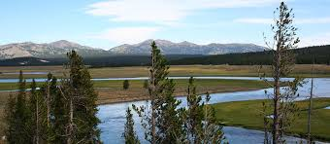
RIVER
Large natural stream of water flowing in a channel to the sea, a lake, or another such stream

