Slide 1
Slate 101: Access and Navigation The basics of accessing and navigating within Slate
Graduate School & International Admissions
Slate 101: Access and Navigation
11/28/2018

Slide 2
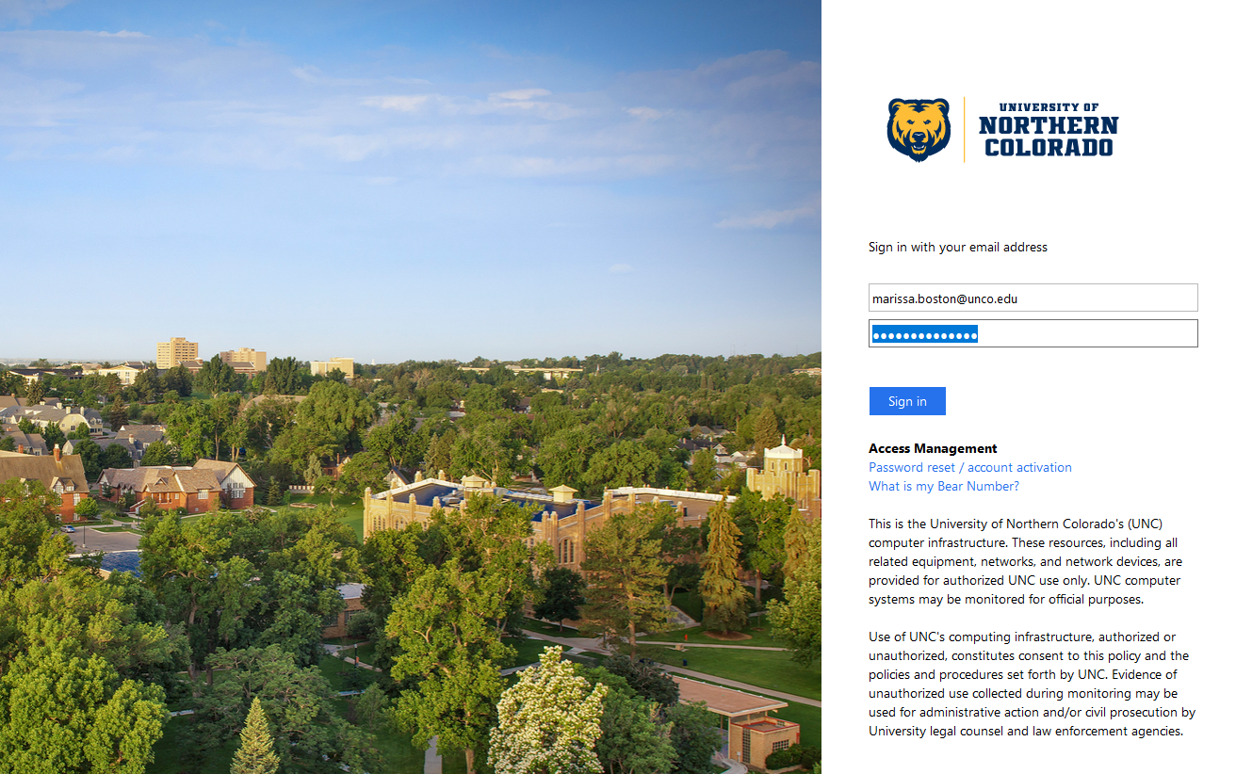
Slate 101
Logging In
Please use Google Chrome or Mozilla Firefox to access Slate.
To log into Slate, you will need to visit https://admissions.unco.edu/manage. We highly recommend bookmarking this page.
Log in using your complete @unco.edu email address and password.

Slide 3
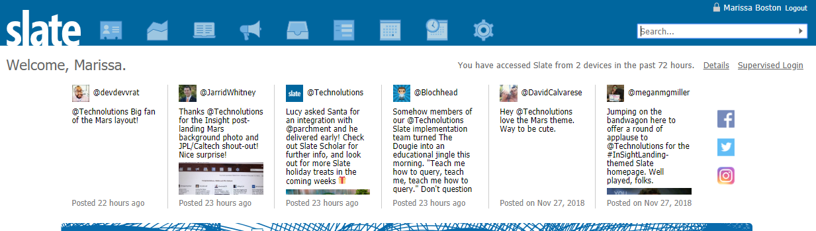
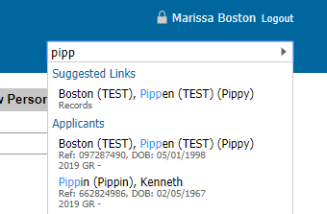
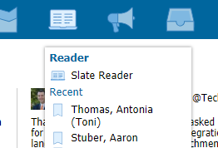
Slate 101
Main Page
This is the main page you see after logging into Slate.
From here, you can search for applicants and access the Slate Reader.
See page 8 for more on the database view!
You can also select an applicant name to go directly to their application within the Reader.
Slate Reader
To access the Slate Reader, click the third icon on the top menu and then select “Slate Reader”.
This is how you access applications for your programs.
Search
You can search for an applicant by entering their first name, last name, or nickname. Simply start typing and a list of potentially matching applicants will appear.
Click on an applicant name to open their application in database view.

Slide 4
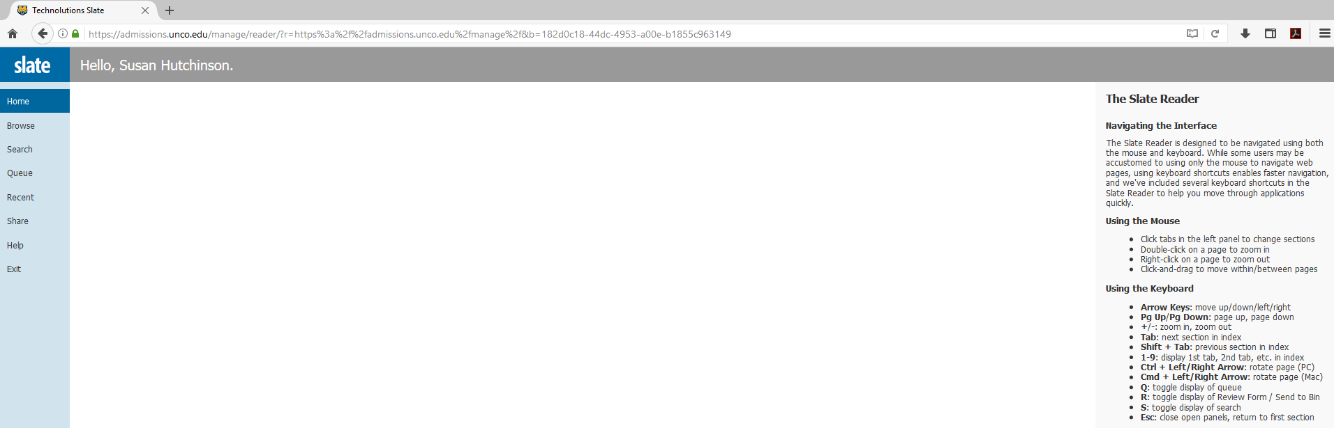
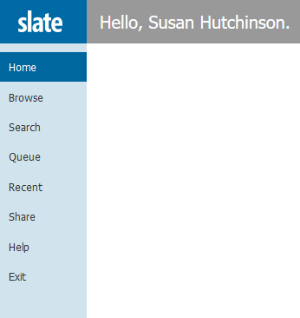
Slate 101
Slate Reader
The initial Slate Reader page is sparse.
Use the links on the left to navigate within the reader and applications.
Left Menu Links
Browse: brings up your “bins” and shows applications for your program and what stage they are in.
Search: allows you to search for a specific applicant.
Queue: shows applications that are specifically in your personal queue.
Recent: a list of recent applications you have viewed.
Exit: returns you to the main Slate page.

Slide 5
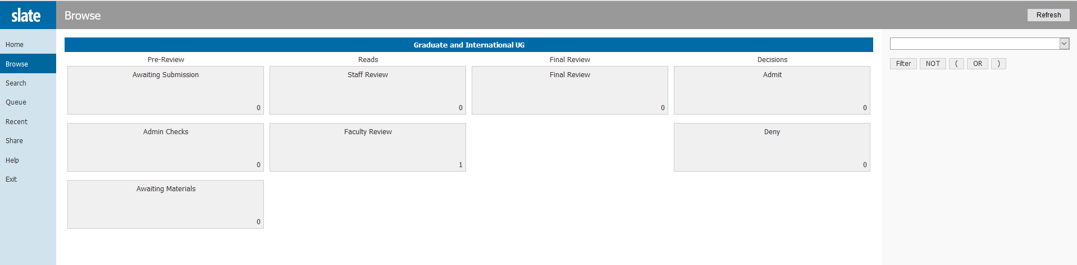
Slate 101
Browse
The Browse tab brings up “bins” that show the number of applications within each part of the application process.
Pre-Review
Awaiting Submission: application has been started, but the application fee has not been paid
Admin Checks: application is in initial review by the graduate school
Awaiting Materials: application has been reviewed and is awaiting transcripts, recommendations, etc.
Reads
Staff Review: application is under final review by the graduate school
Faculty Review: application is ready for faculty/departmental review
Final Review
Final Review: admission recommendation has been received and application is awaiting final processing by the graduate school
Decisions
Admit: applications that have been processed and admitted to a program
Deny: applications that have been processed and denied admission
The number in the lower right of each bin indicates how many applications are currently in it.

Slide 6
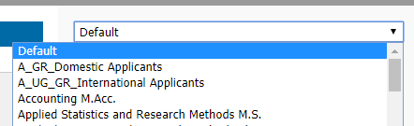
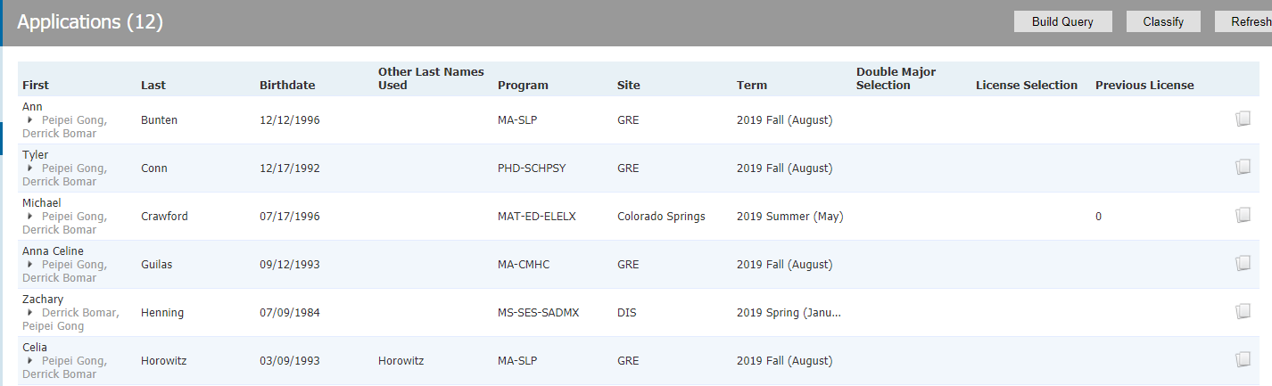
Slate 101
Filtering
When viewing the bins, you can filter applications and narrow them down to a specific program. Use the drop-down menu in the upper right to select a particular program and view applications only for that program.
Reviewing Applications in a Bin
Clicking on a bin will pull up a list of applications within the bin.
Information, including name, DOB, program, site, term, and licensure is displayed.
You can open and view any application within the Slate Reader by clicking on the paper icon at the far right.

Slide 7
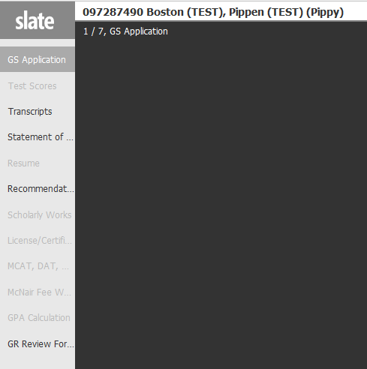
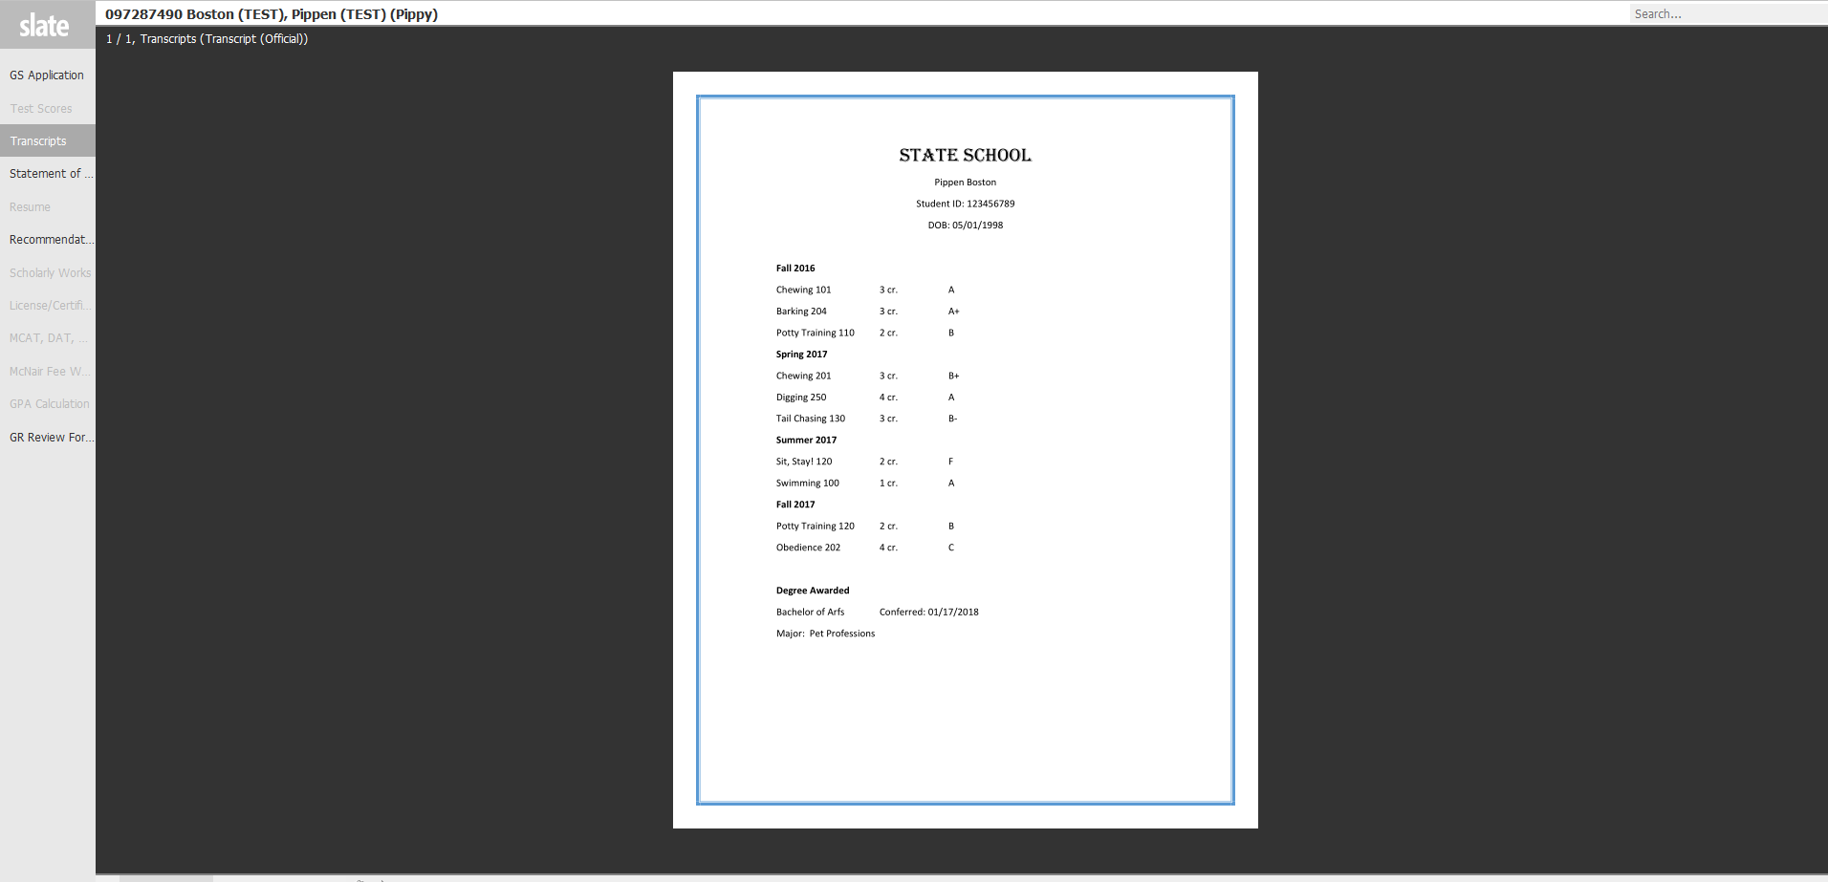
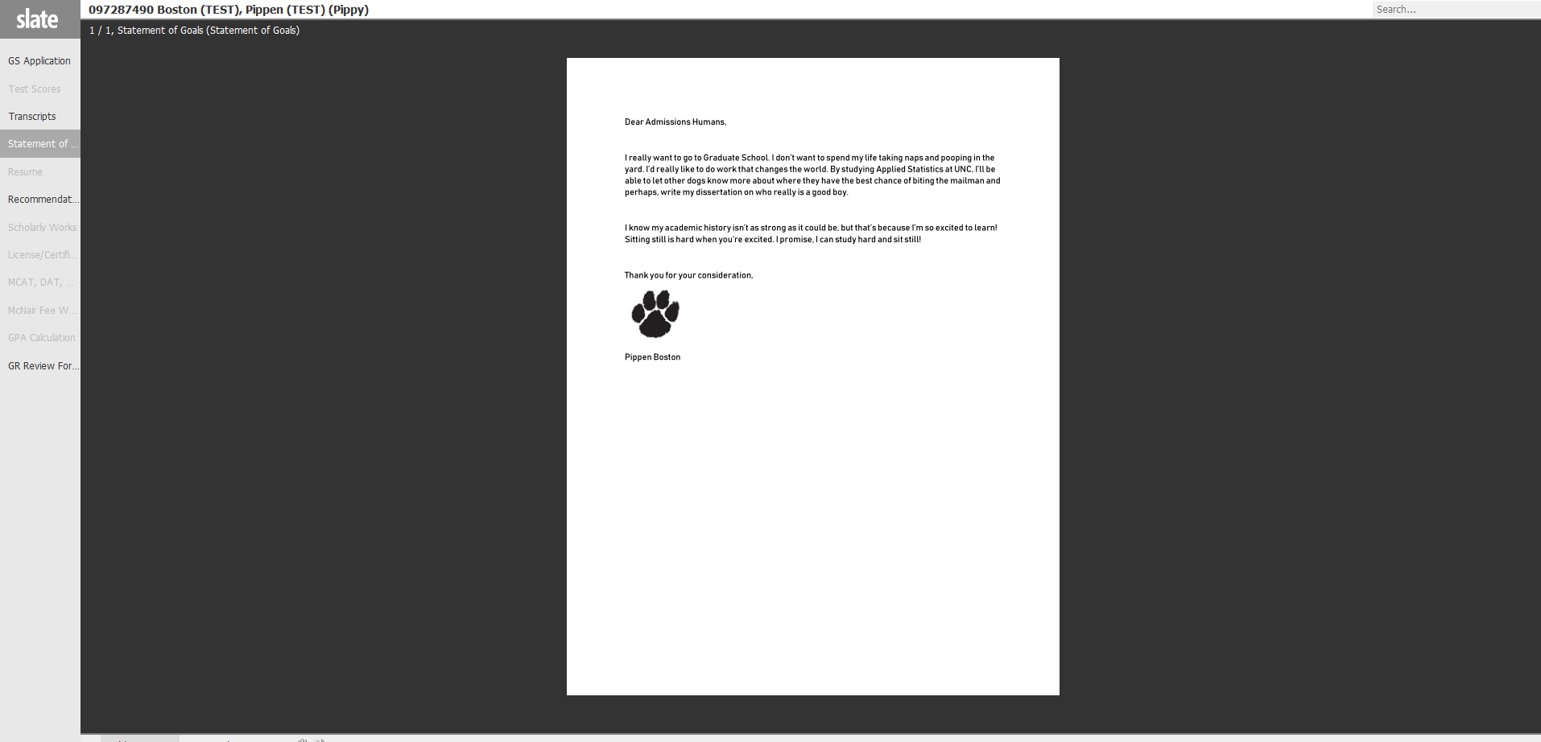
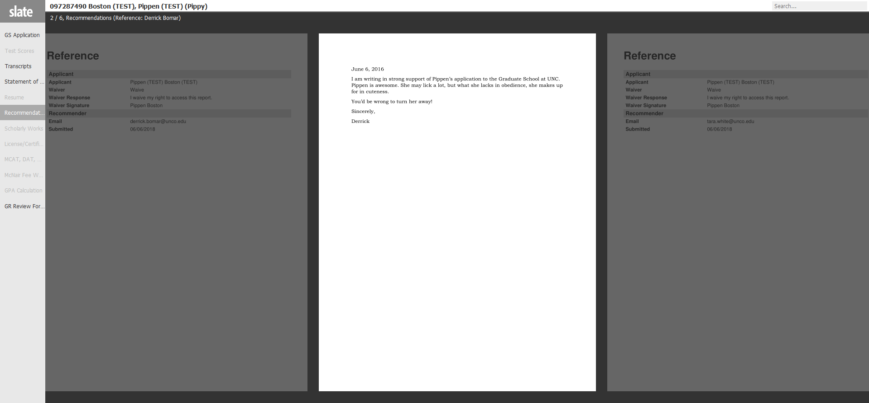
Slate 101
Reader Navigation
Once you open an application within the Reader, you may navigate within it with the following:
The left side menu provides shortcuts to specific requirements of an application.
If an item is not required, it will appear grayed out and you cannot click on it.
You will still be able to view all submitted transcripts.
Any additional documents, statement of goals, resume, writing sample, and copies of licenses/certifications are also viewable.
Again, it may be easier to use your arrow keys to move from page to page within the application.
To exit an application, click the Slate logo in the upper left.

Slide 8
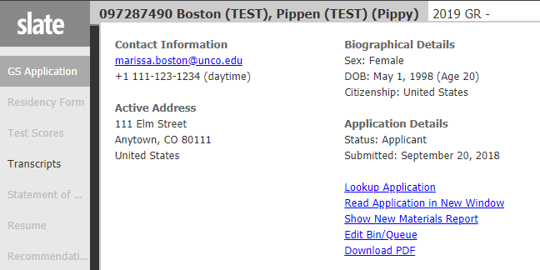
Slate 101
Reader Navigation
When viewing an application in the Slate reader, click the applicant name in the upper right to bring up a new window that includes:
Contact and biographical information for the applicant.
A link to lookup the application in the database view. This opens the application in a new window. Navigating the database view is covered on the next pages.
Option to view the application in a new window
Download PDF button that allows the application to be printed or downloaded

Slide 9
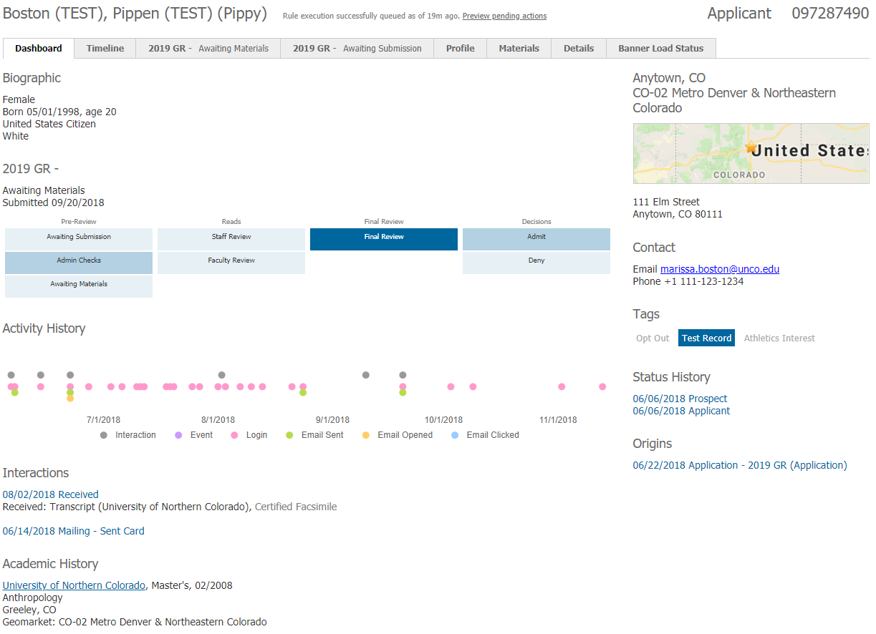
Slate 101
Database View
If you search for an applicant on the main Slate page, you can pull up their application in database view. There are 6 tabs, each providing different information. Some tabs may not be as useful as others.
Dashboard Tab
The Dashboard tab provides an overview of the applicant, including biographical and contact information.
You will also see a visualization of the Slate reader bins, with the dark blue bin indicating where the application currently resides.
The Activity History shows how active an applicant has been. This includes logins, opening emails, and clicking links.
You will see the most recent interactions with the student.
An overview of the applicants’ Academic History is also included for easy viewing.

Slide 10
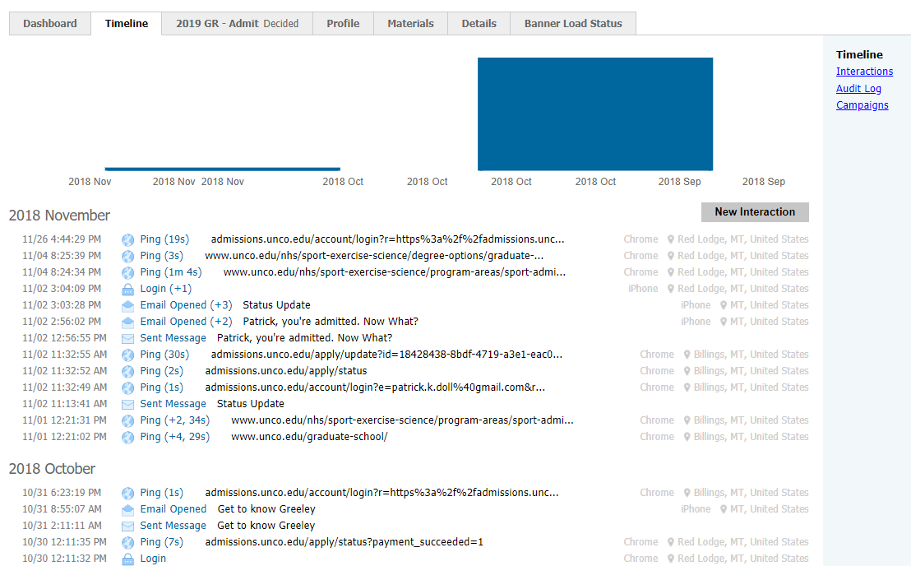
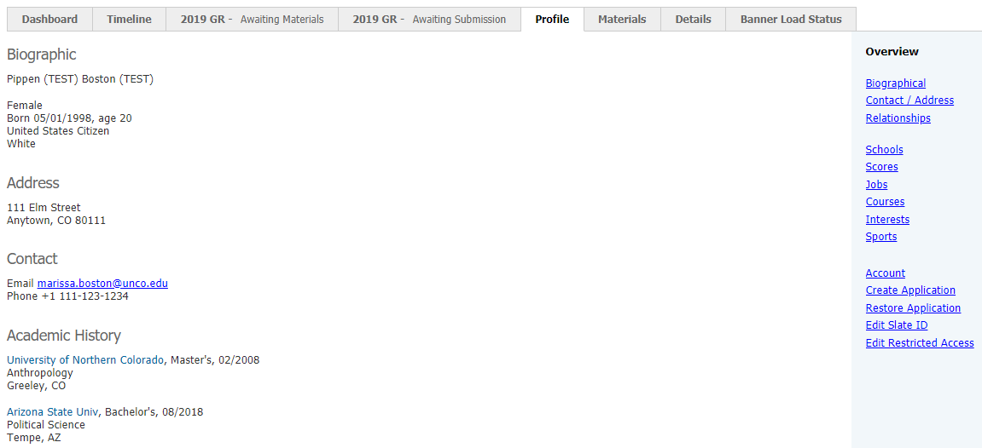
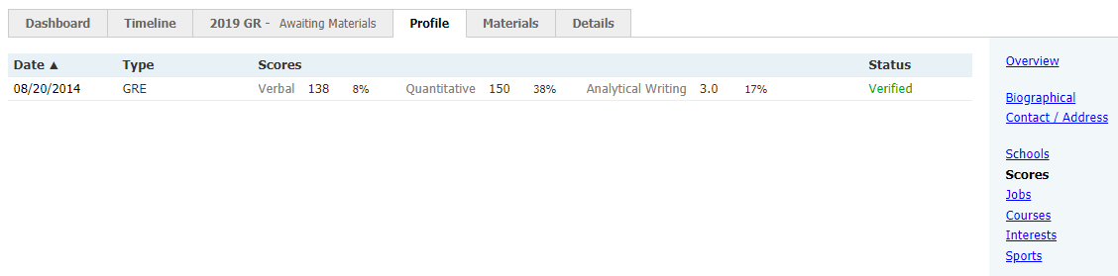
Slate 101
Timeline Tab
The Timeline tab provides detailed information regarding interactions with applicants. You’ll be able to see the following:
Emails sent to applicants, including notification that the email was opened
How often an applicant logs into their application
Profile Tab
The Profile tab details applicant biographical and contact information.
You can also click “Scores” from the right side menu to view test scores, such as GRE results.

Slide 11
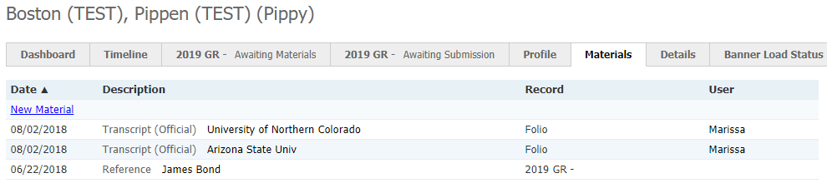
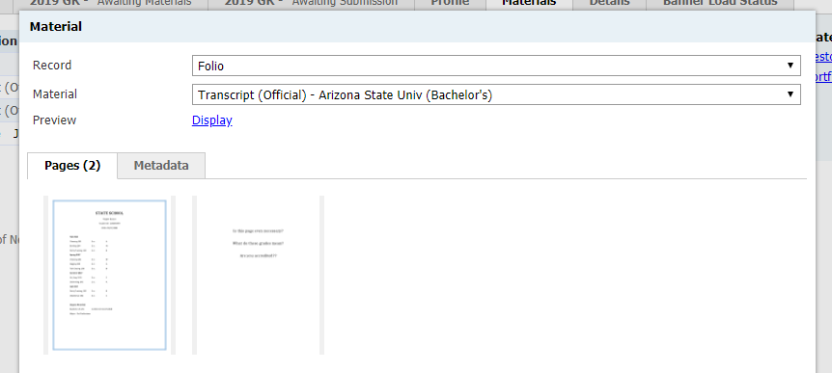
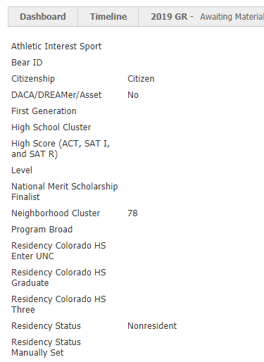
Slate 101
Materials Tab
The Materials tab includes a list of materials and documents we have received for the applicant.
To view a document, simply click the material from the list. A new window will pop up that provides a thumbnail view.
To close the material, click “Close” at the bottom of the window.
A list of materials is also included on the actual application tab.
Clicking “Display” brings up the document in full form.
Details Tab
The Details tab provides information regarding an applicants’ residency status and citizenship.

Slide 12
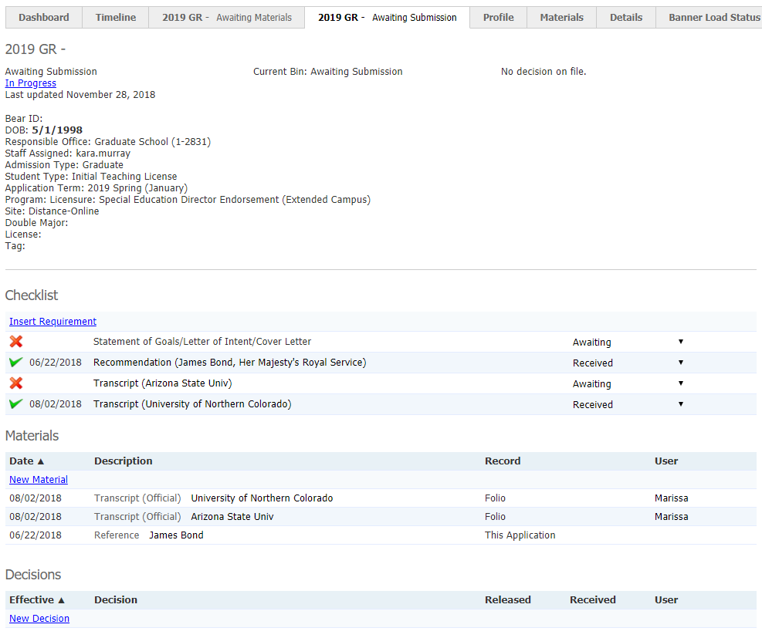
Slate 101
2019 GR Tab
The 2019 GR tab indicates an active application. This is probably the most important tab and the tab you’ll use most in database view. The tab itself includes the status so you know exactly where the application is at in the process.
Application details are listed, including program, site, location, and license information.
Current Bin shows where in the process an application currently is.
The Checklist shows what materials are missing from the application.
Materials received for an application are also listed. Clicking on any material brings up a thumbnail view.
Decisions made for an application are listed here, including admit, deny, or withdrawal.

Slide 13
And that’s it! We know it will take some getting used to, but you’ll be navigating through applications in no time! Our goal is to make using Slate as user friendly as possible and always welcome feedback and suggestions. If you have any questions regarding Slate, please let us know by submitting a question through the Faculty Resource page. Thank you!
Graduate School & International Admissions
Slate 101: Access and Navigation
11/28/2018

