Slide 1
Slate:
Reports
Reviewing & Understanding
Automated Reports in Slate
Graduate School & International Admissions
Slate 101: Reports
08/20/2020

Slide 2
Reporting in Slate
Current Reports
Reports are emailed to you. By default, you’ll receive this email each week on Monday morning. (If you would like to change the frequency of your reports, please let us know. We can email as often as daily or as little as once a month.)
The Report Email will be coming from Slate, specifically from the Technolutions Service Desk. You’ll be able to view reports in their original Slate PDF format or you can view them in a form that you can export to an Excel Spreadsheet.
Overall, reports will include:
Information on incomplete applications
Details on types of admitted students
Number of confirms/regrets
Demographic information
Report data will only be pulled from applications within terms that are currently available.

Slide 3
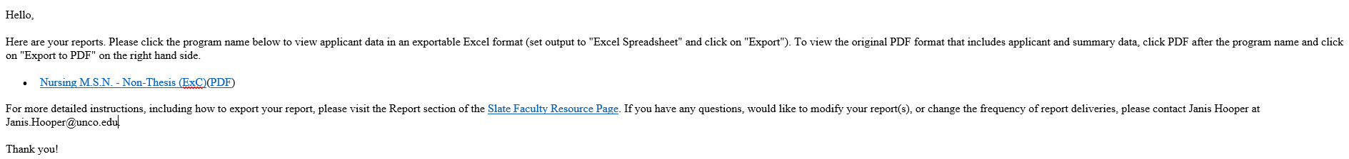
Are the reports useful?
If there is information that you’d like to see on the reports, please let us know! We can also remove columns if there’s applicant information that you do not need on your report. Reports will include applicant information for current and future terms.
Anytime, Anywhere
You can bookmark the link you receive in the email. Visiting the page at any time will give you an up-to-date report any day of the week!
Accessing Reports
To view your reports in an exportable Excel format, simply click the hyperlinked program name in the email.
If you’d like to view the original report format, click the PDF link in parentheses after the program name. Below is a sample email:
Change Recipients?
If there are faculty/staff that should receive reports that aren’t, please let us know so we can include them. We also need to know when faculty/staff no longer need to be receiving reports.
Click here to view the PDF report format!
Click here to view the Excel exportable format!

Slide 4
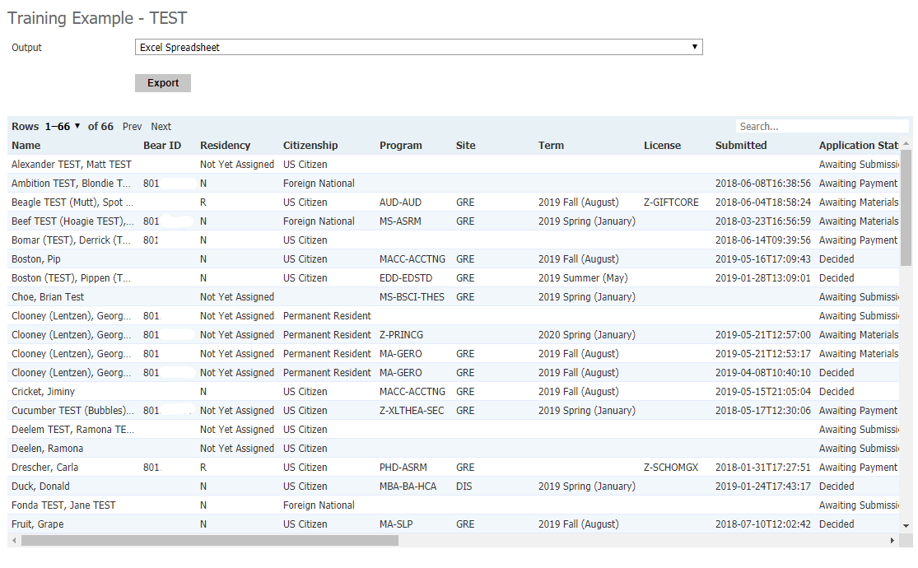
Report Information
If you click the program name on the link (to export to excel), a page will open in Slate where you’ll see your report.
Standard reports include:
Applicant name, residency & citizenship
Bear ID
Program, site & term
Date of submission
Application Status
List of missing items
Admission Decision
Requirements & denial reason
Advisor
Email & Bearmail address
Contact phone numbers
To Export Report to Excel
To export your report to Excel spreadsheet, you simply need to click the gray “Export” button at the top of the report. The Excel spreadsheet will then download. If you’re using Chrome, you can then open it by clicking on the file at the bottom of the browser.

Slide 5
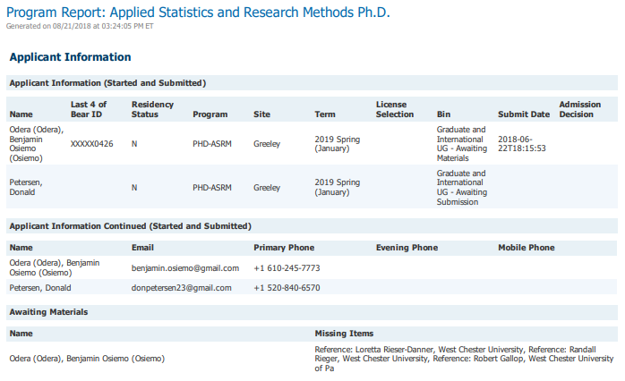
Understanding Report Data
Reports are sent out for each individual program, emphasis area, and for Extended Campus.
Program name, emphasis, & date report was generated.
Easily identify where in the application process an applicant is.
See the residency status of your applicants.
List of applicants, both started & submitted.
A date here indicates the date the student paid the application fee.
List of applicants with contact information.
You’ll see a detailed list of exactly what is missing from an application.
List of incomplete applications.

Slide 6
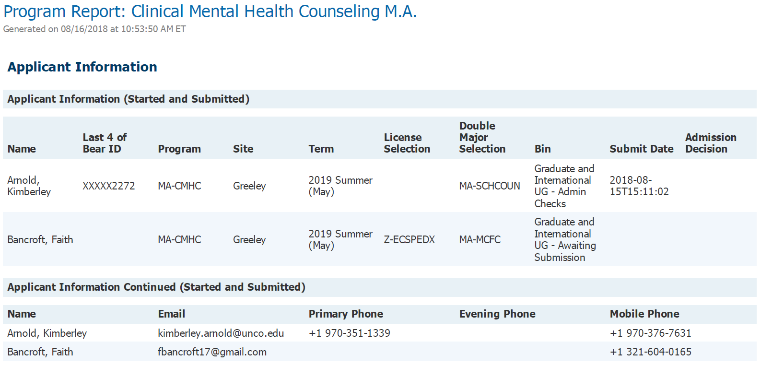

Understanding Report Data
Applicants now confirm or regret by submitting an electronic confirmation form. The following will show under “Admission Decision”:
Admit: applicant has been offered admission
Admit/Confirm: applicant has been offered and accepted admission
Admit/Decline: applicant has been offered and declined admission
Deny: applicant has been denied admission
Withdraw: application has been withdrawn per applicant request
Enroll: applicant has been admitted and is currently enrolled
Applicant Overview & Application Status
If the applicant has applied for a double major and/or licensure, it will be listed here.
If an applicant has contacted you to confirm, regret, or ask that their application be withdrawn, please let us know!
What does this mean?
The term and site the applicant has selected is displayed. (Note: student’s can only apply for terms/sites in which the program is available!)
Awaiting Submission: applicant has not yet paid application fee
Admin Check: Grad School has received application and has begun processing
Awaiting Materials: applicant is missing documentation (i.e. transcripts, statements, recommendations)
Staff Review: Grad School is evaluating application and preparing it for departmental review
Faculty Review: application is ready for departmental review
Final Review: the admission recommendation will be processed and the applicant admitted/denied

Slide 7
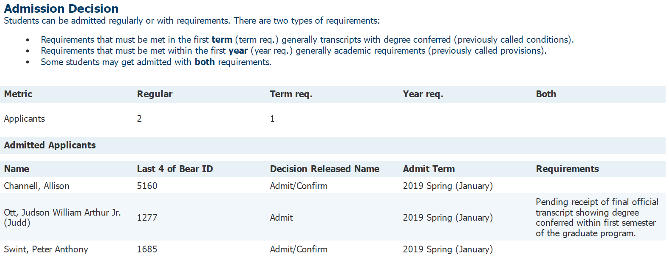
Understanding
Report Data
Term req.: previously conditions, these are requirements that must be met within the applicants’ first term of enrollment.
Year req.: previously provisions, these are requirements that must be met within the applicants’ first year.
Both.: applicants that have been admitted with both term and year requirements. These applicants are not included in the numbers for term and year requirements.
Admission Decisions
Description of types of admission.
Total number of admitted students and if they were regularly admitted or admitted with requirements.
The admit term is displayed for the list of admitted students.
List of admitted applicants.
You will see a detailed description of what the requirements are for a particular applicant.
This only lists admitted applicants and also includes applicant confirm/regret decision.

Slide 8
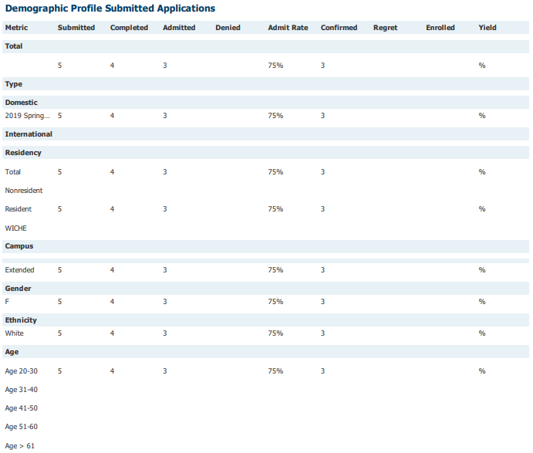

Understanding
Report Data
Demographic data is displayed for the program as a whole so you can view your applicant pool demographics at a glance. Demographic information is only compiled from submitted applications.
Demographic Profile
Total number of submitted, completed, admit/deny, confirm/regret, and enrolled applicants.
Number of domestic and international applicants by term.
Applicant breakdown by residency status.
Number of applicants by campus (Main vs. Extended Campus).
Applicants by gender.
Applicants by ethnicity.
Applicants by age-range.
The Admit Rate is calculated for each demographic profile area and is calculated as:
$\frac{admitted students}{completed applications}$ = Admit Rate

Slide 9
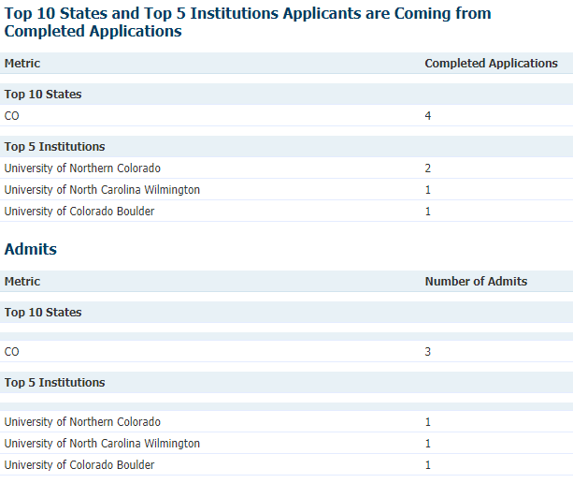
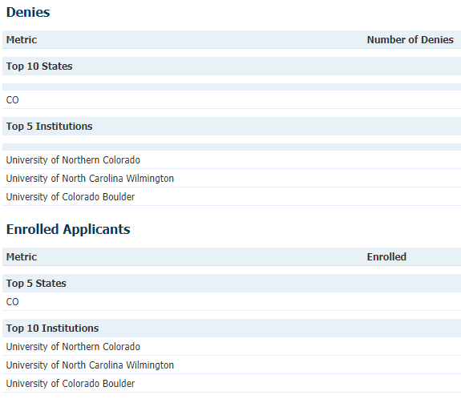
Understanding
Report Data
Slate 101
State and institutional breakdown allows you to see exactly where your applicants are coming from.
State & Institutional Breakdown
See the top 10 states and top 5 institutions that your applicants are coming from. This is compiled from submitted applications.
The top 10 states and top 5 institutions are further broken down by admitted and denied applicants.
This breakdown also includes a section for enrolled applicants.

Slide 10
Thank you!
Our goal is to provide you with information that is
helpful and easy to understand.
If you have questions, concerns, or would like to
discuss anything Slate, please let us know!
Graduate School & International Admissions
Slate 101: Reports
08/20/2020

