Slide 1
SLATE
How to Fill Out the Slate Application
Graduate School & International Admissions
8/20/2020

Slide 2
Guide to Slate Application
Welcome Slate!
In June 2018, the Graduate School & International Admissions office implemented Slate, a new application system that will help to simplify the application process both for students and staff within the Graduate School and beyond.
Benefits
Slate only allows applicants to select start terms that correspond with when their program begins. Applicants no longer have to know exactly when their program starts when they apply!
Slate also only allows students to select a “Double Major” if they apply for certain programs.
The Slate application doesn’t make applicants scroll through portions of the application not relevant to them. For instance, items such as residency questions will only appear if a student selects “Yes” to claiming residency!
Once the application has been submitted for processing in the Graduate School, processes can be marked as done at any time. For example, processing applications doesn’t have to be done before it moves to matching.
There’s much more to Slate than just this, but let’s walk through the application as a new applicant sees it!

Slide 3

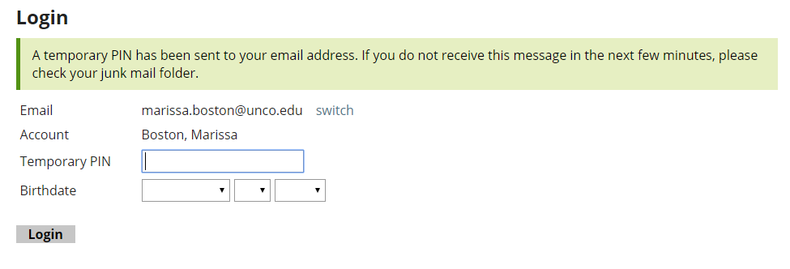
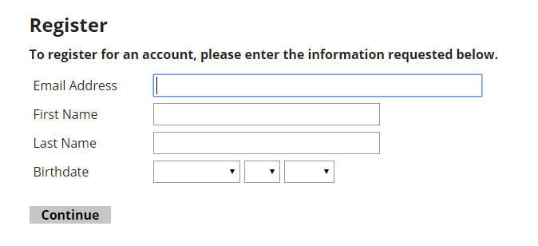
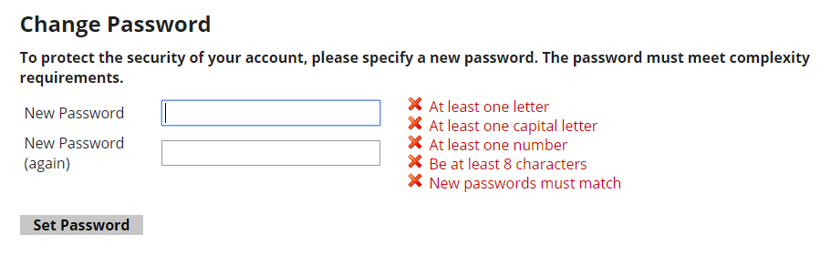
Guide to Slate Application
Applying to UNC’s Graduate School
A new applicant begins their journey at www.unco.edu/apply/. Upon clicking the Bear App 2019 icon, they select whether they are a returning user or a first-time user.
Setting up an Account
After providing an email address, name, and birthdate, applicants receive an email with a temporary PIN. Applicants enter the PIN and birthdate, then click “Login.” They’ll then be prompted to create/change their password.
If an applicant forgets their password, they just need to call the Graduate School at 970-351-2831 or email us at grad.school@unco.edu!

Slide 4
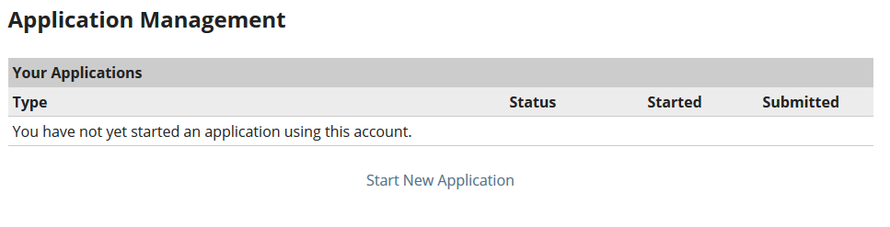
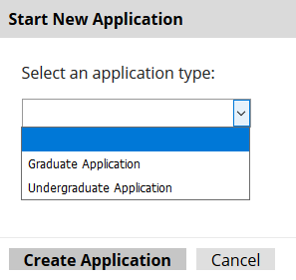
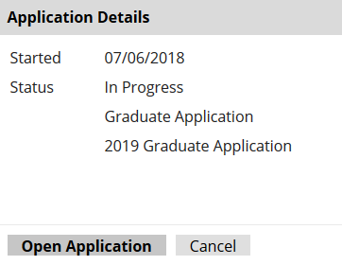
Guide to Slate Application
The entire application is viewable within the Slate Reader just as the applicant completed it!
Starting a New Application
Applicants start at the “Application Management” screen when logging into their application. Here, they select “Start New Application” to begin the process.
Applicants then select what type of application they wish to complete.
An “Application Details” window pops up to confirm the application and allow an applicant to open it.

Slide 5
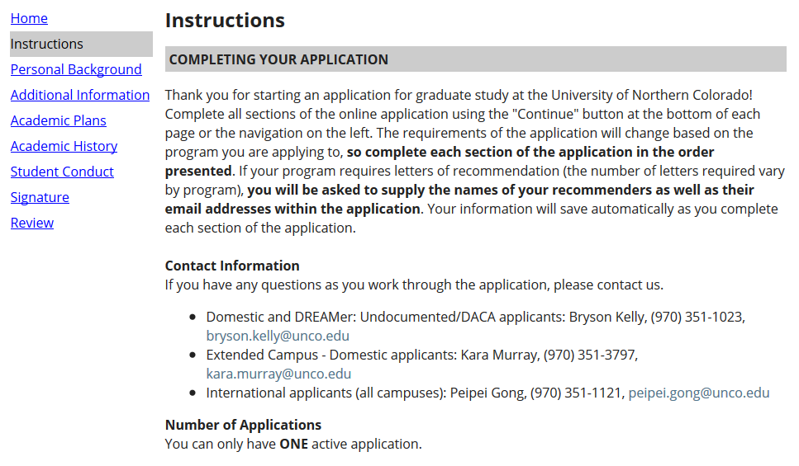

Guide to Slate Application
Instructions: Please Read!
Once the application is open, applicants see the “Instructions” page. This page is super important! Here, applicants will receive information about:
requirements for the application
contact information for enrollment coaches
submitting application materials
deadlines
and the non-refundable application fee!
Please direct students to read this page carefully! A lot of important information is included in the instructions. (A full text of the instructions will be included in a separate PDF.)
Just One!
Applicants can only have one active application!
Applicants must fill the application out in the order it is presented. New information may be requested depending on how they complete a previous part of the application. Skipping around may result in an incomplete or inaccurate application. The “Continue” button at the bottom of each page should be used to navigate the application.

Slide 6
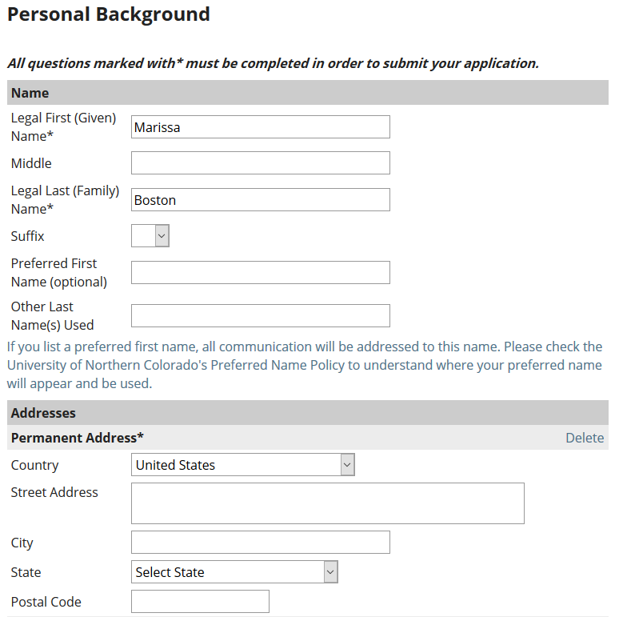
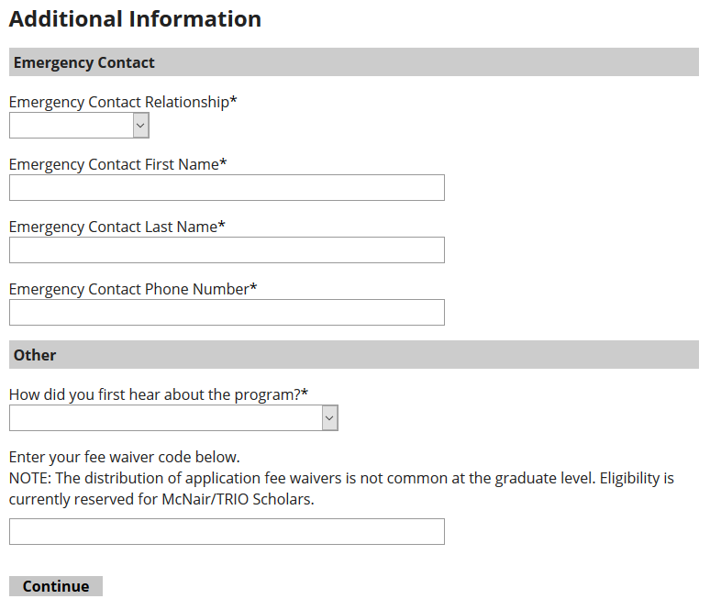
Guide to Slate Application
Personal Background &
Additional Information
Applicants are then asked to provide their personal information, including:
Name, legal and preferred
Permanent and mailing address
Telephone number
Gender, birthdate, and SSN
Birth country and citizenship
Race/Ethnicity
Emergency contact information
They must also select an option for how they heard about UNC and the program.
Lastly, on the “Additional Information” page is where applicants will enter in an application fee waiver code if applicable. Currently, fee waivers are reserved for McNair/Trio Scholars.

Slide 7
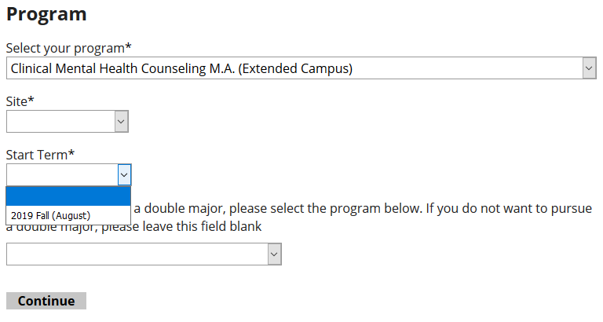
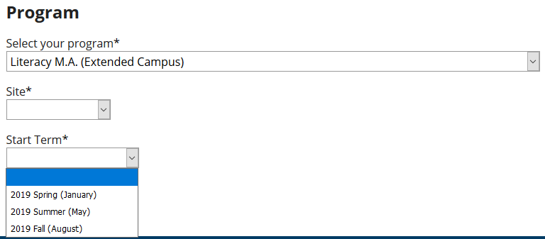
Guide to Slate Application
Academic Plans
Slate are limited options when applicants are selecting the academic program they are applying to. Applicants will only be able to choose a Start Term for which their program is available.
Applicants will no longer be able to select a double major unless they are applying to:
Clinical Mental Health M.A.
Marriage & Family Counseling M.A.
School Counseling M.A.
If an applicant wants to add a second major after they are admitted, they are more than welcome to! Certificates can also be added to a program after admission.

Slide 8
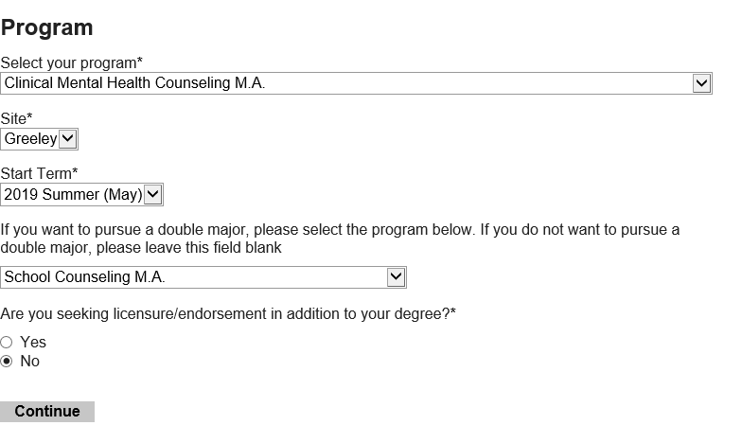
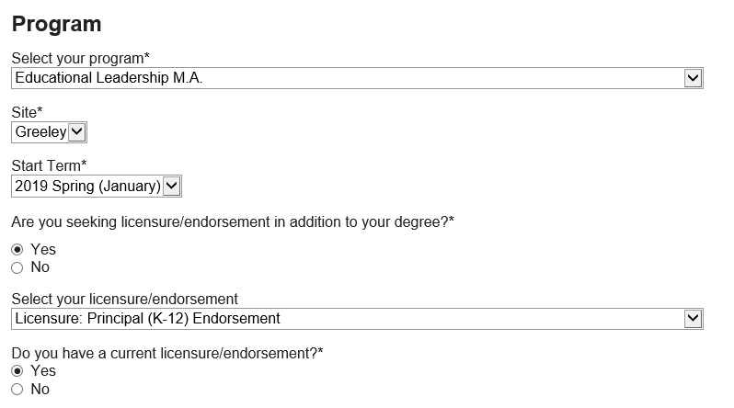
Guide to Slate Application
Academic Plans cont.
Applicants can also select if they would like to pursue a licensure.
If the applicant selects a program with licensure or indicates that they would like to pursue licensure, they are automatically asked if they have a current license. A copy of any current licenses must be uploaded to their application after completion.
If a program includes licensure, the applicant will not be asked to select licensure in addition to the program.

Slide 9
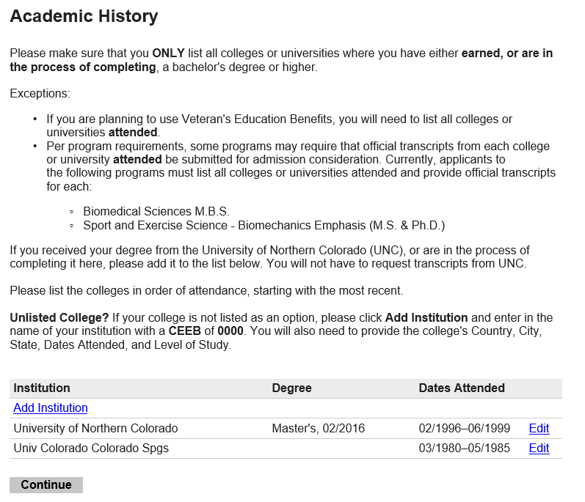
Guide to Slate Application
Academic History
Applicants are then asked to enter information regarding their academic history.
Anyone applying to the Biomedical Sciences M.B.S., SES: Biomechanics M.S. or Ph.D., or any applicant intending to use Veteran’s Education Benefits must list every school attended. Official transcripts must be requested for each institution listed.
All other applicants only need to list institutions where a degree (bachelor’s or higher) was earned or is in progress. Official transcripts must be requested for each institution.

Slide 10
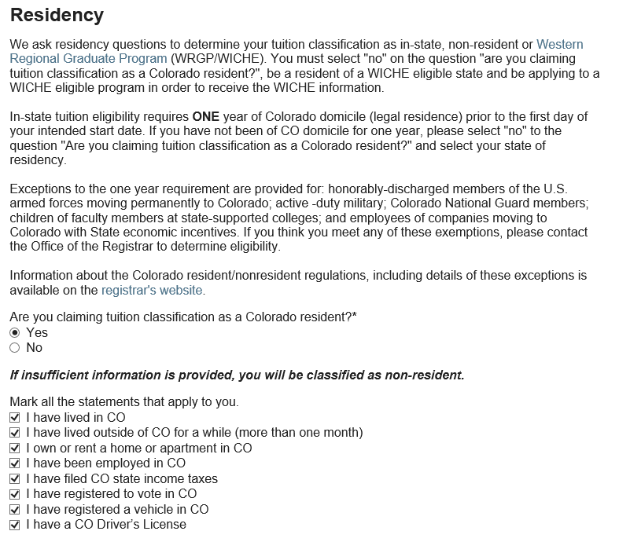
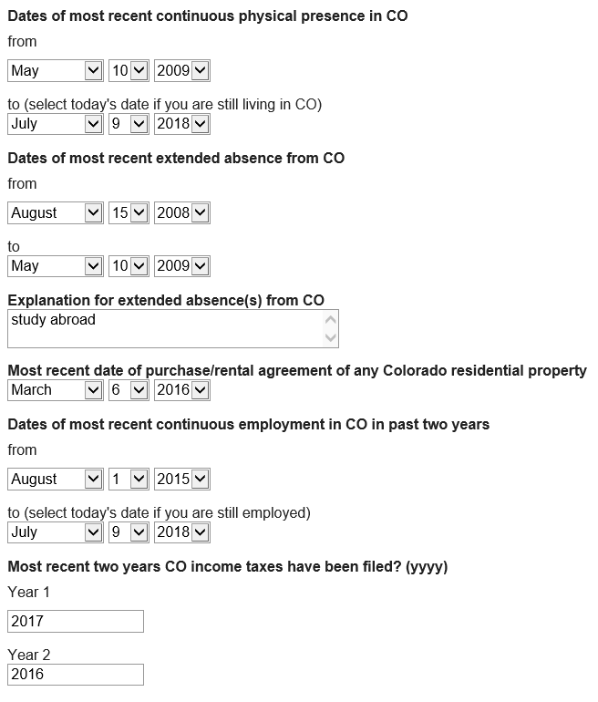
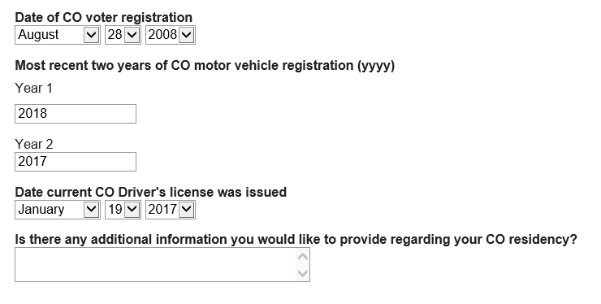
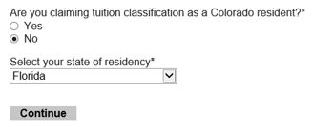
Guide to Slate Application
Residency
Applicants who are U.S. Citizens or Permanent Residents will be asked to answer questions about their residency status.
If they indicate that they are a resident of Colorado, they will be required to answer and provide information to show that they have lived in Colorado for at least one (1) full calendar year prior to when they want to begin their program at UNC.
If an applicant is not a resident of Colorado, they are asked to simply select their state
of residency.

Slide 11
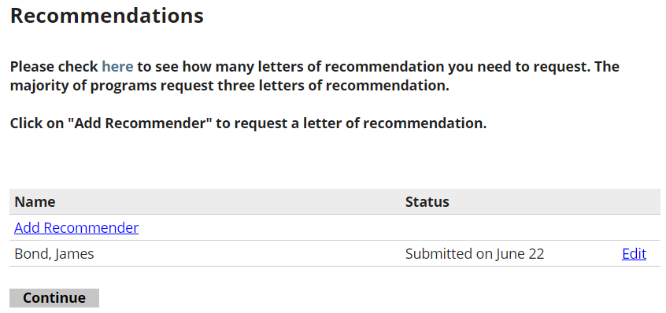
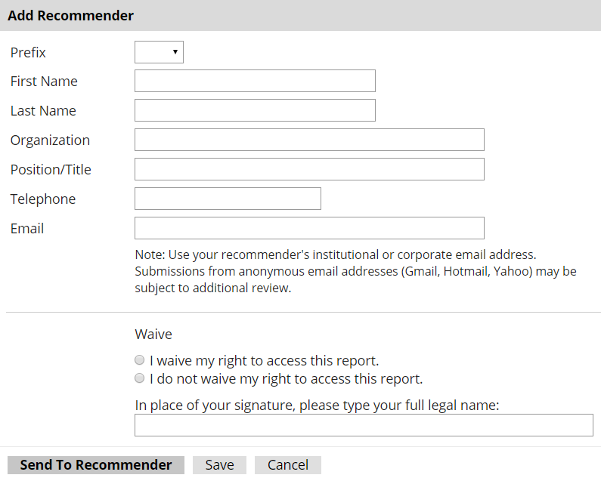
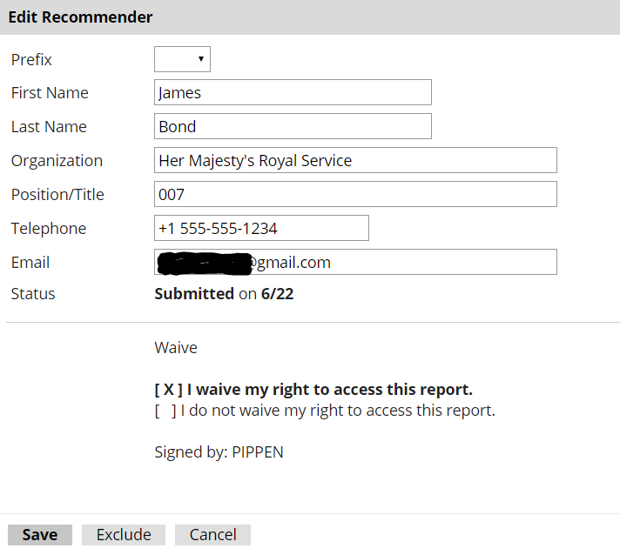
Guide to Slate Application
Recommendations
Applicants are then asked to submit recommendation information. They will be asked to provide the name, organization, title, phone number, and email address of individuals who they would like to provide a letter of recommendation letter.
Applicants must select if they would like to waive their rights to access their recommendations or not. Recommender information can also be edited or excluded if an applicant decides to change their recommender.

Slide 12
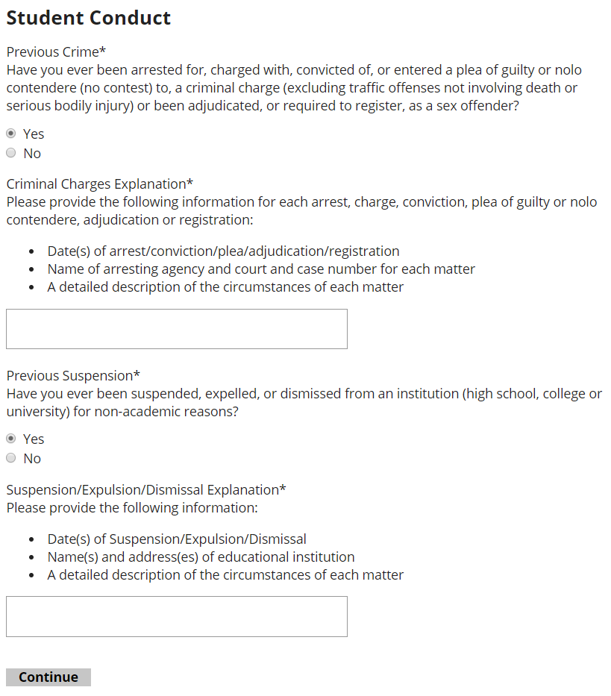
Guide to Slate Application
Student Conduct
Next, applicants are asked to answer two questions regarding crimes and suspension.
If an applicant has been arrested for, charged with, convicted of, or pled guilty/nolo contendere to a criminal charge or if they have previously been suspended from an institution, they must disclose so. They are asked to provide a brief description of the dates and circumstances surrounding the situation.
Answering “yes” to either of these questions does NOT mean an automatic denial to UNC.

Slide 13
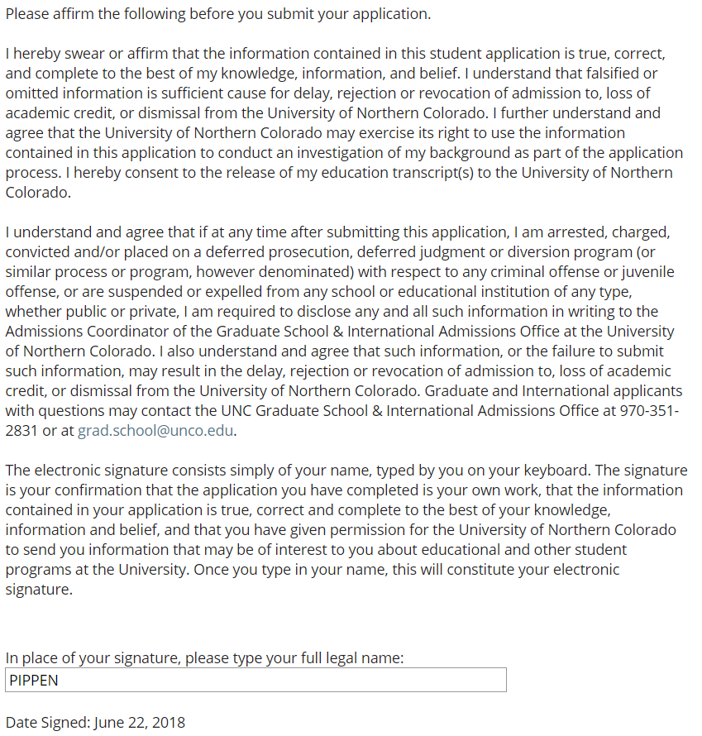
Guide to Slate Application
Signature Page
One of the final steps an applicant must do is electronically sign their application.
The applicant is given text they must read and affirm that they understand. This text asks the applicant to confirm that the application is complete and true to their best of their knowledge, as well as information regarding background investigations, releasing transcripts to UNC, and contact information for the Graduate School among other things.
The signature consists of the applicant typing in their full legal name.

Slide 14
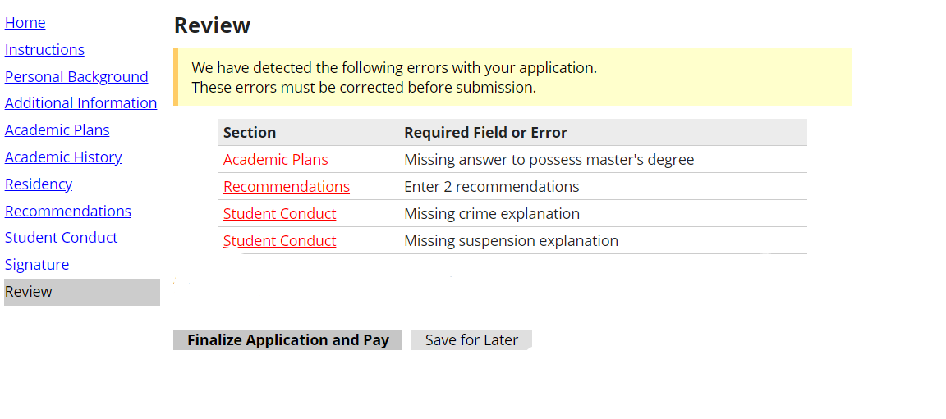
Guide to Slate Application
Review
Before submitting the application and paying the application fee, a review of the application provided. If the application is missing information, applicants will see a warning, asking them to complete/correct the information listed. The application cannot be submitted until these errors are correct.
The applicant may also see warnings, which are portions of the application that may be incomplete but will not prevent submission.

Slide 15
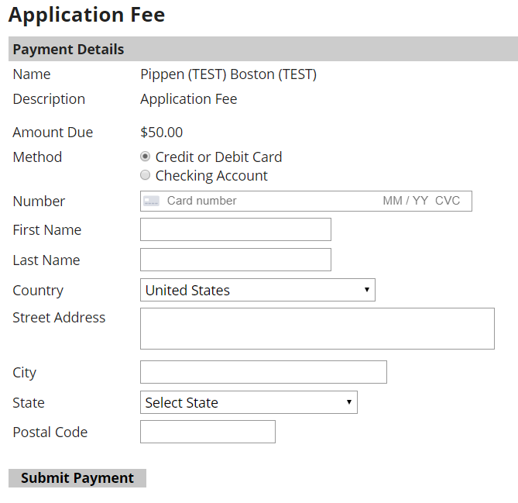
Guide to Slate Application
Application Fees:
Domestic: $50
International: $60
Application Fee Payment
Once the applicant is ready to submit their application, they’ll be taken to the Application Fee page.
Applicants can use a credit/debit card or a personal checking account to pay the application fee.
International applicants may use credit or debit cards that can be used in the U.S. and that handle any currency conversions.

Slide 16
And that’s it! Now you’re familiar with the application process. Our goal is to make using Slate as user friendly as possible and always welcome feedback and suggestions. Thank you!
Graduate School & International Admissions
8/20/2020

