Slide 1
Change of Term Requests
Reviewing Change of Term requests within Slate.
Graduate School & International Admissions
Change of Term
8/20/2020

Slide 2

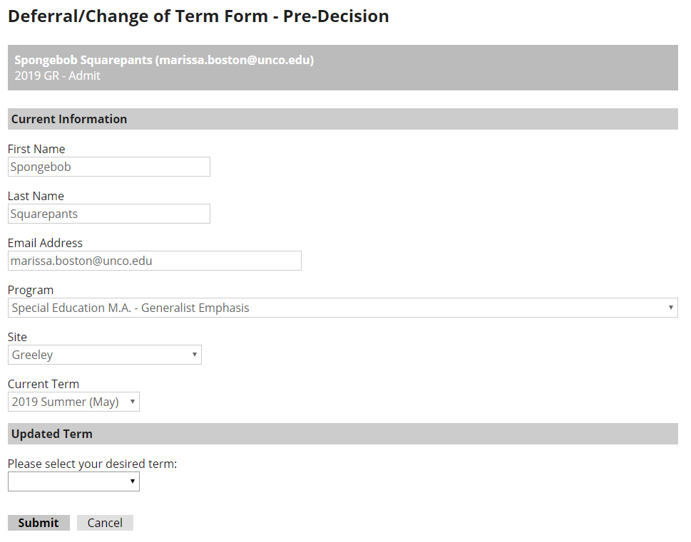
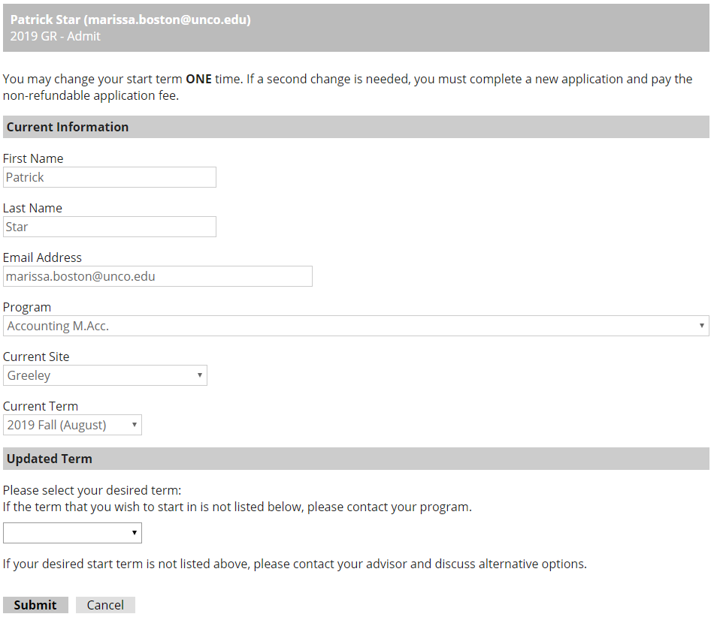
Change of Term
Requests through Slate
Applicants can now request a change of term through Slate. There are separate forms for pre- and post-admission. Applicants can access the forms through their application portal or through the Forms page on the Graduate School website.
Admitted applicants can only request one change of term and must reapply for a new term if the request is denied or they are unable to attend in their new term.
Both forms will pre-populate applicant data, including program, site, and their current start term. Applicants can then select a new term based on when their program is available to start.

Slide 3
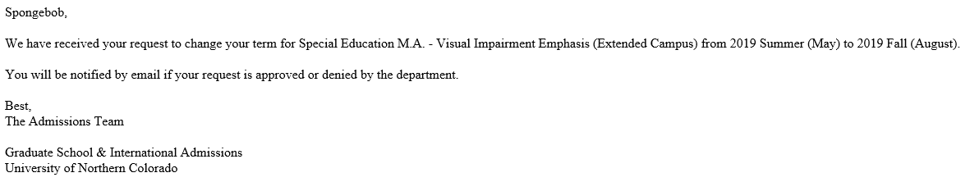
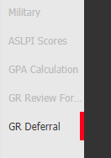
Faculty Review
Post-Admission Requests
If an applicant requests a change of term after admission, the application and form will be sent back to Faculty Review for approval/denial.
When you receive a request for change of term, you’ll open the application in the Slate Reader as you would when you review an application for admission.
Since it is a change of term request, you’ll see a red highlight by the tab reading “GR Deferral.” Click the tab to view the request.
Pre-Admission Requests
Applicants who request a change of term before they’ve been admitted do not require faculty approval. The Graduate School will process the request automatically. Applicants will not be able to request a term in which their program does not typically start.
Applicants also receive confirmation emails when their request is received, approved/denied, and processed.
Spongebob,
We have received your request to change your term for Special Education M.A. – Visual Impairment emphasis (Extended Campus) from 2019 summer (May) to 2019 fall (August).
This means it’s a change of term request!

Slide 4
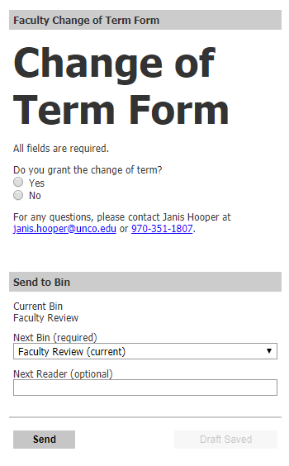
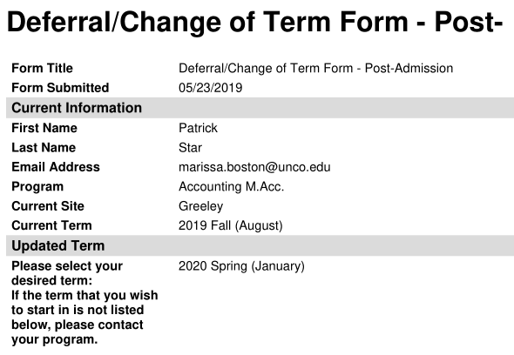
Faculty Review
Change of Term Form
Click on “Review Form/Send to Bin” in the lower right corner to open the form. Here, you’ll select if you approve or deny the request.
Approving/Denying the Request
Once you click the “GR Deferral” tab, you will see the request form. The form includes the applicant’s current/original term of admission as well as the term they would like to change to.
Select whether you would like to approve or deny the request.
Current term
Requested new term

Slide 5

Faculty Review
Approved Requests
If the request is approved, the form will be sent to staff in the Graduate School for processing. Once the changes have been made an email
Denied Requests
If a change of term request is denied, a text box will pop up on the change of term form asking for a Denial Reason. This is required. Please be mindful when completing this section as anything typed in the text box will be sent to the applicant via email.
will be sent to the applicant to inform them that the change was approved and completed.
Remember
Applicants can only request one change of term after they’ve been admitted. If they cannot start in their deferred term, they will need to reapply to the program for another term.
If you deny the request, you’ll be required to enter a reason. This will be sent to the applicant via email.

Slide 6
THANK YOU!
Graduate School & International Admissions
Change of Term - Faculty
8/20/2020

