Slide 1

Utility Cart Training

Slide 2
Utility Cart Definition
Utility carts are defined as small size, unlicensed, utility or service carts. This includes, but is not limited to golf carts, "Gators", ATV's, 4-wheeler ATV's and “utility carts”.

Slide 3
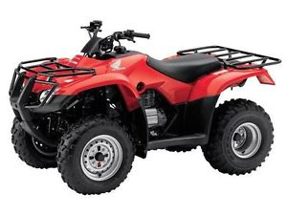
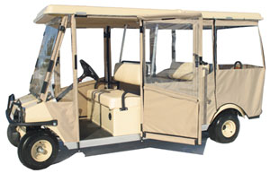
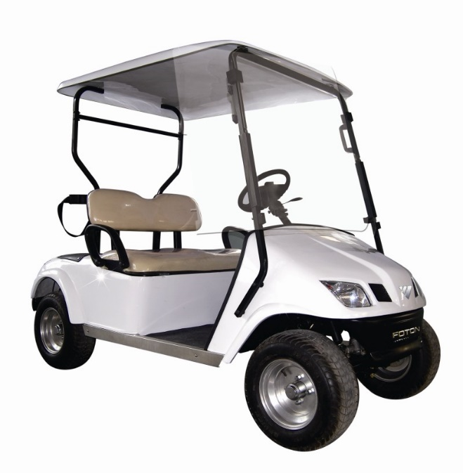
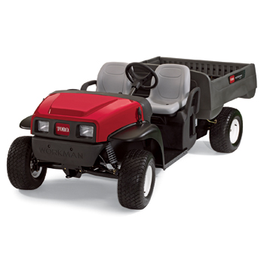
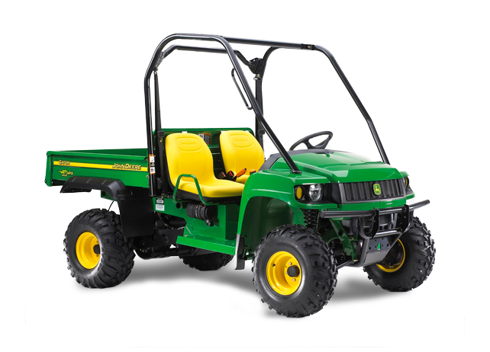
Types of Utility Carts
4-Wheeler/ATV’s
Club Cars
Golf Carts
Gators
Toro Workman

Slide 4
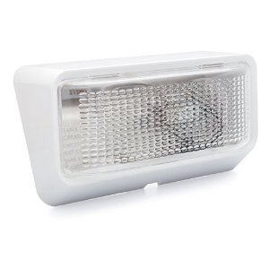
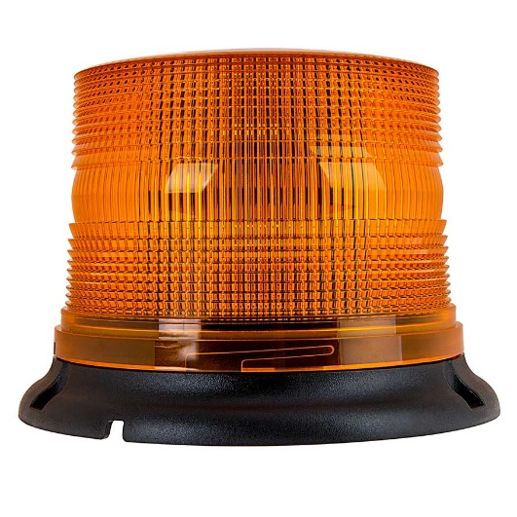
Utility Cart Requirements
Under the Colorado Revised Statue section 42-4-204 all utility carts are required to be equipped with at least one lamp displaying a white light on the front of the vehicle, visible from a distance of no less than five hundred feet to the front of the vehicle. They are also required to be equipped with at least one orange beacon light that is visible on the top or back of the utility cart from a distance of no less than five hundred feet to the back of the vehicle. These lights are required to be used at all times on all carts operating from dusk until dawn (nighttime operations).

Slide 5
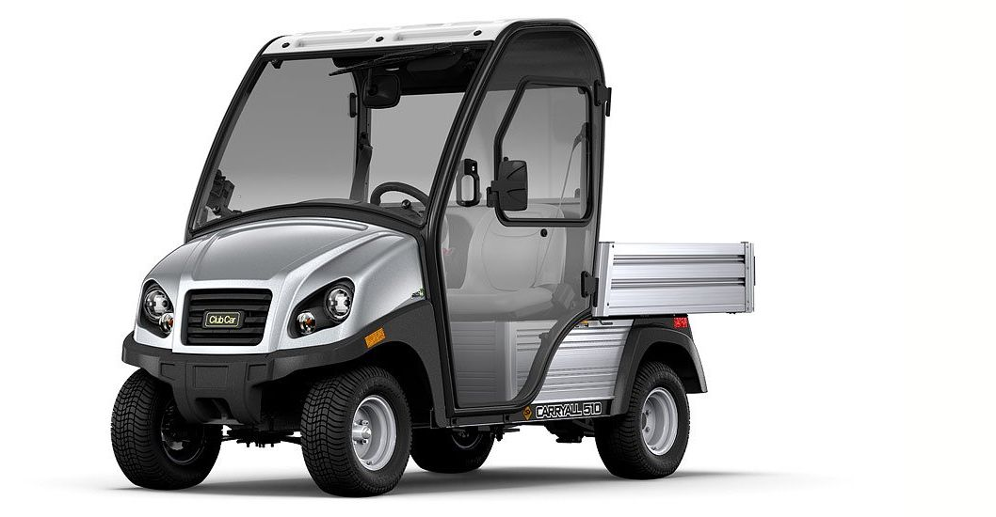
Why are carts different than cars?
Utility carts roll easier
Have a lower center of gravity
Some carts aren’t equipped with seat belts, horns, break lights, or turn signals
Cars ALWAYS have the right of way
In a collision carts ALWAYS lose!

Slide 6
Where are you driving…
The streets on campus
The sidewalks on campus
The parking lots
The streets surrounding the campus
5 mph speed limit on campus

Slide 7
UNC Procedure
Use of Service Carts
Applies to ALL operators of service carts on UNC Campus- electric or gas powered
ALL users must have a current/valid driver’s license in possession
ALL operators must sign a driver’s license certification form prior to ANY cart operation

Slide 8
UNC Procedure
Use of Service Carts, con’t.
ALL employees operating carts must adhere to all applicable vehicle and traffic laws
Employees are responsible for understanding and complying with the service cart policy, and the State Owned Vehicle policy

Slide 9
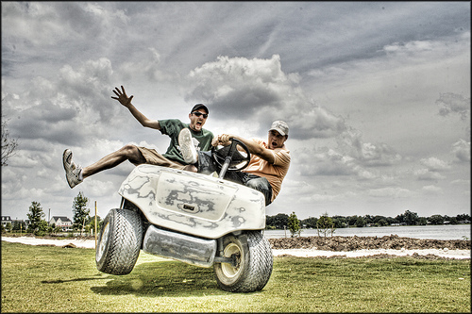
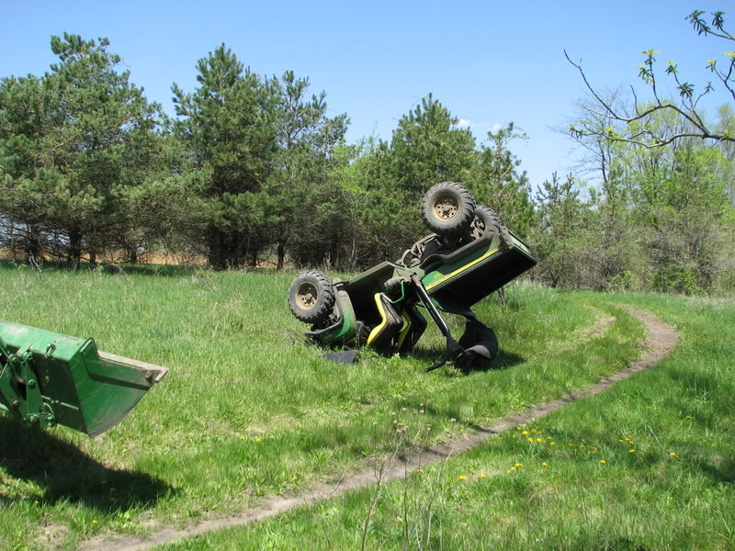
Utility Cart Danger
According to the consumer products safety commission, there are approximately 15,000 utility cart related injuries in the US each year
Occupant ejections and roll overs are the most common accidents

Slide 10
Pre-Trip Inspection
Proper tire inflation, cuts or punctures on the tires, proper steering
ALWAYS look behind cart BEFORE getting aboard!
After loading, are all 4 wheels still touching the ground?
Is the warning signal light working?
Is the reverse warning signal audible (If applicable)?

Slide 11
Night Driving
If using the cart at night, does it have working headlights?
What about the back lights?
Take extra care and be cautious, carts are not high profile vehicles – pedestrians may not see, or HEAR you coming.
If you notice something not working properly, report malfunctions to your supervisor IMMEDIATELY upon discovery.

Slide 12
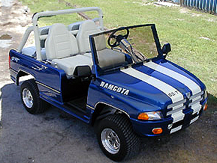
Safety Cart Guidelines
Use cart routes ONLY
Don’t forget that you have to fit in with whatever you’re hauling
Sudden stops or changes in direction may result in loss of control
Keep hands and feet inside at all times when cart is moving

Slide 13
More Safety Guidelines
Avoid tipping over – drive straight up or down a slope
Always remain seated
Slow down before and during turns
Reduce speed, use extra care in inclement weather

Slide 14
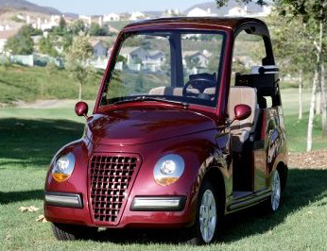
Just plain common sense…
Always tie-down your load
Always set your brake once you get to your destination

Slide 15
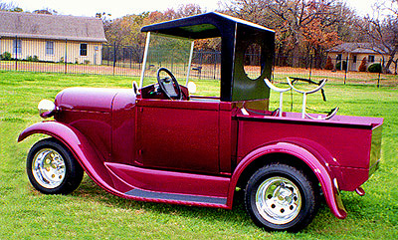
When in doubt, ask…
About load capacity
About operating procedures
About maintenance records

Slide 16

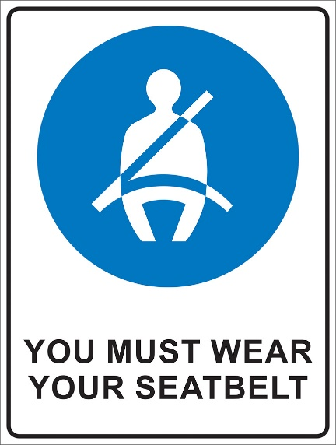
OK, what about a car, truck, or van?
You must wear seat belts – it is a UNC safety rule, AND a state law.
NO SMOKING – period. In ANY utility cart.

Slide 17
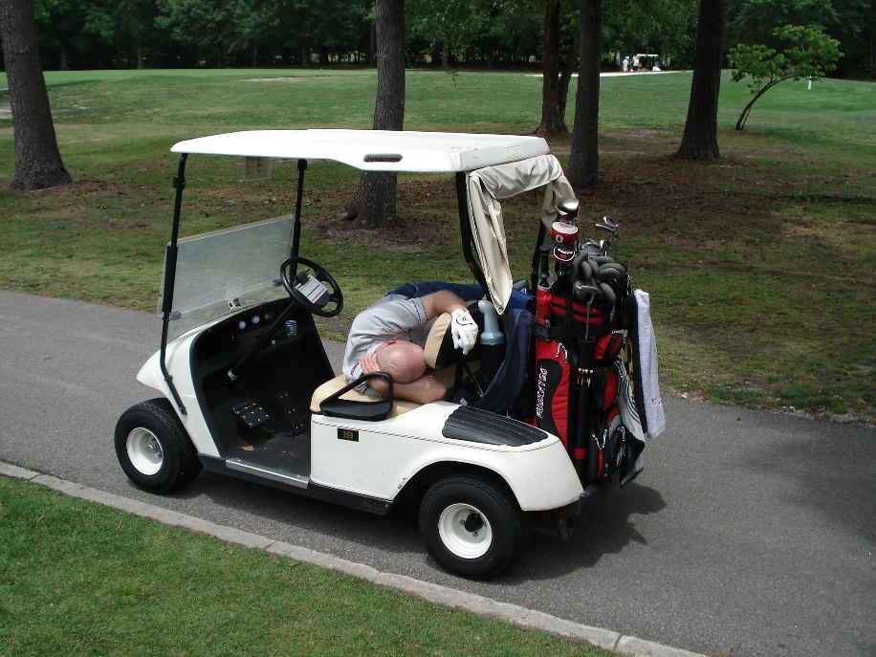
Should you be driving?
Are you tired, upset, fatigued, ill?
Did you ‘celebrate’ at lunch?
Are you taking prescription or over-the-counter medication?

Slide 18
What about…
Driving a mower, tractor or sweeper – all traffic rules and laws still apply;
You must obey traffic signs and signals
Pedestrians have the right-of-way
You must obey campus speed limits

Slide 19
Whatever you drive…
Do a pre-trip check
Review how the utility cart operates BEFORE you turn it on
If it needs fixing, DON’T use it until it’s fixed!
If you are unfamiliar with where you are going… CHECK THE ROUTE MAP

Slide 20
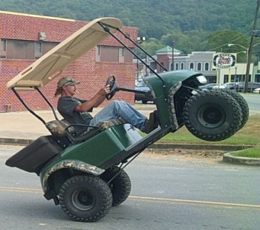
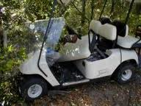
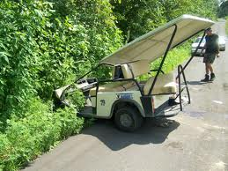
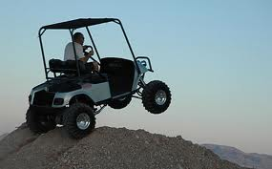
After all…
The whole idea is to get your job done without endangering either yourself or others! Be safe!

