Slide 1

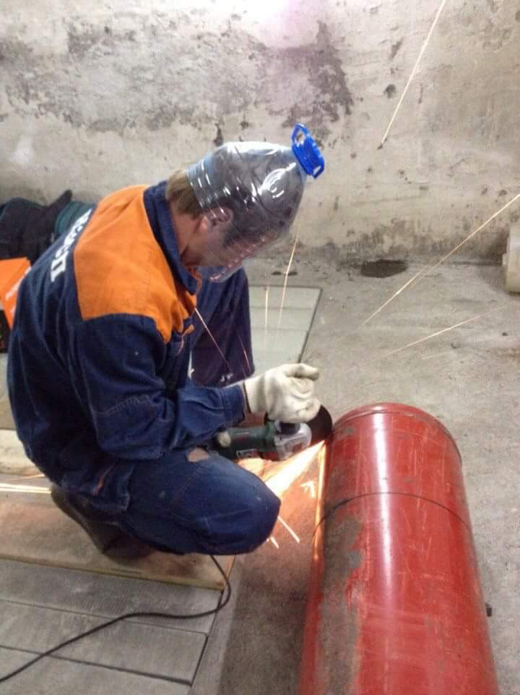
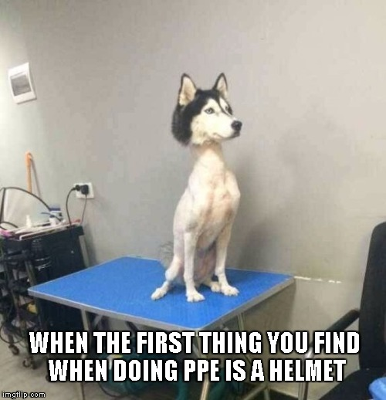
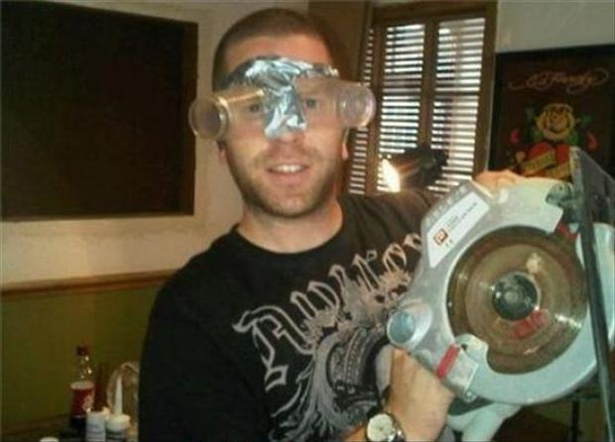
PPE – Eye, Hand, & Head Safety

Slide 2
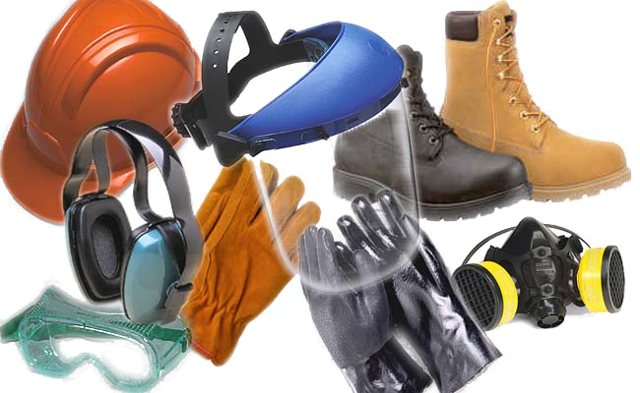
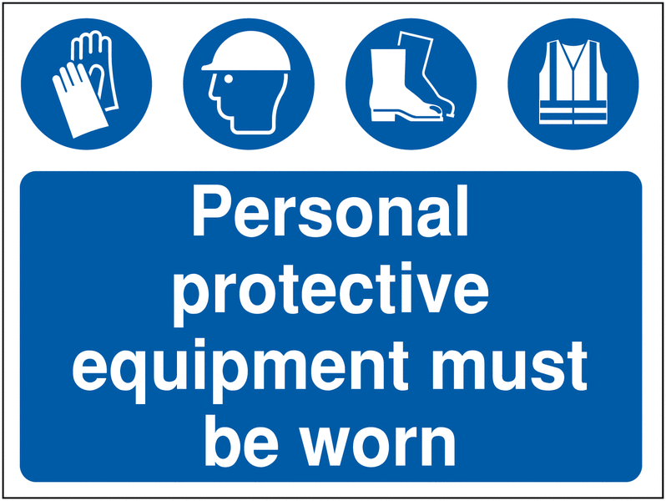

PPE are devices designed to protect the body from contact with work related environmental hazards. This may include:
Proper clothing
  Properly fitting clothing, minimal jewelry, or pulled back hair.
  No large rings
  Steel-toed boots
Goggles, face shields, or safety glasses
The right gloves
  Appropriate material
  Right fit
Proper ear protection
  Ear plugs, ear muffs
Head protection (Hard Hats)
  Each Job Can Require A Different Type of PPE Than Others….
  Choose the Right PPE For Each Job!

Slide 3
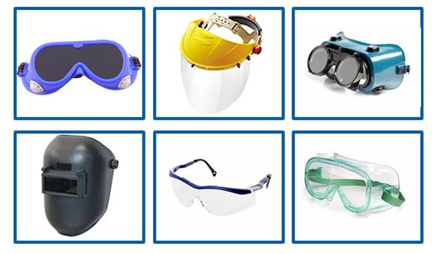
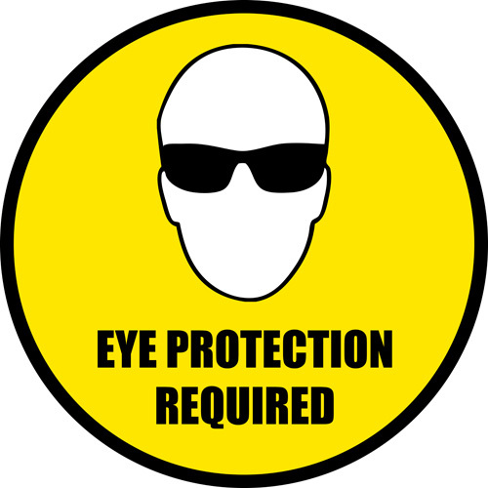
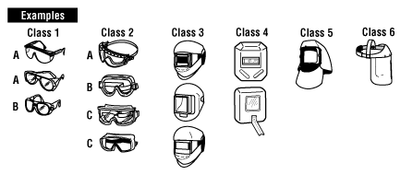
Eyes
What causes eye injuries?
  Almost 70% of accidents result from flying or falling particles or sparks striking the eye.
  Chemicals cause only about one-fifth of eye injuries.
What contributes to eye injuries?
  Not wearing eye protection.
    Nearly three out of every five workers injured were not wearing eye protection at the time of their accident.
  Wearing the wrong kind of eye protection for the job
# 1 injury when PPE is used improperly or not used at all.

Slide 4

Hands
Select and use the right glove for the job
Remove any rings, watches or bracelets that may tear the gloves
Wash hands before and after wearing gloves
Inspect your gloves before you use them
Keep gloves in accessible areas
Store gloves palm-side out in a cool, clean, dry, ventilated area
Never wear gloves around power rotating equipment

Slide 5
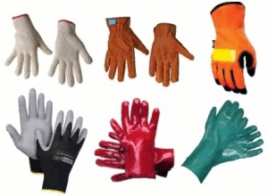
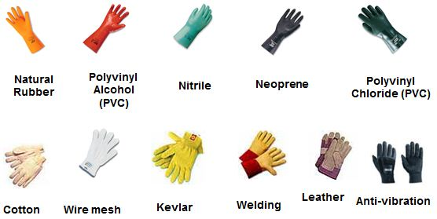
Types of Gloves
Wool
  Protects against cold weather and snow
  Coated Fabric
    Protects against some moderate concentrated chemicals
    Rubber/Plastic/Synthetic
    Great for cleaning or working with oils, solvents, and other chemicals
Leather
  Protects against rough objects, chips, sparks, and moderate heat.
Cotton/Fabric
  Protects against dirt, splinters, and abrasions.
  Helps grip slippery objects.
    Do not use when working with rough, sharp, or heavy materials.
    Kevlar
      Cut and abrasion resistant and provide protection from both head and cold

Slide 6
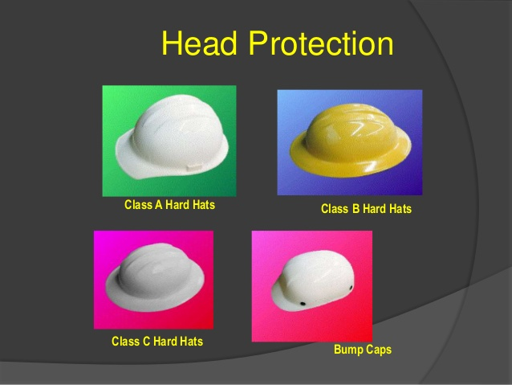
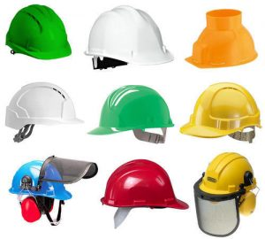
Head
Hard hats are required when working in areas where there is a potential for injury to the head from falling objects. All hard hats must comply with ANSI Z89.1
Types and Classes
Type 1 - Helmets intended to reduce the force of impact resulting in a blow only to the top of the head.
Type 2 - Helmets intended to reduce the force of impact resulting in a blow to the top and the side of the head
Class E Helmets are for where electrical hazards are present (in utility services) that are non-conducting and intended to protect against falling objects and reduce the danger of exposure to high voltage electrical shocks and burns. Offers the highest protection with high-voltage shock and burn protection up to 20,000 volts.
Class G Hard Hats are for General Use intended to protect against falling objects and reduce the danger of exposure to low voltage electrical conductors. They provide impact and penetration resistance and protection from up to 2,200 volts.
Class C Hard Hats are not tested for electrical resistance. They are designed for lightweight comfort and impact protection and are not intended to provide protection from electrical conductors.

