Slide 1

Electrical Safety

Slide 2

Electrical Awareness Statistics
Electrical injuries account for 20,000 Emergency visits / year
Resulting in 1,000 deaths / year
Low-Voltage injuries (110-440V) account for 60% of all injuries

Slide 3
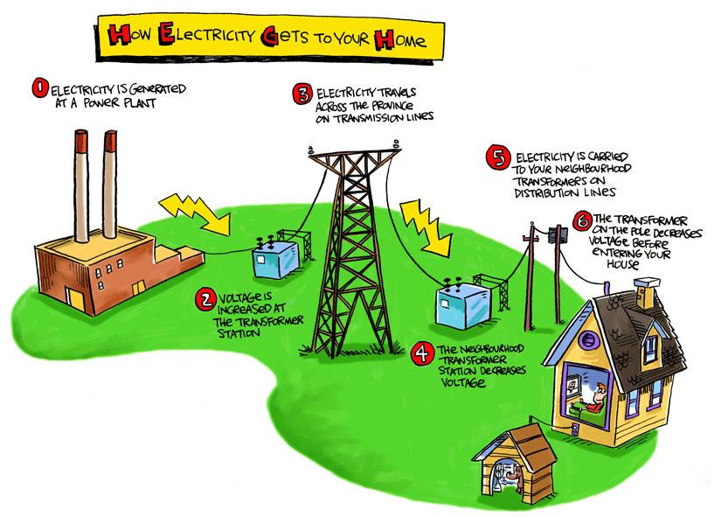
Understanding Electricity
Electricity begins at a “source” (e.g. battery, generator, power plant)
Then the electricity must be “transported” by conductors (e.g. wires, air, water)
A generator provides the “pressure” to transport the electric current

Slide 4
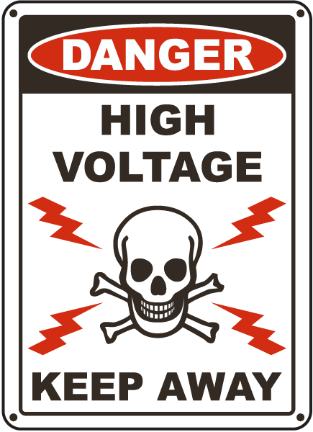
Five Hazards Associated with Electricity
Shock
Burns
Arc-Blast
Explosions
Fires

Slide 5

Five Ways to Minimize Electrical Hazards
Lockout / Tagout of Equipment
Grounding
Proper use of electrical cords
Personal Protective Equipment
Safe Work Practices

Slide 6
Six SAFETY TIPS
Always make sure your HANDS are DRY before you touch a light switch or electrical cord
Before plugging in an appliance make sure there are NO exposed wires that could start a fire or electrocute someone
Keep all electric appliances away from sinks and tubs.
Don’t plug too many things into ONE outlet. This will overload the circuit and cause a FIRE
NEVER run extension or electrical cords underneath rugs
Keep all electrical cords away from heat sources

Slide 7

Extension Cords
NEVER remove the third prong on a three-prong plug to make it fit. The third prong is the ground wire.
Don’t put an extension cord where it’s likely to be stepped on, tripped over or damaged.

Slide 8
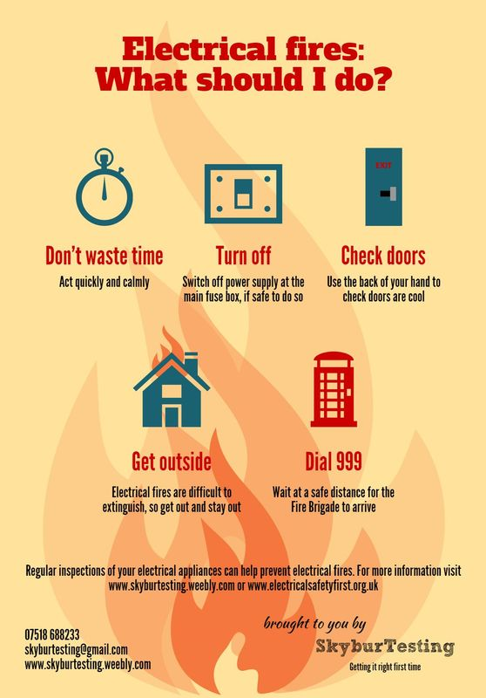
Electrical Fires
Call Fire Department (911)
Shut off Main Power Switch
(if possible)
NEVER USE WATER ON AN ELECTRICAL FIRE!! It can cause an electrical shock.
Use a CLASS C Fire Extinguisher.

Slide 9
ELECTRICITY
LET IT BE YOUR FRIEND
NOT YOUR ENEMY!!

