Slide 1
DSS Online
An informative guide for faculty and staff

Slide 2
DSS Online
DSS has gone fully digital over the summer of 2018
This means…
  No more paper accommodation letters (unless the student chooses to print)
  No more “blue sheets”- the Test Authorization is now completed via DSS Online
  Easier line of communication between DSS staff and students
  Streamlined processes for providing accommodations

Slide 3
DSS Student Process
DSS students will request their accommodations at the beginning of each semester for their individual courses
These requests are reviewed by DSS staff
At this point the professor will receive a letter from DisabilitySupport@unco.edu on behalf of the student, outlining their approved accommodations
This letter will contain instructions for Faculty regarding any accommodations that require further facilitation

Slide 4
How to Facilitate the Testing Accommodation using DSS Online
(no more blue sheets!)

Slide 5
Testing Accommodation
The testing accommodation requires some coordination by the instructor.
Instructors fill out an “Alternative Testing Contract” for each class at the beginning of the semester.
Instructors fill out exam instructions and send exams to DSS so DSS can administer exams with accommodations.
The following slides show step by step instructions for instructors.

Slide 6
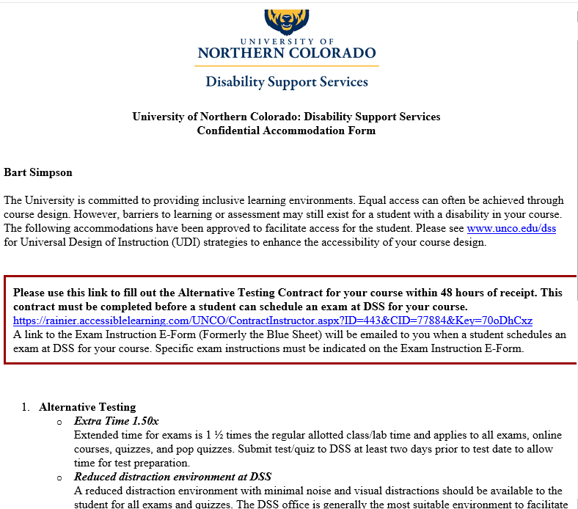
You will receive the student’s accommodation letter by email.
Click the link on the letter to fill out Alternative Testing Contract
(NOTE: this step DOES NOT need to be completed if there are no exams in your course!)

Slide 7
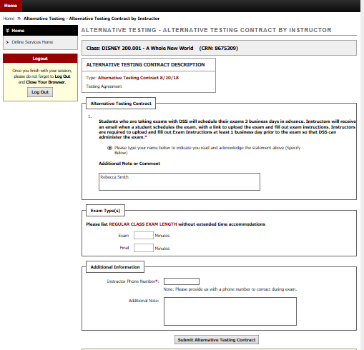
Fill out the Alternative Testing Contract once per semester for each course. Note: if there are multiple students in a course, you will still only need to complete this contract once per course.
This information will be used by DSS when administering exams for your course.
*Note: Students will not have access to the information provided on this form. All contact to faculty will come from DSS

Slide 8
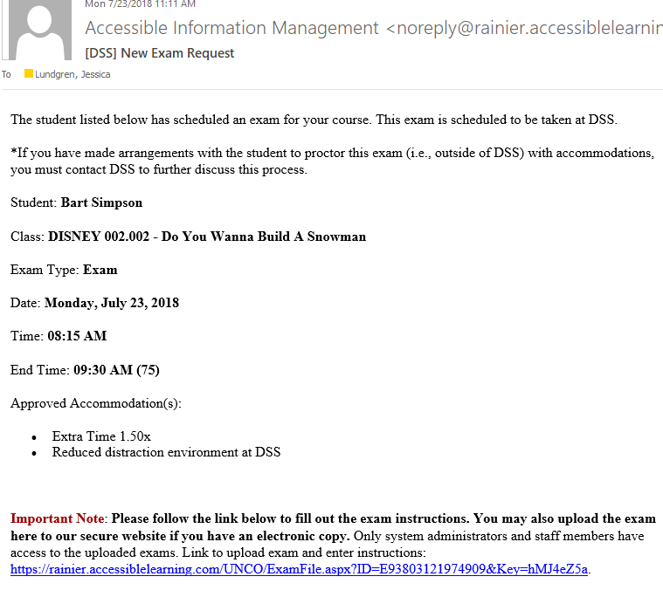
You will receive an email each time a student schedules an exam for your course with DSS.
Follow the link in the email to fill out the instructions for the exam. You may also upload your exam to DSS Online with this link.
Note: this form is specific to each scheduled exam.

Slide 9
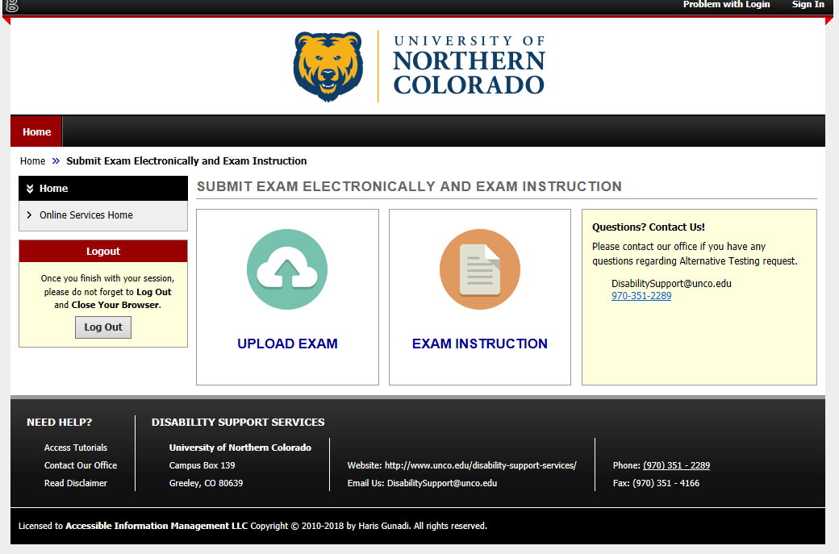
Upload your exam here if you have an electronic copy. Alternatively, you may still deliver your exam to DSS in person, by email, or fax.
This is the new “blue sheet”

Slide 10
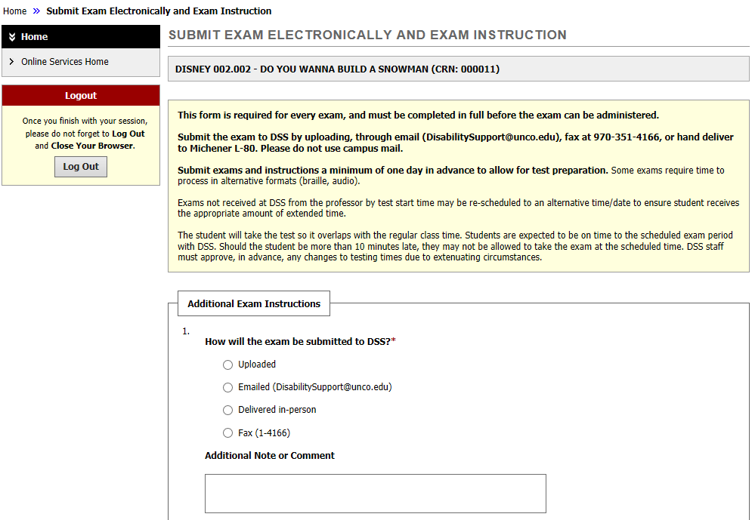
Answer the questions for the exam instructions.
When the student finishes the exam, you may choose to pick it up at DSS or have it delivered to your department.

Slide 11
How to Facilitate the Notetaking Accommodation using DSS Online
(no more green sheets!)

Slide 12
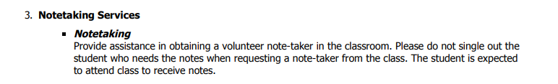
On the accommodation letter find whether the student has been approved for Notetaking Services

Slide 13
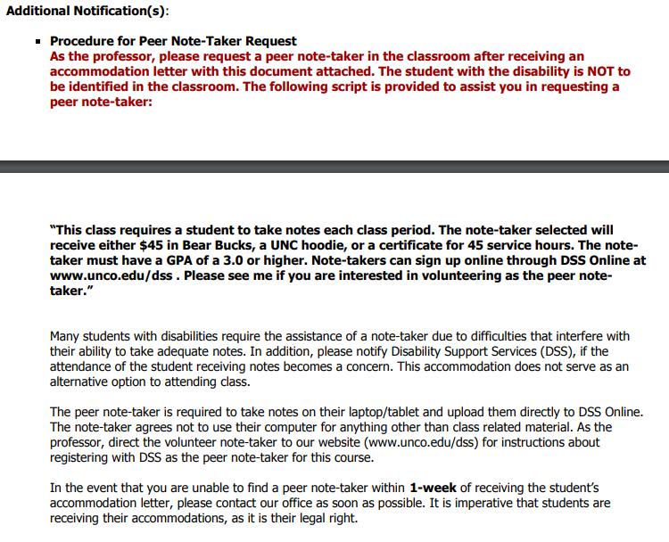
Find the Additional Notification(s) Section at the bottom of the letter:
This section will contain further instructions, including the information formerly on the green half sheets.

Slide 14
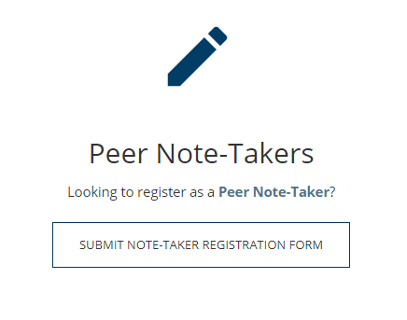
Volunteer Note-takers will register on our website www.unco.edu/dss

Slide 15
If you are unable to find a note-taker for your course within 1 week of the start of classes, please contact our office at 970-351-2289 or by email at DisabilitySupport@unco.edu

Slide 16
Questions?
If you have any questions about DSS online or our office procedures going forward, please do not hesitate to reach out by phone or email.
970-351-2289
DisabilitySupport@unco.edu

