Slide 1

Notetaking Services

Slide 2
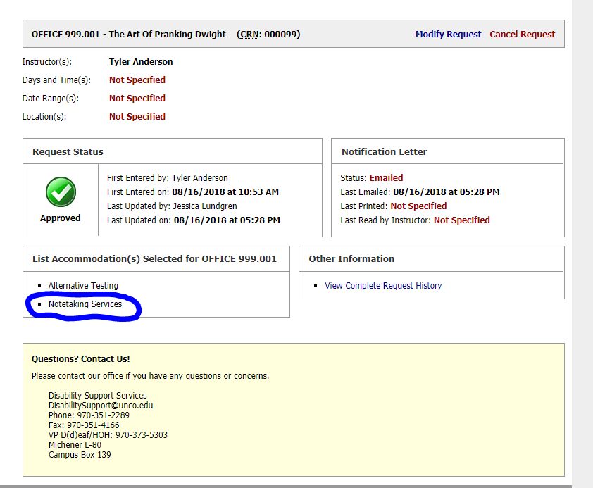
Confirm that you have requested “Notetaking Services” as an accommodation in your course

Slide 3
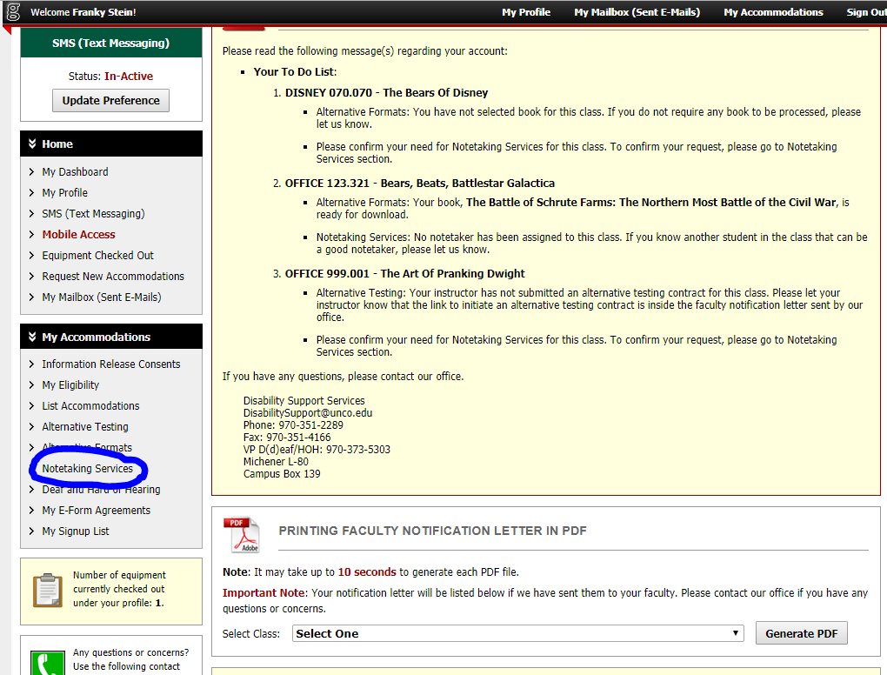
Locate “Notetaking Services” on your dashboard

Slide 4
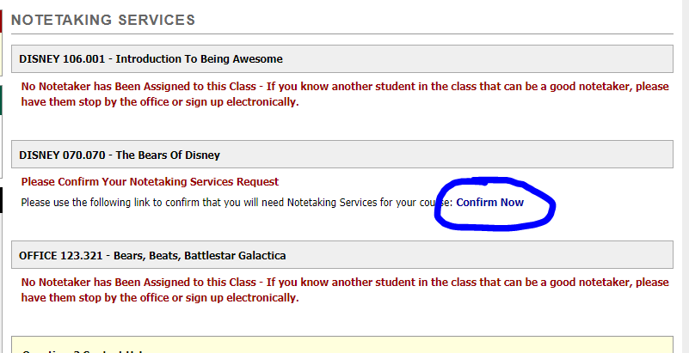
Click to confirm your notetaking requests

Slide 5
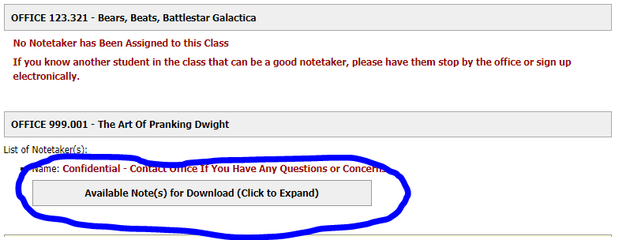
When notes have been uploaded you will be able to download directly from this page

Slide 6
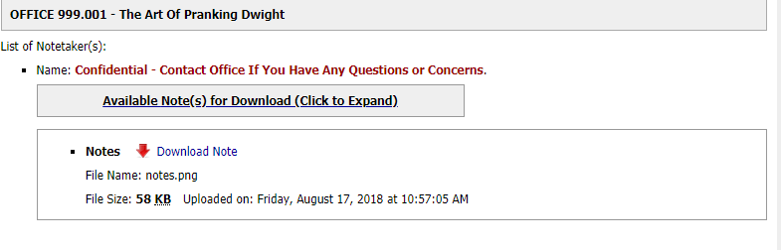
You can print or save your notes once downloaded

Slide 7
If you do not see a notetaker assigned or notes available for download within 2 weeks of submitting your request please email DRCtechnology@unco.edu

