Slide 1
DSS Online
Instructor Access

Slide 2
What is Instructor Access?
Instructor Access is a portal designed for instructors and faculty to manage accommodations for students with disabilities who are enrolled in their courses. Instructors can:
see and read the accommodation letter
see all exams that students have requested
see a list of all textbooks that are being converted into accessible versions
submit captioning requests
see the assigned note-taker
see the notes that have been uploaded from the note-taker

Slide 3
You’ll still receive email notifications for all accommodation requests, but you no longer have to rely solely on emails to facilitate accommodation requests
We hope it is a helpful tool for instructors…especially those with multiple students at a time with accommodations!

Slide 4
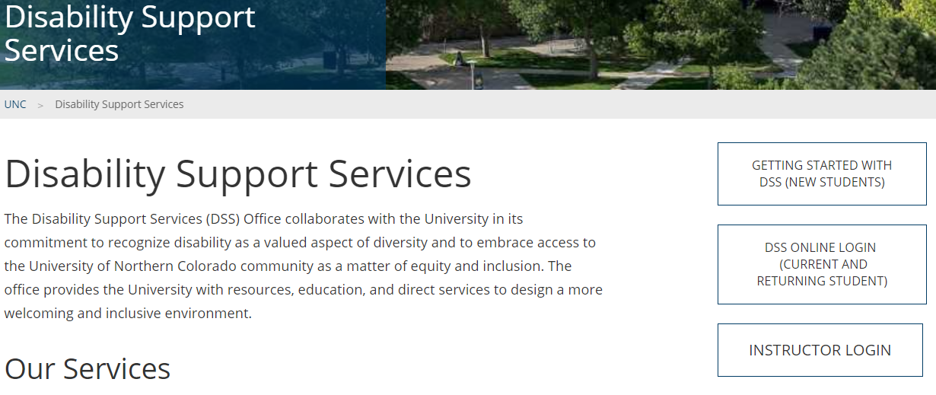
How do I use Instructor Access?
Log in with your UNCO credentials
Link to log in will be found in email notifications from DSS, as well as DSS website Homepage

Slide 5
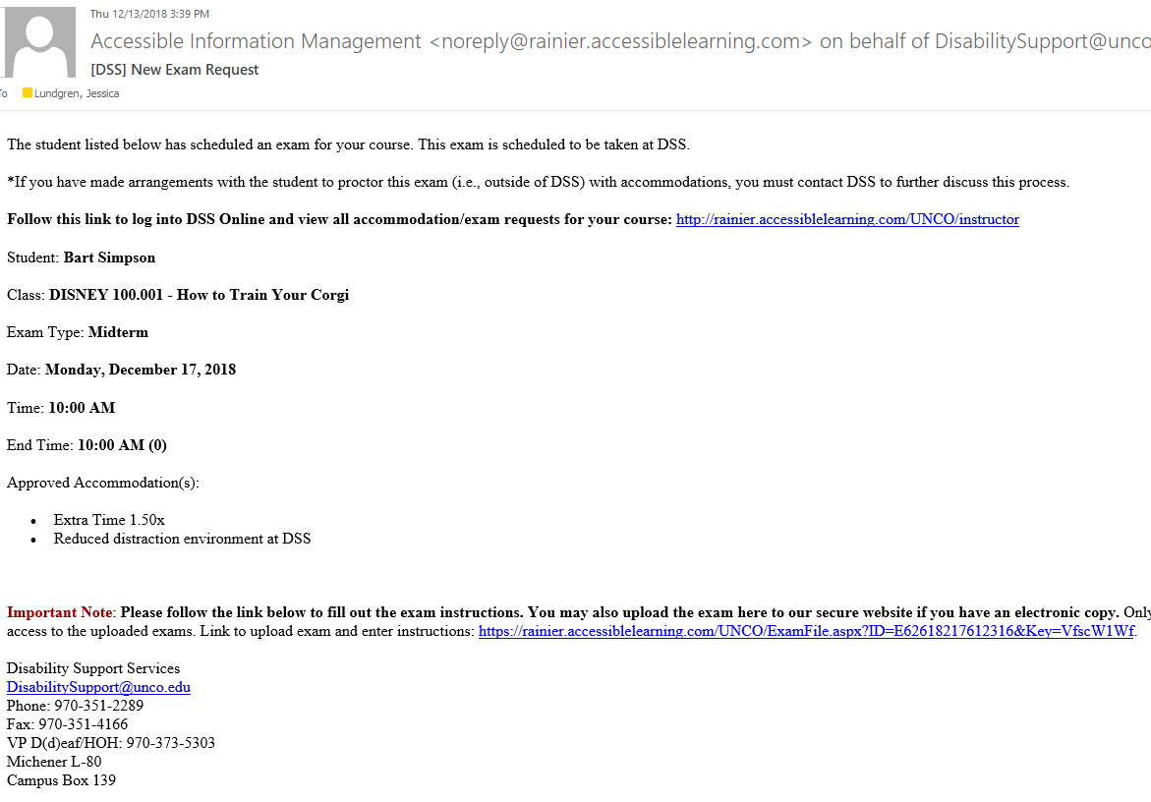
Example of email containing link to login:

Slide 6
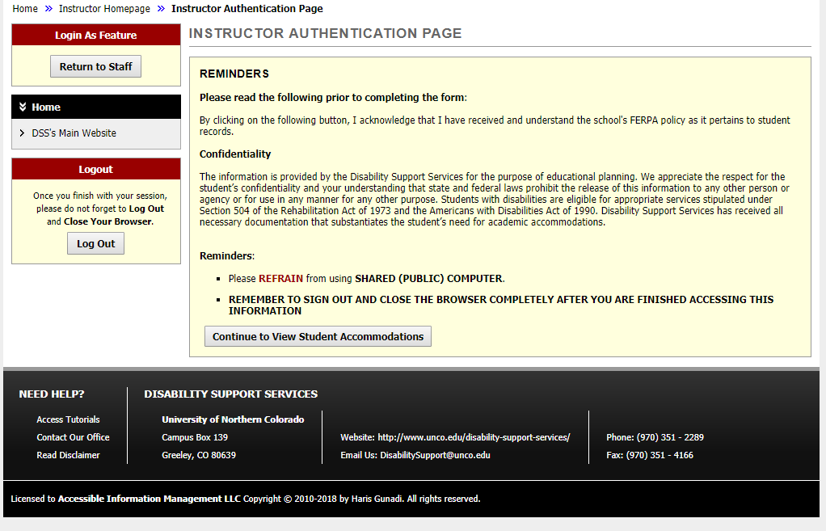
When you log in…
You’ll be directed to the Instructor Authentication page, which is just a reminder about confidentiality. This will appear each time you log in.
Click on “Continue to View Student Accommodations” to move on.

Slide 7
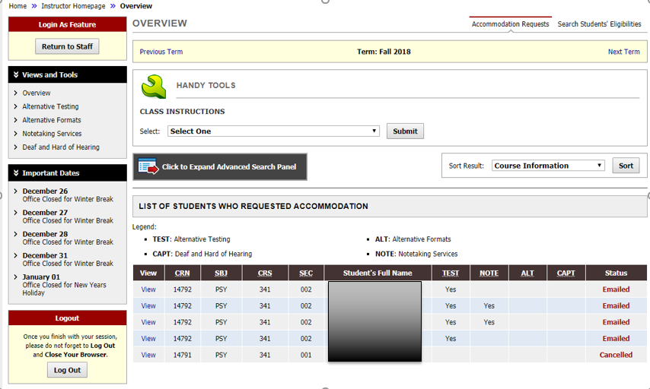
Your Instructor Dashboard Looks like…
View all students in your course who requested accommodations, and a shortcut for which accommodations they requested.
Click “View” to see a student’s accommodation letter

Slide 8
View specific types of accommodation requests that may require instructor facilitation under “Views and Tools”

Slide 9
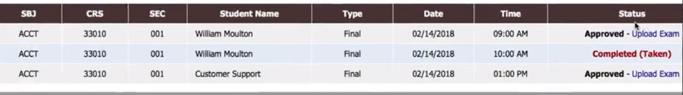
Alternative Testing
See exams your students have scheduled to take at DSS with accommodations
Fill out exam instructions
Upload exams
Students are expected to schedule exams with DSS at least 3 business days in advance (5 days in advance for finals).

Slide 10
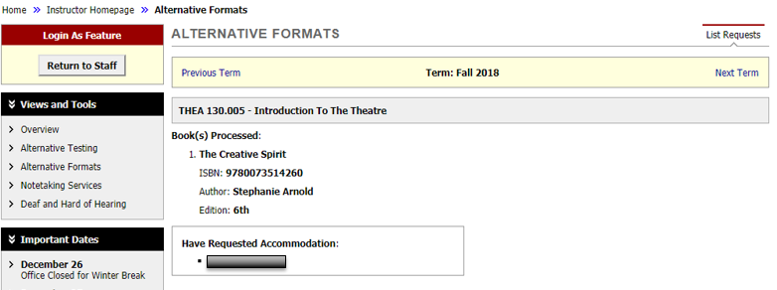
Alternative Formats
See books being processed by DSS into an alternative format, and which students need them

Slide 11
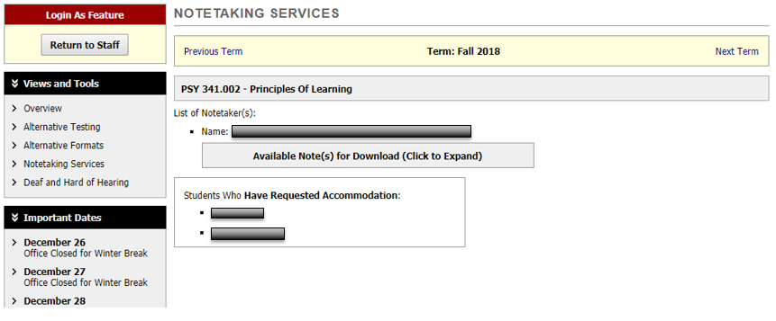
Notetaking
See if there is an assigned note-taker
View uploaded notes
  Are the notes quality/uploaded within 48 hours of class period?

Slide 12
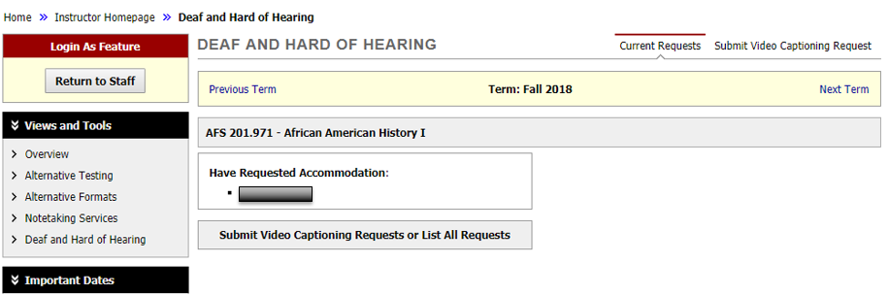
Deaf and Hard of Hearing
See assigned interpreter/transcriber
Submit video captioning requests

Slide 13
Thank you for your support while we continue to improve the online system!
Please contact us with any questions or concerns.
DisabilitySupport@unco.edu
970-351-2289

