Slide 1

Alternative Testing

Slide 2
Important Things to Remember
Exams must be scheduled with DRC 3 business days in advance of the testing date.
Exams must be scheduled to overlap with class period time, unless prior approval has been given due to three classes in a row or other extenuating circumstances.
Final exams must be scheduled with DRC 5 business days in advance.

Slide 3
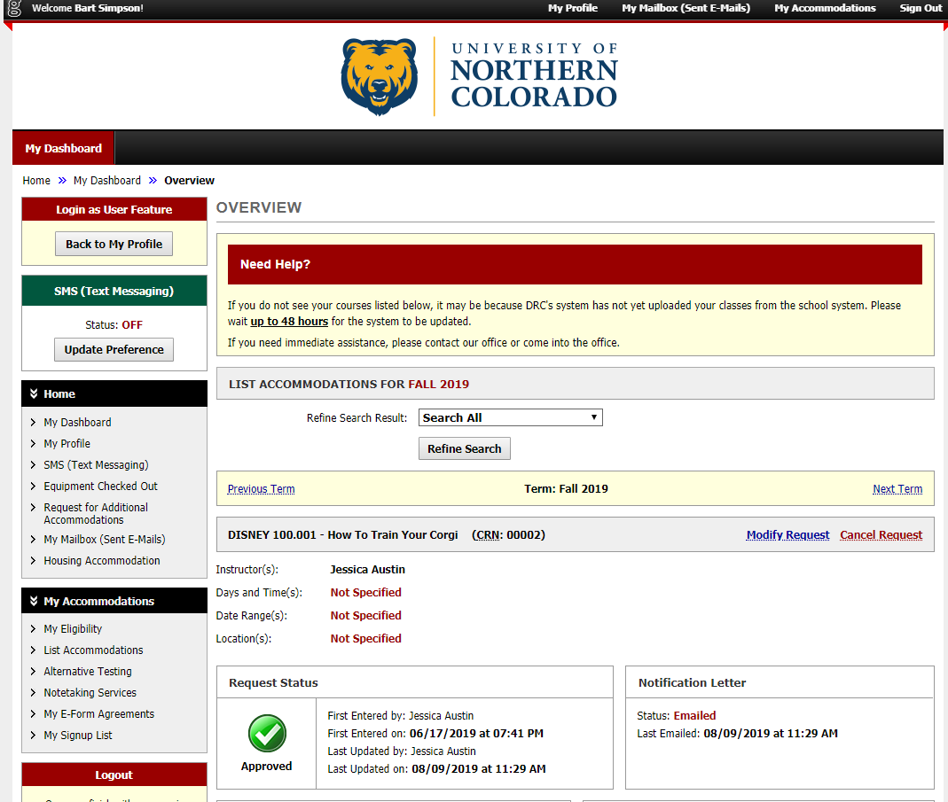
Scheduling an exam:
Log into DRC Online and click the link for “Alternative Testing”

Slide 4
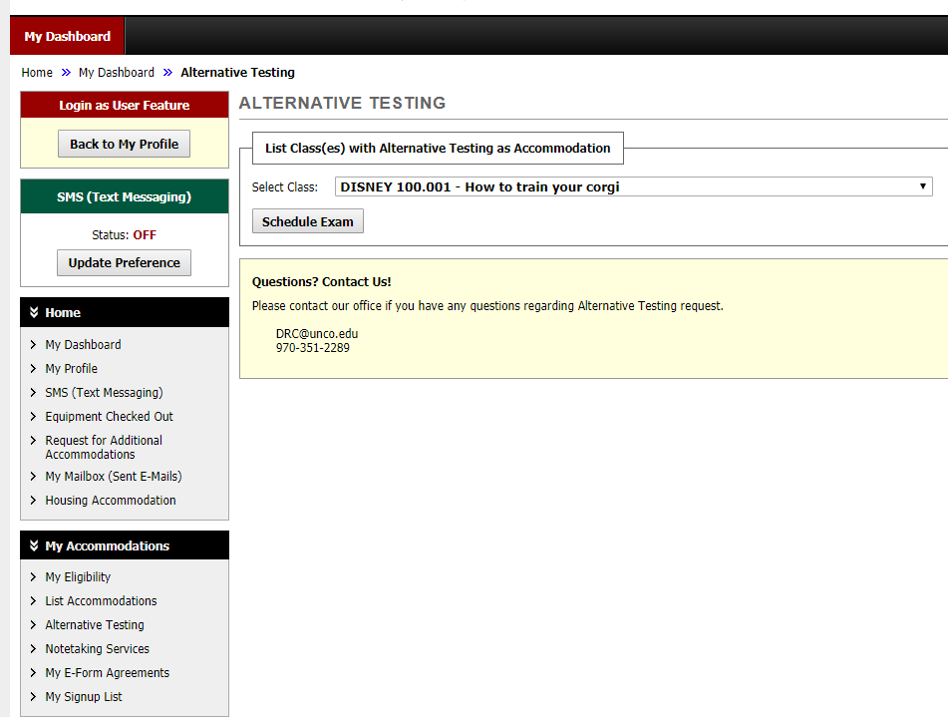
Select the appropriate course and click schedule an exam

Slide 5
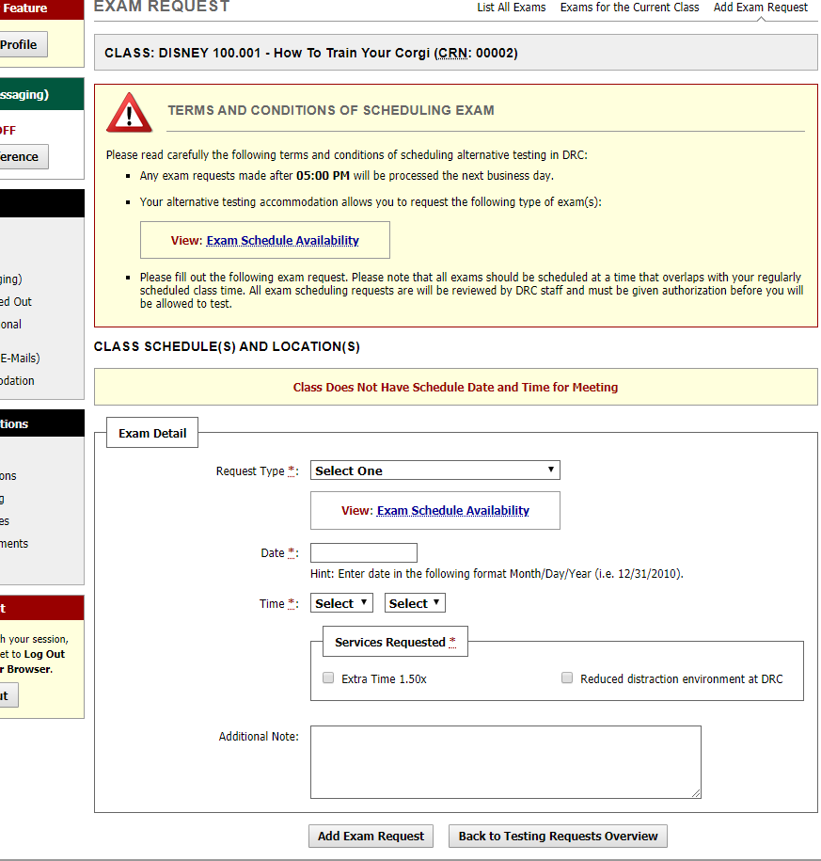
Fill out exam details and select all accommodations you will use on this exam. Click “Add Exam Request”.

Slide 6
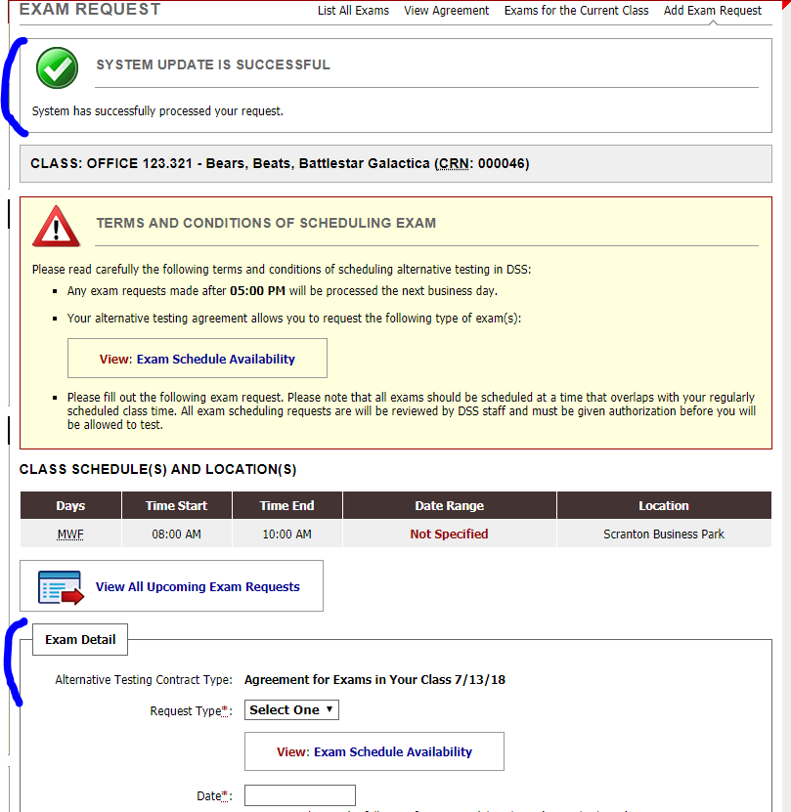
DSS Online will notify you that the exam request was successful. You will also be able to schedule another exam from this page.

Slide 7
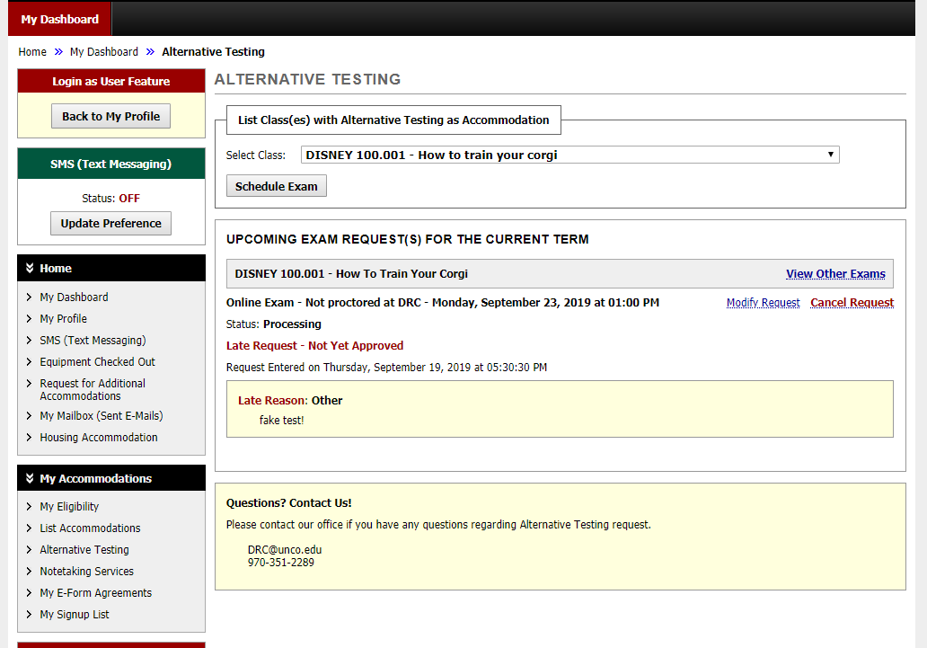
You can view all current exam requests under the Alternative Testing tab. You can also cancel or modify requests here.

Slide 8
DRC Online will automatically email your professors notifying them that you have scheduled an exam. It will provide a link for your professor to upload the exam and provide exam instructions. *It is still a good idea to remind your professor that this notification should be in their email.

Slide 9
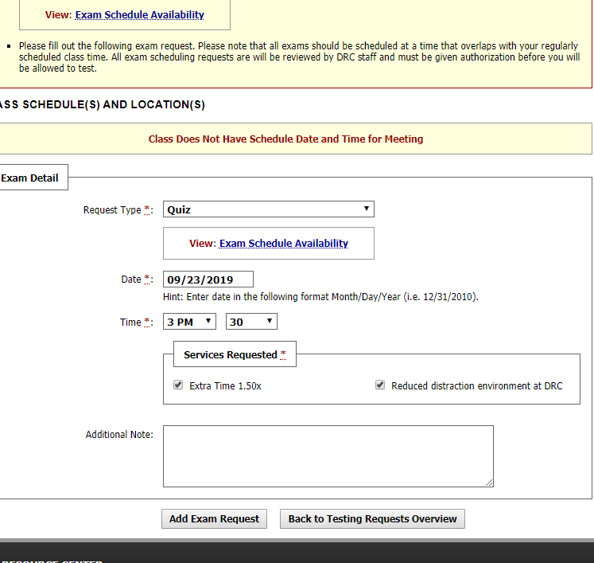
Scheduling an Exam Late
Follow the previous procedures. Input the exam details and click “Add Exam Request”

Slide 10
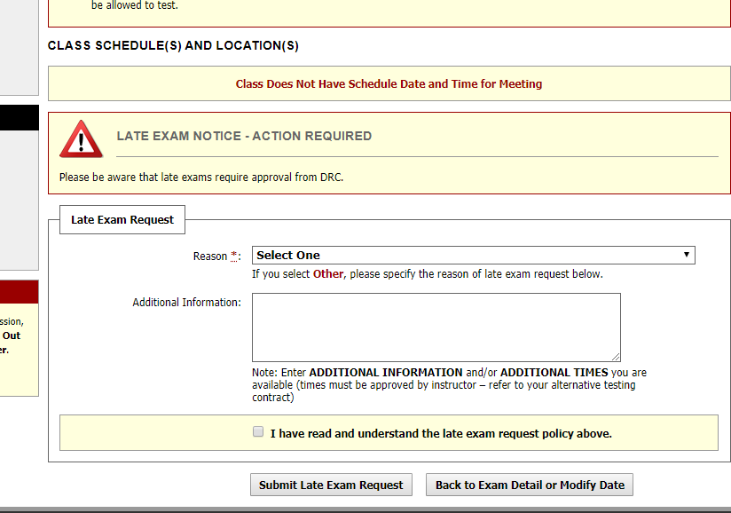
You will receive a Late Exam Notice and be required to select a reason for the late request

Slide 11
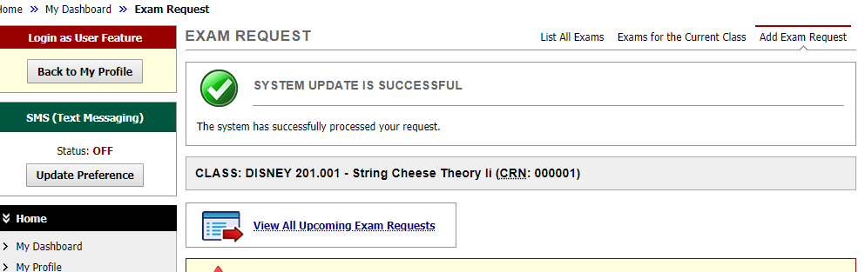
The system will notify you that the request was successful.
*Please note that all late requests are subject to DRC staff and professor approval.

Slide 12
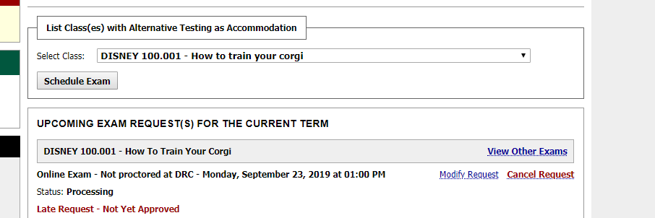
You will be able to view the status of this request under the Alternative Testing tab

Slide 13
Questions?
If you have any questions please contact us at
drc@unco.edu
970-351-2289

