Slide 1
Disability Support
Services
Instructor Training

Slide 2

Introduction to DSS

Slide 5

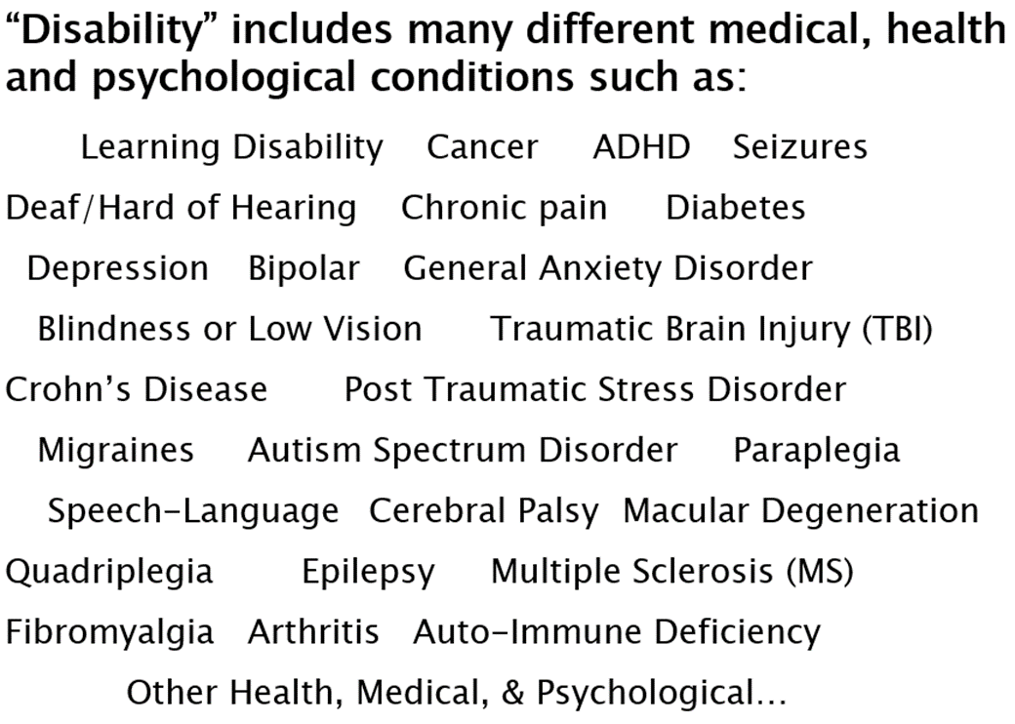
Who do we serve at DSS?
DSS, in fact, works with students who have a variety of disabilities including but not limited to the disabilities listed on this slide.
accommodations that will help remove barriers that the student may encounter in the university setting.
DSS staff engage in an interactive process with each student to determine appropriate accommodations
For example, a person who uses a wheelchair or a person who is blind and uses a service dog.
When you think about a person with a disability, you may think about a person with a visible disability.
Who are the students we work with at DSS?
Notes:
Who are the students we work with at DSS? When you think about a person with a disability, you may think about a person with a visible disability. For example, a person who uses a wheelchair or a person who is blind and uses a service dog. DSS, in fact, works with students who have a variety of disabilities including but not limited to the disabilities listed on this slide. DSS staff engage in an interactive process with each student to determine appropriate accommodations that will help remove barriers that the student may encounter in the university setting.

Slide 6
Working with Students with Disabilities

Slide 7
When/How to refer to DSS
Student discloses the presence of a medical condition or disability AND expresses a need or request for accommodations
Student speaks in general about a disability or medical condition and speaks generally about difficulties they experience
Student appears to be struggling and you believe they may have a disability
Notify DSS (DisabilitySupport@unco.edu) of the student
Ask student if they would like to be in contact with DSS and provide contact information
Provide contact information for multiple academic resources on campus including tutoring services, supplemental instruction, and DSS
It is possible that a student in your class may encounter barriers in your course due to a disability but has not worked with our office.
In these situations you may be uncertain about when you should refer the student to DSS, here are some examples of when and how to refer to DSS:
If a student approaches you and discloses the presents of a medical condition or disability and also expresses an explicit need or request for accommodation,
If the student approaches you and speaks in general about a disability or medical condition and speaks generally about difficulties they experience,
If the student appears to be struggling and you believe they may have a disability, but the student never explicitly states that they have a disability
or explicitly asks or requests for accommodations in your class please provide the student with multiple academic resources that are available on campus
please notify DSS of the student, you can use the email address on this slide
ask if they would like to be in contact with DSS and provide the student DSS contact information.
including tutoring services, supplemental instruction, and DSS.

Slide 8
Confidentiality
Student disability information is confidential.
Students disclose they are on the DSS program by giving instructor accommodation letter
Do not ask students what their disability is
You may ask questions about accommodations and how to provide them
Do not point out or call attention to a student when asking class for a volunteer note taker or providing other accommodations
Confidentiality. Student disability information is confidential. Students disclose they are on the DSS program by giving their instructor an accommodation letter.
Do not ask students what their disability is, you may ask questions about accommodations and how to provide them.
Do not point out or call attention to a student when asking the class for a volunteer notetaker, or providing other accommodations.
Notes:
Read slide

Slide 9
Testing Accommodation
It is the student’s responsibility to provide the instructor with an accommodation letter.
The student is also responsible for scheduling their exams with DSS to use their testing accommodation.
The testing accommodation also requires some coordination by the instructor.
Instructors fill out an “Alternative Testing Contract” (1 per course) at the beginning of the semester.
Instructors fill out exam instructions and send exams to DSS so DSS can administer exams with accommodations.
The following slides show step by step instructions for instructors.
Instructors will also fill out an alternative testing contract at the beginning of the semester; instructors also fill out exam instructions
Testing Accommodation. It is the student's responsibility to provide the instructor with an accommodation letter.
The student is also responsible scheduling their exams with DSS to use their testing accommodation.
The testing accommodation also requires some coordination by the instructor.
and send their exams to DSS, so DSS can administer exams with appropriate accommodations.
The following slides show step-by-step instructions for instructors.

Slide 10
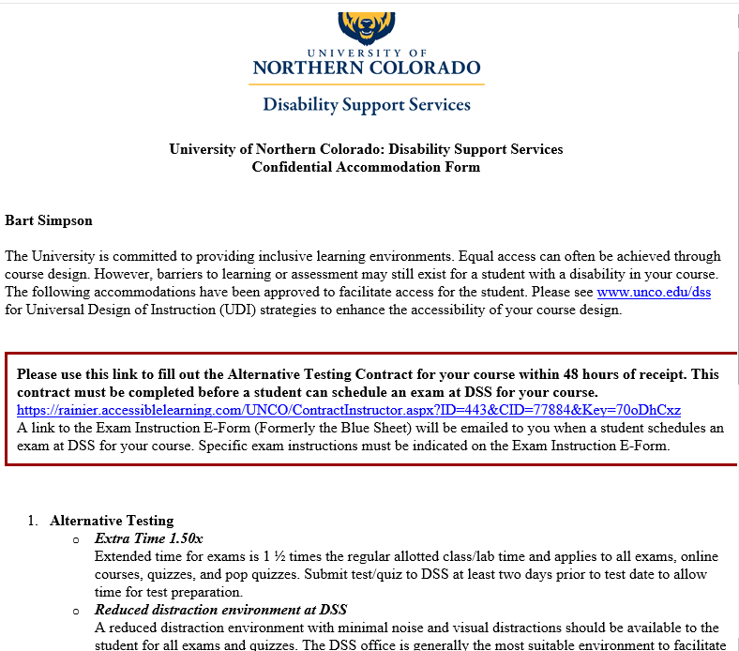
You will receive the student’s accommodation letter by email.
Click the link on the letter to fill out Alternative Testing Contract
Here is a sample accommodation letter, students who have academic disability accommodations will notify their instructor by sending their
accommodation letter by email, if a student is approved for testing accommodations, a link to the alternative testing contract will
will populate at the top of the letter, follow the link to fill out the alternative testing contract.
Notes:
Script here with audio

Slide 11
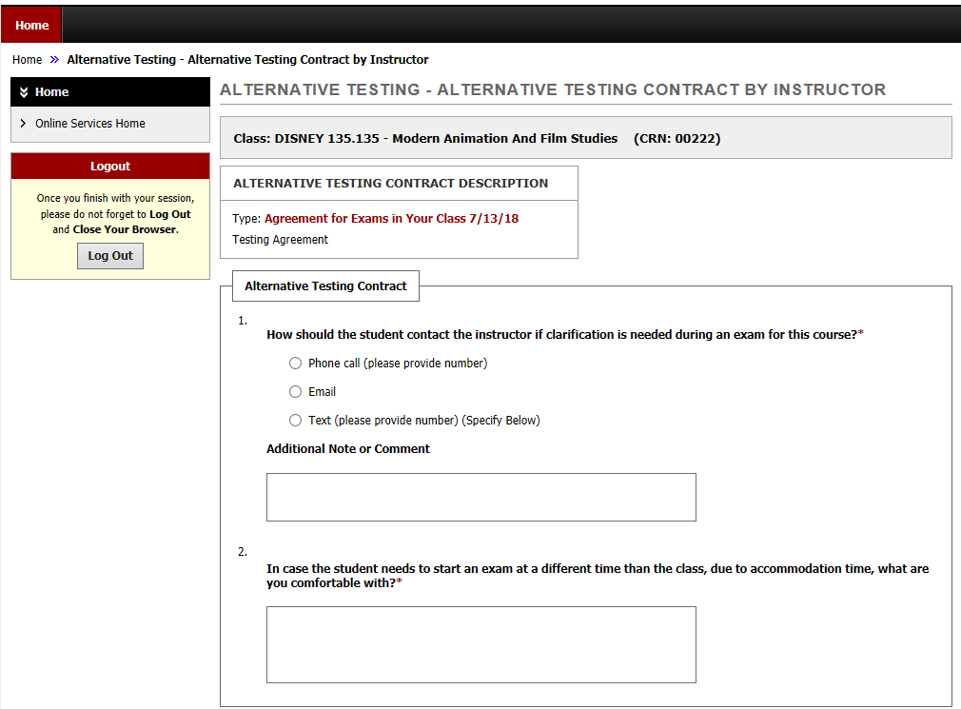
Fill out the Alternative Testing Contract once per semester for each course.
This information will be used by DSS when administering exams for your course.
When you follow the link, you will be taken to DSS Online to complete the alternative testing contract, this contract only needs to be filled out
one time per course, if you have multiple students in your course, who have the testing accommodation, you will not need to fill this out for each student
there are two questions on this contract, 1. How shall the student contact the instructor if clarification is needed and
2. In case the student needs to start the exam at a different time than the class due to accommodation time what are you comfortable with?
DSS will use this information to administer exams for your course; you will also have an opportunity more specific exam instructions later for the exam.
Notes:
Script with audio

Slide 12
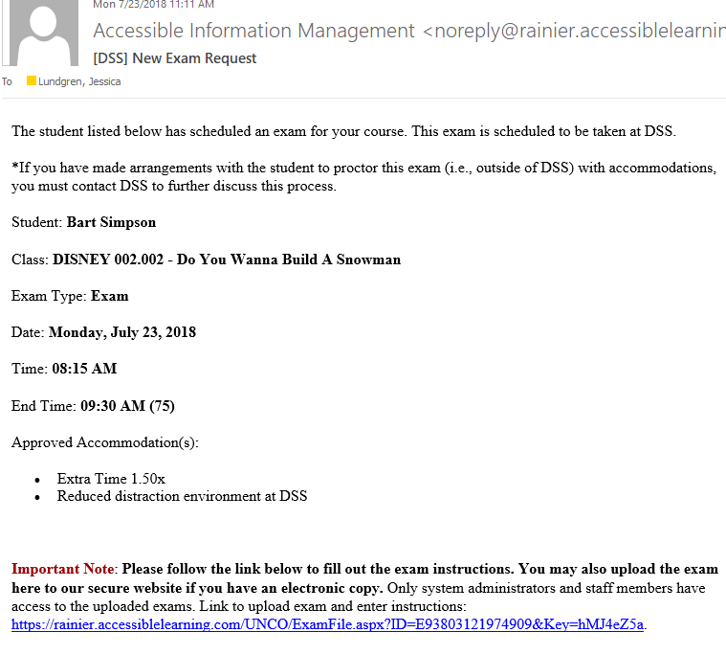
You will receive an email each time a student schedules an exam for your course with DSS.
Follow the link in the email to fill out the instructions for the exam. You may also upload your exam to DSS Online with this link.
Each time student a student schedules an exam for your course you will receive an email confirmation, this email will contain a link to the exam instructions
EForm as well as a link to upload the exam to DSS Onlines secure site
Notes:
Script and audio

Slide 13
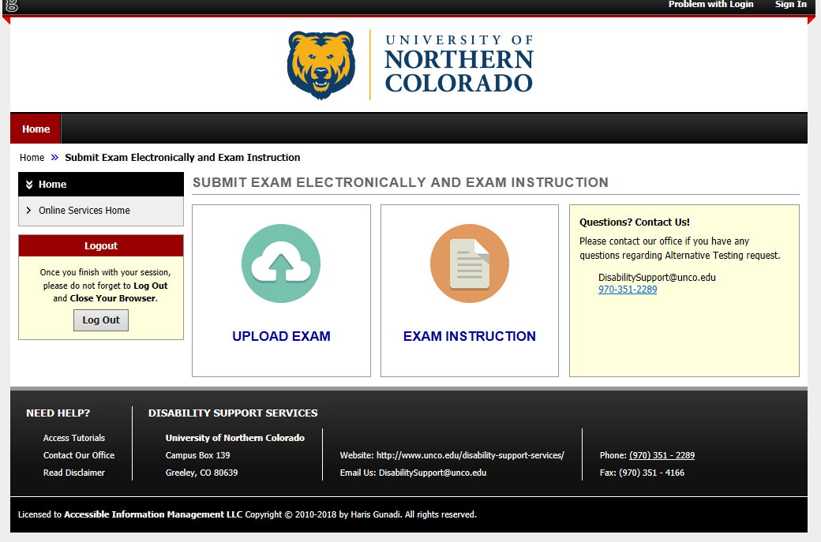
Upload your exam to DSS Online if you have an electronic copy. Alternatively, you may deliver your exam to DSS in person, by email, or fax.
Upload your exam to DSS Online if you have an electronic copy, alternatively you can deliver your exam to DSS in person, by email, or fax.
Notes:
Script and Audio

Slide 14
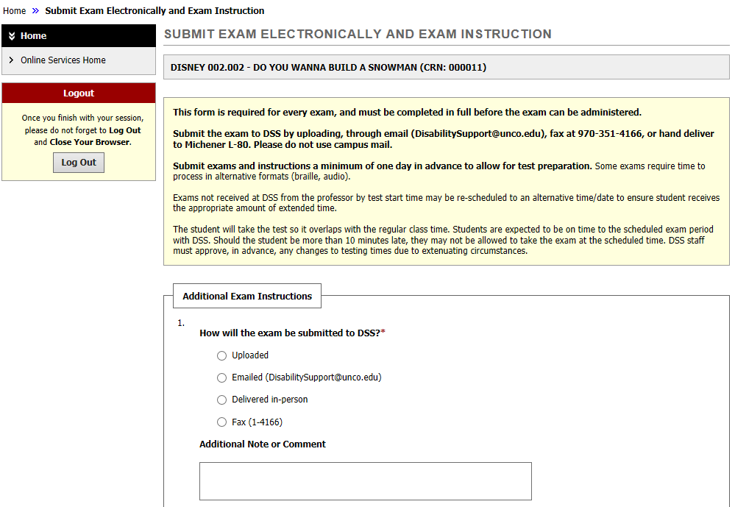
Answer the questions for the exam instructions.
When the student finishes the exam, you may choose to pick it up at DSS or have it delivered to your department.
Answer the questions with exam instructions; let us know if the student is allowed to use any resources, such as notes or a calculator during the exam.
There is also a space to include any special exam instructions, you will also indicate if you would like to pick up the completed exam at DSS
or have it delivered to your department.
Notes:
Script and audio

Slide 15
Interpreting/Deaf and Hard of Hearing
Best practices for working with Deaf/Hard of Hearing students
Direct your attention to the student, not their interpreter
Provide captions on videos, transcript if possible for audio material
Speak towards students, as they may be reading lips
If you aren’t sure what to do, just ask!

Slide 16
Accessible Instructional Materials
Notes:
Make sure all materials online are accessible with screen readers.
Screen readers such as Jaws or NVDA
Advance notice of reading materials so they can be converted
Adaptive Technology
Raised line drawing board
Screen Readers
Dragon (Speech to text)
Ergonomic keyboard
Track pad
Magnification device (CCTV)
Captioning
Printed materials should be high resolution/legible for easy conversion
Ensure accessible work stations are available
The access technology field is always changing, new technology becomes available all the time

Slide 17

Universal Design in Learning
Classroom Environment
Image of classroom that has good lighting, properly spaced desks and aisles, multiple presentation areas and modalities.
Keep isles wide and clear of obstructions, arrange furniture so that everyone has a clear line of sight to the presentation area.
If it makes sense with your presentation, consider setting up the room so that participants have a clear line of sight to each other as well as the presentation area.
for example a U-shaped or Circle configuration, consider posting interactive pieces of the presentation at a variety of heights so all participants
can see, read, and write, or otherwise interact with the materials.
Universal Design in Learning The Classroom Environment.
Notes:
Keep aisles wide and clear of obstructions.
Arrange furniture so that everyone has clear line of sight to the presentation area.
If it makes sense with your presentation, consider setting up the room so that participants have clear line of sight to each other as well as the presentation area. (e.g. ‘U’ or circle configuration)
Consider posting interactive pieces of the presentation at a variety of heights so all participants can see/read/write on or otherwise interact with the materials.

Slide 18

Accessible Presentation Materials
On PowerPoint slides use simple large 24-point font, use background colors that highly contrast with the text color and avoid
Color combinations to avoid include green and red, green and brown, blue and purple, green and blue, light green and yellow, blue and grey,
Also, avoid cluttered backgrounds, use large images, provide a text description of any images, avoid presenting complex tables, or graphs.
A good measure of this is to try and describe the table or graph to a person who is not in the room, if it is to difficult to explain verbally, it is to complex.
Enlarge web page information, caption all videos, DSS can help with this. Have a transcript of videos available in an accessible text format.
This is a comparison image with four boxes to demonstrate good visual presentation readability. Two boxes have high contrast between text and background colors. Two boxes have low contrast between text and background colors.
Accessible Presentation Materials. Use a variety of multi-media such as videos, slides, visual aids, and handouts.
color combinations that are difficult for people to read who have low vision or are color-blind.
green and grey, and green and black.
Spell out abbreviations and acronyms when first used.

Slide 19

Presentation Delivery
Image of instructor with a chalkboard in the background. Instructor is holding an open textbook and is addressing the students in the classroom.
Presentation Delivery. Promote a welcome and non-judgmental learning environment; let participants know if you will field questions during
or after your presentation. Setup participation expectations at the beginning, if you are expecting audience participation, movement around the room,
small group activities, etc. let participants know in advance in order to address any accessibility issues in advance.
Speak Visually Presented Key Content, for example, do not say, "as you can see on this slide" because some may not be able to see
the slide. A good idea is to pretend you are presenting your talk as a phone conference and describe your content
in the way you would describe it in that situation, define all terms and acronyms that might be unknown to someone.
listen carefully, repeat what you think you understand, and ask the person to clarify or repeat the information you did not understand.
Repeat questions participants pose, so that everyone in the audience understands the question.
Offer directions verbally and in writing, if you are having difficulty understanding someone's speech,

Slide 20
THANK YOU!
Contact Us
DisabilitySupport@unco.edu
970-351-2289

