Slide 1
Leadership Project:
Duoethnography
Mitra Chamanbahar and Steve Burgos

Slide 2
What is a duoethnography?
Autoethnography
Auto / ethno / graphy
Autoethnography is a form of qualitative research where the author writes about a personal experience to connect it to a larger cultural, political, or societal meaning.
The actual correct term is an autoethnography. The word duoethnography was coined by Joe Norris.
Duoethnography is a form of research using two people’s personal reflection.

Slide 3
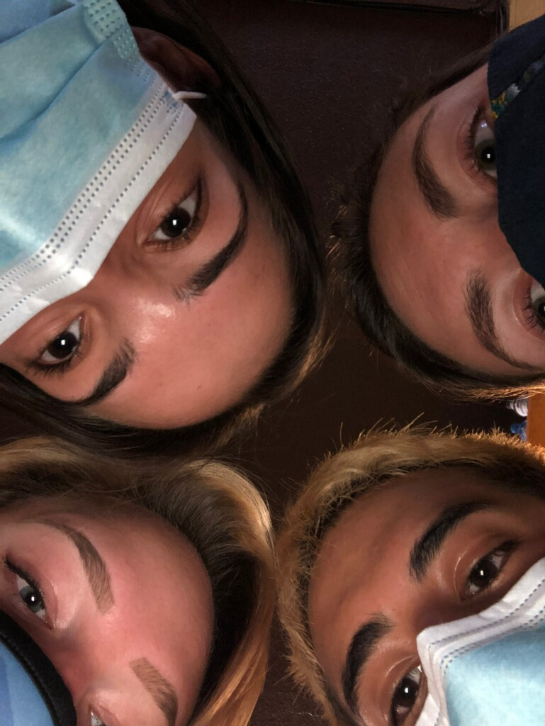
Our Inspiration:
We were inspired to write our autoethnographies because of the Covid-19 Pandemic.
We wanted to write about our experiences as we taught during the Pandemic.

Slide 4
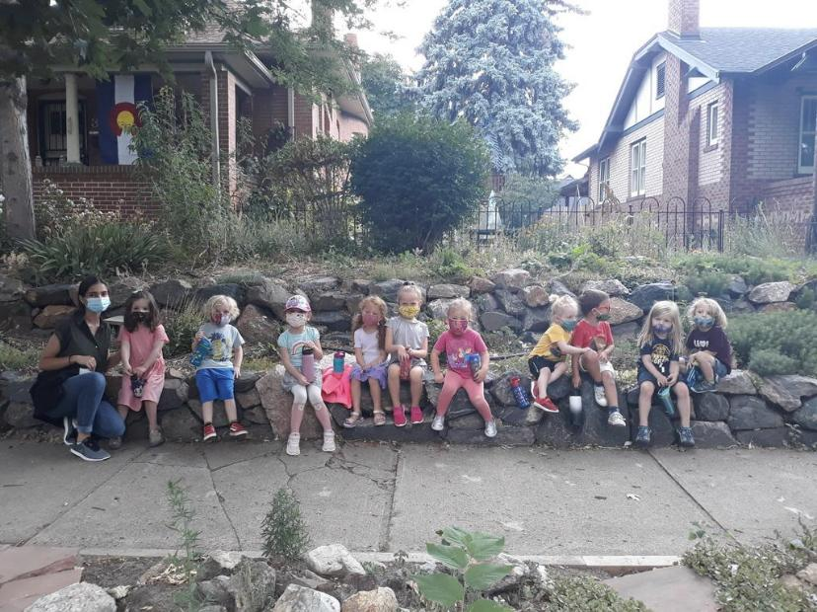
Teaching preschool during a Pandemic:
I was an assistant preschool teacher over the summer of 2020.
This experience made me think about how big world changes affect student learning and student development.
Class picture of my preschool class, July 2020.

Slide 5
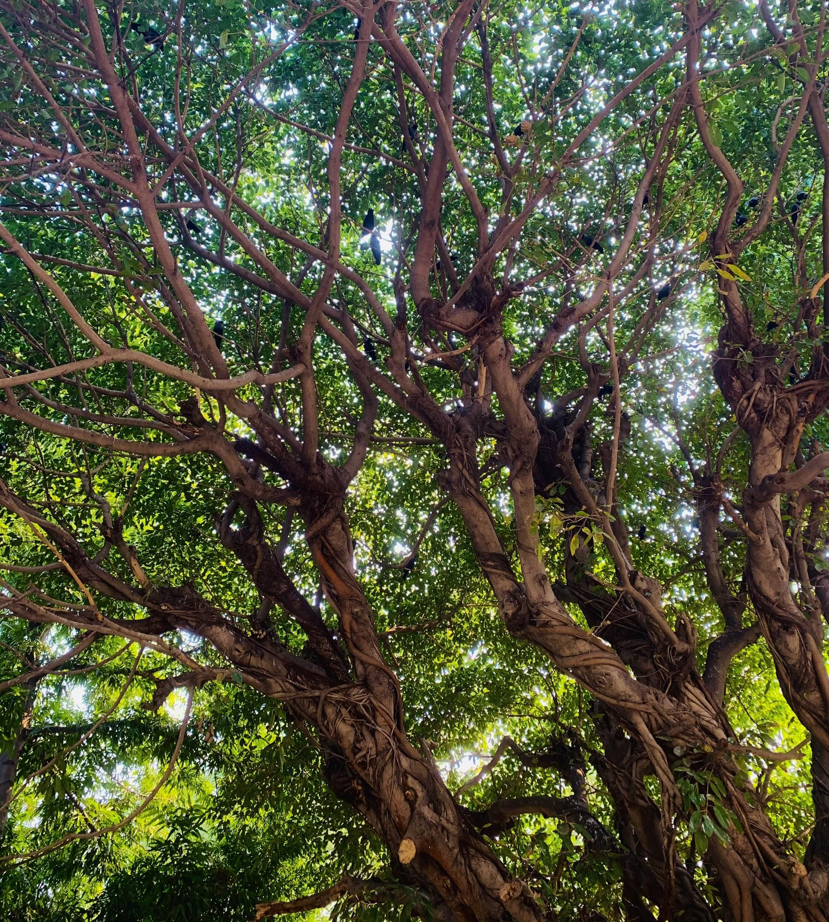
Artistic Reflection:
This artwork represents the idea of adaptation and connectedness.
When I think of adaptation, I think of the resiliency of plants and how they overcome their surroundings in order to thrive.
I felt this same feeling as the Covid-19 pandemic has progressed in that people that have adapted to our new situation are thriving more so than the people that have chosen to ignore it.
Mitra Chamanbahar, Untitled, photography, 2020.

Slide 6
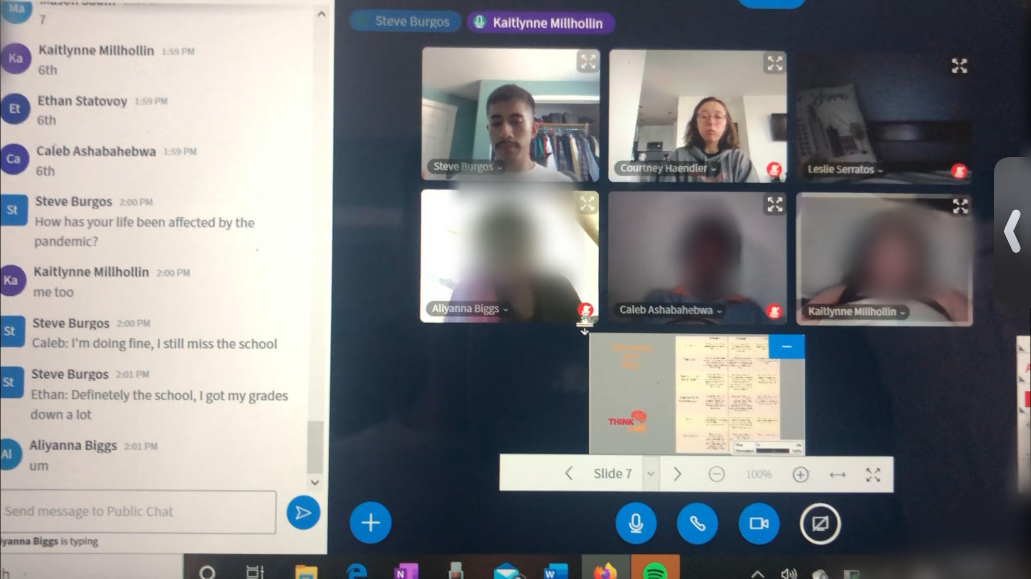
Teaching Online during the Pandemic:
I was a teaching fellow for a summer teaching program called Generation Teach. I was a teacher for 4 different periods, about 60 students in total.
Having conversations with students who for the first time are seeing how big and complicated the world is forced me to begin thinking about what our students are dealing with.
Picture of my 4th Period Zoom Class. July 2020

Slide 7
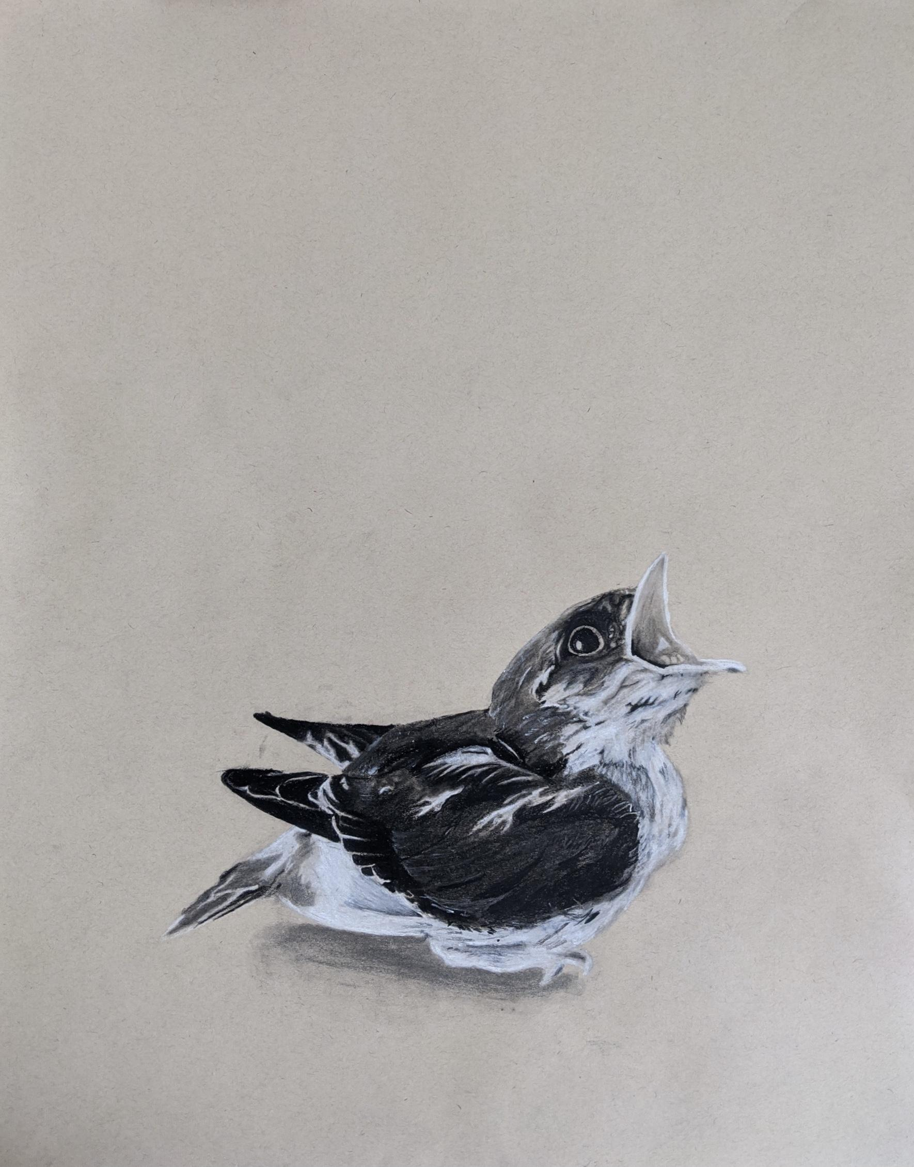
Artistic Reflection:
This piece represents students being forced to grow up faster than they need to.
When a baby bird falls out the nest, the safety they get from their net is gone, now all they have to do is survive.
Covid-19 and Black Lives Matter had forced kids to think outside themselves and grow up.
Steve Burgos. Forced Out the Nest. Charcoal. 2020

Slide 8
Read opening paragraph: Mitra
(Share Screen)

Slide 9
Read opening paragraph: Steve
(Share Screen)

Slide 10
Our Findings
For a lot of students, school is a place where they grow up and find who they are. Usually, school and the world are too intertwined for our students but this summer was different. These kids were bombarded by different real world information, and now they had to worry about more than just themselves. These kids have had to adapt to their new living situation and make best of what they have.

