Slide 1
Cumbres Project
Reagan Moore

Slide 2
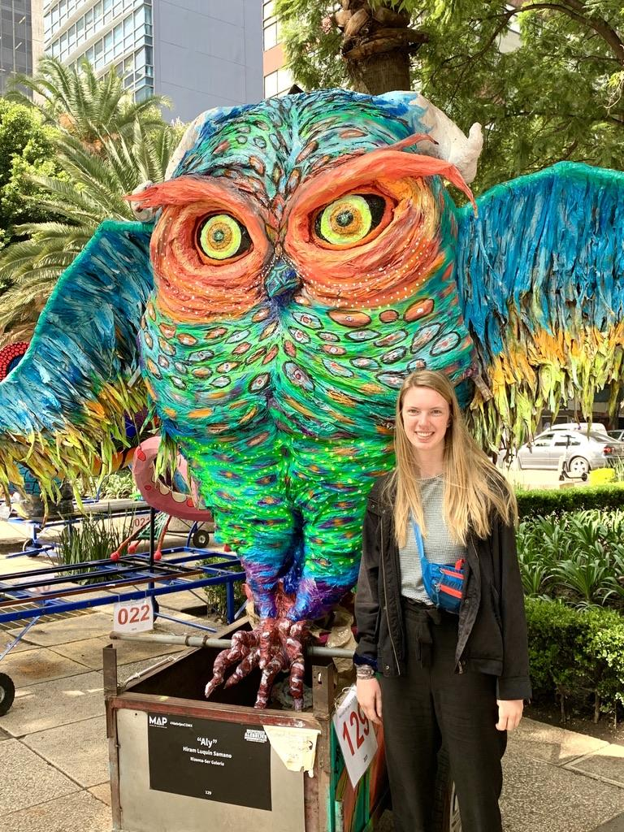
Hello!!
My name is Reagan Moore
studying Spanish k-12 education
teaching english as a second language (TESL)
bilingual education
Cumbres for 4 years

Slide 3
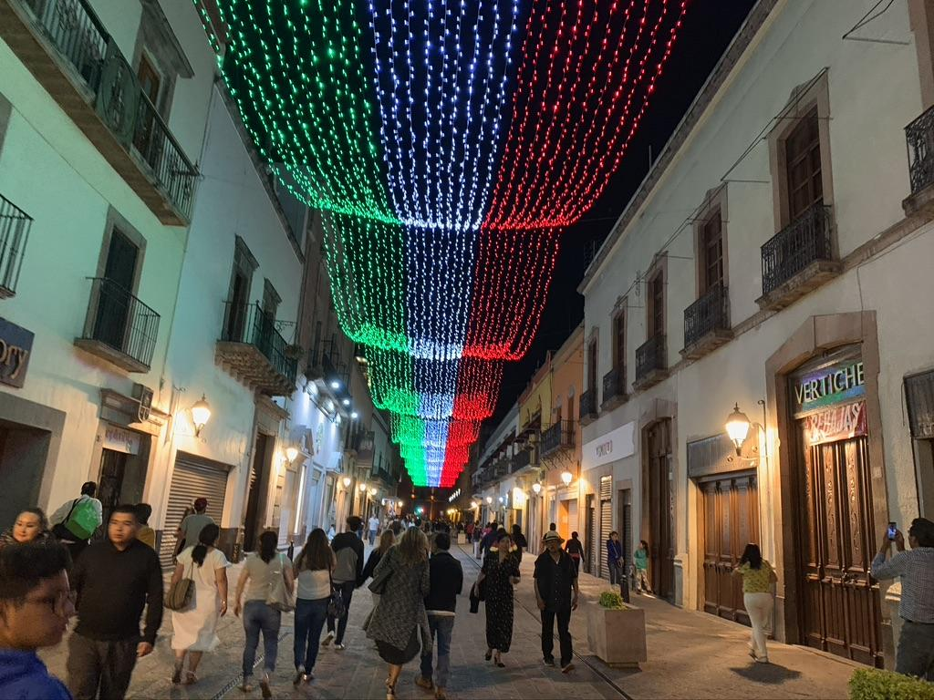
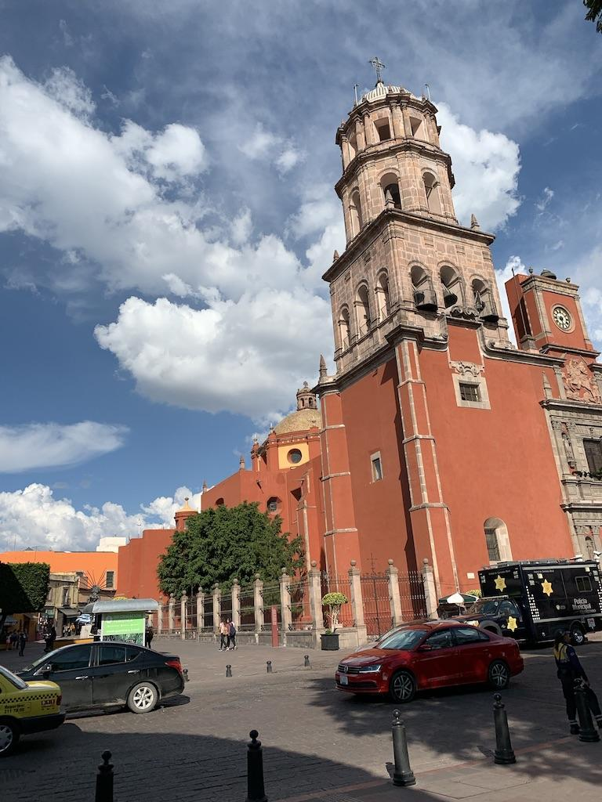
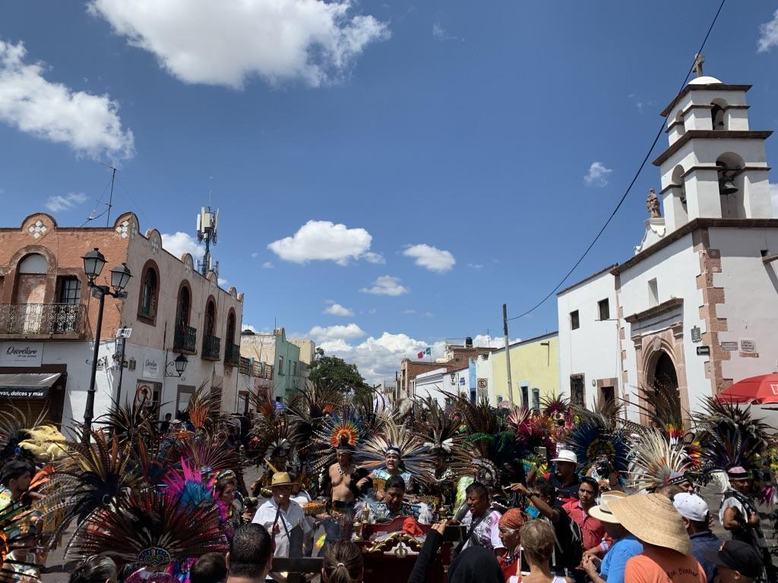
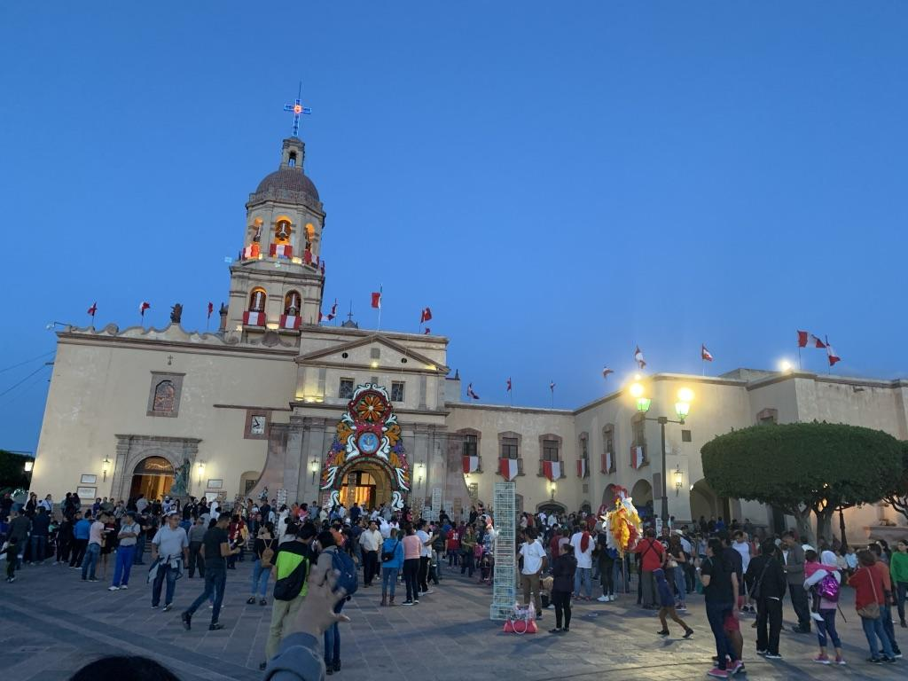

Slide 4
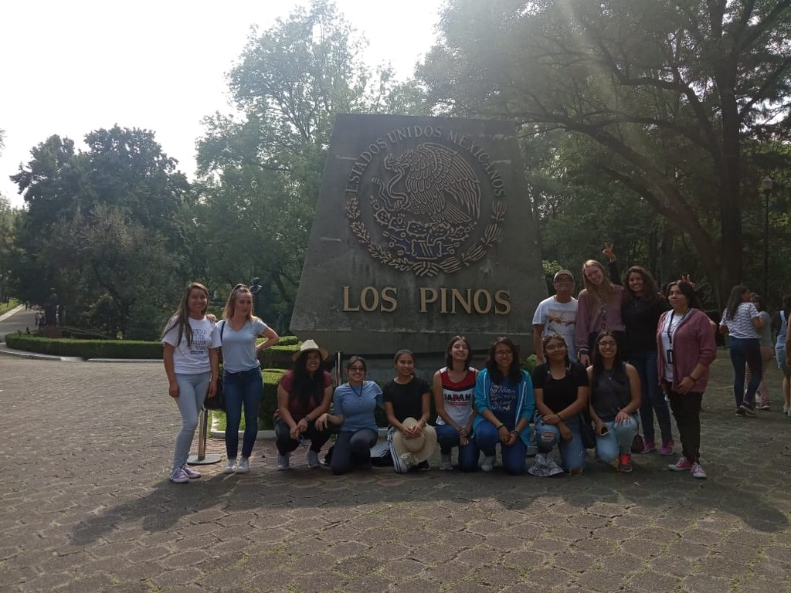
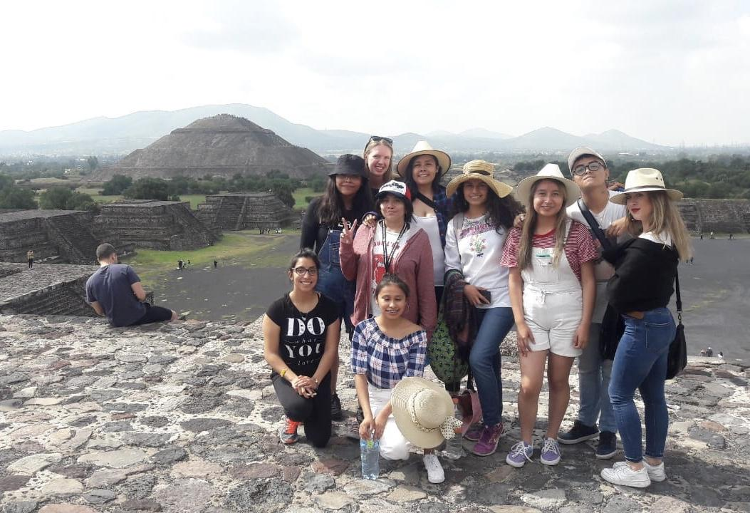
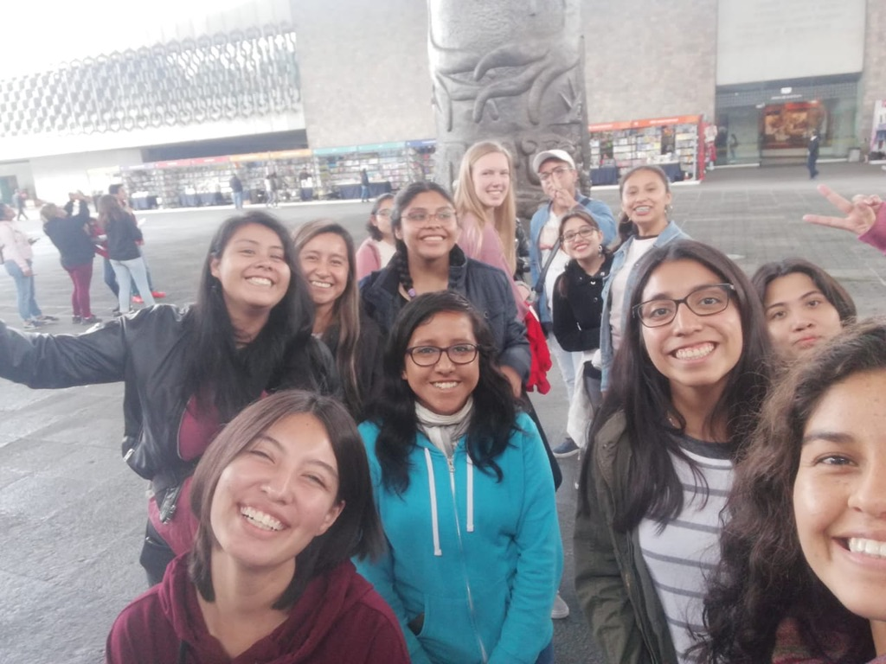
Description of Project
Teaching english classes to host family and friends
Creating and gathering resources to use to teach material
Learning more about Mexican culture to better relate to my students and to have a richer cultural knowledge

Slide 5
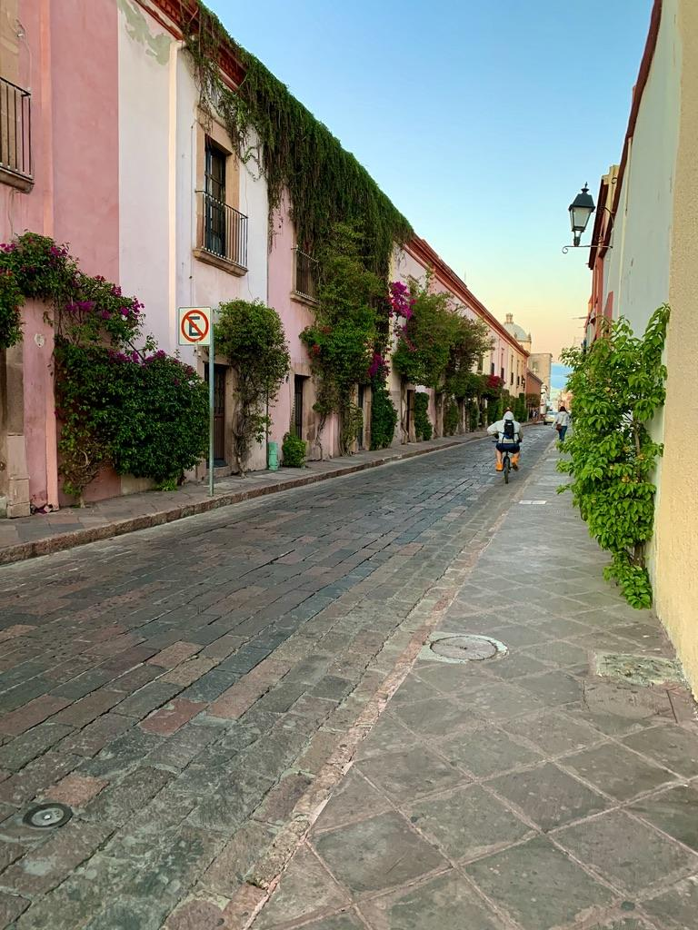
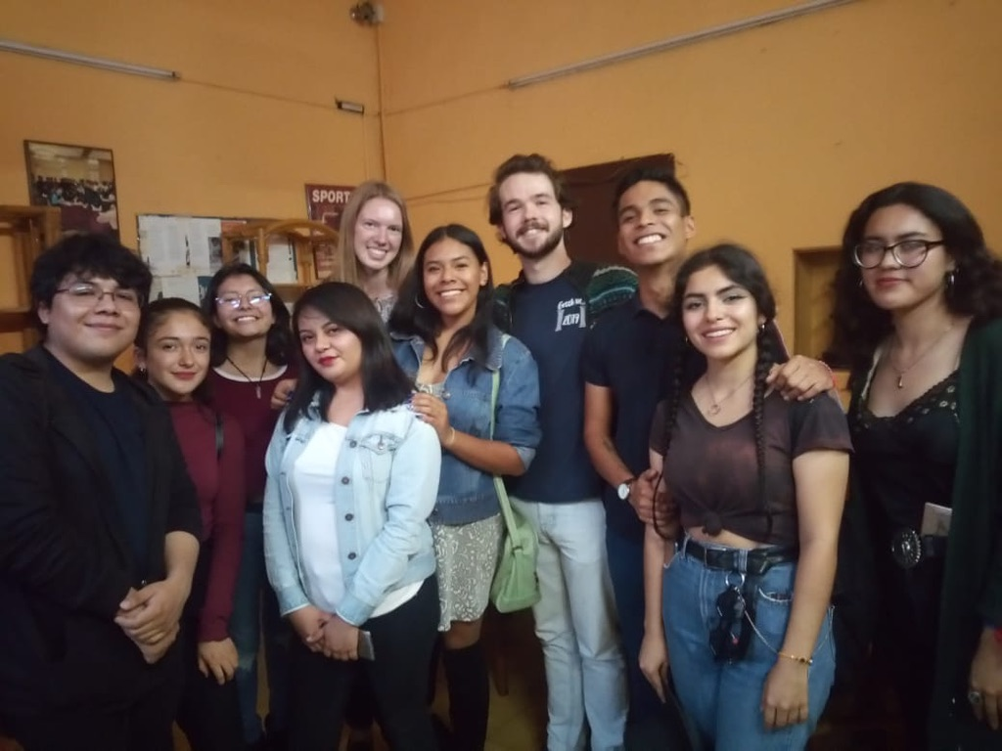
Purpose
I chose this because a good opportunity to practice teaching english as a second language using their L1

Slide 6
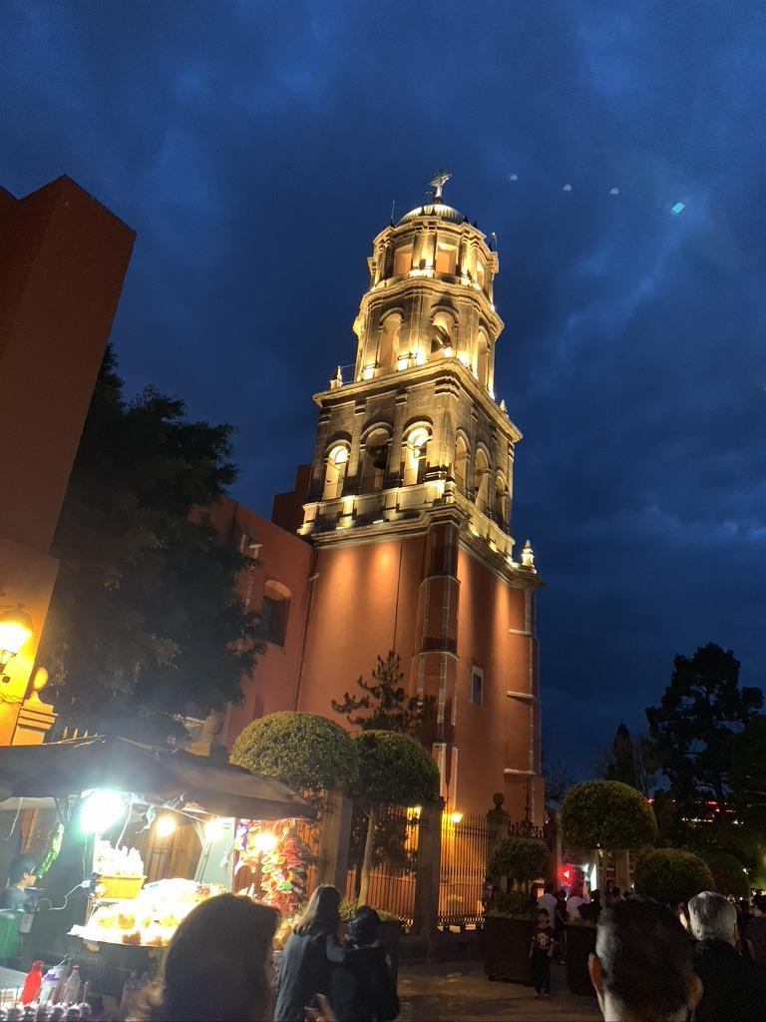
Goals
To help others learn more about the english language and to be able to practice
To improve in my abilities to teach ELL’s, to learn how to use different strategies and techniques
To connect with people in a more personal way

Slide 7
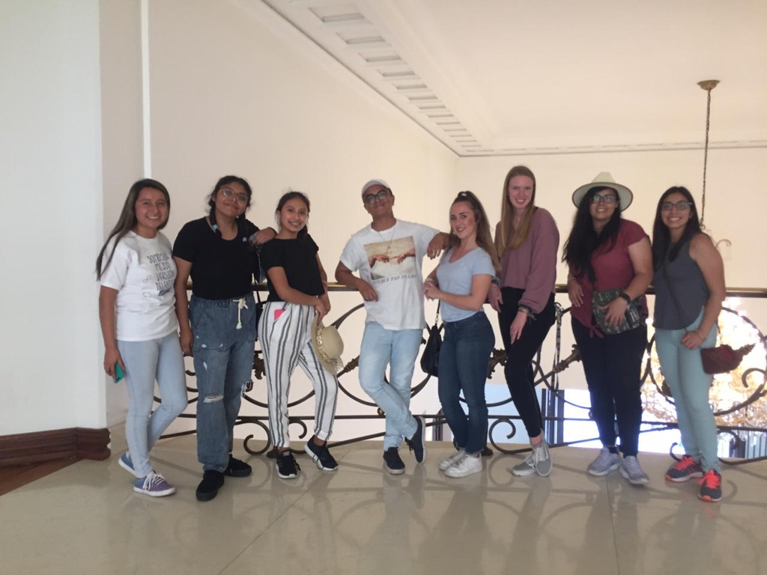
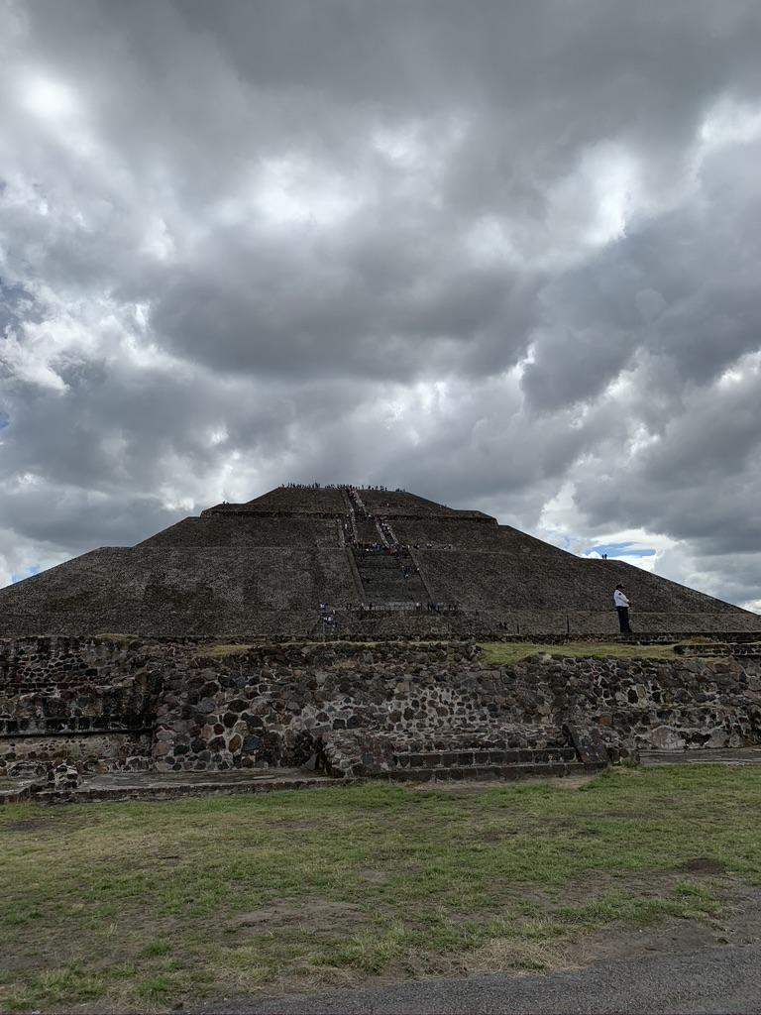
Process
We would meet weekly to have our class, and I would design the lesson based off their previous knowledge and then build upon week after week
We did a lot of conversational learning, it was interesting to use that method more than a grammatical focus because it is more practical

Slide 8
Conclusion
Overall, it was a positive learning experience although it wasn’t my original plan, but adapting to the circumstances and coming up with a new solution all helped me learn more about leadership as well.
This project was extremely impactful because what I learned will carry through and has and will impact me and my career as a teacher.

