Slide 1
Beyond Tutoring
By: Lizeth Dorado

Slide 2
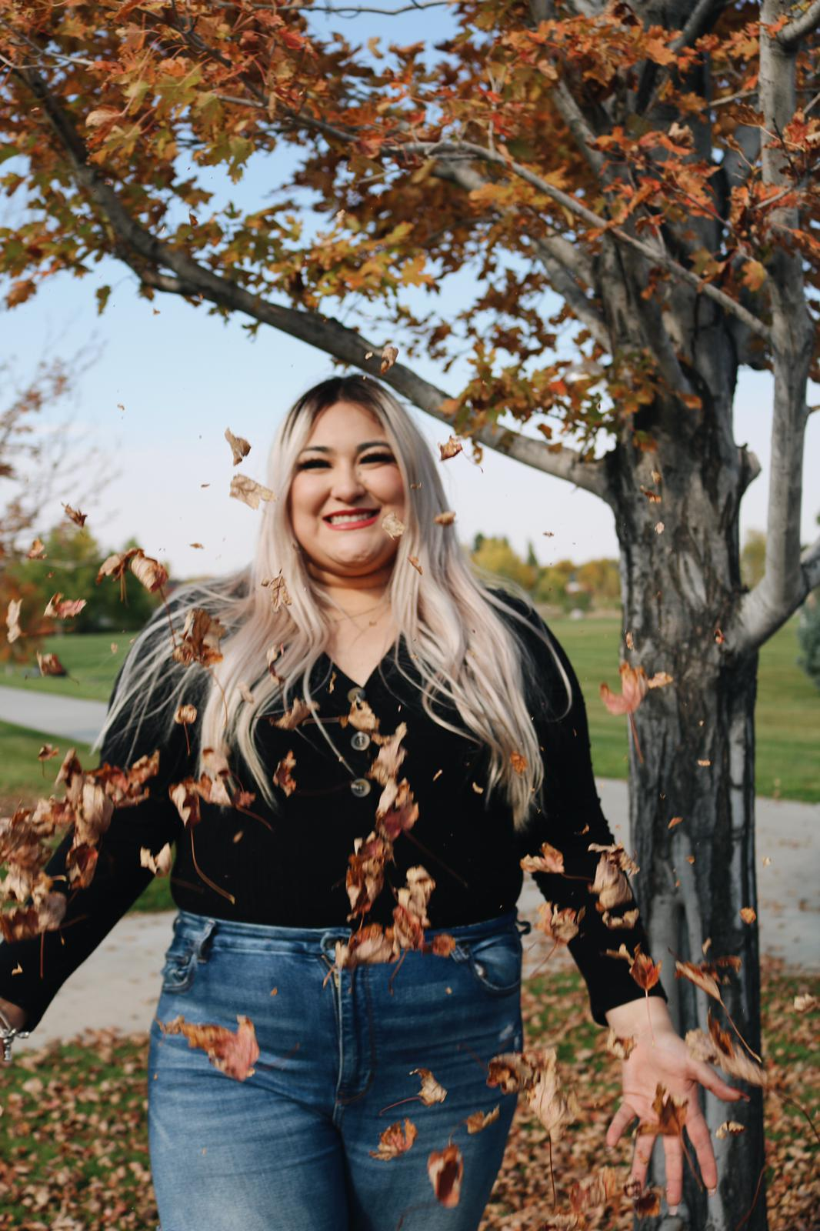
About me !
My name is Lizeth Dorado
I am a senior and am pursuing a degree in Elementary Education with an endorsement in Teaching English as a second language.

Slide 3
My Cumbres experience!
I have been in Cumbres all 4 years I have attended the University of Northern Colorado.
Cumbres helped me make great friends.
I was put into a classroom my first year and I learned that education was indeed what I wanted to pursue.
Cumbres has always been extra helpful.
Cumbres has made me into a better leader.

Slide 4
My leadership project
Before the world changed I had multiple ideas on my leadership project.
I knew I wanted to work with elementary age students.
I also wanted to help English language learners.
I had many ideas, but the covid hit and I had to change plans I had.

Slide 5
Tutoring
At the beginning of Covid I realized that there were a lot of parents and students struggling with online school.
I decided to offer my help for students that were having trouble keeping up with online school.
I would be helping out English language learners along with children from my own community.
I posted on social media and my mom told her friends at work and it turns out many students were not attending class because they didn't have wifi, computers, or just didn't know how. Some parents didn't even know school was online due to the language barrier.
I ended up having 7 students by the end of summer!

Slide 6
Abel
My first student was a family friend. He was in 1st grade and super behind on all his work.
This student did not have a computer to do his work.
- I contacted his school and they were providing students with laptops, so I got information and signed him up so he was able to receive one.
He had wifi at his house all he needed was a device to continue going to school.

Slide 7
Abel
This student was very behind because he had not been attending class.
I was able to get in contact with his teacher and get him logged on to everything her needed.
This student was a struggling reader.
At first I would just help with his classwork.
-Later I realized he needed help with other things in order to be able to complete his assignments.

Slide 8
Abel
Aside from his classwork he needed a lot of help with reading.
I decided to read him more books, and have him practice sounds of letters.
I provided more visuals for him to learn his alphabet.
I did a lot of research, and even bought some books in order to help him.

Slide 9
Abel
After the year was over, the students mom decided to let me keep tutoring over the summer.
It went great and by the end of the summer the student knew his alphabet, the sounds and was even reading some words.

Slide 10
Julie
This was a 4th grade student.
She was super smart and she mostly came to me for enrichment.
She was super smart so I planned assignments that were harder for her.
We would read and plan trips to the library.
She began to open up so much and became such a great writer.

Slide 11
Gabriel
Gabriel is a high schooler that needed help with Algebra.
He was always stuck, but I would find different ways to teach and explain.
He began to learn and could find a way to start his problems without any help.
He has become so much better at math.

Slide 12
Luisa
Luisa is a 4th grade student. I asked her what she thought she needed help with and I gave her some work to figure out where she was.
I found out she needed help understanding what she read, so we took library trips and read a lot together.

Slide 13
Alan
Alan came to me over the summer and is now in 4th grade.
English is his second language and he struggles reading and writing.
At first he needed the voice to text tool, but now we are practicing and he has become better at typing, reading, and writing in English.

Slide 14
Rogelio
Rogelio is in middle school.
He is super smart, but decides not to do the work.
I had to figure out what he was motivated by in order for him to do any work.
He loved to draw and I told him I would let him draw after he did some assignments and it worked!

Slide 15
Erica
Erica is one of my newest students.
She is also an English language learner.
She came from Mexico and is in high school so she is struggling to communicate.
I have been trying to teach her multiple phrases in English.
This has been a very different experiences, but I have learned a lot!

Slide 16
Challenges
Making time for all the students to come on different days, times, and multiple times a week.
Every student is so different, and I have to plan and cater to each student differently.
Because of Covid we had to be careful. Students would come to my house so I had to make sure I wasn’t too close, and if we went to the library they had to wear their mask.
Also, sometimes students need rides so I have to manage my time before and after so I can give them a ride before another student comes.

Slide 17
I learned...
I have learned a lot these past months and still continue to learn.
every student has their own learning style.
to be patient with all students no matter what they were struggling with.
It is so important to build meaningful relationships.
How to talk to parents.
Manage my time
Having empathy and providing equity for my students.

Slide 18
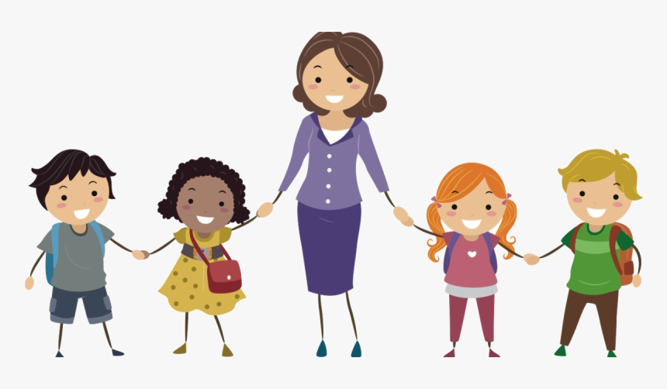
Beyond Tutoring
Lastly, I learned so much more than just how to teach these students.
I built so many meaningful relationships with all my students.
I made friends of all ages.
I got a real world experience that will help me with my future career.
Gain confidence in teaching and lesson planning.
I plan on continuing to help students in my community.

