Slide 1

Bible Bowl: Focus on Reading
Cumbres Leadership Project Presentation Fall 2020
By Jenna & Kenna Carroll

Slide 2
Our Vision
We want students to improve their reading skills
Develop a love/enjoyment of reading
Use problem solving skills when reading
Create community with others

Slide 3
Summary
A friendly Bible based reading & quizzing program for 3rd-12th grade students
Students are given a selection between one and four small books to read & study from September to May
Students read, study and memorize verses in the text
Compete in friendly competitions with other students in the program
We focus on reading and community

Slide 4
Inspiration & Initiative
Inspiration
We both participated in the reading program as students and were inspired to continue the program.
Initiative
We wanted to keep the program going so that students had the opportunity to build a community, improve their reading skills while also feeling like they were a part of something.

Slide 5
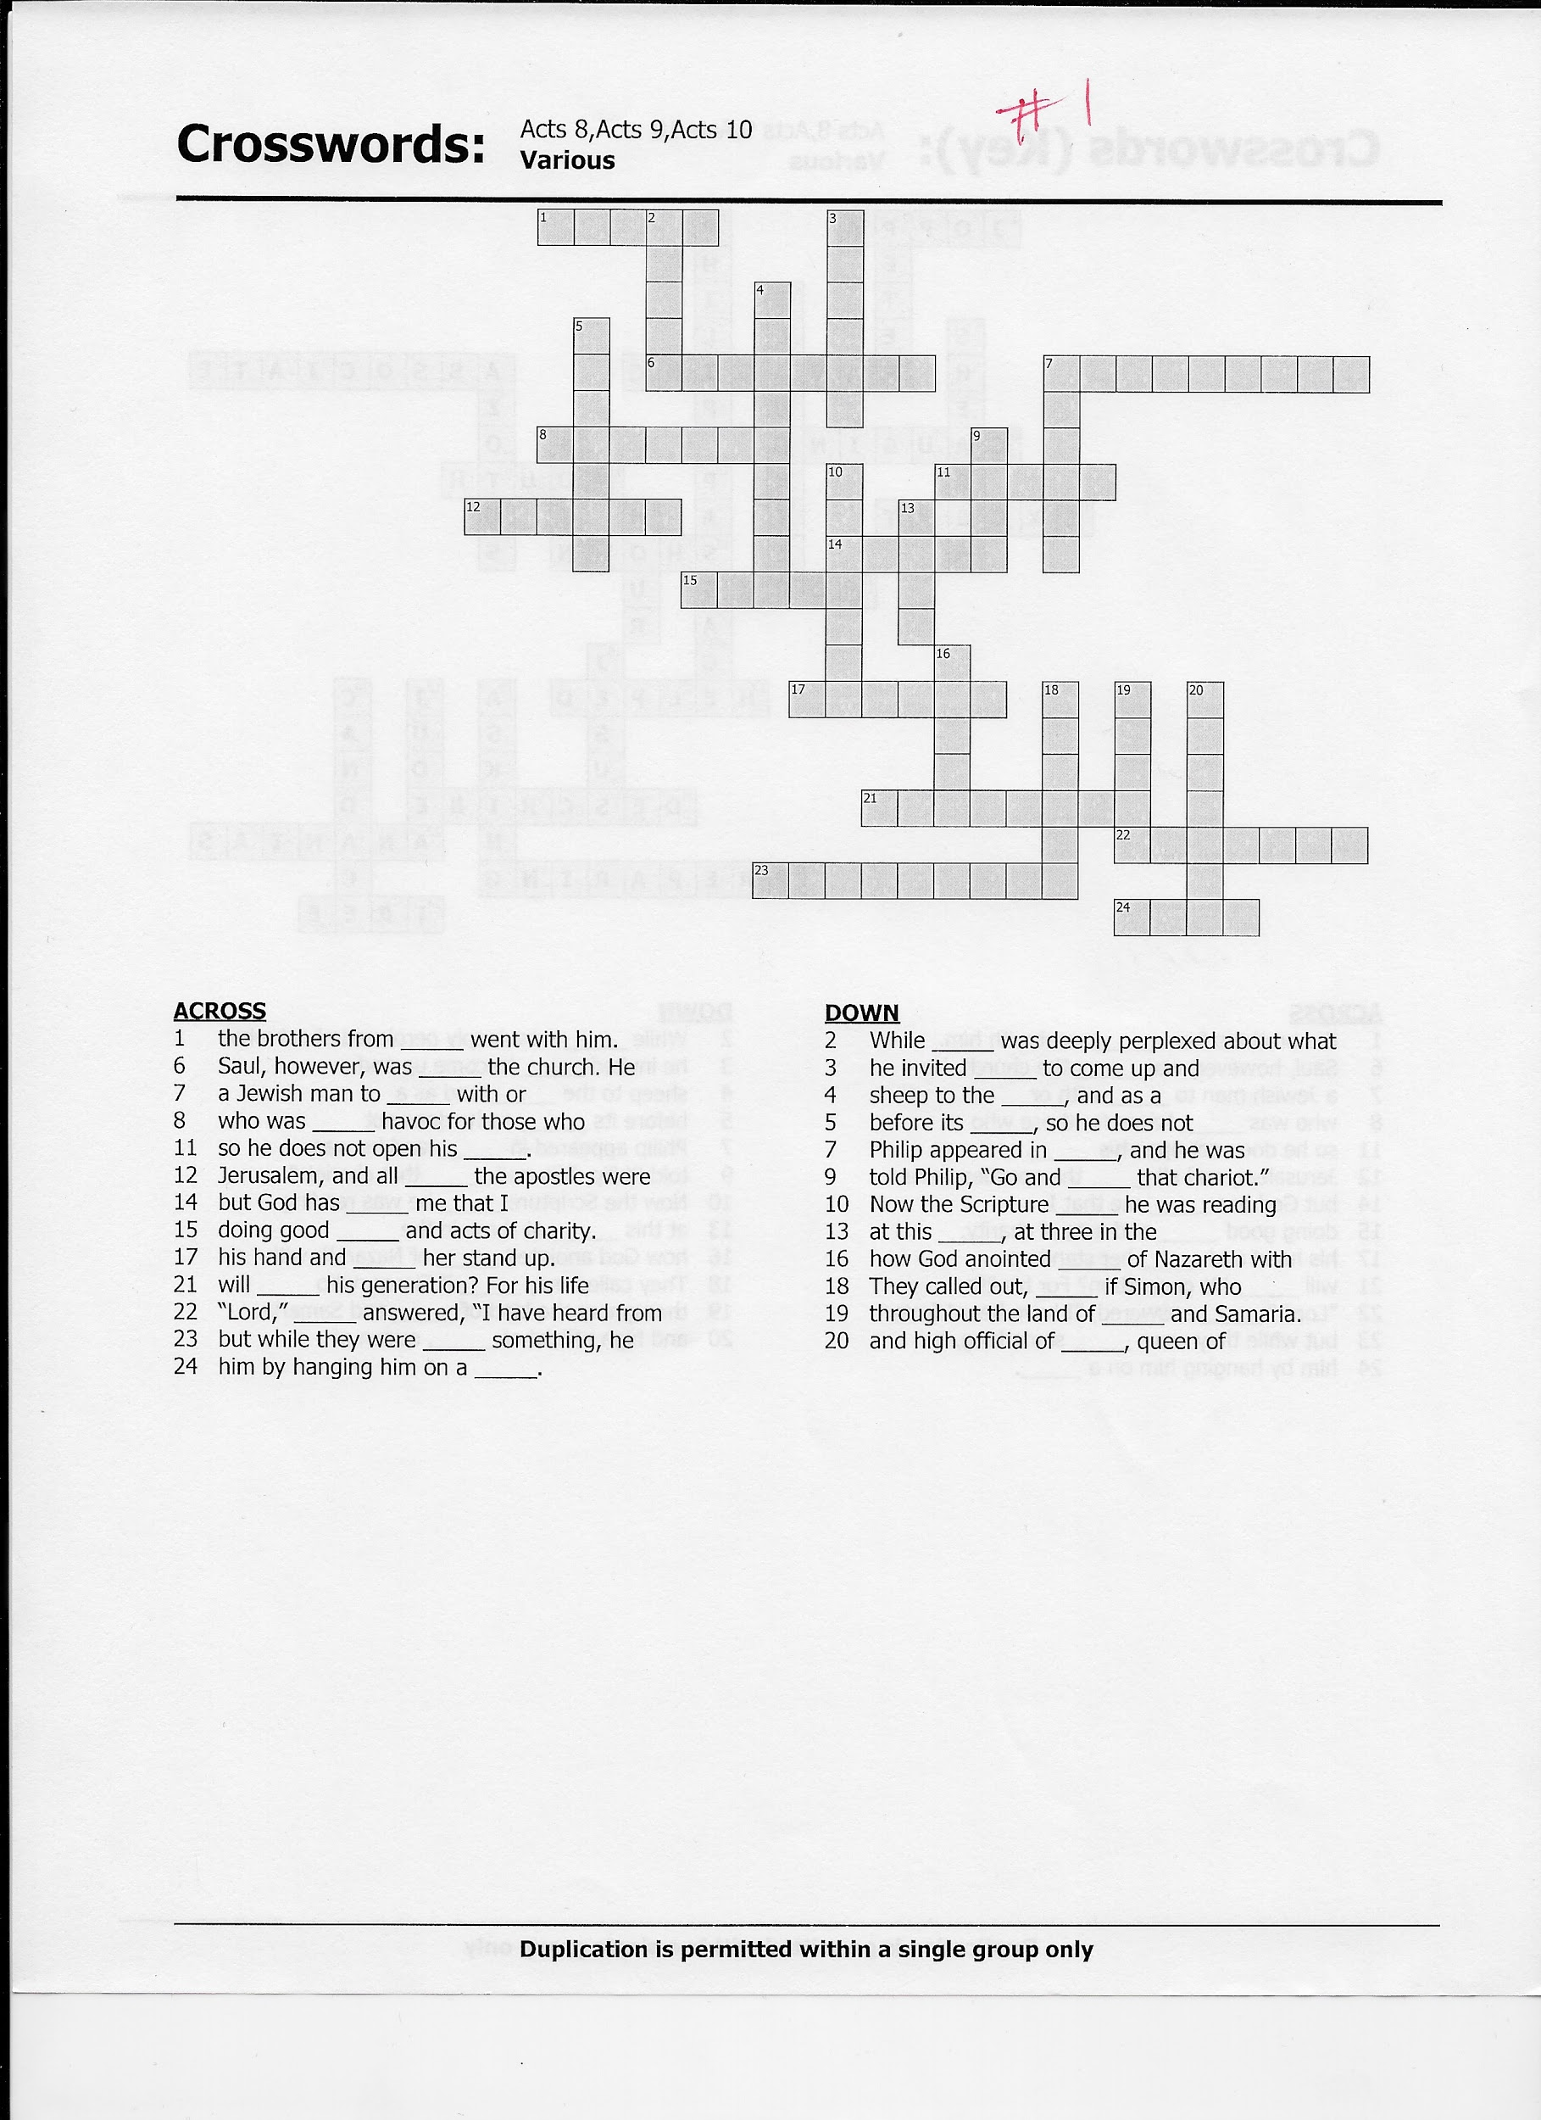
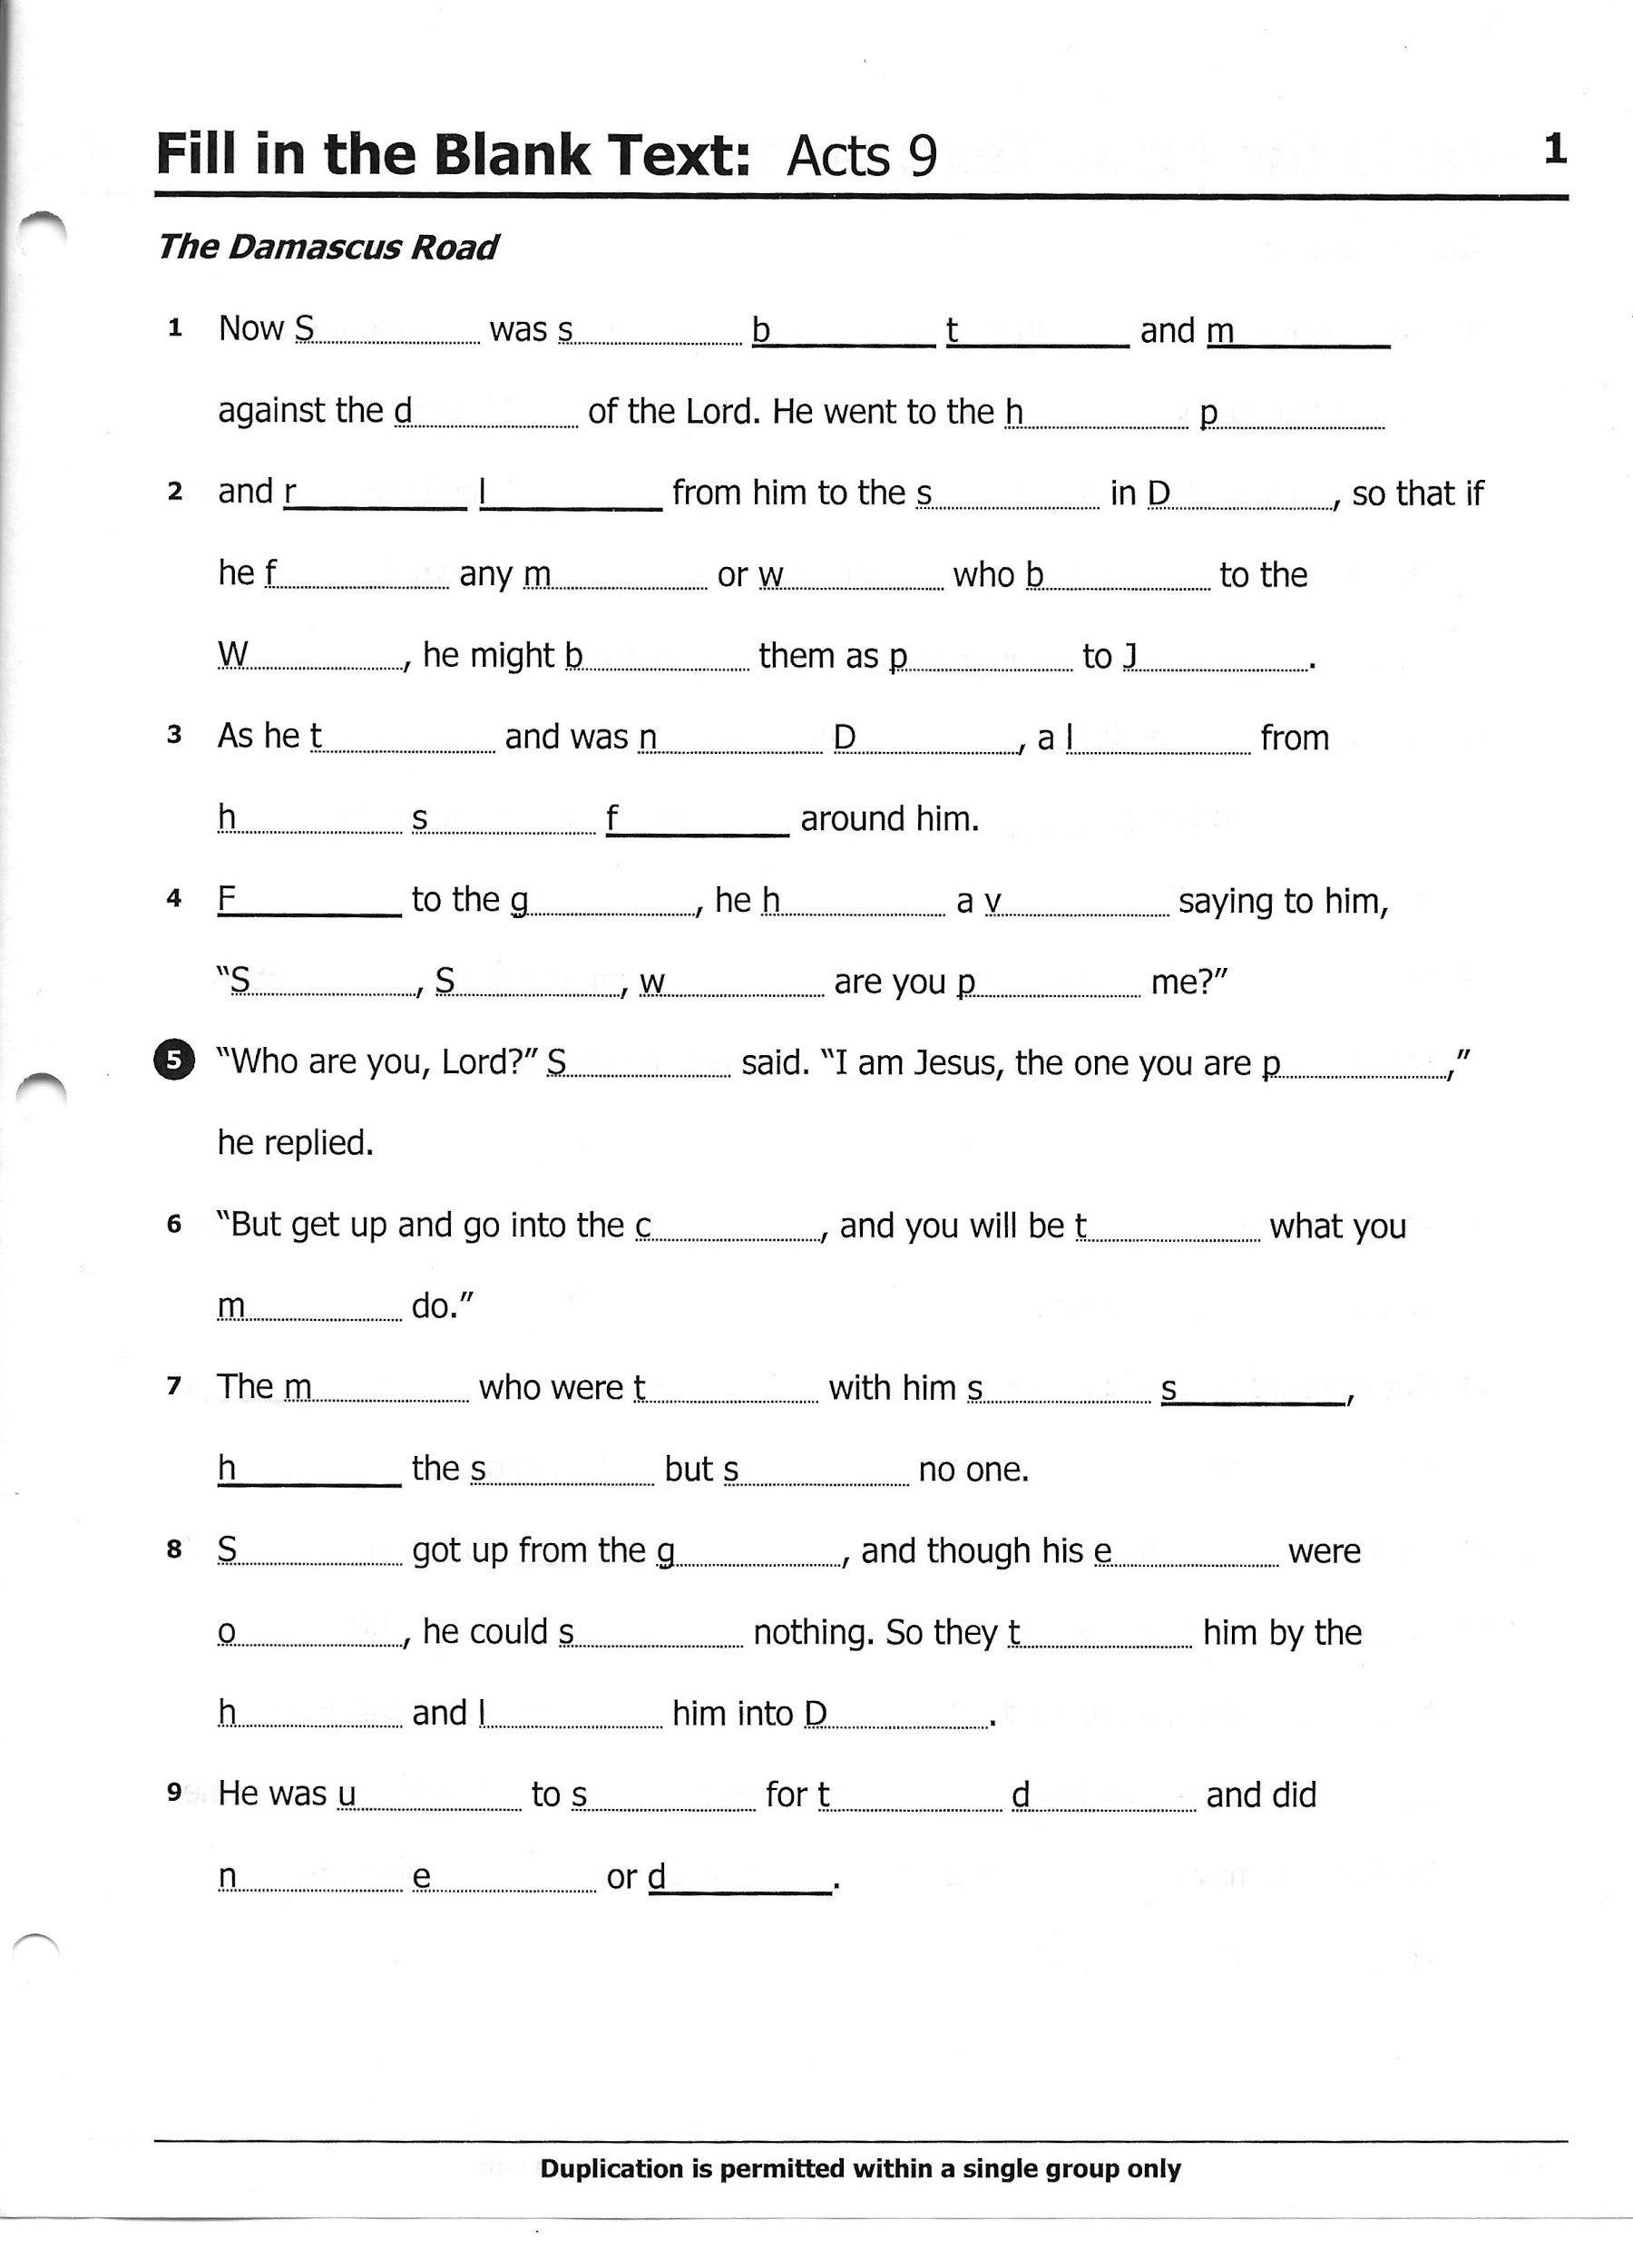
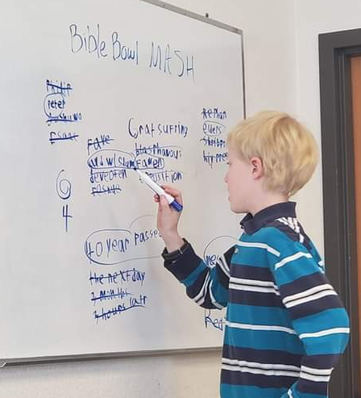
Implementation
At practice:
Meet once a week on Sundays for 2 hours
Read the text together
Play games
Over the season, we met 20 times (20 weeks)
Notes:
During practice, we read the text together, unpack the meaning or story from the text (which can sometimes be confusing). We also play games to help the students remember the text. We had 20 practices this year, we would have met for 28 total practices had COVID not happened.

Slide 6
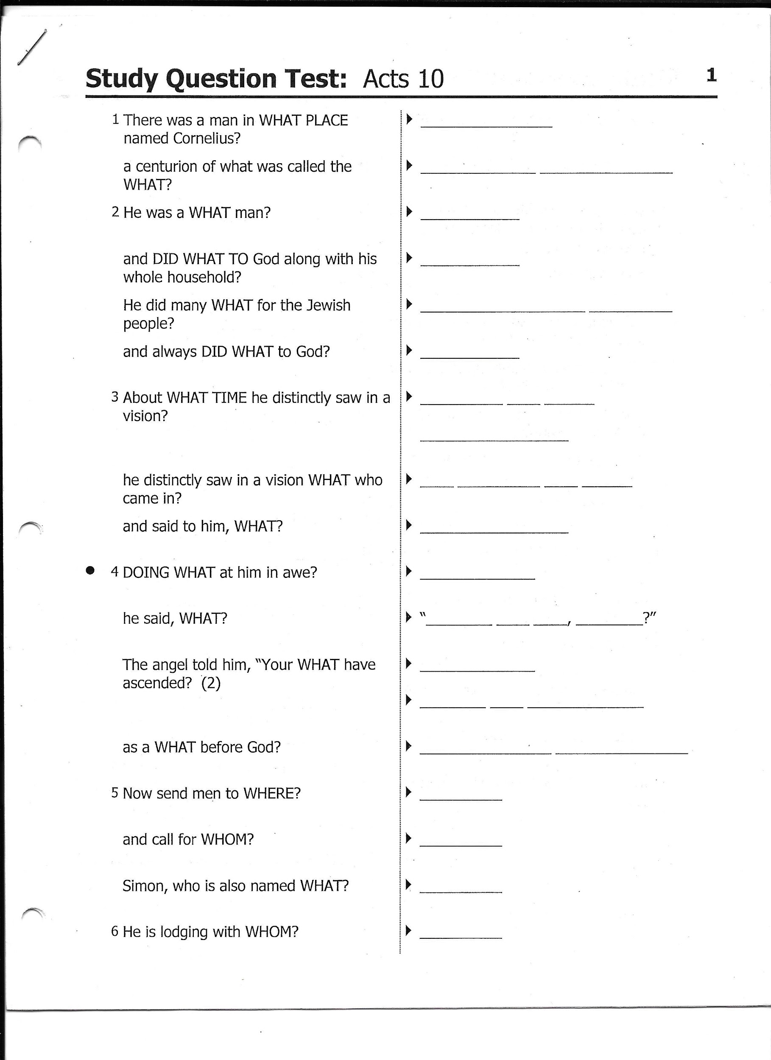
Implementation part 2
At home:
Students have a study packet at home
Students read the text
Some students study with their older siblings
Notes:
At home, students should be reading the text, memorizing the verses, and completing the homework pages. The picture in the slide is a page of homework the students would normally use. Sometimes, we add in optional pages of crossword puzzles, word searches, or fill in the blanks.

Slide 7
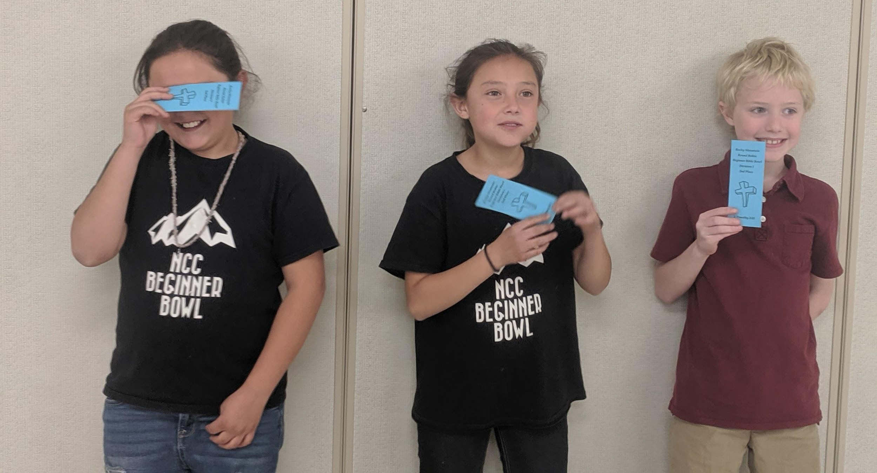
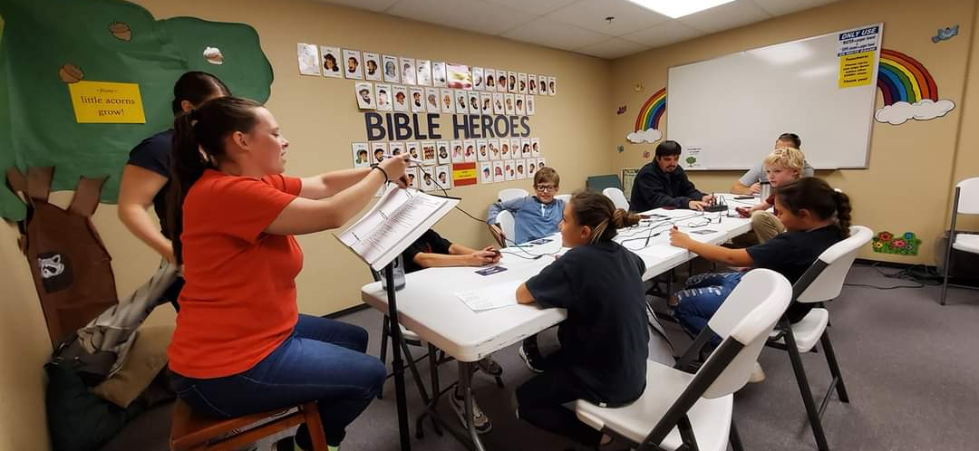
Implementation part 3
At competitions:
Meet at a host church (one of 3 churches)
Meet on the first Saturday of every other month
Meet for ~8 hours (including for snacks & meals)
Friendly competitions
Notes:
Would meet at one of the three host churches: Northglenn Christian Church in Northglenn, CO; Dayspring Christain Church in Windsor, CO; and First Friends Christian Church in Colorado Springs, CO.
Beginner Bowl teams meet once every other month on the first Saturday of the month excluding January (October, December, March, and May)
We meet for around 8 hours, which includes down time, snacks, and lunch. It is not constant competition for students
Competitions for very friendly and allow students to create connections with people all over Colorado.

Slide 8
Influence & Impact
Influence
We were influenced by our previous sponsors and our parents. We had many people in the program who wanted us to be successful and grow academically and spiritually
Impact
We impacted our students by encouraging them to work hard, collaborate and become stronger readers while creating a safe and fun community.

Slide 9
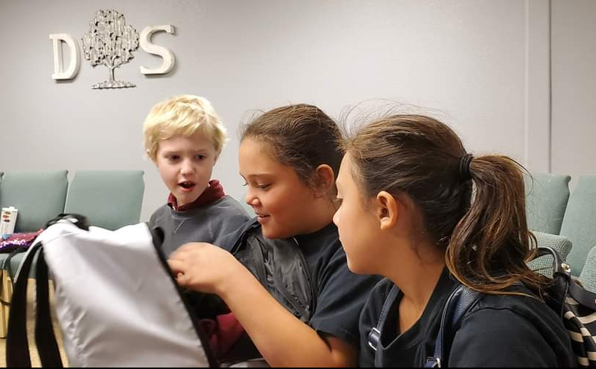
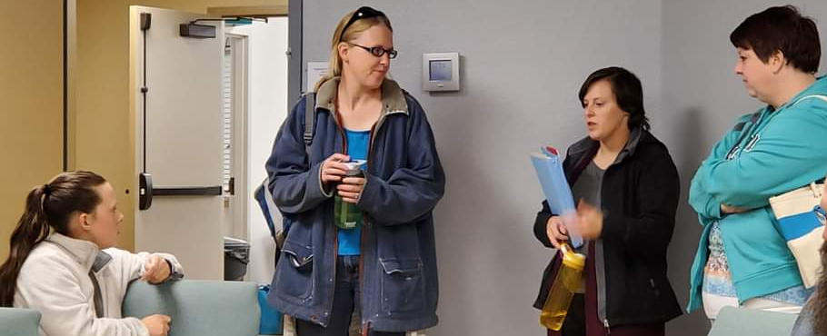
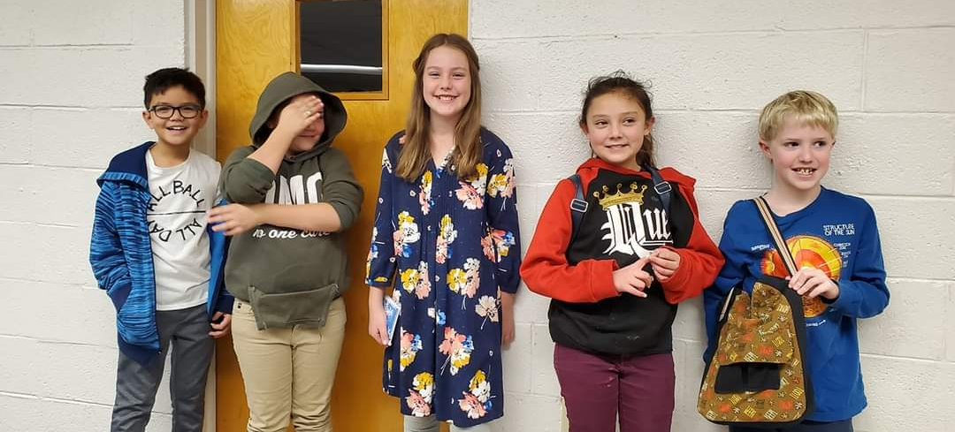
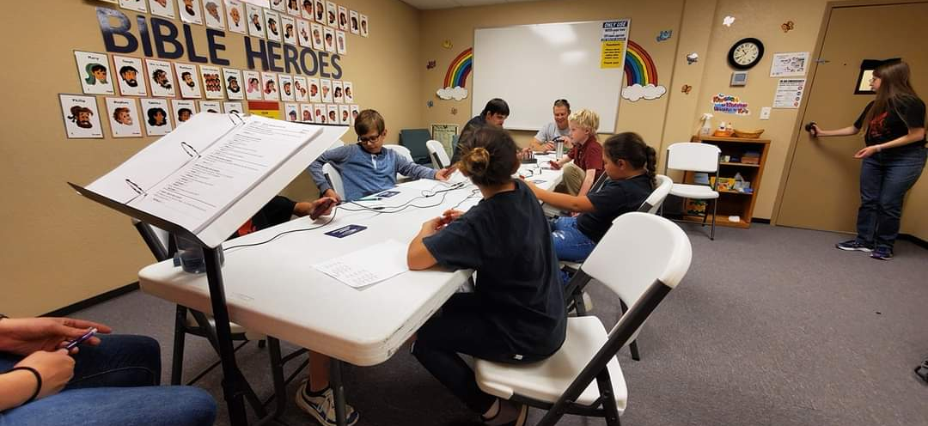
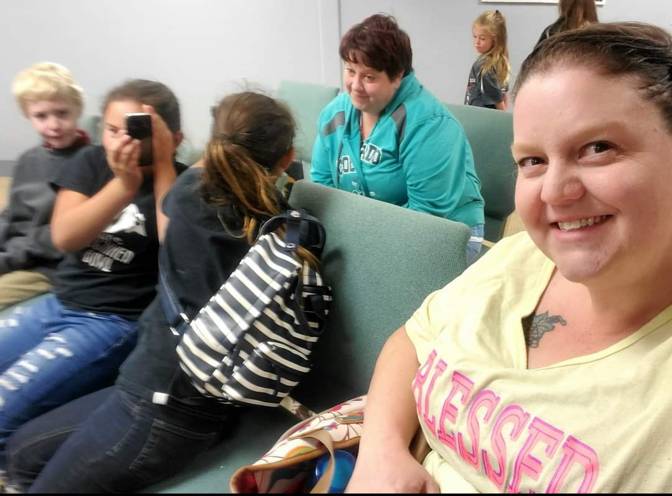
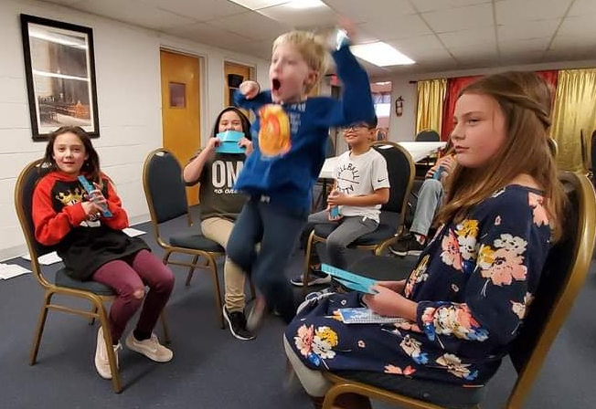
Additional Images from our Experience

