Slide 1

Managing Behaviors:
Social Emotional Learning & Internalizing Symptoms
Department of School Psychology
Group Interventions Professional Development
2020-2021

Slide 2
Pre-training survey
Please fill out the survey below regarding past experience with group interventions.
Pre-training Survey

Slide 3


Slide 4
PART I: Group Interventions for Internalizing Behaviors
Notes:
https://images.app.goo.gl/nuemqroBpsPFWcpS7

Slide 5
Classifying Behavior: Externalizing—Internalizing
A broad classification of children’s behaviors and disorders based on their reactions to stressors.”
“Symptoms at the externalizing end describe conflict with the environment, while those at the other end describe problems within the self.” –Achenbach, 1966

Slide 6
INTERNALIZING SYMPTOMS
Real and imagined problems more centrally affect the child’s internal psychological environment rather than the external world.
  Withdrawn
  anxious
  inhibited
  depressed behavior
  (Liu, 2004)
Notes:
https://images.app.goo.gl/dFwy7vfQnXL4jMS66
Internalizing behaviors are negative behaviors that are focused inward. The dichotomy between internalizing and externalizing is not perfect. For example…

Slide 7
Internalizing Symptoms
Depression
  Depressed mood or excessive sadness; loss of interest in activities; sleeping problems; psychomotor retardation; lack of energy; feelings of worthlessness or excessive guilt; difficulty in thinking, concentrating, or making decisions; a preoccupation with death (in older children and adults); irritability or complaints about physical symptoms (children and adolescents)
Anxiety
  Subjective feelings such as discomfort, fear, or dread; overt behaviors such as avoidance and withdrawal; physiological responses such as sweating, nausea, shaking, and general arousal
Quay, 1986; Merrell, 2007
Notes:
What comes to mind when you hear the term Hyperactivity?
It has been argued that “hyperactivity” is one of the most confusing terms in psychopathology. It really refers to two types of problems. The first type is an excess of motor activity or restlessness, while the second type involves attention deficits, particularly with respect to the child being unable to sustain and modulate his/her attention in a controlled setting such as the classroom. Developing our knowledge base on externalizing behaviors will help us respond with interventions that reduce externalizing behavior

Slide 8
Internalizing Symptoms
Social Withdrawal
  Actively avoiding companionship with others; lacking responsiveness to social initiations from others; behavioral deficits in the skills required to make and keep friends
Somatic Complaints
  Complaints of physical discomfort, pain, or illness that have no known medical, organic, or physical basis
    psychological in origin
Merrell, 2008

Slide 9

Evidence-based Interventions for Internalizing Interventions

Slide 10



Evidence-Based Interventions for Internalizing Behaviors
Adolescent Coping with Depression Course
Skills-based small-group treatment program for actively depressed adolescents ages 9-18
Core components: increasing social skills and pleasant activities, decreasing anxiety and depressive symptoms
16 structured sessions over the course of 8 weeks, 2 sessions/week, each session 2 hours in length
Repeated opportunities to practice skills, develop contracts, and participate in group activities; homework
Notes:
Other skills: how to be assertive in stressful situations, relaxation skills, cognitive restructuring techniques, monitoring mood, problem solving, conflict-resolution techniques, and planning for the future
There is a parallel group intervention for parents of depressed adolescents that informs them of the CWD-A core components and encourages their support and reinforcement of the adolescent’s use of skills. Parents are also taught communication and problem-solving skills.

Slide 11
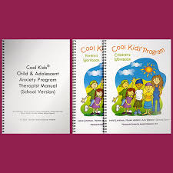
Evidence-Based Interventions for Internalizing Behaviors
The Cool Kids Child and Adolescent Anxiety Management Program
Program for children ages 6-18 with separate parent component
Teaches anxiety management skills which includes identifying and challenging anxious thoughts, feelings, and behaviors; approaching avoided situations/events; using additional coping skills for dealing with teasing and bullying
10 individual or group sessions during the school day, topic-focused
Notes:
(e.g., understanding emotions, followed by experiential learning activities such as discussion, modeling, role play, and application to real-life experiences) *Parent component helps parent or primary caregiver support child’s use of new skills

Slide 12
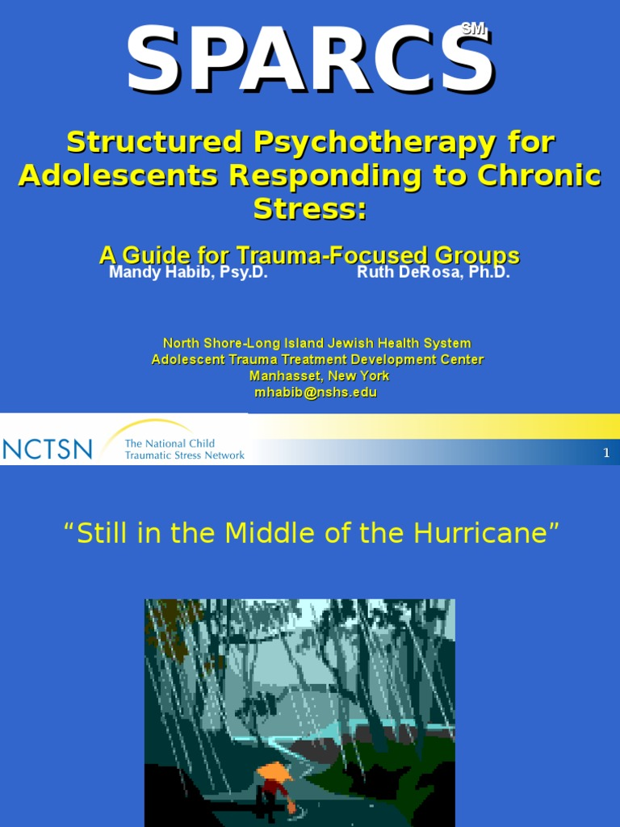
Evidence-Based Interventions for Internalizing Behaviors
Structured Psychotherapy for Adolescents Responding to Chronic Stress
Designed to address needs of chronically traumatized adolescents who may still be living with ongoing stress and depression
Goals: help adolescents cope more effectively in the moment, enhance self-efficacy, connect with others and establish supportive relationships, cultivate awareness, and create meaning in their lives
16 weekly sessions, 1 hour each
Notes:
Topics include: mindfulness practice, relationship building, communication skills, distress tolerance, and problem solving

Slide 13


Evidence-Based Interventions for Internalizing Behaviors
Coping Cat
Cognitive-behavioral group intervention for youth ages 6-17
Common Techniques: modeling real-life situations, role playing, relaxation training, reinforcement
16 sessions broken into 2 parts:
  sessions 1-8: basic concepts are practiced and reinforced;
  sessions 8-16: new skills are practiced in both imaginary and real-life situations varying from low stress, low anxiety to high stress, high anxiety
Notes:
recognizing anxious feelings and physical reactions to anxiety, being cognitively aware in anxiety-provoking situations, and developing a plan to help cope with the situation.

Slide 14
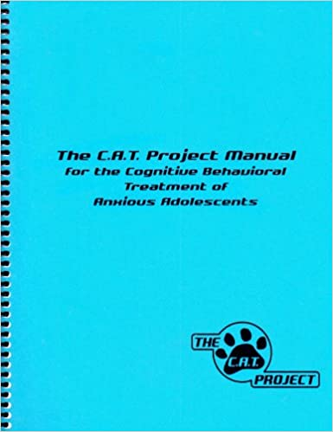

The C.A.T. Project
Evidence-Based Interventions for Internalizing Behaviors

Slide 15
What is the C.A.T. Project?
Evidence-Based Interventions for Internalizing Behaviors
Essentially Coping Cat, but for adolescents ages 14-17 years
Divided into two eight-session segments
Sessions are 50-60 minutes in length (1.5-2 hours for group format)

Slide 16
Evidence-Based Interventions for Internalizing Behaviors
  CBT strategies are presented as part of a 4-step plan. To facilitate recall, the following acronym (FEAR) is introduced:
    Feeling Frightened?
    Expecting bad things to happen?
    Attitudes and Actions that will Help?
    Results and Rewards?

Slide 17
Evidence-Based Interventions for Internalizing Behaviors
  Several key concepts are sequentially introduced during this first segment:
    Focusing on awareness of bodily reactions
    Learning to recognize and focus on ‘self-talk’
    Considering the behavioral implications of anxious self-talk
    Self-evaluation and self-reward
  The teens are then given an opportunity to work with the FEAR plan in real-life examples; some are provided in the workbook, and others are generated from the client’s own life.

Slide 18
Evidence-Based Interventions for Internalizing Behaviors
The second segment of the program is devoted to skill application in increasingly anxiety-provoking situations.
  Training strategies such as modeling coping, role-play, and homework assignments are still used
  Role play and exposure tasks are arranged in sequence [imaginal exposure (low anxiety)→in vivo exposure (increasing anxiety)]
  The last session includes videotaping a film clip(s) about what the teens learned in the program

Slide 19
Evidence-Based Interventions for Internalizing Behaviors
Adolescent-friendly adjustments:
  Program design
  Strategic use of the FEAR plan
  Refer to cognitive “thinking traps” more maturely
  Point system
  Encouraging independence
Flexible adherence to the protocol is encouraged
Notes:
Sensitive the increased likelihood of comorbidity with depression
More information on the nature of anxiety (what it is and where it does and does not come from)

Slide 20
C.A.T. Project Curriculum Structure
Evidence-Based Interventions for Internalizing Behaviors
Sessions 1-8
Introduction to CAT Project
Recognizing Emotions
Introduction to Relaxation
Meet the Parents, Part 1
Identifying and Challenging Self-Talk
Coping and Problem-Solving
Self-Rating and Self-Reward
Application of FEAR Plan

Slide 21
Evidence-Based Interventions for Internalizing Behaviors
  Session 1. Introduction to CAT Project
  Familiarity, basic information, normalization
  Session 2. Recognizing Emotions
  Review, distinguish anxious feelings, introduce step 1 of FEAR Plan – “Feeling Frightened,” identify responses to anxiety, introduce anxiety hierarchy
  Session 3. Introduction to Relaxation
  Review distinctions between anxious and other feelings, identify somatic responses, practice relaxation
  Session 4. Meet the Parents, Part 1
  Encourage parental cooperation, provide parenting guidelines

Slide 22
Evidence-Based Interventions for Internalizing Behaviors
  Session 5. Identifying and Challenging Self-Talk
  Consider function of personal thoughts, introduce step 2 of FEAR Plan – “Expecting Bad Things to Happen,” recognize self-talk
  Session 6. Coping and Problem-Solving
  Change anxious self-talk into coping self-talk, introduce step 3 of FEAR Plan – “Attitudes and Actions that can Help”
  Session 7. Self-Rating and Self-Reward
  Rate and reward performance, introduce step 4 of FEAR Plan – “Results and Rewards”
  Session 8. Application of FEAR Plan
  Example scenarios

Slide 23
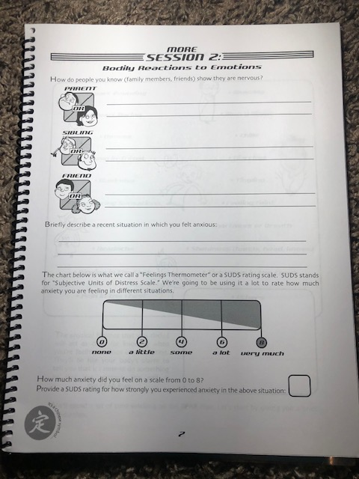
Workbook Sample
Session 2: Recognizing Emotions
Workbook Activity B
Evidence-Based Interventions for Internalizing Behaviors
After facilitating listing of emotions and their physical expressions of emotions…
Introduce the sliding scale or Subjective Units of Distress Scale (SUDS) rating. The youth asks the question “How much anxiety do I feel?” The scale ranges from 0-8:
0 = none 2 = little bit 4 = some 6 = a lot 8 = very much
This can be used to help determine which situations are more anxiety provoking for the youth. The therapist asks the question: “How much anxiety do you feel when ________? To help the youth use the scale more consistently and effectively, add behavioral anchors to each or some of the numbers e.g., a ‘5’ is how anxious I felt when I thought I lost my term paper. An ‘8’ is how I felt when I had to give a five-minute talk in front of the whole school .

Slide 24
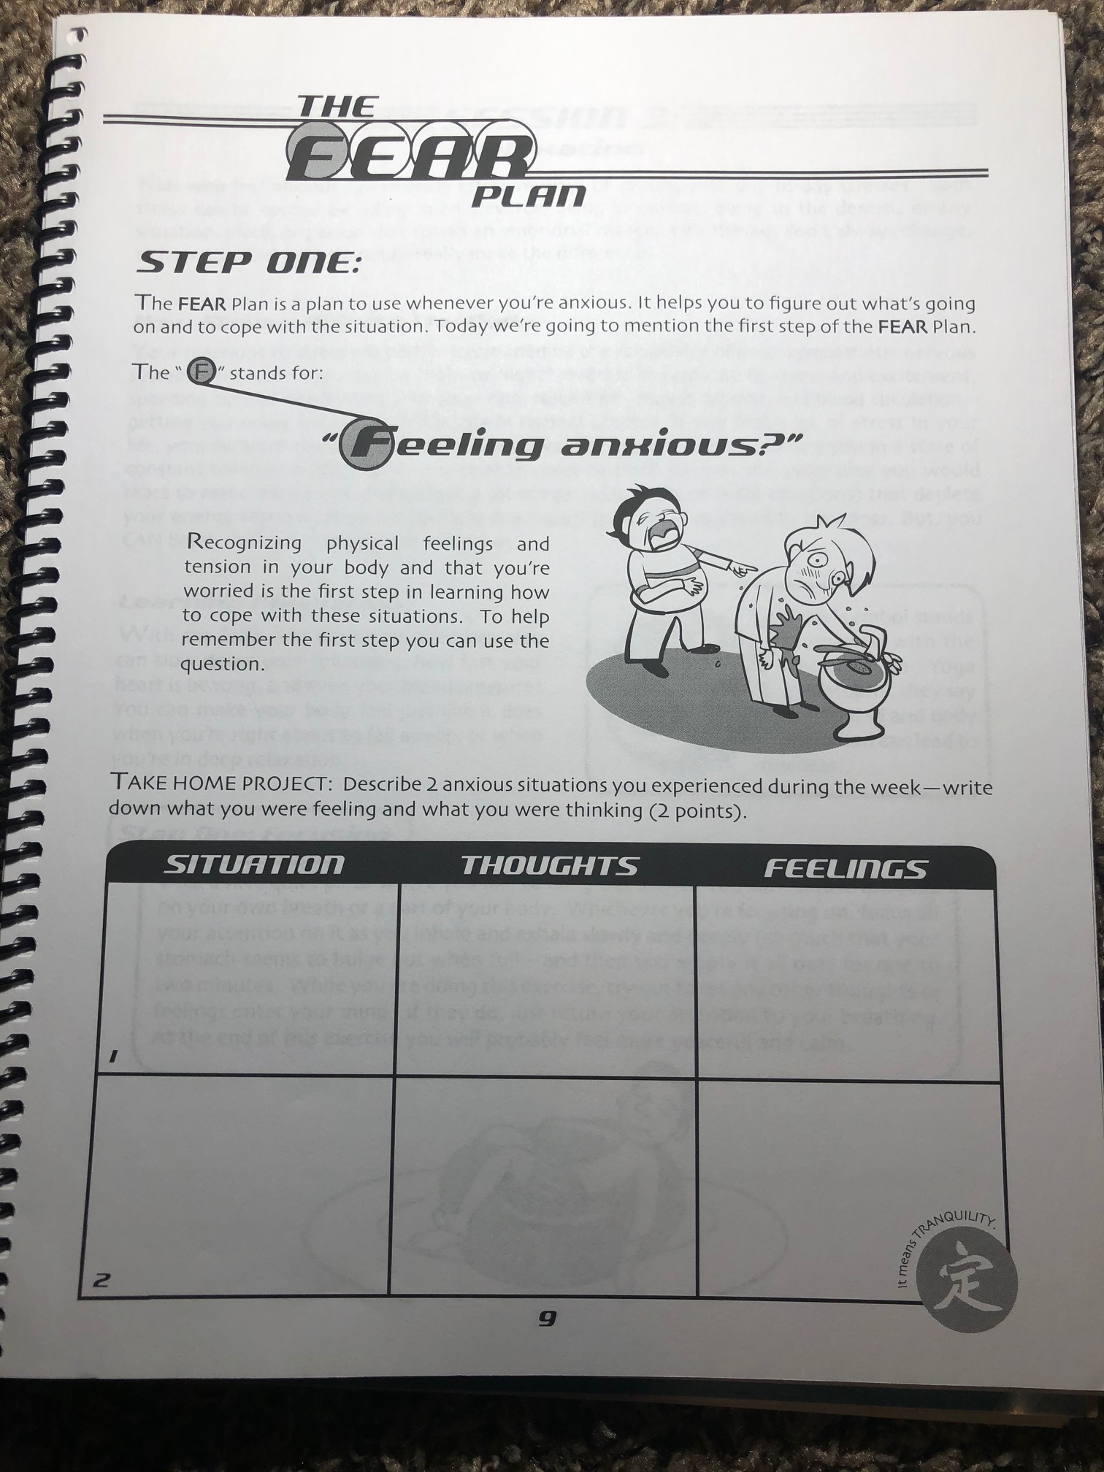
Workbook Sample
Session 2: Recognizing Emotions
Activity 5 (also in workbook)
Evidence-Based Interventions for Internalizing Behaviors
Introduce the FEAR Plan and Step 1 of the plan, “Feeling Frightened?”
“The FEAR Plan is a plan to use whenever you’re anxious. It helps you to cope with situations that make you feel anxious. Today we’re going to learn the first step of the FEAR Plan: Recognizing physical feelings and tension in your body and that you’re worried is the first step in learning how to cope with these situations. To help remember the first step you can use the question: “Feeling frightened?”
Begin constructing a FEAR Hierarchy: Begin to construct a hierarchy of anxiety-provoking situations (“FEAR Hierarchy” space provided in the back of the Workbook). The situations should be listed from least anxiety-provoking (SUDS=1/2/3) to most (SUDS 7/8) anxiety-provoking

Slide 25
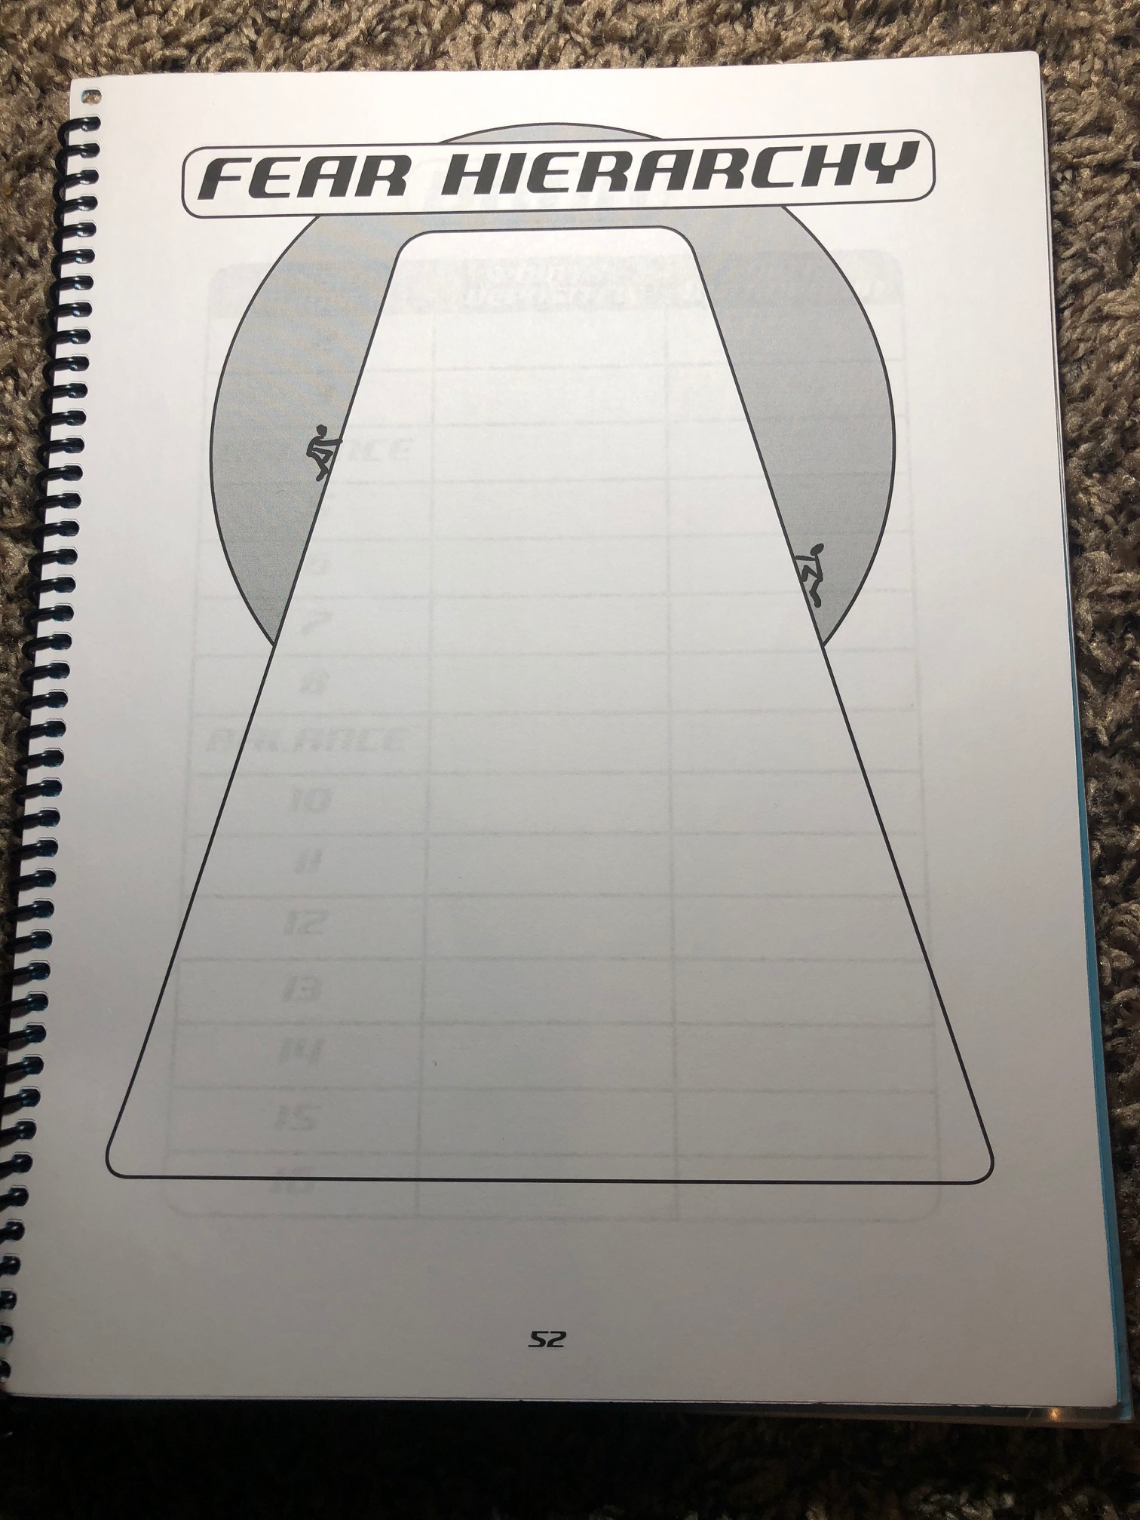
Evidence-Based Interventions for Internalizing Behaviors

Slide 26
C.A.T. Lesson Structure
Evidence-Based Interventions for Internalizing Behaviors
Sessions 9-16
  Meet the Parents, Part II
  Start Practicing
  More Practice
  More Practice
  More Practice
  More Practice
  More Practice
  More Practice

Slide 27
Part II: Group Interventions for Social Emotional Learning

Slide 28
Evidence-based Interventions for SEL
What is social emotional learning? (SEL)
CASEL definition:
the process through which children and adults understand and manage emotions
set and achieve positive goals
feel and show empathy for others
establish and maintain positive relationships
make responsible decisions

Slide 29
Evidence-Based Interventions for SEL
SEL impacts our lives
Social competence
Emotional regulation
Academic success
Safety (e.g., violence prevention)
Health (e.g., drug prevention)

Slide 30
Poor Social Emotional Skills
Evidence-Based Interventions for SEL
Peer rejection
Poor school performance
Mental health problems

Slide 31
Teaching Social Emotional Skills
Evidence-Based Interventions for SEL
core competencies that are central to social and emotional learning:
Self-awareness
Self-management
Social awareness
Relationship skills
Responsible decision-making

Slide 32

Evidence-based Interventions for Social-Emotional Interventions

Slide 33

Evidence-Based Interventions for SEL
The Curriculum-Based Support Group System
Designed to increase resiliency and reduce risk factors among children and adolescents identified as being at elevated risk for early substance use, future delinquency, and violence.
Targets children and youth ages 4-17, living in adverse family conditions, lack coping and social skills, and display early indicators of antisocial behaviors.
Based in cognitive-behavioral and competence-enhancement models of prevention.
10-12 lessons, taught weekly, 1 hour in length. Topics: self-concept, anger and feeling awareness, setting future goals, making healthy choices, peer pressure, making friends, assessing life challenges, and making a public commitment to stay substance free.
Content and objectives tailored for age and developmental status.
The Curriculum-Based Support Group System
Notes:
Core elements: focus on coping with difficult family situations, resisting peer pressure, setting and achieving goals, refusing substances, and reducing antisocial behaviors.

Slide 34

Evidence-Based Interventions for SEL
I Can Problem Solve
Universal school-based program for enhancing the interpersonal cognitive processes and problem-solving skills of children ages 4-12.
Array of engaging activities such as games, stories, puppets, illustrations, and role plays to help children learn problem-solving techniques, identify feelings, discover alternate thinking strategies, and become more aware of consequences linked to behaviors.
Additional goals: prevent and reduce early high-risk behaviors and promote prosocial behaviors
3 age-specific programs: preschool, kindergarten and primary school, and intermediate elementary school.
Courses range from 59 to 83 lessons based on the age group, are 20 minutes in duration, taught 3-5 times per week for the length of the program
Typically class-wide, can be small group
I Can Problem Solve

Slide 35

Evidence-Based Interventions for SEL
Life Skills Training
School-based substance abuse prevention curriculum that aims to modify drug-related knowledge, attitudes, and norms, developed for elementary and high schools.
Skills taught - resisting social influences that encourage drug use, develop general personal and social skills.
Class-wide or group settings
Program runs across 3 years, consisting of 15 lessons in first year, followed by 10 booster lessons in second year, and 5 booster lessons in third year.
Life Skills Training
Notes:
*school wide support to have set up for all the years required

Slide 36

Evidence-Based Interventions for SEL
Promoting Alternative Thinking Strategies
For preschool through elementary school
Teaches: self-control, self-esteem, emotional awareness, social skills, friendship, and interpersonal problem-solving skills, reducing aggression and other behavior problems
Methods: direct instruction, discussion, modeling, storytelling, role playing, and video presentations
3 age-specific programs: preschool PATHS (3-5 years old), the PATHS Turtle Unit (kindergarten), and the PATHS Basic Kit (grades 1-6)
131 lessons, 20-30 minutes in length
Typically class-wide, can be small group
The PATHS Curriculum

Slide 37

Evidence-Based Interventions for SEL
Strong Kids
Brief curricula to teach social and emotional skills, promote resilience, strengthen assets, and increase coping skills, designed for grades 3-5. (Strong Start for PreK and one for grades K-2)
Developmentally appropriate topics: identifying and understanding emotions, social skills, cognitive reframing, relaxation strategies, and problem-solving strategies.
Small group or class-wide
Strong Kids

Slide 38

Strong Kids: Grades 3-5
Evidence-Based Interventions for SEL

Slide 39
Evidence-Based Interventions for SEL
“The Strong Kids Social and Emotional Learning (SEL) programs consist of 12 carefully sequenced lessons that are designed for maximum impact on cognitive, affective, and social functioning within a relatively brief period of time and relatively little preparation and training.”

Slide 40
Evidence-Based Interventions for SEL
Twelve 60-80-minute lessons (ideally one per week)
1) About Strong Kids: Emotional Strength Training
2) Understanding Your Emotions 1
3) Understanding Your Emotions 2
4) Understanding Other People’s Emotions
5) Dealing with Anger
6) Clear Thinking 1
7) Clear Thinking 2
8) Solving People Problems
9) Letting Go of Stress
10) Positive Living
11) Creating Strong and SMART Goals
12) Finishing UP!

Slide 41
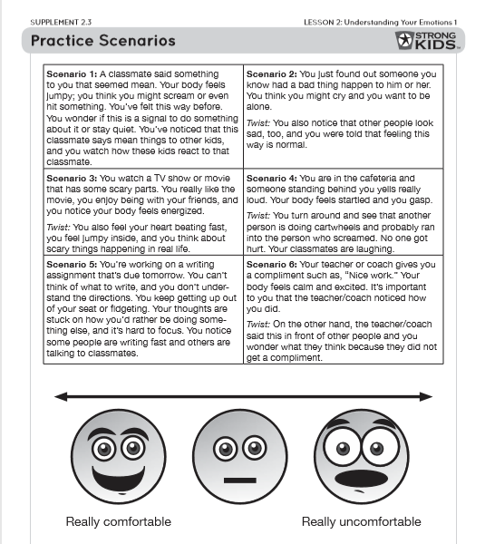
Sample Activity
From Strong Kids: Grades 3-5
Lesson 2: Understanding Your Emotions 1
Supplement 2.3
Evidence-Based Interventions for SEL
Activity B: Identifying Emotions on the Continuum of Comfortable and Uncomfortable
Time: 4-9 minutes.
Use Supplement 2.3 as a handout to practice identifying and exploring emotions in large or small groups.
Sample Script:
Now, let’s practice not only identifying emotions and the physical feelings we have, but also whether we feel comfortable, uncomfortable, somewhere in between, or both comfortable and uncomfortable.
For each example, ask students the following questions:
What physical sensations give you clues about how you feel?
What emotions might you be experiencing? (Hint: We can experience more than one emotion at the same time and different people have different experiences.)
Do you feel comfortable, uncomfortable, or both? (e.g., comfortable: I like feeling that way; uncomfortable: I don’t like feeling that way; both: I felt uncomfortable, but noticed that after a while I felt better.

Slide 42
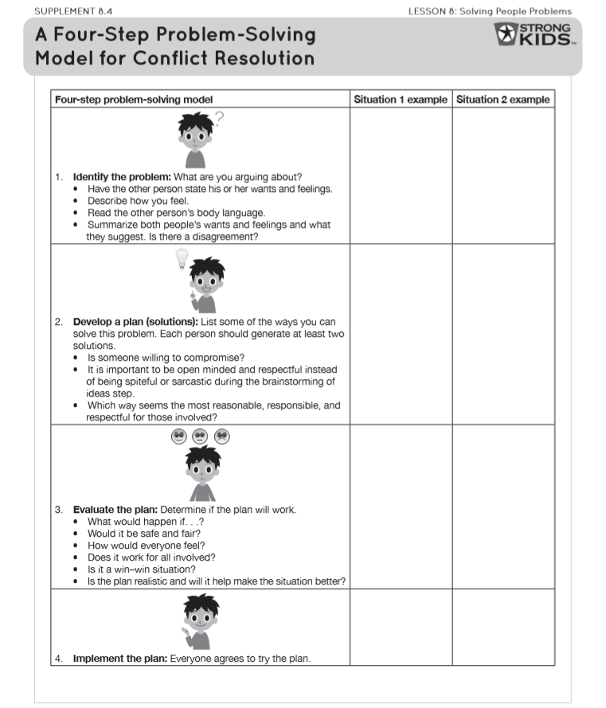
Sample Activity
From Strong Kids: Grades 3-5
Lesson 8: Solving People Problems
Supplement 8.4
Evidence-Based Interventions for SEL
Activity C: Problem Solving Application
Time: 10 minutes
Use Supplement 8.4 again to apply the four-step problem-solving model to example situations. There are three situations listed below the Sample Script:
Sample Script:
Now that we’ve talked about the steps, let’s apply some example situations to these steps. I will read the first situation and we will discuss the steps together as a class. We will write our thoughts in the middle column under Situation 1. For Situation 2, you will partner with the person next to you [or get into small groups], go through the problem-solving model, and write down ideas in the Situation 2 column.
Situation 1
--Problem: Your classmate wants to use the only class computer at the same time you do.
--Twist: You know that your classmate does not have a computer at home, but you do.
Situation 2
--Problem: Your classmate has broken your trust by telling a secret of yours.
--Twist: Now would it make a difference if you had already shared it with a few other people?

Slide 43
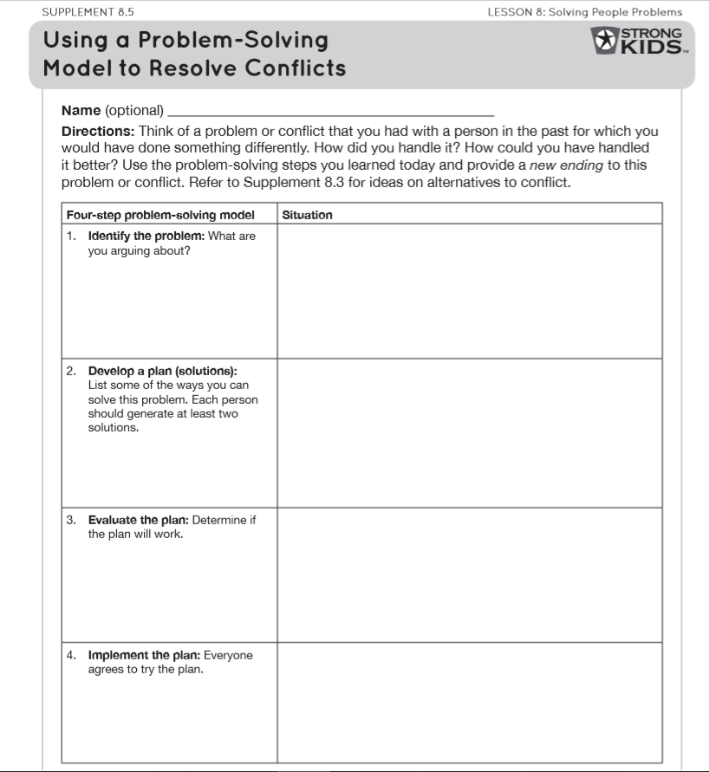
Sample Activity
From Strong Kids: Grades 3-5
Lesson 8: Solving People Problems
Supplement 8.4
Evidence-Based Interventions for SEL
Homework Handout
Pass out the homework handout, Supplement 8.5, Using a Problem-Solving Model to Resolve Conflicts. Explain to students that they will use the problem-solving model to work through a problem in the past or a current situation and that they will provide a new resolution to the problem.

Slide 44
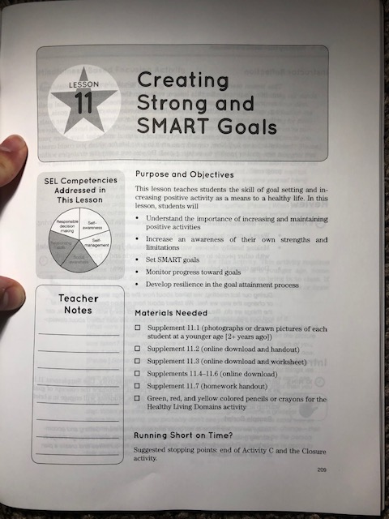
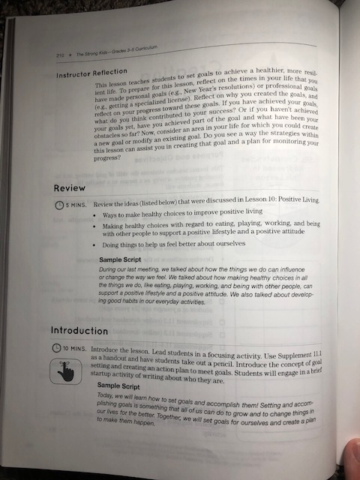
Evidence-Based Interventions for SEL

Slide 45
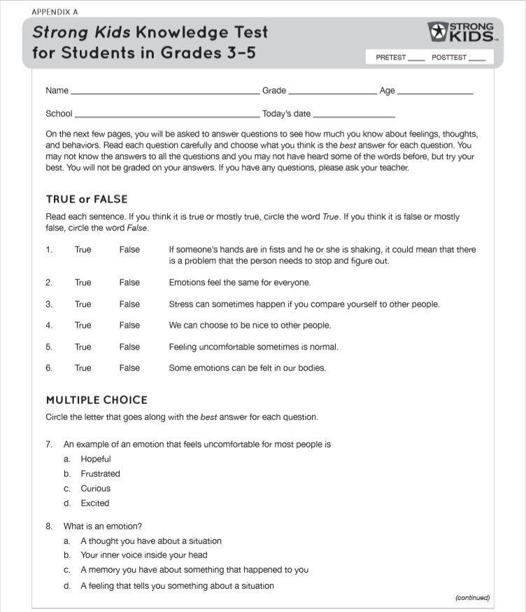
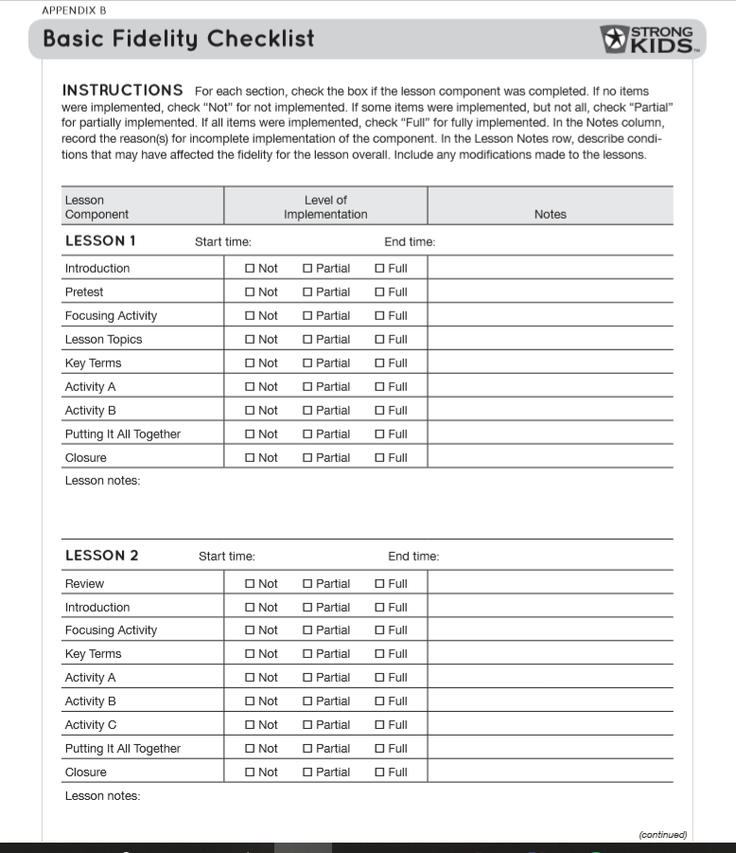
Knowledge Assessment &
Fidelity Check
Evidence-Based Interventions for SEL

Slide 46
Strong
Kids’ Goal
Evidence-Based Interventions for SEL
“Promote resilience and mitigate risk in children and adolescents [through developing their social and emotional skills].”
Embraces CASEL’s five person-centered and interrelated competency areas (CASEL, 2014)
Affordable, low-resource, and evidence-based

Slide 47
Part III: Managing Behaviors in Child and Parent Groups
Bridging the Gap:
In-Depth Group Intervention Training
Notes:
https://images.app.goo.gl/2TUZxzSyMMjttCycA

Slide 48

Best practices in formation of children’s groups
Group Rules, Structure, and Logistics

Slide 49
In very first meeting…
Explain the importance of establishing group rules
Engage students in developing rules
Establish confidentiality
Group Rules, Structure, and Logistics

Slide 50
Establishing confidentiality
Explain confidentiality and its limits in developmentally appropriate terms
Remind the group members that unfortunately, you do not have any control over group members who share something personal or specific about what happened in group. It’s a team effort.
The group members or the group leader may want to create a rule that gives a consequence to whomever breaks confidentiality.
Be sure to discuss the issue of confidentiality whenever a new member or individual outside of the group attends the group
any volunteer or individual who visits the group will abide by the group rules regarding confidentiality
Group Rules, Structure, and Logistics
Notes:
. If there is going to be a visitor or possible new group member, the group may want to discuss and vote on whether everyone is comfortable with a new person joining the group.

Slide 51
Logistics and Planning
Class pick-up times
Number of meetings per week
Meeting length
What students will be doing in group
What is required of them
Any other important information you want them to know on the first meeting.
Develop rules and consistent responses to activities and transitions that can take time away from group
  Getting water, bathroom, sharpening pencil, etc.
  Students can help form developmentally appropriate expectations for the group
Group Rules, Structure, and Logistics
Notes:
Without clear expectations, the short time you have to meet may dwindle away as students ask to leave to use the restroom or gather materials. Setting up clear procedures in advance for how transitions will be handled may help reduce distractions and maximize time.

Slide 52
Strategies for Managing Behavior
Group Rules, Structure, and Logistics
Collaborate and effortfully build rapport
Have a plan
Specifics to consider include:
  Seating
  Using proximity
  Assigning jobs and helpers
  Selecting a “superstar of the group”
  Ignoring minor negative behavior and praising positive behavior
  How to deal with rule violations

Slide 53
Strategies for Managing Behavior
Group Rules, Structure, and Logistics
Make sure response to behavior is appropriate and consistent
Examples of behavior management systems:
  Sticker charts
  Daily behavior report cards
  Token economies
  Incentives
  Strike system
  Marking down negative behaviors or broken rules
  Response cost
  Time Out
Notes:
Time-Out
Practice, designate an area, plan for refusals and re-engagement (if appropriate)
Rule of thumb: 1 minute for every year of the student’s age, up to 5 minutes, and the last two should be quiet, indicating that the child has calmed down and is able to return to the group (Wester-Stratton, 2005).

Slide 54
Important to Note
  A student may not be appropriate for a group setting
  May want to continue sessions individually with student and adapt content as necessary
Group Rules, Structure, and Logistics

Slide 55
Establishing Group Expectations
Give members active roles
Establish lines of communication with all involved and make sure everyone is on the same page
Consistent, predictable, and clearly communicated routines
Goal sheets
Group Homework
Group Rules, Structure, and Logistics
Notes:
https://images.app.goo.gl/iTSzGMVhGdR2ZSzD9

Slide 56
Resistance
If a group member…
  doesn’t understand the skill
  doesn’t agree with techniques being offered
  lacks appropriate skills to participate
  Is dealing with more immediate problems
Group Rules, Structure, and Logistics

Slide 57
Resistance
Keeping the Group on Topic
  Have materials and an agenda ready to go over and to refer to during session
  “It looks like we still need to cover a few things today [pointing to the agenda]. I would like to keep us moving along. Perhaps we can talk more about this after today’s sessions, (name).”
Dealing with Teasing and Bullying
  Doing so immediately
  Send a clear message that it will not be tolerated
  Immediate, brief consequence
  May want to acknowledge bullying victim
  Discontinuing group membership if necessary and doing individual session
  Group discussion
  Follow up with victim
  www.nasponline.org/resources-and-publication/resources/school-safety-and-crisis/bullying-prevention
Group Rules, Structure, and Logistics

Slide 58
Resistance
Absent Students
Consider calling a parent to determine reason after continual absences
What’s being missed in class and group
Stress importance of coming to school
Be non-confrontational
Let parent know you are concerned and would like to see their child continue with group
Problem solve ways to support parents in getting child back to school
Plan a family session
“I have been concerned about your child’s attendance at school. She has been missing a lot of schoolwork and a lot of important topics in our group. If there’s a specific problem that’s keeping her from attending school, maybe we could discuss it and work something out. I am here to help. Is there anything that I can do to help her get to school?”
Group Rules, Structure, and Logistics

Slide 59
Resistance
Students Who Don’t Want to Come to the Group
  Meet individually, find out why, troubleshoot
Disruptive Students
  After multiple timeouts and individual interventions, determine whether group is appropriate for student
  Inform student and parent about decision
  Consider more intensive supports [i.e., referring to school behavioral support team, running functional behavioral assessment (Watson & Steege, 2003)]
  Discuss potential for student to earn their way back to group
Group Rules, Structure, and Logistics

Slide 60
Resistance
Dealing with Questions About the Personal Information of the Group Leader
Thoughtful disclosure can help build rapport
Be professional and tactful
When declining…
“I really like that you are interested in me, and I like to get to know things about you, too. But, some things stay private and this is one of those things.”
“But, our time together goes fast and there are many things we need to do while we’re together. So let’s get back to it!”
Balance pace with sensitivity
Group Rules, Structure, and Logistics

Slide 61
Resistance
Directly Challenging to the Leader
Find out if the following are a factor for the student…
Feels threatened and/or misunderstood
Had unsuccessful experiences with professionals in the past
Cultural differences
Potential steps
Discuss that group can be helpful despite differences and tailored to fit member needs
May feel you are taking the parent or teacher’s side
Group Rules, Structure, and Logistics

Slide 62
Check-in
What are some strategies for making students feel comfortable and engaging them in role plays?
What are some things you can do to be proactive with behavior management in my child groups? Do you want to have a superstar of the group and create jobs for your group members?
What are some statements you can develop to handle a student who is aggressive or dominating the conversation? How do handle that AND also keep the group on track AND allow for other group member participation?

Slide 63
Child Groups :
Applied Practice
Scenario 1—the students in the group are in the process of setting group rules. One student is misbehaving and coming up with inappropriate rules to gain the attention of the other group members. Try to maintain the focus on setting appropriate group rules while paying attention to the positive group rules that are suggested by group members.
Scenario 2—the group leader is introducing a new topic to the group on effective strategies to calm down when you are angry. One student continues to be off-task and asks the group leader personal question. Try to maintain the pacing of the group and introduce the new topic without completely disregarding the student’s interest.

Slide 64
Best practices in the formation of Parent groups
Group Rules, Structure, and Logistics
Notes:
https://images.app.goo.gl/7pJJprwWQpRhMWHZ8

Slide 65
Setting Structure and Group Rules
Initial Meeting:
Set the structure, ground rules, and tone
Have members introduce themselves and share a goal they have for group
Discuss logistics and process
Review purpose of intervention
Discussion number of sessions, mention any possible visitors, whether the group is closed (no new members) versus open (new members may attend)
Discuss expectations for letting you know about missed sessions
Encourage active participation
Welcome!!!
Allow time for expression of concerns
Group Rules, Structure, and Logistics

Slide 66
Setting Structure and Group Rules
Confidentiality
Enforcing a Time Schedule
Sticking to Your Agenda
Group Rules, Structure, and Logistics

Slide 67
Setting Structure and Group Rules
Ask Parents to Share Goals
  Can build cohesion
Dealing with Questions Regarding Qualifications of Group Leader(s)
  Highlight:
    Collaborative nature of group
    How helpful these strategies have been for many other parents
    Be careful about setting yourself up as the “expert”
“I’ve studied [or worked with ___] and know the techniques that will be used in this group very well. However, I am not the one who is at home, living with your children. I am looking to you as parents to share your experiences and what you have learned as parents, since you are the experts on your children.”
Group Rules, Structure, and Logistics

Slide 68
Setting Structure and Group Rules
When Parents Challenge
The Group Leader
  Similar reasons as children
  Parenting inexperience
  “You know, you’re probably right about that. It’s hard to know exactly what it’s like to be a parent when you’ve never been one. And I’m going to be counting on you and the other parents to help me understand what it’s like for you.
  On the other hand, I’ve worked with children and families and studied child behavior. This program has been shown to work for lots of parents. I would like to share this research-supported approach with you.
  I think we both have contributions to make. Hopefully, we can all learn from each other’s experiences.”
Group Rules, Structure, and Logistics

Slide 69
Anticipating Issues
Consider possible challenges and worst-case scenarios
Be prepared to report abuse and neglect according to school, agency, and/or state guidelines
Have a list of referrals
Changing circumstances
Group Rules, Structure, and Logistics

Slide 70
Anticipating Issues
It will get worse before it gets better
Discuss possible scenarios and mentally rehearse for worst possible
  “Expect and be prepared for relapses. They are part of your own learning process. Your child may test the security of his environment every now and again to see if the rules still hold. Then once he knows his base is secure, he can tackle a new challenge. You know, it’s a bit like the old adage ‘Two steps forward, one step back.’”
  Prepare parents for relapses in their own parenting skills
Group Rules, Structure, and Logistics

Slide 71
Anticipating Issues
“Be prepared to feel awkward when you do this kind of play. Be prepared that you will not want to do it, because it feels awkward. And be prepared for your child not to like it at first. Whenever a family member learns a new behavior, there is a natural tendency for other family members to resist the new behavior and try to revert back to the status quo. In fact, some family members might try to pressure you back to the old way of doing things.”
“You will probably feel awkward praising at first, especially if you haven’t done much of this in the past. You may even feel like your praise sounds phony. So don’t wait to praise until you feel warmth toward your child. Just get the words out, even if they are kind of flat. The feelings and genuineness will come later. The more you practice, the more natural it will become.”
Group Rules, Structure, and Logistics

Slide 72
Anticipating Issues
Parents Who Dominate the Conversation
  Simple redirects
    “Good idea, let’s hear from someone who has not commented yet today.”
    “I like the point that you’re making. What do other people think?”
  If parents are particularly difficult to redirect, initiate a group rule
    “Each member is allowed to make two comments per topic,”
    “Let’s move around the circle so that everyone has a chance to comment.”
  Establish rules for equal participation in the beginning to help you ensure a smooth, dynamic group process
    i.e., one person talks at a time, be respectful, do not interrupt
  For particularly challenging parents, you may need to meet with them outside of group to express observations, have them reflect, and workout how to signal them to let others talk
Group Rules, Structure, and Logistics
Notes:
https://images.app.goo.gl/EdmW3kWaWir7YG1XA

Slide 73
Anticipating Issues
Aggressive Parents
  Be assertive (not aggressive) and polite
  Explain why you are cutting off the speaker
  Model techniques such as constructive criticism and taking responsibility for one’s own thoughts and feelings without putting down other people
Group Rules, Structure, and Logistics

Slide 74
Anticipating Issues
Navigating tensions with aggressive parents
  “I’ve been noticing some tension between you and parent A. I will also be talking to parent A about this, but I wanted to talk to you first. There are times where you both make comments toward one another that are not always framed in the nicest manner. I just wanted to remind you about our group rules, specifically about having respect for other group members. Do you think that you can try to reframe these comments into a more positive light or not say them at all?”
Group Rules, Structure, and Logistics

Slide 75
Anticipating Issues
Parents Who Are Overwhelmed
  Try to understand, work with the resistance, and confront issues in a nonthreatening way
Parents Who Stop Attending Group
  Contact, ask for feedback, and be nonconfrontational.
    Let them know you want them to continue.
  Try to get them to come to one more session and then make a final decision
  Express concern and invite them back
  Anonymous feedback forms
Group Rules, Structure, and Logistics

Slide 76
Anticipating Issues
Predicting Positive Change and Success
  Express confidence and optimism in parents’ abilities
  Empower parents
Getting Support for yourself
  Find trusted colleagues for help with problem solving, support, and objectivity
  Take time to relax and enjoy life outside of group!

Slide 77
Check-in
Who’s tougher to manage? Kids or adults?
How will you engage a parent and make them feel comfortable participating in roleplays?
How will you handle a parent who is aggressive or dominating the conversation?
  What are some statements you can make to let the group member know that he or she has been heard, but also keep the group on track and allow for other group member participation?
Group Rules, Structure, and Logistics

Slide 78
Parent Groups : Applied Practice
Scenario 1—A parent in the group attacks another group member by saying that his or her ideas are stupid. As the group leader, express to the group members that all points of view are valid in this group and that all members should be respected.
Scenario 2—Parents in the group are struggling with using some of the strategies at home due to time constraints and other stressors. Lead a discussion with the group that will elicit ideas or solutions. Try to avoid discussions that place the group leader in the role of developing solutions or defending the use of strategies.
Group Rules, Structure, and Logistics

Slide 79
Reflection
How are the ideas and information presented connected to what you already knew?
What new ideas did you get that extended or broadened your thinking in new directions?
What challenges or puzzles have come up in your mind from the ideas and information presented?
Group Rules, Structure, and Logistics

Slide 80
Post-training survey
Please fill out the survey below regarding how you feel about your ability to implement group interventions with fidelity after completing this training.
Post-training Survey

Slide 81
Thank you!

Slide 82
References
Carrizales-Engelmann, D., & Merrell, K. W. (2016). Merrell's strong kids, grades 3-5: A social and emotional learning curriculum. Baltimore, MD: Brookes Publishing.
Kendall, P. C. (2002). The C.A.T. project manual: For the cognitive-behavioral treatment of anxious adolescents. Ardmore, PA: Workbook Pub.
Keperling, J. P., Reinke, W. M., Marchese, D., & Ialongo, N. (2017). Group interventions in schools: A guide for practitioners. New York: The Guilford Press.
Liu, J. (2004). Childhood externalizing behavior: Theory
and implications. Journal of Child and Adolescent
Psychiatric Nursing, 17(3), 93-103.
Merrell, K. W. (2008). Helping students overcome depression and anxiety: A practical guide. New York: Guilford Press.
American Psychological Association Achenbach definitions (find actual sources)

