Slide 1


Introduction to Group Interventions
Department of School Psychology
Online Professional Development Trainings
2020-2021

Slide 2

Pre-training survey
Please fill out the survey below regarding past experience with group interventions.
Pre-training Survey
https://unco.co1.qualtrics.com/jfe/form/SV_cI7zrv3WlOkQAw5

Slide 3
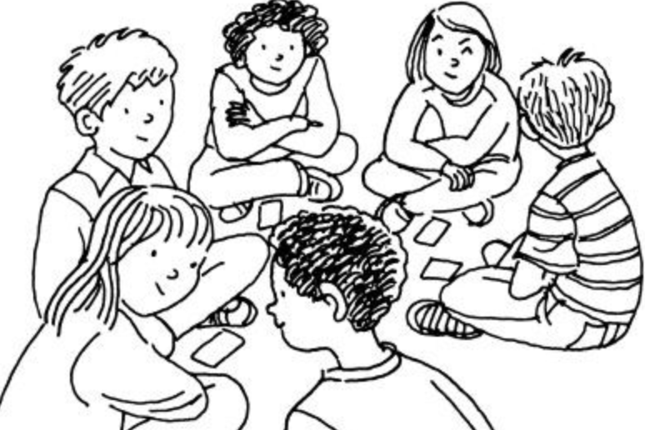
Share with us…
What do academic and mental health group interventions look like where you work?
Who directs the interventions?
Are group interventions more helpful in the schools than individual interventions?

Slide 4
High-Need and High-Impact
Psychological problems are widespread in children (Tolan & Dodge, 2005)
  Approximately half of children in need of mental health services actually receive help (Merikangas et al., 2010)
Utilizing evidence-based interventions (EBI) have resulted in
  improvement of academic performance,
  decrease in stigma,
  reduction in emotional and behavioral disorders
Implementing interventions to develop academic, social, and life skills is a key function of school psychologists
(NASP, 2019; Hussey & Guo, 2003; Bradshaw et al., 2012)

Slide 5
Professional Standards & Competency
Quality training in tiered mental health intervention that meets professional standards be provided at pre- and in-service
Linking data to implementation and continuation of intervention supports should be routine practice for school psychologists
(NASP, 2010; Chafouleas, 2013)
Notes:
https://images.app.goo.gl/xNzk2bX31USRWbfR6

Slide 6
High-Impact Implementation
Carefully selected practitioners receive coordinated training, coaching, and frequent performance assessments
Organizations provide the infrastructure necessary for timely training, skillful supervision and coaching, and regular process and outcome evaluation
(Fixsen et. al., 2005)
Notes:
https://images.squarespace-cdn.com/content/v1/5b9563a25b409bf6ab84e381/1536699230429-MNT73SLNXPDAFLLX2M76/ke17ZwdGBToddI8pDm48kBDc0DY5msIv_iAbnodwVLtZw-zPPgdn4jUwVcJE1ZvWEtT5uBSRWt4vQZAgTJucoTqqXjS3CfNDSuuf31e0tVFEq1xKXKGdO_xkGnL3k_8Ncqw6quSA0YfSgf9uQnNp0hur-lC0WofN0YB1wFg-ZW0/about+5.png

Slide 7
What about the school environment…
Makes group interventions ideal
Makes group interventions difficult
How do you choose who is in what groups?
There is a process for organizing and delivering group interventions
  5 stage process

Slide 8
Group Stages (Crespi, 2009)
1. The Forming Stage
2. The Storming Stage
3. The Norming Stage
4. The Performing Stage
5. The Adjourning Stage

Slide 9
Stage 1: The Forming Stage
Initial orientation to the group with dependence and structure formation.
Polite discourse, rules, and silences are typical of this stage.
Courtesy
  Meet, greet, and develop rapport
Confusion:
  Following basic instructions, members operate with little direction
Caution:
  There is concern about statements outside boundaries
Commonality:
  Bonds of similarity among members emerge
Notes:
https://images.search.yahoo.com/search/images;_ylt=Awr9DtyBbyhfWUwAVUVXNyoA;_ylu=X3oDMTE0NDMxa2hzBGNvbG8DZ3ExBHBvcwMxBHZ0aWQDQzAwOTNfMQRzZWMDcGl2cw--?p=crickets+silence&fr2=piv-web&fr=yset_chr_syc_hp#id=2&iurl=https%3A%2F%2Frevnadinedraytonkeen.files.wordpress.com%2F2018%2F10%2Fcrickets.png%3Fw%3D529&action=click

Slide 10
Stage 2: The Storming Stage
This stage is characterized by conflict and competition, as group members interact and struggle with individual and group dynamics.
Disagreements over process, anger, discourse on rules and ideas, and basic hostility often mark this stage.
Concern
  No member should harm another
Conflict
  As bonds of similarity arise, dissimilarity appears
Confrontation
  Members learn how to confront others
Criticism
  As lack of progress occurs, criticisms emerge
Notes:
https://images.app.goo.gl/aW4YjRXUeHxYyuCb9

Slide 11
Stage 3: The Norming Stage
Characterized by a beginning sense of cohesiveness as members experiment with new roles.
Basic harmony, established rules and roles, and a beginning sense of support are characteristic of this stage.
Cooperation
  Members address basic rules
Collaboration
  As rules emerge, agreement is needed on process
Cohesion
  Togetherness emerges
Commitment
  As a group unit, they move forward
Notes:
https://images.app.goo.gl/PxmFsZPQ84adkZ8G9

Slide 12
Stage 4: The Performing Stage
Characterized by a supportive process as basic conflicts have been resolved and as members are able to “perform.”
High task orientation, productivity, decreased emotionality, and enhanced problem-solving mark this stage.
Challenge
  Members feel increased responsibility for the group
Creativity
  New methods of communication emerge
Consciousness
  With increased openness, member self-recognition increases
Consideration
  Increased awareness of self and others emerges

Slide 13
Stage 5: The Adjourning Stage
Task completion and termination.
Compromise
  Members recognize unresolved issues and strive for balance
Communication
  An awareness of changes through communication occurs
Consensus
  Members deal with conflict through compromise
Closure
  Reluctantly at times, members face closure and termination

Slide 14
Barriers and Bumps?
Problems inherent to using schools as the site for service delivery
Insufficient training
Lack of support from department/district administration and school personnel (Suldo, 2010)

Slide 15
Facilitating awareness
“First, individual practitioners would be wise to be proactive and educate their school colleagues about the potential ranges of services they can offer; education can occur through entry presentations to coworkers in which they briefly summarize their multiple professional roles and by distributing brochures that contain similar information to other potential consumers, such as students and families.”
(Suldo, 2010, p. 371)
NASP's compilation of research on relationship between mental health and academic achievement

Slide 16
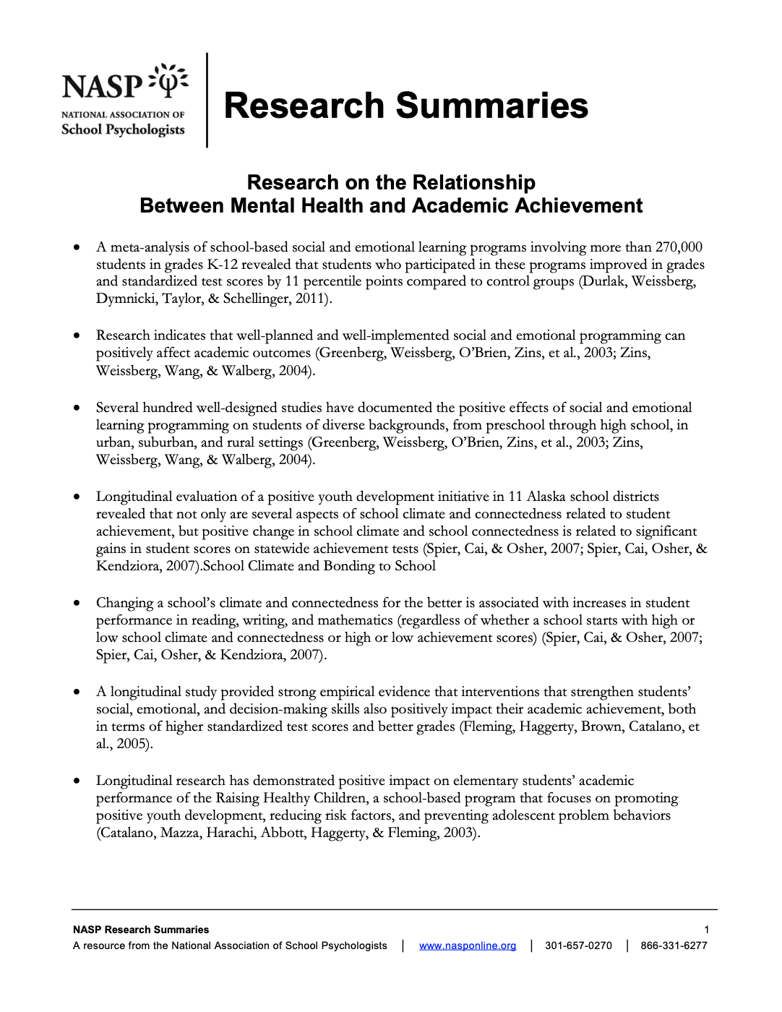

Slide 17
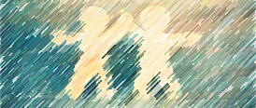
Therapeutic Factors
What participants find most helpful in the treatment process
Essential elements of group-promoted change
Notes:
What exactly are therapeutic factors?
Necessary components to consider for fidelity of implementation of the group. When group participants were asked at the conclusion of their group intervention what they thought was the most helpful part of the group, they ranked the following four categories of factors
https://images.app.goo.gl/T4DMFaM41dsG4myw7

Slide 18
Four Broad Therapeutic Factors
Relationship-climate / Group cohesiveness (almost 50%)
  Elements include encouragement and support, acceptance, liking, and attraction to the group
Other versus self-focus (about 24%)
Emotional awareness-insight (about 21%)
Problem identification change – least important factor in children’s perceptions
(Shechtman & Gluk, 2005)

Slide 19
Adjourning…
What are the benefits and bumps to school-based group interventions?
What questions do you have?
  erin.yosai@unco.edu
  wimmsy.lab@gmail.com
Notes:
https://images.app.goo.gl/CRj8MePZLS8BeqGH6

Slide 20
Post-training survey
Please fill out the survey below regarding how you feel about your ability to implement group interventions with fidelity after completing this training.
Post-training Survey
https://unco.co1.qualtrics.com/jfe/form/SV_3yHFMO7KRSkYxU1

Slide 21
THANK YOU!
Department of School Psychology
Online Professional Development Trainings
2020-2021
Notes:
https://images.app.goo.gl/5aAVNYaKmuyN38yB6

