Slide 1


Group Interventions for Trauma and Suicide
Department of School Psychology
Group Interventions Professional Development
2020-2021

Slide 2
Pre-training survey
Please fill out the survey below regarding past experience with group interventions.
Pre-training Survey
https://unco.co1.qualtrics.com/jfe/form/SV_d7lspTQqFFZSqu9

Slide 3


Slide 4

Evidence-based Interventions for trauma and suicide prevention

Slide 5

Cognitive Behavioral Intervention for Trauma in Schools (CBITS)
School-based group and individual intervention for students in grades 3-8 (ages 6-12) who have experienced some form of trauma in their lives
Designed to reduce symptoms of PTSD, depression, and behavioral problems (e.g., school violence, physical abuse, domestic violence, death, and natural disasters)
Also strives to improve peer and parent support, enhance coping skills
10 group sessions and 1-3 individual sessions, designed to be delivered in school setting *Also offers 2 parent psychoeducational sessions and 1 teacher educational session
CBITS
Download Second Edition Manual for free here

Slide 6

Combined Parent-Child
Cognitive Behavioral Therapy (CPC-CBT)
Based in CBT, suited for ages 3-17 and parents or caregivers​
Structured group or individual treatment program that targets a more severe population than other programs. Often includes families in which child physical abuse by parents has occurred, and parents who have reported significant stress and fear that they may lose control and hurt their child.​
Goals: reduce children’s PTSD symptoms and behavior problems while improving parenting skills and parent-child relationships, reduce use of corporal punishment, offer healthier home​
16-20 sessions that are 2 hours each​
4 session phases: engagement, skill building, safety, and clarification​
Group leaders also conduct child- and parent-only sessions
Fact Sheet from The National Child Traumatic
Stress Network (NCTSN)
CPC-CBT Handouts and Forms

Slide 7

The Grief and Trauma Intervention
(GTI) for Children
Individual or group intervention designed for ages 6-12 with posttraumatic stress due to witnessing or being a direct victim of one or more types of violence or a disaster.​
10 sessions of approximately 1 hour each. Also 1 session conducted with parents and 1 individual session with the child if delivered in group setting.​
Methods: art, drama, and play, while focusing on dreams/nightmares, questioning, anger, and guilt​
GTI for Children

Slide 8

Evidence for Adapting DBT to Suicidal
Behavior in Adolescents
Originally developed for treating women diagnosed with borderline personality disorder (BPD)
Treatment designed to increase capacity of clients to regulate the self
Studies suggest DBT was effective in reducing vulnerability factors for suicide at one year follow up
  Reduced behavior problems in suicidal adolescents checked in to inpatient units
  Signficant reductions on the Beck Depression Inventory (BDI)
  Significant reductions on the Kazdin Hopelessness scale
(Feigenbaum, 2009; Katz, 2004; Rathus & Miller, 2002; Walsh, 2004)

Slide 9

DBT-A Skills Training with Allie Wille

Slide 10

Engaging Group Members
Place image(s) in this area.
Bridging the Gap:
In-Depth Group Intervention Training
Notes:
Before we start, I would like to invite you to be mindful of how the information we cover in the next hour connects to what you already know. I want to ask you to think about how it pushes your thinking into new directions, and to be aware of new challenges and puzzles that may surface as a result of what you hear, read, watch, or experience.

Slide 11
Putting Group Members at Ease
Enthusiasm about the group
Build rapport with each group member
Make all members feel safe and important
Celebrate group successes

Slide 12
Check-in
What ideas do you have?
If you've experienced leading group interventions, what has worked for you?

Slide 13
Specific ways to build group cohesion and encourage participation in Child Groups
Group Check-In
Increases engagement
Opportunity to address occurrences since last session
Plan length of time and stick to it

Slide 14
Specific ways to build group cohesion and encourage participation in Child Groups
Go through the four options on the following two slides. Take some time to decide which appeals to you the most, and why.

Slide 15
4 Options to help students feel heard and supported
Option 1
Option 2
Give the student a few minutes to express their concerns. Then, continue with the check-in. When the designated amount of time for check-in has passed, ask the student if you could continue the discussion after the group and move forward with the session’s agenda.
Give the student a few minutes to express their concerns. Continue with the check-in. Next, ask the student to write down any other thoughts, feelings, and problem-solving techniques that he or she could use to solve the problem while the rest of the group moves on to the items on the agenda for the day.

Slide 16
4 Options to help students feel heard and supported
Option 3
Option 4
Give the student a few minutes to express their concerns. Then have the co-leader meet with the student one-on-one while the group moves on to reviewing the agenda for the day.
Allow the student to continue with the check-in, but connect the challenging situation to the day’s session content.

Slide 17
Specific Ways to Encourage
Participation in Child Groups
Homework and Goal Sheets
Role Plays
Group Discussions

Slide 18
More on Group Discussions
Ensure every member is an active participant
Allow students to pass, but challenge them to share their thoughts
Talking piece
Provide points and reinforcers for positive participation, and explain what that looks like (providing an answer when asked a question, raising a hand, etc.)
Acknowledge even the slightest comment made by a withdrawn student, and praise their efforts
If a student is dominating the conversation, redirect
Rules if students are difficult to redirect e.g., two comments per member, comments move around until everyone has had a chance
Popsicle sticks
Soft object as talking piece that members can toss to those who have not yet participated
Students write answers in notebooks or on small whiteboards, then hold them up at the same time

Slide 19
Building Group Cohesion
Communication Systems
Buddy System
Icebreakers

Slide 20

Abuse, Neglect, Crisis Situations, and Suicidal Ideation in Groups
Place image(s) in this area.
Bridging the Gap:
In-Depth Group Intervention Training
Notes:
Before we start, I would like to invite you to be mindful of how the information we cover in the next hour connects to what you already know. I want to ask you to think about how it pushes your thinking into new directions, and to be aware of new challenges and puzzles that may surface as a result of what you hear, read, watch, or experience.

Slide 21
Abuse and Neglect
Be familiar with the definitions, policies, and procedures for abuse and neglect in your state.
Inform group members about the limits of confidentiality during the first group session. Revisit confidentiality and its limits in subsequent sessions.
“If you tell me that an adult has done something to hurt you, then I will need to keep you safe by telling your family or another adult.”

Slide 22
Physical Punishment
Not necessarily a form of abuse
Important to listen carefully to what is being disclosed
Many children use typically explosive language used by their parents and community members
If unsure, ask what they mean
Don’t assume
When sharing information with colleagues, share only general information to determine the need for reporting, and only when necessary

Slide 23
Suspicion of Child Abuse and Neglect in Child Groups
Strong suspicion but no disclosure, consider having an individual session to further assess the situation
  Remind student of confidentiality rule and its limits
  You don’t want the student to feel tricked into disclosing abuse or neglect
  If the student describes a reportable incident, tell them you will need to share the information with other adults, but that you would like the child to be involved in these conversations.
    At a minimum, explain who you will be talking to and exactly what you will tell.

Slide 24
Reporting Abuse or Neglect
Action is needed when you receive information that a student has been
Physically injured in some way
Speak individually with the student immediately after the group.
Carefully consider the student’s safety and well-being, and involve parents to the greatest extent possible.
Sexually abused
Or neglect is occurring at home.

Slide 25
Guidelines for Parental Involvement
If the abuse may involve the parent and place the student in greater harm from the parent, reporting should be made without informing the parent beforehand
It is recommended to involve the parent as much as possible
Inform parents of need to report disclosed incident
Frank discussion about likely consequences associated with reporting
Have parents present when you call child protective services (CPS) and immediately provide information following the call

Slide 26
If the Parent was involved
It can be helpful to have the Parent make the call to CPS while you are present
  Be sure to talk to the agency yourself, expressing concerns and providing necessary information
If parents are not comfortable making the call, make the call in their presence and provide them with immediate feedback

Slide 27
Crisis Management
When a personal crisis arises (e.g., a serious health problem, a death in the family, substance abuse in the family, divorce, marital problems), students may become more oppositional or withdrawn
More intense intervention than what the current group offers may be required
Consider individual or family sessions

Slide 28
Preparing a list of Referral Resources
Have a comprehensive, up-to-date list of community resources ready, prior to beginning any groups
Substance Abuse and Mental Health Services Administration (SAMHSA) Behavioral Health Treatment Services Locator
Referral resources can also be obtained by calling the parents’ insurance provider
  Offer to contact the referral for the parent or to be present while the parent makes the call

Slide 29
Suicidal Ideation
The Myths and Facts of Youth Suicide:
http://suicideprevention.nv.gov/Youth/Myths/​
Youth Suicide Prevention Presentation Training Aid:
http://smhp.psych.ucla.edu ​
NASP resources:
https://www.nasponline.org/resources-and-publications/resources-and-podcasts/school-climate-safety-and-crisis​
National Suicide Prevention Lifeline: (1-800-273-8255)
https://suicidepreventionlifeline.org/​
Suicide Awareness/Voices of Education (SAVE):
https://save.org/​
Suicide Prevention Resource Center (SPRC):
http://www.sprc.org/​

Slide 30
If a student brings up suicide in group
It is your duty to follow all safety precautions and assess whether the student is at imminent risk of suicide
Assess the following: plan, access to the method, intent
If you do not feel qualified to make the assessment, seek assistance from a mental health clinician or other qualified professional
Be familiar with hospital procedures in the surrounding area
Consult with supervisor, colleagues, or other mental health professionals to ensure you are following appropriate policies and protocols for your agency, school district, and state
If you assess there is imminent danger, seek immediate assistance through hospitalization

Slide 31
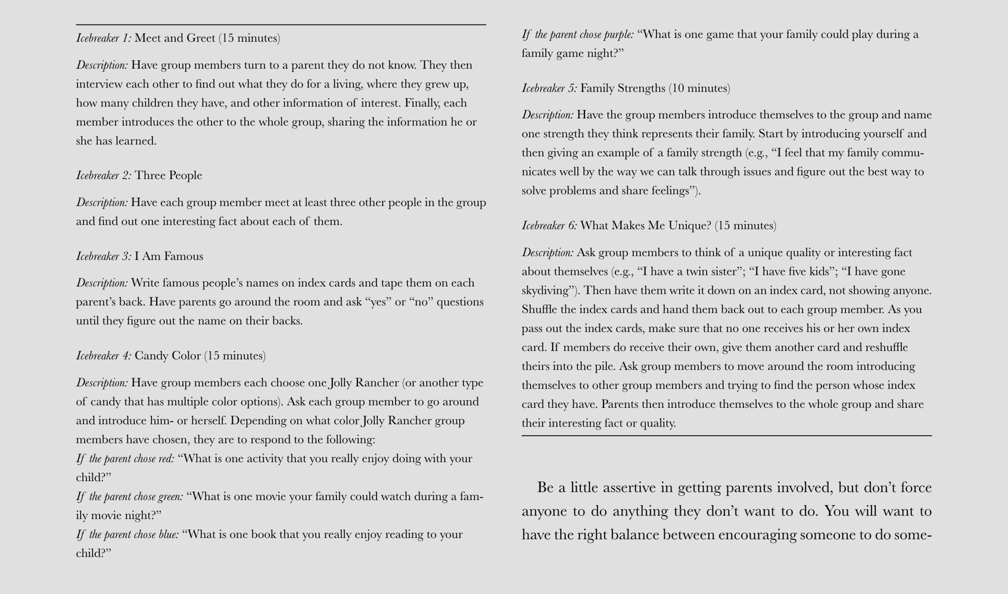
Table 7.1 Adult Icebreaker Activities from Group Interventions in Schools, by Keperling et al.

Slide 32


Appendix 25 Goal Sheet from Group Interventions in Schools, by Keperling et al.

Slide 33
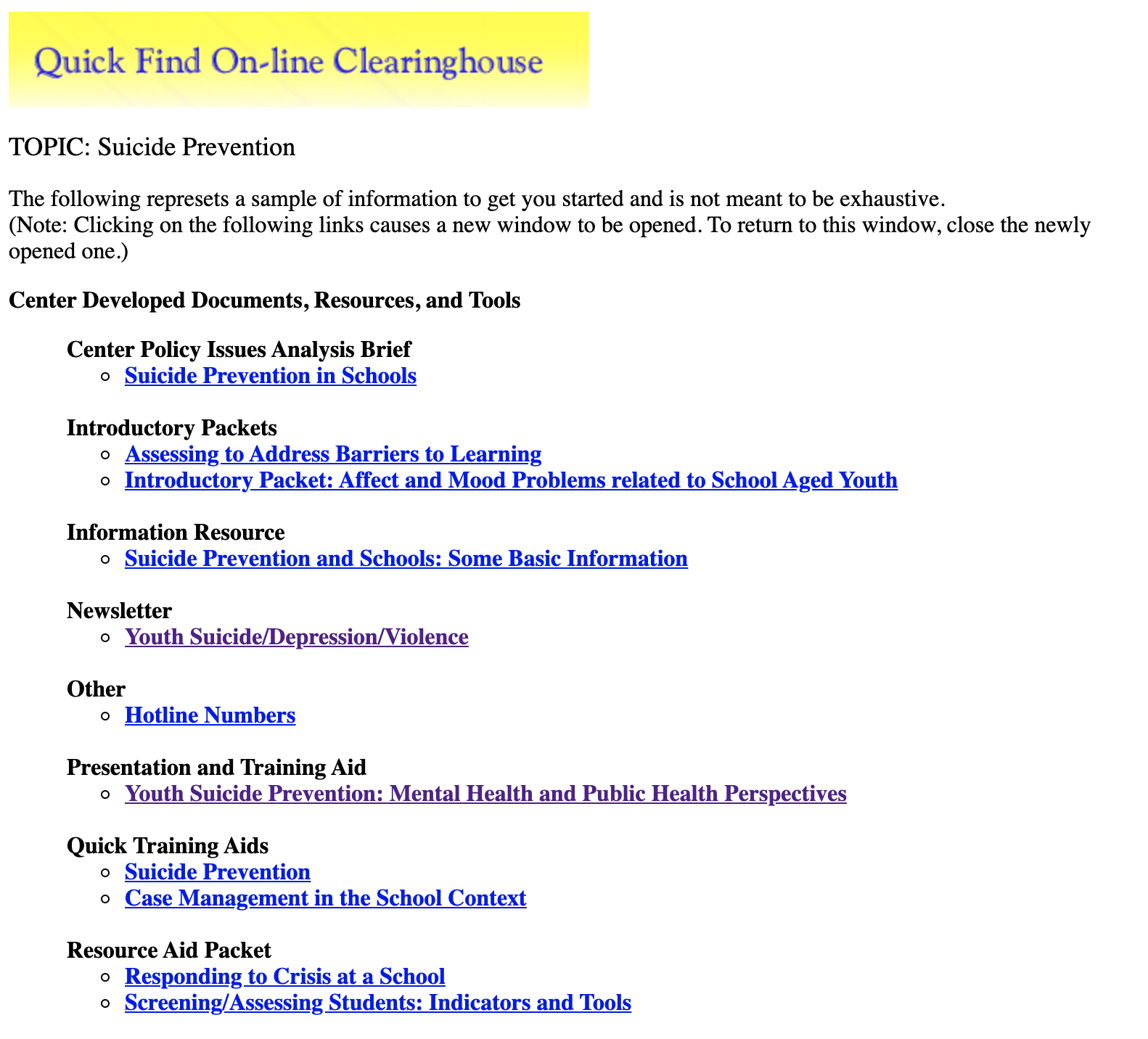
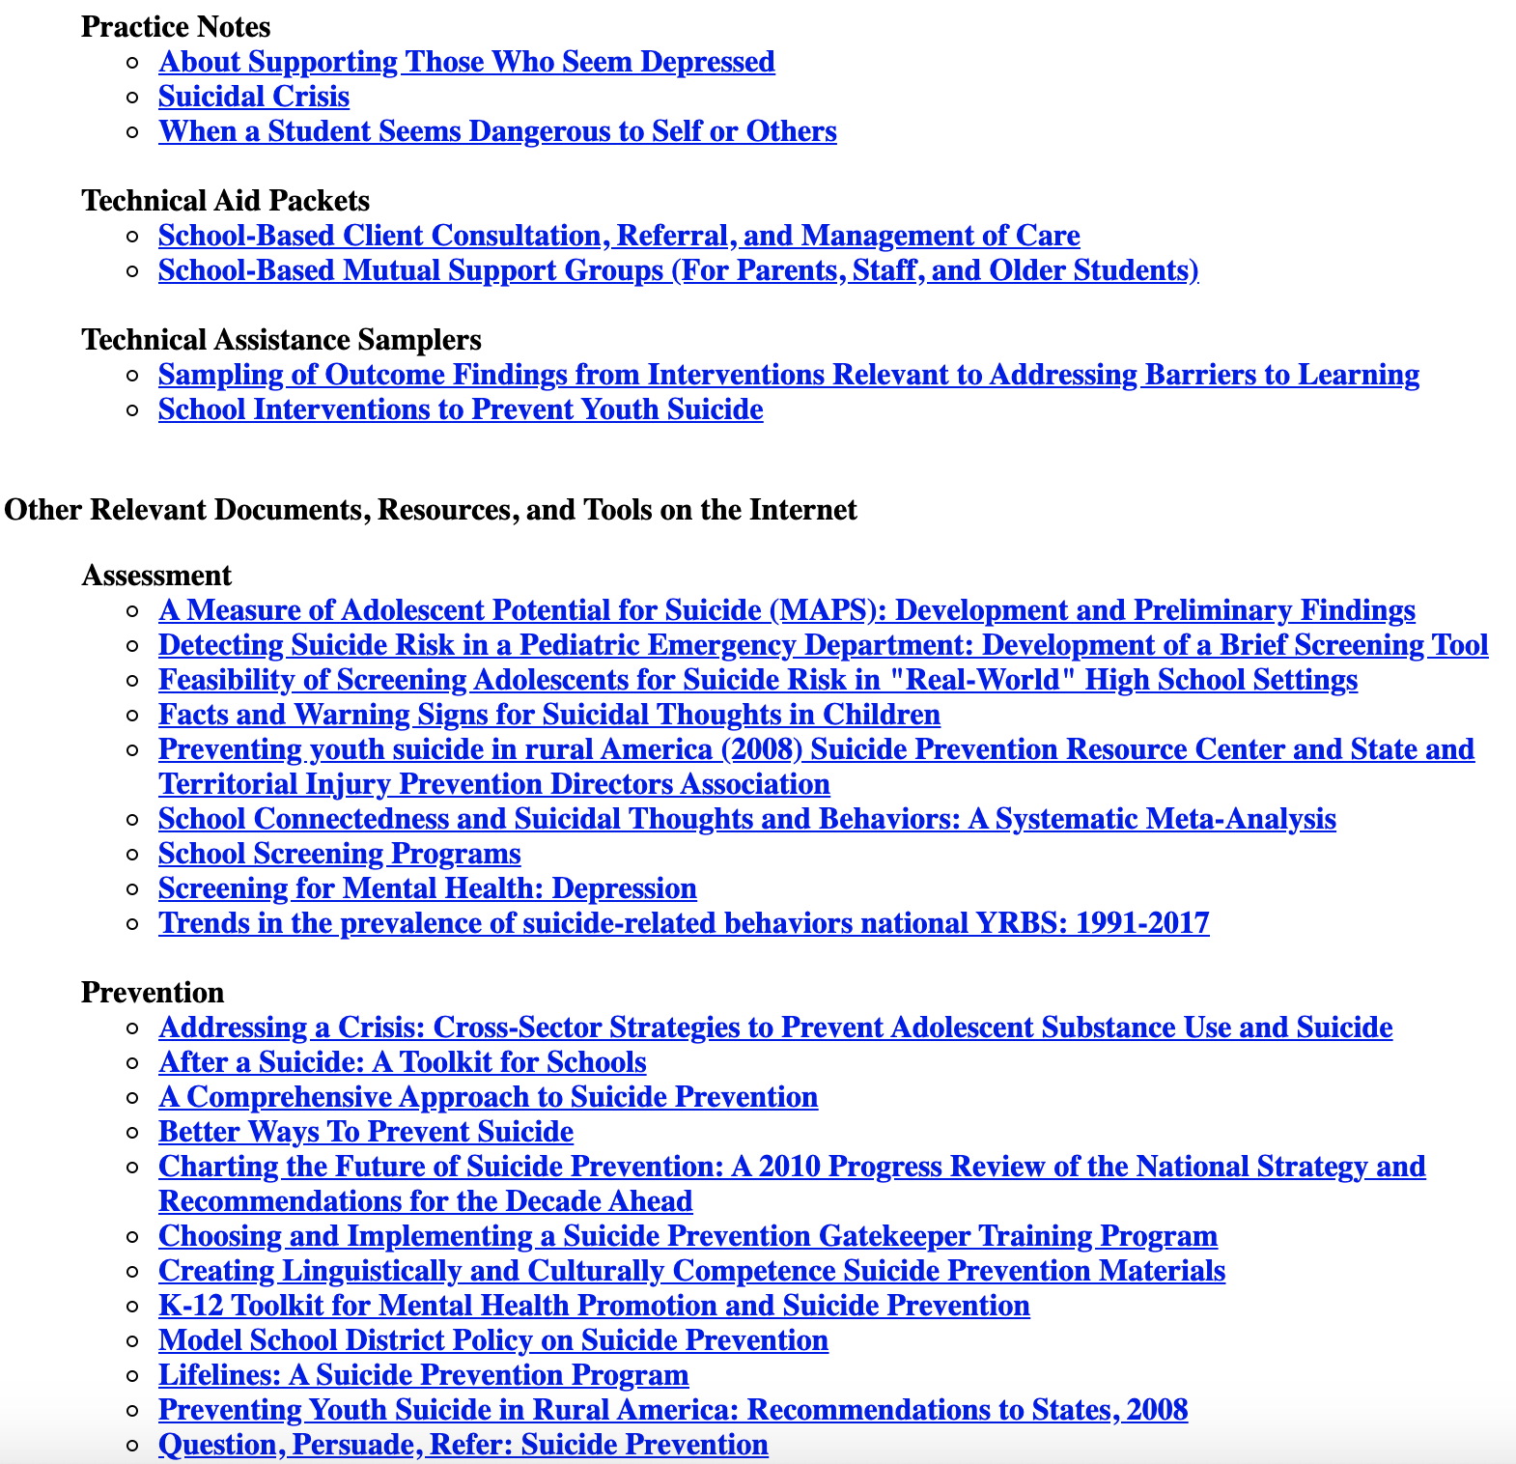
Quick Find resources for Suicide Prevention from http://smhp.psych.ucla.edu

Slide 34
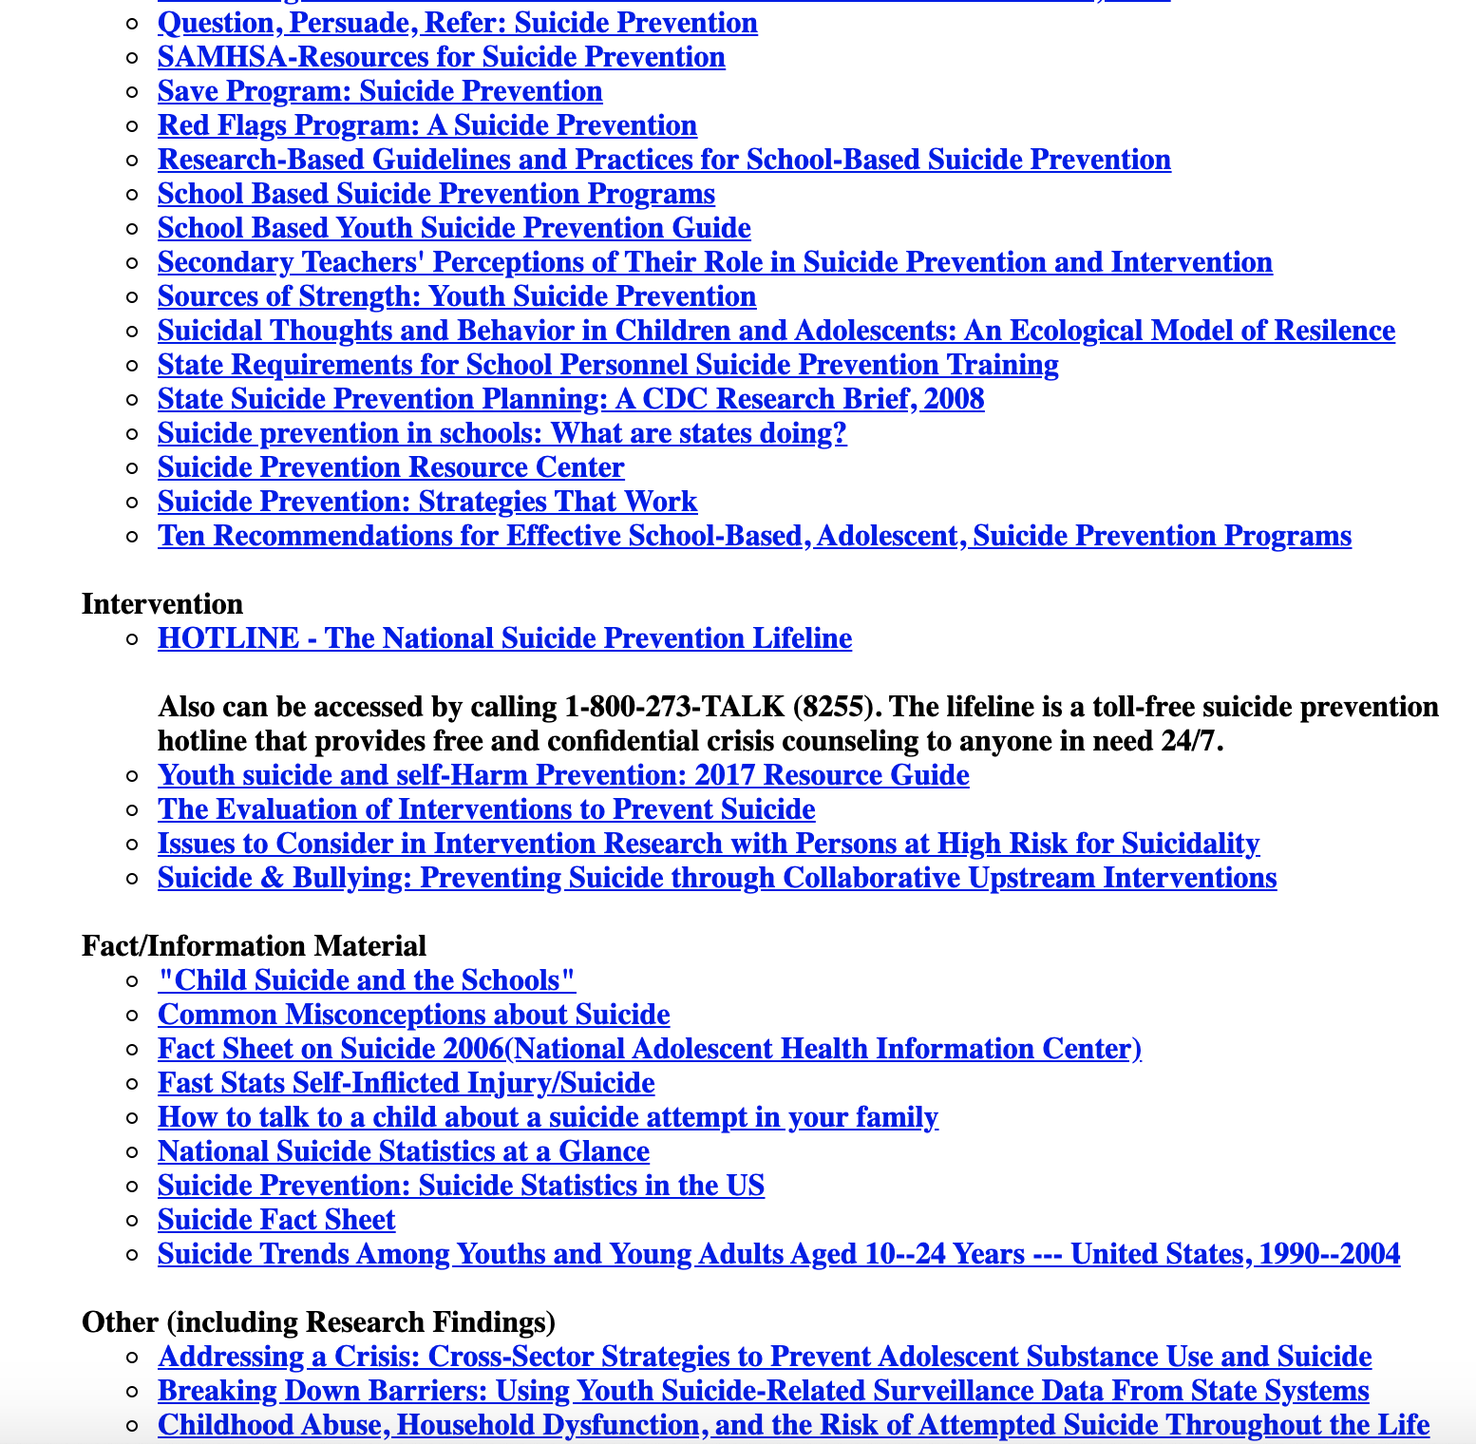
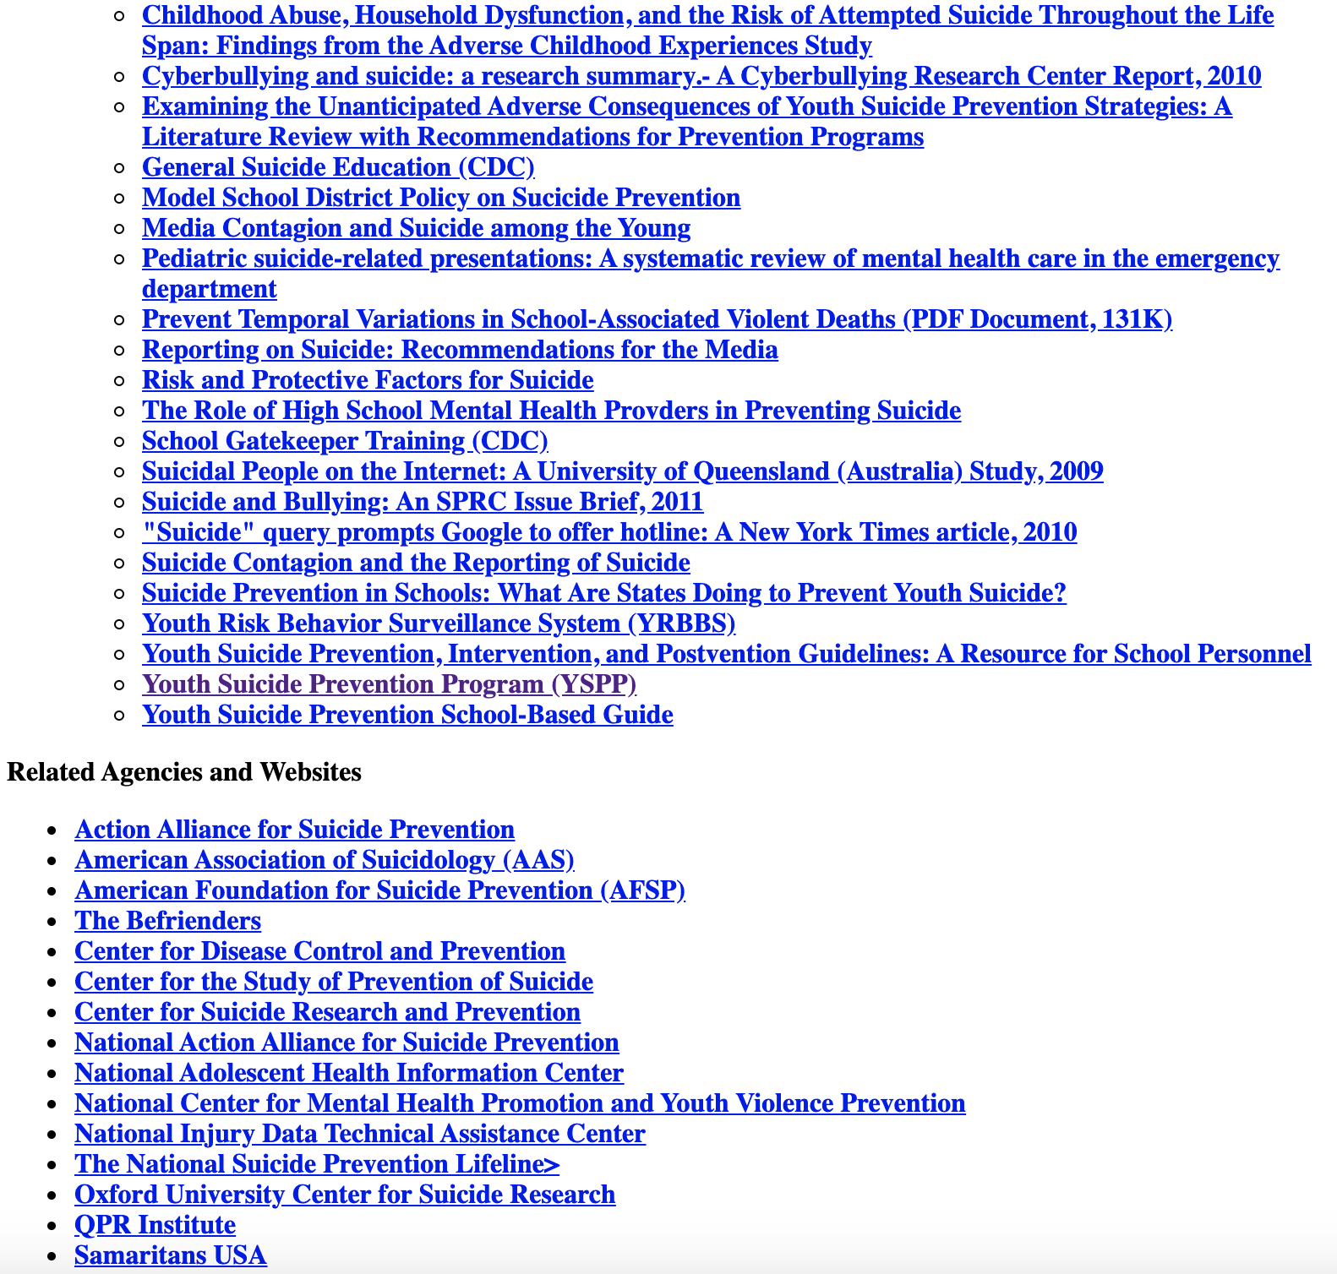
Quick Find resources for Suicide Prevention from http://smhp.psych.ucla.edu continued

Slide 35
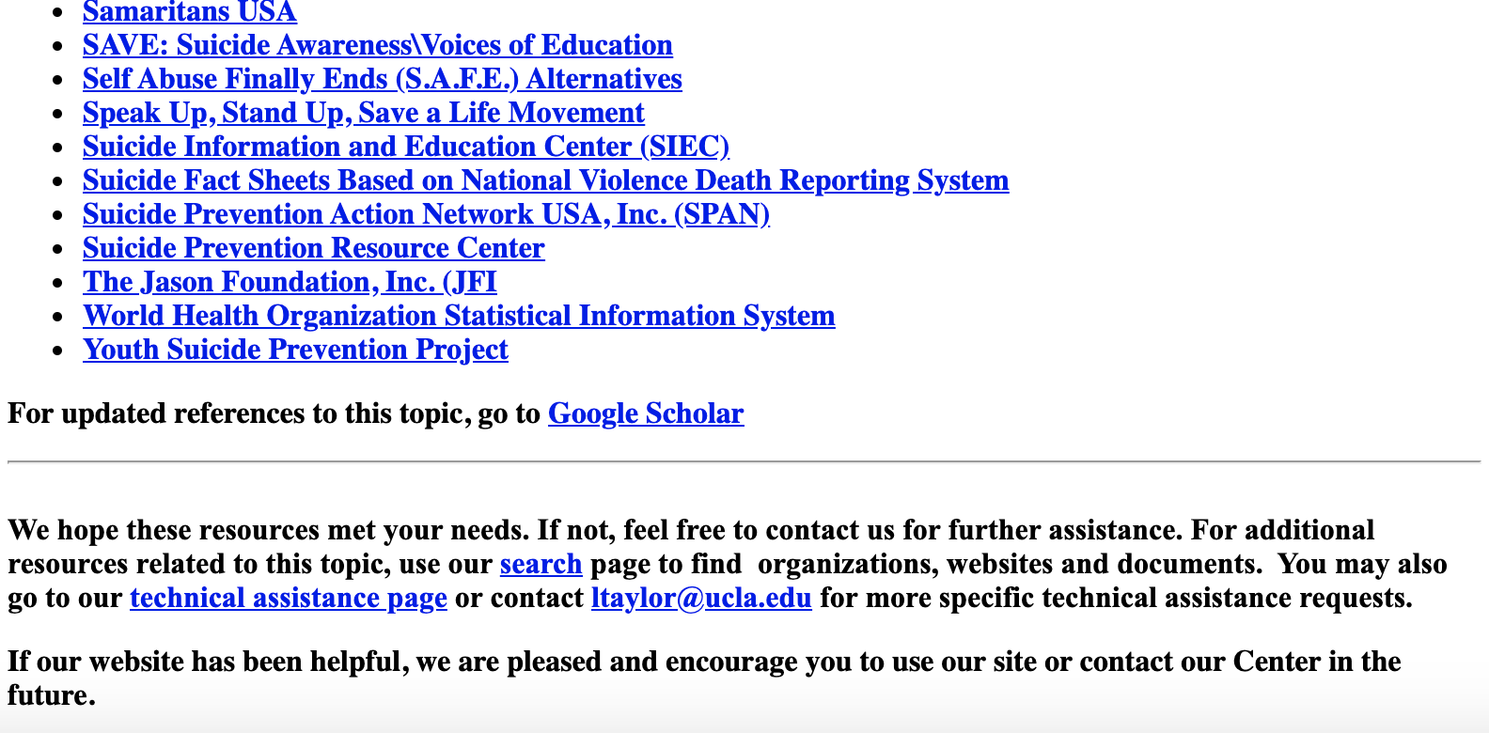
Quick Find resources for Suicide Prevention from http://smhp.psych.ucla.edu continued

Slide 36
Reflection
How are the ideas and information presented connected to what you already knew?
What new ideas did you get that extended or broadened your thinking in new directions?
What challenges or puzzles have come up in your mind from the ideas and information presented?

Slide 37
Post-training survey
Please fill out the survey below regarding how you feel about your ability to implement group interventions with fidelity after completing this training.
Post-training Survey
https://unco.co1.qualtrics.com/jfe/form/SV_emIg7RttCkHnARn

Slide 38

Post-training survey
Please fill out the survey below regarding how you feel about your ability to implement group interventions with fidelity after completing this training.
Post-training Survey
https://unco.co1.qualtrics.com/jfe/form/SV_3yHFMO7KRSkYxU1

Slide 39
