Slide 1

Group Interventions for Externalizing Behaviors
Department of School Psychology
Group Interventions Professional Development
2020-2021
Notes:
Welcome… How many of you were able to attend _____? Recorded, so those unable to attend..

Slide 2
Pre-training survey
Please fill out the survey below regarding past experience with group interventions.
Pre-training Survey

Slide 3

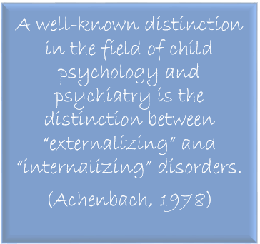
What is this distinction between “externalizing” and “internalizing” disorders?

Slide 4
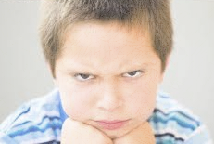
Defined
The construct of externalizing behavior problems refers to a grouping of behavior problems that are manifested in children’s outward behavior and reflect the child negatively acting on the external environment. (Campbell, Shaw, & Gilliom, 2000; Eisenberg et al., 2001)

Slide 5

Conversely…
Internalizing behavior problems, such as withdrawn, anxious, inhibited, and depressed behaviors, more centrally affect the child’s internal psychological environment rather than the external world.
(Liu, 2004)
Notes:
Internalizing behaviors are negative behaviors that are focused inward. The dichotomy between internalizing and externalizing is not perfect. For example…

Slide 6
Externalizing disorders consist of these types of behaviors:
Aggression
Consists of physical or verbal behaviors that harm or threaten others, including children, adults, and animals
Delinquency
Reflects diverse antisocial acts such as theft, burglary, robbery, vandalism, drug use, and violence
Hyperactivity
First type – excess of motor activity or restlessness
Second type – involves attention deficits, particularly with respect to the child being unable to sustain attention in a controlled setting such as the classroom
(Hinshaw, 1987)
Notes:
What comes to mind when you hear the term Hyperactivity?
It has been argued that “hyperactivity” is one of the most confusing terms in psychopathology. It really refers to two types of problems. The first type is an excess of motor activity or restlessness, while the second type involves attention deficits, particularly with respect to the child being unable to sustain and modulate his/her attention in a controlled setting such as the classroom. Developing our knowledge base on externalizing behaviors will help us respond with interventions that reduce externalizing behavior

Slide 7
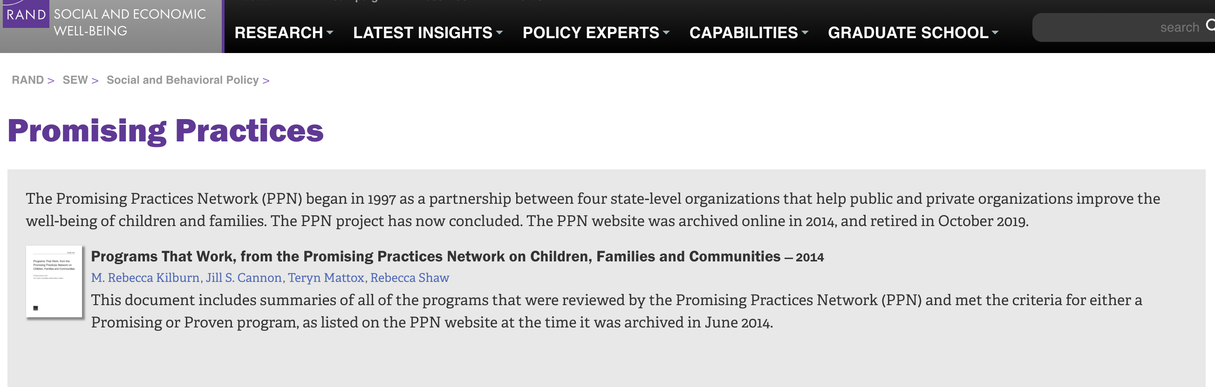
Locating Evidence-Based
Group Interventions
https://www.rand.org/well-being/social-and-behavioral-policy/projects/promising-practices.html
Video walk through of Programs that Work ebook
Notes:
ASK before clicking on information to come up on slides: How do you find interventions?
After this info appears, pull up actual pdf, and scroll through TOC

Slide 8

Locating Evidence-Based
Group Interventions
https://www.blueprintsprograms.org/
Video walk through of Blueprints registry website
Notes:
After this info appears, pull up actual website, show how they’re ranked, how to find registry

Slide 9
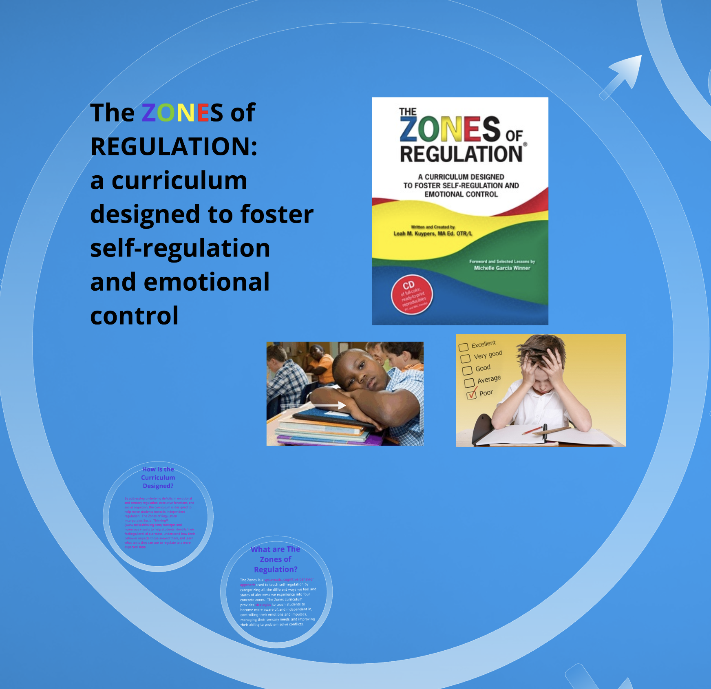

Zones of Regulation
https://www.zonesofregulation.com/teaching-tools.html
https://prezi.com/nms1ykn-uxgw/understanding-the-zones-of-regulation-curriculum/

Slide 10


Evidence-Based Interventions for Externalizing Behaviors
Be Proud! Be Responsible!
Decision-making intervention about sex, designed for adolescents 12-18
Awareness of behaviors that put them at risk of contracting and transmitting STDs, HIV
Intends to delay sexual activity, reduce frequency of unprotected sex, and support adolescents in their decisions about their own sexual behaviors
Six 50-minute modules; can be delivered over the course of 1 day or at a rate of one module per week
Each module incorporates theme that encourages group members to be proud of themselves and their community, to behave responsibly, to consider consequences of their actions, and how these consequences can impede their future goals.
Be Proud! Be Responsible!
Notes:
The following interventions have been found to be proven or promising in the area of externalizing behaviors, which includes problem solving, social skills, and self-control.

Slide 11

Evidence-Based Interventions for Externalizing Behaviors
The Coping Power Child Program
Preventive intervention for at-risk children in late elementary school and early middle school (ages 8-12), typically delivered in school settings. *Sessions available for parents
34 group sessions, 1 hour each, once a week (typically lasts 15-18 months, ~2 school years)
Based in CBT and key factors of social competence, self-regulation, problem-solving, and positive relationships
Content: how to set goals, organization and study skills, problem-solving skills, how to resist peer pressure, how to enter positive peer groups
The Coping Power Child Program

Slide 12


Evidence-Based Interventions for Externalizing Behaviors
The Coping Power Parent Program
Preventive intervention delivered to parents of at-risk children in late elementary and middle school (ages 8-12), typically delivered in school settings
These parents play a central role in helping their children develop effective social and emotional skills
16 group sessions, 1 hour each, once a week
Content: praise and positive attention, setting clear rules and expectations, promotion of child study skills, appropriate discipline practices, parental stress management, family communication and problem solving, and reinforcement of problem-solving skills from the Coping Power Child Program.
Typically runs in conjunction with the child group, but can be run as a separate intervention for parents
The Coping Power Parent Program

Slide 13


Evidence-Based Interventions for Externalizing Behaviors
The FRIENDS Programs
Feelings, Remember to relax, I can try my best, Explore solutions and coping step plans, Now reward yourself, Do it every day, Smile
CBI that focus on promotion of emotional resilience to prevent anxiety and depression in childhood through adulthood.
Offered in 4 age-specific programs: Fun FRIENDS (ages 4-7), FRIENDS for Life (ages 8-11), My FRIENDS Youth (ages 12-15), and Adult Resilience (ages 16 and older).
10 weekly sessions, plus 2 booster sessions following program completion
Addresses attachment, physiological, cognitive, and physical symptoms that occur while experiencing anxiety through play-based activities, role play, and other hands-on activities
Friends Resilience

Slide 14

Evidence-Based Interventions for Externalizing Behaviors
Making Proud Choices!
Multimodule, decision-making intervention about sex, designed to be educational and culturally sensitive for adolescents 12-18, typically used in the school setting
Based on CBT, offers knowledge, confidence, and skills necessary to reduce the risk of STDs, HIV, and pregnancy
8 sessions, 1 hour each
Engaging curriculum: group discussions, videos, games, brainstorming, hands-on exercises, and skill-building activities
Making Proud Choices

Slide 15

Evidence-Based Interventions for Externalizing Behaviors
The Triple P – Positive Parenting Program
Multilevel system of providing parenting and family support, designed to prevent social, emotional, behavioral, and developmental problems in children ages birth to 12
Offers practical strategies to help parents confidently manage their children’s behavior and build healthy relationships
Based in social learning theory
5 levels of increasing intensity. Level 4 is an intensive strategy for parents of children with more severe behavior difficulties
Include interactive seminars, real-life discussions, and a toolbox of strategies based on parent’s need
Triple P Positive Parenting Program

Slide 16

Planning, Organizing, and Establishing the Group
Place image(s) in this area.
Bridging the Gap:
In-Depth Group Intervention Training
Notes:
Before we start, I would like to invite you to be mindful of how the information we cover in the next hour connects to what you already know. I want to ask you to think about how it pushes your thinking into new directions, and to be aware of new challenges and puzzles that may surface as a result of what you hear, read, watch, or experience.

Slide 17


Slide 18
Take time up front to
Determine logistics
Involve all key individuals in the planning
Anticipate potential problems and prepare solutions
Notes:
Logistics such as what?
Location, time, and how you will get students to and from the group will help ensure that the group starts and ends on time
Who?
Teachers, administrators
Any thoughts on troubleshooting group intervention problems ahead of time?
Problem solving can be challenging. We’ll go over strategies for troubleshooting common issues that tend to come up at the beginning of a group.

Slide 19
Planning and Preparing for Sessions
Plan
Plan for every contingency before the students are there.
Check in
Check in with all stakeholders
Review
Review content
Prepped
Have copies ready, if passing materials out
Double- Check
Check needed equipment
Ensure
Ensure accessibility of materials
Create
Create a checklist

Slide 20

Having a Group Co-Leader
Responsibilities and activities can be divided.
phone calls
getting students from class to the group
distributing handouts
checking in with teachers, and following up
Assist with behavior and crisis management.
one can focus on group content while the other focuses on group members’ behavior
-

Slide 21

Establishing the Group
Restroom
Seating
Expectations and consistency
Teach, model, and practice
Arriving/Entering
Behaving/
Participating
Leaving, etc.

Slide 22
Special Considerations for Parent Groups
Food
Childcare
Transportation
Other incentives
The more familiar you are with potential barriers, the greater chance you have for success.
Discuss with school personnel and parents what could be potential barriers and elicit potential solutions.

Slide 23
Evaluating the
Group Process
Student feedback is important
Reflections
Touching base with classroom teachers, parents, and student group members

Slide 24
When Student Attendance is Low
Continue to brainstorm incentives
01
Make sure session is beneficial for those who do attend
02
Run individual session if only one person shows up
03

Slide 25
When Parent Attendance is Low
Contact them with a phone call or voicemail letting them know they were missed
Encourage them to contact you if they have any questions
Provide contact information (weigh benefits of personal cell vs other number)
Send materials home to them

Slide 26
Reflection
How are the ideas and information presented connected to what you already knew?
What new ideas did you get that extended or broadened your thinking in new directions?
What challenges or puzzles have come up in your mind from the ideas and information presented?

Slide 27
Post-training survey
Please fill out the survey below regarding how you feel about your ability to implement group interventions with fidelity after completing this training.
Post-training Survey

Slide 28

Post-training survey
Please fill out the survey below regarding how you feel about your ability to implement group interventions with fidelity after completing this training.
Post-training Survey
https://unco.co1.qualtrics.com/jfe/form/SV_3yHFMO7KRSkYxU1

Slide 29
