Slide 1
APA Hooray!

Slide 2
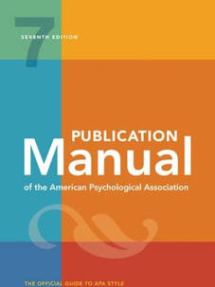
Big Ideas APA Publication Manual-7th Edition
Times New Roman* font, 12 point, black
1 inch margins on top, bottom, left, right
Double-spaced throughout
Left justified
Indent paragraphs
Page numbers in upper right hand corner
Notes:
sans serif fonts such as 11-point Calibri, 11-point Arial, or 10-point Lucida Sans Unicode, or. serif fonts such as 12-point Times New Roman, 11-point Georgia

Slide 3
APA Big Ideas Continued
Scholarly writing-more formal
Avoid “you.”
OK for some papers/reflections to use first-person “I”
Avoid jargon, slang, contractions, too many pronouns
APA uses in-text citations (Author(s), year, p. ).
Reference list (if included) is at end of paper, not footnotes.
Usually include title page and page numbers
No header required in APA 7 for student papers
Follow ELPS Writing Tips Sheet!

Slide 4
In-text Citations are Used in APA One Author Two Authors
Example 1 | In 2015, Earhart reported that aeronautical engineering careers are taking off.
Example 2 | Earhart (2015) reported that aeronautical engineering careers are taking off.
Example 3 | A report cited that aeronautical engineering careers are taking off (Earhart, 2015).
Example 1 | In a 2010 study, Ball and Vance determined eating chocolate covered cherries can lead to illness.
Example 2 | Ball and Vance (2010) determined eating chocolate covered cherries can lead to illness.
Example 3 | Research shows eating chocolate covered cherries can lead to illness (Ball & Vance, 2010).
Use et al. for 3 or more authors.

Slide 5
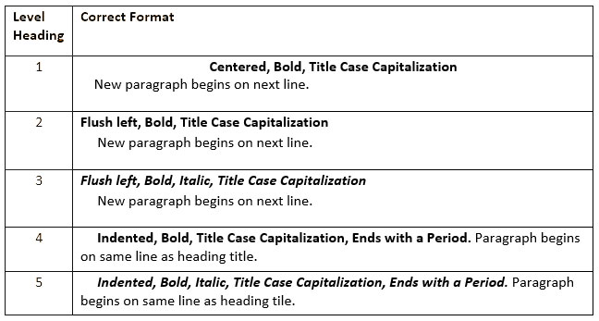
Heading Levels-Headings provide an outline for the reader

Slide 6
Reference List
Only include the sources that you cite.
When in doubt, cite.
Alphabetize by last name.
Use hanging indent.
Watch capitalization-you will not capitalize all words!
Use initials for first and middle names.
Name. (Date). Title of the article or book. Journal, other information.
Check citations if using EasyBib or other citation tool.

Slide 7
Support for Writing and APA
UNC Library Guide
http://libguides.unco.edu/apa
OWL Purdue APA Formatting is great resource
https://owl.english.purdue.edu/owl/resource/560/01/
APA Style
https://apastyle.apa.org
Grammarly-Free app
www.grammarly.com/

