Slide 1
The Fighting Gamecocks
Mitchell L. Yell, Ph.D.
The University of South Carolina

Slide 2
Providing a Free Appropriate Public Education: Lessons from the Due Process Hearing Front Mitchell L. Yell University of South Carolina myell@sc.edu Special Education Director Leadership Academy (SEDLA) Vail, Colorado

Slide 3
What We Will Do Today
Time | Content
9:00 – 10:00 | Lessons from due process hearings-FAPE
10:00 – 10:15 | Break
10:15 – 12:00 | Lessons from due process hearings-FAPE & Behavior
12:00 – 1:00 | Lunch
1:00 – 2:15 | Behavior plans
2:15 – 2:30 | Break
2:30 – 3:30 | Discipline

Slide 4
Background Information
Federal State
Statute 29 U.S.C. § 1401 et seq. Title 22, Article 20 § 22-20 et seq.
Regulations 34 C.F.R. Part 300 Code of CO Regs 2220-R-1.00
Case Law 90%
Policy OSEP Policy Guidance, DCLs, Q & As, etc. (see references)

Slide 5
Litigation: The typical way
U.S District Courts: 94
U.S Courts of Appeals: 13
U.S Supreme Court: 1

Slide 6
Local Due Process Hearing-Tier 1
Litigation: The “special” way
State Review Hearing-Tier 2 (8 states)
U.S District Court
U.S Courts of Appeal
U.S Supreme Court

Slide 7
Why Should We Pay Attention to Due Process Hearings?
My background in hearings
Do hearings set precedent?
Why should we pay attention to hearings?
Costly: Time and expense
Remedies: Tuition reimbursement, Compensatory education
Harbinger of things to come
Exhaustion of Administrative Remedies

Slide 8
General Advice from the Due Process Hearing Front
Involve parents in decision-making
Make school principals your best friend!
Provide professional development to principals, general & special education teachers, on evidence-based educational practices
If a mistake is made, admit it & fix it!
Ensure that IEPs are procedurally & substantively correct and implemented as agreed upon

Slide 9
FAPE & Litigation
Special education is a “growth industry” in education litigation
70% of education litigation comes from special education (10% to 12% of the public school population)-Gerl, 2015
80% to 90% of special education litigation involves FAPE issues (Gerl, 2015)

Slide 10
The Primary Requirement of the IDEA and the crucial obligation for special education administrators and teachers is to provide a special education that confers a free appropriate public education (FAPE)

Slide 11
Free Appropriate Public Education (FAPE)
Special education & related services that are:
Provided at public expense
Meet the standards of the SEA
Includes preschool, elementary, or secondary education
Are provided in conformity with the individualized education program (IEP)
IDEA, 20 U.S.C. § 1401 (a)(18)
Notes:
Since the original passage of the Education for All Handicapped Children Act (now the IDEA) has defined a free appropriate public education as…
FAPE is the foundation of special education and is individually for eligible students with disabilities through the IEP process
Shortly after the EAHCA was passed, disputes arose between parents and school district regarding the content of a FAPE

Slide 12
According to Senator Robert Stafford (1978), Congressional authors “did not attempt to define ‘appropriate’ but instead we established a base-line mechanism, a written document called the Individualized Education Program (IEP)” (Stafford, 1978, p. 75).

Slide 13

Amy Rowley

Slide 14
Appeal to the U.S. Supreme Court
Question presented: What does free appropriate public education require in the context of the Education of All Handicapped Children Act of 1975?
Certiorari Granted on November 2, 1981
Argued on March 23, 1982
Board of Education v. Rowley, 1982 (458 U.S. 176)
Notes:
Would it be the lower de minimis standard of the 10th circuit or would it be the higher meaningful benefit standard of the 6th circuit

Slide 15
Supreme Court Ruling: June 28, 1982
The High Court rejected the maximization standard, holding that FAPE requires noted Congress had intended to bring “previously excluded handicapped children” into the public school system and developed procedures for schools to ensure an individualized instruction
The FAPE requirements of the EAHCA are satisfied “when the State provides personalized instruction with sufficient support services to permit the handicapped child to benefit educationally from that instruction”

Slide 16
The Rowley Two-Part Test
Has the state complied with the procedures set forth in the law?
Is the resulting IEP reasonably calculated to educational benefit?
Notes:
The Court applied the two-part to the case of Amy
The school district had complied with the procedures of the law , thus meeting part 1 of the test
Also, the court held that Amy had received educational benefit because she was passing from grade to grade, thus meeting part 2 of the test benefit-Footnote
Herein lay the problem-Amy had a IQ of 125 and was academically very able-The Supreme Court was essentially able to sidestep the 2nd part of the test
When applying the FAPE test to individual cases, courts began to have different interpretations of the 2nd or substantive part of the Rowley test

Slide 17
Individuals with Disabilities Improvement Act of 2004
In considering an IDEA complaint, the hearing officer is supposed to make his/her decision “on substantive grounds based on a determination of whether the child received a free appropriate public education” (20 U.S.C. § 1415(f)(3)(E)(i)).
“In matters alleging a procedural violation, a hearing officer may only find that a child did not receive a free appropriate public education” if the procedural violations resulted in substantive harm (20 U.S.C. § 1415(f)(3)(E)(ii).

Slide 18
Individuals with Disabilities Improvement Act of 2004
Procedural inadequacies that may cause substantive harm include errors that:
impeded the child’s right to a FAPE;
significantly impeded the parents’ opportunity to participate in the decision making process regarding the provision of FAPE to the child;
caused a deprivation of educational benefits. (20 U.S.C. § 1415(f)(3)(E)(i-iii).

Slide 19
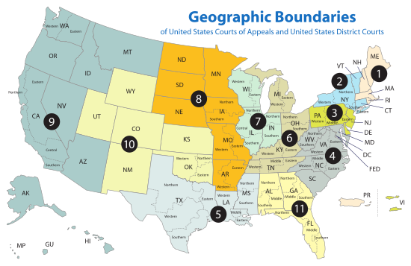
FAPE Tests
Lower
Standard
Lower
Standard
Confused!
Lower
Standard
Higher Standard
Lower
Standard
Lower
Standard
Higher Standard*
Lower
Standard

Slide 20
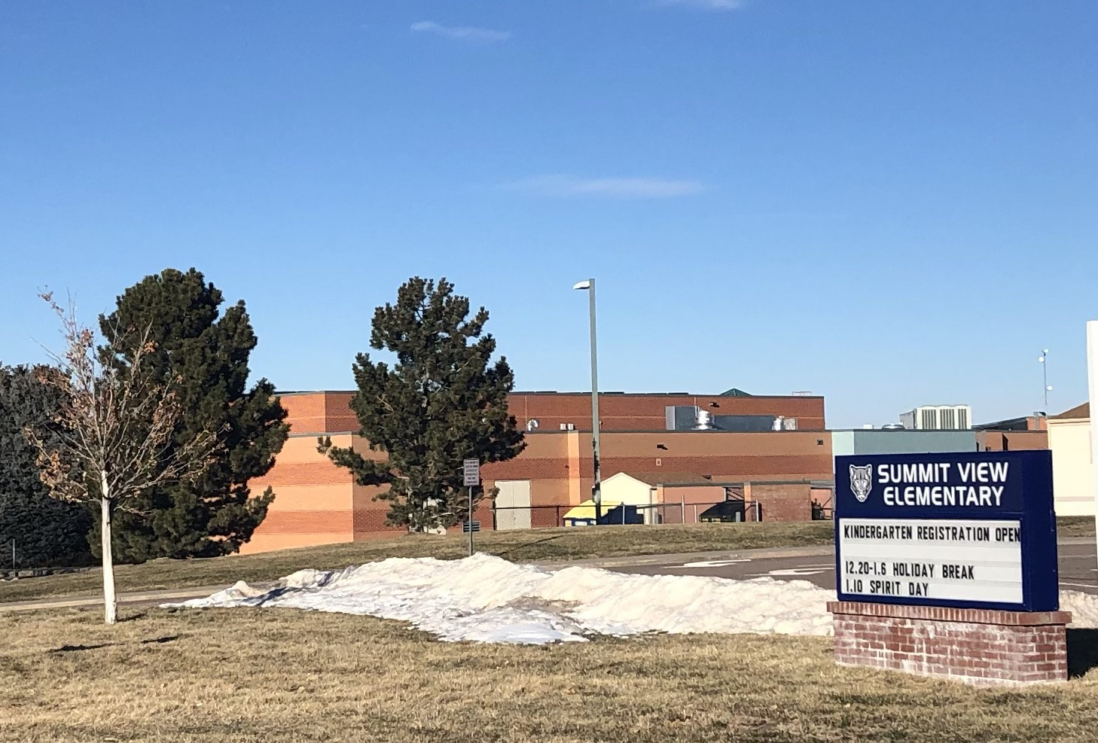

Endrew F. v. Douglas County School District (10th Cir. 2014)

Slide 21
The Tenth Circuit’s Educational Benefit Standard
“The educational benefit mandated by the IDEA must merely be more than de minimis” (Endrew, 2015, p.17)

Slide 22
Appeal to the U.S. Supreme Court
Question presented: What is the level of educational benefit school districts must confer on children with disabilities to provide them with a fee appropriate public education guaranteed by the Individuals with Disabilities Education Act?
Certiorari Granted on September 29, 2016
Argued on January 11, 2017
Endrew F. v. Douglas County Public School District, 2017
Notes:
Would it be the lower de minimis standard of the 10th circuit or would it be the higher meaningful benefit standard of the 6th circuit

Slide 23
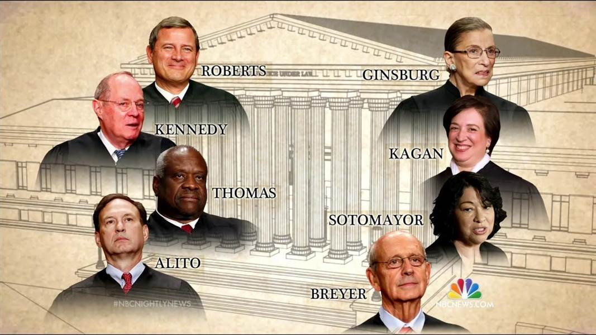

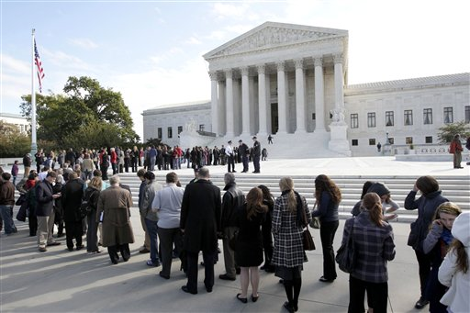
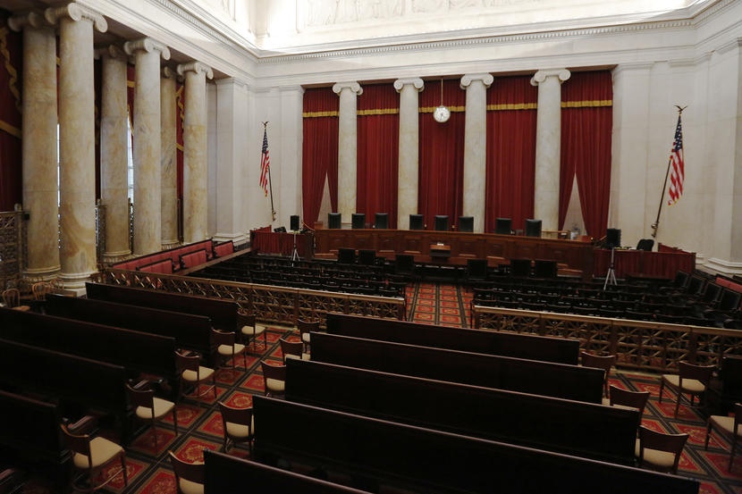
Oral Arguments: January 11, 2017

Slide 24


Slide 25
Supreme Court Ruling: March 22, 2017
The High Court rejected the “merely more than de minimis” standard, vacating the decision and remanding the case back to the 10th Circuit to apply the new standard.
“To meet its substantive obligation under the IDEA, a school must offer an IEP reasonably calculated to enable a child to make progress appropriate in light of the child’s circumstances.’

Slide 26
The Rowley/Endrew Two-Part Test
Has the state complied with the procedures set forth in the law?
Is the resulting IEP reasonably calculated to enable the student to make progress appropriate in light of his or her circumstances?
Notes:
The Court applied the two-part to the case of Amy
The school district had complied with the procedures of the law , thus meeting part 1 of the test
Also, the court held that Amy had received educational benefit because she was passing from grade to grade, thus meeting part 2 of the test benefit-Footnote
Herein lay the problem-Amy had a IQ of 125 and was academically very able-The Supreme Court was essentially able to sidestep the 2nd part of the test
When applying the FAPE test to individual cases, courts began to have different interpretations of the 2nd or substantive part of the Rowley test

Slide 27
The Three Dimensions of FAPE: Procedural, Substantive, & Implementation

Slide 28
Procedural Dimension
These safeguards are designed to protect the rights of parents and their child with a disability by requiring the school district take actions to involve parents in the special education process
Procedural requirements represent the “how” and “when” of the IDEA
Has the school district complied with the procedures set forth in the law? (Board of Education v. Rowley, 1982)

Slide 29
Substantive Dimension
The substantive requirements of IDEA refer to a school districts obligation to provide a FAPE that designed to lead to student progress.
Substantive requirements represent the “what” of the IDEA
Is a student’s IEP “reasonably calculated to enable the child to make progress appropriate in light of his circumstances.” (Endrew F. v. Douglas County School District (2017).

Slide 30
Individuals with Disabilities Education Improvement Act of 2004
A hearing officer makes his/her decision “on substantive grounds based on a determination of whether a student received a free appropriate public education” (20 U.S.C.§ 1415(f)(3)(i)).
“In matters alleging a procedural violation, a hearing officer may only find that a child did not receive a fee appropriate public education if the procedural violation resulted in substantive harm” (20 U.S.C.§ 1415(f)(3)(i)).
Harmless Error Exception

Slide 31
The Most Serious Procedural Violations
“In matters alleging a procedural violation, a hearing officer may only find that a child did not receive a FAPE if the procedural inadequacies –
(i) Impeded the child’s right to a FAPE
(ii) Significantly impeded the opportunity to participate in the decision-making process regarding the provision of a FAPE to the parent’s child; or
(iii) Caused a deprivation of educational benefit.”
34 C.F.R. § 513(a)(2)(i-iii)

Slide 32
What Does this Mean?
A hearing officer must ask:
Did the school commit a procedural error?
Did the procedural error cause substantive harm?

Slide 33
Implementation Dimension
In failure to implement cases, parents have asserted that a school district has denied FAPE, based on the claim that the school district failed to partially or fully implement their child’s IEP.
“Implementation focuses simply on whether the services in the IEP have actually been provided…FAPE issues involve what should have been done, implementation issues involve what actually was done” (M.S. v. Utah School for the Deaf and Blind, 2017, p. 6).

Slide 34
Materiality-Alone Approach in Implementation Litigation
Van Duyn v. Baker School District 5J, 502 F.3d 811 (2007)
‘We hold that a material failure to implement an IEP violates the IDEA.’
“A material failure occurs when there is more than a minor discrepancy between the services a school provides to a disabled child and the services required by the child's IEP. . .”
“[W]e clarify that the materiality standard does not require that the child suffer demonstrable educational harm in order to prevail.”

Slide 35
Dissent in Van Duyn
Judges are not in a position to determine which parts of an agreed-upon IEP are or are not material. The IEP Team, consisting of experts, teachers, parents, and the student, is the entity equipped to determine the needs of a special education student, and the IEP represents this determination. Although judicial review of the content of an IEP is appropriate when the student or the student's parents challenge the sufficiency of the IEP . . . such review is not appropriate where, as here, all parties have agreed that the content of the IEP provides FAPE.

Slide 36
The Procedural & Substantive Standard

Slide 37
Distinction
The Procedural Dimension: Knowing what procedures the law requires and ensuring that those procedures are followed (e.g., the when and how).
The Substantive Dimension: Focuses on the adequacy of a student’s IEP in terms of its likely or actual results (e.g., the content of an IEP).

Slide 38
What Have I Found to Be the Most Serious School District Errors?
Procedural
Failing to properly conduct child find activities
Failing to conduct a full and individualized assessment
Failing to involve a student’s parents in IEP formulation and monitoring
Predetermining program and/or placement

Slide 39
Hearing Issues: Child Find
Did the school district have a reason to suspect that a student may be eligible under the IDEA?
Did the school district fulfill its evaluation obligations under the IDEA within a reasonable period of time?

Slide 40
Hearing Issues: “Meaningful” Parental Involvement
The “core of the statute” is "the cooperative process that it established between and schools.”
Shaffer v. Weast, 546 U.S. 49, (2005).
“Procedural violations that interfere with parental participation in the IEP formulation process undermine the very essence of the IDEA”
Amanda J. v. Clark County School District, 260 F.3d. 877 (9th Cir. 2001)

Slide 41
What Have I Found to Be the Most Serious School District Errors?
Substantive
Failing to establish the foundation of an IEP with a complete and thorough assessment
Internal consistency of the IEP
Failing to address needs identified in the PLAAFP statements in the services, goals, or both services and goals.
Failing to craft measurable annual goals
Failing to collect, report and use data on a student’s progress

Slide 42
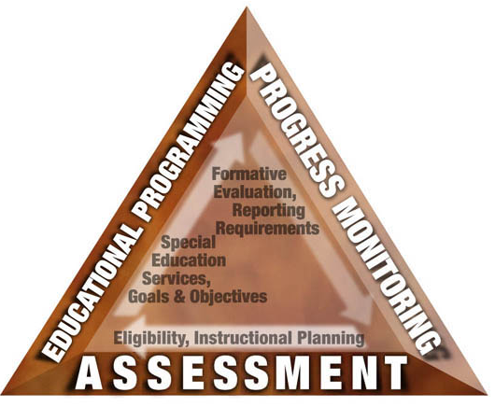
Assessment is the Foundation of a Student’s IEP

Slide 43
An Internally Consistent IEP
Special Education services, Related Services, Supplementary services, & program modifications
Current, relevant assessment data on all of a student’s needs
Present Levels of Academic Achievement and Functional Performance statements
Ambitious, Measurable Annual Goals & Methods of Measurement
All
Most
All
If a need doesn’t require a goal go directly to services

Slide 44
Implications of the IDEA, the Endrew F. Decision, and Policy Guidance
Ensure that there is direct relationship between the PLAAFP and the other components of the IEP
If the PLAAFP statement describes a problem with a child's reading level and points to a deficiency in reading skills, the problem should be addressed under both (a) goals and (b) specific special education and related services provided to the child.” (Question 36, IDEA Regulations of 1997)

Slide 45
One component/decision must lead directly to the next.
Internal consistency assures that:
All needs identified in the PLAAFP are addressed either through Specially-designed Instruction (SDI), Accommodations, or both.
“Rogue” goals for SDI for which no need is documented are avoided
Students are neither “under-accommodated” nor “over-accommodated”
Services and supports are linked logically to PLAAFP/needs
Data from evaluation and progress monitoring are used to examine the IEP’s appropriateness on a regular basis

Slide 46
A Goal is not Measurable if it Cannot be Graphed!!

Slide 47
“When I have a school district with a FAPE case the first thing I do is go to the teacher and say: ‘Give me information on your student’s progress.’ If the teacher doesn’t have data, I consider advising the school district to settle.”
Kathleen Mehfoud
-Attorney with Reed & Smith and Consultant to LRP-
- Tri-State Special Education Law Conference, 2015
Notes:
LRP, used to stand for legal research publications, but now they just use LRP as a name. It is the largest publisher of legal information in special education, owns Special Education Connect database and IDELR (Individuals with Disabilities Education Law Reporter).

Slide 48
“The IEP must aim to enable the child to make progress. After all, the essential function of an IEP is to set out a plan for pursuing academic and functional advancement.” - Endrew F., 2017, p. 11-

Slide 49
What Have I Found to Be the Most Serious School District Implementation Errors?
Implementation
Failing to implement “material” parts of the IEP as agreed upon
U.S. Courts of Appeals in 6 Circuits have either cited or used the materiality test with respect to a denial of FAPE
“The IEP, like a contract…embodies a binding commitment and provide notice to both parties as to what services will be provided to a student” (M.C. v. Antelope Union School District, 2017, p. 1197).

Slide 50
“These two issues-content (substantive) and implementation-are different in their nature-plan versus action-our analysis of shortfalls in those areas also must be different. A material deviation from the plan (the IEP) violates the statute. - J.L. v. School Board of Broward Cty, FL (2019).

Slide 51
“Material” Implementation Errors
Failing to provide the agreed upon special education services, related services, supplementary services, or program modifications listed in the IEP when those services are necessary for a student to make progress appropriate in light of his/her circumstance
Failing to provide the agreed upon amount of these services or modification listed in the IEP

Slide 52
Materiality Standard
U.S. Circuit Courts of Appeals for the 4th, 8th, 9th, 10th, 11th Circuits
U.S. Circuit Court for the 5th Circuit-Materiality plus benefit

Slide 53
Circuit Court’s Addressing Implementation
Sumter County School District v. Heffernan (2011)-U.S. Courts of Appeals for the 4th Circuit
“Accordingly, we that a material failure to implement an IEP or…a failure to implement a material portion of an IEP, violates the IDEA.”
Houston ISD v. Bobby R. (2000)-U.S. Courts of Appeals for the 5th Circuit
“…(A) party challenging the implementation of an IEP must show more than a de minimis failure to implement all elements of that IEP, and, instead, must demonstrate…failed to implement an essential element of the IEP that was necessary for the child to receive an educational benefit.”
Neosho School District v. Clark (2003)-U.S. Courts of Appeals for the 8th Circuit
“…we cannot conclude that an IEP is reasonably to provide a free appropriate public education if there is evidence that the school actually failed to implement an essential element of the IEP that was necessary for the child to receive an educational benefit”( footnote #3).

Slide 54
Two Examples of Circuit Court’s Addressing Implementation
Van Duyn v. Baker School District (2007)-U.S. Courts of Appeals for the 9th Circuit
“A material failure to implement an IEP occurs when the services a school provides to a disabled child fall significantly short of the services required by the child's IEP.”
L.J. v. School Board of Broward County, Florida (2019)-U.S. Courts of Appeals for the 11th Circuit
”A material implementation failure occurs only when a school has failed to implement substantial or significant provisions of a child’s IEP.”

Slide 55
What is the “Per Se” Approach?
“Judges are not in a position to determine which parts of an agreed-upon IEP are or are not material. The IEP Team, consisting of experts, teachers, parents, and the student, is the entity equipped to determine the needs of a special education student, and the IEP represents this determination…Having so agreed, the school district must “provide[ ] [special education and related services] in conformity with the individualized education program.”
(Van Duyn v. Baker School District-Dissent, Judge Ferguson, 2007)

Slide 56
Based on my DPH Experiences, What Do I Recommend?

Slide 57
Prerequisites
Don’t miss the small stuff (e.g., names, dates)
Don’t say dumb stuff!!

Slide 58
Examples of “Dumb” stuff!!
“We don’t offer extended school year to any students, therefore ESY that will not be a discussion point at the IEP meeting”
“The IDEA doesn’t allow tutoring services”
“This meeting shouldn’t take long. Mr. ___ has the IEP ready, all you need to do is sign it.”
“I don’t modify instruction. In my class everyone is treated equally.”
“I will have to pass this questions on to the powers that be to determine if we are allowed to provide____”.

Slide 59
Recommendation #1
Understand and avoid procedural violations in the development of the IEP that could, in and of themselves, constitute a denial of FAPE.

Slide 60
Recommendation #2
When developing the content of a student’s IEP and subsequently reviewing and revising it, be sure that the present levels of performance and annual goals are based upon assessments and other relevant data that are current, address all of a student’s needs, and inform the IEP team regarding the appropriate special education and related services.

Slide 61
Recommendation #3
Ensure that annual IEP goals are appropriate, ambitious, and measurable.

Slide 62
Recommendation #4
Continuously monitor and measure a child’s progress on annual goals (and objectives/benchmarks, if applicable) and maintain specific data to demonstrate that progress has been made.

Slide 63
Recommendation #5
Provide frequent and systematic data-based reports to a student’s parents on their child’s advancement toward their goals.

Slide 64
Recommendation #6
When progress report and other data do not reflect that an annual goal will be met, reconvene the IEP team to determine why and make academic/functional changes!

Slide 65
Recommendation #7
Ensure fidelity of implementation of the the IEP using the per se approach

Slide 66
Resources
Council for Exception Children (CEC): www.exceptionalchildren.org
Council for Administrators of Special Education (CASE): www.casecec.org
Progress Center: www.promotingprogress.org
National Center on Intensive Intervention: www.intensiveintervention.org
Center on Positive Behavior Interventions & Support: www.pbis.org
IRIS Center: https://iris.Peabody.Vanderbilt.edu
OSEP, IDEAs that work: www.OSEPideasthatwork.org
OSEP, The Individuals with Disabilities Education Act: https://sites.ed.gov/idea
OSEP Policy Support Documents: https://sites.ed.gov/idea/policy-letters-policy-support-documents/
Spedlawblog.com – Mitchell Yell, David Bateman, & Kevin Brady

