Slide 1
Writing Program Placement @ UNC
Tara Wood, PhD
Associate Professor, English
Writing Program Administrator

Slide 2
Presentation Outline
Written Communication Overview
Option A
Directed Self-Placement Survey Details & ENG 132 Data
Option B
Option C

Slide 3
Written Communication Overview
To fulfill the Written Communication category of the LAC, students need to complete 6 credit hours of writing coursework.
OPTION A
LAW1 (with SAI) + LAW2
OPTION B
LAW1 + LAW2
OPTION C
LAW2 + LAW3

Slide 4
Written Communication Courses
LAW1 = ENG 122
LAW2 = ENG 123, ENG 225, PVA 152, BA 205, SCI 291, SCI 225
LAW3 = ENG 323

Slide 5
Option A: LAW1 (with SAI) + LAW2
Who should take this option?
Students who might need a little extra support to complete ENG 122 (LAW1), which is a highly predictive course for retention and persistence.
How do we know which students need extra support?
They meet one of our indicators (HSGPA, ACT/SAT scores, Directed Self Placement Survey score).

Slide 6
Directed Self-Placement Survey
What is this?
Survey comprised of attitudinal, reading comprehension, and syntax/mechanics questions. It is used to help determine whether students might benefit from supplemental academic instruction.
Who should take it?
All students should take it (except those who bring in credits for LAW1 or have high enough ACT/SAT scores to place into the upper option).
What happens with the scores?
The scores are posted in SLATE and inform whether the student receives a recommendation to take ENG 132 (SAI) alongside ENG 122.

Slide 7
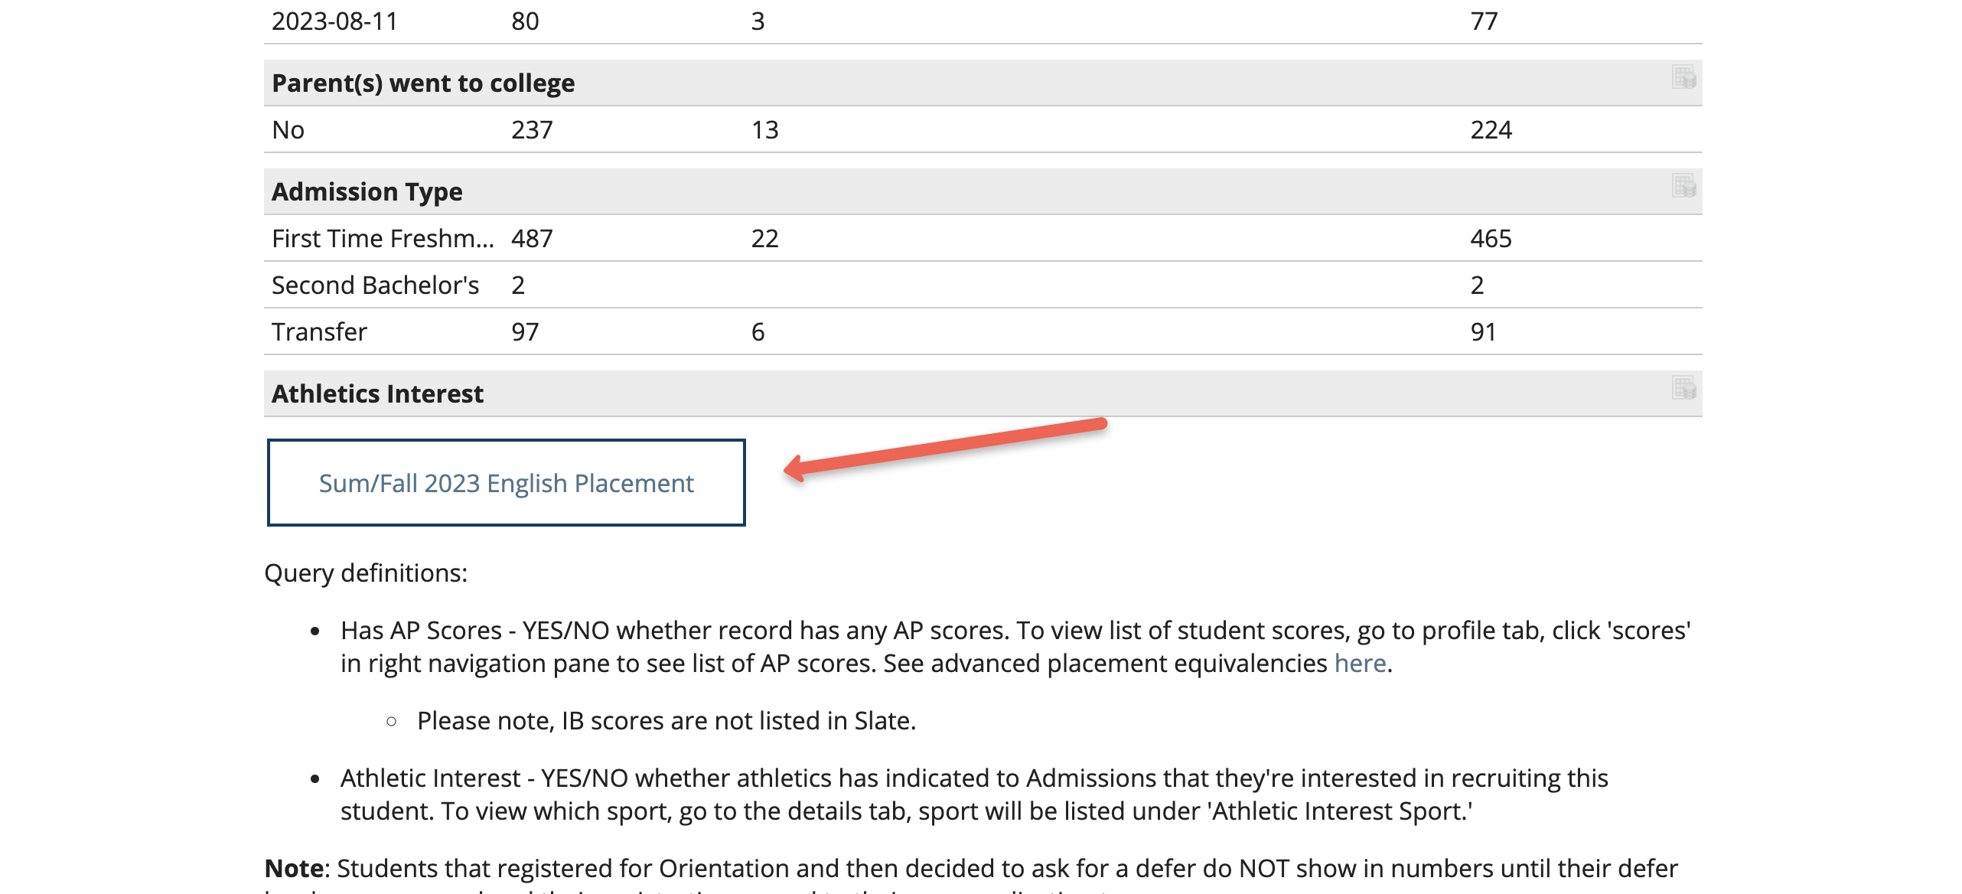
https://admissions.unco.edu/portal/advising

Slide 8
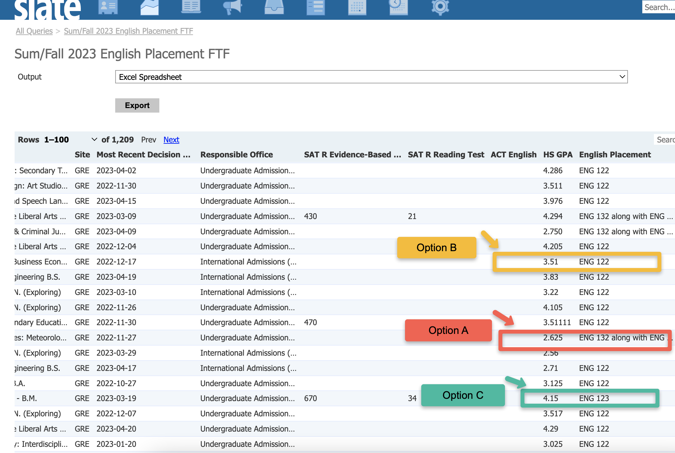

Slide 9
ENG 132 (SAI)
Semester | 132 Students Passing 122
FA18 | 92%
FA19 | 87%
FA20 | 87%
FA21 | 94%
FA22 | 87%
Average Pass Rate (past 5 yrs) | 89.4%
FA 22
65% of ENG 132 students passed ENG 122 at the predictive benchmark of B or above (Source: SSC & Insight SAI)

Slide 10
Option B: LAW1 + LAW2
Who should take this option?
Students who don’t need (or want) the SAI (ENG 132).
How do we know which students should take this option?
They do not have high enough test scores to place into Option C.

Slide 11
Option C: LAW2 + LAW3
Who should take this option?
Students who will benefit from a more advanced writing pathway to complete the Written Communication component of the LAC.
How do we know which students should take this?
They have high enough test scores OR they bring in credit for a CO-2/LAW2 course with no credit for a LAW1/CO-1 course.

Slide 12
Final Tips
ENG 132 is a recommendation-based course
Option C needs promotion; please help identify students for whom this option is appropriate
I work in the summer! Tara.wood@unco.edu or Teams

Slide 13
Thank you

