Slide 1

A Research-Based Academic First Year Seminar:
UNC’s UNIV 101
Dr. Angela Vaughan

Slide 2
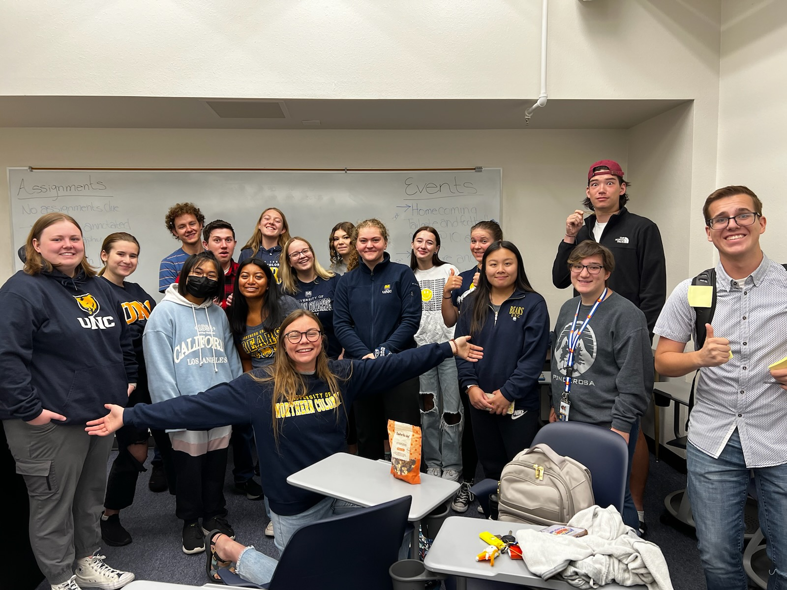
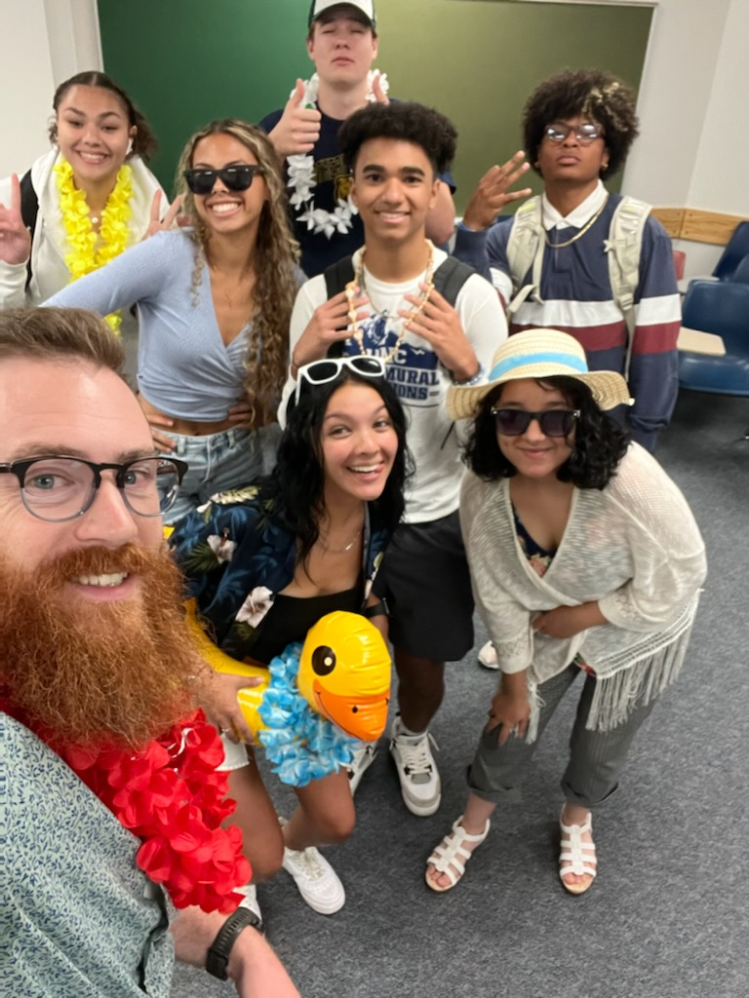
What is UNIV 101?
A 3-credit research-based academic course
  Balances challenging college-level academic tasks with scaffolded support from highly trained instructors and class leaders

Slide 3
What is UNIV 101?
A research-based academic course
  Students are expected to read research articles, write papers, complete a research project and take exams
  Theories such as goals, motivation, information processing and memory
  Educational Psychology discipline
A practical skills course
  Time management, 4-yr education plan, professional communication, etc.
Notes:
Based on decades of research on ed psych theories
Nationally, most challenging task for students – time management
Will give them specific tools and strategies to try
Can’t communicate with profs with text messages
What do you do when profs don’t respond
Office hours, etc.
4-yr plan so that you know what you’ve gotten yourself into

Slide 4
What is UNIV 101?
Required for:
  TRIO students (Center for Human Enrichment)
  GOAL students
  Undeclared students
  Psychology and online psychology majors
  Honors

Slide 5
What is UNIV 101?
Partnerships
  Library
  Psychological Services Clinic
    Individual and Group Counseling Opportunities
  Career Readiness
  SOAR
  GOAL
  CHE

Slide 6
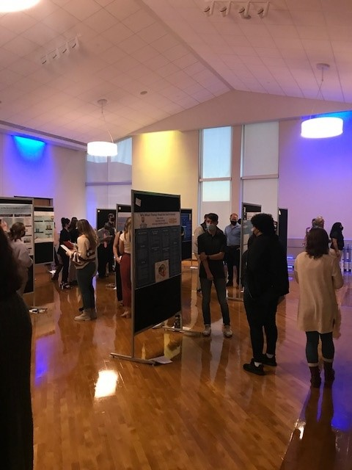
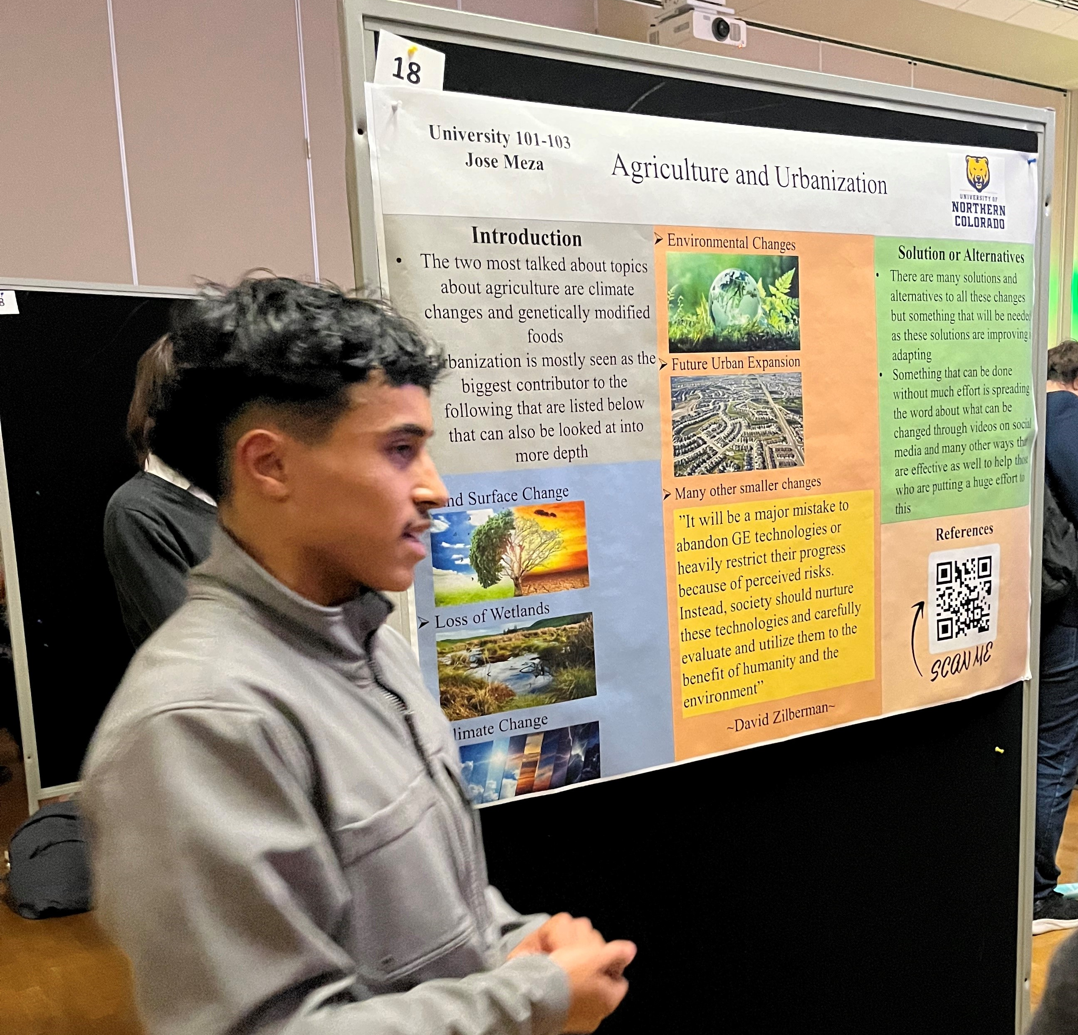
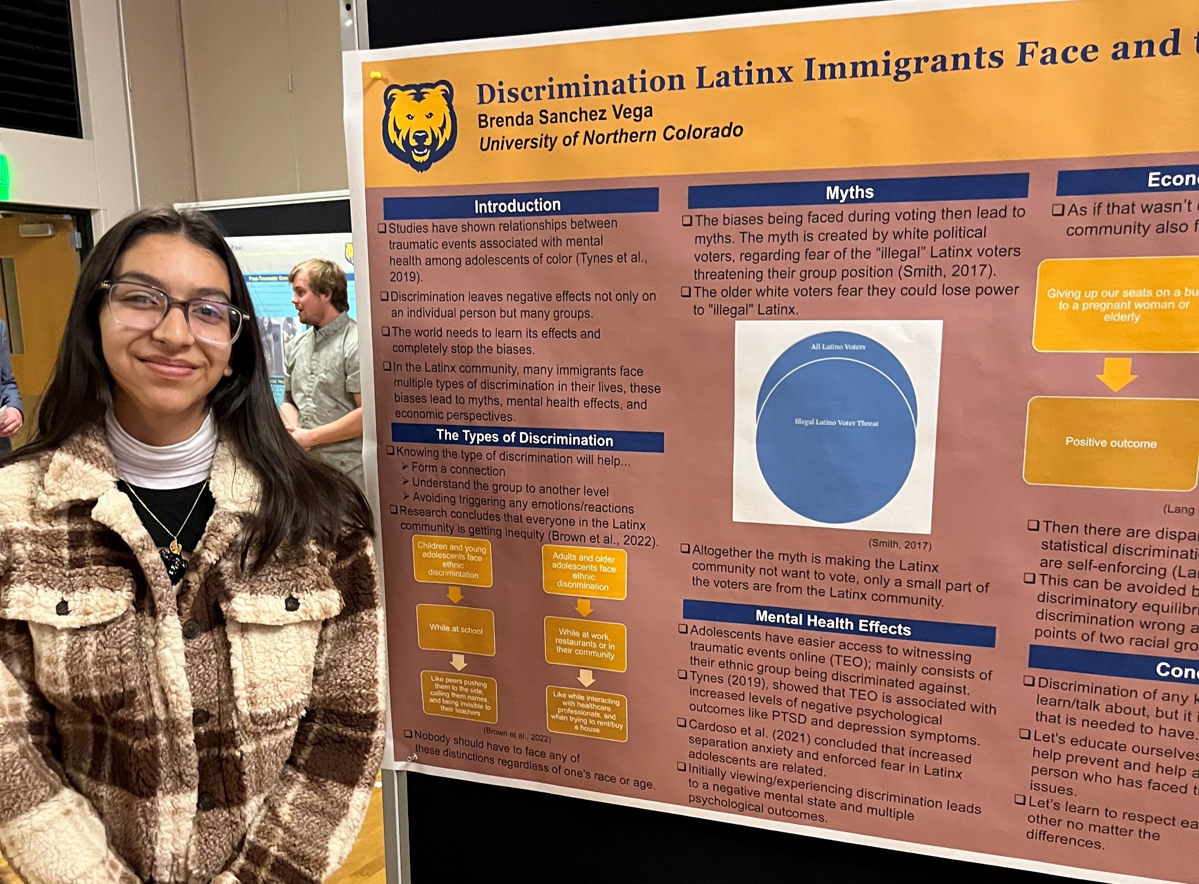
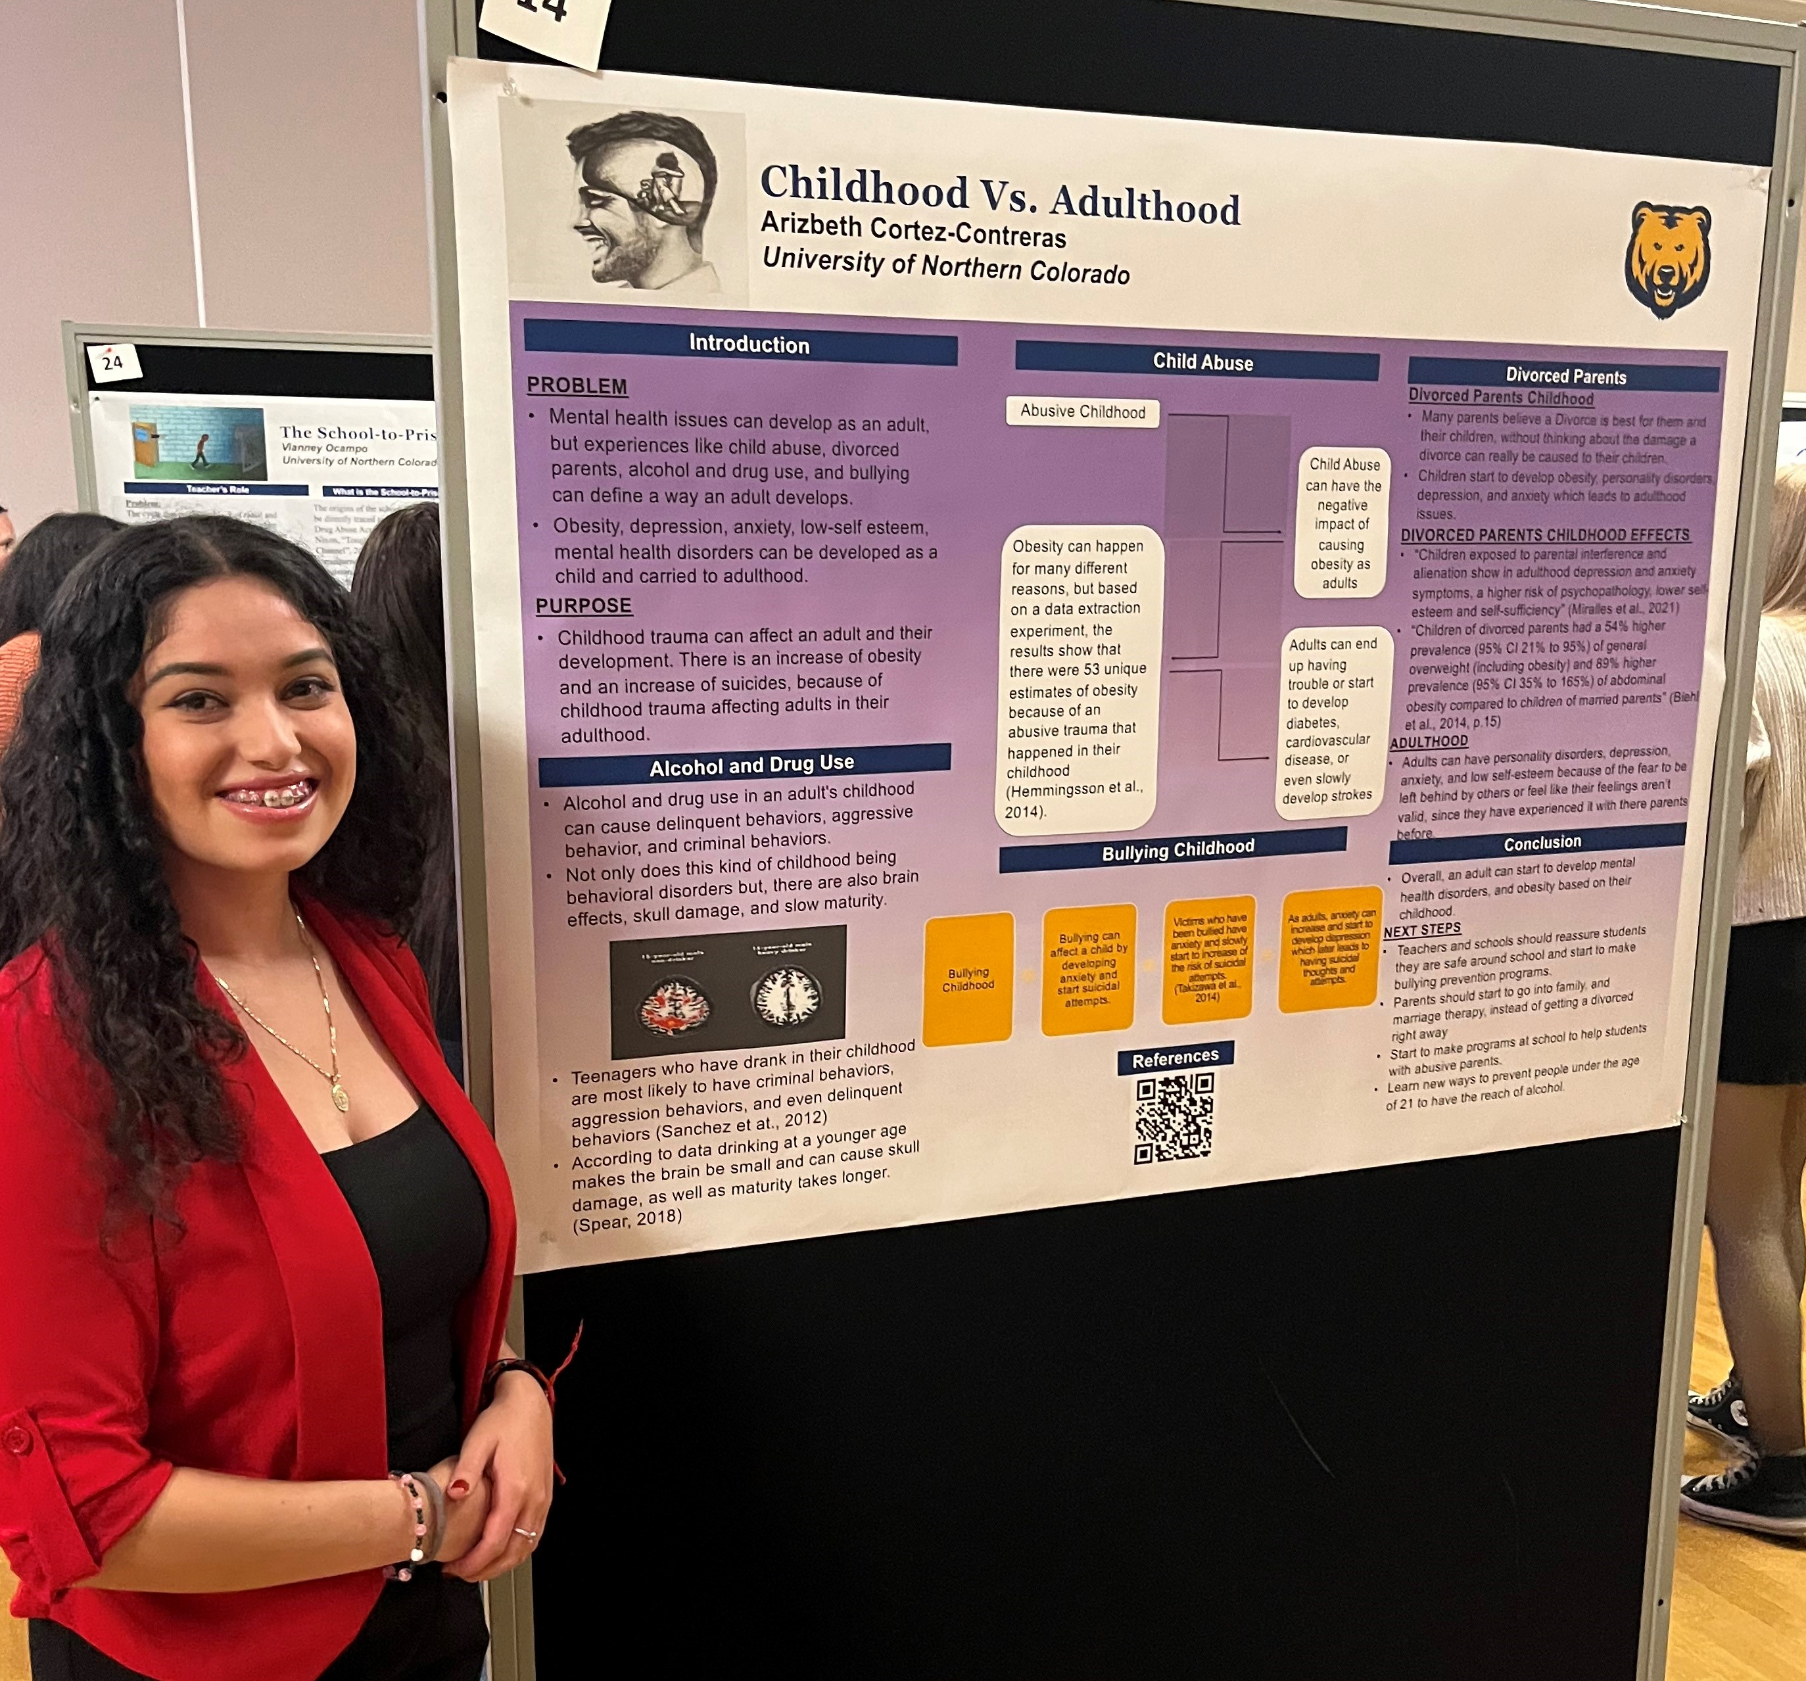
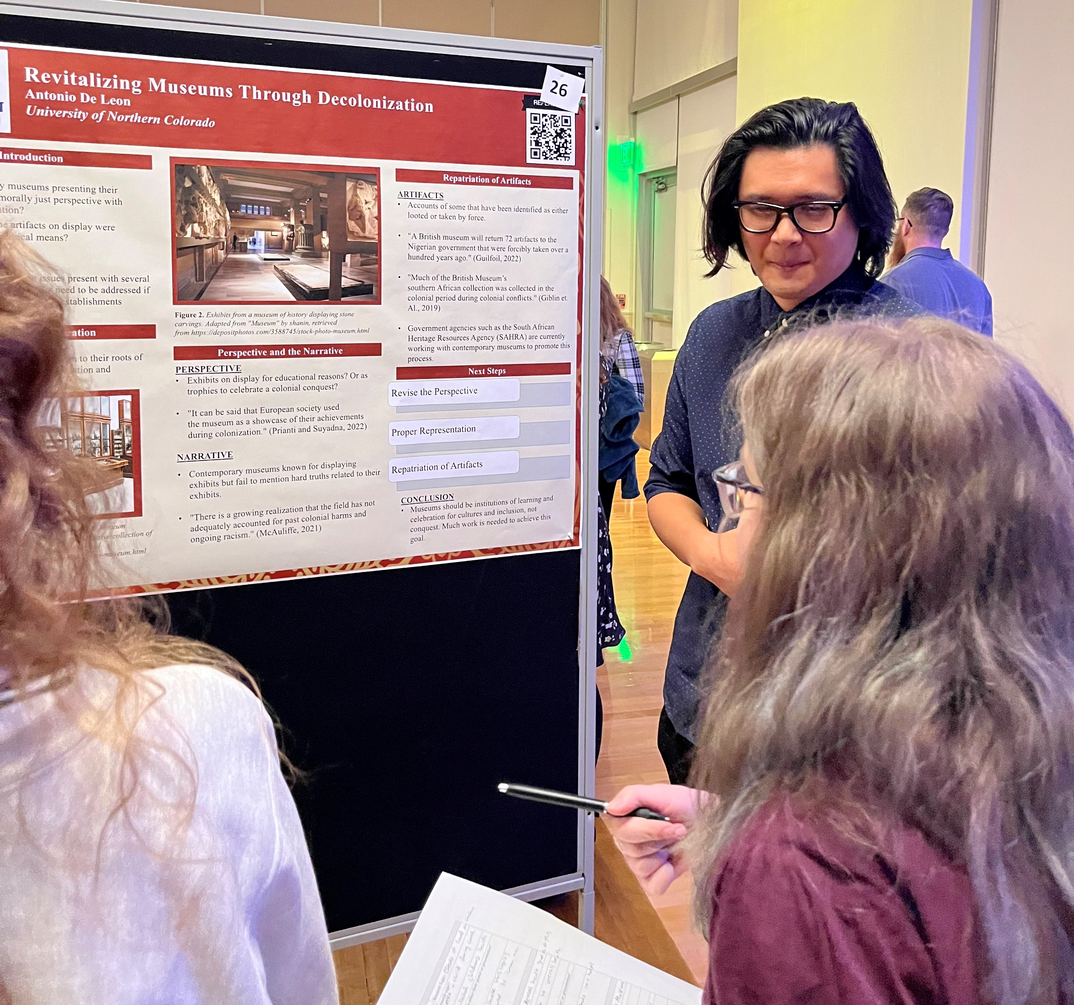
Annual UNIV 101 Research Nights
University Center Longs Peak Ballroom
  Week of Nov 13th

Slide 7
UNIV 101 Instructors
Full-time Doctoral Students
  Educational and psychological disciplines
    Counselor Ed and Supervision; Special Education; Educational Psychology; Biology Education; Counseling Psychology
  Masters degree
  Applications, recommendations, and interview process
  Competitive selection
  Comprehensive Training
Notes:
Start getting books as soon as possible

Slide 8
Peer Mentorship
Class Leader Program
  Nominated by instructors during freshman semester
  Application and interviews
  Competitive selection
  One in every section
Participation
  Every day in class
  Community building
    Sporting events
    Study sessions
  Previous Falls: 18 – 20 events
Notes:
Hand out pencils and notecards

Slide 9
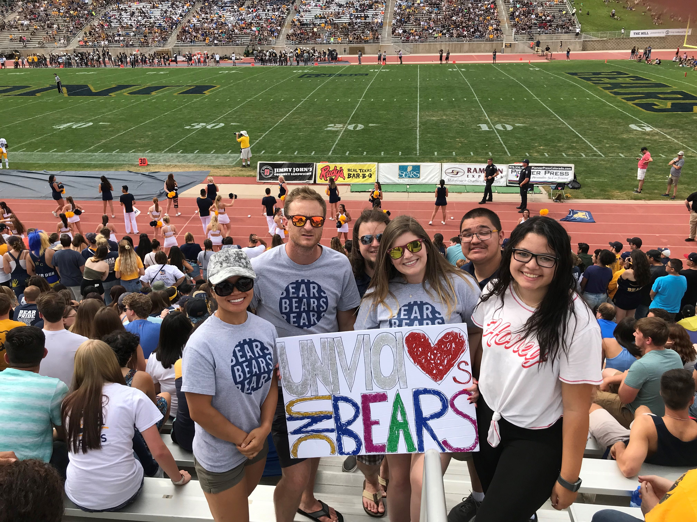
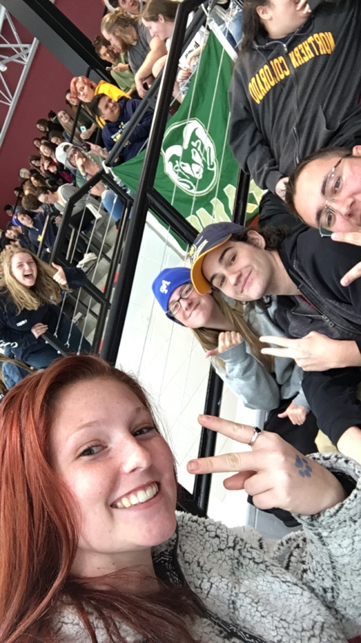
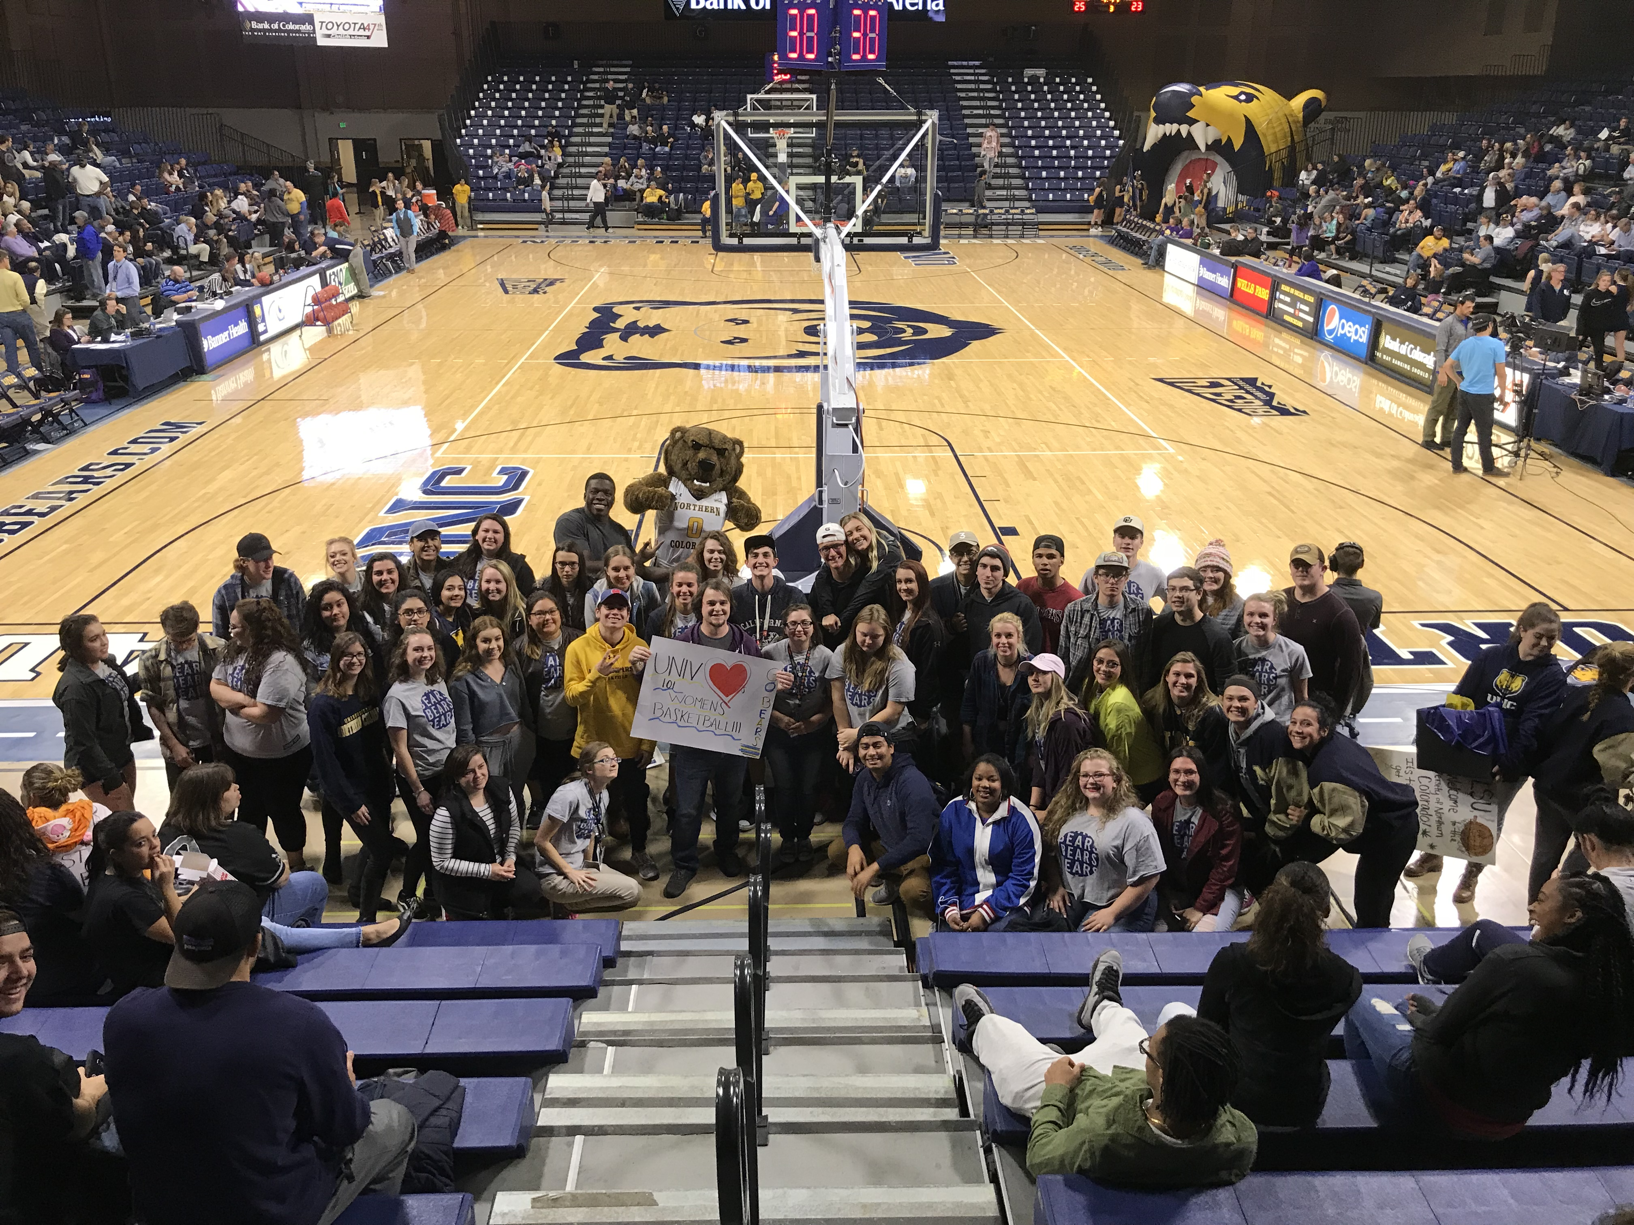

Slide 10
Data & Registration

Slide 11
www.unco.edu/university-101
Angela.Vaughan@unco.edu
(970)351-1175

