Slide 1
Notes:
Hello, and thank you for taking the time to view the Aims2UNC Intake video. The purpose of this video is provide you with important information about our program, and to help you prepare for maximizing the benefits of being an Aims2UNC Student.

Slide 2
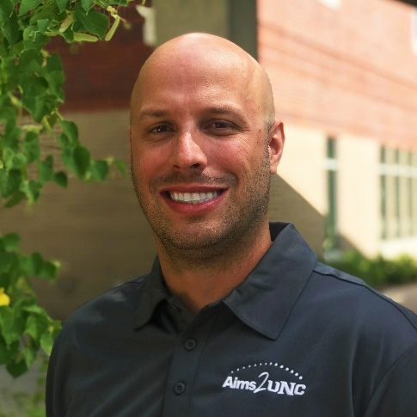

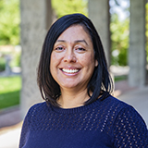
Aims2UNC Staff
Steve Mitchell
Jacob Sutton
Jackie Chabot
Senior Advisor
(Advising)
Coordinator
(Engagement Activities & Admissions)
Program Coordinator
Notes:
First I would like to introduce the Aims2UNC staff.
Steve Mitchell is the Program Coordinator for the Aims2UNC program. He oversees the program, and works to build connections for students at Aims and at UNC. Please feel free to reach out to him any time with questions or concerns.
My name is Jacob Sutton, and I am our Senior Advisor for the program. Once you have watched this presentation and submitted your Participation Agreement, you will begin meeting with myself and some of our other staff. I will work with you over your time at Aims to provide streamlined advising towards the four year degree you choose at UNC.
Jackie Chabot is our program coordinator responsible for the application process and facilitating engagement activities to help support your educational goals. Jackie spends a lot of time and energy creating engagement opportunities centered on helping build a sense of community on both campuses throughout the program. Makes sure to take advantage of these opportunities.

Slide 3
Program Overview: Transition v. Transfer
Aims2UNC is a transition program that is centered on supporting students as they pursue an associate’s degree from Aims and a four-year degree at UNC.
Notes:
Aims2UNC is a transition program that is centered on supporting students as they pursue an associate’s degree from Aims and a four-year degree at UNC.
Unlike a traditional transfer program, which focus on a singular point of contact and is transactional in nature, our program focuses on students in a holistic manner throughout their time at Aims as they prepare to complete their educational journey at UNC. In other words, our program is a thoughtful, prolonged process rather than a snapshot in time.
This distinction is key and is what makes the Aims2UNC transition program so special. When applying to the Aims2UNC program you are also applying to be a non-degree seeking student at UNC which affords you many of the benefits we will discuss later.

Slide 4


Benefits of Aims2UNC
Streamlined Advising
  Customized advising with both your Aims and UNC degree requirements in mind
Engagement Activities
  Access to Aims and UNC resources, facilities, clubs, etc.
Dual Campus Experience:
  Ability to live in UNC Housing while a student at Aims
  Access to UNC campus without paying student fees
  Access to Aims classes, facilities, and services
Overall Cost Savings
  The Aims2UNC Scholarship (up to $500 per semester)
  Aims Tuition Rate for 2023-2024:
    Weld County Tax District: $77/credit
    In-State: $122/credit
    WUE: $183/credit
    Out-of-State: $461/credit
  22-23 UNC In-State: $435.75/credit ($331.75 after COF)
  22-23 WUE: $610.25/credit
  22-23 UNC Out-of-State: $872.50/credit
  Assistance applying for UNC Scholarships when preparing to transition.
Option to attend UNC in the future for applicants who were denied admission
  These students receive communications encouraging them to apply to Aims2UNC after their admission decision is released
Notes:
The Aims2UNC Program has several benefits. Because you are considered a non-degree seeking student at UNC while a degree-seeking student at Aims we are able to remove barriers, streamline our advising, and facilitate engagement activities.:
First, we are able to remove barriers because this application will serve as your UNC application when you are ready to transition. You will be asked to complete a short transition form at that time, but after that we will be able to share all academic transcripts that Aims has with UNC to make your transition seamless.
Second, we can provide streamline advising based on your personal needs and educational goals with both your Aims and UNC degree requirements in mind, We will look to accomplish this through cooperative efforts between Aims2UNC and UNC advisors, along with additional supplemental advising programming.
Third, as long as you are currently enrolled in classes at Aims, you can access resources, facilities, clubs, and events on both campus. This also includes the opportunity to live in UNC housing while you are a student at Aims. Our program looks to host several events centered on developing a sense of community and belonging on both campuses.
Lastly, as a member of our program you will experience different cost savings measures, including the Aims tuition rates while at Aims and the Aims2UNC Scholarship.

Slide 5
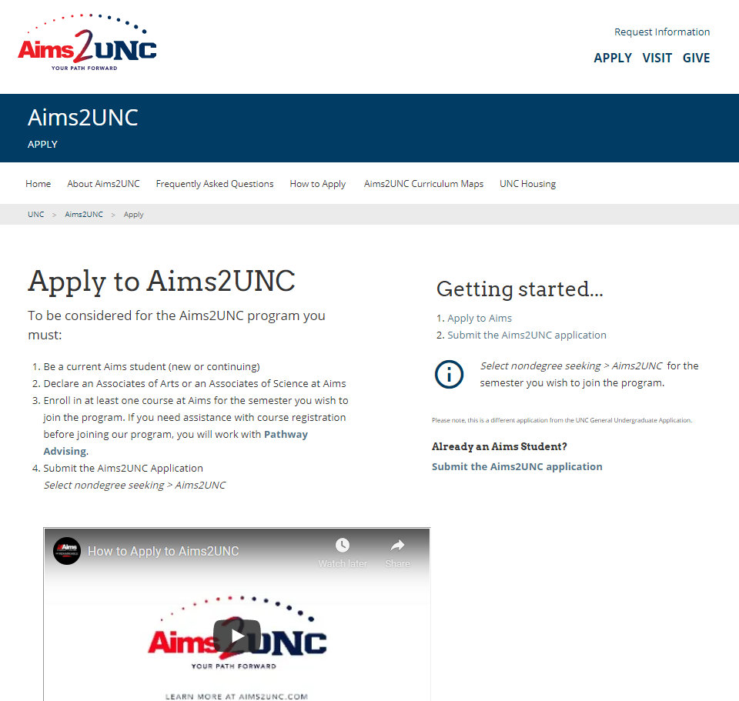
Program Requirements:
Once Admitted:
All students have a minimum of 2 advising appointments per term
Students must maintain a 2.0 to be in good academic standing, 3.0 GPA to receive our scholarship at Aims (up to $500 per semester). This is in line with UNC’s Admission Based Transfer Scholarships (2.75 GPA or higher): https://www.unco.edu/admissions/costs-aid/transfer-scholarships.aspx
All students must complete 2 Aims2UNC sponsored/approved engagement opportunities per term.
  Many of these will take place on the UNC campus before students become full students there.
  This helps them to be familiar with the campus, services, and programs before they transition from Aims to UNC.
Reminder: Not all students who attend UNC after Aims will have gone through the Aims2UNC program.
To Apply:
https://www.unco.edu/aims2unc/apply.aspx

Slide 6
Academic Standing Referrals
UNC does not allow students on academic suspension to participate in the Aims2UNC Program. Those students could enroll as general students at Aims Community College.
Students on Academic Probation can participate in Aims2UNC.
We will work with eligible students to complete Fresh Start when returning to UNC in collaboration with their current/future UNC Advisor.

Slide 7
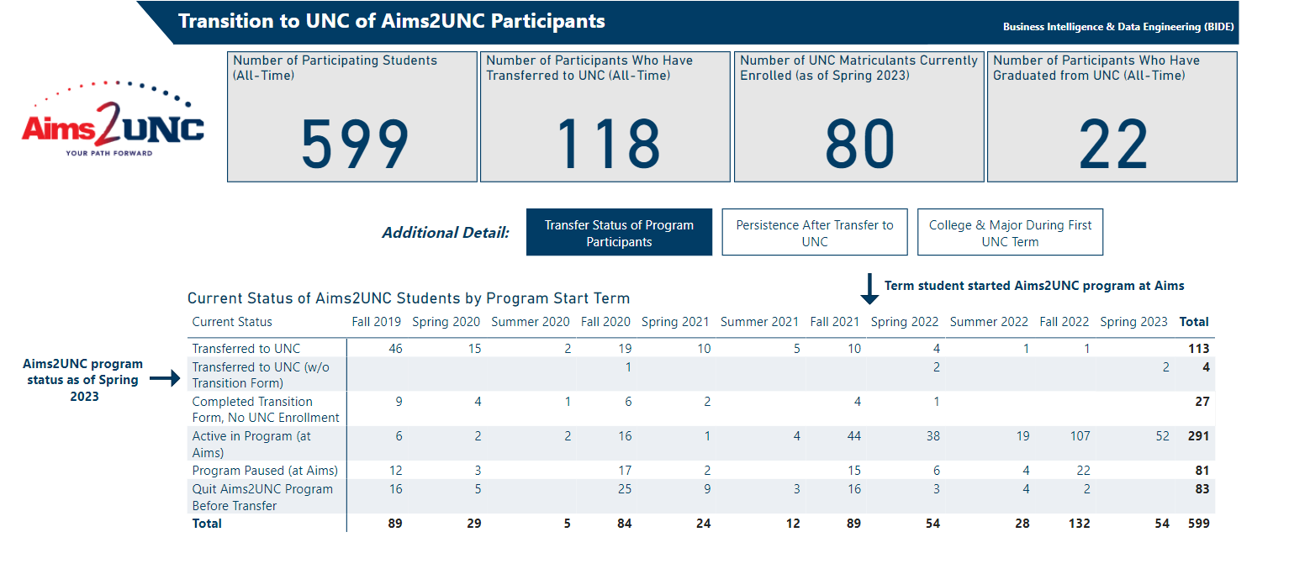
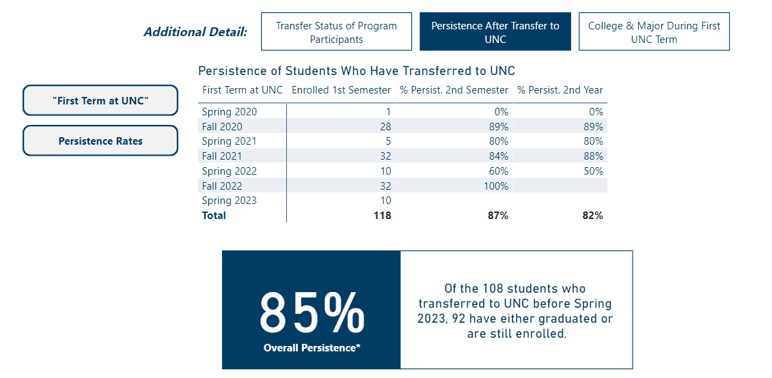
Program Statistics:
  Top Majors:
  Psychology (on-campus and extended campus)
  Business Administration
  Elementary Education
  Human Services
  Biological Sciences
  Criminology & Criminal Justice
  Sport & Exercise Science
  Sociology (on-campus and extended campus)
  Communication Studies (on-campus and extended campus)
  Software Engineering
  Early Childhood Education

Slide 8
Transitioning Students: Fall 2023
Note: Data are changing daily due to student graduation applications and summer course decisions
Graduating Spring or Summer 2023: 74
Planning to attend UNC this Fall: 47 registered (as of 4/25)
Top Incoming Majors:
  Business Administration (10)
  Psychology (10)
  Human Services (7)
  Criminology & Criminal Justice (6)
  Sport & Exercise Science (Human Performance, Exercise Science, Physical Education Concentrations) (6)
  Early Childhood Education (3)
  History Education & History (Liberal Arts) (3)
  Software Engineering (3)
  Elementary Education (2)
  Economics (2)
We are working with students to get set up for advising appointments with respective advisors/departments at UNC.
Several students have attended Destination UNC, and are being invited to Transfer Student Orientation in August as well.

Slide 9
Aims2UNC Advising Resources
Aims2UNC Site: https://www.unco.edu/aims2unc/
Aims2UNC FAQ’s: https://www.unco.edu/aims2unc/frequently-asked-questions.aspx
Aims2UNC Curriculum Maps: More of these guides are in process
https://www.unco.edu/registrar/transfer/partnerships-transfer-guides/aims2unc-curriculum-maps.aspx
  Guides how Aims2UNC advises students before coming to UNC.
  Provides clear map of which courses both Aims and UNC advise students to take towards both degrees.
  Sets students up to transition to UNC and have the LAC waived (with the exception of Graphic Design).
  Identify which classes towards UNC degrees that can be taken for lower cost at Aims.
Aims-UNC Institutional Transfer Guides:
https://www.unco.edu/registrar/transfer/partnerships-transfer-guides/
  We utilize on these, as well as the UNC catalog & Transferology, to help students identify what they can take at Aims towards their UNC degree if curriculum maps are not yet available.

Slide 10
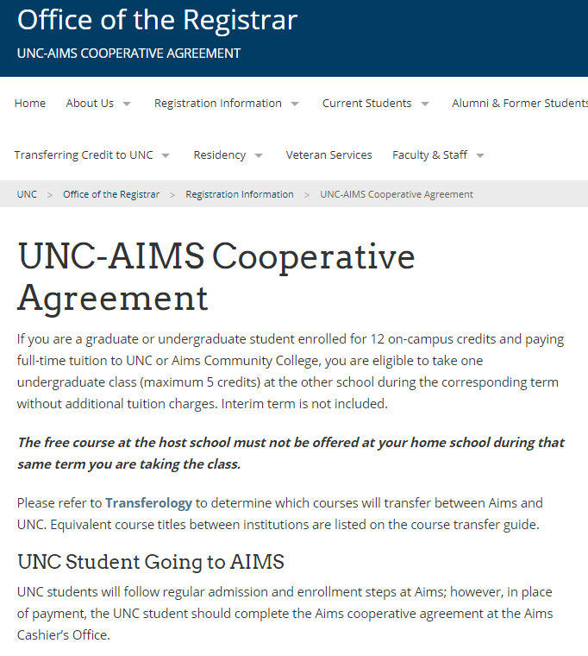
Aims & UNC Cooperative Registration Agreement
Students at Aims or UNC may enroll in 1 course (max 5 credits) at the other institution, if it is not being offered at their home institution that term.
Students enrolled in 12 credits of coursework at their home institution can take the class at the other institution with no additional tuition charges
Often referred to as a “free class”. Students do pay lab and special course fees, plus textbooks.
Example:
  PSY 332 (Death and Dying) not offered every semester at UNC. Students can take the equivalent (PSY 2222 at Aims) in Fall or Spring
  CHEM 331/331L (Aims Equivalent CHE 2111) and 332/332L (CHE 2112) not currently offered at Aims, could be taken at UNC via the agreement.
Websites for more info:
  https://www.unco.edu/registrar/registration/aims.aspx
  https://www.aims.edu/departments/cashiers-office/coop-registration

Slide 11


How would you like to collaborate?
More co-advising opportunities?
Collaboration with UNC Admissions?
Regular program updates?
How to connect with non Aims2UNC students (general degree-seeking, high school concurrent students)
Students taking coursework at Aims
?

Slide 12
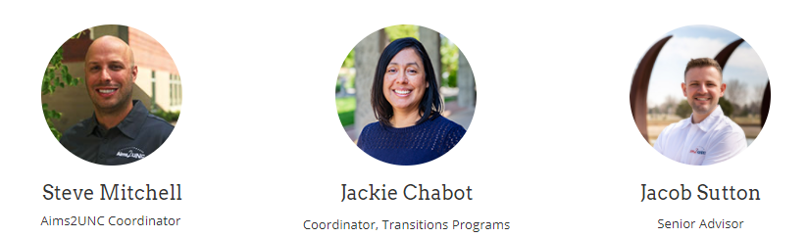
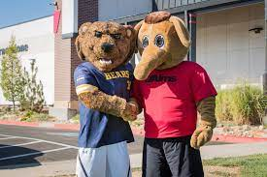
Questions? Contact us!
Steve.Mitchell@aims.edu
970-339-6557
Jackie.Chabot@aims.edu
970-339-6531
Jacob.Sutton@unco.edu
970-829-5097
TBD: Future Aims2UNC Student Success Coach
General Program Inquiries:
https://www.unco.edu/aims2unc/
aims2unc@aims.edu

