Slide 1
Presumed Dead: Tennyson’s Impact on the Cinema
Dr. Rebecca Umland
University of Nebraska at Kearney

Slide 2
Alfred, Lord Tennyson (1809-1892) Poet Laureate 1850-1892
Photographed by John Jabez Edwin Mayall
in 1864,
the year Enoch Arden was published
Notes:
http://www.victorianweb.org/photos/mayall/9.html

Slide 3
Enoch Arden 1864
The story for the title poem was suggested to Tennyson by his sculptor friend, Thomas Woolner, though many versions exist
Enoch Arden quickly established Tennyson as a ”Poet of the People,” garnering both critical and popular acclaim

Slide 4
Tennyson and Homer’s Odyssey
“The Lotos-Eaters” (1832) expands and alters a brief episode from Book IX of The Odyssey
”Ulysses” (1833, 1842), a companion poem, creates a moment suggested by Canto XXVI of Dante’s Inferno
Water journeys as either perilous and/or agents of change are prominent in Tennyson’s poetry
Notes:
W.H. Auden, The Enchafed Flood

Slide 5
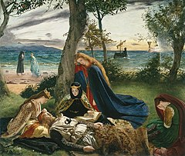
Tennyson’s Arthurian poems: water journeys
An early excursion into the Arthurian Legends was “The Lady of Shalott” (1832). Many artistic renditions of this poem exist. Top is that of John William Waterhouse (1888)
The “Morte D’Arthur” (1842) and a later more complete version, “The Passing of Arthur,” in Idylls of the King, feature Arthur’s death barge and the last witness, Sir Bedivere. Bottom: “The Death of King Arthur,” by James Archer (1860)

Slide 6
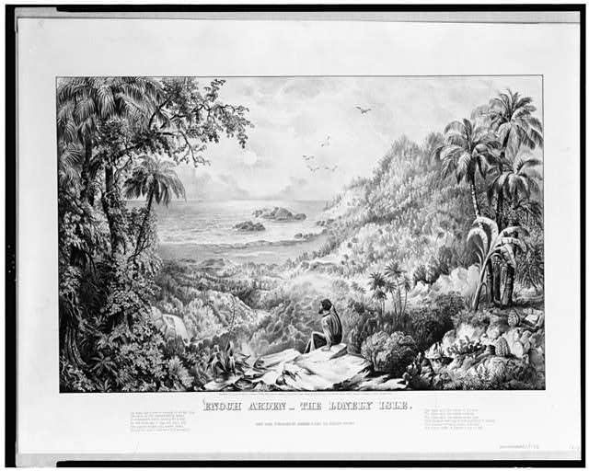
19th Century Illustrations of Tennyson’s Enoch Arden
A sure sign of popularity--Currier and Ives Lithographs (1869):
Top :“The Lonely Isle” depicts Enoch’s ten years as a cast away after he survives the shipwreck
Bottom: “The Hour of Trial” details the moment when Enoch views the domestic happiness of Philip, Annie, his own surviving son and daughter, and Annie and Philip’s infant
Notes:
Library of Congress

Slide 7
Remediation of Tennyson’s Enoch Arden
Enoch Arden’s popularity led to its transposition in music and the silent screen

Slide 8
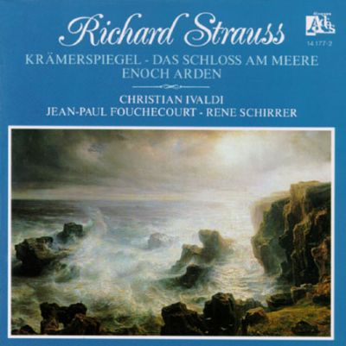
Music: Enoch Arden (1897) Richard Strauss (1864-1949)
Strauss was a German composer of late romantic and early modern music.
Note that Strauss was born the year Tennyson’s poem was published.
This version was written for piano and a narrator. (Op. 38)

Slide 9
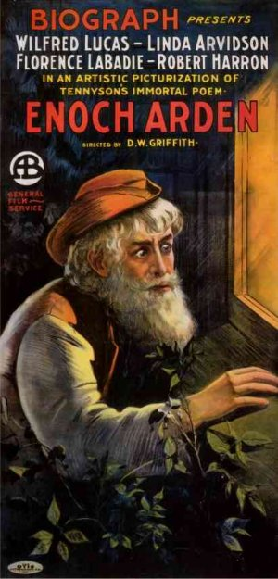
Silent cinema ENOCH ARDEN 1911 D.W. Griffith 1875-1948
The 1911 silent film version of Tennyson’s Enoch Arden, directed by D. W. Griffith, is a straight transposition of the poem
An advertisement for the film. Griffith worked for the New York company, Biograph, a pioneer in the American Film Industry, before he moved to Los Angeles
Notes:
D.W. Griffith image from Biography.com (Film Actor, Theater Actor, Director)
Both Griffith and Cabanne versions have been preserved

Slide 10
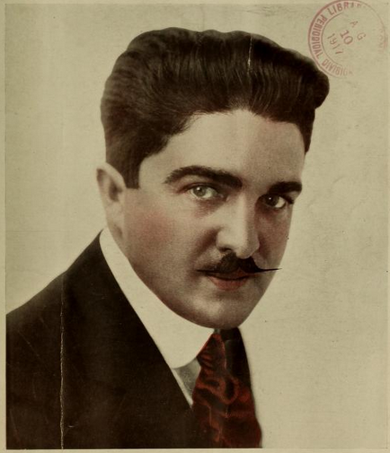
ENOCH ARDEN 1915 CHriSTY CABANNE (1888-1950)
Notes:
Silent Film Archives https://www.silentfilmstillarchive.com/enoch_arden.htm

Slide 11
Enoch Arden(1911) 33 minutes (Parts 1 and 2) Enoch’s Departure
Griffith’s adaptation follows the poem very closely, and singles out dramatic moments that lend themselves to the silent cinema
One instance is Enoch’s departure for the sea journey that will change their lives forever
An anxious Annie (Linda Arvidson) implores Enoch (Wilfred Lucas) to stay, as their young children look on

Slide 12
Enoch Arden (1911) Enoch’s Return
Through the window, Enoch incognito, witnesses the domestic happiness that should have been his
His son (Robert Harron) and daughter (Florence La Badie), now teenagers, look adoringly upon their infant half-sibling, the child of Annie and Philip (Francis J. Grandon), in a prosperous parlor setting

Slide 13
Hollywood and the romantic comedy
The romantic comedy, particularly the “screwball comedy,” and the “remarriage comedy” were all ways of dodging the Hollywood Production Code (1934-1968)
A missing spouse was also a sensitive issue during the war years of the 1940s and 1950s
Too Many Husbands (1940), directed by Wesley Ruggles, is one successful comic version

Slide 14
Too Many Husbands: Too much of a good thing?
After the initial shock of his return, Vicky (Jean Arthur) finds herself in the thrilling position of being the object of competition by both husbands, thriving on the rivalry
Her first husband, Bill (Fred MacMurray) surfaces only six months after being presumed dead in boating accident to find she has wed his business partner and best friend, Henry (Melvyn Douglas)
Notes:
Imdb.com

Slide 15
Too Many Husbands: Three’s a Crowd?
A second honeymoon in Paris after a judge declares Vicky’s marriage to Bill, her first husband, to be the binding one.
Henry refuses to give up, and follows along, bringing travel brochures to spark Bill’s wanderlust in the hopes he will repeat his past mistake and set out on another journey (like Tennyson’s “Ulysses”)
Vicky once again seems thrilled with the rivalry

Slide 16
My favorite wife (1940): A Comic Reversal
A clever reversal of the missing husband motif, the wife (Irene Dunne) is stranded on an island with a handsome man (Randolph Scott), while her husband, Nick Arden (Cary Grant) has her declared dead so he can wed Bianca (Gail Patrick)

Slide 17
A double love triangle in my favorite wife (1940)
During their seven years on the island, Steve Burkett (Scott) and Ellen (Dunne) referred to each other as “Adam” and “Eve”
Jealous Nick Arden (Grant) nonetheless finds himself in a second marriage to Bianca (Patrick) but when Ellen returns just after the ceremony, guilt prevents consummation, while cowardice prevents confession

Slide 18
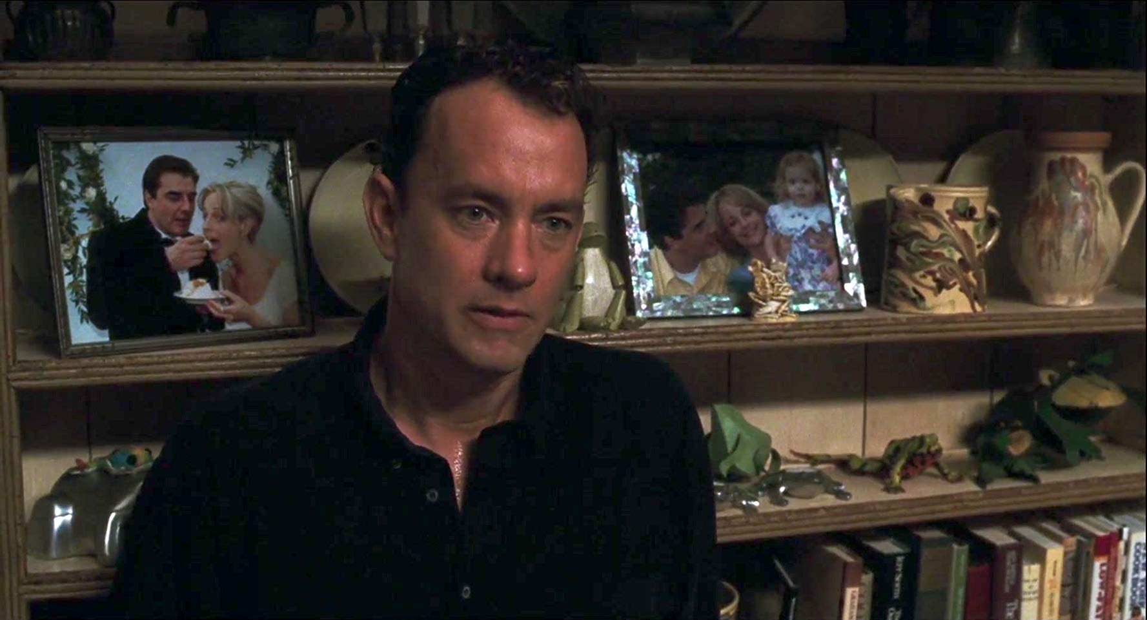
Outside looking in: ENOCH’S RETURN CAST AWAY (2000)
A cautionary story about both the misuse of time, and how to survive when hope is gone, this film signals a return to Tennyson’s poem, featuring both the love triangle and dispossession. Top: A painful gaze through a window at Kelly’s new life ( a la Enoch)
Tom Hanks turns in a stellar performance as the Enoch character, Chuck Noland, who returns to find his fiancée, Kelly Frears (Helen Hunt), has married his dentist, Jerry Lovett (Chris North), with whom she has a daughter. Bottom: pictures of her new life

Slide 19
A Parting kiss: affirmation and a bittersweet farewell
Unlike Enoch, Chuck is given a final reunion with his love, culminating in an affirmative kiss
Yet he knows his life with Kelly is over; he has been dispossessed in time and makes the sacrifice for the well-being of her new family, like Enoch before him

Slide 20
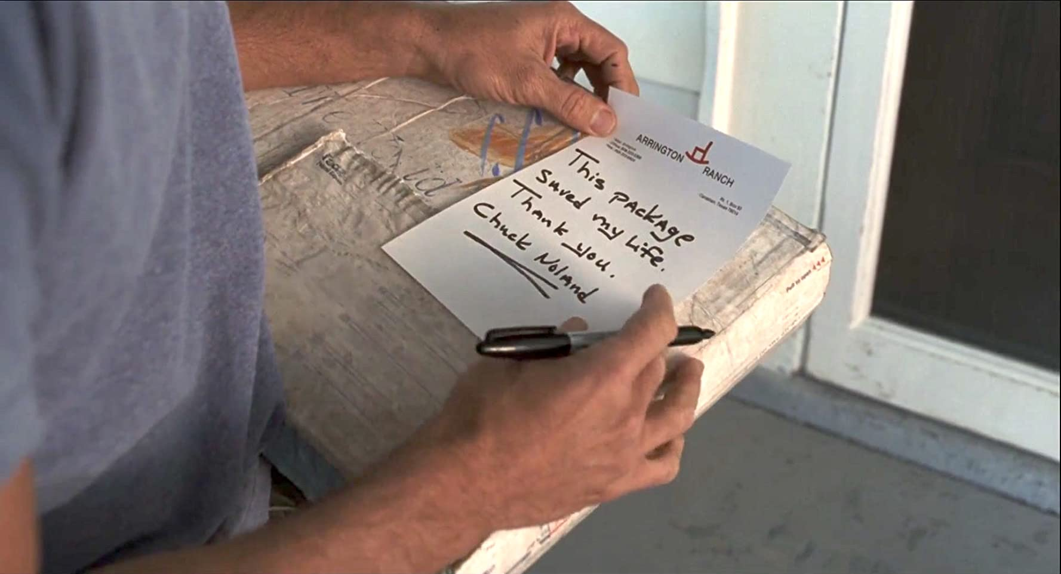
Providence: “This package saved my life. Thank you. Chuck Noland”
Top: The opening of Cast Away features the FedEx pick-up of a package from a ranch in Texas. This is one of three items that sustains Chuck while marooned on the island
Bottom: He never opens the package, which has a pair of angel wings sketched on the outside, but opts to return it to its sender, with an attached note

Slide 21
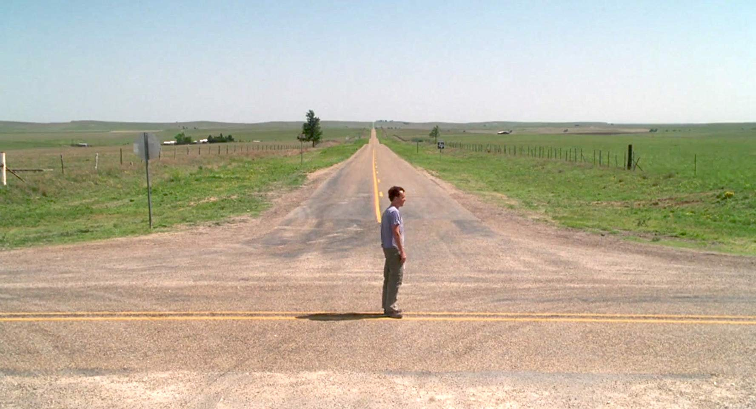
Angel lady: Lost and found
Bettina Peterson (Lari White) stops to give directions to Chuck, who “seems lost” in rural Texas (top)
At a crossroads, literally and figuratively, Chuck sees the same angel wings etched on the back of her pick-up as Bettina drives away
In the final shot of the film (bottom), hope for a new life is conveyed, even without definite direction

