Slide 1
Resilience via Impact:
The 6 Core Powers of
Strong & Resilient People
SASSI 2020 Presentation
Alumni & current students provide insights toward the building of Marrow’s Resilience Theory of the 6 Core Powers of Strong and Resilient People

Slide 2
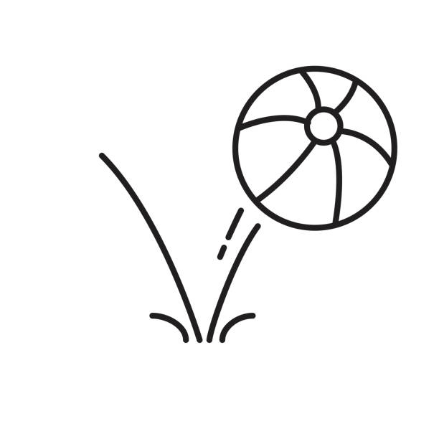
What is Resilience? Latin term "Resilio" ...........meaning to bounce back.

Slide 3
Marrow's Previous Studies Revealed 8 General Themes
Locus of Control
Heroism
Social Support
Physical Stamina
Communication Commitment
Concern for Others
Acknowledgement of Future Plans
Opportunistic Reframes of Event

Slide 4
Resilience Requires:
The enactment of the 6 Core Powers (Self-Empowerment, Future Vision, Social Connection, Life Quality, Communication, and Resources) to conquer and manage life's challenges, changes, and loss. (Marrow, 2020).

Slide 5
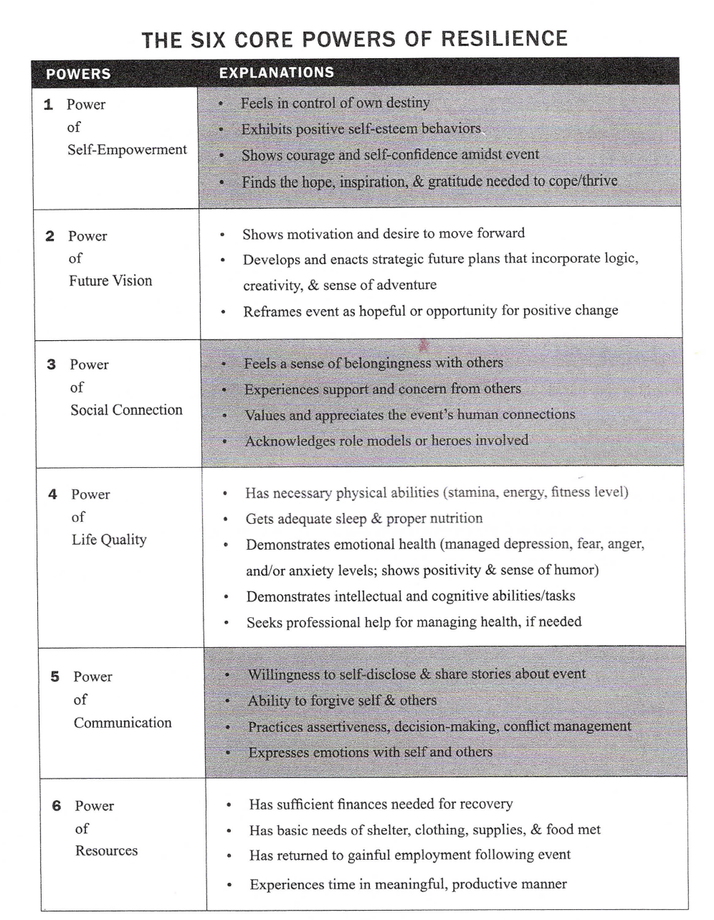

Slide 6
Resilience Insights from UNC Communication Alum

Slide 7
Summer Preston, Ph.D., UNC Alum
Resilience, Health & Body Image in the Gym
Doctoral Dissertation: “Bearing the Weight of Healthism: A Critical Discourse Analysis of Women’s Health, Fitness, and Body Image in the Gym”
Interviewed women (aged 18-67) about experiences at a local chain gym, pseudonym Be Fit Gym
I identify as a Critical-Interpretive Health Communication scholar
Findings illustrate a neoliberal ideology surrounding health and exercise
Individual responsibility for ‘health’, often conflated with ‘appearance of health’
Women simultaneously reproduce this ideology while also demonstrating cracks of resistance (i.e. self-empowerment, sense-making, avoiding the scale as a measure of health)

Slide 8
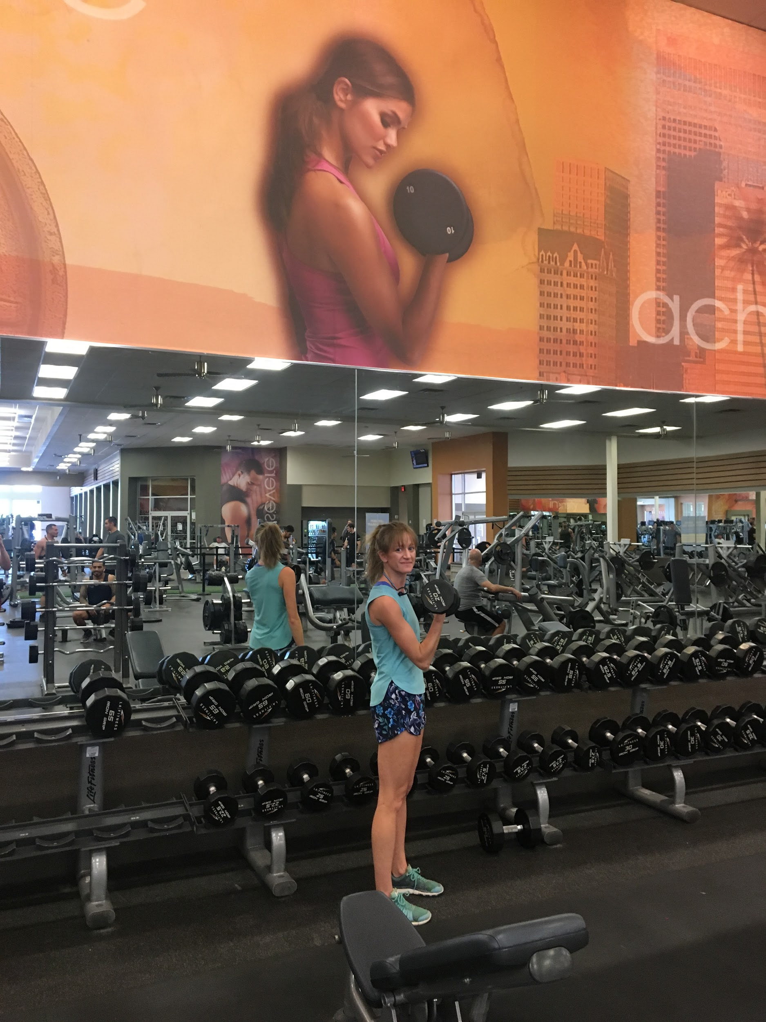
Findings: Intersections with Resilience
1. Power of Self-Empowerment
Women feel in control of decision to workout
See other women in intimidating areas of gym, find inspiration
2. Power of Future Vision
Desire to age healthily, build healthy habits now for future selves and family
Start of new year framed as opportunity for positive change
4. Power of Life Quality
Exercise helps with mental and physical health
Building fitness to be happy and healthy
Image of the researcher lifting 20lbs representing self-empowerment and resistance to prescribed image (above) of a hyper-feminized woman in the weight-room (limited to lifting 10lbs)

Slide 9
Betty Brown, M.A., UNC Alum Resilience in Action
“I do know it somehow has to do with sticking together as we try to make sense of chaos, and that seems a way to begin. We could start with something relatively easy: C.S. Lewis famously said about forgiveness, “If we really want to learn how to forgive, perhaps we had better start with something easier than the Gestapo”. Maybe, counterintuitively, it makes sense to start right off with hard, rather than easy: Where is life’s meaning after Katrina or an unwanted divorce?” (Lamont, 2013, p. 2-3)
The Powers of Social Connection and Communication through story
Walter Fisher – the most influential theorist in area of Narrative Criticism
Per Fisher (1989) all communication can be seen as stories, shaped by history, culture, & characters
Alasdair MacIntyre, describes a human as “essentially a story-telling animal, but a teller of stories that aspire to truth.”
There is a three-step process through which narratives enable us to organize stimuli and interpret reality
1) make sense of people, places, events & actions → 2) decide what an experience is about, and → 3) lead to decision

Slide 10
Betty’s Story
Summer of 2003: Family Communication with Dr. Marrow
Family motto – called family theme: My mother often said “we don’t wash our dirty linen in public”
I learned this theme well and kept silent about too many obstacles
2005: Dr. Marrow began her study of resilience interviewing those who lost homes in hurricane Katrina
2010: We traveled to Peru to work with a Partners of the Americas volunteer group in a recovery project for those who lost homes in a devastating earthquake.
March 2013: We started studying Resilience as either an “Obstacle” or an “Opportunity”
August 2013: It is emotional for me to realize how big my life changed just five months later, when I was diagnosed with Stage IIIC cancer
That family theme can be described as a type of metaphor – a word picture.
I was the type of person who in a personal crisis would “roll up the sidewalk,” “lock the doors,” and “unplug the telephone.” That is what I planned to do.
My husband of ten years would not let me this time, he said “you have to tell people and let people in”
The result was hundreds of encouraging messages (our mail carrier told us she had never delivered so many cards)
This obvious social support encouraged our mail carrier when her husband received a cancer diagnosis
Email brought messages of prayer support from around the world from people we met had because of our volunteer work
A charm bracelet was worn during every treatment, reminding me of connections.
Friends and family members sent charms marking shared life events.
Nurses asked me and I was able to share stories about these people
Recovery from cancer and cancer treatment was doubtful. Three dear ones with the same diagnosis have passed away since this happened to me.
Remaining clear of cancer remains doubtful, though time helps
I experienced Resilience in Action.

Slide 11
Betty’s Resilience in Action
3. Power of Social Connection
One reason for my recovery was because of Social Connection, because of powerful connections and support
I felt a sense of belonging
I experienced support and concern
I had role models when others receiving treatment mentored me
Two women became “side effect sisters” as we received weekly chemo treatment each, side by side. Together we lost hair and toenails and gained laughter and friendship.
5. Power of Communication
It took a kind of courage to exercise this Power of Communication
I had to be willing to self-disclose
I had to forgive myself for getting ill
I had to make decisions about treatment. Of course, that was done with my husband
I had to express emotions that I would have preferred to keep under a mask
I prefer not to use the word “survivor” as that suggests being a “victim”

Slide 12
Hope Over Fear
My husband and I recently returned from a driving trip to the SE region of the United states. We saw many hurricane evacuation route signs in areas where Katrina struck in August 2005. You might remember that Katrina was one of the first natural disasters studied by Dr. Marrow and her teams of researchers.
There were no shoulders on these roads to pull off on if you run out of gasoline. The signs were a reminder to be prepared before it is time to evacuate. Could this be a metaphor for running out of energy on your own?
What is your plan?
Are you developing a support system now?
Before the storm?
Before the diagnosis?
Elizabeth Warren (quoting President Obama) said in her final debate as a Democratic Presidential candidate on February 19, 2020 “I choose hope over fear.”
Obama said in an address to the United Nations
We choose hope over fear. We see the future not as something out of our control, but as something we can shape for the better through concerted and collective effort. We reject fatalism or cynicism when it comes to human affairs; we choose to work for the world as it should be, as our children deserve it to be.
We have choices, too
We can choose to tell our stories, choose a plan, and choose to develop a support network now.
Sitting down to tell our stories and to listen to the stories of others provides a source of hope.
This is true Resilience in Action.

Slide 13
Explanation of Select Powers by Students

Slide 14
3- Power of
Social Connection
Presented by Megan Case & Tanner Porter

Slide 15
What is the Power of Social Connection?
The power of social connection is the power within all of us to lean and rely on people in our lives
Friends, family, even coworkers can fall into the category of a positive social connection
We have learned (and I’m sure you have as well) that our ability to combat tough times in life is in-part reliant on the people we have within our close circles.
These are people we care about and people who care about us!

Slide 16
How does the Power of Social Connection contribute to resilience?
Having positive social connections decreases your chances of developing depression, lowers your stress levels, and improves your overall health
“supportive relationships that foster attachment, guidance, reliable alliance, social integration, and reassurance of worth” (Suttie, 2017) are especially beneficial
Positive social relationships help individuals learn to be more selfless and increase their gratuity which in turn, strengthens the amount of social support individuals continue to attain
More positive social support = more feelings of purpose and optimism

Slide 17
Source
Suttie, Jill. “Four Ways Social Support Makes You More Resilient.” Greater Good Magazine:
Science-Based Insights for a Meaningful Life, The Greater Good Science Center at the University of California, Berkeley, 13 Nov. 2017, greatergood.berkeley.edu/article/item/four_ways_social_support_makes_you_more_r esilient.

Slide 18
6- Power of
Resources
Presented by Daveon Douglas & Joanna Freeman

Slide 19
What is Resilience?
Resilience is typically defined as the capacity to recover from difficult life events.
“It’s your ability to withstand adversity and bounce back and grow despite life’s downturns,” says Amit Sood, M.D.
Dr. Marrow (2019) defines resilience as:
“Having the freedom, courage, creativity, and ability to navigate and grow from life’s challenges, changes, and losses.”

Slide 20
Resilience: Nashville Tornado 2020
There is no better example of resilience and the power of resources than the survivors of the tornado that hit Nashville.
Unfortunately, no matter how much these victims worked hard and were probably financially savvy, this is the kind of unexpected event that shook them to their core.
Working together with financial institutions, insurance companies, donations and sponsors they have shown the resilient spirit to recover. The Power of Resources!

Slide 21
Resilience: Nashville Tornado 2020
25 people killed
Not stopping to think about the financial consequences, the residents turned to grieving, picking up the pieces of shattered lives and helping each other
Communities turned out to help those injured or left homeless or simply to share their grief
The Power of Resources are at work:
Donations and financial support is rolling in to help rebuild and recover. (Stangling D. et. al, 2020)

Slide 22
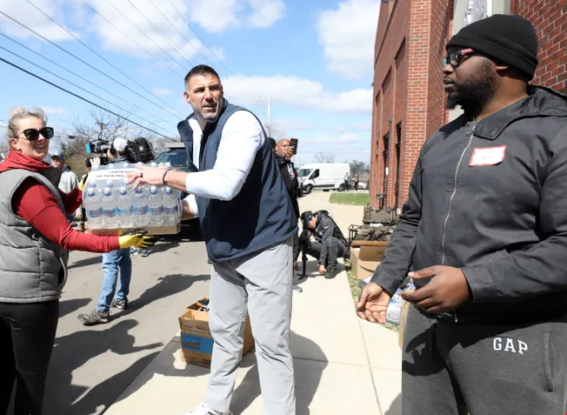
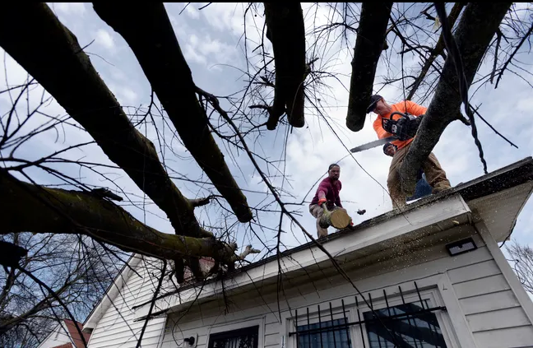
Mount Zion Bishop Joseph Walker said at a Nashville prayer service:
"Tonight is an opportunity to come together as a city. There has been a devastating level of loss, but we've also seen the incredible spirit of Nashville, the resilience, the volunteers, people are doing great things.”(Stangling D., et. Al, 2020)

Slide 23
This my friends is a real life
definition of Resilience and the Power of Resources!

Slide 24
Sources
Marrow, S. Ph.D. (2020). University of Northern Colorado. Speech Communication Theory. Six core powers of resilience.
Marrow, S. Ph.D. (2020). University of Northern Colorado. Speech Communication Theory. Discover resilience through the lens of adventure. (Lanning, T., Creative Producer).
Soot, A. MD. (2020). Executive Director, Global Center for Resiliencey and Well-Being. What is resiliency. Retrieved from https://www.everydayhealth.com/wellness/resilience/.
Stangling D., Wadhwani A. and Bartlett, K. (Mar 5, 2020). USA Today. The incredible spirit of Nashville: Grit and hope amid the grief after deadly Tennessee tornadoes. Retrieved from
https://www.usatoday.com/story/news/nation/2020/03/05/nashville-tornado-tennessee-residents-
help-victims-clean-up/4961781002/.

Slide 25
Be on the lookout for…
Specific Resilience in Action stories gathered by students
These are real stories of resilience directly from people who have experienced adversity in their lives
To be included in future conference proceedings!

