Slide 1
Why major in political science Or international affairs?
Department of Political Science and International Affairs,
University of Northern Colorado, Greeley, CO, USA

Slide 2
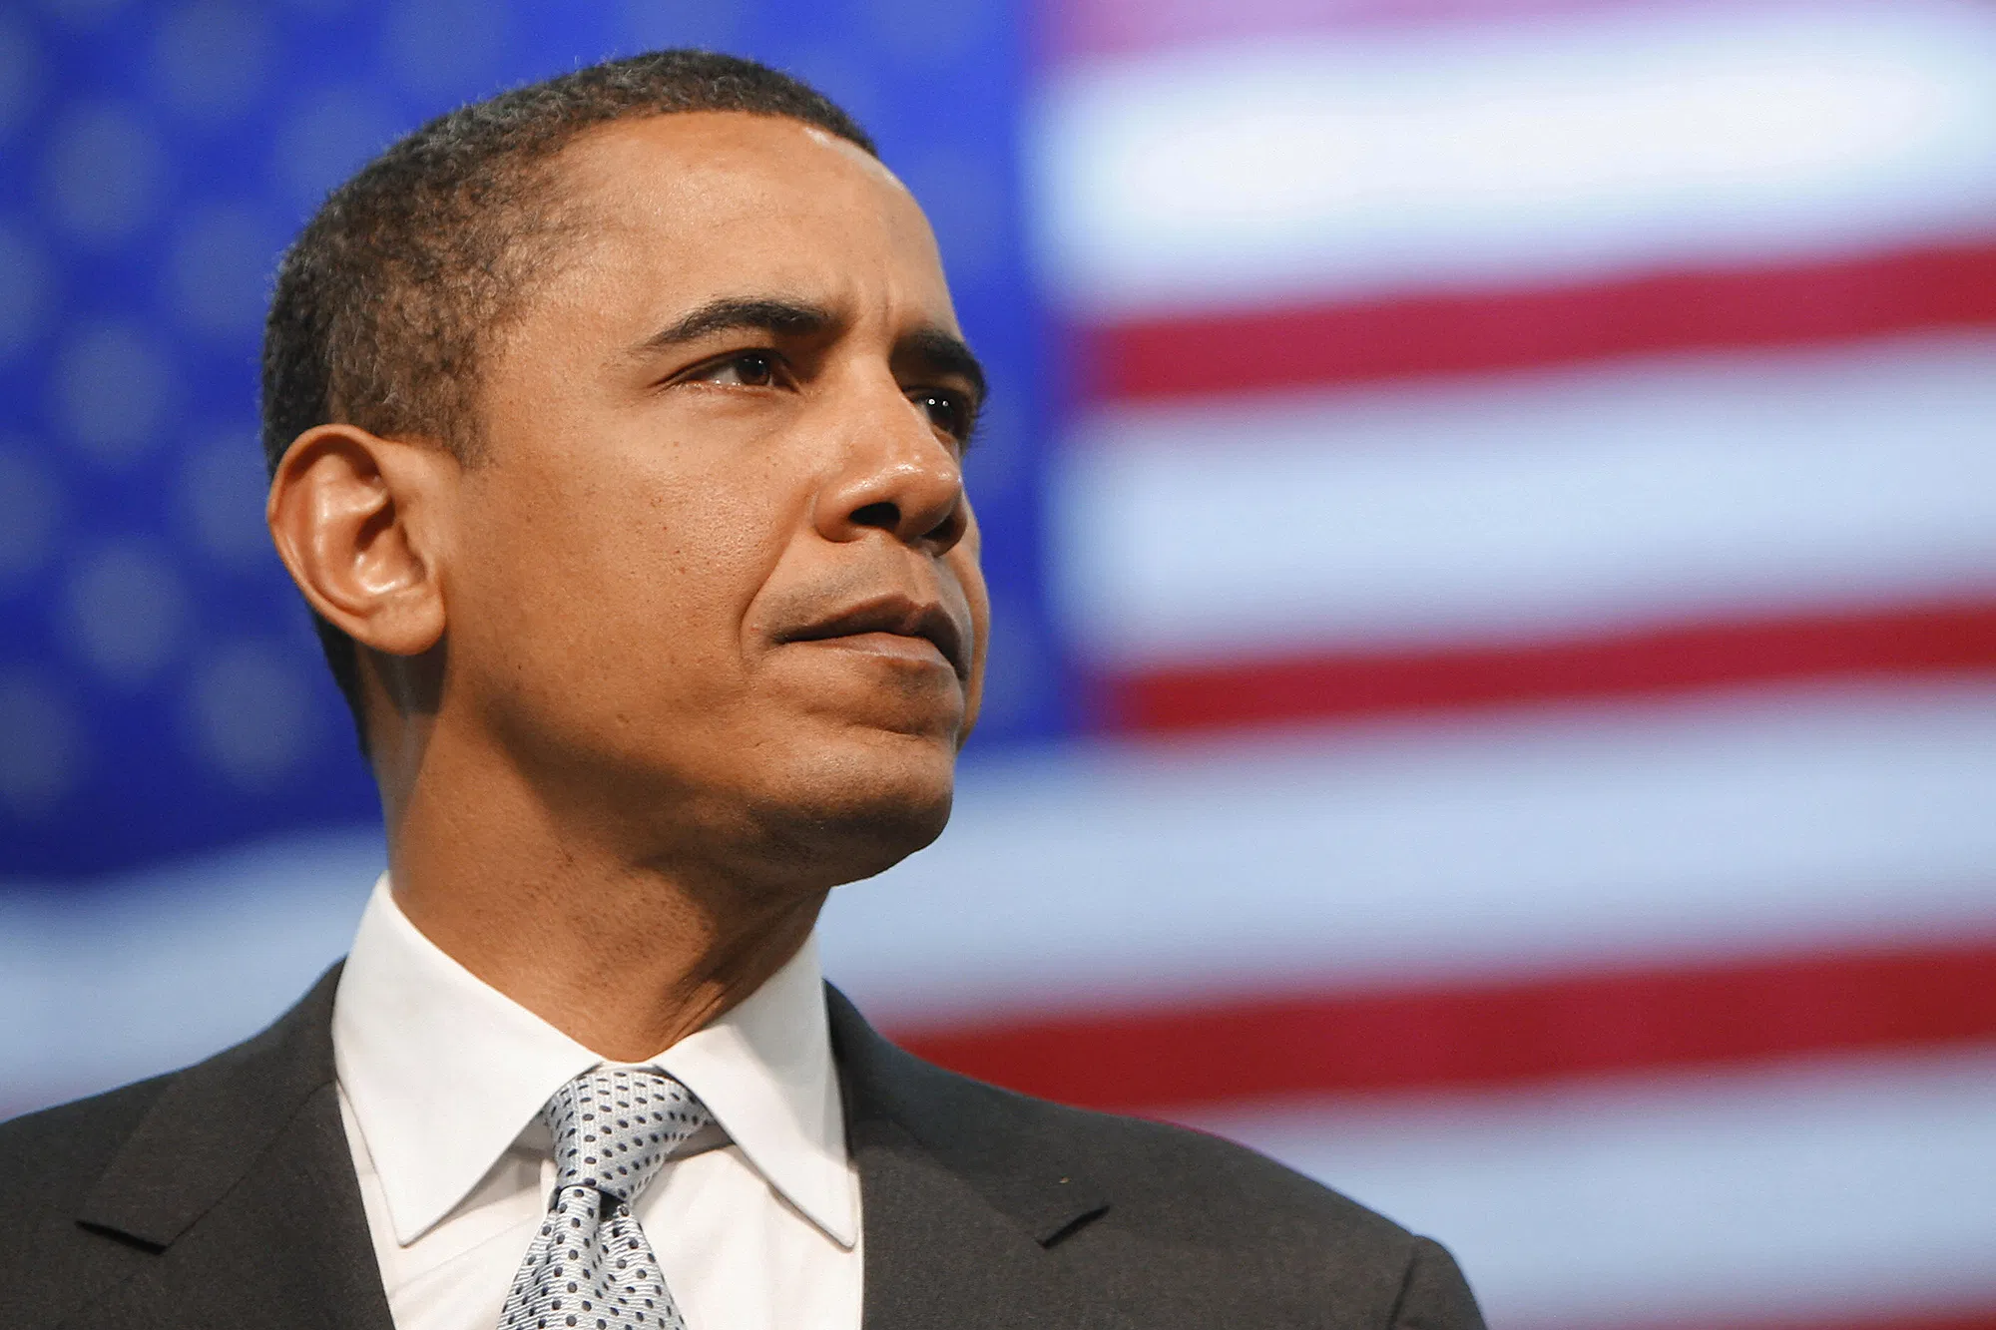
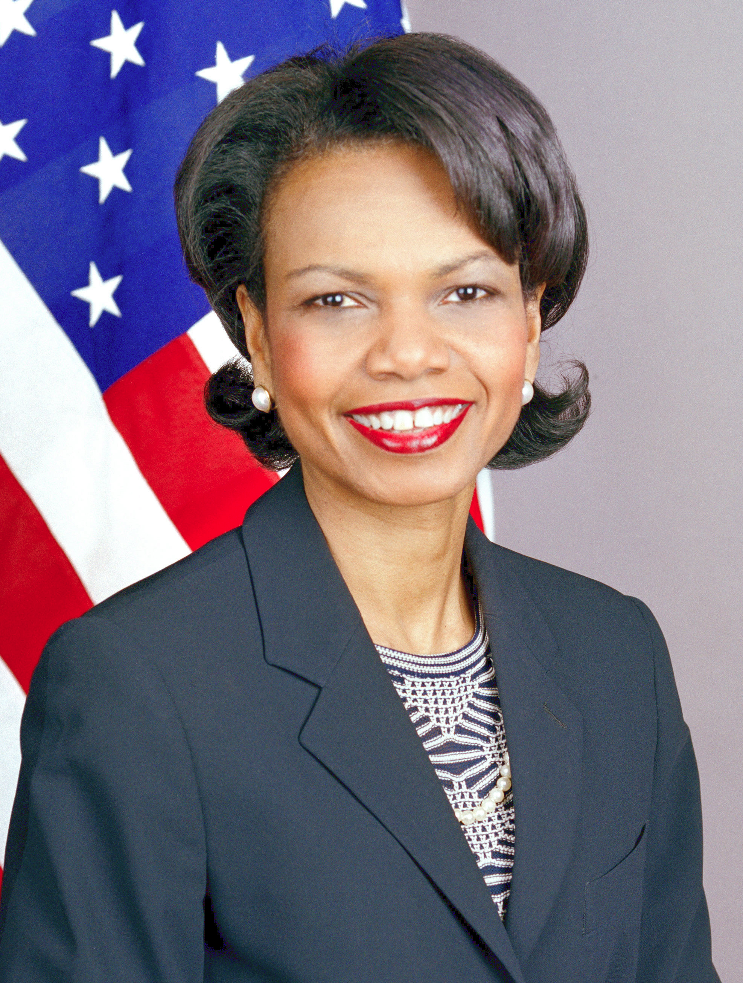
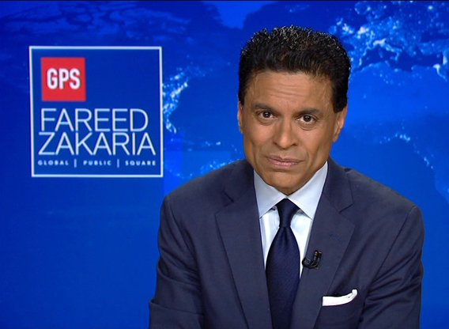
You may have heard of... Famous political science majors!
President Barack Obama & Vice President Joe Biden
Condoleezza Rice- 66th United States Secretary of State, serving under President George W. Bush.
Fareed Zakaria- Journalist, Foreign Policy Expert, News Anchor
Aisha Tyler- Actress, Director, and Author
Bill Simmons- Sports Columnist
Alec Baldwin- Actor

Slide 3
Why Major in political science or international affairs?
Wide variety of career opportunities!
Better pay!
Do what you love!
Do you care about a political problem? You can help solve it!
Travel the world!
Specialists with knowledge in international relations, foreign policy, specific political problems, and international affairs are needed everywhere!

Slide 4
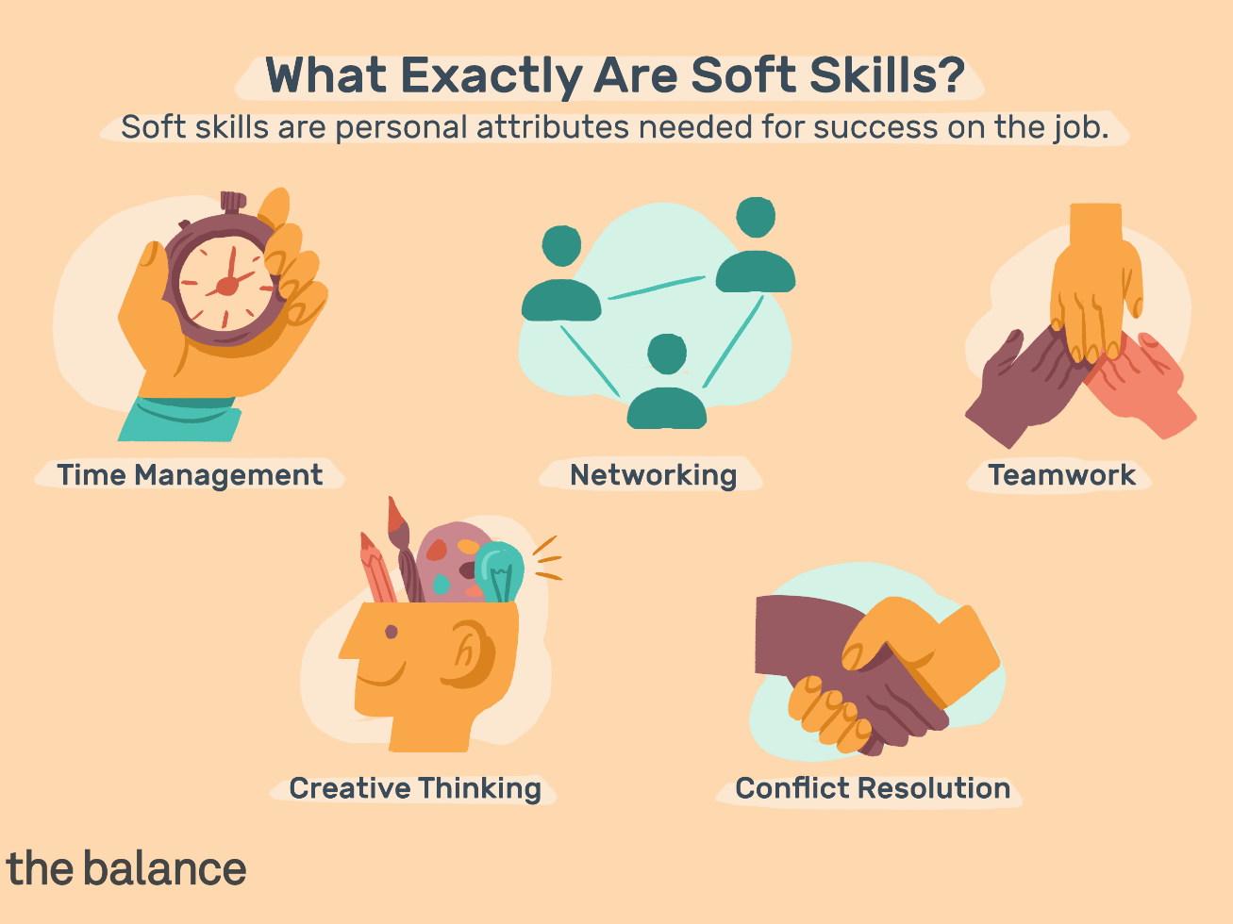
Employers want “soft skills”: Political science gives you those skills!
Why soft skills matter, an interview with Thomas L. Friedman
https://www.youtube.com/watch?v=Dp8rk1prArg

Slide 5
skills you will learn:
A strong understanding of your audience
Ability to manage crises and solve problems
Writing and research skills
Public speaking and presentation skills
Proficiency with social media
Critical thinking and writing skills
Synthesizing complex information
Foreign language proficiency (for International Affairs majors)

Slide 6
Don’t want to work directly in “politics”?
That’s OK!
See below for a variety of unique career opportunities!
A degree in Political Science/ Int’l Affairs will help you on any career path and in your daily life because you will learn...
How to understand political problems!
How to be a better member of the public!
How to engage in reasoned and respectful debate with friends, coworkers, supervisors, fellow citizens, and yourself!

Slide 7
Careers in political science & international affairs
Government Service
Law
Foreign Relations/ Diplomatic Service
Politics/ Political Campaigns
Education
Nonprofits/ Advocacy/ Activism
Journalism
Broadcasting

Slide 8
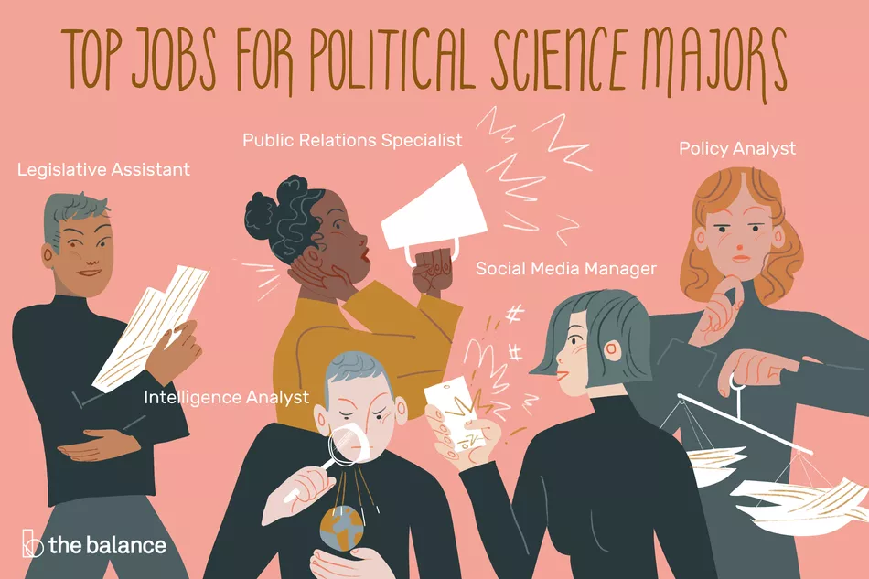
Image by Emily Roberts- The Balance 2019

Slide 9
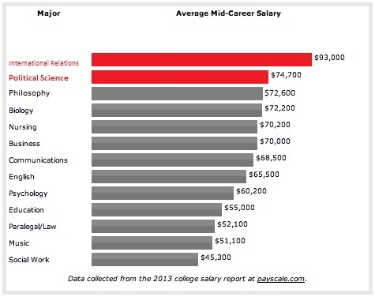
Why Major in Political Science or International Affairs?
Great Salary Prospects!

Slide 10
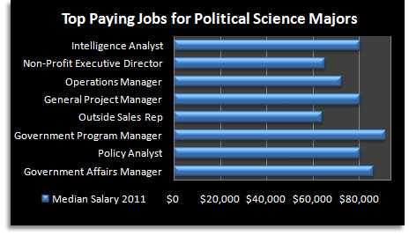

Slide 11
Career options: Government service
Government
Public Policy
Research
Legislative Assistant/ Congressional Staff Member
Regional Planning
Intelligence (ex: CIA agent!)
Foreign Services (ex: Department of State)
Law enforcement
Legislative, Judicial, Executive Services
Program Administration
City/Town Management
Local or State Government Administration / City Planner / City Housing Administrator/ County Treasurer

Slide 12
Career Options: International Affairs & Political Advocacy
International Affairs*
Ethics and anti-corruption
Media/ Communication Policy
Foreign Policy / Foreign Service
Resource Development
UN/ Intergovernmental Organizations
Non-Governmental Organizations (Int’l NGOs too!)
Advocacy/Activism
Human Rights, the Environment, Gun Rights, Refugees, Immigration, Public Health, etc...
*International Affairs careers are often available to Political Science majors as well!
Int’l Affairs majors also have proficiency in another language, which some jobs may require. Language skills increase the number of jobs you might be qualified for, especially if you want to work overseas!

Slide 13
Career options: Politics & Business
Politics
Elected or appointed official
Campaign management
Political Advising / Consulting
Staff administration
Special interest advocacy
Public Relations Specialist
Business
Sales
Human Resources
Management
Advertising
Market Research Analyst
Education
College-Student Leadership and Activities Directors
K-12 Educator/ Government teacher
Professor/ Higher Education

Slide 14
Career Options: Nonprofit & Journalism
Nonprofit
Administration
Management
Public Relations
Fundraising
Nonprofit organizations
Foundations
Professional associations
Special interest groups/ lobbying
Journalism
Editing
Reporting
Sales
Newspapers & Magazines
Internet news companies
Corporations
Political parties & action committees

Slide 15
Other options: go to graduate or Law school!
Master’s in Public Administration
Master’s in International Affairs / International Relations
Master’s in Political Science
PhD in Political Science, International Relations, Public Administration, or International Affairs
Law School
If you pursue a graduate degree, look for a research or teaching assistantship, which usually involve tuition waivers and paid work during your time in graduate school.

Slide 16
About our department
Small class sizes
Get to know your professors
Political Science Club
Model Arab League
Pizza study groups
Friendly environment
Student lounge
Make friends

Slide 17
Graduate success stories!
Alyssa Logan (B.A. ’14)
Former Regional Peace Corps Volunteer Leader in Ethiopia
Current Regional Representative for Colorado Senator Michael Bennet
Abraham M. Denmark (B.A. ’00)
Former Deputy Assistant Secretary of Defense for East Asia
Former Senior Vice President for Political and Security Affairs at The National Bureau of Asian Research
Recipient of the Secretary of Defense Medal for Outstanding Public Service
Current Director of the Wilson Center’s Asia Program
Collin Cannon (B.A.’13)
Director of Advocacy and Development at the Immigration Refugee Center of Northern Colorado

Slide 18
Graduate success stories!
Kawika Riley (B.A. ‘05)
Former Washington D.C. bureau chief for the Office of Hawaiian Affairs
Current Community Change Manager for Liliʻuokalani Trust Foundation
Molly Burich (B.A. ’05)
Current Director of Public Policy at Biosimilars and Reimbursement at Boehringer Ingelheim Pharmaceuticals Inc.
Janice Sinden (B.A. ‘97)
Former Chief of Staff for Denver Mayor Michael Hancock
Current President and CEO of the Denver Center for Performing Arts
Tracy Meyer (B.A. ‘92)
Current Lawyer at Bean, Kinney & Korman in Arlington, Virginia

Slide 19
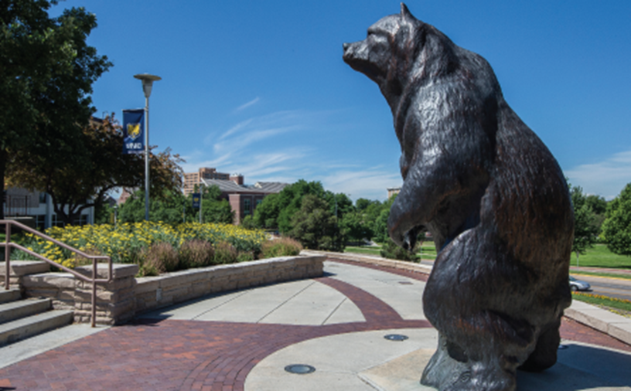
About the department
Available Majors:
B.A. in Political Science
B.A. International Affairs
Choose one of the following:
Area Studies (Options include Africa and the Middle East, Asia, Europe, or Latin America Concentrations)
International Political Economy
Available Minors:
Political Science
Legal Studies
Contact Dr. Gregory Williams at Gregory.Williams@unco.edu
Browse Internship Opportunities:
https://www.unco.edu/hss/political-science-international-affairs/current-students/internships.aspx

Slide 20
Contact us!
Website: https://www.unco.edu/hss/political-science-international-affairs/
Email: PoliticalScience.InternationalAffairs@unco.edu
Phone: (970) 351-2058
Faculty:
Stan Luger, Professor and Chair: Stan.Luger@unco.edu
Brook Blair, Professor: Brook.Blair@unco.edu
Richard Bownas, Associate Professor: Richard.Bownas@unco.edu
Gregory Williams, Assistant Professor: Gregory.Williams@unco.edu
Chelsea DeCarlo, Instructor: Chelsea.DeCarlo@unco.edu

Slide 21
Resources for Majors!
American Political Science Association Career and Graduate School Guide:
https://www.apsanet.org/Portals/54/files/Publications/APSA%20Ideal%20Liberal%20Arts%20Major.pdf?ver=2015-06-17-105627-340
American Political Science Association Internship Resources:
https://www.apsanet.org/RESOURCES/For-Students/Internship-Resources
Tips for Entering the Job Market:
https://www.apsanet.org/CAREERS/Careers-In-Political-Science/After-Completing-a-Bachelors-Degree’

