Slide 1
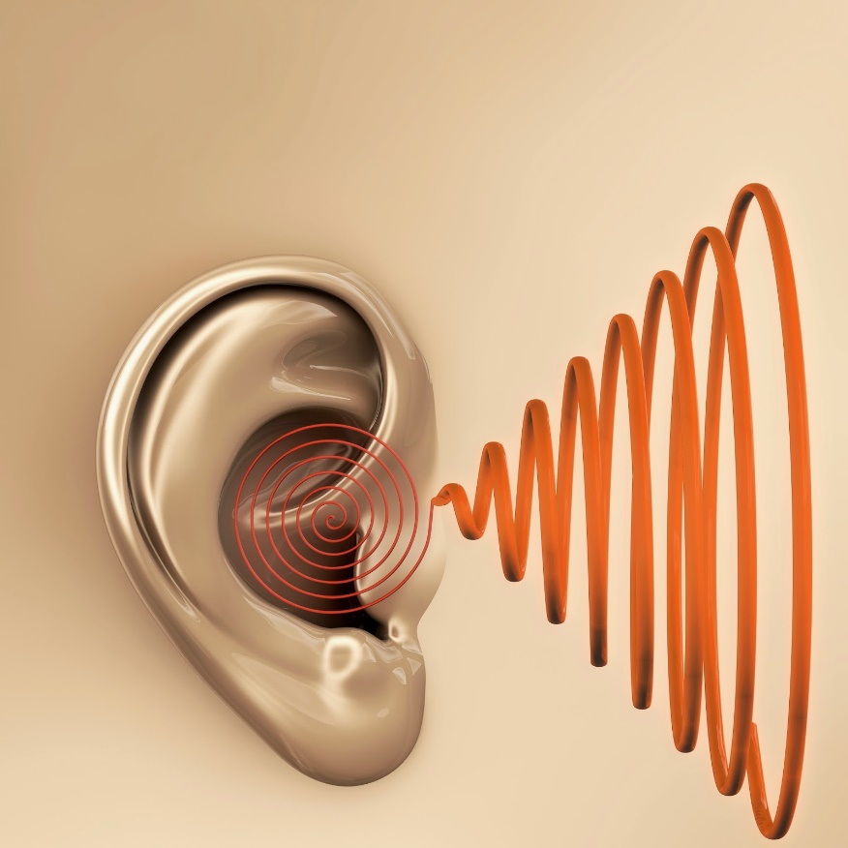
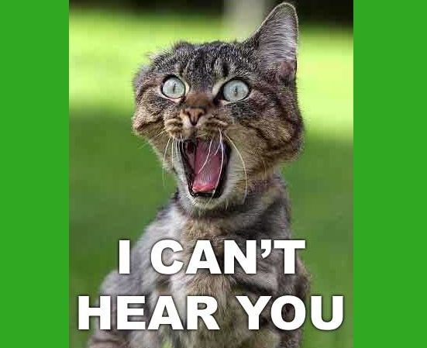
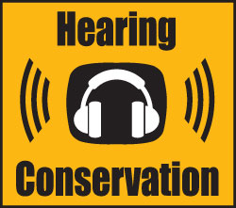
Hearing Loss Prevention

Slide 2
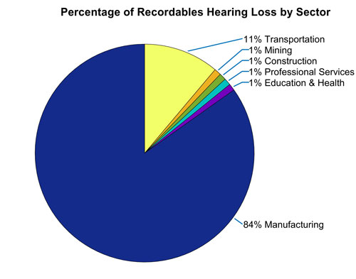
Hearing Loss Statistics
4 million workers go to work each day in damaging noise
10 million people in the U.S. have noise-related hearing loss
22 million workers are exposed to potentially damaging noise each year
Hearing loss accounts for 14% of occupational illness

Slide 3
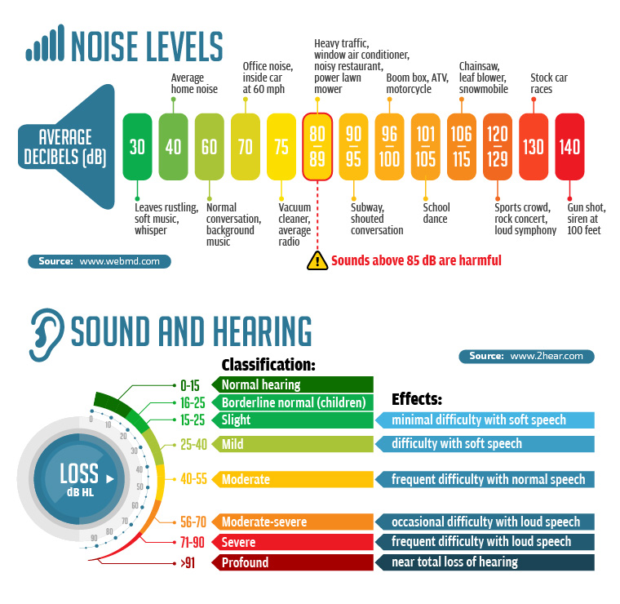
Sound
Sound is measured in two variable
Frequency – High or low pitch
Intensity – Level of loudness measured in decibels (dB)
Noise Level Survey Industrial Standard for noise level exposure
Duration per day, hours Sound level dB slow response
8.................................|......... 90
6.................................|......... 92
4.................................|......... 95
3………………….|…… 97
2.................................|......... 100
1.................................|........ 105
1/2 .............................|......... 110

Slide 4
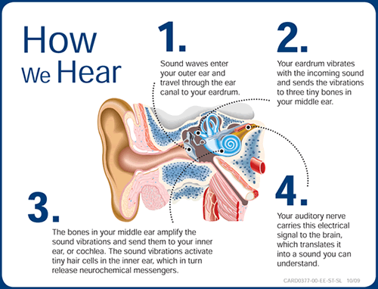

Slide 5
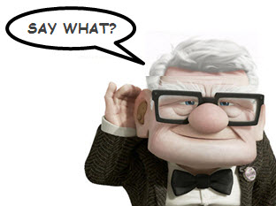
TYPES OF HEARING LOSS
Noise-induced hearing loss - gradual permanent loss of hearing due to
continuous high level noise exposure
Sudden hearing loss – viral infections, acoustic trauma, & vascular
Age-related hearing loss - gradual loss due to aging
Congenital hearing loss - present at birth due to genetics
Ototoxic hearing loss – caused by exposure to certain drugs & toxic agents
Temporary Threshold Shift (TTS) – a temporary reduction in hearing due to fatigue of the ear caused by noise exposure
Standard Threshold Shift (STS) – a change in hearing sensitivity for the worse
Acoustic trauma – immediate hearing loss from exposure to an extremely loud event
All types can collectively contribute towards the severity of hearing loss

Slide 6
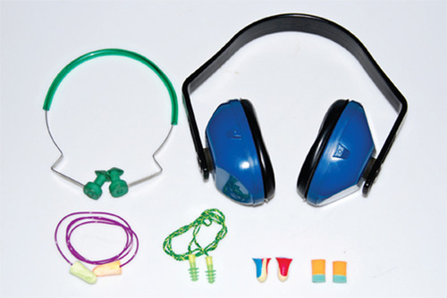
Personal Protective Equipment
Many types of PPE available for hearing protection
Ear plugs
Semi-insert ear plugs
Ear muffs
“Dual protection”
Employees should wear a hearing protector if the noise or sound level at the workplace exceeds 85 decibels. Hearing protectors reduce the noise exposure level and the risk of hearing loss.
The effectiveness of hearing protection is reduced greatly if the hearing protectors do not fit properly or if they are worn only part time during periods of noise exposure. To maintain their effectiveness, they should not be modified.

Slide 7
