Slide 1
ergonomics

Slide 2
Overview
Common work-related musculoskeletal disorders (MSDs)
Risk factors
Ergonomic control methods

Slide 3
introduction
Ergonomics can be described as “fitting the job to the worker”.
An ergonomic work system is one that:
Promotes human well-being and worker safety
Optimizes the productivity and performance of a system or task.
Creating an ergonomic work environment may involve:
The station at which you work
The tools you use during a task
Other equipment that may be needed

Slide 4
introduction
Overexertion is the leading cause of workplace injury.
It is costly to employers and can have lasting effects on workers.
Repetitive motion is also among the leading causes of workplace injury.
Even sitting at your desk, be conscious of your habits!

Slide 5
Musculoskeletal disorders
MSDs affect muscles, nerves, blood vessels, ligaments, and tendons
Symptoms of MSDs include:
Discomfort
Pain
Numbness
Loss of motion/flexibility
Spasticity
Stiff joints
Swelling
Tingling
Inflammation
Throbbing
Paralysis
Burning

Slide 6
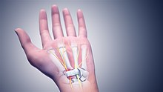
Common work related msds
Carpal Tunnel Syndrome
Tennis Elbow
Neck strain
Tendinitis
Back strain
Rotator Cuff
Trigger Finger
Many more…

Slide 7
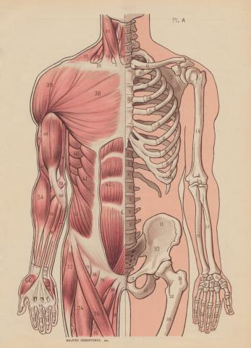
Most commonly affected areas
Certain parts of the body are more prone to work related stresses, these areas include:
Back
Arms, Elbows, Shoulders
Hands, Fingers, Wrists
Neck
Knees, Ankles, Feet

Slide 8
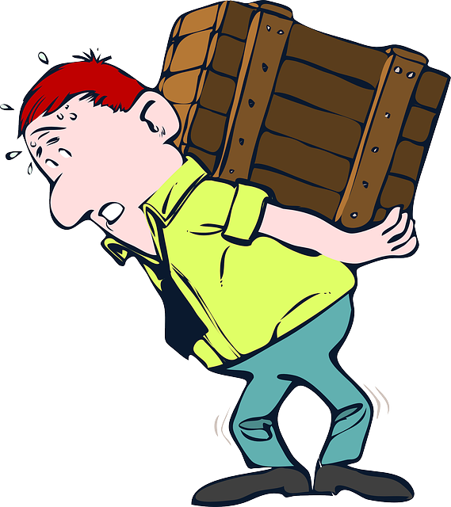
Risk factors

Slide 9
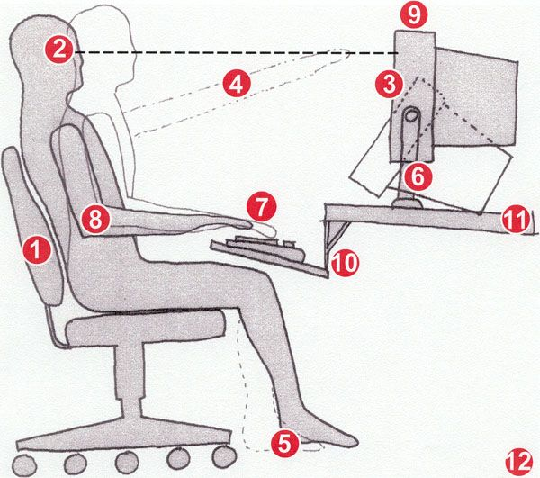
Risk factors
Risk factors for work-related MSDs depend on:
Work positions and postures
How often a task is performed
The level of effort and duration of a task

Slide 10
Examples of Risk factors
Exerting excessive force
Lifting/pushing heavy objects
Performing the same task repetitively
Working in awkward postures or the same posture for a long period of time
Reaching, kneeling, squatting, leaning, bending wrists, etc.
Cold temperatures
Vibration
Hands, arms
Whole body
Exposure to a combination of these factors can expedite negative symptoms

Slide 11
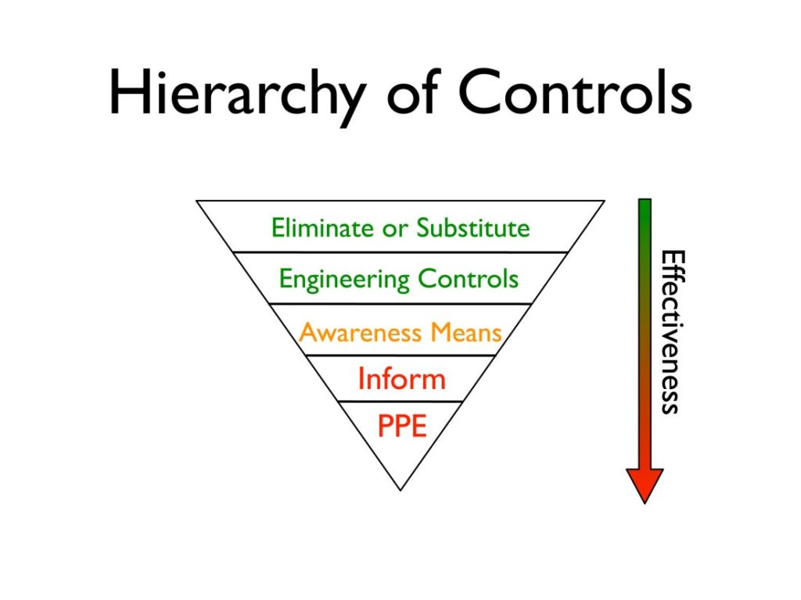
Control methods

Slide 12
Ergonomic control methods
Establish an ergonomics program
Training
Conduct job hazard analysis
Early recognition and reporting from all levels

Slide 13
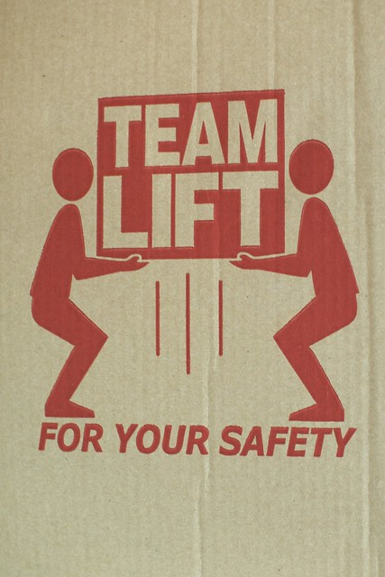
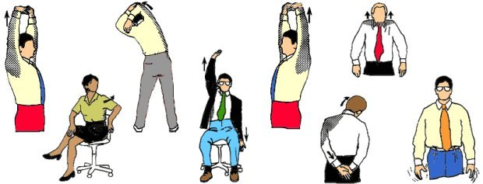
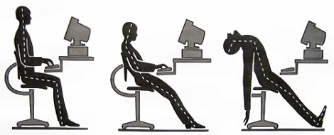
Proper work practices
Use proper lifting techniques
Team lift particularly heavy or awkwardly shaped items
Stretching
Implementing a work/rest ratio
Task variety, switch back and forth throughout the day.

Slide 14
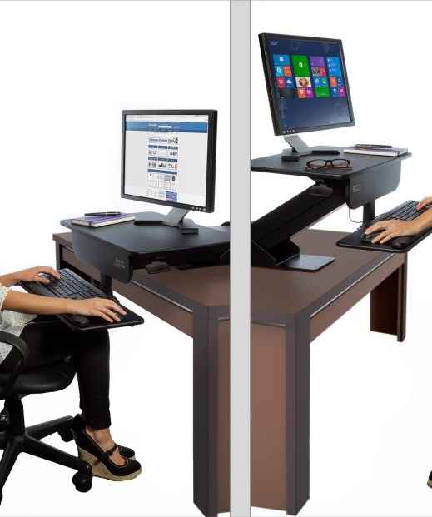
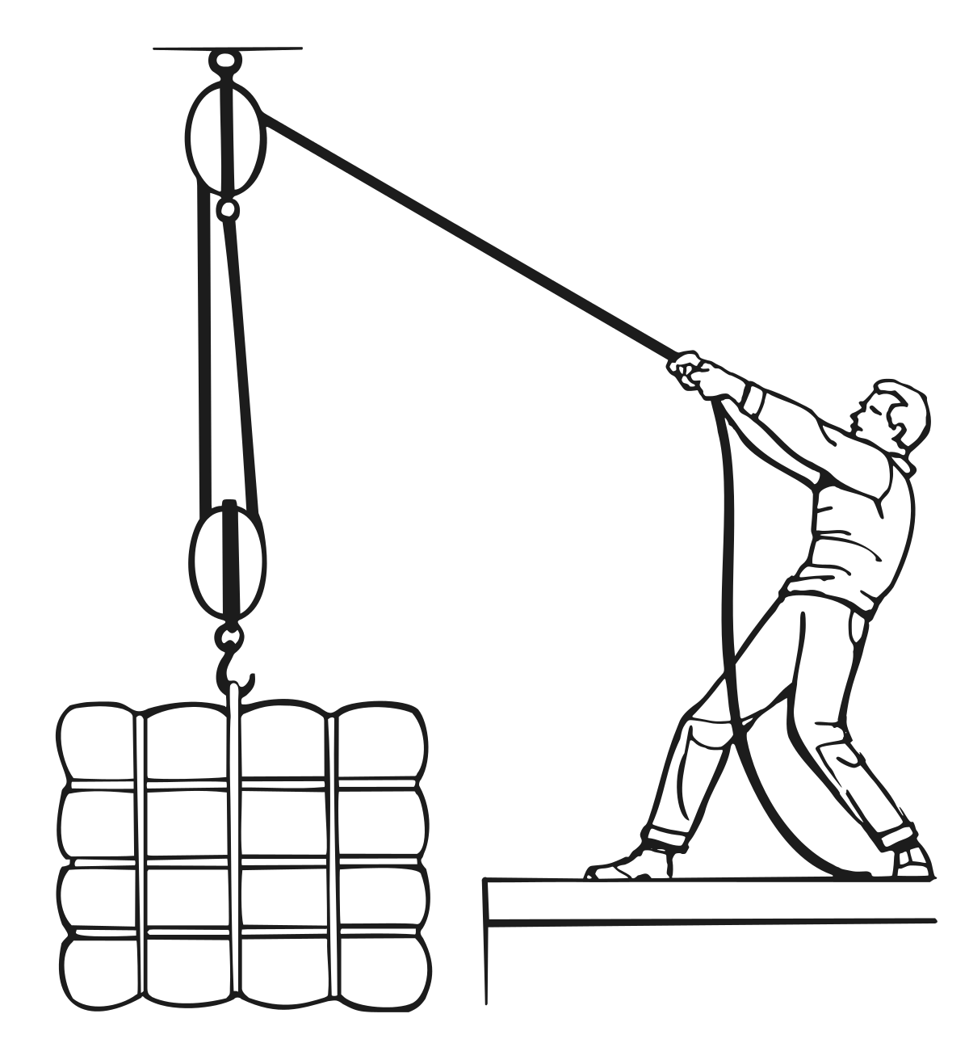
Engineering controls
Engineering controls involve a physical change to the work station itself, they don’t rely on behavioral factors or personnel. Some examples include:
Work station design and setup
Ergonomically designed tools
Ergonomically designed equipment
Load weight reduction
Elevated work stations
Fume hoods
Safety cabinets

Slide 15
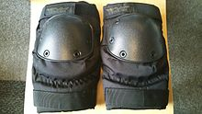
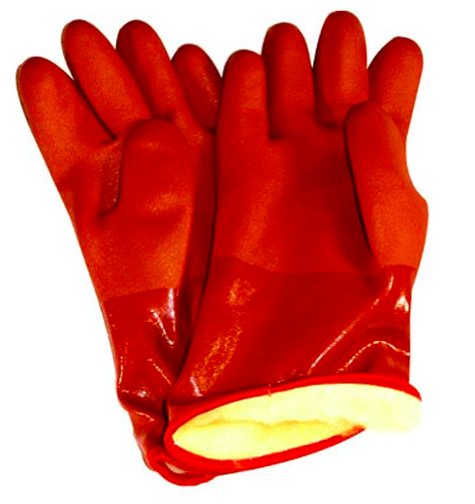
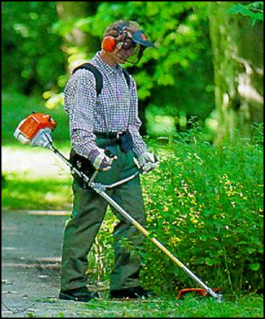
Personal protective equipment
PPE can be used as a control method
Gripping gloves
Knee pads
Vibration gloves
Thermal gloves
Lifting straps
Shoulder harness
Lifting braces

Slide 16
reporting
You should report any signs or symptoms you may have to your supervisor if:
Pain is persistent, severe or worsening
Pain radiates
Symptoms include numbness or tingling
Symptoms keep you from sleeping at night
Fingers blanch or turn white

Slide 17
Get involved
Feel free to offer suggestions and comments to your supervisor or EHS regarding your job.
Take pride in the way your job is done. Make it the safest, most efficient system you can!
Attend training

Slide 18
Questions?
Thank you for attending this presentation!

