Slide 1
Completing Your Licensure
Spring 2020
Charles R Warren, PhD
Office of Professional Licensure
University of Northern Colorado
charles.warren@unco.edu
https://www.unco.edu/education-behavioral-sciences/office-professional-licensure/

Slide 2
Task List
Get organized on the Cloud
Review the CDE checklist
Collect all of the needed files
Order your eTranscript @ registrar… maybe
Send the forms to the Office of Professional Licensure
Student Information Form
Approved Program Verification Form
Test Scores
https://www.unco.edu/education-behavioral-sciences/office-professional-licensure/
Wait to apply until you have everything

Slide 3
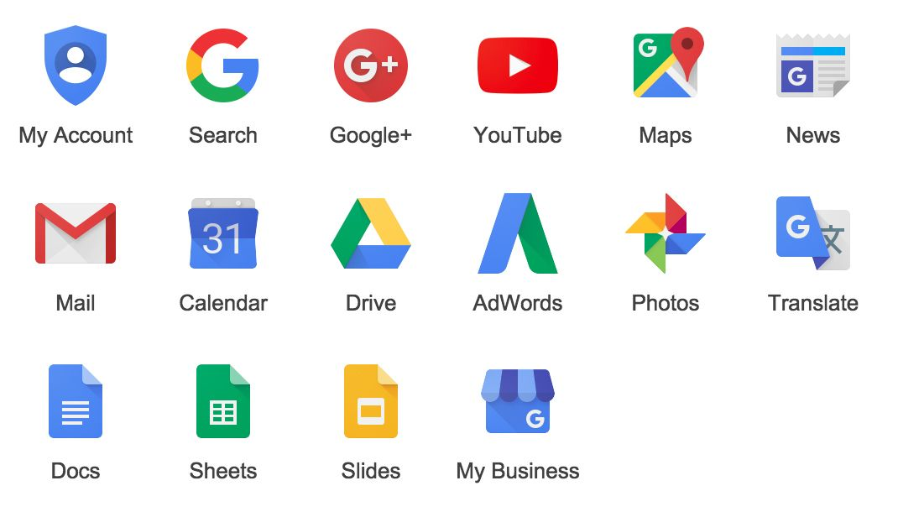
Get organized on the Cloud Everything will need to be uploaded into applications – so they need to be pdf’s
Any Platform will do:
Google
Microsoft
Others
If you graduate, your Bearmail will stay alive for a year.

Slide 4
Use the CDE webpage to get organized www.cde.state.co.us
Follow the arrows
First – go to your eLicensing account (you made this when you did your fingerprinting)

Slide 5
Sign in:
If you haven’t an account – Register!

Slide 6
Here’s your account: Go to Checklists

Slide 7
Choose the appropriate checklist on this page:
Teachers choose this:

Slide 8
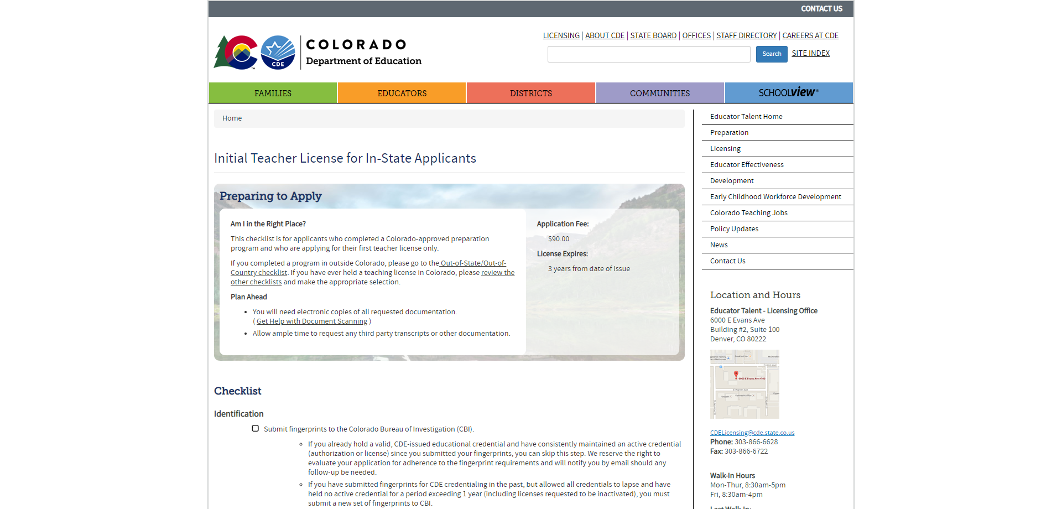
Review the CDE checklist – you’ll need everything on the list when you apply
https://www.cde.state.co.us/cdeprof/checklist-initialteacher
You’ll need a credit card
$90 for the first endorsement
$20 for each added (like CLD) if needed

Slide 9
You already submitted fingerprints, right?
If so, no need to do it again.

Slide 10
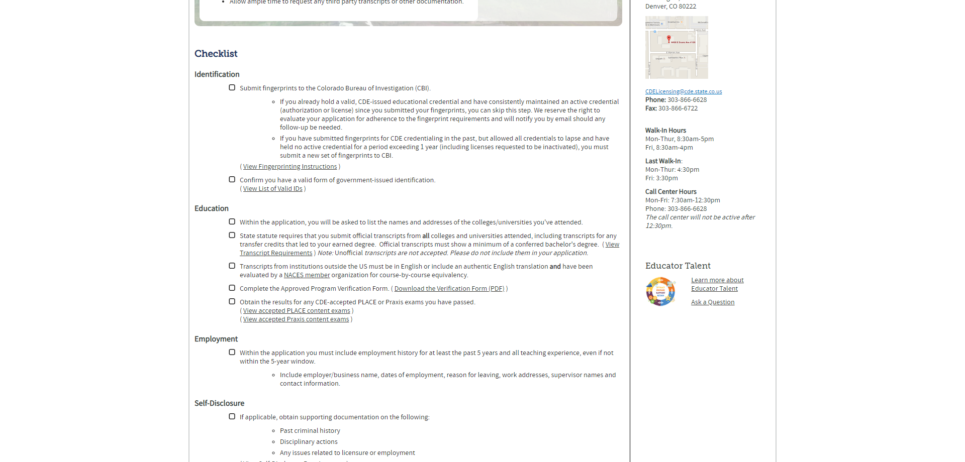
You’ll need a pdf of your Colorado Driver’s License – make one!
There are other forms of ID in the List of Valid ID’s

Slide 11
You’ll need to know the names and addresses of all colleges you’ve attended – with Transcripts
Order transcripts from other colleges as eTranscripts now!
You’ll need to upload them as pdf files.
Don’t order the UNC one yet!
You have to wait until your degree has been awarded about 6 weeks after graduation.

Slide 12
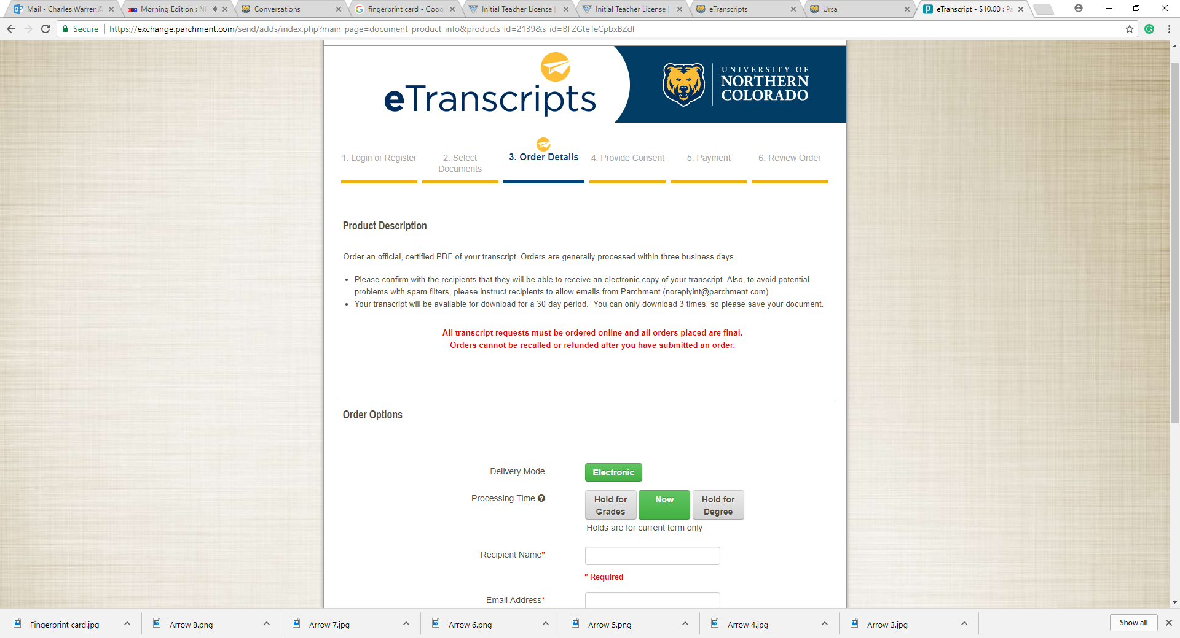
Order your eTranscript @ registrar… maybe
In URSA
Are you graduating this semester?
You can do this now
MAT student?
Wait until you have a grade for student teaching
“Hold for Degree” gets you the eTranscript the quickest.

Slide 13
Degree from a Foreign country?
Do This soon – it takes a while.

Slide 14
The Approved Program Verification comes from my Office
You will send it to me at the end of this course – it is an assignment in the Canvas Shell course.
We will send it back to you as a pdf.

Slide 15
A copy of your PRAXIS Score Sheet also has to be uploaded
Make sure you have had the scores reported to UNC.
Save the pdf of your score sheet from ets in a safe place!

Slide 16
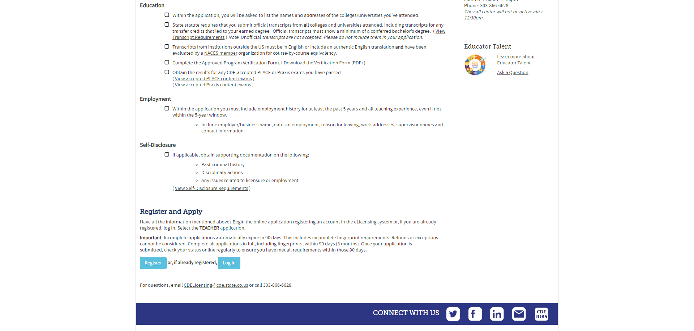
You’ll need to type in the Names, Addresses, and Phone numbers of your employment from the past five years
Even if your old supervisor has left.
And reason for leaving…

Slide 17
Never fib on a Self Disclosure It is checked against your background check
If you have questions or concerns, give me a call

Slide 18
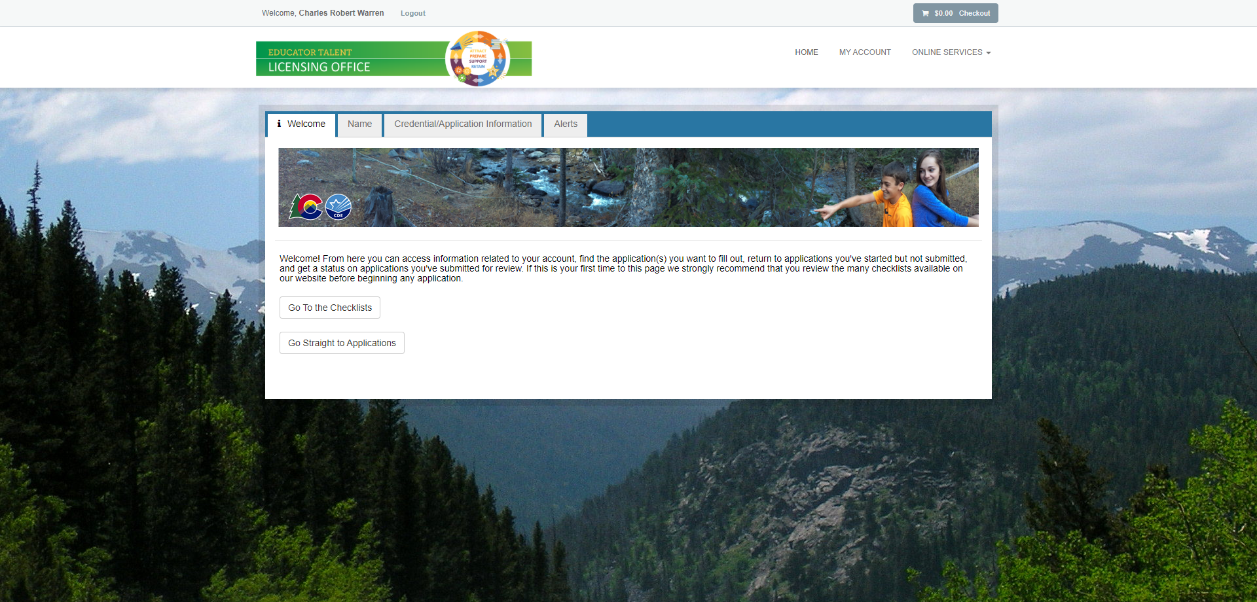
When it is time to Apply – You check here to start:

Slide 19
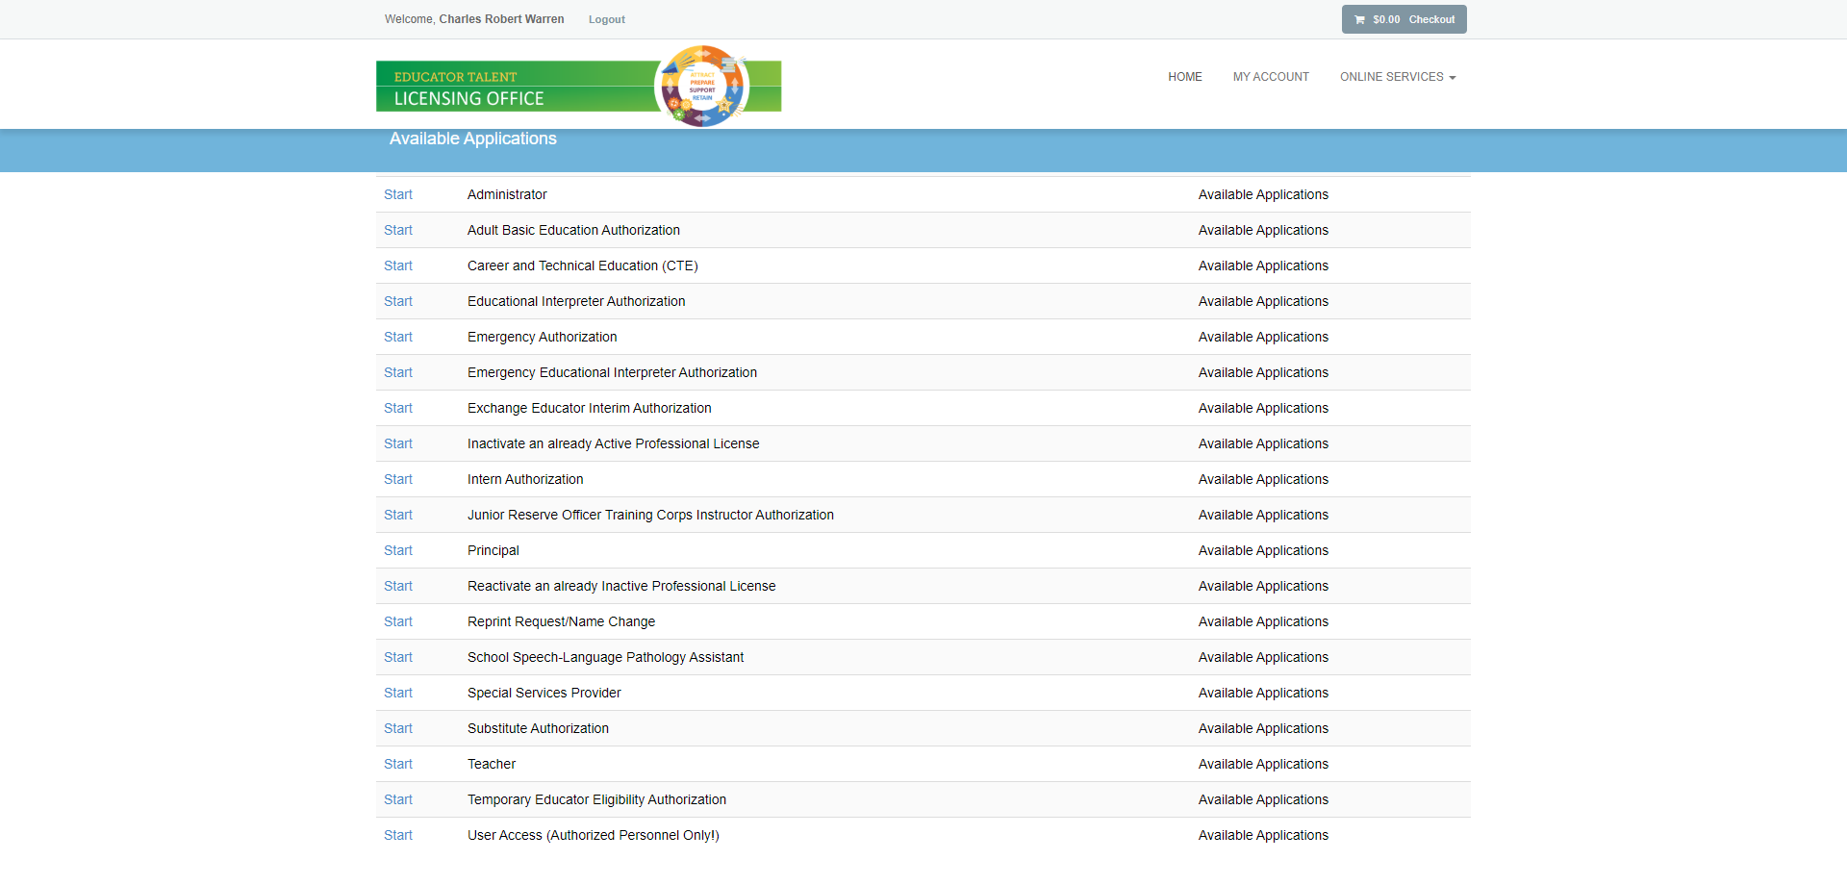
Choose the correct application from this list:

Slide 20
In the next Module, You’ll have three assignments
Student Information Form
Approved Program Verification Form
Praxis Scores
You only complete the top portion
Submit these as PDFs to Office of Professional Licensure
eTranscripts should arrive right after degrees are conferred
– watch your unofficial transcript in URSA for the graduation date to appear!

Slide 21
What if I have a job starting before the Transcript is ready?!?
Contact Dr. Warren as soon as you know!
I will work with the registrar and CDE to get your teaching endorsement as soon as possible.
Your initial teaching endorsement works for subbing.

Slide 22
In Summary – Do this NOW!
Get Organized in the Cloud
Review your Checklist and Start Collecting
If you haven't done it, Complete your fingerprint requirement
If you’re graduating in December, order your eTranscripts
“Hold for Degree”
Review your Social Media
https://www.unco.edu/education-behavioral-sciences/office-professional-licensure/

Slide 23
Next Steps:
You will get your Initial Endorsement within days of applying
Good for Three years:
Your school will have an Induction program
Additional Coursework – CLD requirements
Additional Degrees mean additional pay
After three years – Professional License (5yr)
https://youtu.be/jrCwKSRfIek
Jon.shaw@unco.edu

Slide 24
Questions?
Email me: charles.warren@unco.edu

